Slide 1
DUMBWAYS BOOT BOOTCAMP 1ST WEEK
Muhammad. Ferhad

Slide 2

ALL ABOUT VMWARE
1ST WEEK

Slide 3

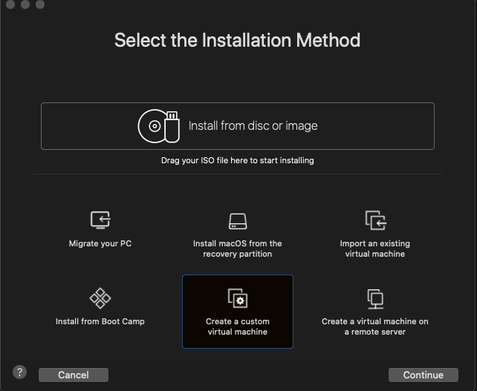
VMWARE-INSTALL-UBUNTU
Create VM

Slide 4
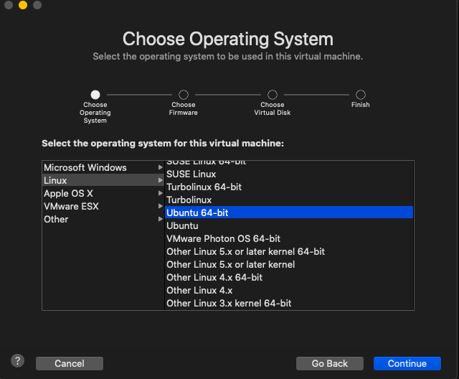
VMWARE-INSTALL-UBUNTU
Pilih OS

Slide 5
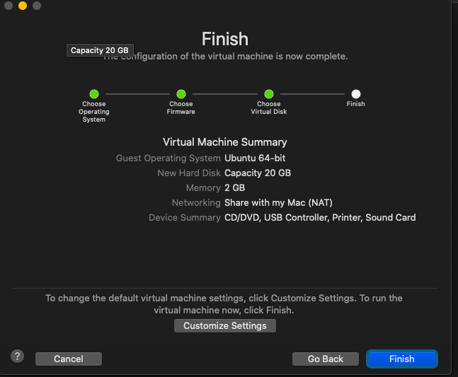
VMWARE-INSTALL-UBUNTU
Create disk & ram

Slide 6
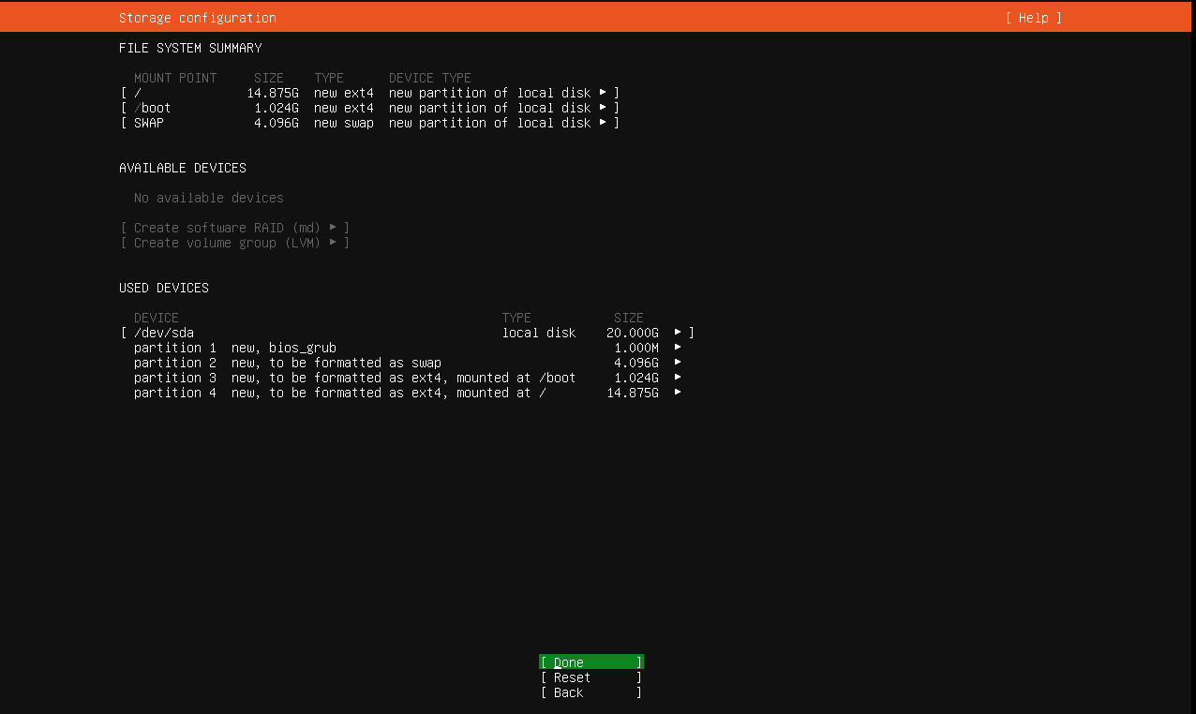
VMWARE-INSTALL-UBUNTU
Config disk, memory
swap

Slide 7
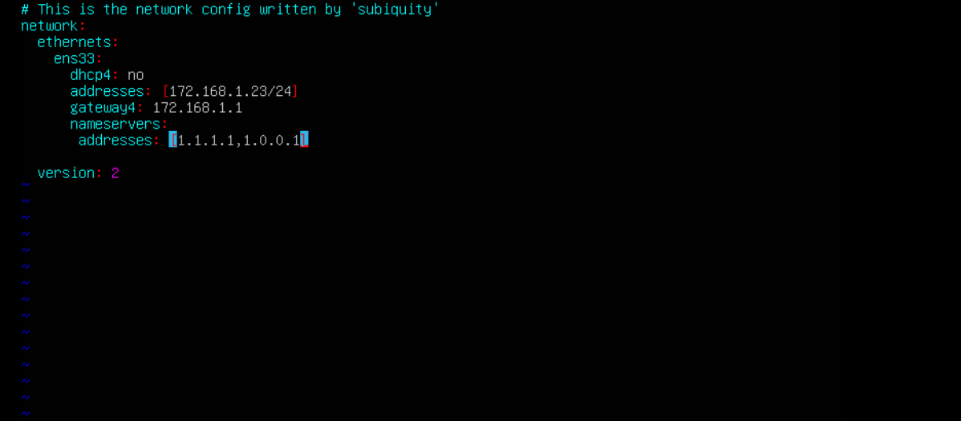
Setting ip static pada virtual mesin menggunakan netplan
VMWARE-SETUP-NETWORK
Config network

Slide 8
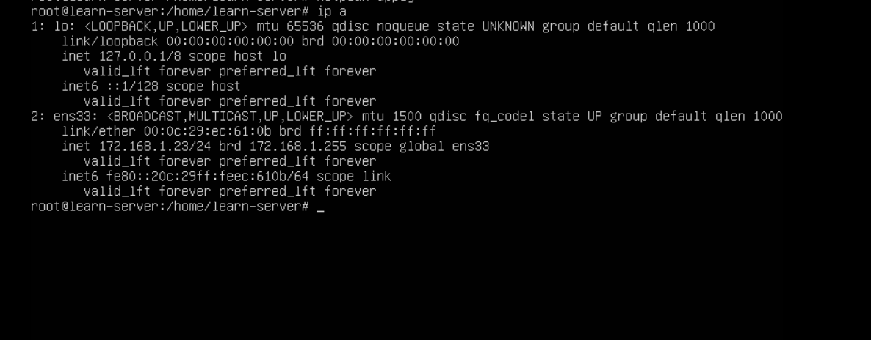
Check ip di server apakah sudah berhasil di buat
VMWARE-SETUP-NETWORK
Config network

Slide 9
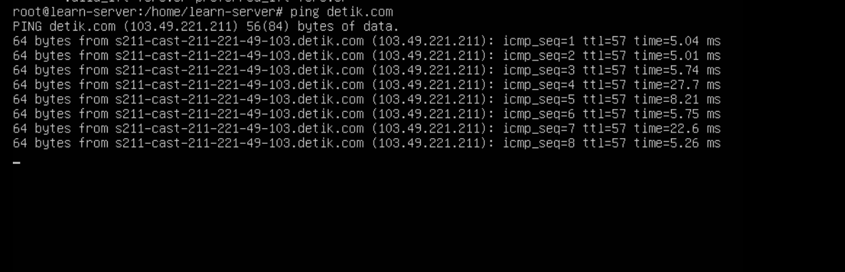
Test jaringan ke luar menggunkan perintah ping
VMWARE-SETUP-NETWORK
Test Network

Slide 10
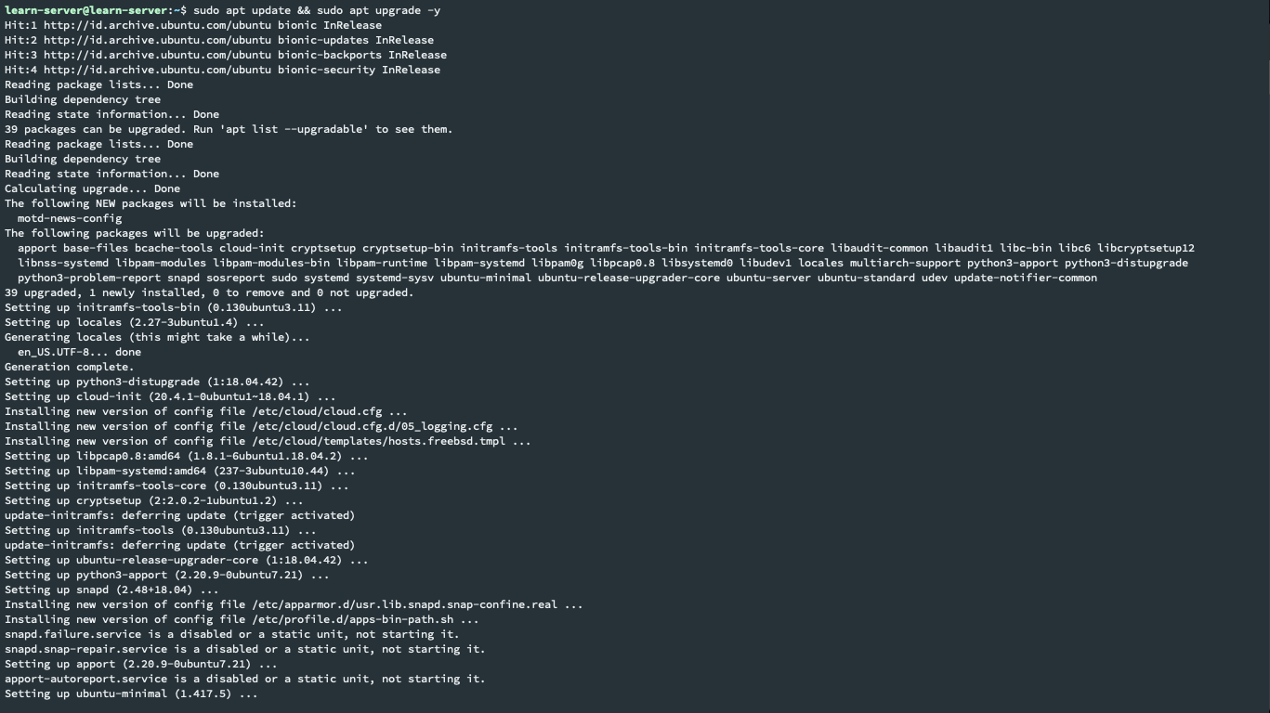
VMWARE-INSTALL-APPLICATION
Update & upgrade
library server

Slide 11
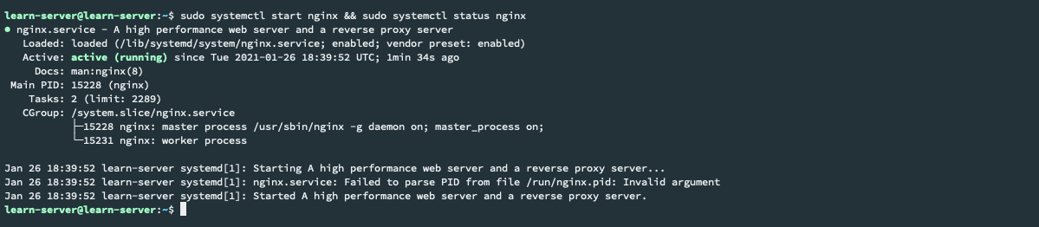
Install nginx sebagai webserver
VMWARE-INSTALL-APPLICATION
Install Webserver

Slide 12
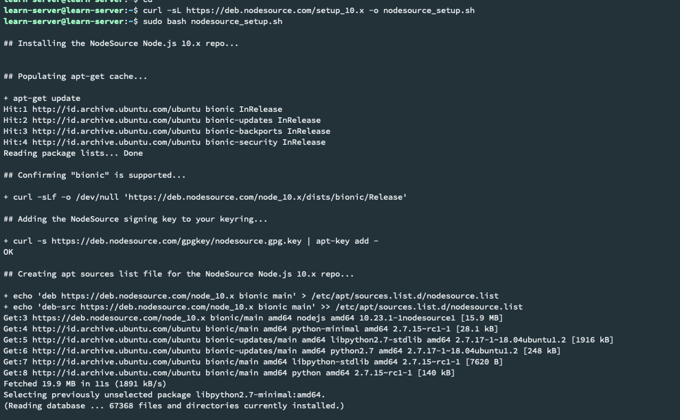
Install Package Nodejs 10 & NPM Package
VMWARE-INSTALL-APPLICATION
Install Nodejs

Slide 13
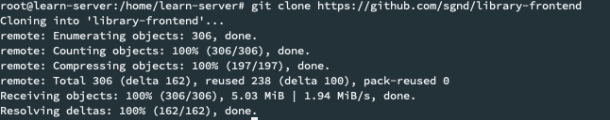
Salin aplikasi di pada repository git
VMWARE-INSTALL-APPLICATION
Copy source
application

Slide 14
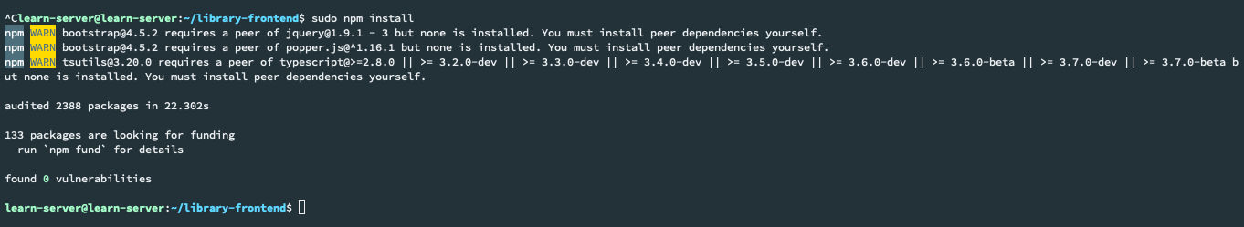
Deploy Aplikasi menggunakan perintah npm install & npm start
VMWARE-INSTALL-APPLICATION
Deploy
application

Slide 15
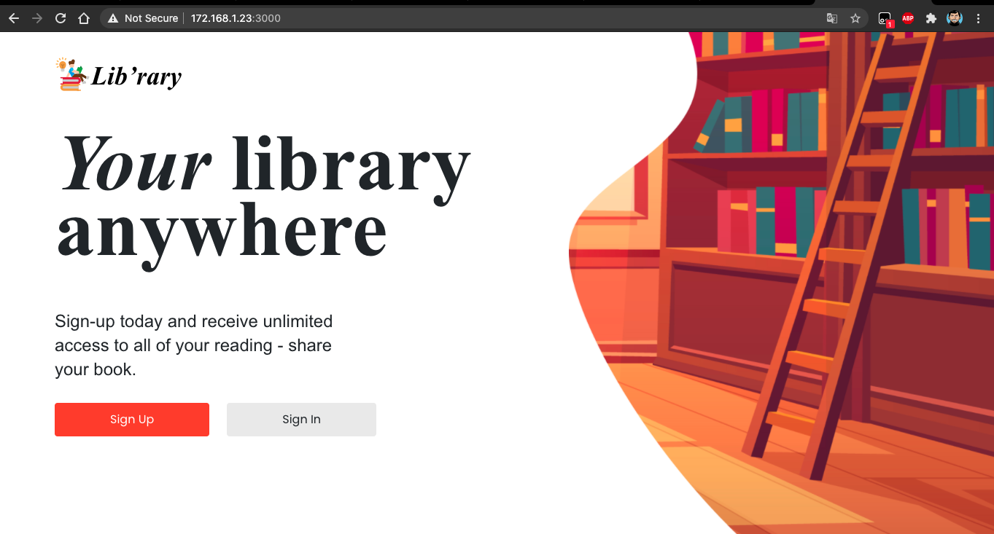
Check aplikasi pada browser
VMWARE-INSTALL-APPLICATION
Test application
On Browser

Slide 16
ALL ABOUT AWS
1ST WEEK

Slide 17





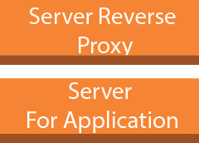
AWS-CREATE & SETUP SERVER
Security Group
Amazon EC2
instance
Elastic IP
Key Pair

Slide 18
AWS-SERVER FOR APPLICATION
sudo su
apt update && apt upgrade
git clone https://github.com/sgnd/library-frontend
cd sgnd/library-frontend
npm install
Install pm2 Service
Vi ecosystem.config.js
pm2 start ecosystem.config.js
curl -sl https://deb.nodesource.com
/setup_10.x | bash –
apt- install nodejs -y
Update & Upgrade
Install Nodejs
Clone Repo & Deploy
Install pm2 Service

Slide 19
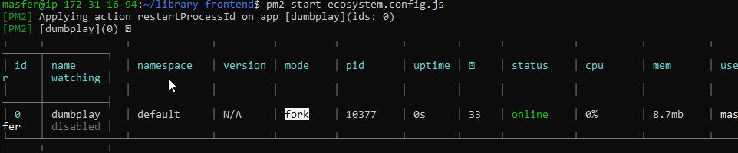
AWS-SERVER FOR APPLICATION
PM 2 Config

Slide 20
AWS-SERVER-REVERSE-PROXY
sudo su
apt update && apt upgrade
apt install nginx
systemctl start nginx && systemctl status
Curl localhost
vi /etc/nginx/sites-available/serve.conf
systemctl start nginx && systemctl status
ln -s /etc/nginx/sites-available/serv.conf /etc/nginx/sites-enabled/
Update & Upgrade
Install NGINX
Config NGINX
Symbolic Link

Slide 21
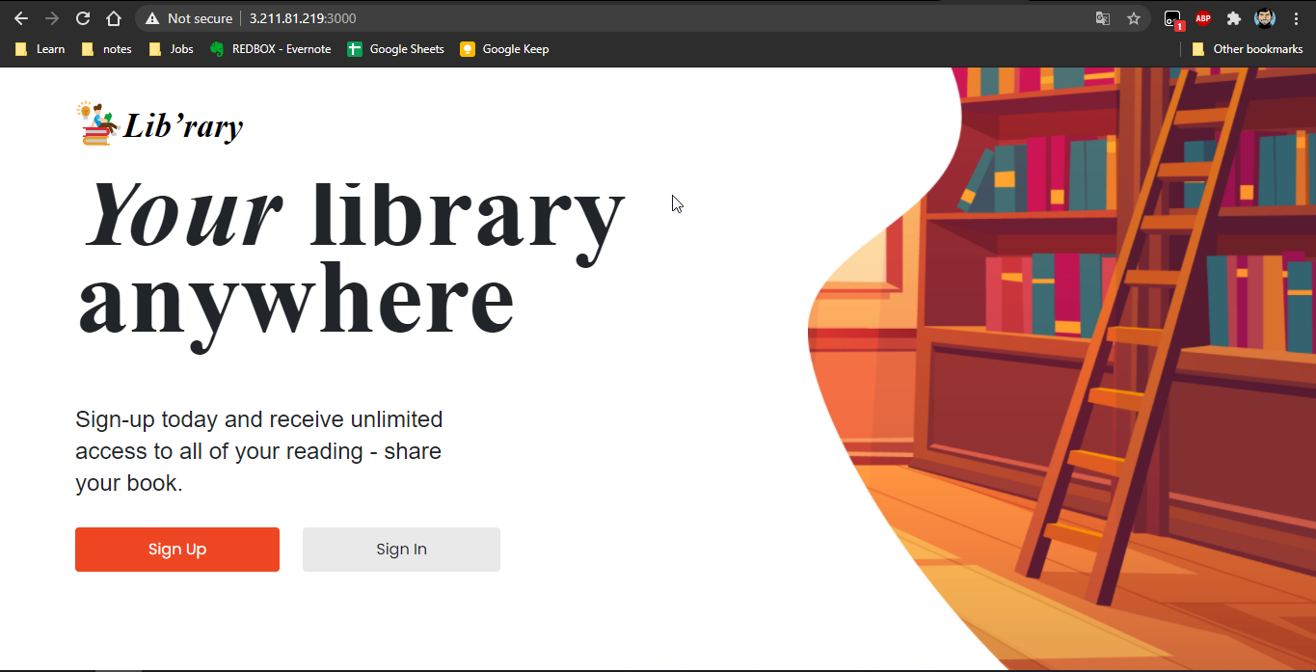
AWS-SERVER REVERSE-PROXY
Akses Web server

Slide 22
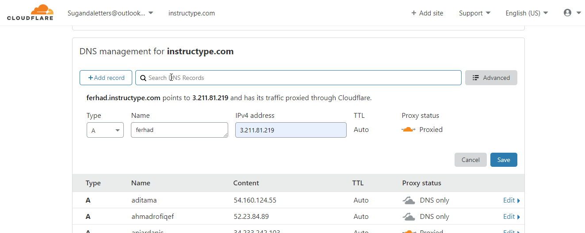
AWS-CUSTOM-DOMAIN

Slide 23
AWS-SSL-CONFIGURATION
sudo add-apt-repository ppa:some/ppa
sudo apt-get install python-certbot-nginx
vi /etc/nginx/sites-available/serve.conf
nginx –t
service nginx restart && service nginx status
Akses on browser https://ferhad.instructype.com/
sudo certbot --nginx -d ferhad.instructype.com
Install Lets Encrypted
Config Letsencrypted
Config NGINX
Execute

Slide 24
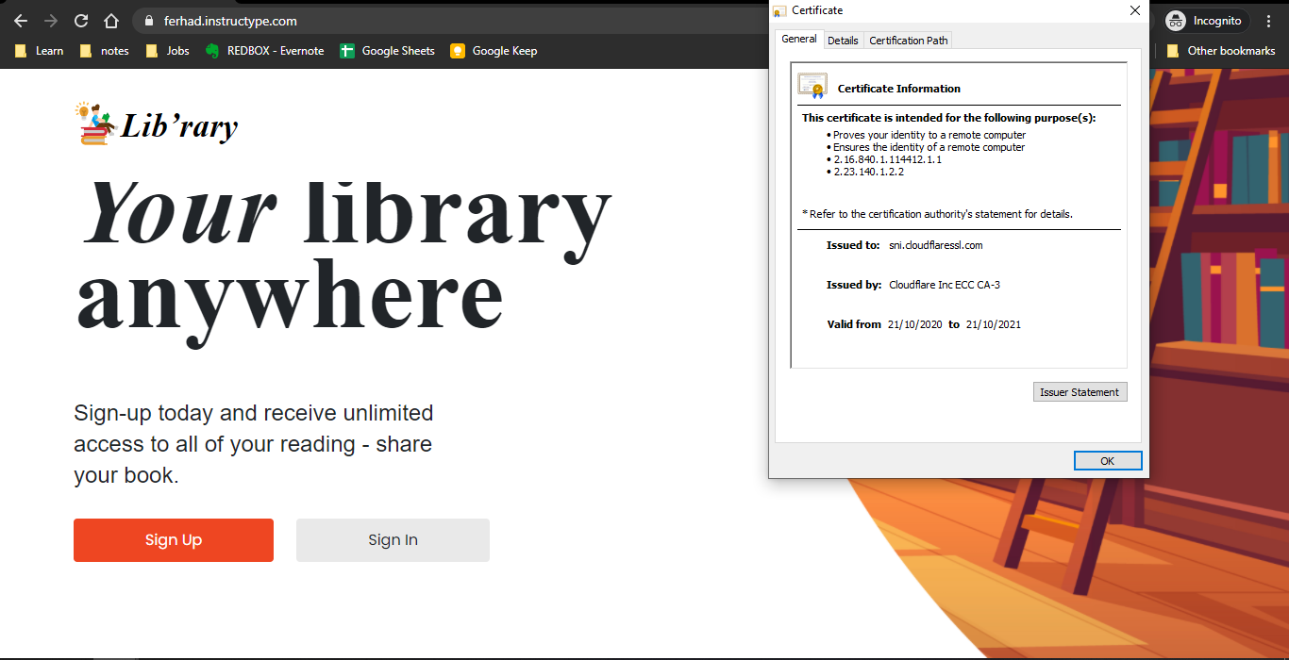
AWS-SSL-CONFIGURATION
Akses Web server

Slide 25


