Slide 1


Chapter 1
The public sector in the economy

Slide 2
Learning outcomes
Give a brief overview of different views of the role of government in the economy
List key reasons why governments intervene in the economy
Distinguish between the main tiers of government
Discuss the current fiscal challenges faced by South Africa.
Discuss the normative and positive views of public economic analysis.

Slide 3
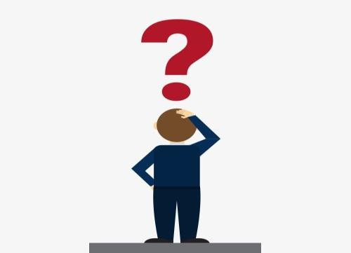
Should Governments Take Part in an Economy?
Or put otherwise…
Should Economies Consist of Households and Firms
or Include Governments as Well?

Slide 4
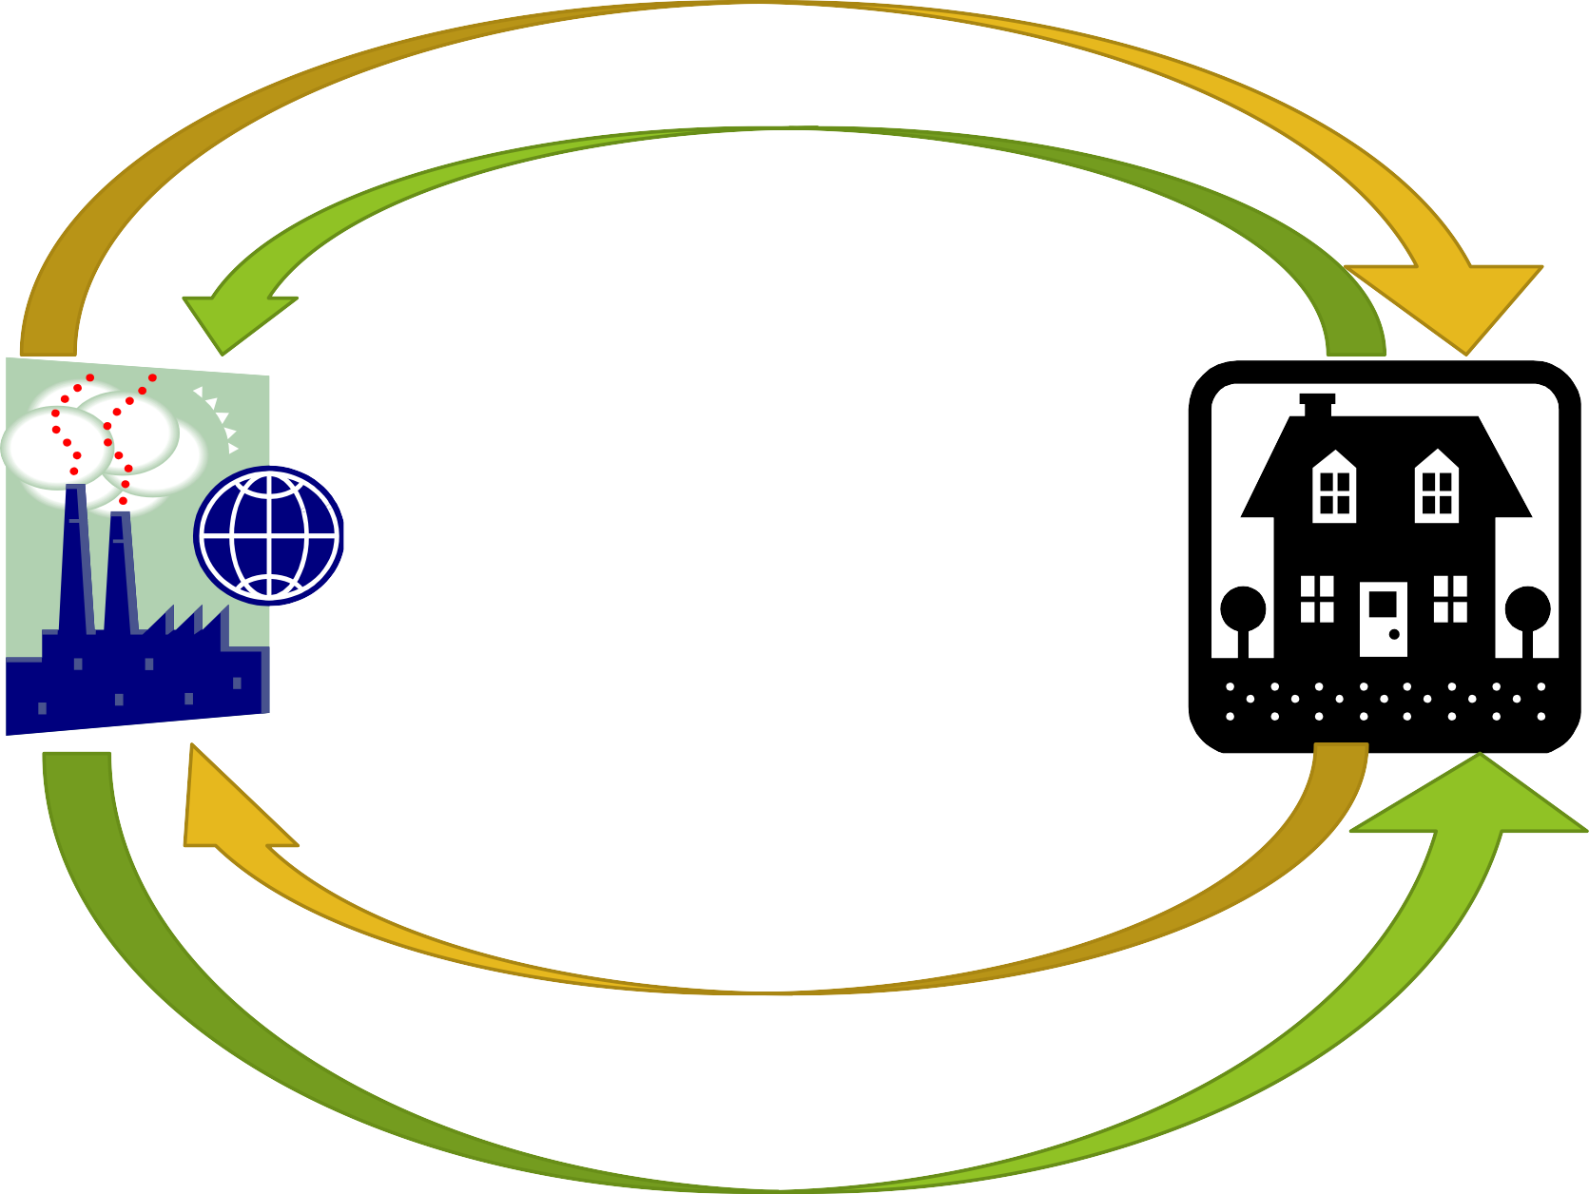
Rent, Interest, Profit , Wages
Land, Capital, Entrepreneurship, Labor
Factors Market
Households
Businesses
Products Market
Sales (RRR)
Goods and Services

Slide 5
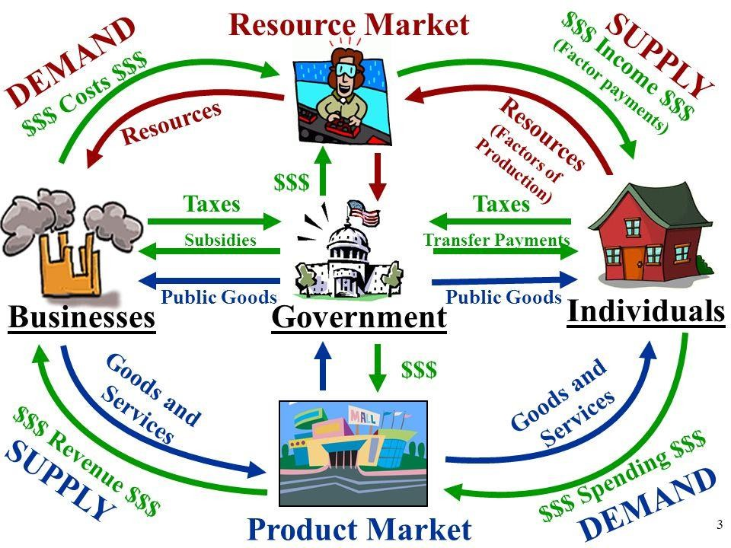
An Economy where Governments Take Part
5

Slide 6
Why “Complicate” matters by bringing Governments
into the picture?
This (and subsequent questions) lead to the world of Public Finance/Public Economics
6

Slide 7
Market Failures and the Need for Government Intervention
What are Market Failures?: When the allocation of resources by a free market is not efficient or equitable.
Types of Market Failures:
Public Goods: No incentives for private producers to provide such goods (e.g., national defense, public health).
Externalities: Costs/benefits affecting third parties (e.g., pollution).
Monopolies: When one firm controls the market, reducing competition.
Imperfect Information: Consumers and firms lack complete information, leading to inefficient choices.
Government’s Role: Is to correct these failures through taxation, subsidies, regulation, and provision of public goods.

Slide 8
Public finance/economics is the study of the role of the government in the economy. It studies the taxing and spending activities of government. Put in other words, Public economics studies how government policies affect the economy, particularly in areas like taxation, public expenditure, and regulation. Why It Matters? Governments are key economic players, influencing economic growth, redistribution, and efficiency.
The Four Questions of Public Finance
When should the government intervene in the economy?
How might the government intervene?
What is the effect of those interventions on economic outcomes?
Why do governments choose to intervene in the way that they do?

Slide 9
What is the role of government in the economy?
Government intervenes in the economy to:
• Provide public goods and services
• Regulate markets and correct failures
• Ensure economic stability and growth
• Reduce income inequality

Slide 10
Core Economic Functions of the Government
1. Allocation: Provision of public goods (education, healthcare, infrastructure).
2. Redistribution: Reducing inequality via taxation and social welfare programs/grants.
3. Stabilization: Managing inflation, employment, and economic growth.
4. Regulation: Ensuring fair competition and preventing market failures.

Slide 11
Allocation Function - Why it matters:
• Free markets underproduce public goods.
Examples: National defense, roads, education.
The South African Government invests in transport (SANRAL, TRANSNET), housing (RDP), and healthcare (proposed NHI).

Slide 12
Redistribution Function
Purpose: Reduce economic inequality by redistributing income.
How it is done:
• Progressive taxation (higher earners pay more taxes).
• Social grants (child support, disability grants, old age pensions).
Impact in South Africa:
• About 18 million people receive social grants (SASSA). If other forms of grants are included, we are sitting at around 28 million.
• Helps alleviate poverty but also strains the government budget.

Slide 13
Stabilization Function
• What it means:
Ensuring macroeconomic stability (low inflation, stable GDP growth).
• Key tools:
• Fiscal policy (government spending and taxation).
• Monetary policy (interest rates, inflation control by SARB).

Slide 14
Regulatory Function
• Why is regulation needed?
To prevent monopolies, protect consumers, and ensure fair labor practices.
Examples in South Africa include:
• Competition Commission: Prevents price-fixing and monopolies.
• Labour laws: Minimum wage, BEE policies.
• Environmental regulations: Carbon tax, pollution controls.

Slide 15
PUBLIC FINANCE IN SOUTH AFRICA
Most Southern African countries have a parliamentary democracy with an executive president elected by parliament.
Democracy is a balance between 'might' and 'right'. The state takes all the power (it has all the 'might'), but its power must be limited so that it does not abuse this power (to make sure it does 'right').
Democracy is about balancing rights and responsibilities. Citizens can expect the government to do things for them like providing protection, health services, education and housing. Citizens also have responsibilities like obeying the law and paying tax to the state.

Slide 16
South Africa is a democratic state. The first rule of democracy is that elections must be held regularly. The Constitution stipulates that an election must be held at least every five years, in which everybody over 18 years of age may vote for the political party they support. The party that wins the most votes is known as the "ruling party" and is responsible for setting up the government.
The Constitution itself is protected
As the Constitution itself is protected, it is much more difficult to change it than it is to change an ordinary law. Parliament can usually change laws if more than 50% of the Members of Parliament (MPs) who are present support the change - as long as there is a quorum (i.e. the minimum number of people required to make a decision are present).
To change the Constitution, however, at least two third (and in some sections, even 75%) of the total number of MPs (members of parliament) must agree.
Independent courts, particularly the Constitutional Court, protect and enforce the Constitution. The courts have the power to force even the President or Parliament to abide by the Constitution.

Slide 17
THREE SPHERES OF GOVERNMENT
The Constitution divides government into three tiers or levels in order to develop a closer relationship between the government and the people that it serves. These are:
THE NATIONAL GOVERNMENT (takes exclusive responsibility for matters relating to foreign affairs, defence, intelligence, tertiary education, national transport and national taxation.)
THE PROVINCIAL GOVERNMENT (9)
THE LOCAL GOVERNMENT (ABOUT 278 MUNICIPALITIES)

Slide 18
South Africa: Legacy of the past
Poor economic outcomes immediately before the constitutional change in 1994
Widespread poverty and unemployment – aggravated by the global financial crisis and COVID-19 pandemic

Slide 19
SOUTH AFRICA FISCAL CHALLENGES
1. High Public Debt
Rising Debt Levels: South Africa's government debt has been steadily increasing, with total public debt approaching 74% of GDP in recent years.
Debt Servicing Costs: A significant portion of government revenue is spent on servicing debt (interest payments), reducing the funds available for essential services and development projects.
2. Budget Deficits
Consistent Budget Deficits: South Africa has run persistent budget deficits, where government expenditures exceed revenue.
Revenue Shortfalls: Insufficient tax revenue collection due to a narrow tax base and high levels of tax evasion, along with a large informal economy, contribute to budget deficits.

Slide 20
3. Unemployment and the Informal Economy
High Unemployment: South Africa's official unemployment rate is amongst the highest in the world, with youth unemployment even higher.
Informal Economy: A large informal sector (estimated at about 8-10% of GDP) operates outside the formal tax system, making it difficult for the government to raise sufficient revenue.
4. Inequality and Poverty
High Inequality: South Africa has one of the highest Gini coefficients in the world, reflecting extreme income inequality.
Poverty Levels: Approximately 55% of the population lives below the poverty line, and many depend on government transfers (social grants) for survival.

Slide 21
5. State-Owned Enterprises (SOEs) Financial Strain
SOEs Debt Crisis: Several key state-owned enterprises, such as Eskom (electricity), South African Airways (SAA), and Transnet (rail), are burdened with unsustainable debt.
Bailouts: The government has been forced to intervene with financial bailouts to prevent SOEs from collapsing, further straining public finances.
6. Structural Economic Challenges
Low Growth Rate: South Africa's economic growth has been slow, averaging less than 2% over the past decade.
Dependency on Mining: The economy is highly dependent on mining and commodities, leaving it vulnerable to global price fluctuations and economic shocks.

Slide 22
7. Rising Social Expenditure
Increased Spending on Social Grants: The government spends a significant portion of its budget on social grants (e.g., child support grants, pensions), with over 18 million people relying on them.
Education and Healthcare: Expanding and improving public education and healthcare services require significant investment, especially as the population grows.
8. Corruption and Mismanagement
Public Sector Corruption: Corruption within government departments and SOEs has resulted in the misallocation of resources, inefficiencies, and reduced public trust.
9. Global Economic Factors
Global Economic Uncertainty: Economic downturns in global markets, fluctuations in commodity prices, and geopolitical risks affect South Africa’s exports and tax revenues.

Slide 23
Realms of Analysis in Public Economics: Normative vs. Positive Economics
1. Positive Economics
Definition: Positive economics is concerned with describing and explaining economic phenomena without making judgments about what is good or bad. It focuses on objective analysis of "what is" in the economy.
Goal: To analyze cause-and-effect relationships, using facts and data to predict outcomes of specific policies or events.
Example in Public Economics:
"What is the effect of increasing VAT on consumer spending and income?"
Examining how a change in taxation affects government revenue and consumer behavior, based on data and statistical models.

Slide 24
2. Normative Economics
Definition: Normative economics involves value judgments about what the economy should be like or what particular policies should be implemented. It is prescriptive in nature and deals with "what ought to be.“
Goal: To provide policy recommendations and evaluate economic policies based on societal goals such as equity, justice, and efficiency.
Example in Public Economics:
"Should the government increase the minimum wage?"
Suggesting policies based on what is considered beneficial for society (e.g., equity, fairness) even if it is not purely grounded in empirical facts.

Slide 25

End of Chapter

