Slide 1
1150 Programming Logic
Files

Slide 2
Files
Many types of files and many ways to work with them
What type of data in a file? Text, image, executable code, music, word document... ?
Do we want to read, write, or add (append) data to the end of the file?
How to read the file? Read in the entire file, or just some of it?
We'll focus on reading, writing, and appending data to plain text files
Soon, we'll look at images, Word, and Excel documents

Slide 3
Writing and reading text files
To work with simple text files there are 3 steps:
open() the file in the correct mode (read, write, or append)
Work with the file
e.g. if you opened the file to read it, then read the data
If you opened the file to write to it, then write your data
If you opened the file to append data, then append your data
close() the file when you are done

Slide 4
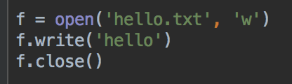
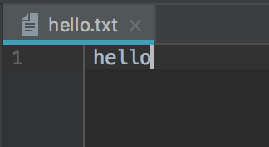
Write a text file
The 'w' means write mode
Open, work with file, close

Slide 5
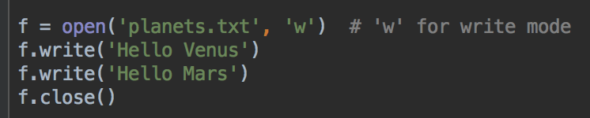
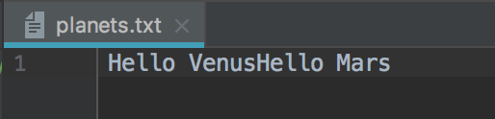
Modify your file
Run this code. What's in planets.txt ?
All on one line - if you want text to be on different lines, you must tell Python to write a \n character

Slide 6
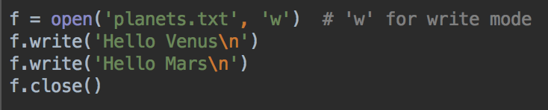
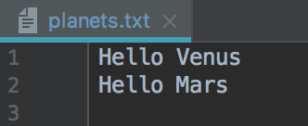
Writing \n
Add \n to the end of your strings
Run your code again, what's different?
Each string on a separate line

Slide 7
Run your program again
What happens to planets.txt?
Are more lines added to the end, or is it overwritten?
If you open a file in write 'w' mode:
If the file does not exist, it will be created
If the file already exists, it will be erased and written over with the new data
So be careful you are writing to the correct file

Slide 8
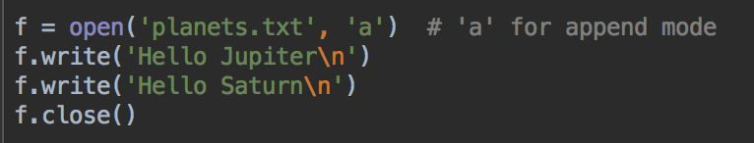
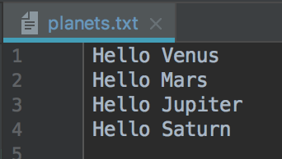
Append mode
The 'a' means append mode
Change your program to this
Note 'a' argument

Slide 9
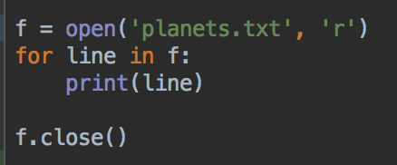
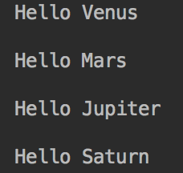
Reading a file, line by line
The 'r' means read mode
Note 'r' mode
Can iterate over the file object - so you can process one line at a time
Note you get the newline characters too

Slide 10
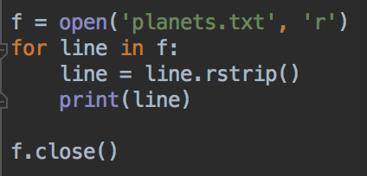
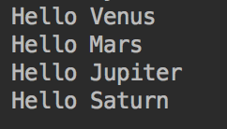
Reading a file, line by line
The 'r' means read mode
Remove the newline with the string method rstrip()
This method removes whitespace from the end of strings, so removes the newlines
Caution - if there is more whitespace at the end of your lines that you do want, you'll need to investigate other solutionsz

Slide 11
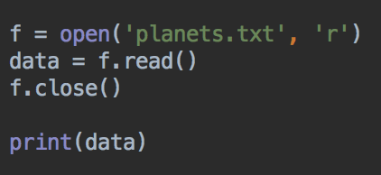
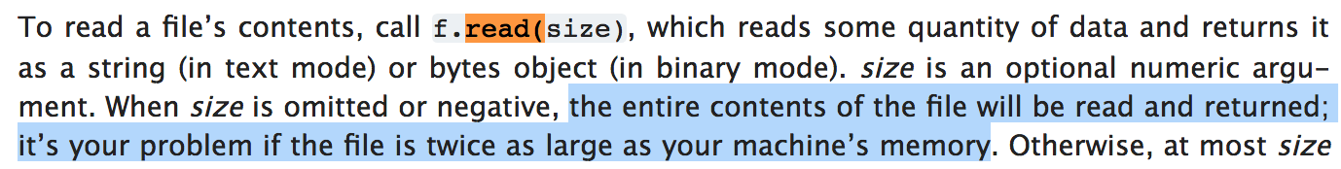
Reading all the lines with read()
f.read() returns a string with all the data from the file
What would happen if you tried to read a really big file?
Usually, the lines in a file are for organizing the data in the file, so other methods are usually more useful

Slide 12
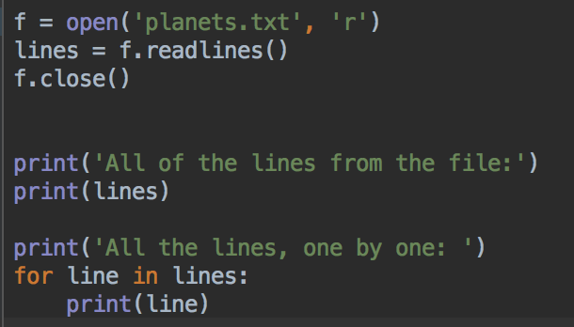
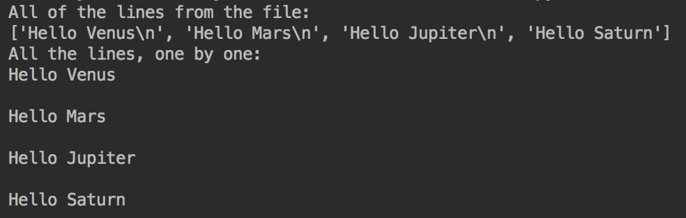
Reading all the lines with readlines()
If you need all the lines in the file, readlines() returns all the lines as a list of strings
Including the newline characters

Slide 13
line by line vs. reading all the lines
line-by-line:
Can only process one line at a time - but often, that's no problem
More efficient use of memory, don't need to store the whole file
Only way to deal with large files
Can't go backwards - lines are read in order from the start to the end
read all the lines:
good for small files, may be impractical for large files
have all the data accessible to program
once data is read into a list, can access data in any order

Slide 14
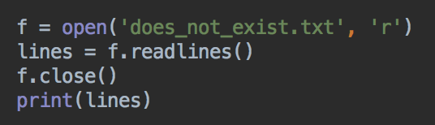
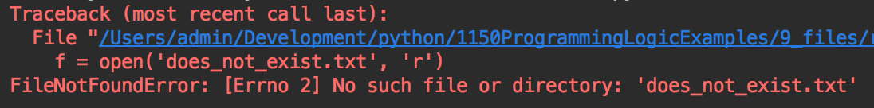
Reading - error if file not found
Change the filename in your file reading program to a file that does not exist

Slide 15
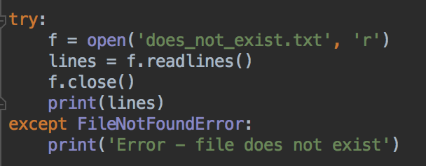
Error handling
Add try block - indent the file reading code
Follow with an except block that names the type of error that might happen

Slide 16
try, or attempt to do this
If the file is not found, do this
The program won't crash if the file is not found, it will continue with whatever code is after the try.. .except blocks.
If the file is found and there's no error, the error message is not printed. The program continues as usual

Slide 17
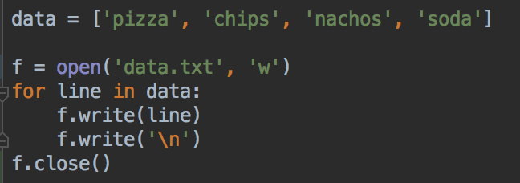
Writing the new lines
Writing a list
Remember you need to write new lines

Slide 18
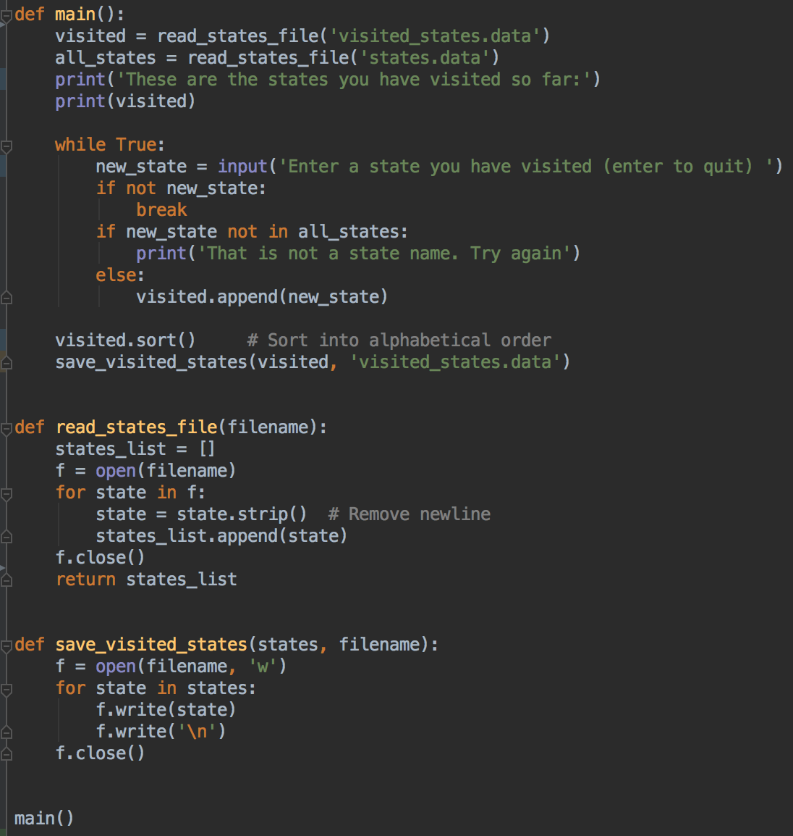
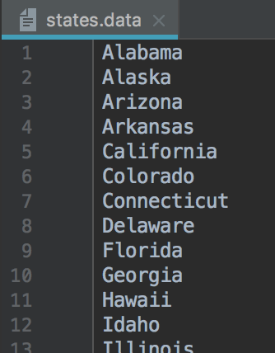
state wish list
In the example code repository
Requires a file containing all the state names
Start of states.data

Slide 19
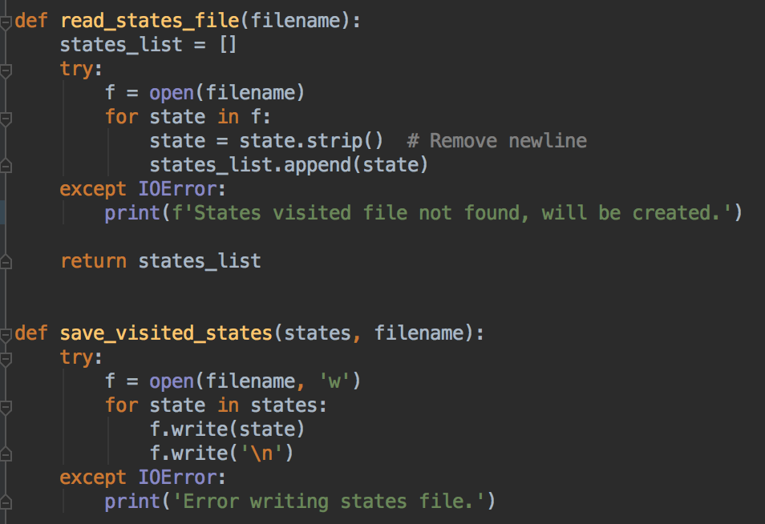
state wish list with error handling
read and save functions with try and except
The first time the program runs, the file with the list of states the user has visited doesn't exist
But, that doesn't matter - it will be created as soon as they enter a state
So, we need to catch and ignore the error

Slide 20
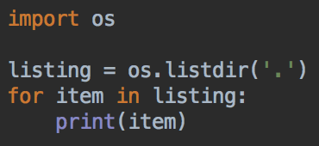
os module, listing files and directories
Import the os module to access operating system methods
Use a import os statement

Slide 21
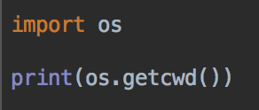
Finding the current working directory
This is usually the directory your Python script is running from
Example output on my computer

Slide 22
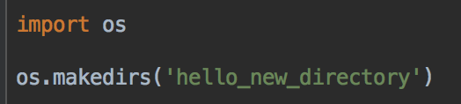
Making a new directory
Example:
Your turn: Make a directory called quotes

Slide 23
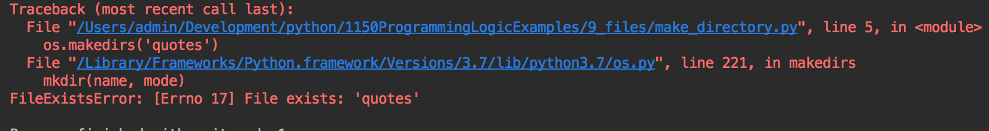
Try running your program twice
Crashes if directory already exists

Slide 24
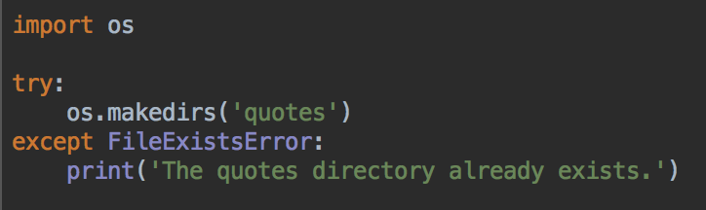
Fix - try-except blocks
These say: Try doing the thing after try:
If it works, great - carry on with the program
If there's an error, run the code in the except: block to deal with it* if possible. Then carry on
*dealing with it could be printing an error message, asking the user what to do next, ignoring it, trying again, or something else

Slide 25
Writing to files somewhere else
To read or write a file to another location, you need to know where the file is, or will be created
So. you need to know the file's path
This can be relative to your script
Or absolute, the entire path from your computer's root directory

Slide 26
File properties
Files have 2 properties: a filename and a path
The path leads to the folder (directory) location of the file
In Windows the root folder is usually C:\
Path components are separated by backslash \
A file path looks like… C:\users\username\documents
In MacOS and Linux the root folder is /
Path components are separated by forward slash /
A file path looks like... /Users/username/documents

Slide 27
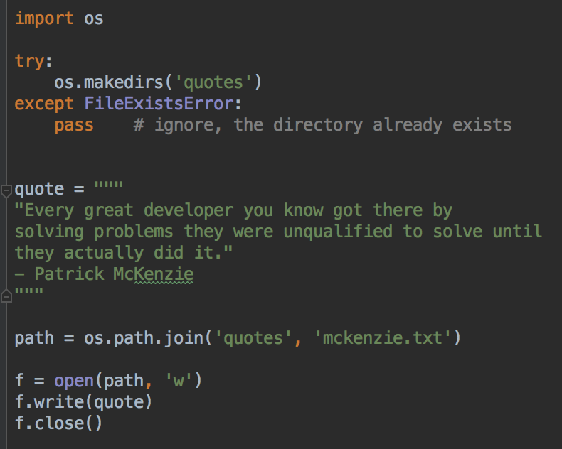
Writing a quote to a file in the quotes directory

Slide 28
Your turn
Write this quote to a file called hunt.txt in your quotes directory
"""
"No one in the brief history of computing has ever written a piece of perfect software. It's unlikely that you'll be the first." - Andy Hunt
"""

Slide 29
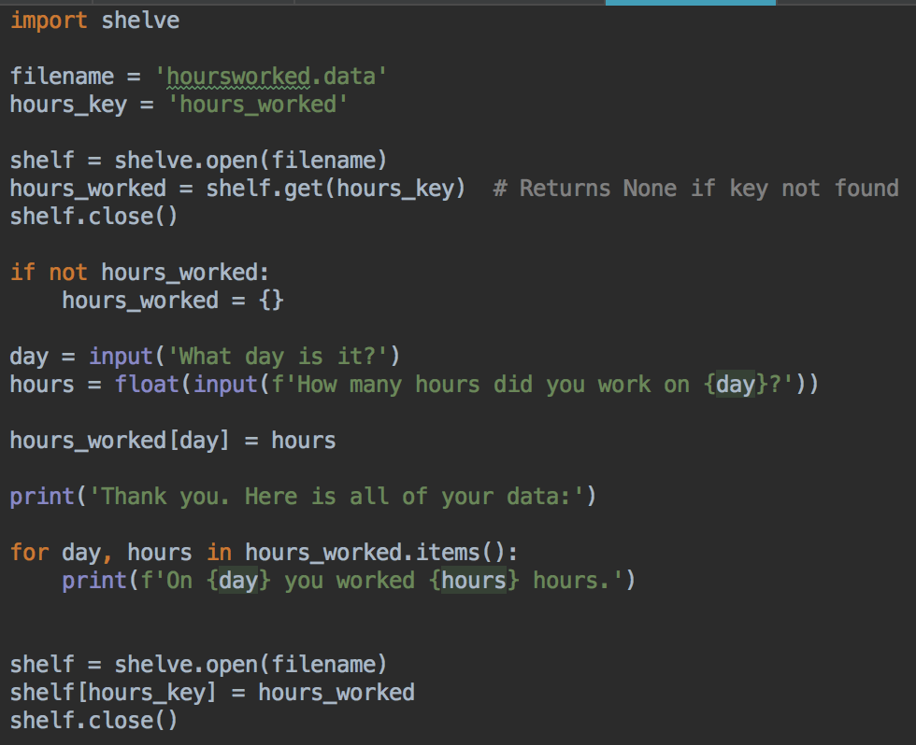
Saving variables with shelve
Like a permanent dictionary
Open a shelf, use dictionary notation, close shelf when done
Data is available when program runs next time

