Slide 1
ITEC 1150 Programming Logic
The Dictionary Data Type

Slide 2
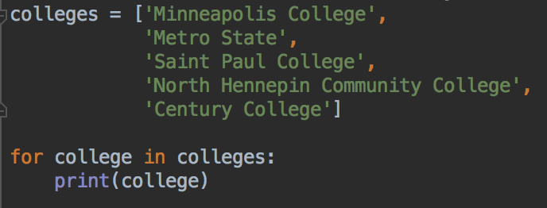
Last week: lists
A collection of things, typically all of the same type
The list has an order, the items are kept in the same order
Can add and remove items
Functions to get the number of items, sort the list, reverse, shuffle
Can loop over lists

Slide 3
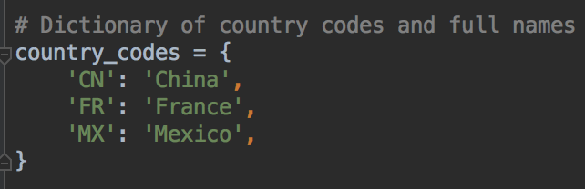
Dictionaries
Lists are a kind of data structure
Another common data structure in Python is the dictionary
Dictionaries store key: value pairs

Slide 4
Dictionaries - key: value pairs
Used to associate a key with it's value
Keys must be unique
Like a regular dictionary - words are associated with their definitions

Slide 5
Dictionaries - key: value pairs
Syntax: use curly braces { }
Link a key and it's value with colons :
Separate key: value pairs with commas ,

Slide 6
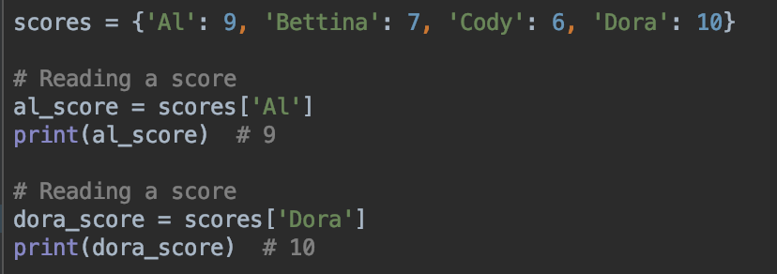
Reading data from a dictionary
Use square brackets

Slide 7
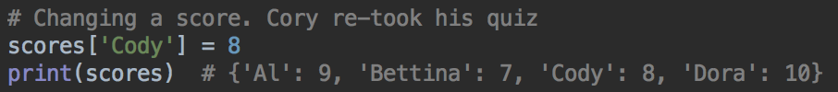
Changing data
Use the square bracket notation

Slide 8
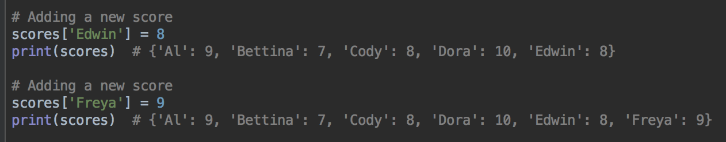
Adding data
Square brackets again

Slide 9
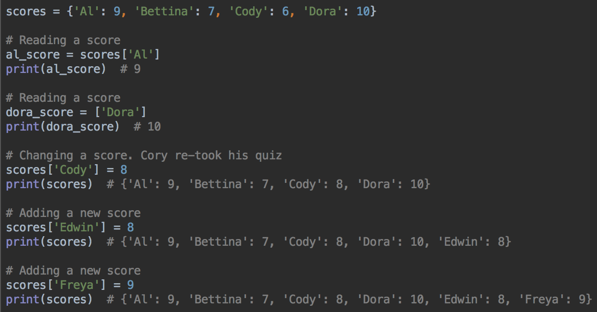
Adding, reading, modifying

Slide 10
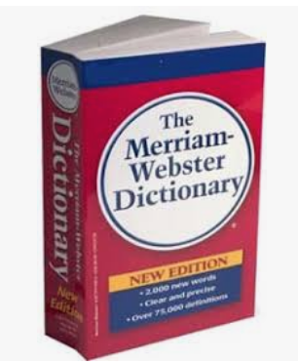
Lists vs. Dictionaries
Lists keep their elements in order. We often have to get the first element, or the last element, or want to process all of the elements in order
Newer versions of Python keep dictionary keys in the order that the keys were added to the dictionary, but older versions don't
And other languages have dictionaries or something very similar, and the order of keys may not defined - they might be in a different order to the way the key: value pairs were added
With a dictionary, what matters most is that the keys are associated with the correct values
In a real dictionary:
We never need to ask for the 100th word in a dictionary.
We do ask for a word (the key) to find its definition (the value).
Dictionaries are designed for data that is retrieved by its key.
When numeric order is most important, use the list data type.
When a certain key must be associated with a certain value, use the dictionary data type.

Slide 11
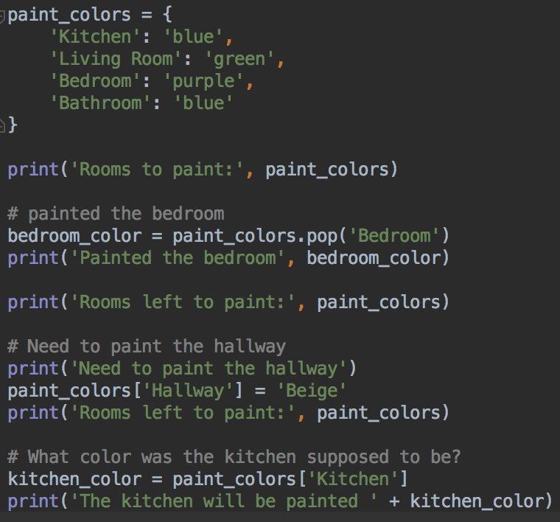
Dictionary Example
Create dictionary
Remove a key, return value
Add a key:value pair
Get the value for a key

Slide 12
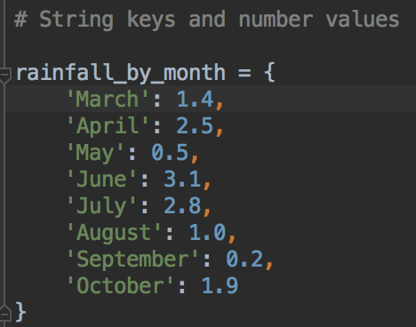
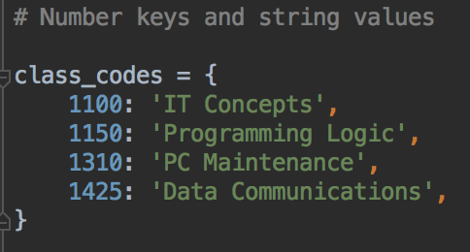
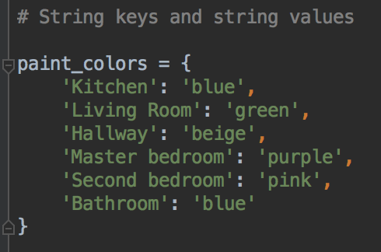
Dictionary Examples
Often, all the keys are the same type
All the values are the same type
Can have string keys and number values, string keys and string values etc...

Slide 13
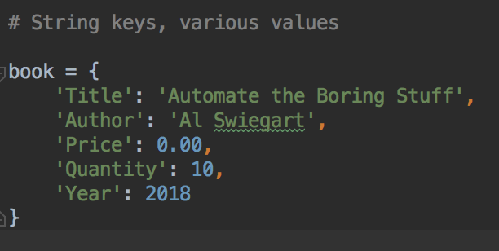
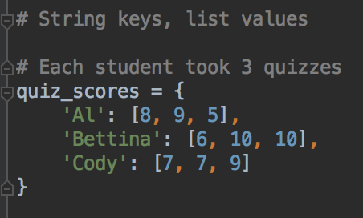
Dictionary Examples
The values can be different data types to represent different data about one object
The values can be lists, or other dictionaries

Slide 14
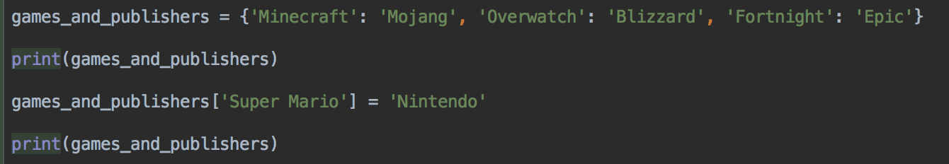
Adding key: values pairs to a dictionary
dictionary[new_key] = new_value

Slide 15
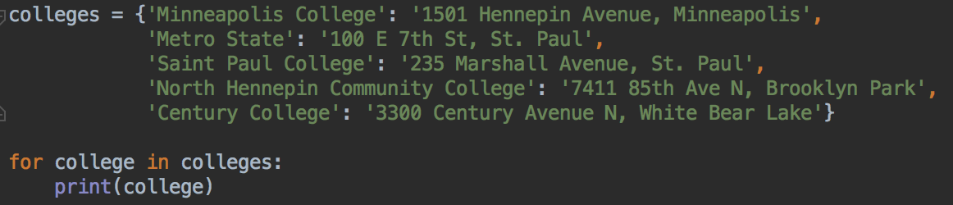
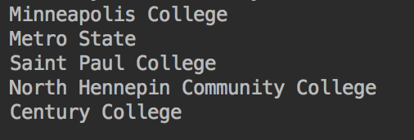
Looping over a dictionary
What does this print?
Just the keys ->

Slide 16
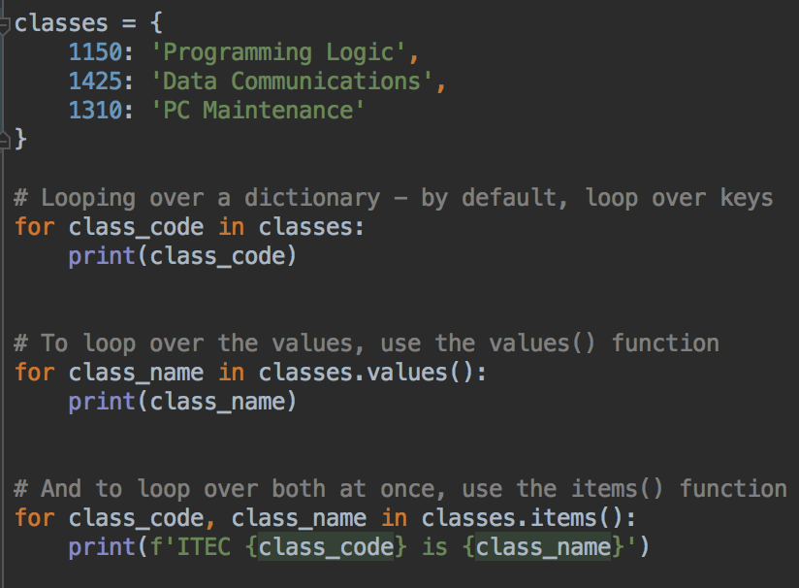


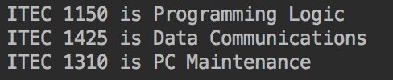
Looping over a dictionary
You can loop over the keys - the default
Or loop over the values with values()
Or loop over both keys and values with items()

Slide 17
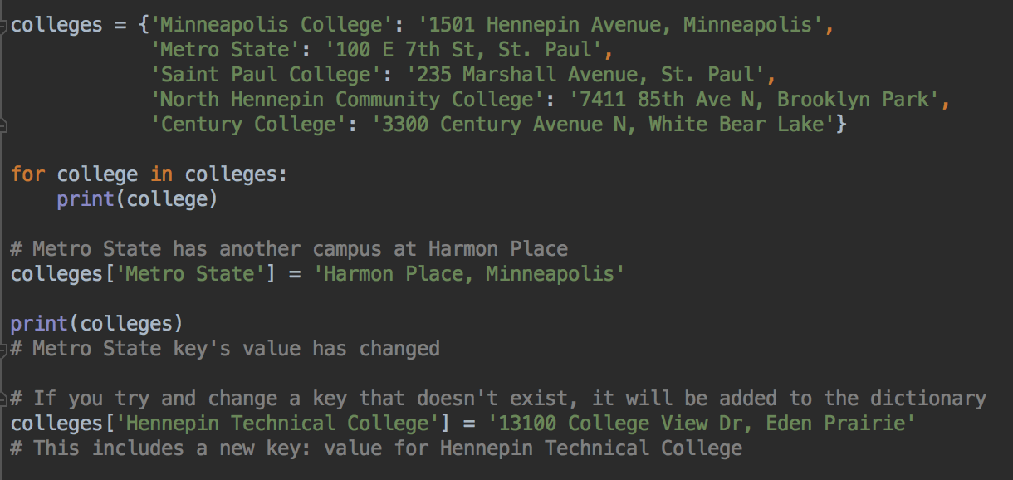
Modifying data in a dictionary
Same syntax as adding a new key:value dictionary[key] = new_value
If the key is already in the dictionary, the existing value will be overwritten
Keys must be unique within a dictionary, can't have two keys the same

Slide 18
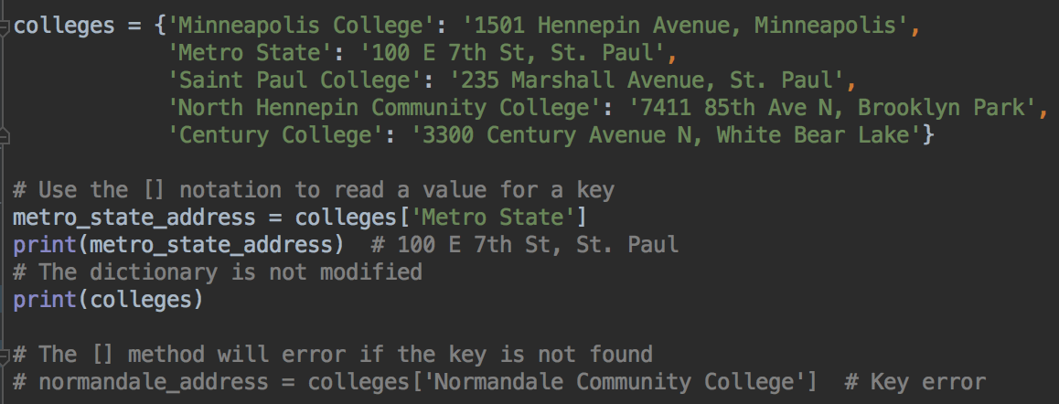
Getting a value for a key from a dictionary
One method - use [] syntax
This will error if the key is not in the dictionary

Slide 19
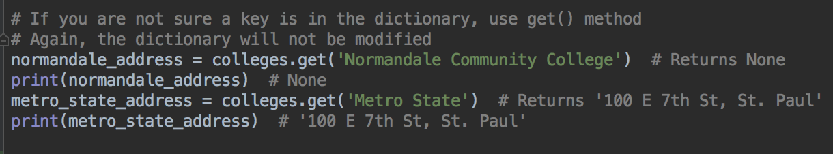
Getting a value for a key from a dictionary
Another way - the get() method
Safer - will not error if the key is not found
get() returns the key's value, if the key is there
get() returns None if the key is not in the dictionary

Slide 20
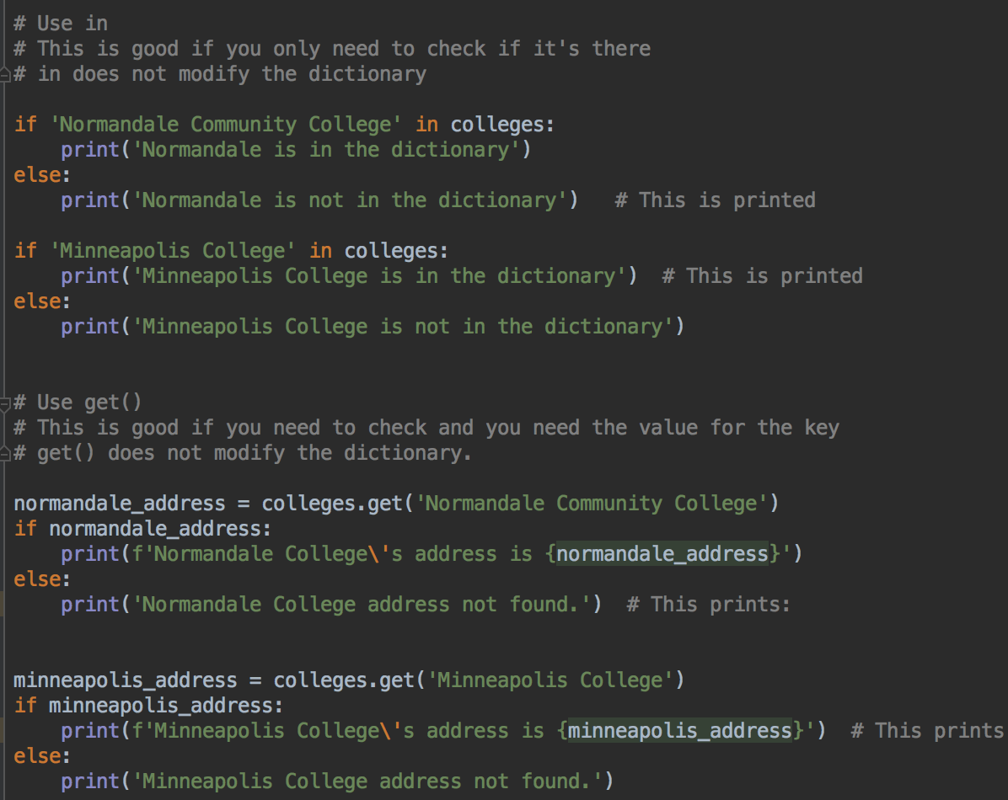
Is a key in the dictionary?
Can use in in the same way as for lists, to check if a key is in the dictionary
Can also use get() to check if a key is in the dictionary, and get the value if it is

Slide 21
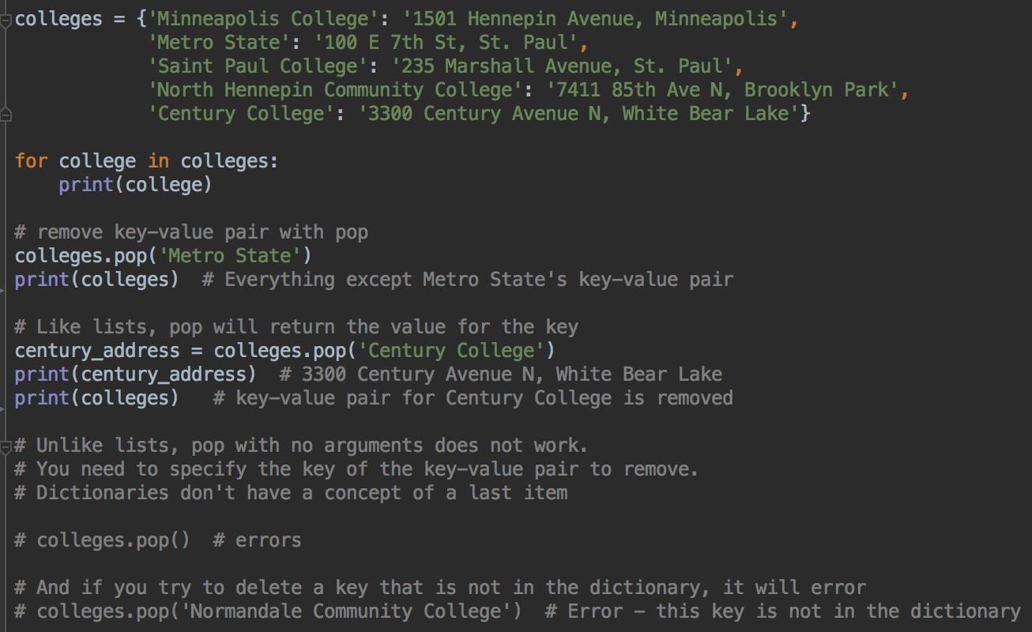
Removing data from a dictionary
Use pop() to remove a key: value pair
pop() will error if the key is not in the dictionary

Slide 22
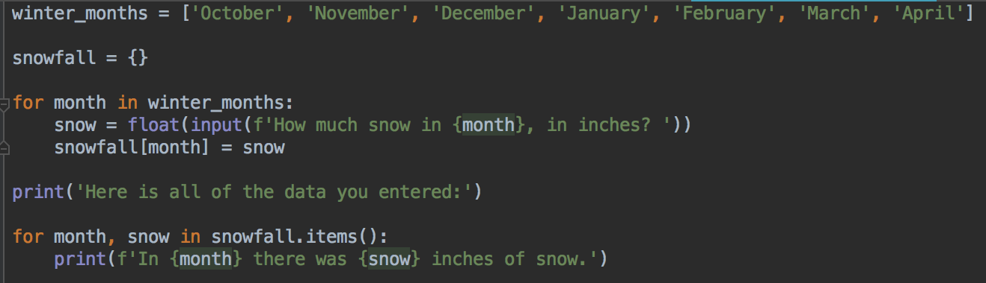
User input for a dictionary: snowfall program
User input for values in the dictionary
The keys come from a list

Slide 23
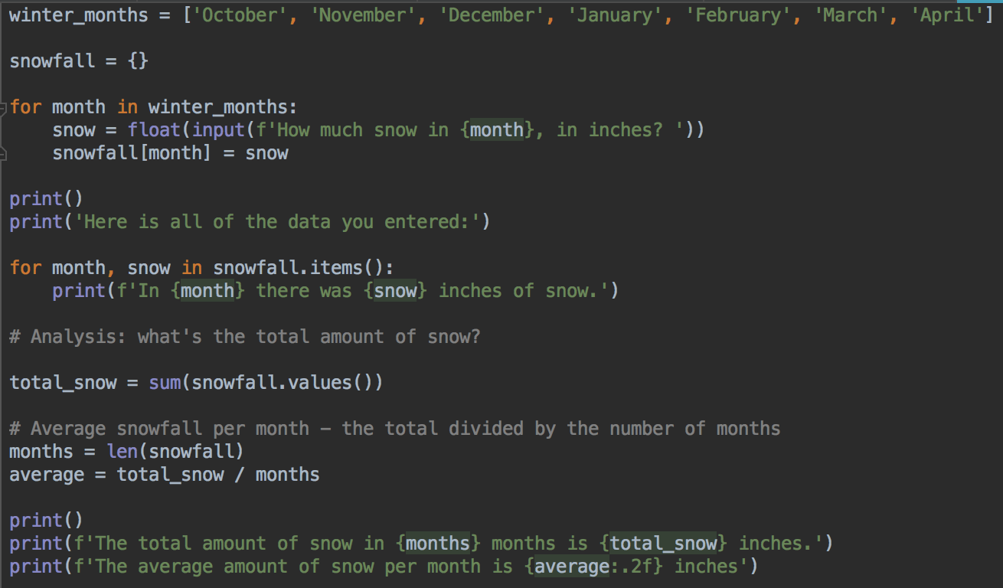
User input for a dictionary plus analysis: snowfall program
Can use sum() and len() on the keys or values
Your turn: your user wants a program that does the same thing, but for rainfall in the three months of June, July and August
Ask for the data, print the total and average

Slide 24
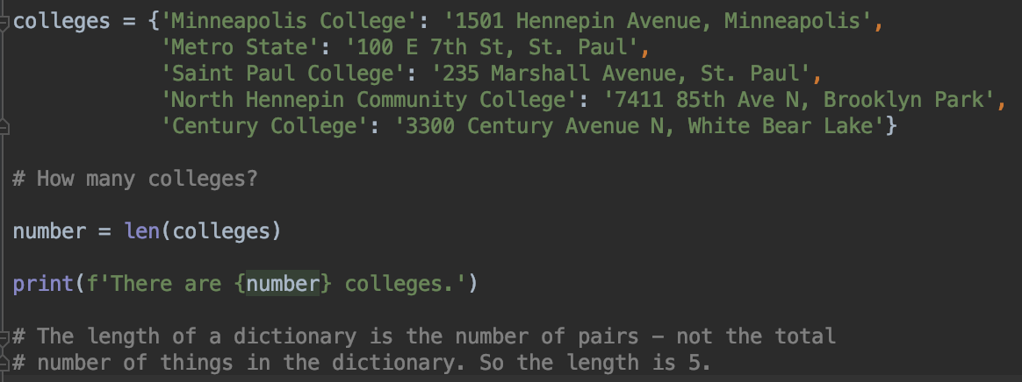
How many things in the dictionary?
Use the len() function to get the number of key-value pairs
Your turn: how many rainfall records are in your rain dictionary?

Slide 25
Dictionaries can contain lists, other dictionaries
Dictionaries can contain lists

Slide 26
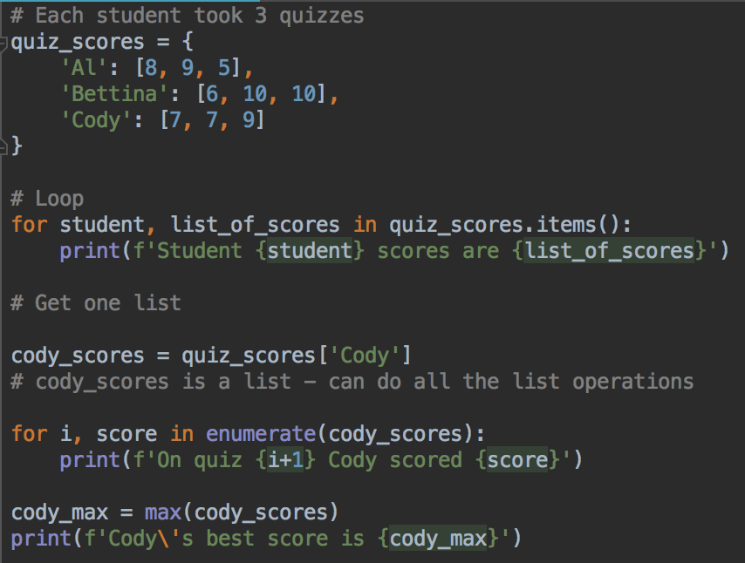
Dictionary containing lists
All the things you know about lists still apply

Slide 27
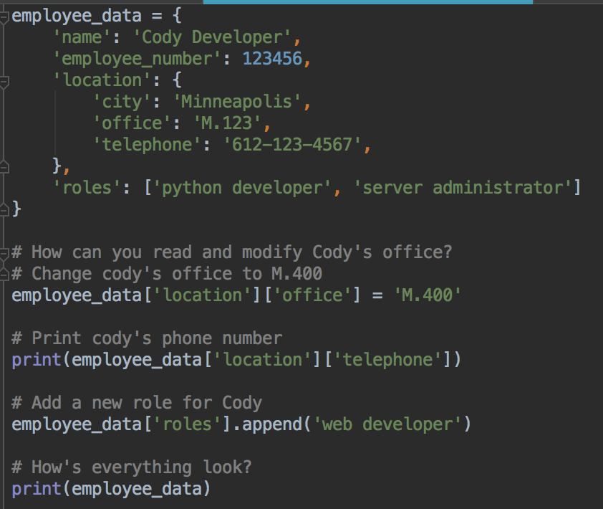
Dictionary containing dictionaries
Things still work
Can do dictionary operations on nested dictionaries

