Slide 1
Programming Logic
Working with Excel and Word Files
Creating and Reading Microsoft Office Documents

Slide 2
Word and Excel are very common
Very likely to you'll need to use with either or both of these in school, and at work
Creating, or using data from documents and spreadsheets
Being able to manipulate these programmatically can be very helpful
Automating repetitive tasks

Slide 3
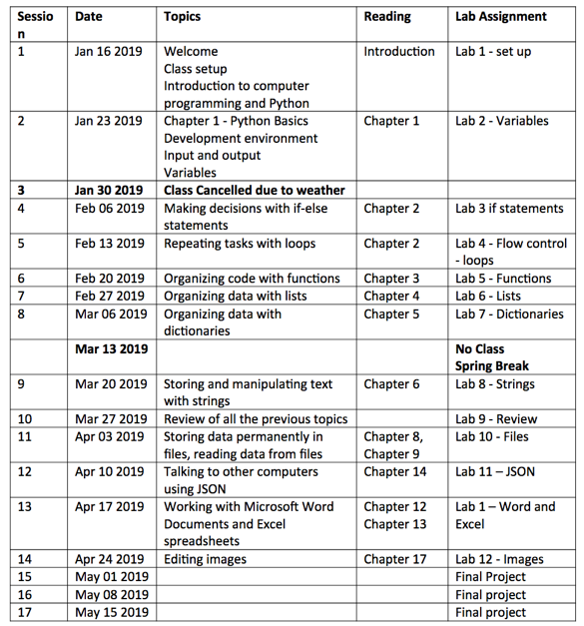
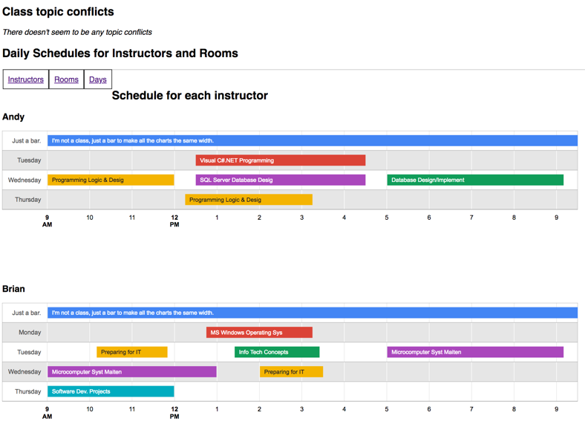
Examples
Syllabus schedule - generate a table for a semester with the correct dates in the second column
ITEC Schedule conflict finder, built from an Excel spreadsheet
Yes, I have heard of macros… but Python is easier to write IMO

Slide 4
Python standard library doesn't have this functionality
We'll usethe openpyxl library
https://openpyxl.readthedocs.io/en/stable/

Slide 5
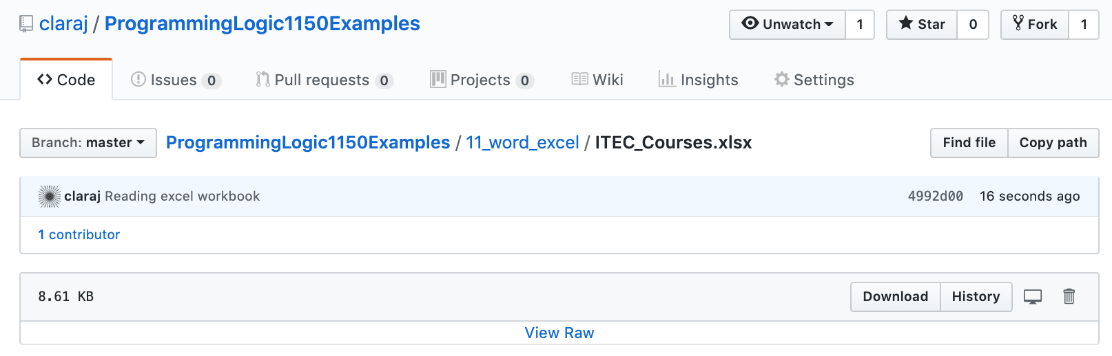
Download example Excel worksheet
https://github.com/claraj/ProgrammingLogic1150Examples/blob/master/11_word_excel/ITEC_Courses.xlsx

Slide 6
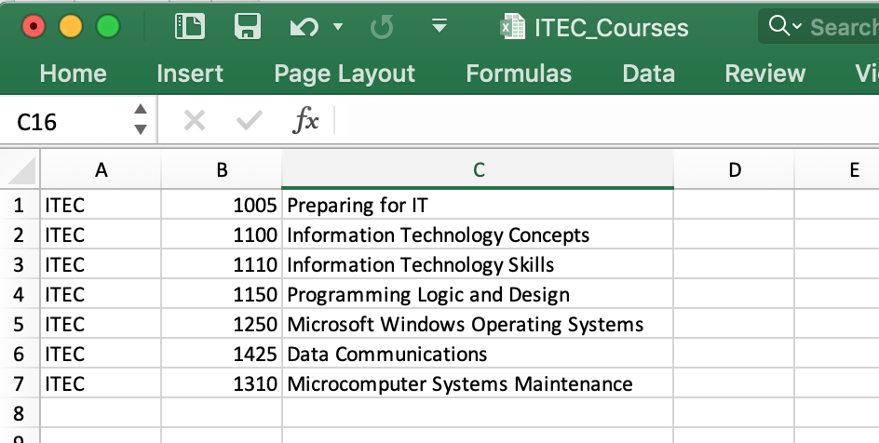
Example workbook ITEC_Courses.xlsx
Codes and names for the seven classes in the IT Fundamentals certificate
Create a new PyCharm project
Add this file to your project
Drag and drop the file into your PyCharm project

Slide 7
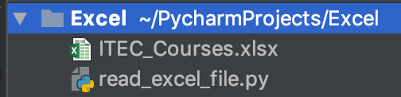
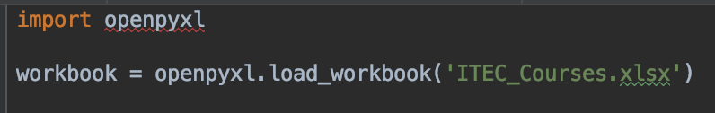
Reading Excel Spreadsheet
In your project, create a new Python file
Enter this code
Notice error on first line
We need to import openpyxl

Slide 8
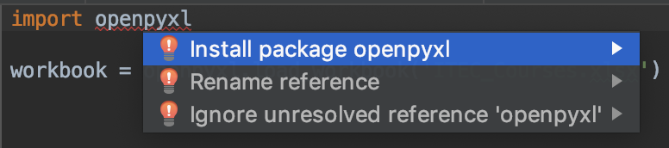
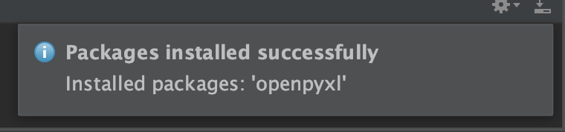
Install openpyxl
Move cursor to first line, over openpyxl text
Windows: Press Alt + Enter
Mac: Press Option + Enter
Select Install package openpyxl.
Watch for Packages installed successfully message

Slide 9
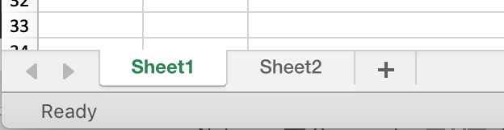
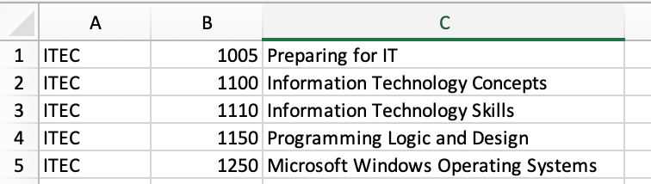
Read Excel file into program
Excel spreadsheets are made of sheets, the tabs at the bottom of the screen
Each sheet is made of a grid of cells, organized into rows and column
The columns are labeled with letters
The rows are numbered
Each space for holding one piece of data is called a cell
Can refer to an individual cell in a sheet by it's column and row
So, "Programming Logic and Design" is in cell C4

Slide 10

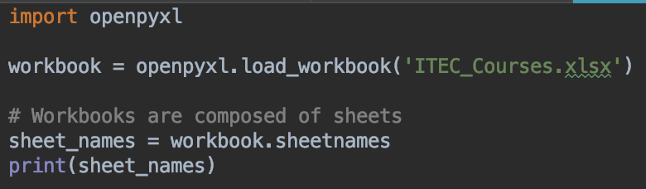
Read Excel file into program
Load worksheet
Get sheet names
What sheets does this workbook have?

Slide 11
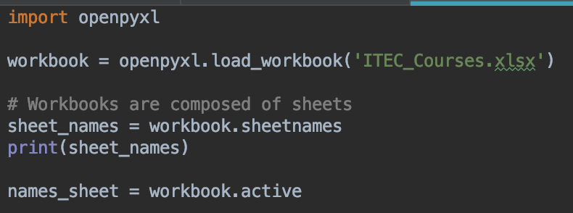
Select a worksheet
workbook.active returns the first worksheet

Slide 12
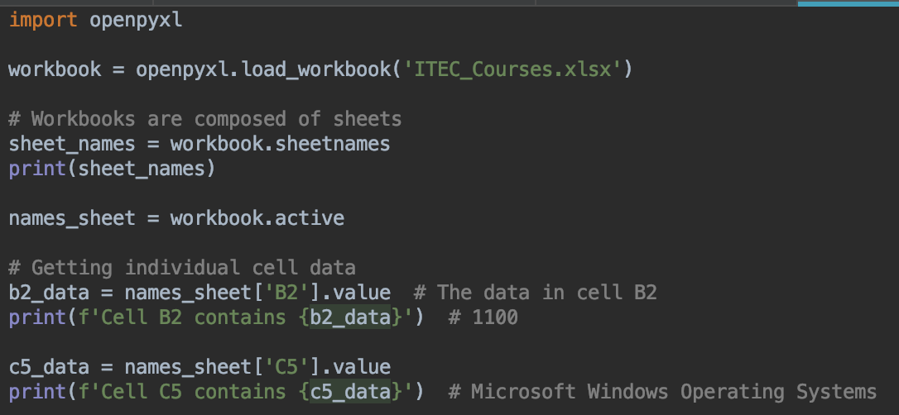
Get data from individual cells
Your turn: can you get the data from cell B4?

Slide 13
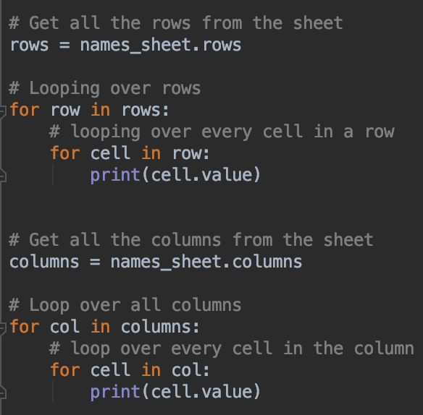
Loop over all data from a column or row
Notice nested loops

Slide 14
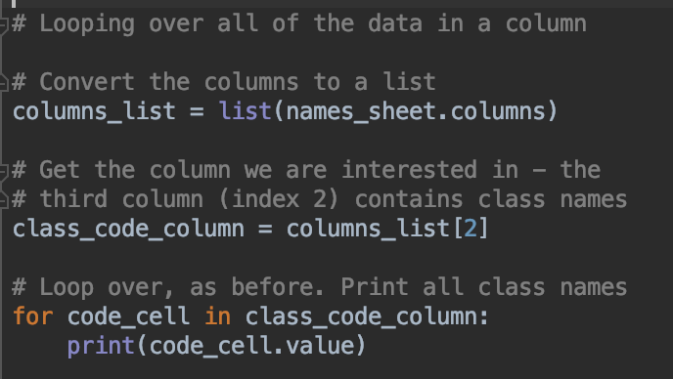
Getting data from one column
Your turn: Can you modify this code to print all the class codes from column B?

Slide 15
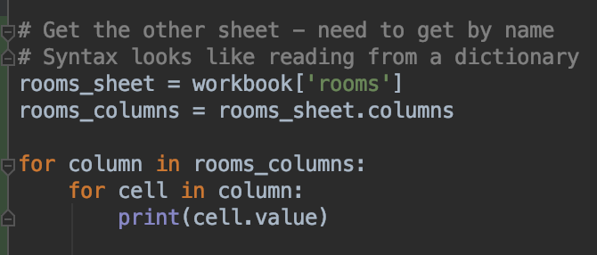
Working with another sheet
Get by name, from the workbook object
Syntax is like reading from dictionaries

Slide 16
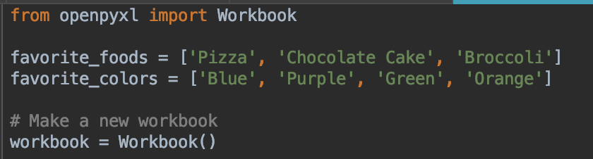
Creating Excel Spreadsheets
Create a new Python file
Replace the example lists with your own favorite foods, favorite colors
We'll write this data to a new spreadsheet workbook

Slide 17
No Excel or Word on your computer?
Upload your file to your student OneDrive account
Log in to your student email and look for the OneDrive icon
Can view Excel and Word files in your browser
http://mctc-studentservices.custhelp.com/app/answers/detail/a_id/456/~/onedrive-for-business
You can get Word and Excel for free
PCs: http://mctc-studentservices.custhelp.com/app/answers/detail/a_id/464/related/1
Mac users: http://mctc-studentservices.custhelp.com/app/answers/detail/a_id/468/

Slide 18
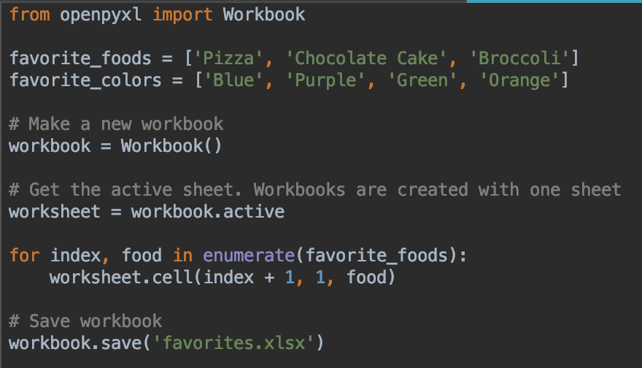
Add this to your file
Create a workbook
Select the worksheet to write data to
Use the cell method to set data in a cell
Rows and columns are counted from 1!
Save workbook

Slide 19

Writing using the cell method
The arguments are (row, column, data)
Rows and columns are counted from 1

Slide 20
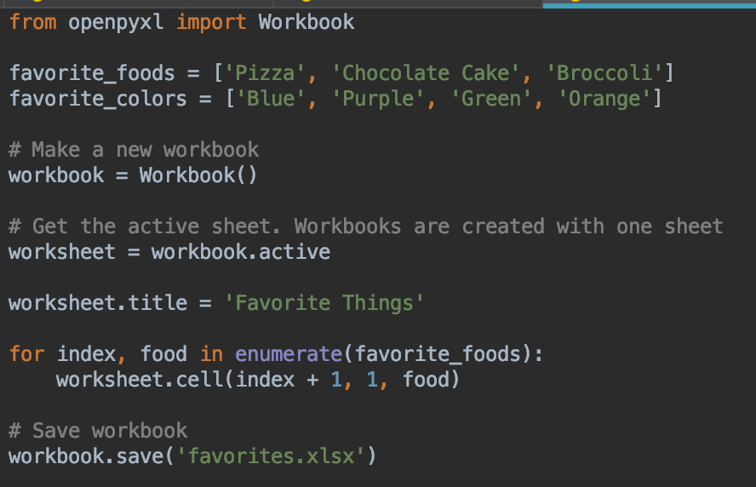
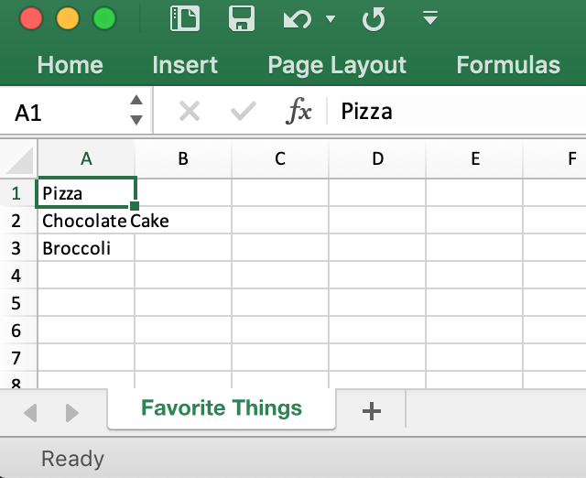
Modify code – set the worksheet title
Run and test
Confirm the sheet's name is set

Slide 21
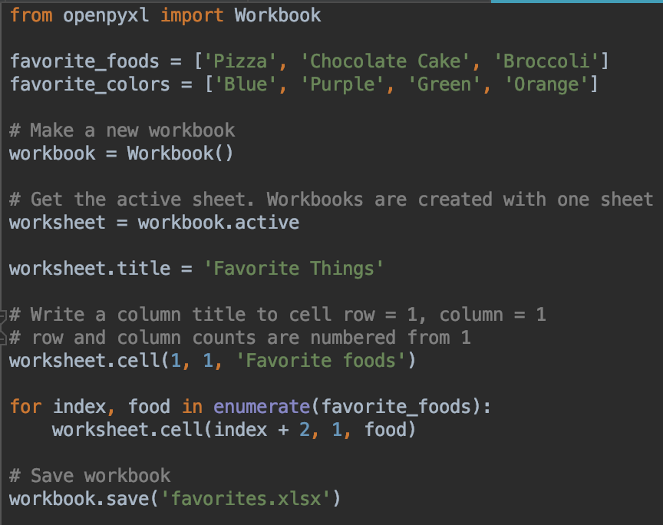
Modify code – add a title to the column in the first cell
Notice the row argument has changed – have to add on 2

Slide 22
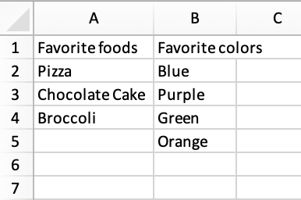
Can you write the favorite color list to the second column?
The first cell in the column should be "Favorite colors"
Your saved spreadsheet should look like this

Slide 23
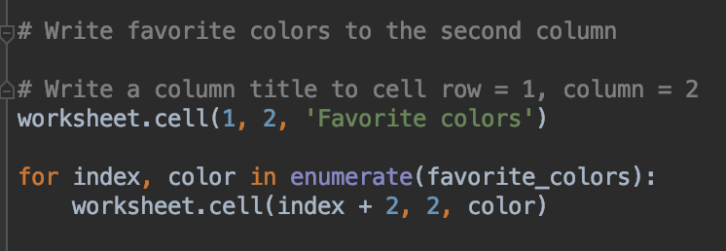
Solution – add this before saving the workbook
There's no requirement to have the same length of data in the lists, or columns

Slide 24
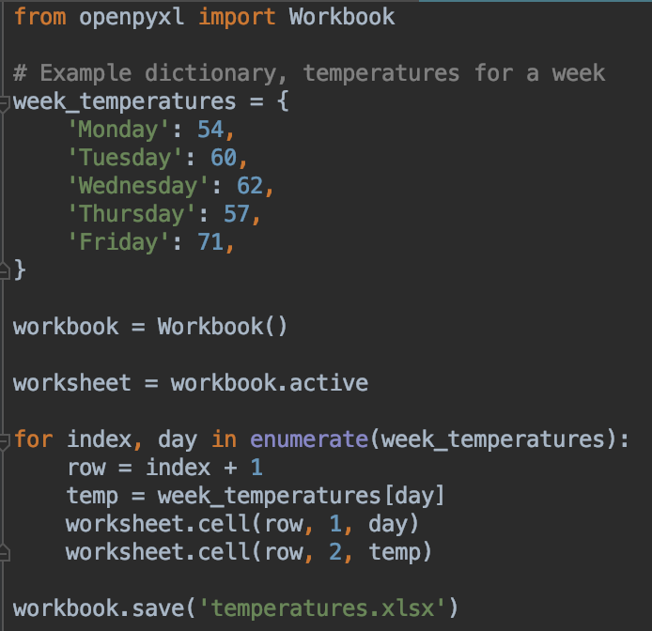
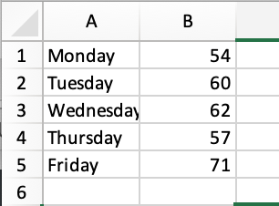
Writing a dictionary to a spreadsheet
Run and test
Working? See next slide

Slide 25
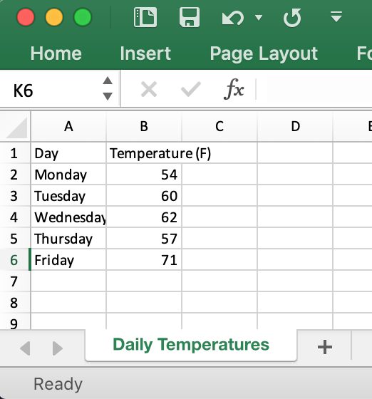
Your turn
Modify this code so the first cell in the first column says "Day"
The first cell in the second column says "Temperature (F)"
The rest of the data should be written to the column
Change the sheet title to "Daily Temperatures"

Slide 26
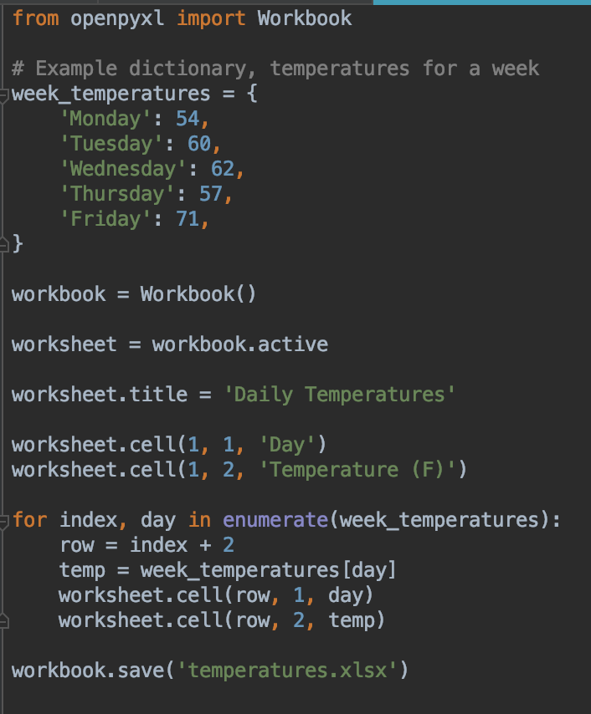
Solution
Set title
Write text in first row of each column
Add 2 to the index in the loop

Slide 27
Word
Reading and Writing word documents with python-docx
https://python-docx.readthedocs.io/en/latest/

Slide 28
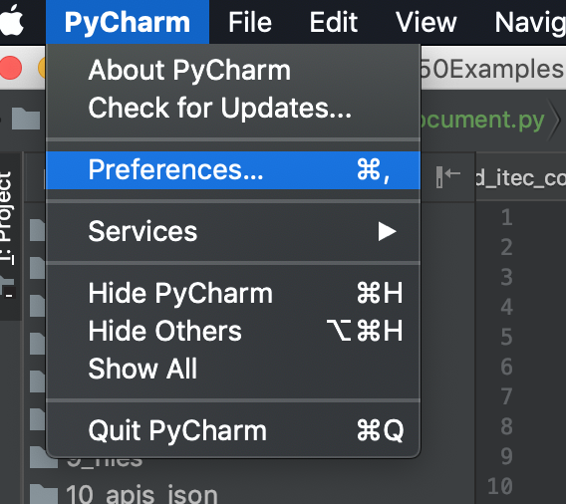
Installing python-docx
We have to install this manually
Select Preferences or Settings from the main PyCharm menu

Slide 29
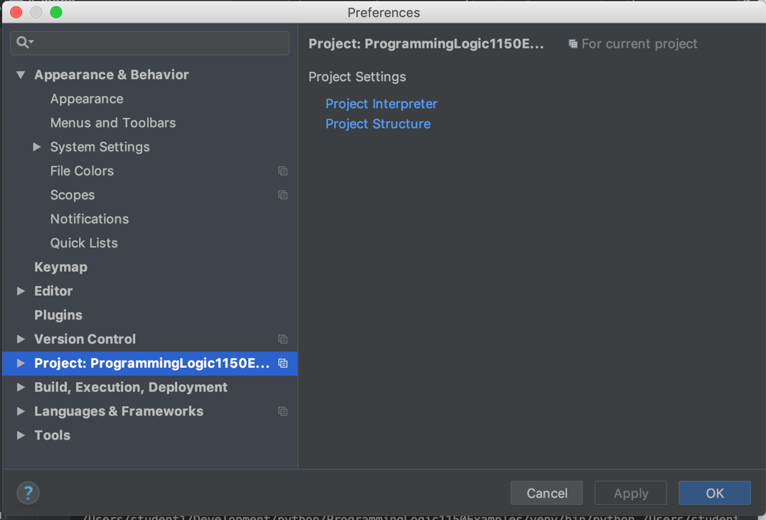
Select your project from the left hand menu
Click on Project Interpreter

Slide 30
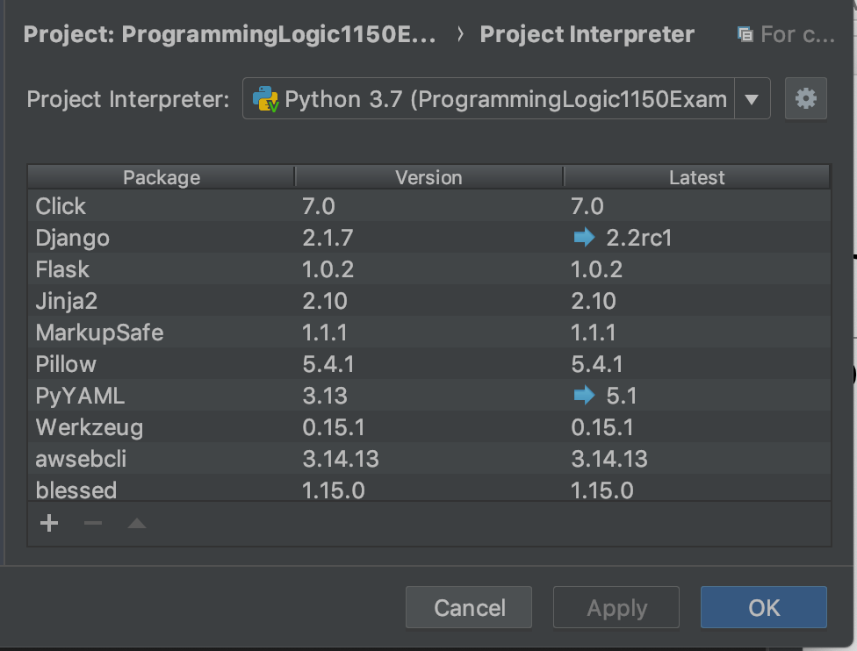
Click on the +
Your list of packages may be different to mine, but that doesn't matter

Slide 31
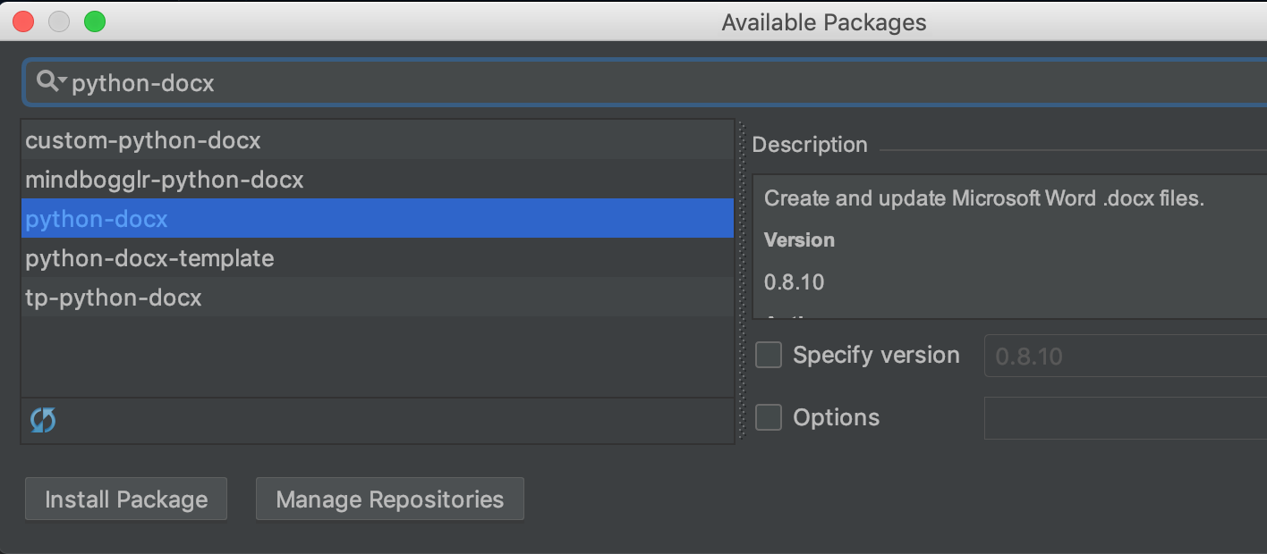
Search for python-docx
Select python-docx
Click Install Package

Slide 32
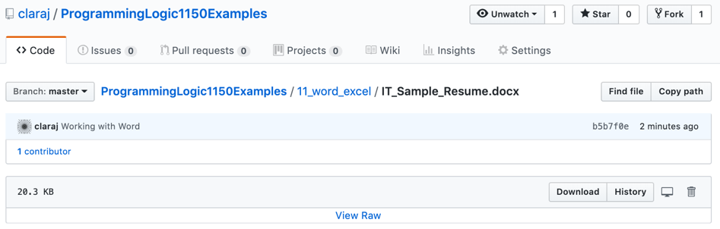
Create New Python file
Download the example word document from
https://github.com/claraj/ProgrammingLogic1150Examples/blob/master/11_word_excel/IT_Sample_Resume.docx
Or, use any Word
document of your own
Copy the Word file to your project

Slide 33
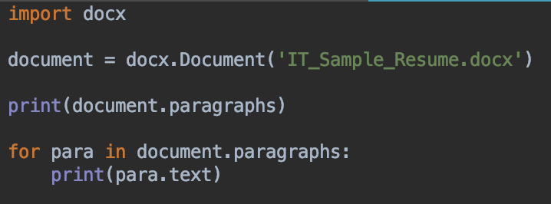
Create a new Python file
Add this code
Change the file name, if you are using a different file
Run and test
All the text from your document will be printed

Slide 34
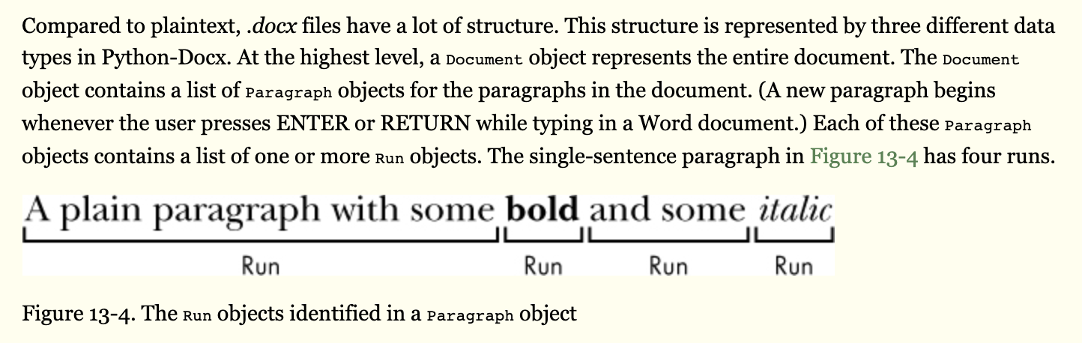
More on reading Word files in the textbook

Slide 35
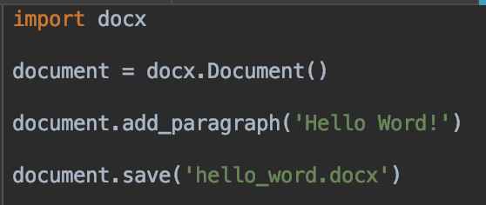
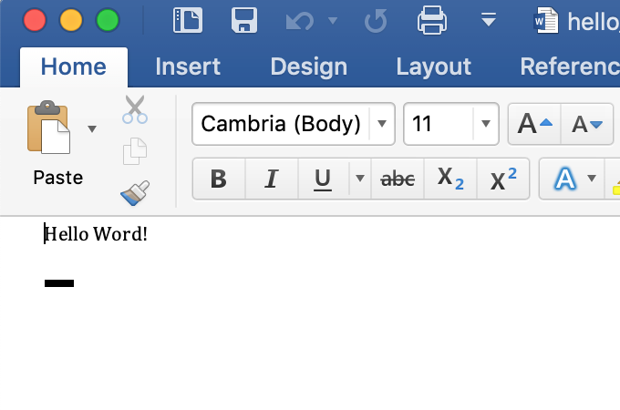
Create and write to a Word file
New Python file
Run and test – new Word document created

Slide 36
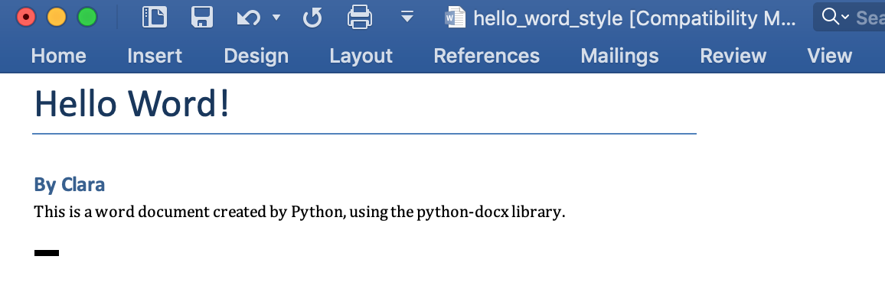
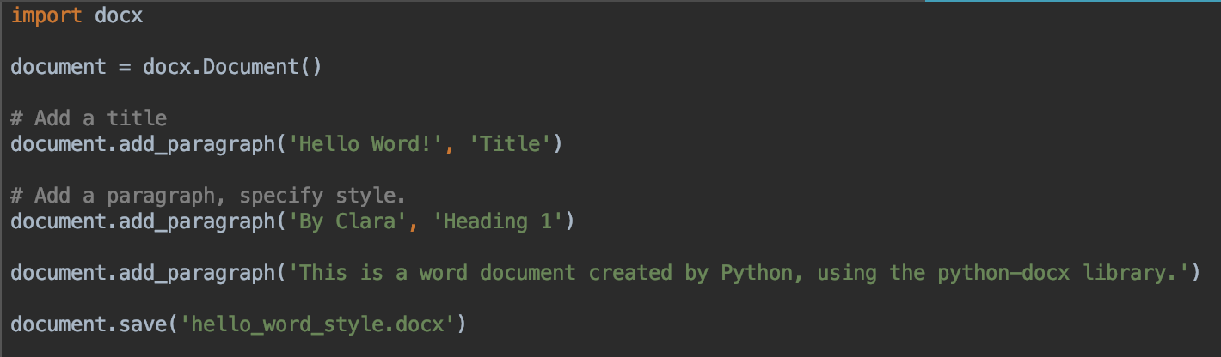
Writing styles
Modify your file
Use your own name

Slide 37
Modifying code that writes to a Word document
Close the Word document before you try to write to it again
Otherwise, you won't see the changes your program made

Slide 38
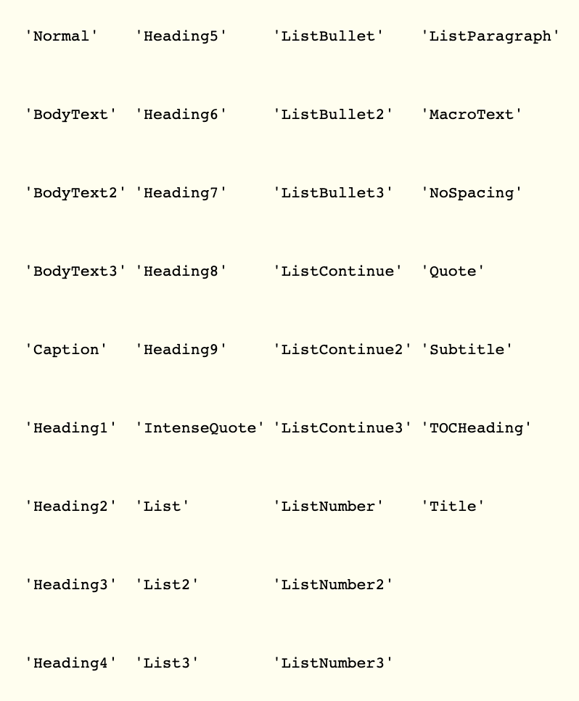
Style names
Can use any of these names – but use spaces in the names
So 'Heading 2'
or 'List Number'
or 'List Continue 3'

Slide 39
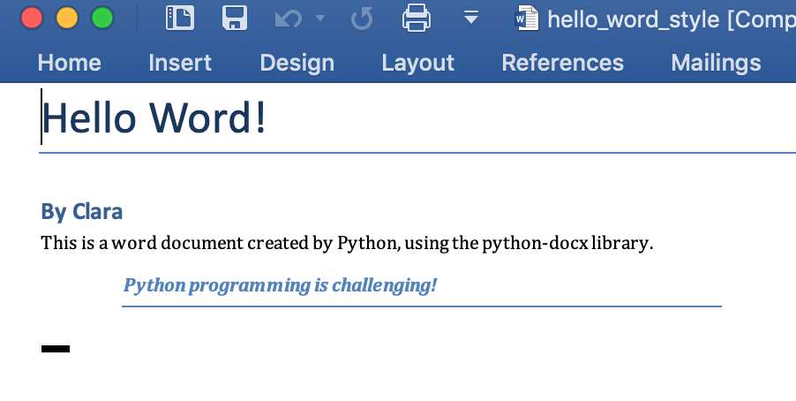
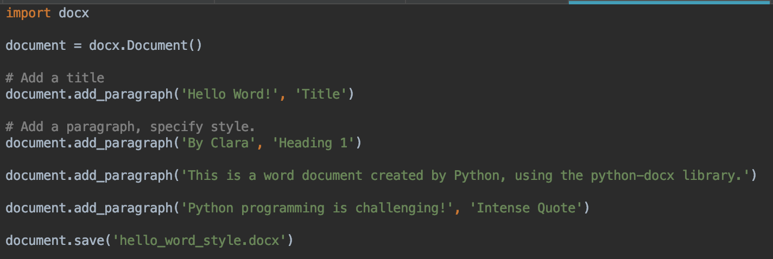
Try another style
Your turn – add another paragraph in the style of your choice

Slide 40
Styles within a paragraph?

Slide 41
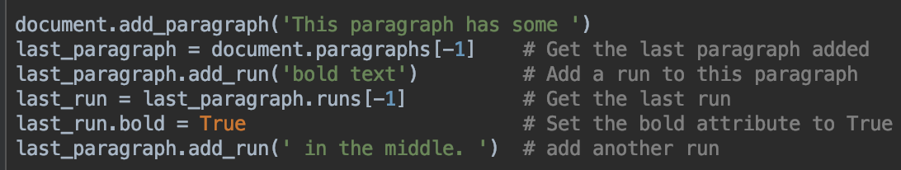
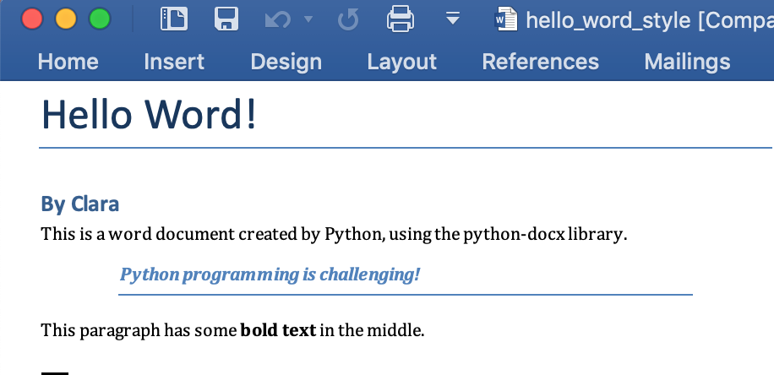
Add this to your document
Add this before the document.save() line

Slide 42
Can you make the bold text underlined as well?
What do you think the name of the attribute might be?

Slide 43
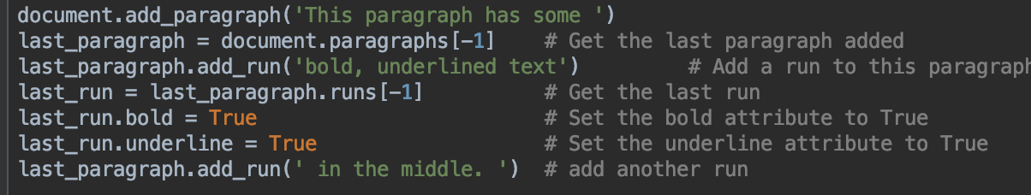
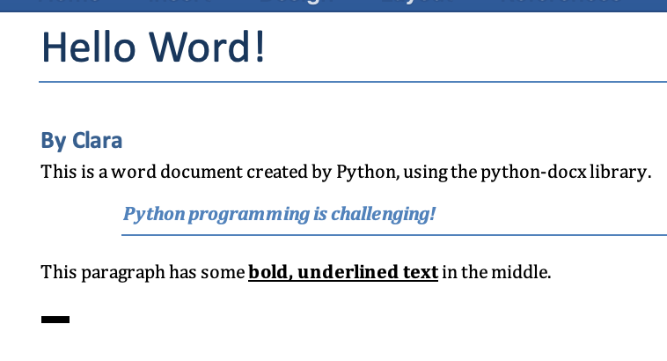
Solution
Can set the run's underline attribute to True
There's also an italic attribute

Slide 44
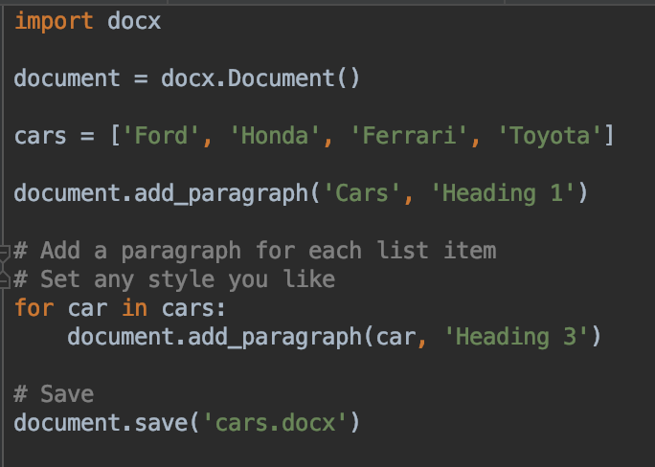
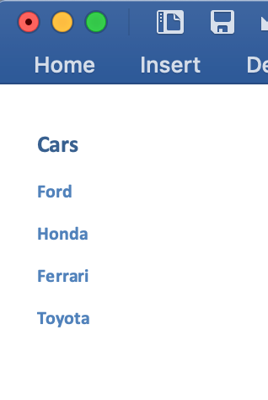
Writing a list to a Word document

Slide 45
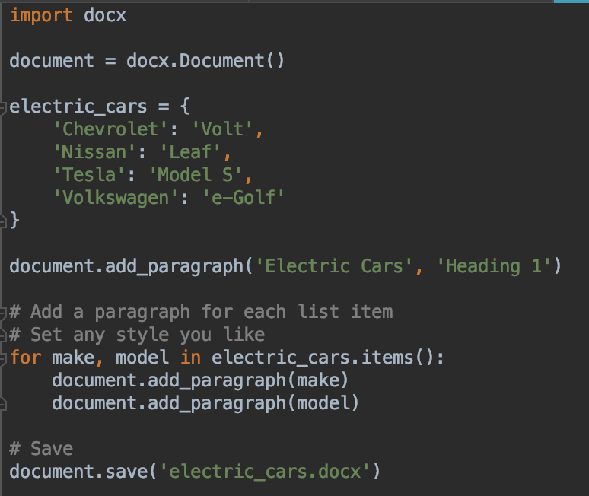
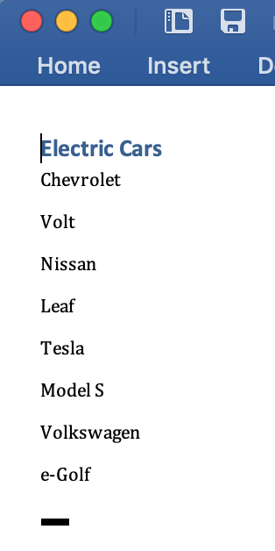
Writing a dictionary to a Word document
Modify your program, run and test
Remember to close the existing document before you run your code

Slide 46
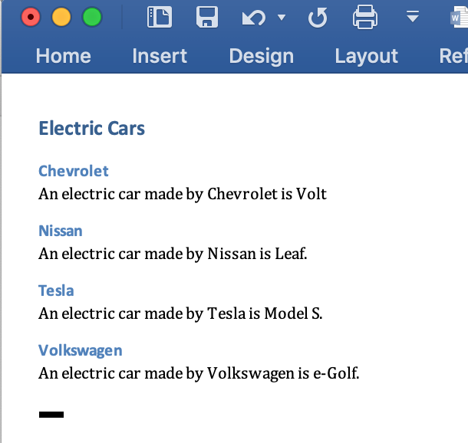

Adding Styles

Slide 47
Working with Word and Excel
You need to understand some basics of how these documents are structured
Both Word and Excel can be very complex, and the python-docx and openpyxl have many more features to do much more complicated manipulations of these documents
Like pivot tables in Excel, or citations in Word
See the links at the start of each section to read more about these libraries

Slide 48
Lab time

