Slide 1


Amenities & Packaging
Concept Product Portfolio
HOSPITALITY, IN PERFECT PROPORTION
CONCEPT / NOT PRODUCTION ARTWORK · v1.0 · 2026-10-06 · Logo shown from supplied raster, PENDING PRODUCTION MASTER
Notes:
Cover. GEM — Amenities & Packaging is a descriptive business stream under the GEM master brand (register C03, C05, T01). Everything shown is a concept; no structure, material, volume, ingredient, claim, supplier, MOQ or price is stated. The logo is the supplied raster, PENDING PRODUCTION MASTER (VAL-02).

Slide 2
02 · BUSINESS STREAM
One master brand. One descriptive stream.
POTENTIAL OFFER · COMMERCIAL SCOPE PENDING
Product and packaging design
Sourcing and selection
Customisation and property editions
Manufacturing coordination
Replenishment programmes
Register E01–E14: target offer, approved as direction. External capability claims remain CONDITIONAL on operational validation. GEM does not claim manufacturing, warehousing or owned logistics (E06, E10–E12).
GEM™ — Amenities & Packaging is a descriptive business stream under the GEM™ master brand. It is not a separate identity: same logo, same palette, same typography, with a descriptive line set in type.
GEM is positioned as a hospitality supplier and partner, not a hotel operator. The stream translates the brand's principles of precision, proportion and restraint into the physical touchpoints a guest holds, opens and keeps.
What GEM is proposing: a coordinated family of amenities and packaging that one property can adopt as a whole. What GEM can currently prove: the brand system. Commercial scope, capability and supply are CONDITIONAL until validation closes (AC03, VAL-01).
DESCRIPTIVE STREAM · APPROVED (C03, T01) · CAPABILITY CLAIMS CONDITIONAL (VAL-01)
Notes:
Positioning per register C08, C09 and AC02: supplier and partner, not an operator. The offer list is the register's target architecture (E01–E14), stated as potential offer only.

Slide 3
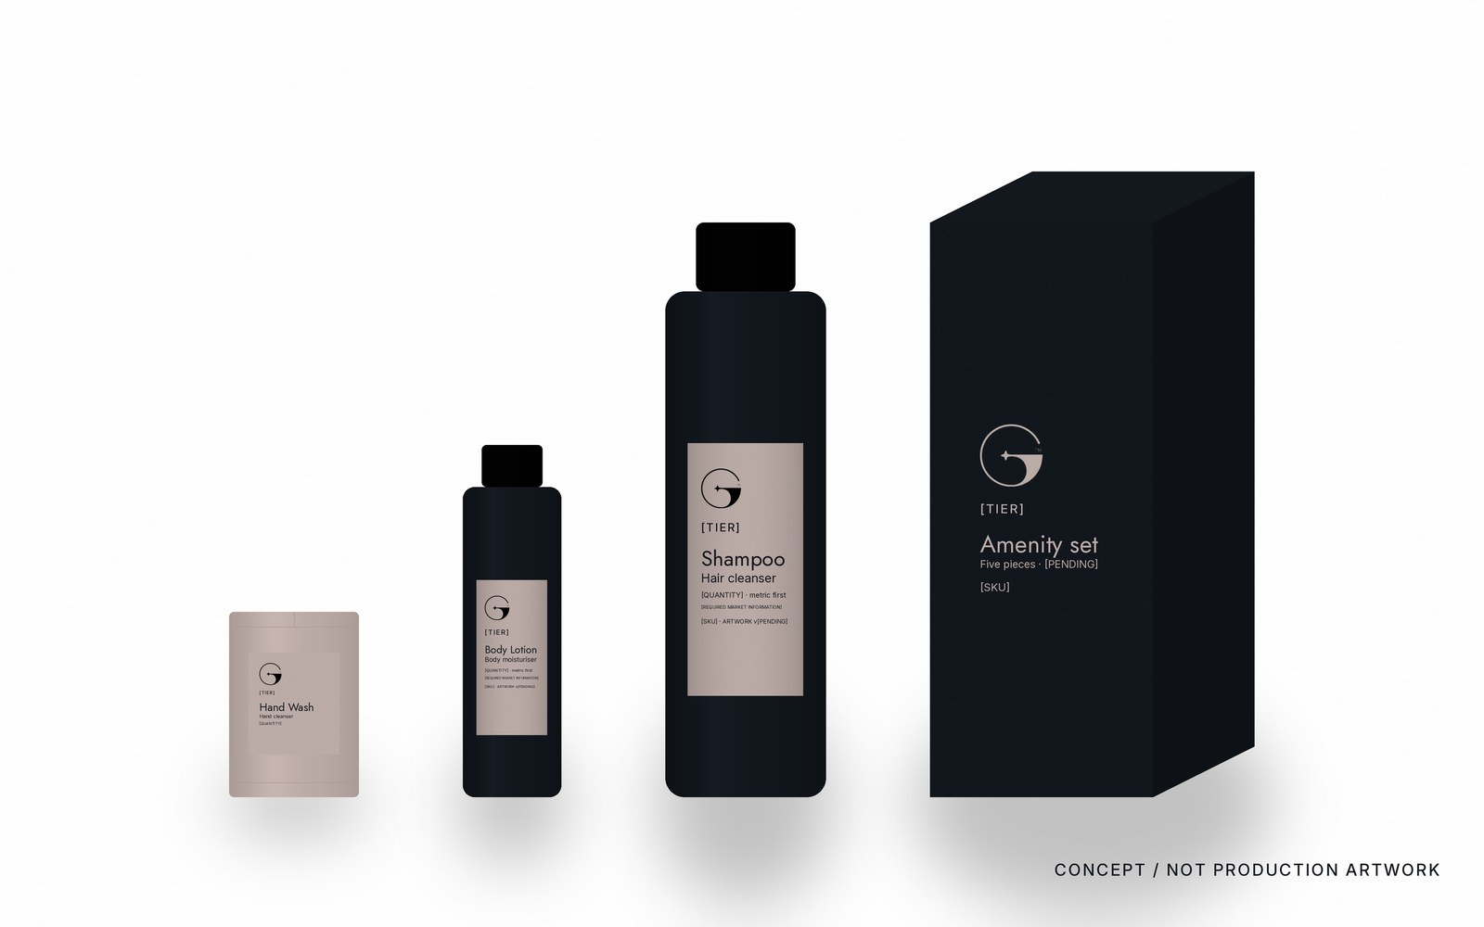
03 · PORTFOLIO PRINCIPLE
ONE SYSTEM. MANY TOUCHPOINTS.
Every product is part of one coordinated guest experience. The same symbol, the same proportions, the same hierarchy and the same quiet surfaces, from a sachet to a carton.
CONCEPT / NOT PRODUCTION ARTWORK
Notes:
Family recognition comes from proportion and hierarchy, not from decoration (principles 01–04). Scales shown are relative only; no dimension is implied.

Slide 4


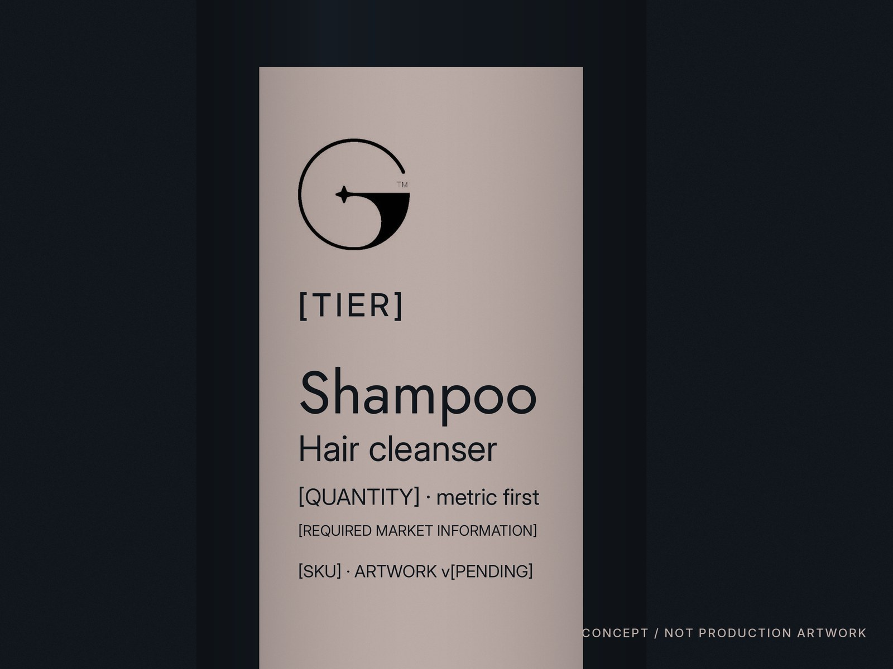

04 · PILOT FAMILY · SHAMPOO
GEM™ · [COLLECTION / TIER] · Shampoo · Hair cleanser · [QUANTITY / SIZE] · [INSTRUCTIONS · REQUIRED MARKET INFORMATION] · [SKU / ARTWORK VERSION]
In-room application: guest bathroom vanity.
CONCEPT / NOT PRODUCTION ARTWORK · QUANTITY, INGREDIENTS, CLAIMS, ORIGIN, SUPPLIER: [PENDING]
Notes:
SHAMPOO: pilot family product (register T02, T03). Six-level information hierarchy per T05. No formulation, fragrance, volume, claim, origin, supplier, MOQ or price is stated. Structure shown is a concept; any alternative structure is [REQUIRES SUPPLIER].

Slide 5



05 · PILOT FAMILY · CONDITIONER
GEM™ · [COLLECTION / TIER] · Conditioner · Hair conditioner · [QUANTITY / SIZE] · [INSTRUCTIONS · REQUIRED MARKET INFORMATION] · [SKU / ARTWORK VERSION]
Same system. Differentiated by product name and controlled hierarchy only.
CONCEPT / NOT PRODUCTION ARTWORK · QUANTITY, INGREDIENTS, CLAIMS, ORIGIN, SUPPLIER: [PENDING]
Notes:
CONDITIONER: pilot family product (register T02, T03). Six-level information hierarchy per T05. No formulation, fragrance, volume, claim, origin, supplier, MOQ or price is stated. Structure shown is a concept; any alternative structure is [REQUIRES SUPPLIER].

Slide 6


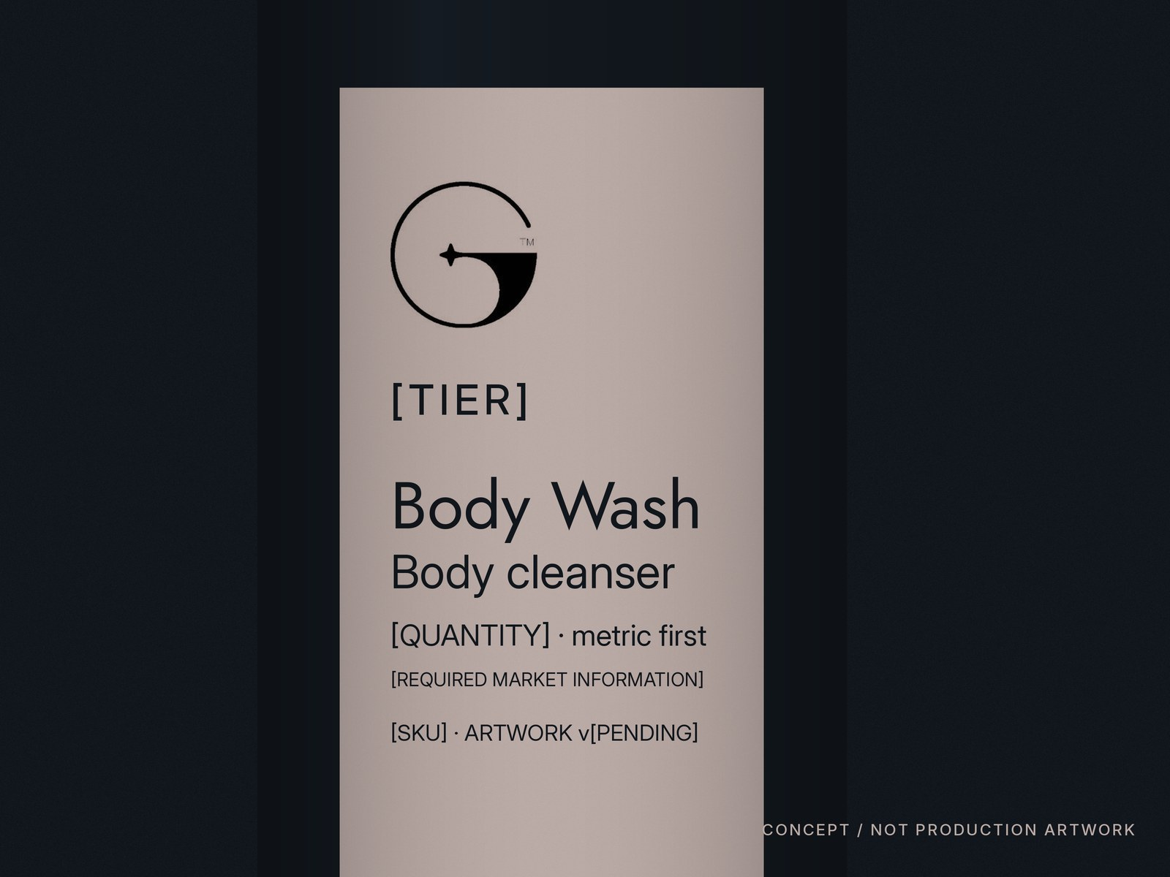

06 · PILOT FAMILY · BODY WASH
GEM™ · [COLLECTION / TIER] · Body wash · Body cleanser · [QUANTITY / SIZE] · [INSTRUCTIONS · REQUIRED MARKET INFORMATION] · [SKU / ARTWORK VERSION]
Family logic continues. Wall-mounted and refill formats: [REQUIRES SUPPLIER].
CONCEPT / NOT PRODUCTION ARTWORK · QUANTITY, INGREDIENTS, CLAIMS, ORIGIN, SUPPLIER: [PENDING]
Notes:
BODY WASH: pilot family product (register T02, T03). Six-level information hierarchy per T05. No formulation, fragrance, volume, claim, origin, supplier, MOQ or price is stated. Structure shown is a concept; any alternative structure is [REQUIRES SUPPLIER].

Slide 7
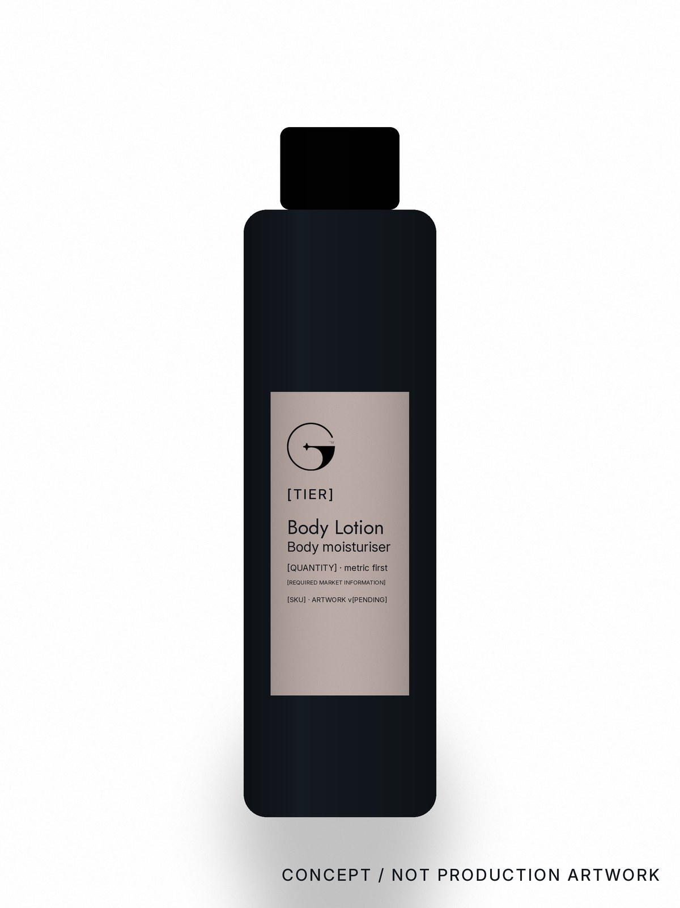
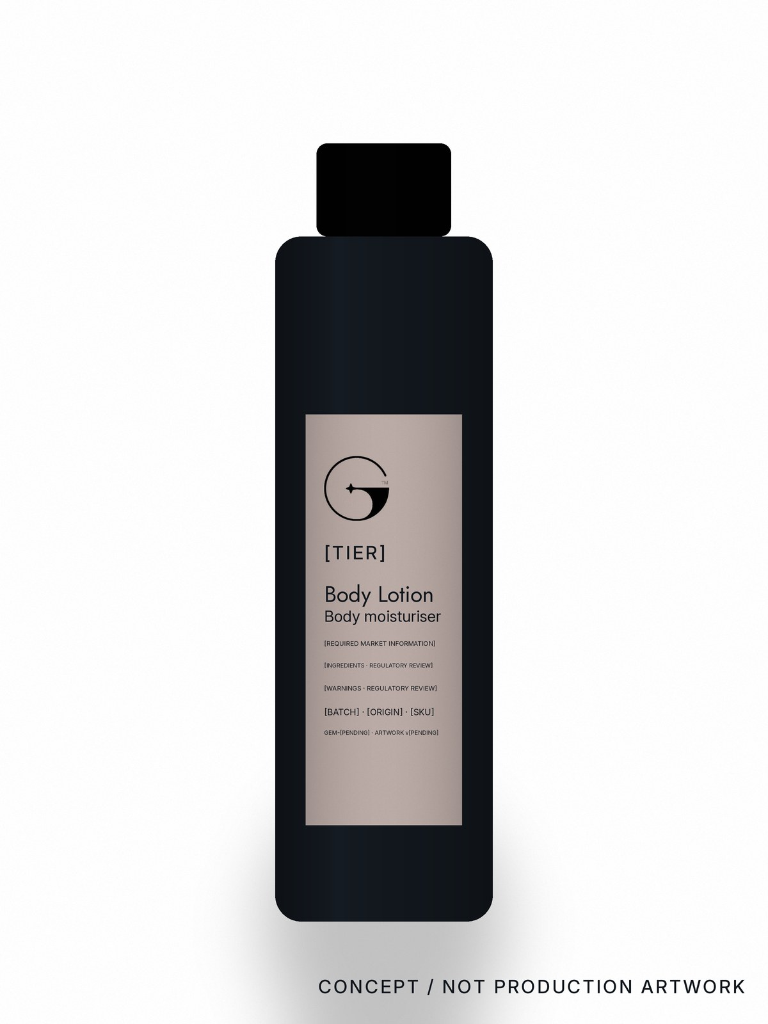

07 · PILOT FAMILY · BODY LOTION
GEM™ · [COLLECTION / TIER] · Body lotion · Body moisturiser · [QUANTITY / SIZE] · [INSTRUCTIONS · REQUIRED MARKET INFORMATION] · [SKU / ARTWORK VERSION]
Guest-room placement and vanity arrangement.
CONCEPT / NOT PRODUCTION ARTWORK · QUANTITY, INGREDIENTS, CLAIMS, ORIGIN, SUPPLIER: [PENDING]
Notes:
BODY LOTION: pilot family product (register T02, T03). Six-level information hierarchy per T05. No formulation, fragrance, volume, claim, origin, supplier, MOQ or price is stated. Structure shown is a concept; any alternative structure is [REQUIRES SUPPLIER].

Slide 8
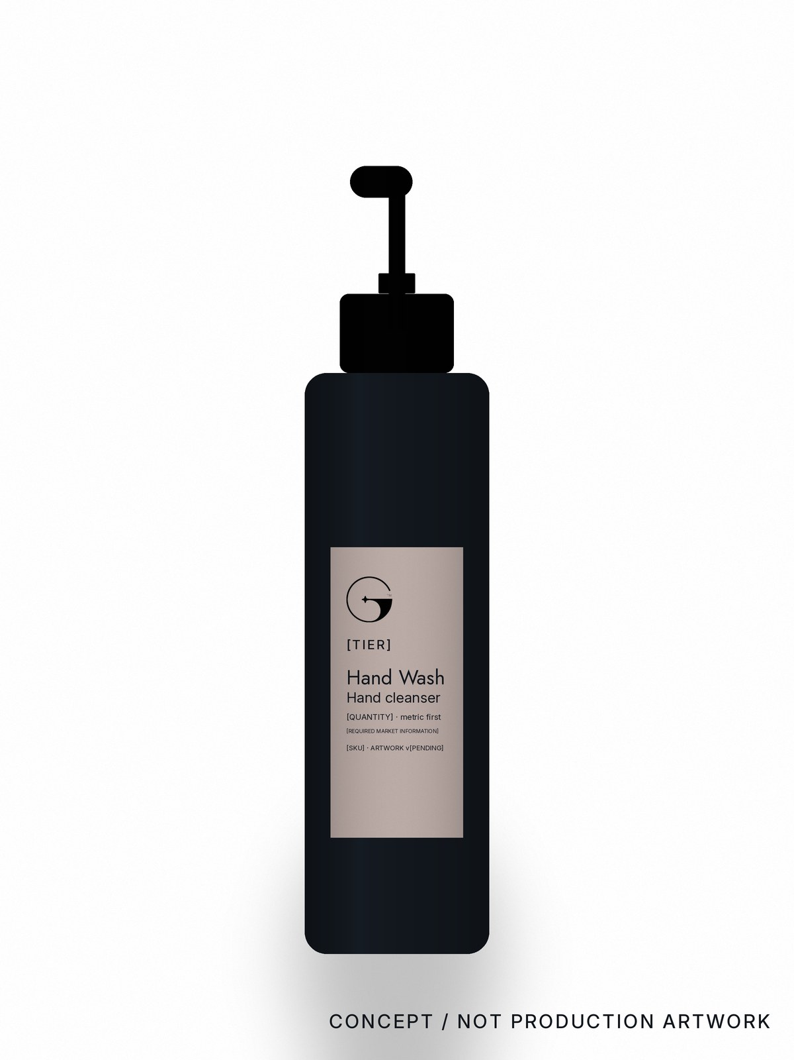

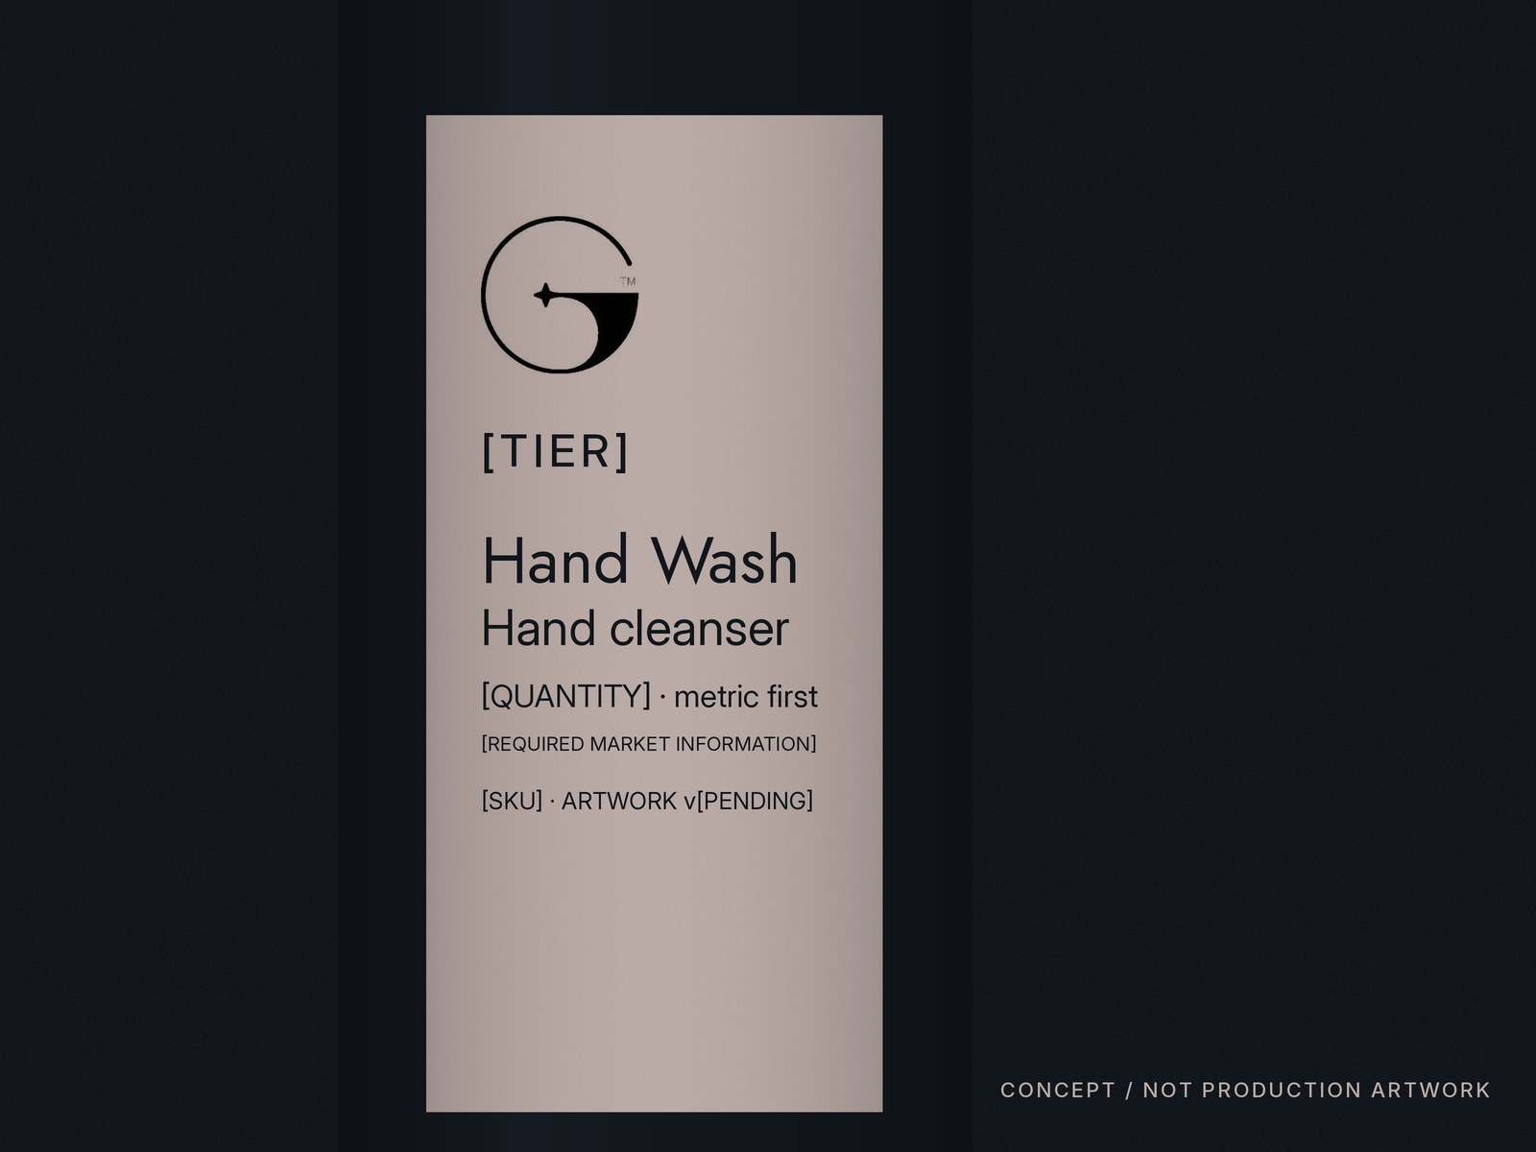

08 · PILOT FAMILY · HAND WASH
GEM™ · [COLLECTION / TIER] · Hand wash · Hand cleanser · [QUANTITY / SIZE] · [INSTRUCTIONS · REQUIRED MARKET INFORMATION] · [SKU / ARTWORK VERSION]
Guest bathroom, public washroom, suite. No dispenser or bottle structure is approved.
CONCEPT / NOT PRODUCTION ARTWORK · QUANTITY, INGREDIENTS, CLAIMS, ORIGIN, SUPPLIER: [PENDING]
Notes:
HAND WASH: pilot family product (register T02, T03). Six-level information hierarchy per T05. No formulation, fragrance, volume, claim, origin, supplier, MOQ or price is stated. Structure shown is a concept; any alternative structure is [REQUIRES SUPPLIER].

Slide 9
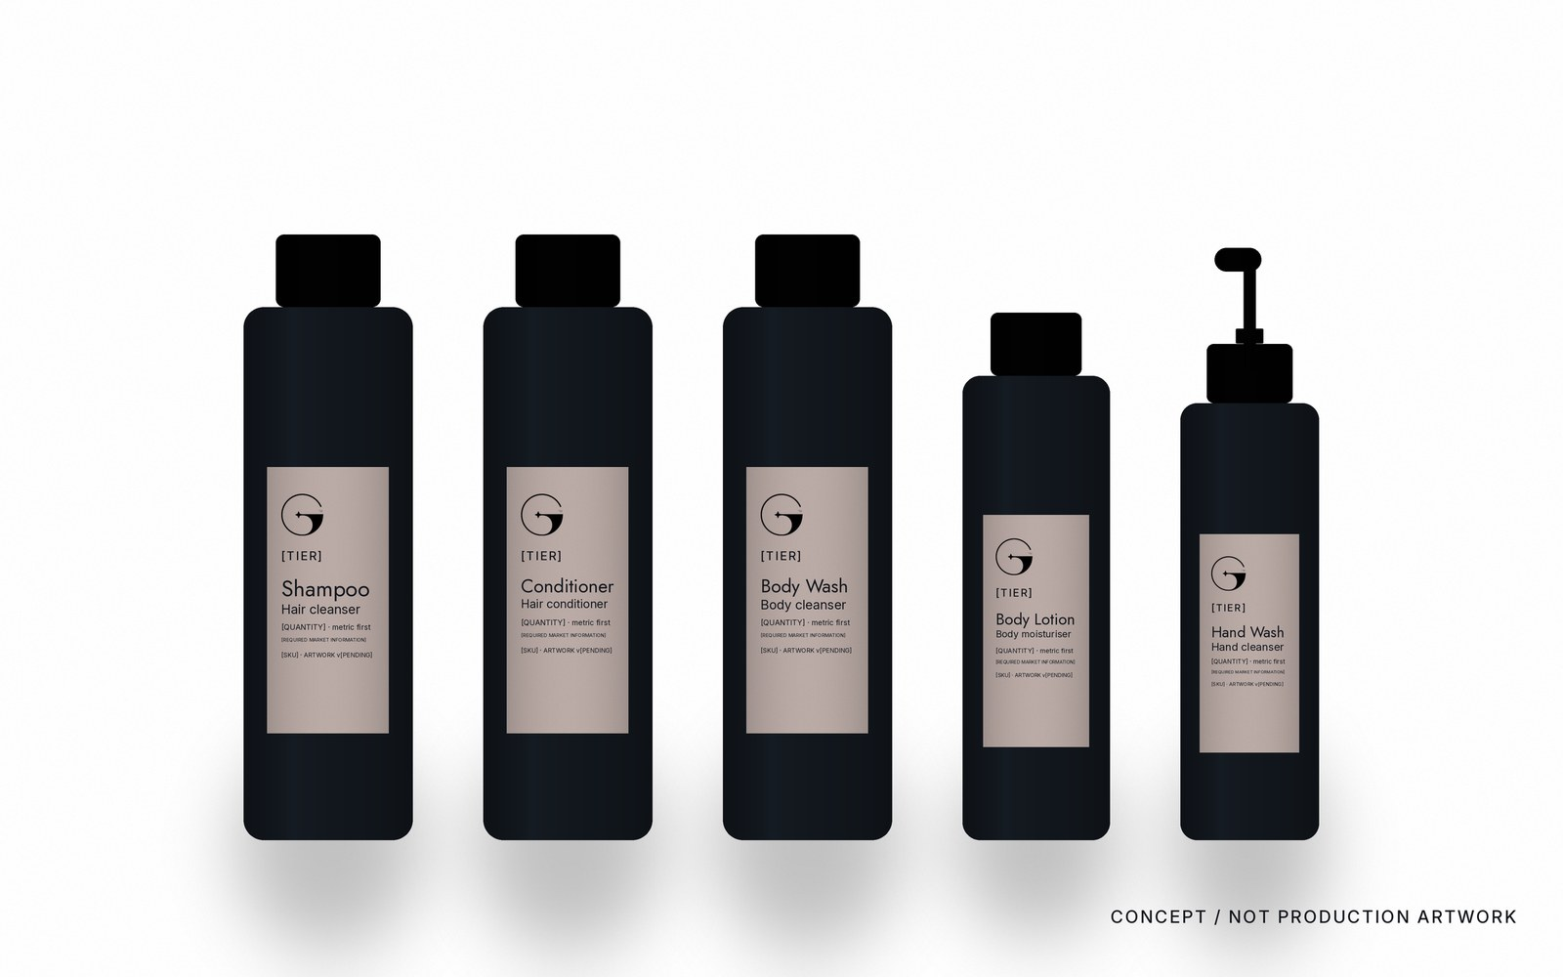
09 · PACKAGING SYSTEM · FAMILY LINEUP
Consistent proportion, hierarchy, typography, spacing and colour. Recognition comes from the family, not from any single pack.
CONCEPT / NOT PRODUCTION ARTWORK
Notes:
Pilot family: Shampoo, Conditioner, Body Wash, Body Lotion, Hand Wash (T03). Relative sizes are illustrative.

Slide 10
10 · PACKAGING ARCHITECTURE
Bottle · Tube · Refill · Carton · Sachet · Pump / dispenser · Presentation set
Every structural format is a concept direction. Structure, closure, resin or substrate, decoration method and carton construction are [REQUIRES SUPPLIER] (Part C slide 32). No dimension is stated.
STRUCTURAL CONCEPT · [REQUIRES SUPPLIER] · CONCEPT / NOT PRODUCTION ARTWORK
Notes:
Structural framework per Part C slide 32: bottle or tube format, resin, closure, decoration method, carton and inner pack are supplier decisions tested before release.

Slide 11
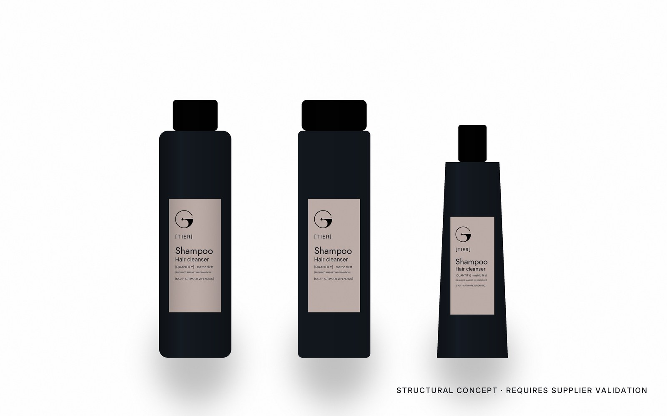
11 · PRIMARY PACK · THREE CONCEPT FORMATS
Cylindrical bottle · Rectangular bottle · Soft tube
STRUCTURAL CONCEPT · REQUIRES SUPPLIER VALIDATION · NONE OF THESE IS AN APPROVED STRUCTURE
Notes:
Three alternative primary-pack formats on one label system. None is approved; the supplier dieline is the only dieline (Part C slide 31).

Slide 12
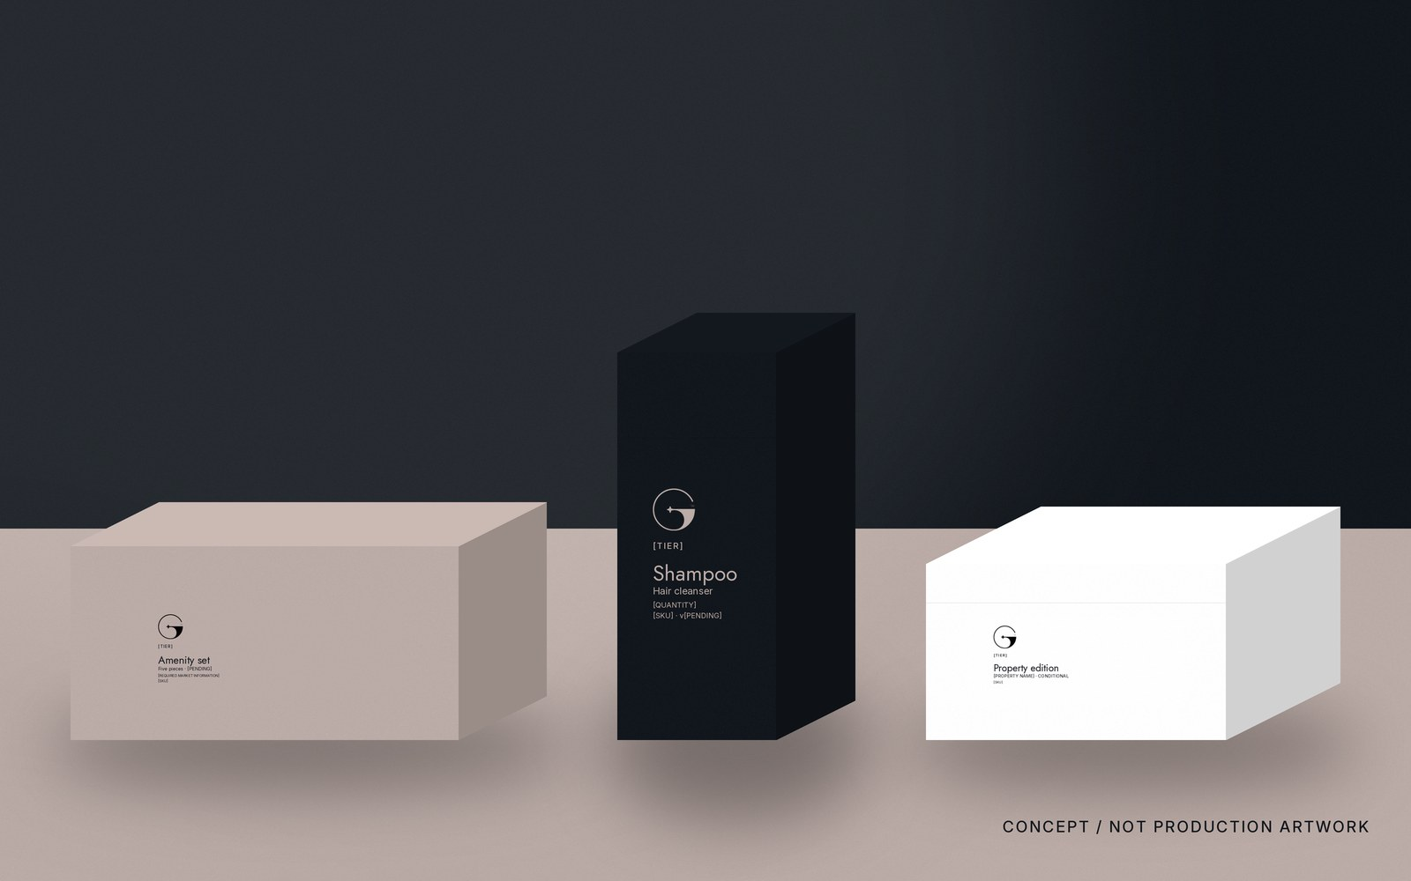
12 · SECONDARY PACKAGING
Carton · Sleeve · Box · Multi-product set. Restraint and geometry do the work: one symbol, one hairline, matte board. No decorative luxury cues, no foil by default, no gold.
CONCEPT / NOT PRODUCTION ARTWORK · DIELINE [REQUIRES SUPPLIER]
Notes:
Print principles per Part C slide 22 and finish direction U01–U10: uncoated warm paper, deep Ink board, deboss or blind emboss, soft-touch selectively; foil only if specifically approved; no chrome, holographic or heavy gloss.

Slide 13
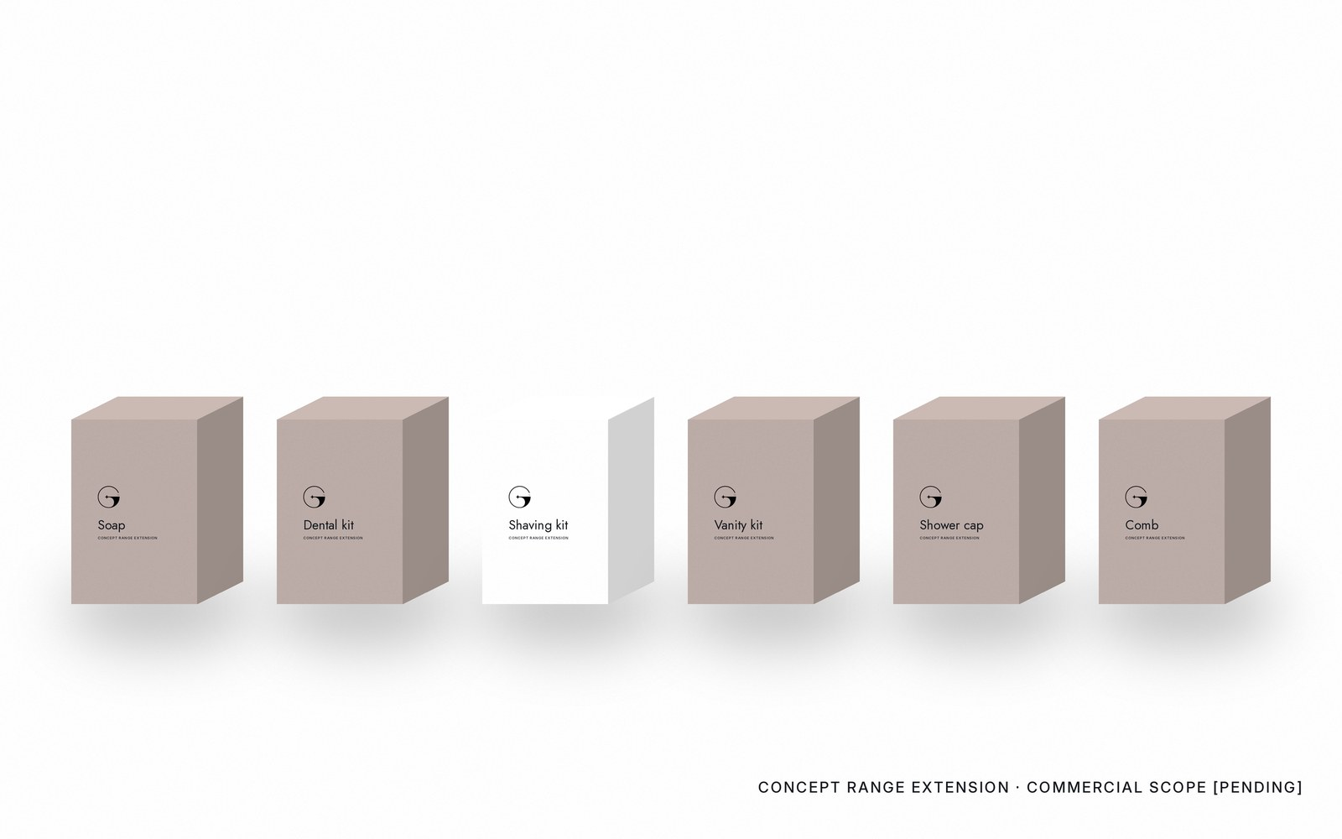
13 · POTENTIAL RANGE EXTENSIONS · PERSONAL CARE · CONCEPT ONLY
Soap · Dental kit · Shaving kit · Vanity kit · Shower cap · Comb. Examples of packaging opportunities only. GEM does not currently claim to manufacture or supply them; contents and specifications are not defined.
CONCEPT RANGE EXTENSION · COMMERCIAL SCOPE [PENDING]
Notes:
Exploratory only. Not approved product lines (register C10: show only approved active streams; these are packaging opportunities within the approved stream, not new streams).

Slide 14

14 · POTENTIAL RANGE EXTENSIONS · GUEST ACCESSORIES · CONCEPT ONLY
Sewing kit · Slippers · Laundry bag · Tissue box · Shoe-care kit · Cotton pads. Compact packaging, one hierarchy, one family. Contents and specifications are not defined.
CONCEPT RANGE EXTENSION · COMMERCIAL SCOPE [PENDING]
Notes:
Packaging opportunities only; no supply claim.

Slide 15
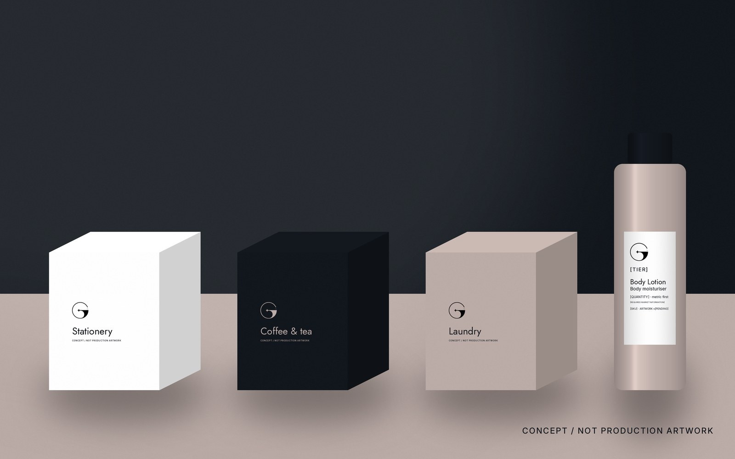
15 · ROOM TOUCHPOINTS
Bedside stationery · Coffee point · Wardrobe · Bathroom vanity. One identity creates continuity across guest moments; the objective is coherence, not completeness.
CONCEPT / NOT PRODUCTION ARTWORK
Notes:
Guest journey per Part A slide 55: arrival, stay, dining, service, departure, return. Only the packaging layer is shown.

Slide 16
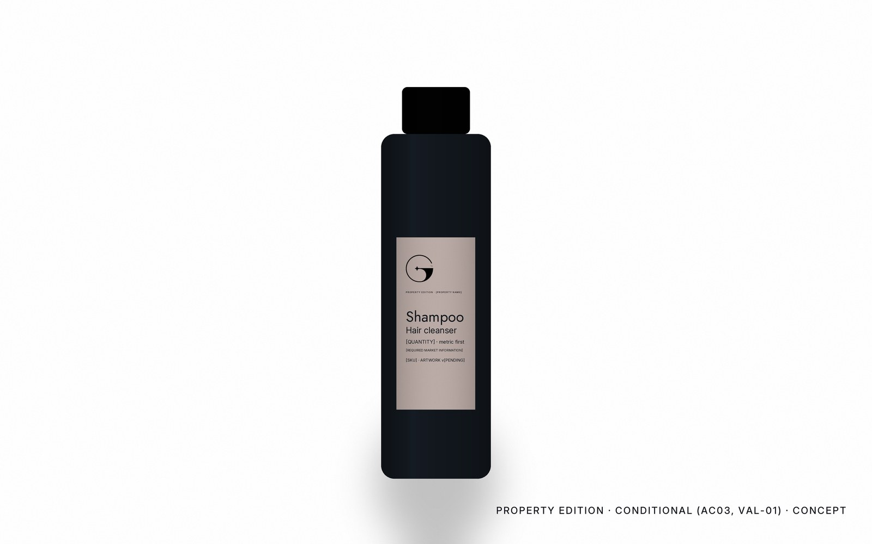
16 · PROPERTY EDITION · CONDITIONAL
A controlled adaptation for one property.
Property Edition is named in the register (E14) and in Part A slide 60; its scope is CONDITIONAL until commercial validation closes (AC03, VAL-01).
The adaptation is controlled: the GEM identity is unchanged; the property is named as a typeset descriptive line at the tier level. No separate logo, no new palette, no stream symbol (C04, C11, C12).
Tier naming: Property Edition and Bespoke Programme are register names; the name of the standard range is [REQUIRES OWNER].
PROPERTY EDITION · CONDITIONAL (AC03, VAL-01) · CONCEPT
Notes:
Property-specific content stays CONDITIONAL or CONCEPT per the source documents. Whether a family or property name may occupy the collection/tier level is [REQUIRES OWNER · Product / Amenities Lead].

Slide 17

17 · CO-BRANDED APPLICATION · CONCEPT
GEM™ + PROPERTY NAME
Partners stand beside GEM, not inside it (Part A slide 31). The supplier relationship is shown as a typeset line: "Supplied by GEM™ for PROPERTY NAME". Optical balance, each brand's clearspace, a hairline where appropriate.
Never merge, recolour, contain or redraw either identity. Precedence follows the approved agreement; the equal-partner arrangement is a default, not a mandate (I10, I11).
PROPERTY NAME is a fictional placeholder; no real partner is approved.
CO-BRANDING CONCEPT · SUBJECT TO PARTNER AGREEMENT
Notes:
Co-branding rules per Part A slide 31 and register I10–I12.

Slide 18
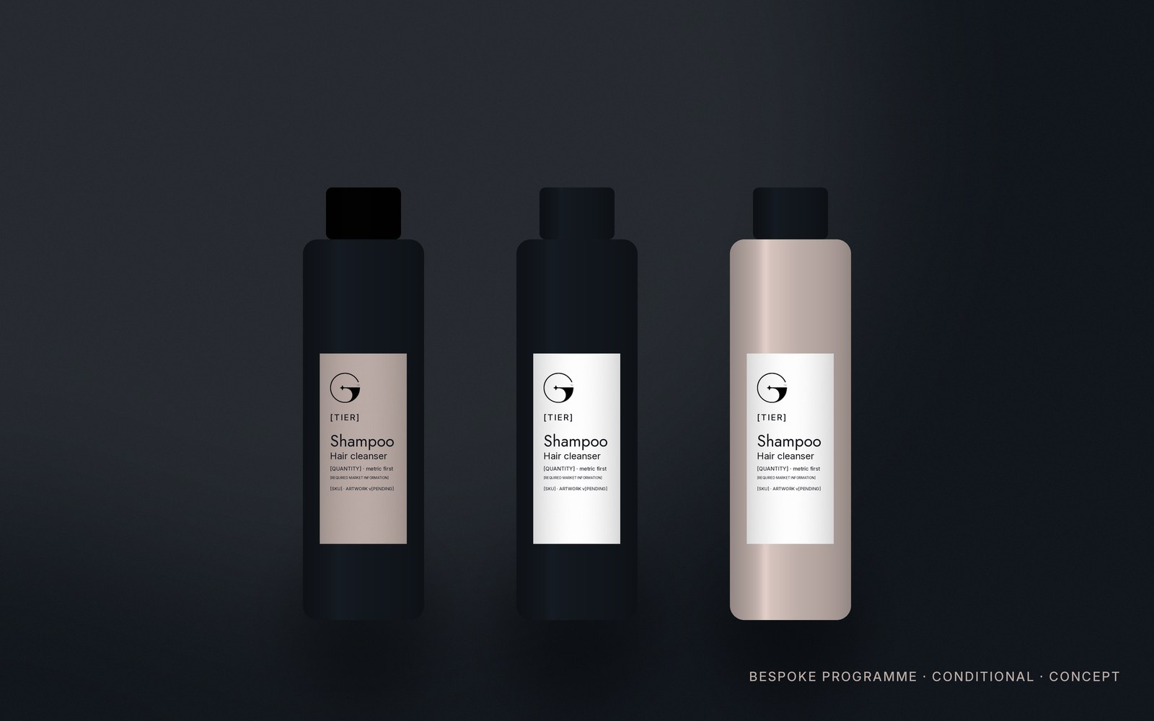
18 · BESPOKE PROGRAMME · CONDITIONAL
Controlled customisation. The identity stays dominant.
Bespoke programmes are named in the register (E14) as part of the intended offer; the tier is CONDITIONAL (Part A 60, Part C 27).
What may flex: label tone within the four colours, surface, format and information set per property.
What never flexes: the symbol, the palette, the typography, the hierarchy, the one-spark rule. Customisation is not unrestricted design; every variant is approved through brand governance (C06, C07).
BESPOKE PROGRAMME · CONDITIONAL · CONCEPT
Notes:
Any future stream or programme inherits the identity and never forks it (Part A slide 17).

Slide 19
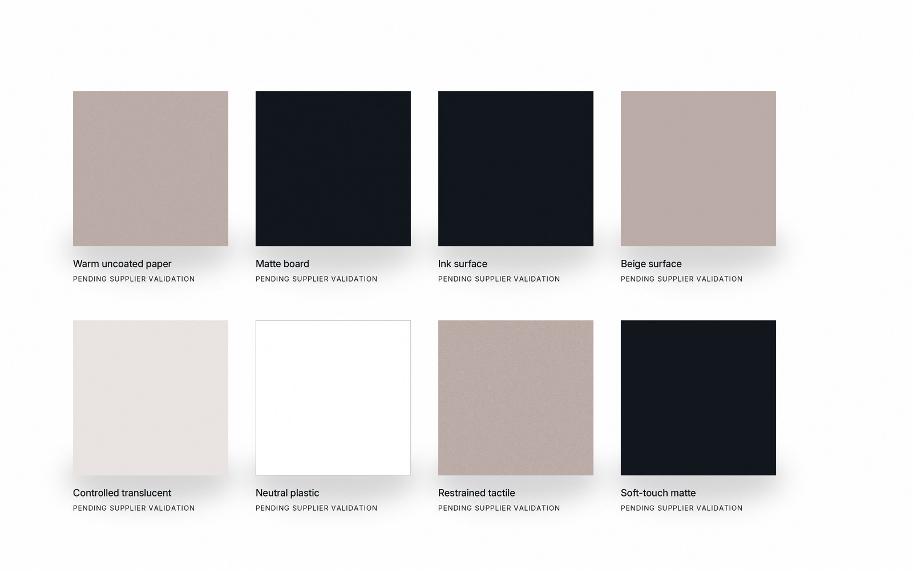
19 · MATERIAL DIRECTION · PENDING SUPPLIER VALIDATION
Warm uncoated paper · Matte board · Ink and Beige surfaces · Controlled translucent material · Neutral plastics · Restrained tactile finishes. Feel before shine. No substrate, GSM, polymer, resin, recycled content or certification is stated.
MATERIAL DIRECTION · PENDING SUPPLIER VALIDATION
Notes:
Direction per Part A slide 63 and Part C slide 23 (paper and board attributes [REQUIRES SUPPLIER / OWNER]); register U01–U03.

Slide 20
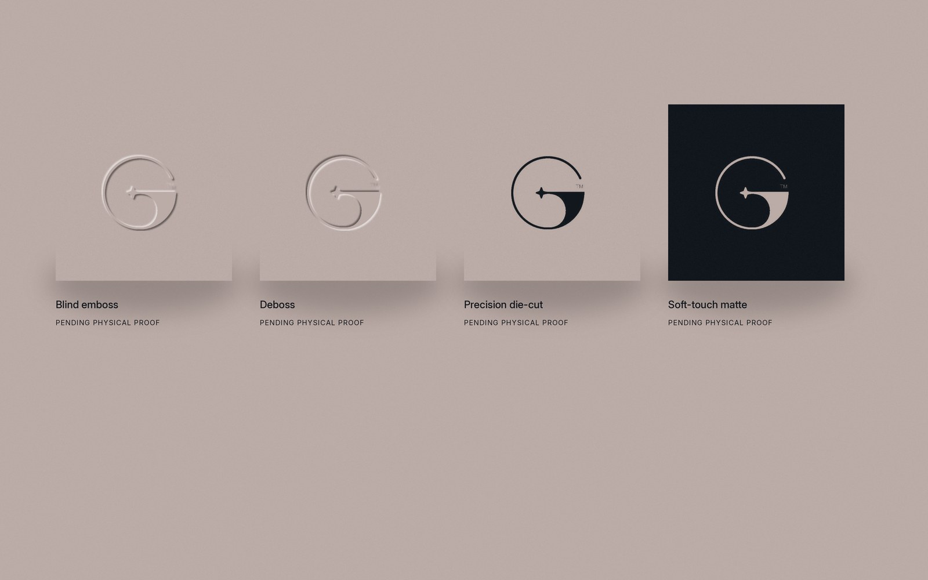
20 · FINISH DIRECTION · PENDING PHYSICAL PROOF
Blind emboss · Deboss · Precision die-cut · Soft-touch matte. Avoid decorative gold foil, chrome, holographic finishes and heavy gloss. Depth, pressure, plate, minimum feature size and tooling are defined only by supplier trials.
FINISH DIRECTION · PENDING PHYSICAL PROOF
Notes:
Part C slides 24–25; register U04–U10.

Slide 21
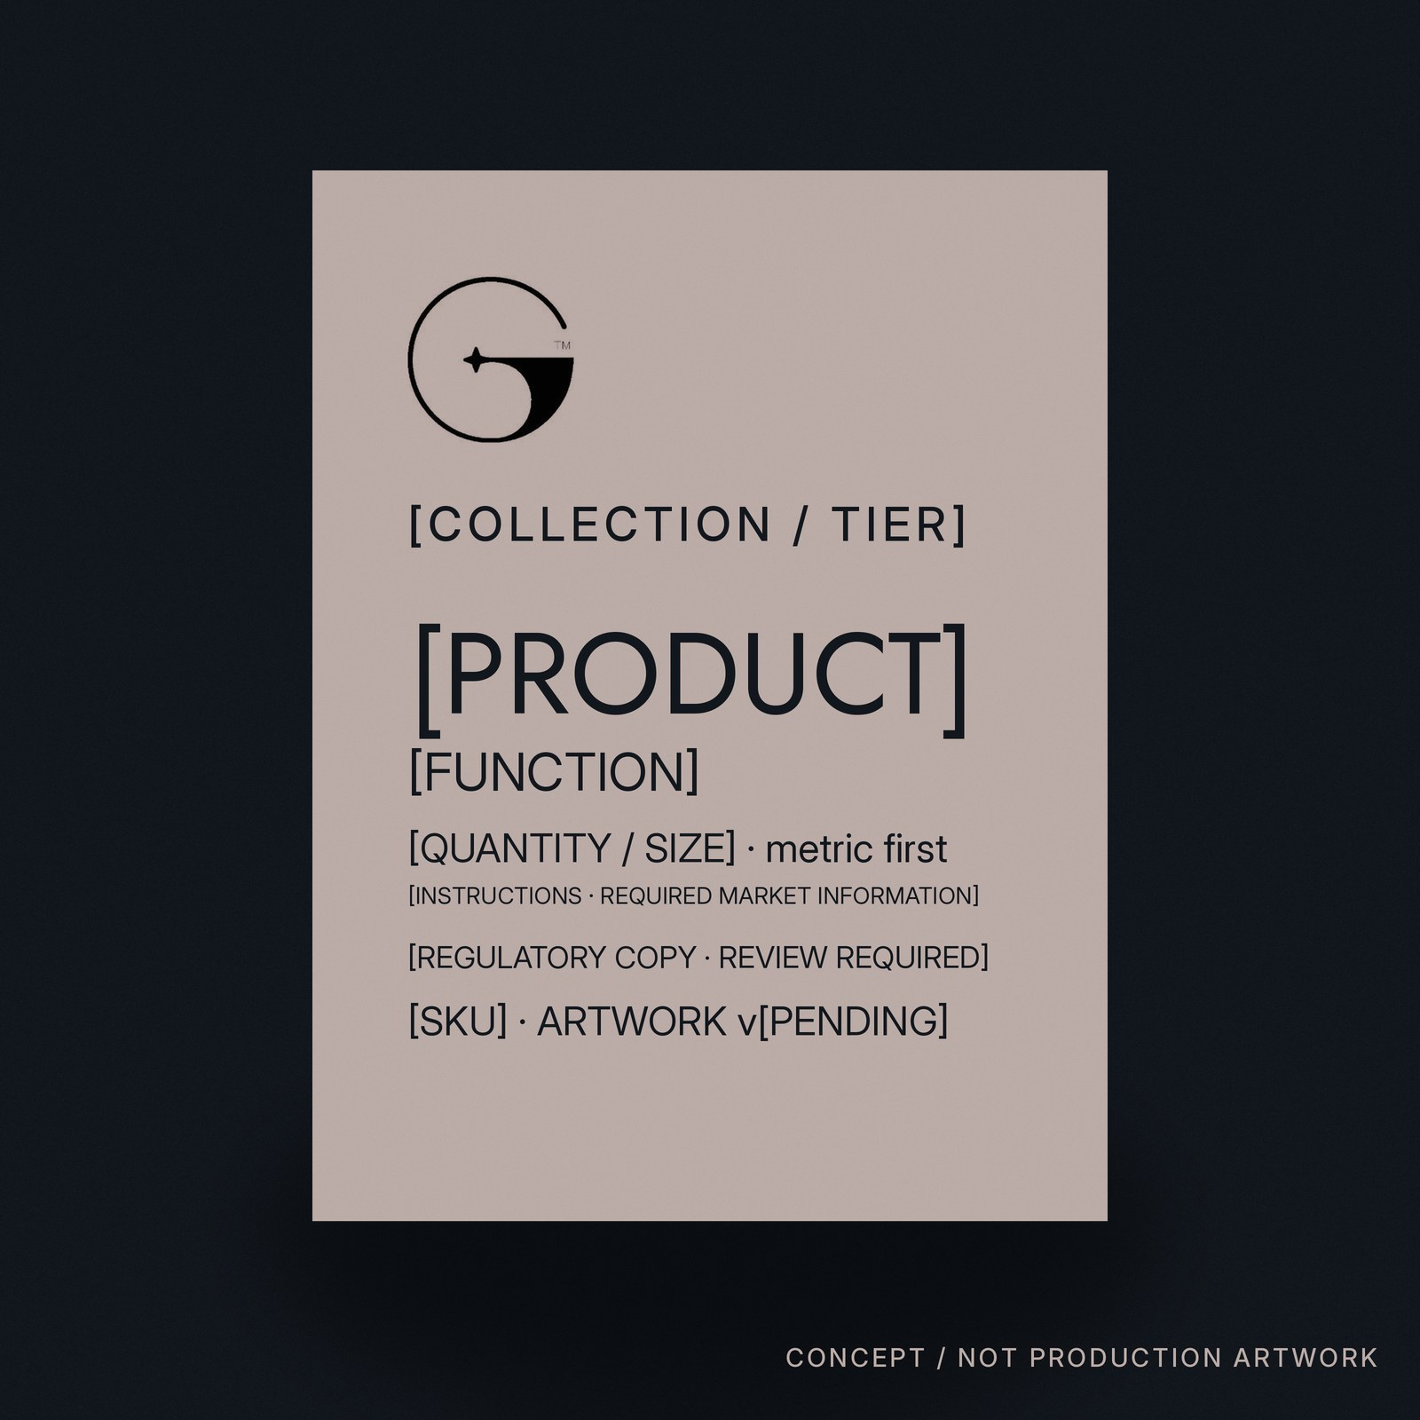
21 · INFORMATION HIERARCHY · APPROVED ORDER (T05)
Six levels. Read from the top, down.
01 GEM™
02 [COLLECTION / TIER]
03 [PRODUCT] · [FUNCTION]
04 [QUANTITY / SIZE] · metric first
05 [INSTRUCTIONS · REQUIRED MARKET INFORMATION] · [REGULATORY COPY]
06 [SKU] · [ARTWORK VERSION]
HIERARCHY APPROVED (T05) · ALL CONTENT PLACEHOLDER · REGULATORY COPY: REGULATORY REVIEW REQUIRED
Notes:
Hierarchy per register T05 and Part A slide 61 / Part C slide 29. Ingredients, claims, warnings, origin and regulatory text are supplied by the accountable owner and reviewed per market (Part C slide 33).

Slide 22
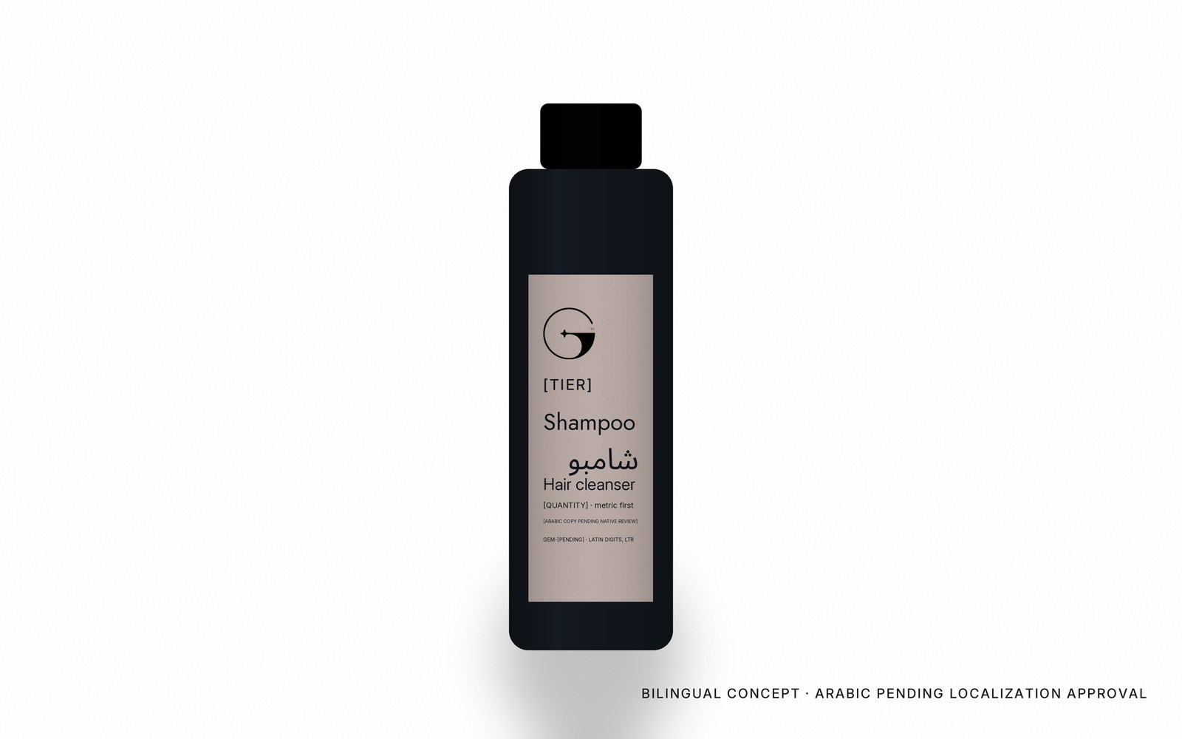
22 · BILINGUAL PACKAGING · ARABIC PENDING LOCALIZATION APPROVAL
English and Arabic, with equal care.
Arabic is planned as mandatory for Saudi-market packaging unless a qualified regulatory review confirms an exception (T11).
True right-to-left setting. No tracking on Arabic. The logo is never mirrored. Technical identifiers (SKU, batch, codes) stay in Latin digits, left to right (M11, M12).
Which language leads on a pack is set per market policy: [REQUIRES OWNER]. The Arabic shown is a working string; all Arabic copy remains PENDING LOCALIZATION APPROVAL until native review (M16, VAL-07). Regulatory text: [ARABIC COPY PENDING NATIVE REVIEW].
BILINGUAL CONCEPT · ARABIC PENDING LOCALIZATION APPROVAL · NOT APPROVED COPY
Notes:
Bilingual rules per Part A slides 37–39 and Part B RC2 slides 12–13. The register's Arabic-first default (S07) is scoped to wayfinding; the packaging language order is not decided and is marked [REQUIRES OWNER].

Slide 23
23 · FROM CONCEPT TO PRODUCTION
This document does not replace Part C.
01
02
03
04
05
Concept direction
Product / commercial scope confirmation
Supplier structure
Dieline
Regulatory information
06
07
08
09
10
Artwork development
Supplier proof
Physical sample
Approval
Production release
GEM™ Production Standards V3.0 — Part C — RC2 governs steps 03 to 10: supplier dielines, materials, finishes, proof levels P1–P5, golden samples, regulatory review and release (14-step workflow, Part C slide 5). THIS DOCUMENT DOES NOT REPLACE PART C PRODUCTION STANDARDS.
CONCEPT PORTFOLIO · PRODUCTION CONTROLS: PART C RC2 · WORKING EDITION / PENDING PRODUCTION VALIDATION
Notes:
Mapping to Part C: supplier structure (slide 32), dieline (31, App. G), regulatory copy (33, App. H), preflight (19, App. C), proofs (49), physical sample (36, App. I), release (5, App. A).

Slide 24
EVERY DETAIL, IN PROPORTION.
GEM™ — Amenities & Packaging · CONCEPT PRODUCT PORTFOLIO
All products, structures, materials and applications shown are conceptual unless explicitly identified as approved. Final specifications require commercial, supplier, regulatory and production validation.
HOSPITALITY, IN PERFECT PROPORTION
Notes:
Closing. The headline is an editorial line for this portfolio; the primary tagline remains HOSPITALITY, IN PERFECT PROPORTION, fixed (B04).

