Slide 1
A presentation on – “Energy and time efficient task offloading and resource allocation on the generic IoT-fog-cloud architecture” Authored by: Huaiying Sun, Huiqun Yu, Guisheng Fan & Liqiong Chen
By: Mohammed Shahzad
444105788@student.ksu.edu.sa

Slide 2
Contents of this presentation
Introduction to the Survey
The Research Paper:
Introduction
System Architecture
The ECTORA algorithm
Conclusion
Concluding thoughts

Slide 3
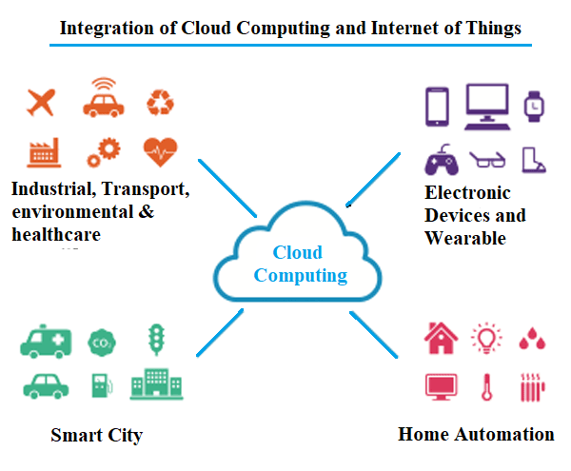
Introduction to the Survey(1)
Offloading and resource allocation
With the exponential increase in the number of IoT devices and the amount of emitted data from these devices, it is expensive and inefficient to offload all tasks to the remote data center.
This paper proposes a general IoT-fog-cloud architecture that fully exploits the advantages of fog and cloud.
Then, the energy and time efficient computation offloading and resource allocation is formulated into the energy and time cost minimization problem.

Slide 4
Introduction to the Survey(2)
Offloading and resource allocation
We then propose an ETCORA algorithm to solve the problem, improving the energy consumption and completion time of application requests.
Finally, extensive simulations are carried out to verify that the proposed method indeed outperforms the other two methods in reducing energy consumption and completion time of requests.

Slide 5
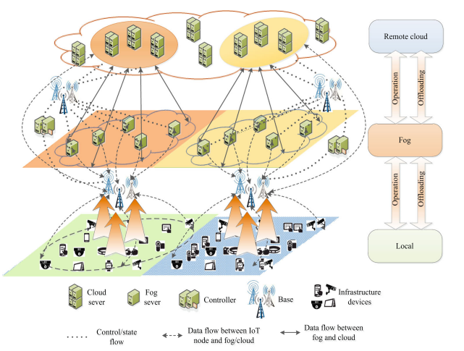
The Research Paper: Introduction
Offloading and resource allocation
This paper is mainly to provide the optimal computation
offloading strategy and transmission power strategy.
A huge amount of data emitted by distributed IoT devices are transferred to the centralized cloud for processing.
It is not efficient for some applications with rigid service delivery deadlines such as virtual reality, augmented reality and so on to be executed on remote cloud only.
Because of the limited resource on IoT devices, we offload the tasks of various application requests to a computing system with sufficient resources.

Slide 6
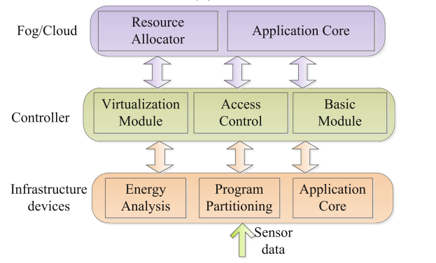
The Research Paper: System Architecture
The system architecture has three layers.
The first layer is the infrastructure layer, which contains some IoT devices. The second layer is the fog layer, including some fog servers and controllers, which can be located at different geographic locations. The third layer is the cloud layer comprising cloud servers.
The energy analysis module of the IoT device determines whether the device can serve offloaded tasks of other devices according to the energy and time constraints.
The basic module of controller is responsible for information communication.

Slide 7
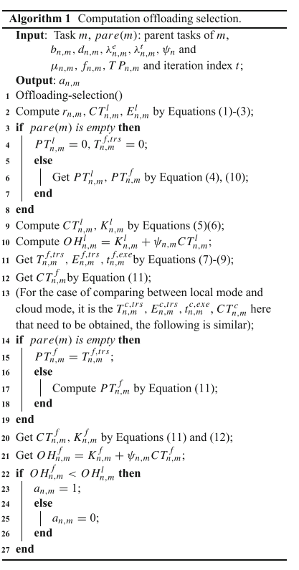
The Research Paper: The ECTORA algorithm
Offloading and resource allocation
A huge amount of data emitted by distributed IoT devices are transferred to the centralized cloud for processing. This always incurs high delays and impressive costs for using the cloud-based computational resources.
Because of the limited resource on IoT devices, we offload the tasks of various application requests to a computing system with sufficient resources.

Slide 8
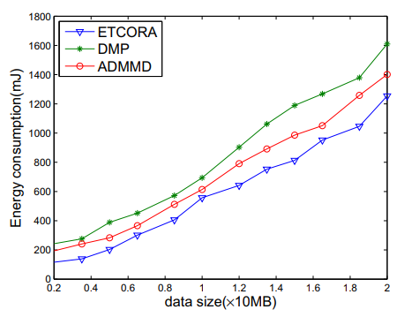
The Research Paper: Conclusion
Results show that the ECTORA method indeed outperforms the other two methods in reducing energy consumption and completion time of requests.
Another two significant factors are the security and reliability of services, because they would also have direct impact on the performance of the IoT applications.
IoT-fog-cloud environment to extend the practicability of it. If so, it will benefit many aspects of our daily life such as the transportation, medical, industrial automation, smart home and emergency response.

Slide 9
Conclusion
Further research to solve problem of QoS thereby addressing the Scalability issue in IoT systems.
We hope that IoT-fog-cloud environment realization will benefit many aspects of our daily life such as the transportation, medical, industrial automation, smart home and emergency response.
All in all, the survey provides relevant information that can be utilized by researchers interested in IoT.

Slide 10
Thank you

