Slide 1
A presentation on – “Performance, Reliability and Scalability for IoT” Authored by: Andriy Luntovskyy and Larysa Globa
By: Mohammed Shahzad
444105788@student.ksu.edu.sa

Slide 2
Contents of this presentation
Introduction to the Survey
The Research Paper:
Introduction
QoS and scalability issue
Big Data and ML
Conclusion
Concluding thoughts

Slide 3
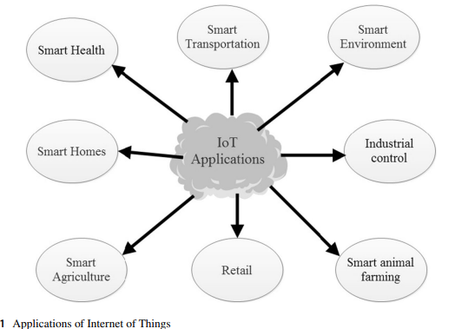
Introduction to the Survey(1)
The survey paper titled "Performance, Reliability and Scalability for IoT" authored by Andriy Luntovskyy and Larysa Globa discsses issue of QoS optimization in IoT systems which is crucial for performance, reliability and scalability.
The extended Internet of the future needs these solutions based on the cooperation between fog and clouds with delegating of the analytics blocks via agents, adaptive interfaces and protocols.
The next problem is as follows: IoT can generate large arrays of unmanaged, weakly-structured, and non-configured data of various types, known as "Big Data". The given papers deals with the both problems.

Slide 4
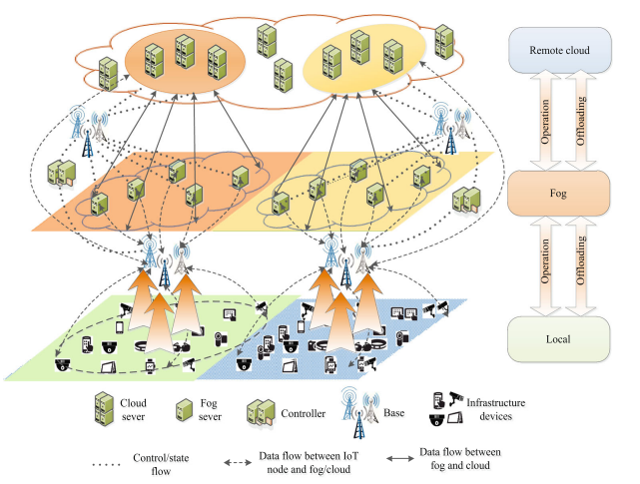
Introduction to the Survey(2)
This subject also needs special discussion for risks evaluation and cooperative intrusion detection.
Some advanced approaches for optimization of Performance, Reliability and Scalability for IoT-solutions are offered within the paper.
The paper discusses the Best Practices and Case Studies aimed to solution of the established problems.

Slide 5
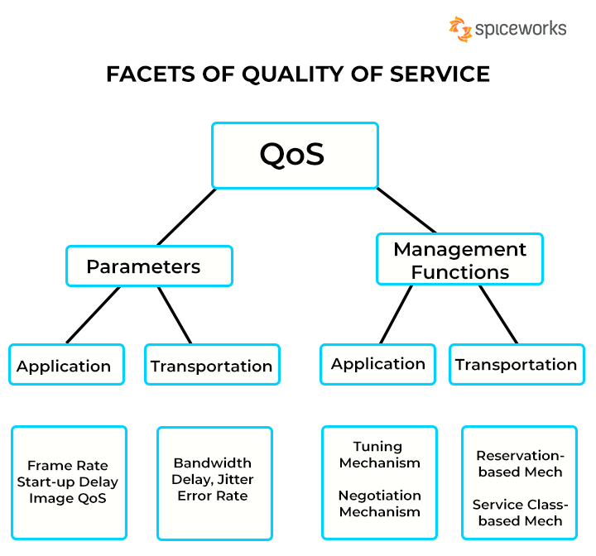
The Research Paper: Introduction
The paper states that, there are a lot of apps and software platforms to IoT support. However, a most important problem of QoS optimization, which lays in Performance, Reliability and Scalability for IoT, is not yet solved.
Apart from QoS, the survey paper also mentions Big Data.
Also, relatively modern technologies like Blockchain, Machine Learning, IoT, Robotics, 5G are surveyed for its increasing requirements of higher QoS, advanced Performance, Reliability and Scalability.

Slide 6
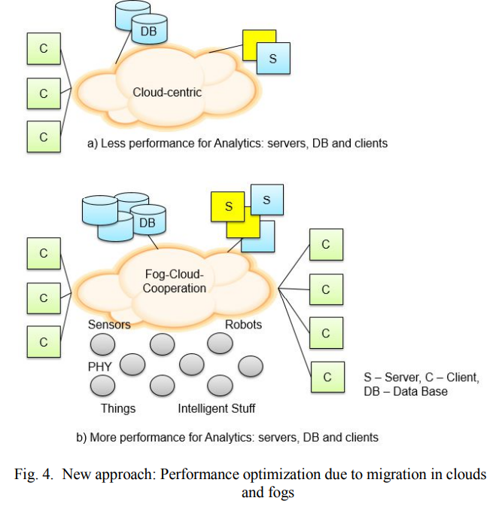
The Research Paper: QoS and Scalability
IoT is based nowadays on IPv6. This brings more freedom in addressing of immense quantity of available devices: sensors piconets, Embedded, Wearable, etc.
The small intelligent nodes in IoT-scenarios communicate via energy-autarky gateways. The considered approaches are able to increase the performance, reliability and scalability in desktop applications and IoT both.
Further performance optimization can be reached via the analytics migration into the clouds. The cloud-centric systems can discharge the energy-critical mobile nodes.

Slide 7
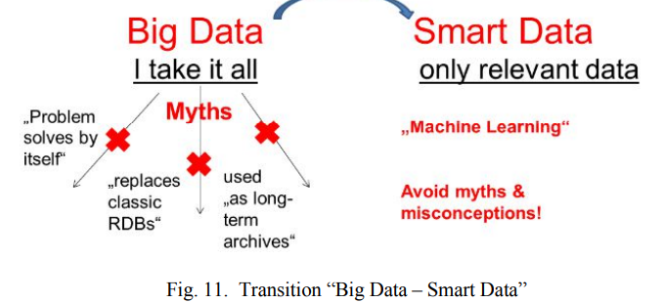
The Research Paper: Big Data and ML
A typical data acquisition and evaluation model is shown in Figure. Mostly, the collected data are large unstructured and unmanaged. Huge as well as heterogeneous data volumes (approx. 100PB to 100EByte) are acquired additionally causing Big Data shortcomings.
The (cloud-based) ML system enables artificial creation of knowledge from the obtained voluminous experimental data in background mode.
An artificial system is learned from samples and examples and can summarize them after the completion of the study and evaluation (training) phase.
The ML system recognizestemplates and trends in research data. Thus, the ML (cloud) system can also evaluate data on representativeness and compliance.

Slide 8
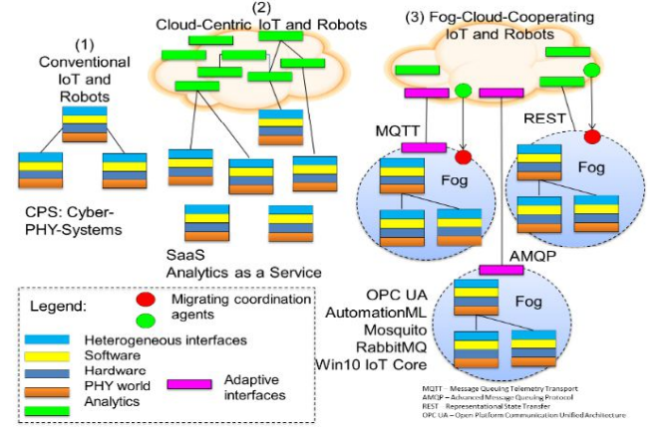
The Research Paper: Conclusion
IoT-scenarios need nowadays the efficient access and management models under considering of the Qo parameters and low-energy-criteria.
The extended Internet of the future needs these solutions based on the cooperation between fog and clouds.
The given work is also dedicated to Big Data sources and solutions in modern IoT issues. The best practic0es and case studies on Big Data and ML were discussed. The given papers deals with the both problems.
The aspects of Security and Privacy in such potentially dangerous IoT-scenarios need a special considering for risks evaluation and cooperative intrusion detection with further research.

Slide 9
Concluding thoughts
In this survey paper, some classical as well as the advanced approaches to the optimization of Performance, Reliability and Scalability for IoT solutions were analyzed.
All in all, a good survey of the field, provided its novelty of view point of scalability for QoS optimization.
Clearly, some advanced approaches for optimization of Performance, Reliability and Scalability for IoT-solutions are surveyed within the paper.
However, as the authors mention, it indeed is a work-in-progress research.

Slide 10
Thank you

