Slide 1
A presentation on IoT based on the book - “A Reference guide to the IoT” Authored by Greg Dunko, Joydeep Misra, Josh Robertson and Tom Snyder ;RIoT, Bridgera
By: Mohammed Shahzad
444105788@student.ksu.edu.sa

Slide 2
Contents of the presentation
Introduction to IoT
Current applications in short
Sections 1 to 5 from the book we are discussing about
Concluding thoughts

Slide 3
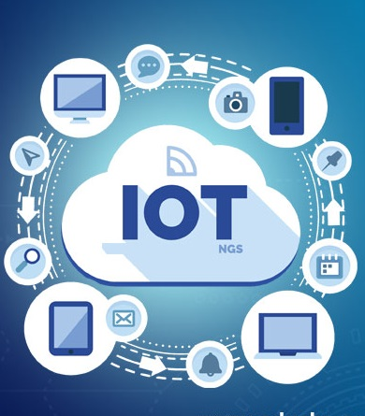
Introduction
IoT is the intersection of the digital with the physical.
Physical devices are now enhanced with sensing, computing, and communication capabilities.
Wearables such as Fitbit and connected home devices like Nest are most commonly cited examples of IoT.
These are however quite basic early IoT systems.

Slide 4
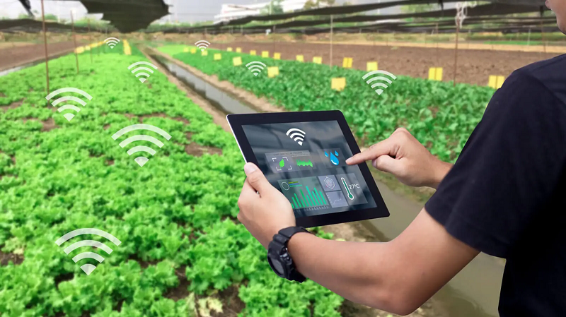
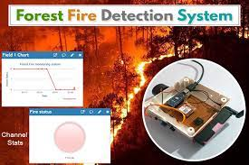
Applications of IoT
Current and early IoT applications:
IoT solutions are becoming popular at the city and county level to make emergency response services
Smart home fire detector on the market warn people in cases such as fast moving tornadoes or forest fires.
The basic wearable devices are connected to first responder systems as EMT’s rush to an emergency.

Slide 5
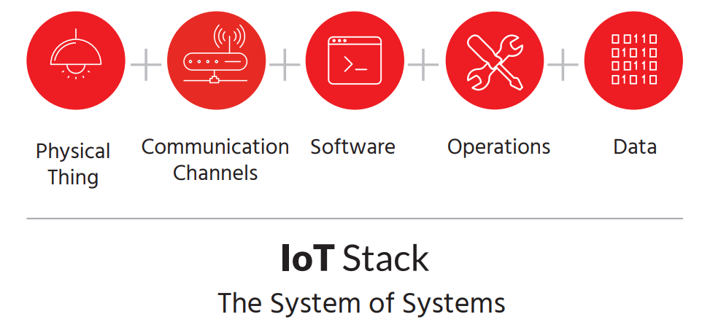
Sections 1 through 5
The book is divided into 5 sections.
Section 1 deals with the physical things part of IoT.
Section 2 is all about communication among IoT devices and between networks and “things”
“The cloud” and other SaaS options and their Operations are discussed in section 3 and 4 respectively.
Section 5 addresses data in IoT, concerns and “Big data”

Slide 6
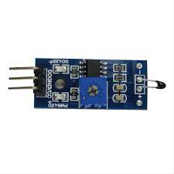
Section 1: The Physical Things(1)
Sensors and Actuators
The fundamental source of IoT data is sensors.
A sensor (basically transducer) is a physical device that converts one form of energy into another. An actuator however takes an electrical input and turns it into physical action.
One important characteristic of Sensors is it need to be accurate.
since you will make mission-critical decisions based on later analysis of the data, which will hold little value if the data is wrong.
Figure: A temperature sensor module

Slide 7
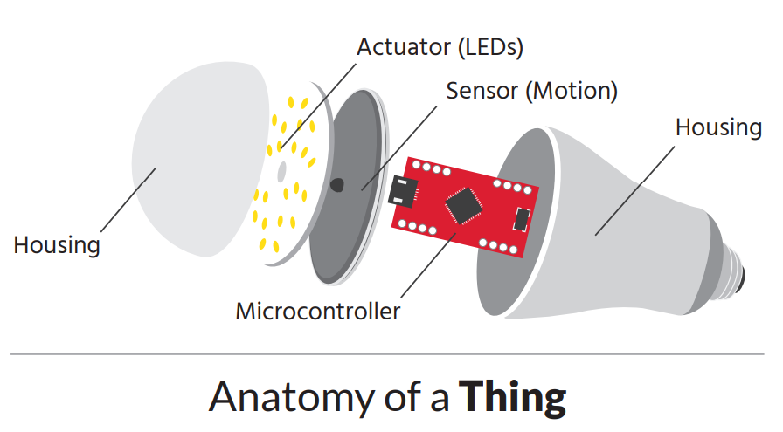
Section 1: The Physical Things(2)
Microcontroller: The “Brain” of the IoT Device.
Specifications of the micro/controller device
-Microprocessor type(more memory or speed)
-Amount of memory
-operating voltage
-number and type of I/O ports
-control interface
-source of power(battery, mains electricity, solar)
Battery size is a utility tradeoff in IoT devices

Slide 8
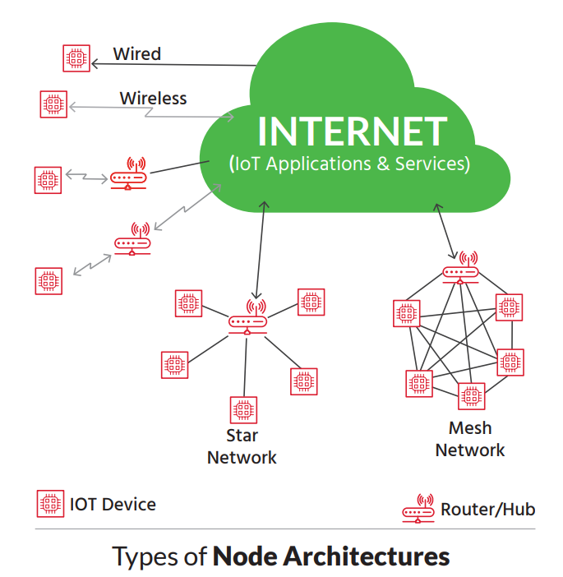
Section 2: Communication channels(1)
Communication among things:
Connecting things-to-things, things-to-server, server-to-server.
IoT systems enable Things to communicate with servers as well as other Things.
IoT Wireless Radio Solutions:
Your application will dictate the connectivity method needed for your device. Connectivity range options include:
- short range solutions (e.g. RFID or Bluetooth),
- medium range solutions (e.g. ZigBee, Thread, or Wi-Fi), and
- long range Wide Area Networks (WAN) solutions (e.g. cellular or satellite).

Slide 9
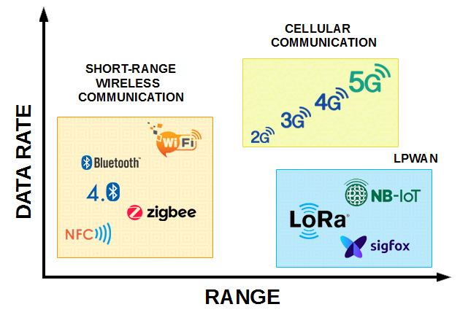
Section 2: Communication channels(2)
1) Long Range IoT Radio Solutions:
Disadvantageous for:
Using cellular networks can be expensive. These networks are designed for voice and high data throughput/low latency communications, which are not typical requirements of IoT applications.
Cellular solutions are not designed for very low power operation.
older 2G and 3G infrastructure will likely begin to phase out.
Instead of focusing on existing cellular technologies, we will introduce alternative long-range solutions.
Low Power Wide Area (LPWA) Networks
LoRa (LOng RAnge)
Sigfox
Satellite

Slide 10

Section 2: Communication channels(3)
2) Medium range IoT solutions:
We define medium range as a radio solution with signal range no greater than 100 meters. Example: Zigbee, Wi-Fi, zwave.
3) Short Range IoT Radio Solutions:
We define short range as solutions with signal range ≤30m. The most common technologies in use include Bluetooth (or its evolution Bluetooth LE) and RFID.
BLE Low energy Bluetooth is the hot topic for IoT services. One adv of Bluetooth is its user popularity, already integrated to mobile devices and low range.

Slide 11
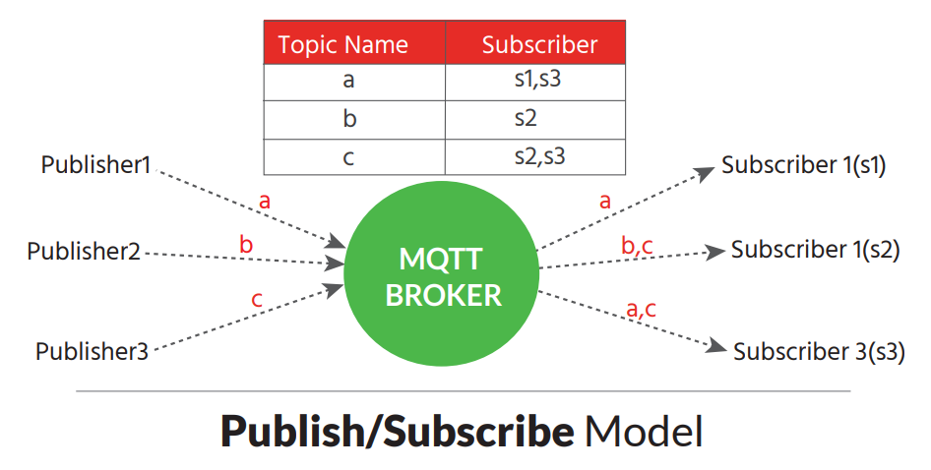
Section 2: Communication channels(4)
Communication with the world:
IoT systems enable Things to communicate with servers as well as other Things.
Message Queuing Telemetry Transport (MQTT) and Constrained Application Protocol (CoAP) are two alternative internet protocols. TCP/IP is power hungry.
MQTT was originally used in satellite applications but has evolved to handle today’s range of IoT applications.
CoAP, on the other hand, is somewhat new and has been gaining traction.
MQTT-MQTT uses a “publish/subscribe” message transport model.

Slide 12
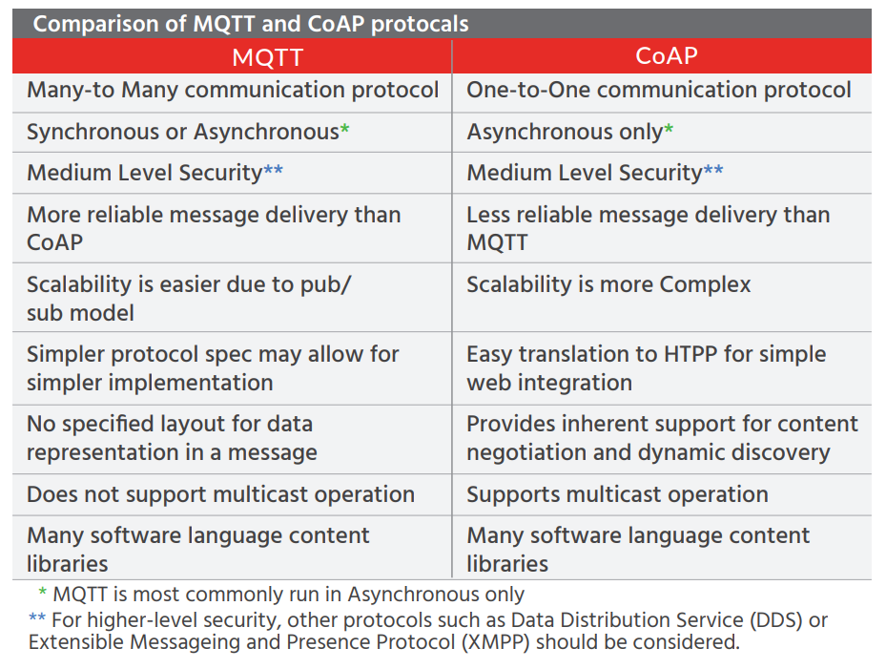
Section 2: Communication channels(5)
MQTT Advantages: independent operations, security, varied levels of QoS
Disadvantages: need for central broker, TCP protocol implications like overhead.
CoAP for “use with constrained nodes and constrained networks.” Like MQTT, CoAP is commercially supported and growing rapidly among IoT providers.
CoAP characteristics- UDP use, multicast, security with datagram protocol, web friendly.

Slide 13
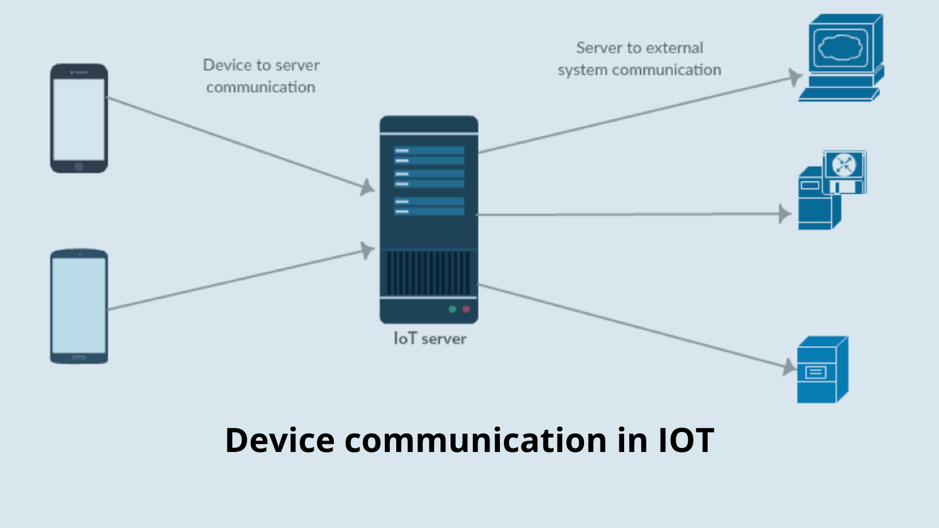
Section 2: Communication channels(6)
Reliability and Quality of Service
The amount of faults a system can sustain is called reliability, it includes:
Data reliability; because data can be tampered
Device reliability; because IoT devices can fail
Data reliability depends on the accuracy of data collected and transmitted by the IoT system.
Device reliability depends on largely on environmental factors and the security of the network in which the device is running.

Slide 14
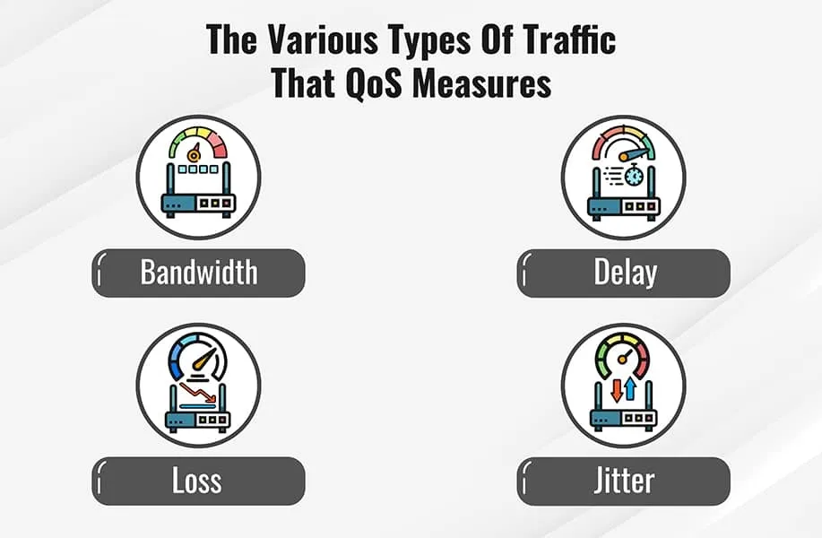
Section 2: Communication channels(7)
Quality of Service is a metric to describe the overall performance of a system.
QoS in IoT systems depends on:
Internal communication
Communication with the outside world
Communication is usually resource expensive process in any system.
QoS can be improved using computation instead of communication whenever possible.

Slide 15
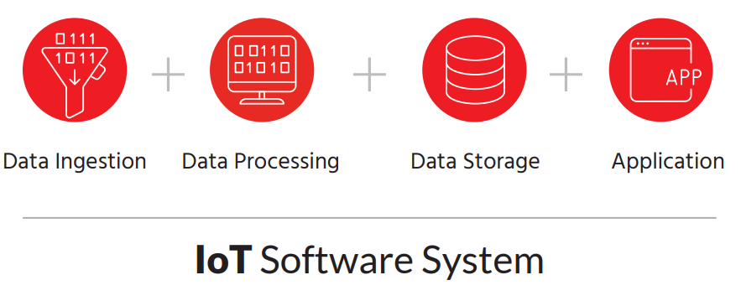
Section 3: Software(1)
The ability to connect computer-like devices to the internet allows us to utilize remote computing resources. These are not constrained by size, location, power consumption, or network connectivity.
These computing resources referred to as “The Cloud.”
Components of a cloud: An IoT deployment, an IoT software system is generally running on Cloud infrastructure, consisting of:
• Data Ingestion
• Data Processing
• Data Storage
• Application

Slide 16
Section 3: Software(2)
Tasks of System software
1. Data Ingestion: The most common task for data ingestion is to listen for and capture the message stream from devices. Technologies include: Apache NiFi, Publish/subscribe model(MQTT), request report model (CoAP)
2. Data Processing: Its primary function is to apply logic to incoming device data and invoke the corresponding action. Technologies include Lambda and Kappa
3. Data Storage: NoSQL databases are an obvious choice for storing high volumes of data without having a fixed schema.
4. Application: An IoT Software Application provides three critical functions:
1. Enables human interaction with the IoT system through a User Interface (UI)
2. Provides a mechanism for data analytics
3. Provides data visualization capabilities

Slide 17
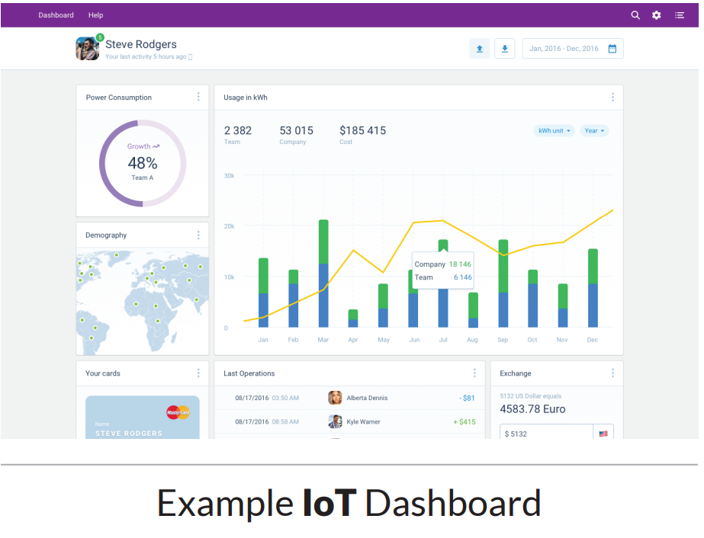
Section 3: Software(3)
Using the obtained data
For Data Analytics:
IoT end-user can generate analytics using machine learning algorithms to get more insight.
Real-time analytics would allow the system to detect deviations from known usage patterns and generate an alert. This can help in managing and detecting anomalies early.
For Data Visualization:
Data visualization capabilities provide graphical representations of data, allowing you to spot trends and take appropriate action.
You can also embed commercial visualization tools (like Microsoft’s PowerBI or Tableau) into an IoT application.

Slide 18
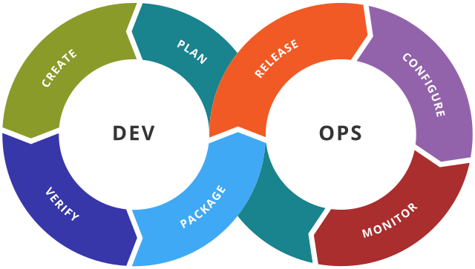
Section 4: Operations(1)
An IoT system requires a diversified set of technologies deployed remotely.
Datacenter infrastructure, the hardware and firmware associated with devices (physical things)
Operation components:
1)Infrastructure: network, server, and storage infrastructure.
2)DevOps: Saas concept that development and operations must work together beyond the release of a product or service.
3)Physical things: firmware updates, battery mgmt., and sensor calibration
4)Security: protecting the system and everything connected to it.

Slide 19
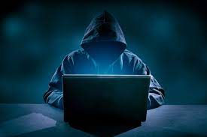
Section 4: Operations(2)
Addressing Security concerns
Edge devices tend to get less attention from systems administrators and, thus, can make an attractive target for hackers.
In the rush for convenience, security and privacy are often overlooked. IoT security is still in its infancy, leaving the door open for malicious attacks.
IoT devices generally come with very limited processing capabilities. This makes it hard to run state of the art encryption-based security solutions inside the devices.
Using TLS/SSL encryption. For this type of communication, private key encryption is stored at the device level.
IP white-listing filters untrusted messages at the device level. This is an easy measure to implement in IoT platforms using a static IP addresses.
IoT devices are vulnerable to common cyber attacks

Slide 20
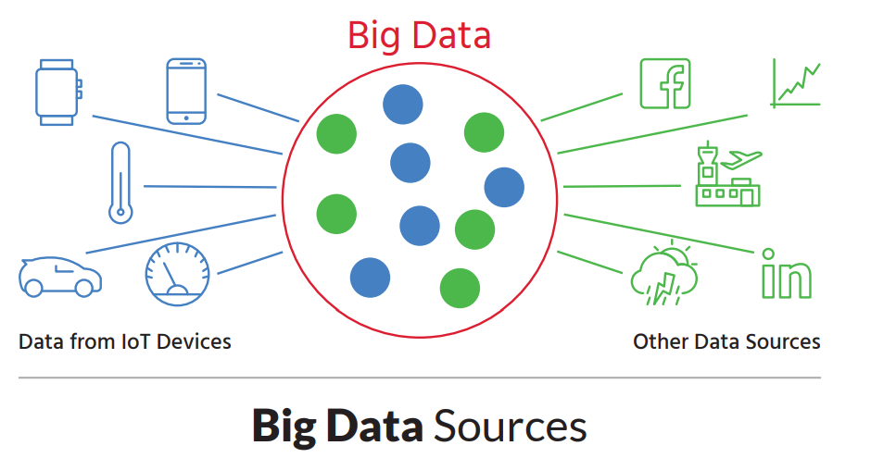
Section 5: Data
Big data exists with other small data foundations in the background
A critical monitoring system, such as crash detection on a self-driving car, needs to be capable of real-time, local decision-making. The process of sending information to the cloud, processing, and sending commands back is simply too slow, actionable data is needed instantly.
How small data evolves into big data:
Aggregating data from the above example with that of other sources is how small data becomes Big Data.

Slide 21
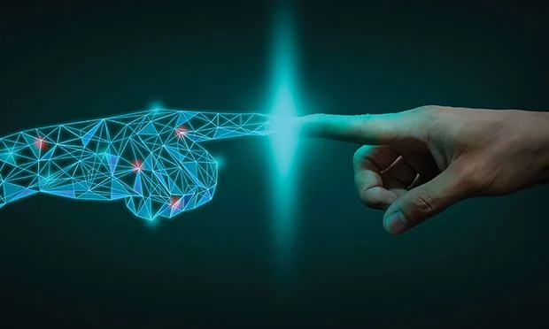
Concluding thoughts
While experts may disagree on the projected value of the new Data Economy, they all agree that it will have a greater economic impact than the Internet itself.
Sensor costs are approaching a level that allows trillions to be deployed annually.
Big Data analytics and artificial intelligence are at the lowest cost point in history.
It is easier to develop a connected device now than ever before.
Data and human intelligence

Slide 22
Thank You.

