Slide 1
A presentation on – “Distributed Edge computing in IoT”
Based on the research paper titled “Distributed aerial processing for IoT-based edge UAV swarms in smart farming” by Anandarup Mukherjeea, Sudip Misraa, Anumandala Sukrutha and Narendra Singh Raghuwanshi.
By:
Mohammed Shahzad
444105788@student.ksu.edu.sa

Slide 2
Contents of this presentation
Introduction –> Introduction to the research paper
Problem statement and their solution approach
DAP - System architecture, Modelling, Algorithms
Results discussion
Conclusion

Slide 3
Introduction
Introduction to the research (DAP)
This work addresses the challenges of a decentralized and heterogeneous Unmanned Aerial Vehicle (UAV) swarm deployment
They address the resulting problem of sensing and processing resource-intensive data aerially within the Edge swarm in the fastest and most efficient manner possible.
To address under-utilization of the available computation resources in heterogenous swarms, they propose a Nash bargaining-based weighted intra-Edge processing offload scheme to mitigate the problem of heavy processing in some of the swarm members.

Slide 4
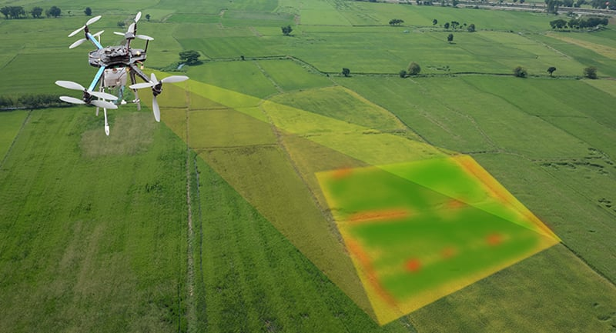
Introduction
Introduction to Agricultural IoT
The involvement of IoT in farming applications such as precision agriculture, livestock management, inventory management, and others has increased the productivity, yield, and raised economic benefits to farmers through connected sensors, actuators, and networked systems and UAVs
The biggest challenge faced during the implementation of a real-time UAV-based sensing solution by making use of multimedia data is the low computational power and limited energy resources of these UAVs.
Fig: Agricultural IoT

Slide 5
Introduction
Introduction to Agricultural IoT
Various solutions are proposed to address the problems of low computation capability of such UAVs.
Solutions such as:
1. cloud based data processing offloading from single UAVs ,
2. processing offloading from a UAV to a ground server, etc.
offer limited respite from the challenges at hand as these are heavily dependent on network connectivity, bandwidth, and quality of service for reliable and timely operation.

Slide 6
Problem statement and solution approach
Problem statement
The biggest challenge faced during the implementation of a real-time UAV-based sensing solution by making use of multimedia data is the low computational power and limited energy resources of these UAVs.
The areas of implementation of such multi-UAV networked solutions may not always promise the availability of network connectivity, network quality, or bandwidth, especially in applications involving operations in remote and infrastructure-constrained applications such as agriculture and disaster management

Slide 7
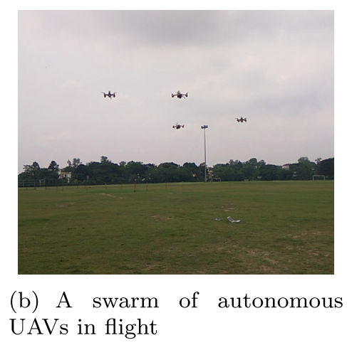
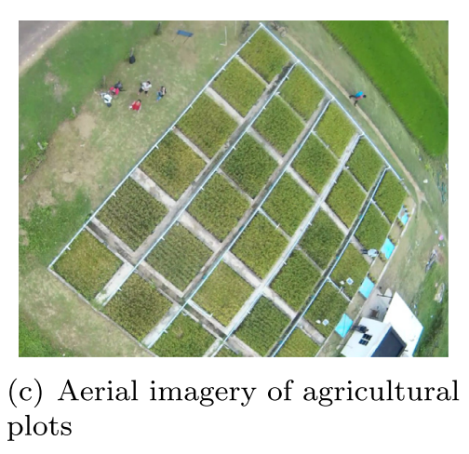
Problem statement and solution approach
Their approach
To address our problem statement, we propose an intra-swarm distributed processing scheme for mitigating the processing load from the multimedia Edge UAV node.
The UAV with camera sensors offloads the majority of its processing onto other swarm members, due to relatively lesser processing load on them.
In this work, we distribute the captured video frames to other swarm members for processing.
As the member UAVs do not have a camera sensor to process their data, each of the member UAVs processes the data offloaded to them for processing, besides their regular and comparatively low-scale processing and scalar sensing tasks.

Slide 8
Problem statement and solution approach
Their approach
A Nash bargaining solution is applied to the utility function to strategize the distribution of acquired video frames from the multimedia UAV with the camera to the other UAV nodes in the swarm before deployment.
This approach allows the setting of an optimum frame rate of video capture, the swarm size, and even the communication architecture of the swarm.

Slide 9
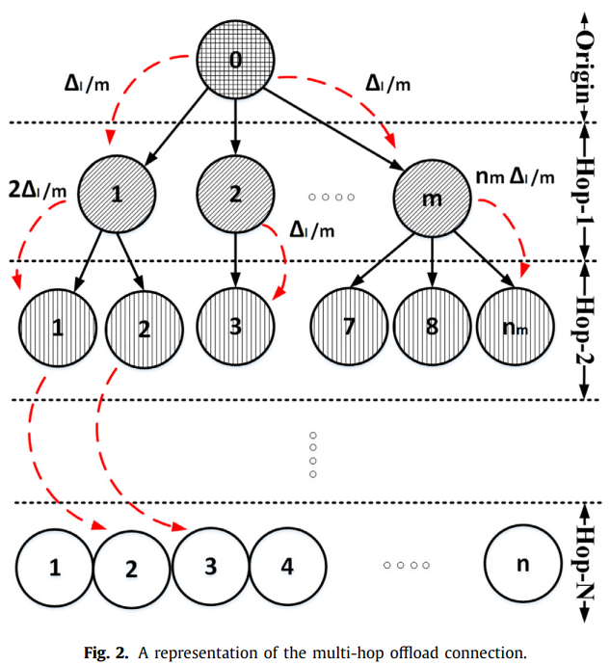
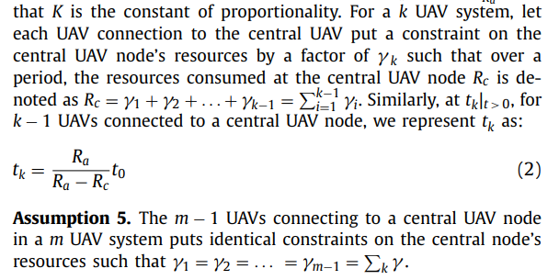
Distributed Aerial Processing (DAP)
The System Architecture
A one-hop UAV data-offload architecture consists of a central UAV to which m UAVs can connect.
each UAV connected to a central node puts a certain amount of strain on its resources
For a k UAV system, let each UAV connection to the central UAV put a constraint on the central UAV node’s resources by a factor of γ k such that over a period, the resources consumed at the central UAV node Rc is denoted as Rc = γ1 + γ2 + . . . + γk−1 = k−1 i=1 γi.
tk = Ra * t0 /(Ra − Rc) where Ra is available resources, Rc is consumed resources due to maintaining connections (fig 2)

Slide 10
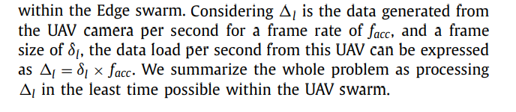
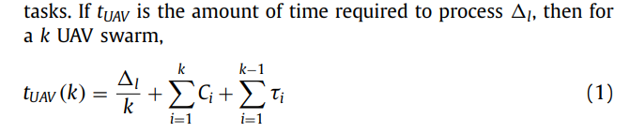
Distributed Aerial Processing (DAP)
The System Architecture
If tUAV is the amount of time required to process l, then for a k UAV swarm, tUAV (k) (fig 2)
Ci is a constant representing the internal processing time of the ith UAV, and τ i is the delay incurred during the transfer of one frame from one UAV to another in a single hop.
Inter Arrival time is denoted as IA = tf(i)− f(i−1)

Slide 11
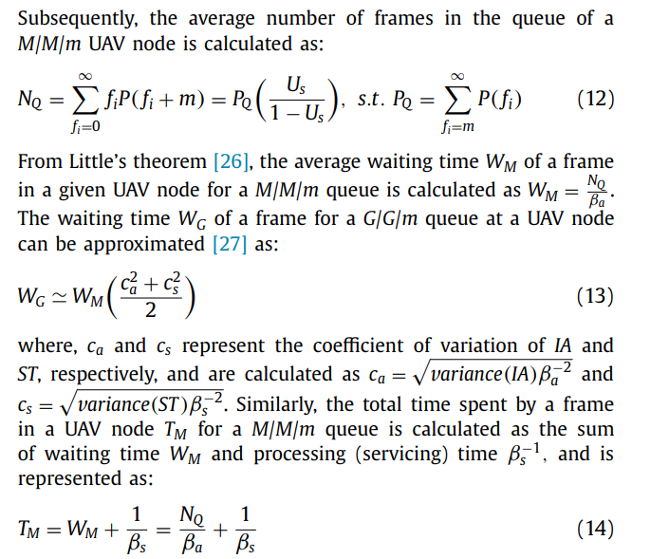
Distributed Aerial Processing (DAP)
UAV node traffic modeling
Service Time: It is the time for which the ith image frame f(i) resides in a UAV node, and is denoted by ST
We denote the mean IA rate and the mean ST by βa and βs, respectively. βa and βs
Where Nq is average Number of frames in processing queue
The probability that there are fi frames in a queue is calculated as P(fi).
For a single image frame fi and a single processing UAV node, we formulate the utility of the UAV node as Us = βaβs−1

Slide 12
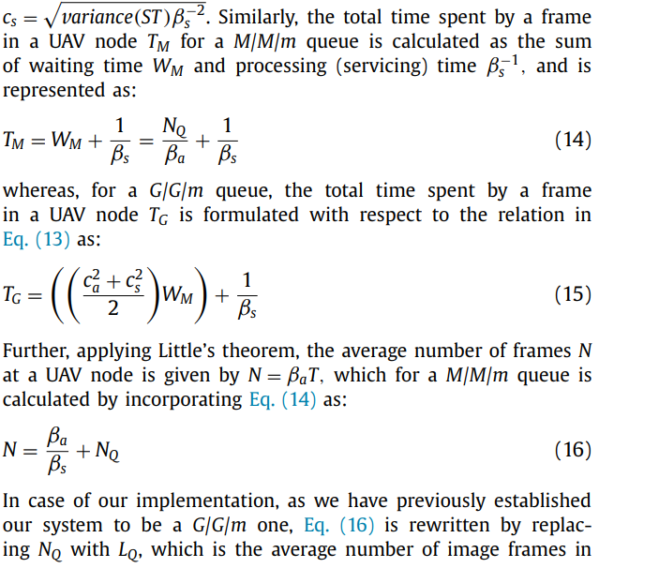
Distributed Aerial Processing (DAP)
UAV node traffic modelling
Traffic modelling

Slide 13
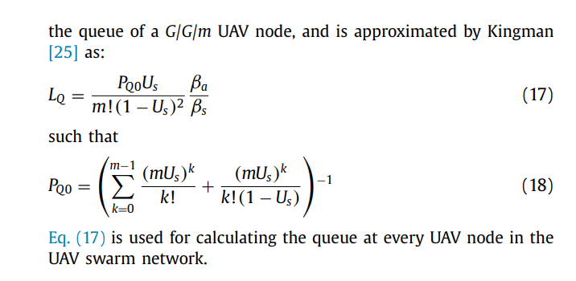
Distributed Aerial Processing (DAP)
UAV node traffic modeling
Traffic modelling
Eq. (16) is rewritten by replacing Nq with Lq, which is the average number of image frames in the queue of a G/G/m UAV node.

Slide 14
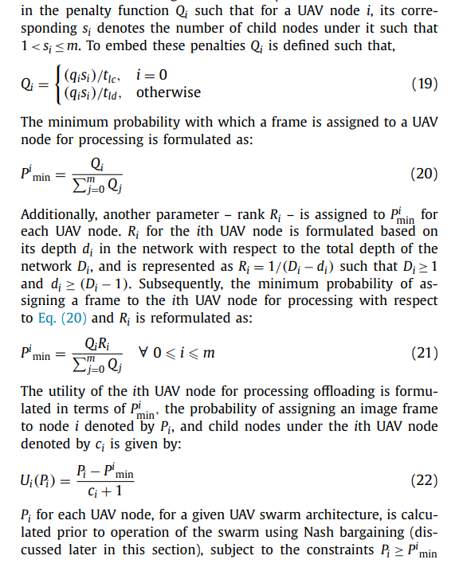
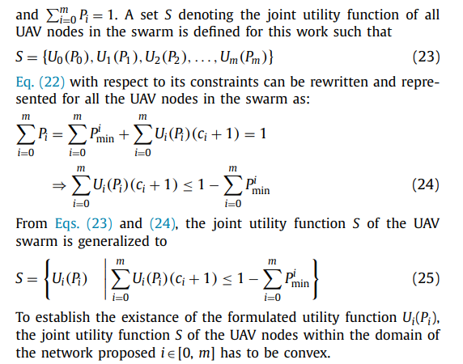
Distributed Aerial Processing (DAP)
Strategizing a Nash bargaining game

Slide 15
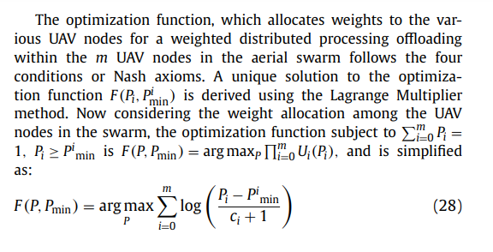
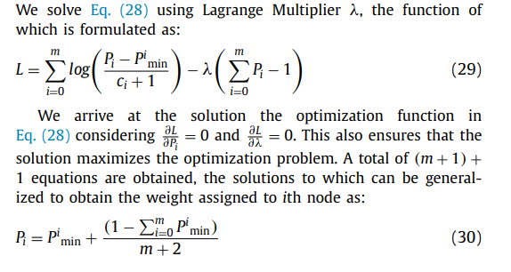
Distributed Aerial Processing (DAP)
Strategizing a Nash bargaining game

Slide 16
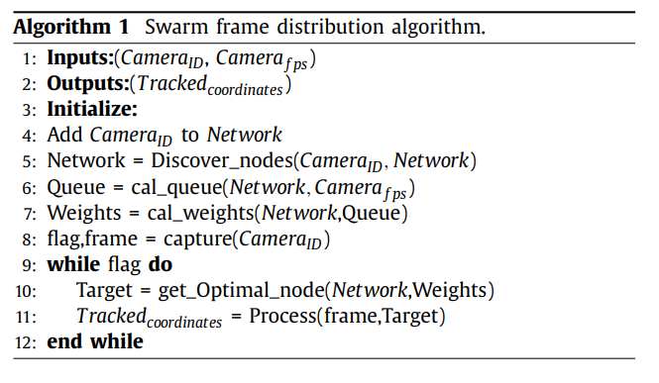
Distributed Aerial Processing (DAP)
Algorithms for processing and node selection
All the UAV nodes other than central and leaf UAV nodes have two probabilities – one with which its parent UAV node assigns it a frame, and the other with which it processes the frame by itself without passing it to its child node.
The central UAV node does not process any image frames and acts as a client in a client-server communication analogy. Post-assignment of an image frame for processing, a leaf UAV node does not have the option of offloading their processing to other UAV nodes and act only as servers. The intermediate nodes act as both clients as well as servers.
Algorithm 1 is responsible for the distribution of the generated image frames within the swarm members, depending on the network traffic and available processing

Slide 17
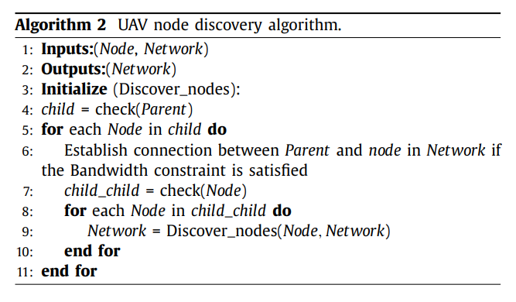
Distributed Aerial Processing (DAP)
Algorithm for node discovery
Initially, given the ID of the central UAV node with the attached camera sensor, and information of the camera’s capture rate in frames per second (fps), a network is formed by the central UAV node by polling for UAVs in its vicinity and within its swarm using Algorithm 2.
Algorithm 2 on a UAV node first checks whether the node is a child node or not. If at first pass, the node does not find any parent nodes, it becomes the parent node (root node).
Further, if it is a child node, it establishes a connection with the parent node upon satisfying the bandwidth requirements for data offloading.
Once the network is formed, the average queue length at every UAV node is calculated using Eq. (16).

Slide 18
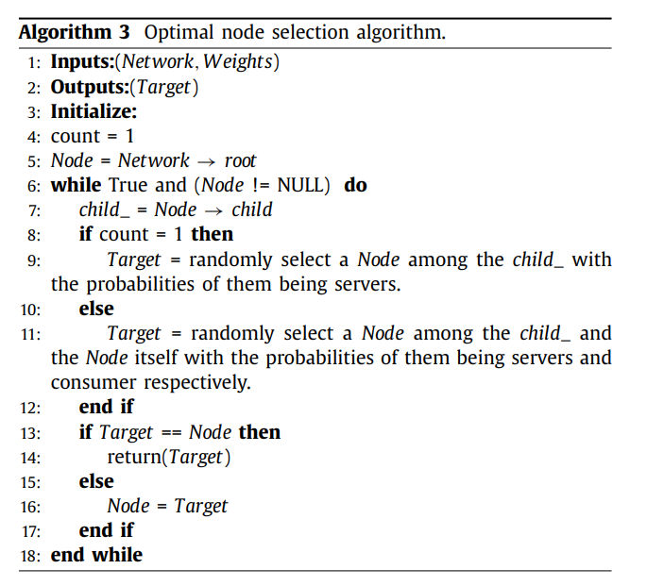
Distributed Aerial Processing (DAP)
Algorithm for optimal node selection
The image frames captured at the central UAV node are assigned to available UAV nodes for processing using Algorithm 3.
This algorithm first checks whether the current node is the root node and whether it has children nodes (child_).
If the current node has only one level of children nodes, it randomly selects any one of the children nodes for acting as servers during the distributed processing. Otherwise, the child node can act as a data generator (consumer) as well as a data processor (server).
This is repeated until the leaf nodes are reached. Algorithm 3 thus decides its target nodes. The list of these selected nodes is returned to Algorithm 1.
The selected nodes process the offloaded images using a pre-trained visual tracking algorithm and return the coordinates (Tracked-coordinates) of tracked humans to the central UAV node.

Slide 19
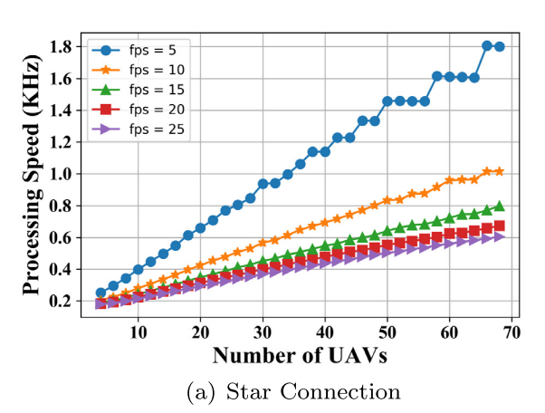
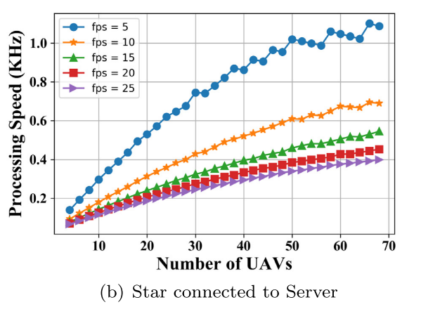
Results obtained using DAP
Results analysis
Collective network processing speed-
Fig. 8 shows the available collective processing speed of the network in kHz. In Fig. 8(a) and (b), it is seen that as the network size goes up, the collective processing speed of the network for various values of γ increases.
However, for the available real life hardware metrics, it is observed that for approximately 200 UAVs in the star and its associated network, the collective network processing speed reaches 3 kHz, saturates, and eventually drops to 1 kHz.

Slide 20
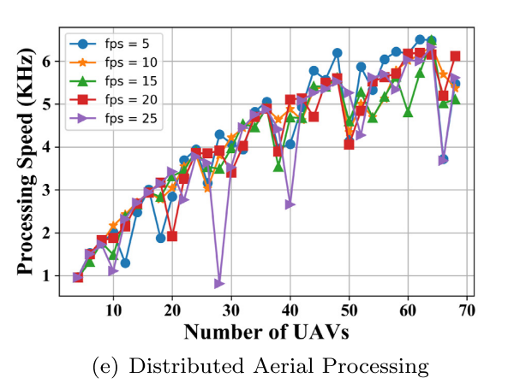
Results obtained using DAP
Results analysis
The poor performance of mesh topology is attributed to the resources spent in establishing peer connections in the network, which leaves very little for the processing of image frames.
Eventually, it is seen that DAP outperforms all the topologies regarding the collective network processing speed.

Slide 21
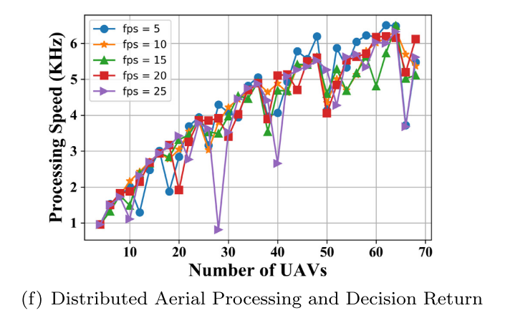
Results obtained using DAP
Results analysis
In Fig. 8(e) and (f), we see that although some UAVs show a fall in their individual available processing speeds, the collective processing speed of the network increases with increase in the number of UAVs in the network.

Slide 22
Conclusion
The main contributions of this work are:
1. A proposition for the use of heterogeneous UAV swarm consisting of mixed UAVs armed with either scalar or multimedia sensors, jointly performing remote sensing over farmlands, is put forward.
2. A distributed multimedia data processing approach for mitigating the processing load of a few swarm members to the whole swarm is proposed to contain the processing within the Edge itself.
3. A Nash bargaining based game is proposed to decide the intraswarm offload architecture such that for a given number of UAVs, the optimized offload architecture formed aims to minimize processing lag, reduce the offload delay times, and allocates maximum processing resources to the multimedia data offloaded.
4. An evaluation hardware consisting of four UAVs in a swarm is setup. The communication, time, and energy metrics measured from the hardware is used for emulating the behavior of our proposed approach for a large Edge swarm.

Slide 23
Conclusion
This work proposes an intra-UAV swarm processing offloading scheme to mitigate the problem of increased processing delays due to processing-intensive tasks such as visual identification of farmlands, crop health monitoring, and crop growth tracking.
Our proposed weighted offloading is governed by the use of a Nash bargaining game between the probability of a node processing the data itself or offloading it to a child node by a queueing theory-based analysis of the network traffic in the said swarm
The results show that unlike star networks, our proposed DAP scheme is highly scalable, and for a larger number of UAVs, performs faster than star networks, as shown in Fig. 5. DAP always outperforms the mesh topology regarding average processing times.

Slide 24
Thank You!

