Slide 1
CHAPTER 3 Radio Propagation and Propagation Path-Loss Models
King Saud University
College of Computer and Information Sciences
Computer Engineering Department
Prepared by CEN 591 course students

Slide 2
Introduction
In this chapter, we present the radio channel and identify parameters that distort the information-carrying signal as it penetrates the propagation medium.
In general, radio wave propagation consists of three main attributes: reflection, diffraction and scattering.
We also discuss the several empirical models used for calculating path-loss.

Slide 3
Basic Propagation Mechanisms
Reflection, diffraction, and scattering:
Reflection occurs when a propagating electromagnetic wave impinges upon an object
Diffraction occurs when the radio path between the transmitter and receiver is obstructed by a surface that has sharp edges EE4367 Telecom. Switching & Transmission Prof. Murat Torlak
Scattering occurs when the medium through which the wave travels consists of objects with dimensions that are small compared to the wavelength, or the number of obstacles per unit volume is large.

Slide 4
Radio Propagation Models
• Transmission path between sender and receiver could be Line-of-Sight (LOS) Obstructed by buildings, mountains and foliage
• Even speed of motion effects the fading characteristics of the channel

Slide 5
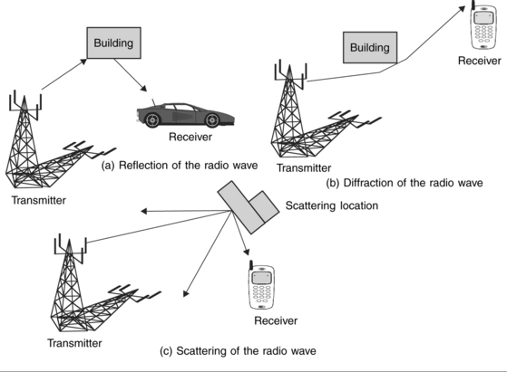
Radio wave propagation

Slide 6


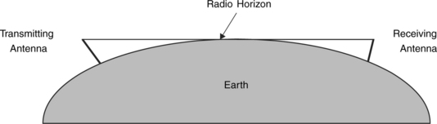
Free-Space Attenuation
The received power, P_{r}, at the receiving antenna (mobile station), located at a distance, d, from the transmitter (base station) is given for free space propagation as:
If other losses (not related to propagation) are also present, we can rewrite
Notes:
where:
P_{r} = received power
P_{t} = transmitted power
λ = wave length
ω_{c} = carrier frequency in rad./sec
c = velocity of electromagnetic waves in the free space (3 × 10⁸ m/s)
G_{b} = gain of the transmitting (base station) antenna
G_{m} = gain of the receiving (mobile) antenna
d = antenna separation distance between transmitter and receiver (i.e., base station and mobile station)
L₀ = other losses expressed as a relative attenuation factor
L_{p} = free space path loss, often expressed as an attenuation in decibels (dB)
We can express L_{p} (dB) in free space as:
where:
f = carrier frequency in MHz
d = separation distance in km (> 1 km)
It should be noted that the free-space attenuation increases by 6 dB whenever the length of the path is doubled. Similarly, as frequency is doubled, free-space attenuation also increases by 6 dB.

Slide 7
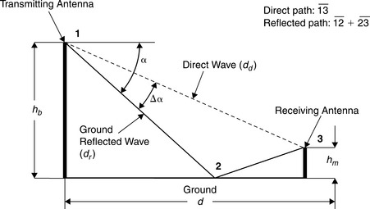
Attenuation over Reflecting Surface

Slide 8



Attenuation over Reflecting Surface
We assume that the base station and mobile station antenna heights, h_{b} and h_{m}, are much smaller compared to their separation, d, and the reflecting earth surface is flat. The received power at the antenna located at a distance, d, from the transmitter, including other losses, L₀, is given as
where:
The expression for the effects of ground reflections from a flat (or plane) earth provides results that are approximately correct for
The results are not valid for Δα > π/8. When Δα > π/8, the attentuation factor will be:

Slide 9


Example
With hb = 100 ft, and hm = 5 ft, and a frequency of 881.52 MHz (λ = 1.116 ft), calculate signal attenuation at a distance equal to 5000 ft. Assume antenna gains are 8 dB and 0 dB for the base station and mobile station, respectively. What are the free-space and reflected surface attenuations? Assume the earth surface to be flat.
Free-space attenuation:
Attenuation on reflecting surface:
Solution:

Slide 10
Example
Consider a base station transmitting to a mobile station in free space. The following parameters relate to this communication system:
• Distance between base station and mobile station: 8000 m
• Transmitter frequency: 1.5 GHz (λ = 0.2 m)
• Base station transmitting power, P_{t} = 10 W(10 dBW)
• Total system losses: 8 dB
• Mobile receiver noise figure N_{f} = 5 dB
• Mobile receiver antenna temperature = 290 K
• Mobile receiver bandwidth B_{w} = 1.25 MHz
• Antenna gains are 8 dB and 0 dB for the base station and mobile station, respectively.
• Antenna height at the base station and mobile station are 30 m and 3 m, respectively.
Calculate the received signal power at the mobile receiver antenna and signal-to-noise ratio (SNR) of the received signal.

Slide 11
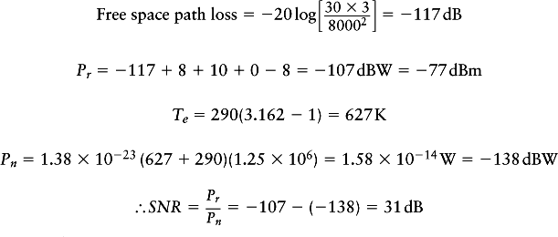
Solution:

Slide 12
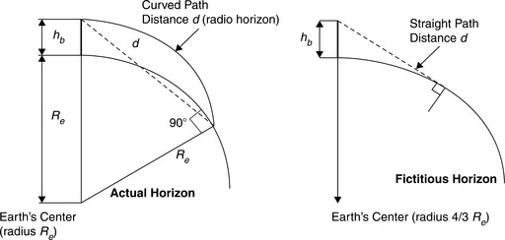
Effect of Earth’s Curvature
The distance d to the radio horizon can be determined for a terrestrial transmitter as follows.

Slide 13
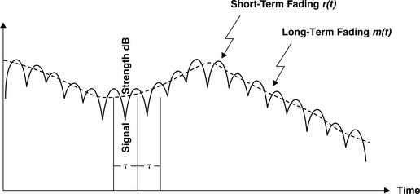
Slow & Fast Fading Propagation
The slow fading is caused by movement over distances large enough to produce gross variations in the overall path between the base station and the mobile station.
Fast fading occurs usually over distances of about half a wavelength.
Notes:
When we focus on a distance of a couple of kilometers, we observe that signal power fluctuates around a mean value and the fluctuations have a somewhat longer period. This is referred to as long-term or slow fading.
When we concentrate and examine the signal power over a few hundred meters, we find that signal power fluctuates more rapidly. These rapid fluctuations are caused by a local multipath. The phenomenon giving rise to these rapid fluctuations is referred to as short-term or fast fading.

Slide 14
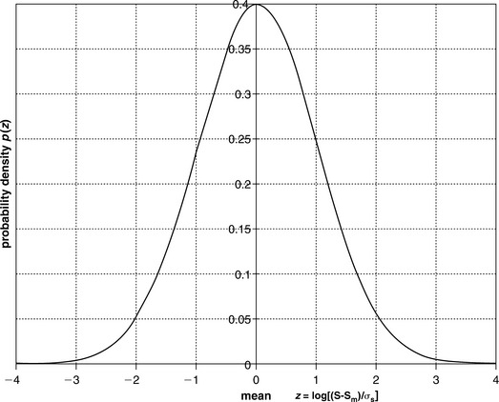
Shadow Effect
Shadow effect is often called lognormal fading because its distribution is represented by lognormal distribution.
Because of shadowing by buildings and other objects, the average within individual small areas also varies from one small area to the next in an apparently random manner, referred to as the shadow effect.

Slide 15

Doppler Shift Modeling
Doppler shift is the random changes in a channel introduced as a result of a mobile user’s mobility.
Doppler spread has the effect of shifting or spreading the frequency components of a signal.
It should also be noted that whenever relative motion exists between transmitter and receiver, there is a Doppler shift in the received signal. The maximum Doppler shift f_{m} is given as:
where:
c = velocity of electromagnetic waves in free space
v = velocity of the moving vehicle
f = frequency of the carrier

Slide 16
Doppler Shift Modeling
Mobility causes time-varying delays (Doppler shift)
• Doppler spread (Ds) : difference between Doppler shifts of multiple signal paths
• If time t change by 1/(2Ds), then the combined received sinusoidal envelope move from peak to valley
• Therefore, the time-variation scale is of the order of 1/Ds
• Coherence time Tc := 1/Ds

Slide 17
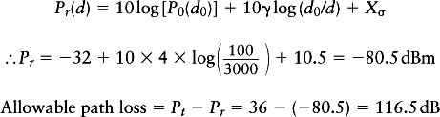
Example
Calculate the received power at a distance of 3 km from the transmitter if the path-loss exponent γ is 4. Assume the transmitting power of 4 W at 1800 MHz, a shadow effect of 10.5 dB, and the power at reference distance (d0 = 100 m) of −32 dBm. What is the allowable path loss?
Using this equation:
Solution:

Slide 18
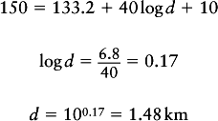
Example
What is the separation distance between the transmitter and the receiver with an allowable path loss of 150 dB and shadow effect of 10 dB? The path loss in dB is given as:
where:
d = separation distance in km
Using this equation:
Solution:

Slide 19
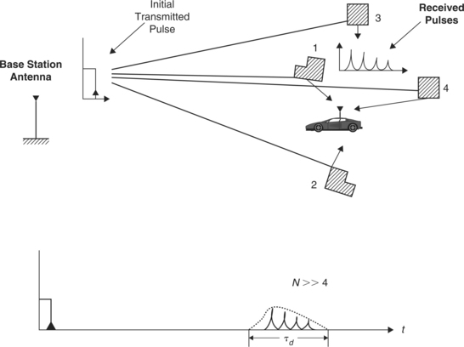
Multipath Fading
Multipath delays occur as a transmitted signal is reflected by objects in the environment between a transmitter and a receiver.
These objects can be buildings, trees, hills, or even trucks and cars.
Notes:
The reflected signals arrive at the receiver with a random phase offset, since each reflected signal generally follows a different path to reach the user’s receiver, resulting in a random signal that fades as the reflections destructively or constructively superimpose on one another. This effectively cancels or adds part of signal energy for brief periods of time. The degree of fading will depend on the delay spread of the reflected signals as embodied by their relative phases, and their relative power.

Slide 20
Time Dispersion
Time dispersion occurs when the channel is band-limited or when the coherence bandwidth of the channel is smaller than the modulation bandwidth.
The time dispersion leads to inter-symbol-interference (ISI), where the energy from one symbol spills over into another symbol, thereby increasing the bit-error-rate (BER).
On the other hand, when there is no dispersion and delay spread is less than the symbol duration, the fading will be flat, thereby affecting all frequencies in the signal equally.
Flat fading can lead to deep fades of more than 30 to 40 dB.

Slide 21

Coherence Bandwidth
The coherence bandwidth (Bc) between two frequency envelopes is given as
Frequency components of a signal separated by more than B_{c} will fade independently. A channel is a frequency-selective channel if B_{c} < B_{w}
In order to avoid channel-induced ISI distortion, the channel is required to be flat fading by ensuring that Bc > Bw.

Slide 22

Coherence Time
The coherence time, Tc, describes the expected time duration over which the impulse response of the channel stays relatively invariant or correlated. The coherence time is approximately inversely proportional to Doppler spread
where:
maximum Doppler spread
v = velocity moving vehicle
= λ = wavelength = c/f
f = frequency of carrier
c = speed of electromagnetic wave in free space (3 × 10⁸ m/s)

Slide 23
Coherence Time
If the transmitted symbol interval, Ts, exceeds Tc, then the channel will change during the symbol interval and symbol distortion will occur.
In such cases, a matched filter is impossible without equalization and correlator losses occur. A Rayleigh fading signal may change amplitude significantly in the interval Tc.

Slide 24
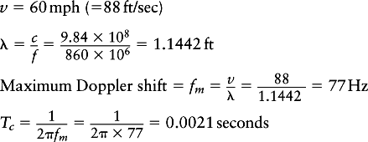

Example
Assuming the speed of a vehicle is equal to 60 mph (88 ft/sec), carrier frequency, fc = 860 MHz, and rms delay spread τd = 2μ sec, calculate coherence time and coherence bandwidth. At a coded symbol rate of 19.2 kbps (IS-95) what kind of symbol distortion will be experienced? What type of fading will be experienced by the IS-95 channel?
The symbol interval is much smaller compared to the channel coherence time. Symbol distortion is, therefore, minimal. In this case fading is slow.
Solution:

Slide 25
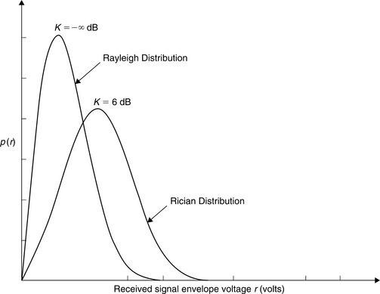
Signal Fading Statistics
Rapid variations (fast fading) in signal power caused by local multipaths are represented by Rayleigh distribution.
The long-term variations in the mean level are denoted by lognormal distribution. With a LOS propagation path, the Rician distribution is often used for fast fading.

Slide 26
The long-term variations in the mean level are denoted by lognormal distribution.

Slide 27
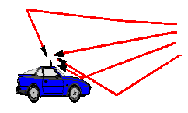
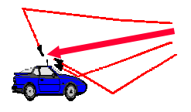
Models for Multipath Fading
Rayleigh fading
• (infinitely) large collection of reflected waves
• Appropriate for macrocells in urban environment
• Simple model leads to powerful mathematical framework
Ricean fading
• (infinitely) large collection of reflected waves plus line-of sight
• Appropriate for micro-cells
• Mathematically more complicated

Slide 28
Propagation Path-Loss Models
Propagation path-loss models play an important role in the design of cellular systems to specify key system parameters such as transmission power, frequency, antenna heights, and so on. Several models have been proposed for cellular systems operating in different environments (indoor, outdoor, urban, suburban, rural).
We discuss two widely used empirical models:
Okumura/Hata and
COST 231 models.

Slide 29
Okumura/Hata Model
Okumura analyzed path-loss characteristics based on a large amount of experimental data collected around Tokyo, Japan
Hata derived empirical formulas for the median path loss (L-50) to fit Okumura curves. Hata’s equations are classified into three models:
Typical Urban
Typical Suburban
Rural

Slide 30

Okumura/Hata Model
1. Typical Urban
where:
a(h_{m}) = correction factor (dB) for mobile antenna height as given by:
• For large cities
• For small and medium-sized cities

Slide 31

Okumura/Hata Model
2. Typical Suburban
3. Rural
where:
f_{c} = carrier frequency (MHz)
d = distance between base station and mobile (km)
h_{b} = base station antenna height (m)
h_{m} = mobile antenna height (m)

Slide 32
The range of parameters for which the Hata model is valid is:
150 ≤ f_{c} ≤ 2200 MHz
30 ≤ h_{b} ≤ 200 m
1 ≤ h_{m} ≤ 10 m
1 ≤ d ≤ 20 km

Slide 33
Cost 231 Model
This model is a combination of empirical and deterministic models for estimating the path loss in an urban area over the frequency range of 800 MHz to 2000 MHz. The model is used primarily in Europe for the GSM 1800 system.
or
Free space loss is given as:
The roof top to street diffraction and scatter loss is given as:

Slide 34
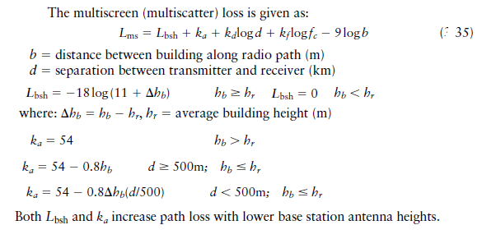
Cost 231 Model

Slide 35

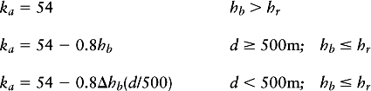
Cost 231 Model
The multiscreen (multiscatter) loss is given as:
where:
b = distance between building along radio path (m)
d = separation between transmitter and receiver (km)
where: Δhb = hb – hr, hr = average building height (m)

Slide 36
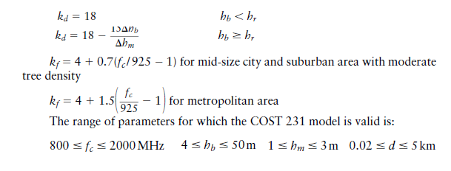
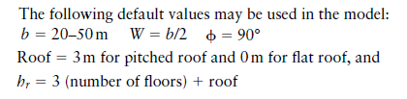
Cost 231 Model
Both Lbsh and ka increase path loss with lower base station antenna heights

Slide 37
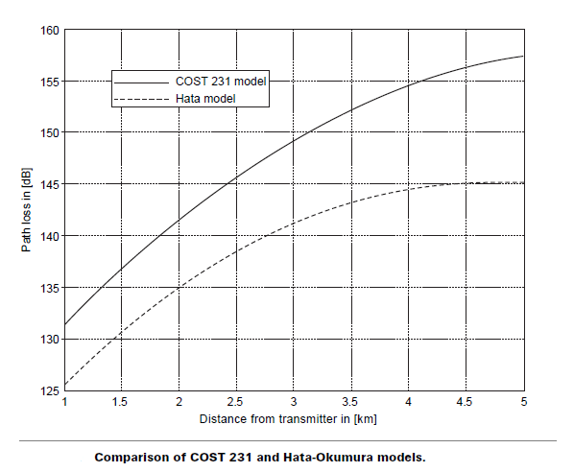
Cost 231 Model

Slide 38
IMT-2000 Models
Used by International Mobile Telecommunication-2000 (IMT-2000) for the indoor office environment, outdoor to indoor pedestrian environment, and vehicular environment.
The key parameters of the IMT-2000 propagation models are:
Delay spread, its structure, and its statistical variation
Geometrical path loss rule (e.g., d−γ, 2 ≤ γ ≤ 5)
Shadow fading margin
Multipath fading characteristics (e.g., Doppler spectrum, Rician vs. Rayleigh for envelope of channels)
Operating radio frequency

Slide 39
IMT-2000 Models
Indoor Office Environment
Outdoor to Indoor and Pedestrian Environment
Vehicular Environment:
where:
d = separation between transmitter and receiver (m)
n = number of floors in the path
Δh_{b} = base station antenna height measured from average roof top level (m)

Slide 40
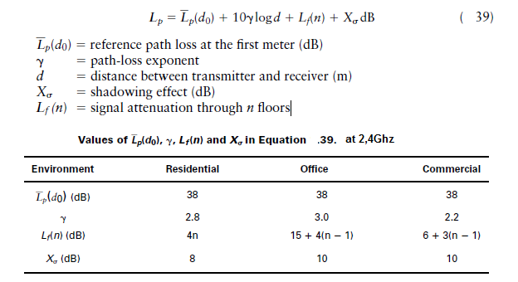
Picocells Indoor Path-Loss Models
Picocells cover part of a building and span from 30 to 100 meters.
The path-loss model for a picocell is given as:

Slide 41
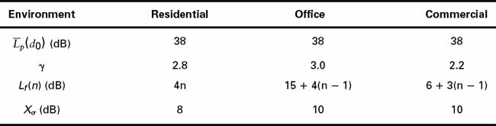
Indoor Path-Loss Models
Picocells cover part of a building and span from 30 to 100 meters . They are used for WLANs and PCSs operating in the indoor environment. The path-loss model for a picocell is given as:
Notes:
where:
p(d0) = reference path loss at the first meter
(dB)γ = path-loss exponentd = distance between transmitter and receiver
(m)Xσ = shadowing effect (dB)
Lf(n) = signal attenuation through n floors

Slide 42

Example
In a WLAN the minimum SNR required is 12 dB for an office environment. The background noise at the operational frequency is −115 dBm. If the mobile terminal transmit power is 100 mW, what is the coverage radius of an access point if there are three floors between the mobile transmitter and the access point?
Transmit power of mobile terminal = 10 log 100 = 20 dBm
Receiver sensitivity = background noise + minimum SNR = −115 + 12 = −103 dB
Maximum allowable path loss = transmit power – receiver sensitivity = 20 –(−103)= 123 dB
(d0) = 38 dB, Lf(n) = 15 + 4(3 −1) = 23 dB, γ = 3, and Xσ = 10 dB
Solution:

Slide 43

Link Margin Calculation
To consider the losses incurred in transmitting a signal from point A to point B, we start by adding all the gains and losses in the link.
The receiver power P_{r} is given as:
where:
Pt is the transmitter power
Gt and Gr are the gains of transmitter and receiver
Lp is the path loss between the transmitter and receiver.

Slide 44
Link Margin Calculation
Finally, there is an effect on signal-to-noise (SNR) ratio due to the quality of the components used in the receiver’s amplifiers, local oscillators (LOs), mixers, etc. The most basic description of a component’s quality is its noise figure, Nf, which is the ratio of the SNR at the input of the device versus the SNR at its output. The overall composite effect of several amplifiers’ noise figures is cumulative, and can be obtained as:
where:
Nfk is the noise figure in stage
kGk = gain of the kth stage.

Slide 45
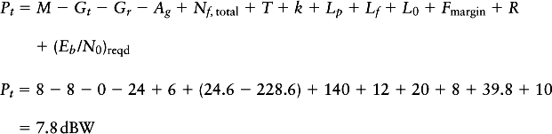
Example
Given a flat rural environment with a path loss of 140 dB, a frequency of 900 MHz, 8 dB transmit antenna gain and 0 dB receive antenna gain, data rate of 9.6 kbps, 12 dB in antenna feed line loss, 20 dB in other losses, a fade margin of 8 dB, a required Eb/N0 of 10 dB, receiver amplifier gain of 24 dB, noise figure total of 6 dB, and a noise temperature of 290K, find the total transmit power required of the transmitter in watts for a link margin of 8 dB.
Lp = 140 dB; Ag = 24 dB; Nf = 6 dB; Fmargin = 8 dB; Gt = 8 dB; Gr = 0 dB;
L0 = 20 dB; Lfeed = 12 dB; T = 24.6 dB; R = 39.8 dB; (Eb/N0)reqd = 10 dB; and M = 8 dB
Solution:

Slide 46
Summary
In this chapter, we discussed propagation and multipath characteristics of a radio channel.
The concepts of delay spread that causes channel dispersion and intersymbol interference were also presented.
Since the mathematical modeling of the propagation of radio waves in a real world environment is complicated, empirical models were developed by several authors.
Various empirical and semi-empirical models used for calculating the path losses in urban, suburban, and rural environments
Doppler spread, coherence bandwidth, and time dispersion were also discussed.

