Slide 1
A presentation on “A Cooperative Learning Scheme for Energy Efficient Routing in Wireless Sensor Networks” presented by Dr Sami Alwakeel and Dr Najla A. AlNabhan at the 2012 11th International Conference on Machine Learning and Applications
By: Mohammed Shahzad
444105788@student.ksu.edu.sa

Slide 2
Contents of this presentation
Introduction to Topic of WSNs
The research on “CEERA”
Introduction
Model environment
CEERA’S learning scheme – The algorithm
Performance evaluation
Conclusion
Concluding thoughts

Slide 3
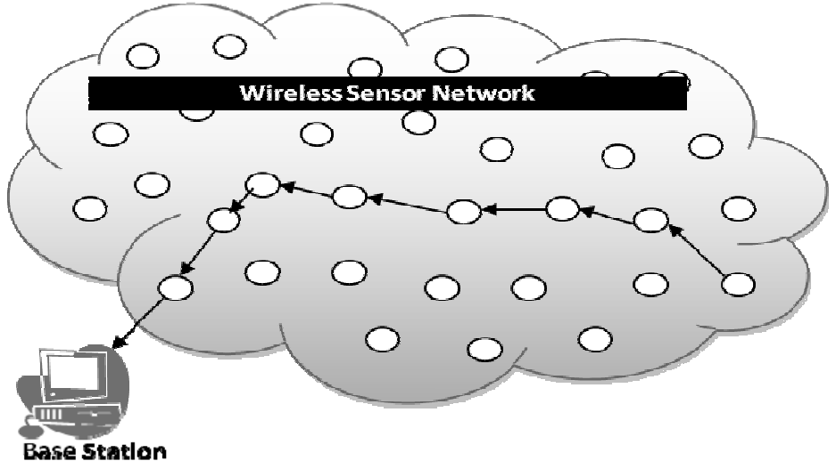
Introduction to Topic of WSNs
A WSN consists of a large number of cooperating devices small-scale nodes with limited computation, and wireless communication capabilities.
In WSNs, a sensor node typically includes:
A sensing unit,
a microcontroller,
a radio transceiver,
battery, or power sources as sensor nodes are constrained by the amount of battery power available
Network lifetime and efficiency are the most considered issues in Wireless sensor networks (WSNs) based systems. The scarcest resource being energy.
Figure: A Wireless sensor network

Slide 4
The research paper “CEERA”(1)
Section 1 of 5 – Introduction
In WSNs, it is necessary to conserve individual node energy to maximize system life.
Introducing CCERA: A novel design for a cooperative energy-efficient routing algorithm (CEERA) for WSNs.
The algorithm efficiently avoids the energy consumption problem as it does not require any prior configuration or routing discovery operations.

Slide 5
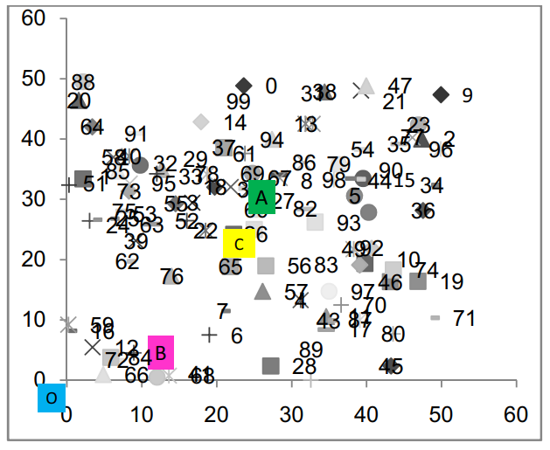
The research paper “CEERA”(2)
Section 2 of 5 – Model environment
We now look at the network model and other related models, including: deployment, traffic, and energy models.
A. Network Model: Data being sensed by the nodes in the network must be transmitted to a control center or a Base Station (BS).
B. Deployment Model: Deployment is either random or deterministic.
C. Traffic Model: The inter-arrival time between messages is network dependent.
Fig: The random network topology and multiple locations of the BS are shown.

Slide 6
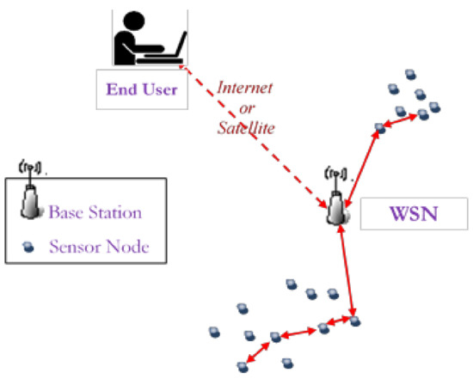
The research paper “CEERA”(3)
Section 2 of 5 – Model environment
We now look at the network model and other related models, including: Performance, traffic, and energy models.
D. Energy Model: An important consideration in sensor networks is the amount of energy required for sensing, computation, and communication.
F. Performance Measures: Their Main performance measures are: Throughput, Delay, Delay time jitter, total energy dissipations, no of dead nodes
Figure: WSN use case

Slide 7
The research paper “CEERA”(4)
Section 3 of 5 – CEERA’S learning scheme – The algorithm
In Cooperative transmission, each transient node ‘t’ that receives the packet will carry out the following steps:
1) Calculates the ID difference.
2) Starts a timer counter.
3) Listens to BS’s ACK, and periodically decrements its timer.

Slide 8
The research paper “CEERA”(5)
Section 3 of 5 – CEERA’S learning scheme – The algorithm
If the BS acknowledgment is not received within the timer value, the transient node retransmit message and appends its address to the address list of transient nodes.
This process is repeated by every transient node until BS acknowledgement (ACK) is received.
Upon receiving the ACK, all nodes clear the call and reset their counters.

Slide 9
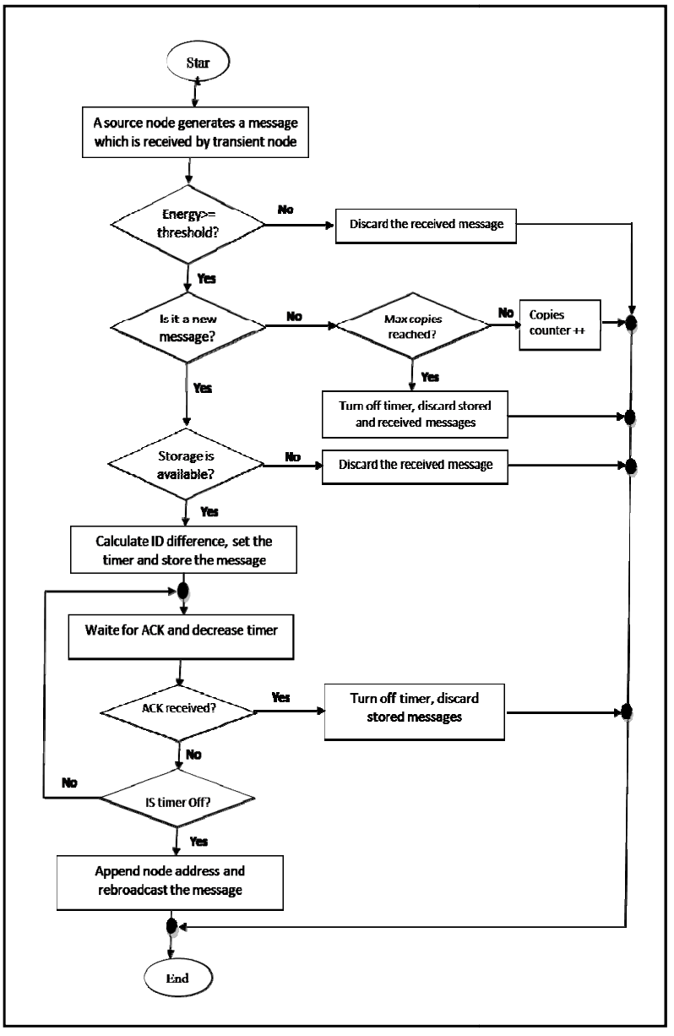
The research paper “CEERA”(6)
Section 3 of 5 – CEERA’S learning scheme – The algorithm
Steps:
Start: Start of algorithm
Source node generates message and is received by transient nodes
Check: Energy Greater than or equal to threshold; Yes: Next, No: Discard
Check: Is it new message? Yes: check: Max copies reached?
Yes: Discard , No: Next; No: Discard
Check: Storage available Yes: Next, No: Discard
Calculate ID difference, set timer, store message
Fig: The flowchart of CEERA

Slide 10
The research paper “CEERA”(7)
Section 3 of 5 – CEERA’S learning scheme – The algorithm
Steps:
Wait for acknowledgement ACK and decrease timer
Check: Acknowledgement received? Yes: Turn of timer, discard No: next
Check: Is timer off? Yes: Rebroadcast message and append node address, No: Step 7
End
Fig: The flowchart of CEERA

Slide 11
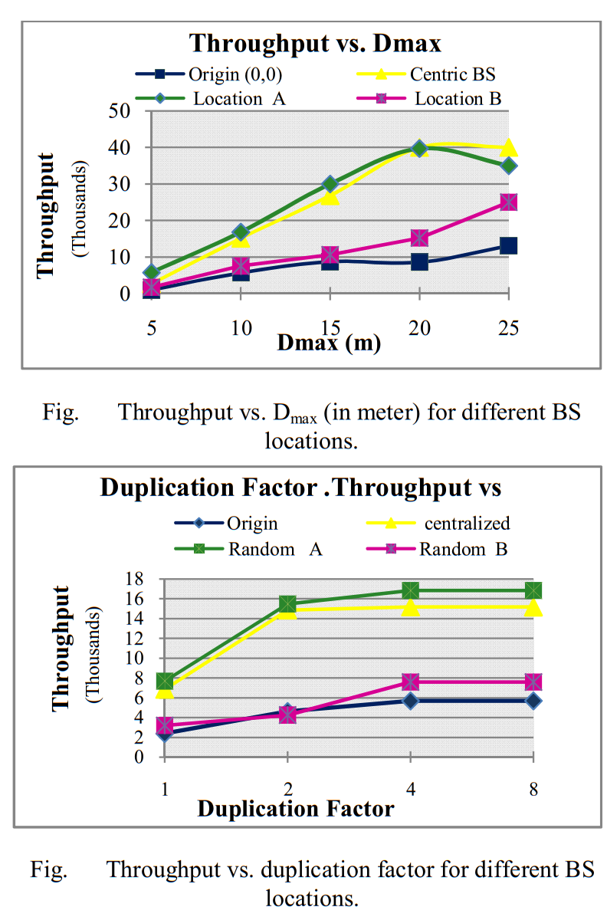
The research paper “CEERA”(8)
Section 4 of 5 – Performance evaluation
The researchers implemented their own event-driven simulation written in C++
They studied the impact of varying the scalar factor, Dmax, buffer size, and duplication factor.
The performance was measured for Throughput delay, DTJ, memory occupation per node, energy dissipation, per initial energy, no. of died nodes, and duplicated arrivals.

Slide 12
The research paper “CEERA”(8)
Section 4 of 5 – Performance evaluation
The resultant analysis reiterated a significant improvement in energy usage in routing with CEERA.
CEERA outperforms Flooding 15, 27, and 41 times.
Also, CEERA achieves over a factor of 1.34 and 1.26 reduction in energy dissipation.

Slide 13
The research paper “CEERA”(9)
Section 5 of 5 – Conclusion
The paper suggests future work that can optimize existing algorithm which includes:
CEERA introducing zero scalar factor for key nodes (BS neighbours),
Finding a method for optimal factors selection and evaluation,
Incorporating data aggregation to minimize energy dissipation and allowing node mobility.

Slide 14
Concluding thoughts
Routing in sensor networks is a promising research area.
Applications of WSNs show how it is important to design protocols and algorithms for wireless networks to be intelligent in bandwidth and energy consumption.
All in all, this paper concluded with future research topics which will help researchers interested in the field to carry on the idea and make further research contributions.

Slide 15
Thank You

