Slide 1
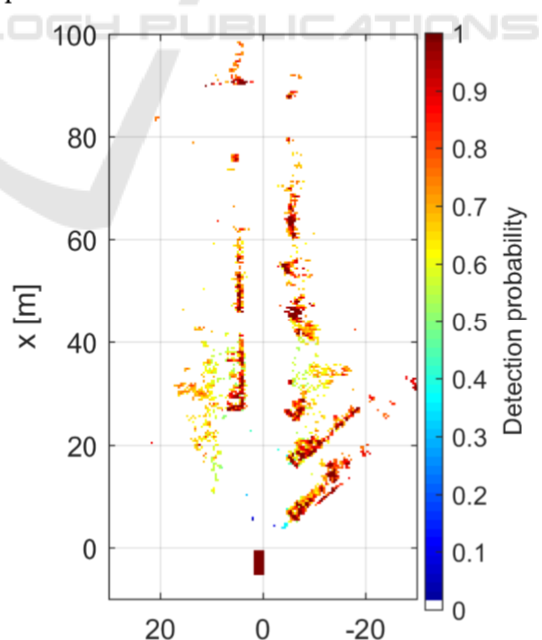
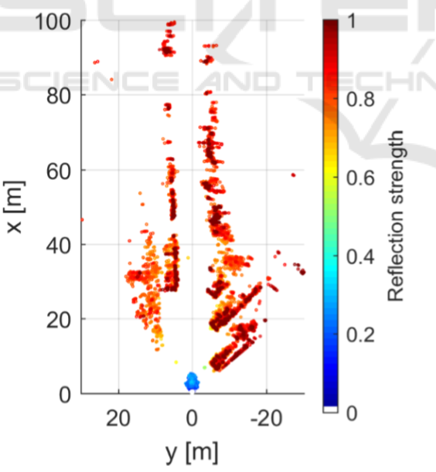
GRID-BASED DBSCAN

Slide 2
???
3D vs 2D projection?
Grid size?
  Will be clear with the real data
Free space detection (!)
  Again: real data
Video data to verify?

