Slide 1
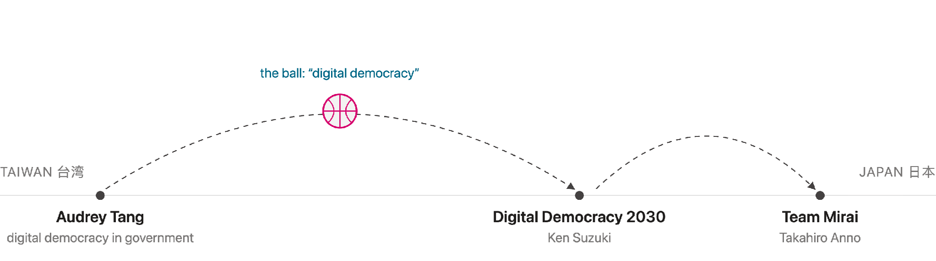
未来から現在へ、そしてもう一度未来へ
Taiwan's present, after touching the future
“After working with Audrey Tang, I felt like I was working in the future. After facing institutional reality, I felt I had returned to the present. Being here in Japan feels like Back to the Future.”
Yen-Lin Huang mashbean — Taiwan civic tech → government → platform governance → digital identity
Notes:
Hi everyone. I'm Yen-Lin Huang, also known as mashbean. I started in Taiwan's civic tech community, then worked in the Taiwanese government, and after leaving I kept working on platform governance, censorship resistance, public deliberation, and digital identity. I was worried I might say too much in five minutes, so yes, I prepared a script — my first governance mechanism for myself today. Working with Audrey Tang felt like working in the future; institutional reality brought me back to the present; being here with MetaGov feels like Back to the Future. If the future is a basketball, the ball has been passed from Audrey's hands to Japan — Ken Suzuki and Digital Democracy 2030, Anno-san and Team Mirai. So instead of describing Taiwan as the future, I want to talk about Taiwan's present: the problems that remain. I call them gates.

Slide 2
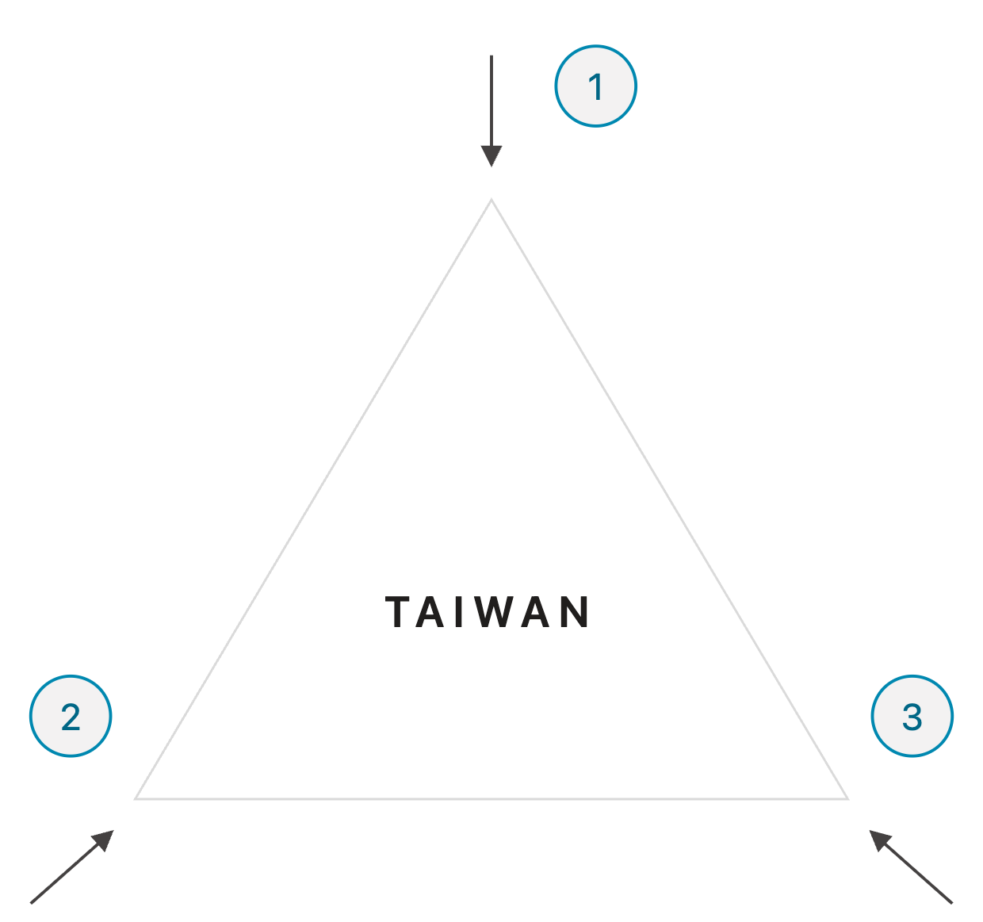
Taiwan's digital environment: three forces at once
分極化 / 情報操作 / 市民テック
1 Polarized public discourse
Food safety, housing, elections, identity — the same facts produce different realities. Online debate turns ineffective fast.
2 External manipulation and cyber pressure
Information operations make people doubt authenticity itself: genuine advocates can be mistaken for “coordinated actors,” and the whole policy debate gets contaminated.
3 High-capacity civic technologists
g0v, vTaiwan, Cofacts, civic hackers, AI-agent experiments. A small community with real effects — and in the AI era, tools get built very quickly.
Notes:
For people less familiar with Taiwan, here is the background. First, Taiwan is politically polarized — public discourse becomes ineffective very quickly in digital spaces. Just last weekend, opposition parties mobilized a large protest over tainted cooking oil; people with different political orientations saw almost entirely different versions of the same issue. Second, Taiwan faces massive cyberattacks and information manipulation, which makes people doubt the authenticity of other people's positions — housing advocates get amplified by coordinated actors, then get suspected of BEING an information operation. The debate becomes contaminated. Third, Taiwan has a very capable group of civic technologists — small community, often surprisingly effective, and in the age of AI agents, tools get built fast. Polarization, external threat, civic tech capacity: these three define the environment.

Slide 3
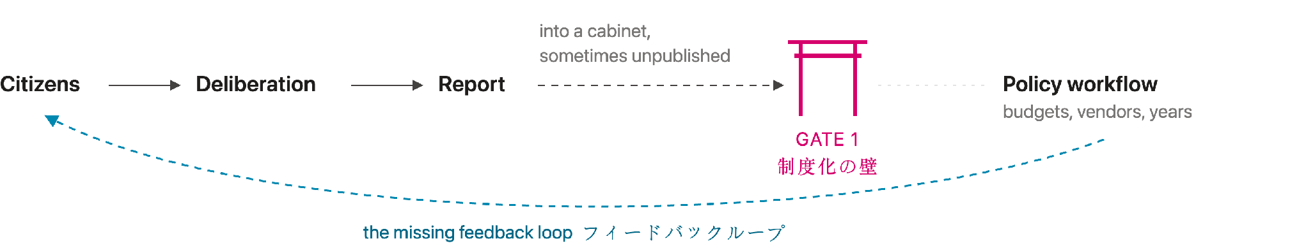
Gate 1: tools do not automatically create feedback loops
制度化の壁 / フィードバックループ
Government experiments I saw
Insight
Polis — Computational Democracy Project
Leadership matters before deliberation becomes procedure. Fancy tools can improve access and summarization — they cannot replace institutional uptake. The missing piece is the feedback loop.
Talk to the City — AI Objectives Institute
Online Deliberative Platform — Stanford DDL
Service-design deliberation workshops
Notes:
When I was in government, I was a decentralized architect in the Section of Plurality at the Ministry of Digital Affairs. Our goal was co-presence: people thinking and acting together. We used Polis, Talk to the City, Stanford's Online Deliberative Platform, and ran service-design deliberation workshops with ministries, experts and citizens — trying to create feedback loops EARLY in policymaking, when input can still improve the policy rather than decorate it. But here is the first gate: institutional uptake. Tools disappear when political leadership changes. Public input becomes text in a report; the report goes into a cabinet; sometimes it is never published. Insight one: leadership matters — early insights are messy and need ministers to make technocrats take them seriously. Insight two: fancy tools solve access and summarization, but cannot by themselves create the feedback loop.

Slide 4
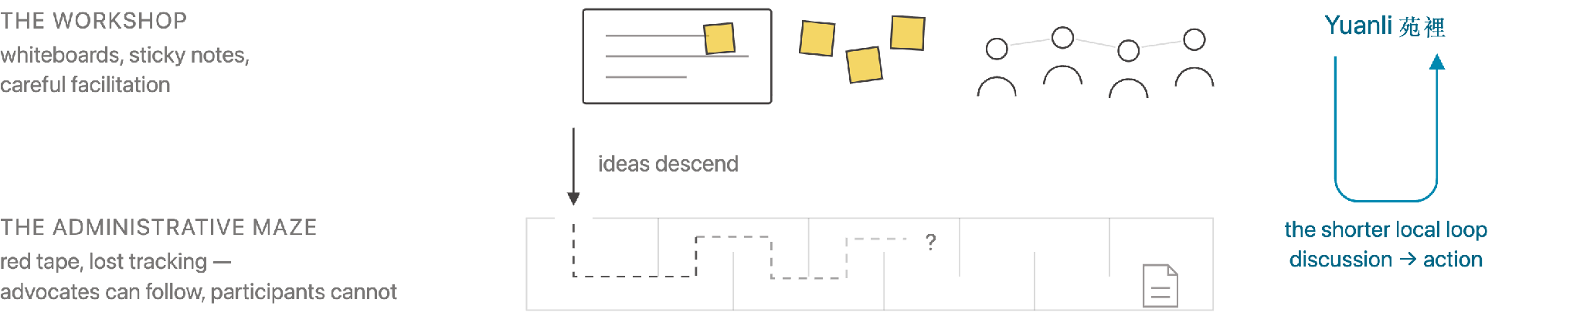
Gate 2: participation without follow-through becomes tokenism
参加の形骸化 / 実装への距離
Taiwan has a long deliberative-democracy tradition and a unique youth-facilitator ecosystem. Many youth deliberation events use simple tools: whiteboards, sticky notes, transcripts, careful facilitation.
Hopeful signs
Youth Basic Act — passed last year; law, not yet practice
National Youth Conference
Children's participatory budgeting in Yuanli 苑裡
The problem: after the event, ideas enter administrative red tape. Professional advocates may track them. Ordinary participants usually cannot.
Notes:
Another gate is tokenism: inviting people to participate while not taking their views seriously. I served on the Executive Yuan Youth Advisory Committee and on the preparatory committee for the National Youth Conference. Taiwan has a unique ecosystem of youth facilitators; deliberative events use simple tools — whiteboards, sticky notes, long conversations, transcripts — and the energy is real. But afterwards, ideas disappear into administrative red tape. Professional advocates can track what happens; ordinary participants cannot. The problem is structural: costly for officials to turn ideas into policy, costly for participants to keep following. Hopeful signs: the Youth Basic Act passed last year — the question is how it moves from law to practice. And smaller local experiments may work better: in Yuanli, children ran a participatory budget. Modest scale, but precisely because it is modest, the loop between discussion and action is clearer.

Slide 5
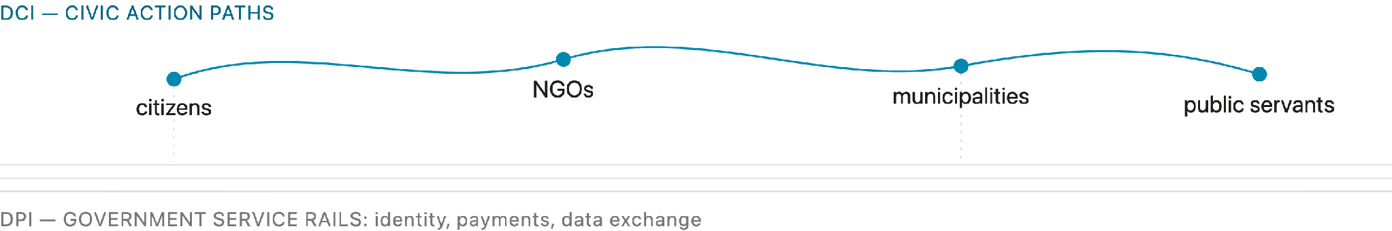
From DPI to DCI: civic agency, not just government service
市民の能動性 / Civic agency
Digital Public Infrastructure
Digital Civic Infrastructure
Government services: identity, payments, data exchange, administrative efficiency. The state's rails, built for delivery.
Connection, learning, deliberation, action. Tools that help citizens and public servants move together — civic agency as the design goal.
Allen Lab observation: useful tools do not always need to be fancy. If they help key actors move one step further, they can already sustain meaningful deliberation.
Notes:
This connects to what I've observed at Harvard Kennedy School's Allen Lab as a Policy Fellow. Danielle Allen's idea of Digital Civic Infrastructure is useful here. Digital Public Infrastructure usually focuses on government services — identity, payments, data exchange, administrative efficiency. Digital Civic Infrastructure asks how digital tools strengthen civic agency: how people connect, learn, deliberate, and act together. My insight: useful tools do not always need to be fancy. If a tool helps key actors inside government or civil society move one step further, that may already be enough to sustain a meaningful experiment.

Slide 6
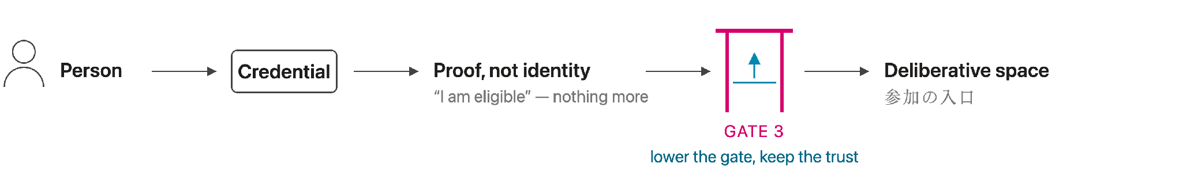
Gate 3: digital identity can build trust, but it is also a gate
信頼 / プライバシー / 参加の入口
In Taiwan, online deliberation must deal with manipulation, spam, and distrust. At Matters , an anti-censorship community platform, anonymity protects whistleblowers — and creates moderation pressure.
Can people prove what matters without exposing who they are?
a resident · an affected person · a member of a political community · an eligible participant
Taiwan is difficult. That is why it is interesting — polarization, external threat, and civic tech capacity make it a test site for new deliberation tools, policy processes, and digital trust.
Notes:
Finally, one issue often missing from deliberation discussions: digital identity. Safe deliberative spaces online need participants to trust each other — especially in Taiwan, where external manipulation is intense. This year I've been General Manager of Matters, an anti-censorship community platform. Anonymity protects whistleblowers — during major Hong Kong events, Matters hosted many important writings — but it also means heavy attacks: every day we filter spam and coordinated abuse while trying not to harm real whistleblowers. So privacy-preserving digital identity is crucial: people should not need to reveal personal data, but may need to prove qualifications — being a resident, being affected, being part of a political community. But identity is also a gate: verification can block participation. The design challenge is lowering the gate while keeping the trust. To close: polarization, external threat, civic tech capacity. Taiwan is difficult — that is why it is interesting. New tools, new policy processes, and new forms of digital trust may emerge there. Thank you.

