Slide 1

CSE445 MACHINE LEARNING • GROUP 5
Face Recognition Using Machine Learning:
Models, Accuracy & Real-Time Detection
Mehedi Hasan Dip (ID: 2232167042) Sayef Ali Khan (ID: 2321942642)
Group 5 • Mehedi Hasan Dip • Sayef Ali Khan
1
Notes:
[Both members] Introduce yourselves by full name, Group 5, CSE445, then go straight in.

Slide 2

Requirements
Matplotlib
NumPy
OpenCV-Python_headless
Pandas
Scikit-learn
Group 5 • Mehedi Hasan Dip • Sayef Ali Khan
2
Notes:
Explain the shared preprocessing quickly, then the three models in one line each: KNN=nearest match, SVM=best boundary, RF=voting trees.

Slide 3
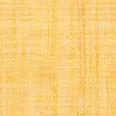
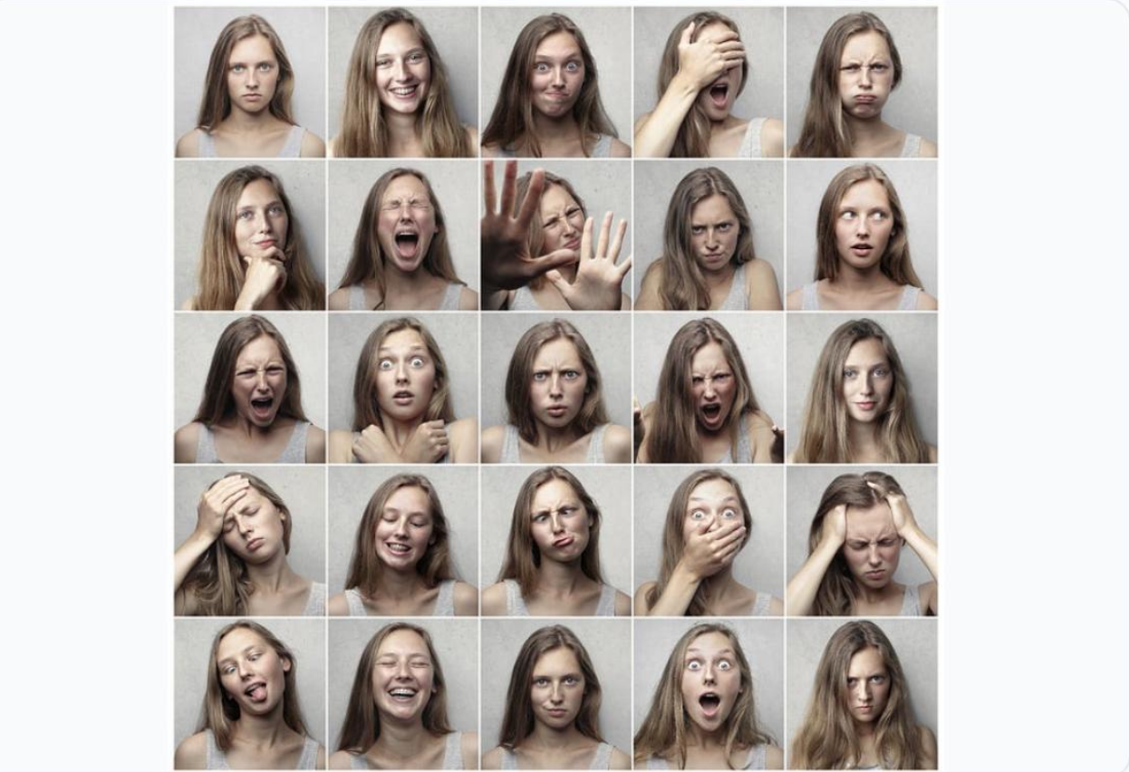

Data Preparation
Olivetti (AT&T) Faces Dataset
Data Source: Loaded directly via scikit-learn's fetch_olivetti_faces ().
Scope Selected: Extracted first 10 subjects (100 grayscale
images, 64×64 pixels) exhibiting varying facial expressions, lighting, and accessories.
Disk Structuring: Converted to 8-bit JPG files and saved in
structured per-subject directories (e.g., person_00/, person 01/).
Design Logic: Mirrors real-world directory structures and enables true OpenCV image file I/O rather than relying solely on in-
memory arrays.
Group 5 • Mehedi Hasan Dip • Sayef Ali Khan
3
Notes:
Explain the shared preprocessing quickly, then the three models in one line each: KNN=nearest match, SVM=best boundary, RF=voting trees.

Slide 4
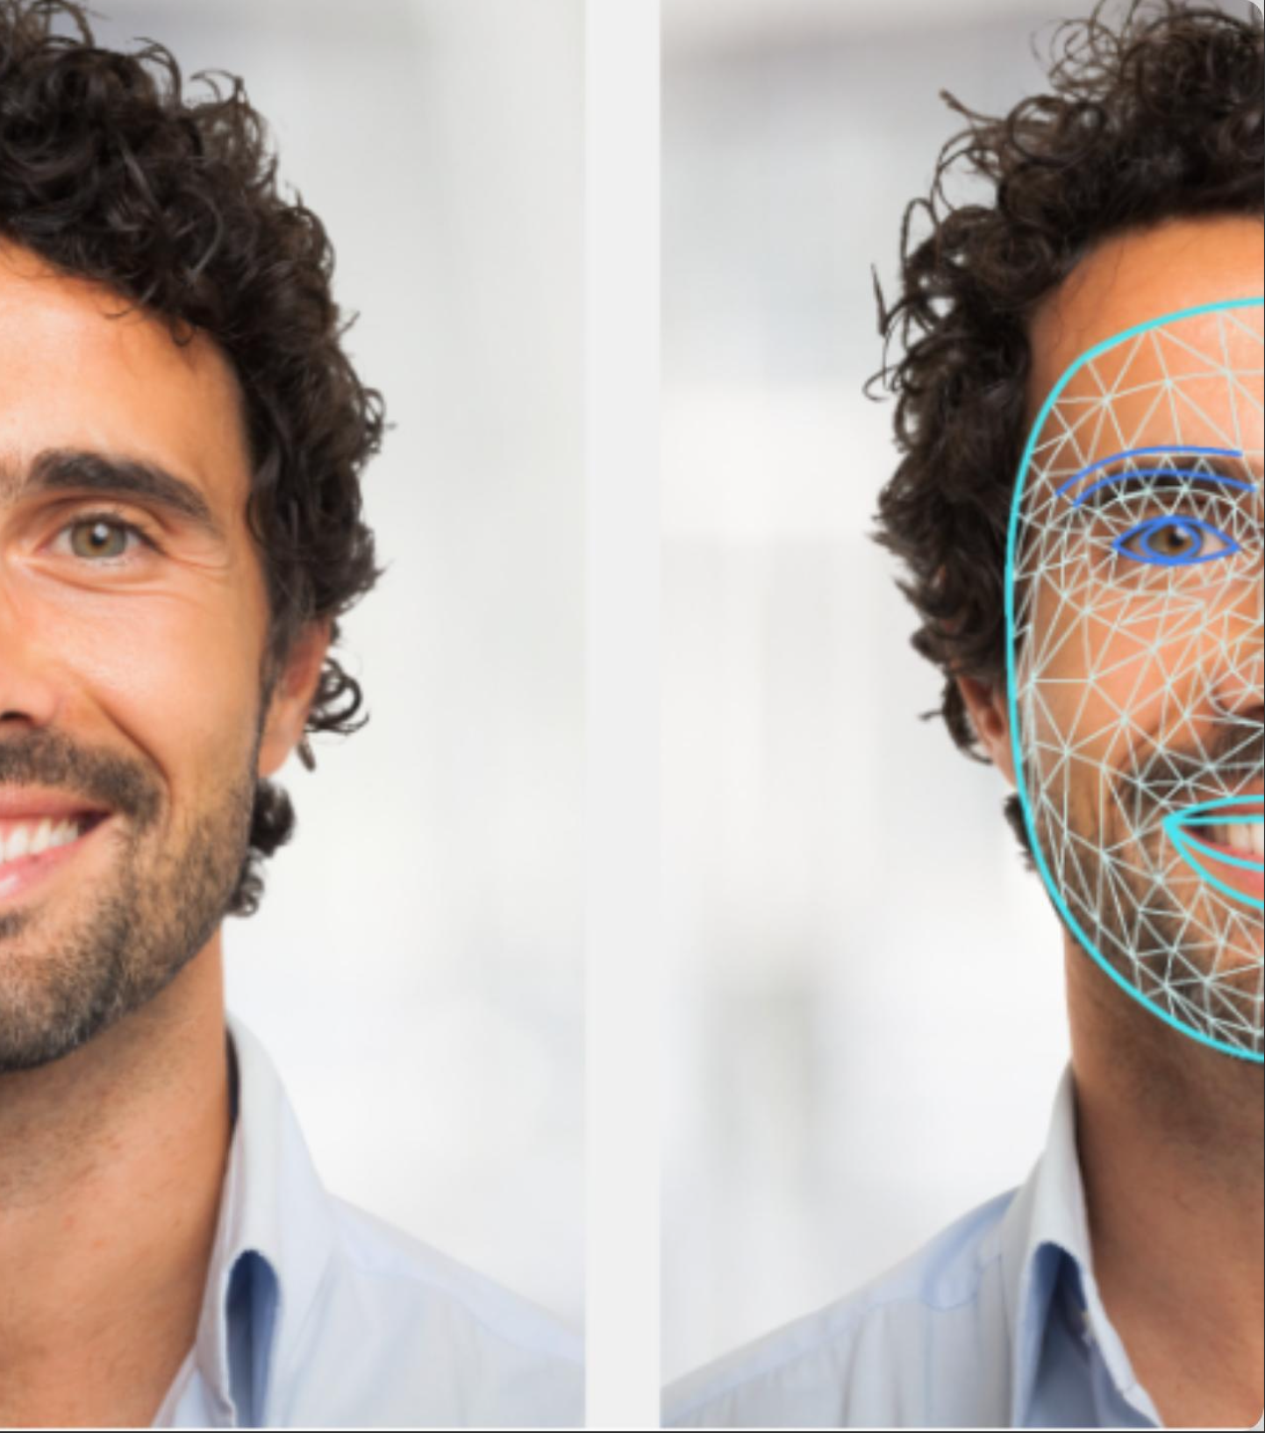
Data Preprocessing
1. Face Detection: Haar Cascade classifier locates face bounding box.
2. Cropping &Resizing: Resized to standard 64×64 pixels for fixed vector lengths.
3. Histogram Equalization: cv2.equalizeHist() reduces lighting variance.
4. Normalization &Flattening: Scaled to [0,1] range &flattened to 4096-d feature vector.
Feature matrix X (100 × 4096) and label vector y stored for reuse.
Output
Group 5 • Mehedi Hasan Dip • Sayef Ali Khan
4
Notes:
Explain the shared preprocessing quickly, then the three models in one line each: KNN=nearest match, SVM=best boundary, RF=voting trees.

Slide 5
Train/Test Split
Stratified Sampling Strategy
Dataset partitioned into a 70% Training Set and 30% Held-Out Test Set using scikit-learn's train_test_split(stratify=y).
70/30
Stratified Ratio
Rationale &Design Logic:
With only 10 images per subject, random splitting risks under-
representing certain identities in the test set. Stratification guarantees exactly 7 train images and 3 test images per subject, ensuring fair evaluation across all 10 identities
Group 5 • Mehedi Hasan Dip • Sayef Ali Khan
5
Notes:
Explain the shared preprocessing quickly, then the three models in one line each: KNN=nearest match, SVM=best boundary, RF=voting trees.

Slide 6
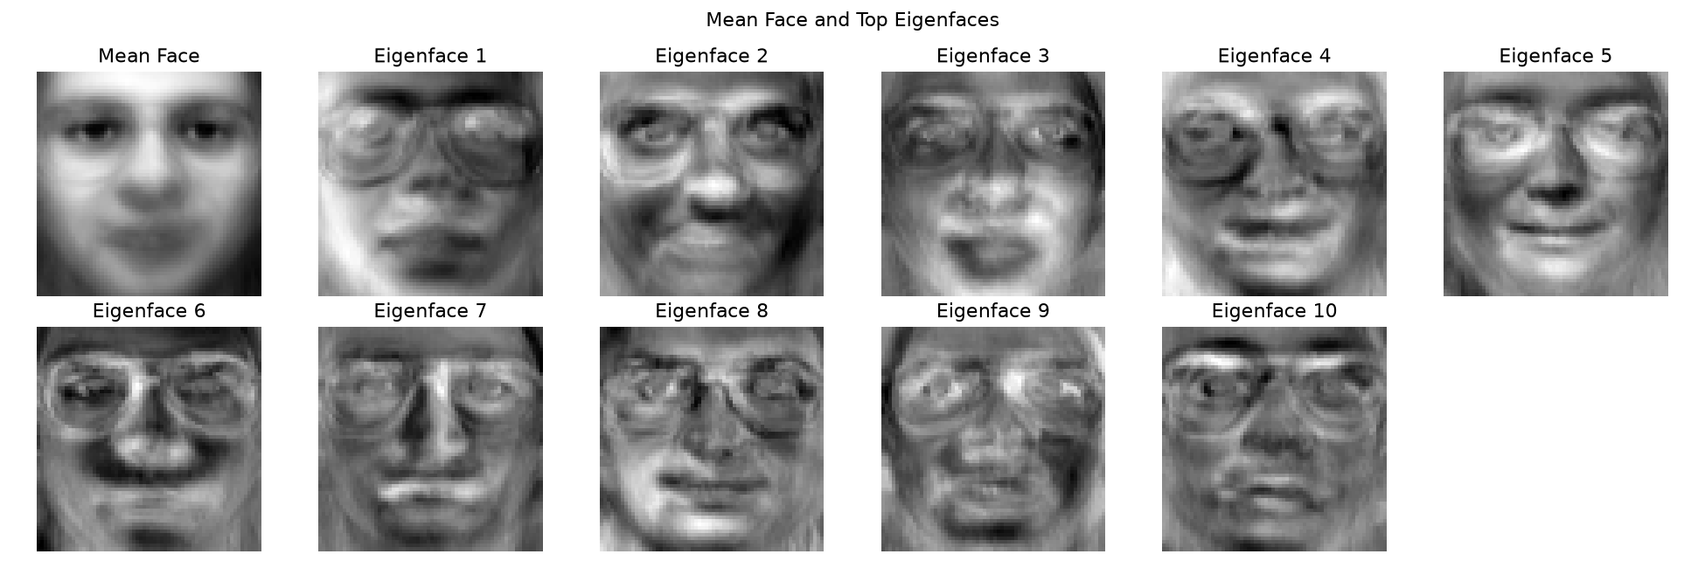
Feature Extraction
Principal Component Analysis (PCA)
Overfitting Risk: Preprocessed 64×64 images yield 4,096-dimensional vectors. Training with only 70 images would cause severe overfitting.
Variance Retention: PCA was fit strictly on the training set to compress vectors while retaining 95% of total variance.
Compression Ratio: Reduced to 42 components, achieving a 97.5× reduction in dimensionality.
Design Choice: Unsupervised, computationally fast, prevents overfitting, and provides clear visual artifacts for report evaluation.
Group 5 • Mehedi Hasan Dip • Sayef Ali Khan
6
Notes:
Explain the shared preprocessing quickly, then the three models in one line each: KNN=nearest match, SVM=best boundary, RF=voting trees.

Slide 7

MODELS & IMPLEMENTATION
Three Classical ML Models, One Feature Pipeline
Every face is reduced to the same feature vector before classification:
Resize
50×50px
Histogram
Equalize
Flatten +
Normalize
K-Nearest Neighbors (KNN)
Support Vector Machine (SVM)
Random Forest
Classifies a face by the label of its closest match (Euclidean distance) among all training samples.
Linear-kernel classifier that finds the best-separating boundary between each pair of identities.
An ensemble of 100 decision trees; each tree votes and the majority label wins.
All three trained and compared using scikit-learn, with stratified train/test splitting and 5-fold cross-validation.
Group 5 • Mehedi Hasan Dip • Sayef Ali Khan
7
Notes:
Explain the shared preprocessing quickly, then the three models in one line each: KNN=nearest match, SVM=best boundary, RF=voting trees.

Slide 8
EVALUATION METRICS
Accuracy, Precision, Recall & F1 Score
Measured on a held-out 20% test set (2 images per person, never seen during training):
Model | Accuracy | Precision | Recall | F1 Score
KNN (K=3) | 95.00% | 96.67% | 95.00% | 94.67%
SVM (linear) | 100.00% | 100.00% | 100.00% | 100.00%
Random Forest | 100.00% | 100.00% | 100.00% | 100.00%
Also checked with 5-fold cross-validation (all 100 images): KNN 96.00% ± 3.74%, SVM 99.00% ± 2.00%, Random Forest 100.00% ± 0.00% — consistent with the table above.
Group 5 • Mehedi Hasan Dip • Sayef Ali Khan
8
Notes:
Read the table plainly: KNN made one mistake out of 20, SVM and RF made zero. Mention the 5-fold cross-validation numbers confirm the same ranking.

Slide 9
MODEL COMPARISON
Which Model Performs Best?
Verdict
Random Forest and SVM tie for the best raw performance — 100% on every metric. KNN is slightly behind (95% accuracy) but is the one we actually deploy for live detection — it gives a distance value that lets the system say “Unknown” for a stranger, which SVM and RF cannot do directly.
Group 5 • Mehedi Hasan Dip • Sayef Ali Khan
9
Notes:
Point at the chart: RF and SVM bars are all at 100. Then explain the twist — we still use KNN live because of the distance-based Unknown detection, not because it scored highest. This is the key insight of the whole project.

Slide 10


REAL-TIME DETECTION
How Recognition Works Through the Webcam
1. Detect
2. Preprocess
3. Match
4. Decide
5. Confirm
Haar Cascade finds the face region in each video frame.
Resize + equalize + normalize — same pipeline as training.
KNN (K=1) finds the closest trained face by distance.
If the distance is within that person's threshold → accept. Otherwise → Unknown.
Needs 5 of the last 8 frames to agree before showing a final label.
Green = confirmed match
Yellow = checking
Red = Unknown face
Group 5 • Mehedi Hasan Dip • Sayef Ali Khan
10
Notes:
Walk the five stages left to right, then point at the color legend — this is exactly what appears on screen during the live webcam demo.

Slide 11




STRENGTHS
Advantages
Fully automatic
Knows what it doesn't know
Lightweight
No manual input needed once trained.
Strangers get “Unknown”, not a wrong guess.
Classical ML — no GPU or deep learning needed.
Stable output
High accuracy
Explainable
Frame-voting removes flickering predictions.
Up to 100% on the evaluated test data.
Every decision has a clear distance value behind it.
Group 5 • Mehedi Hasan Dip • Sayef Ali Khan
11
Notes:
Pick 3 of these six to say out loud rather than reading all six.

Slide 12





HONEST LIMITS
Disadvantages & Limitations
Trained/tested on the ORL benchmark dataset, not real-world faces collected by us.
Works best on clear, front-facing images — accuracy may drop with side angles or poor lighting.
Haar Cascade can miss faces in poor lighting or unusual poses.
Fixed enrollment — adding a new person currently means retraining the model.
No liveness check — a printed photo or phone screen can, in principle, be accepted.
Some thresholds were tuned by hand rather than learned automatically.
Group 5 • Mehedi Hasan Dip • Sayef Ali Khan
12
Notes:
Pick 2-3 to say clearly: not real-world data, no liveness check, manual threshold tuning.

Slide 13


PROBLEMS WE FACED
Challenges & How We Overcame Them
Every stranger got matched to the nearest known person
The predicted label kept flipping between frames
Fix: Added a distance threshold per person, calibrated against 30 unseen “stranger” identities.
Fix: Added an 8-frame voting buffer — needs 5 matching votes before committing to an answer.
Phone-screen photos looked different from real webcam faces
Limited time meant the original plan included voice recognition too
Fix: Built a calibration tool to collect phone-camera samples and retrained on both versions.
Fix: Dropped the voice part early to focus fully on making face recognition reliable.
Group 5 • Mehedi Hasan Dip • Sayef Ali Khan
13
Notes:
For each card: state the problem in one sentence, then the fix in one sentence.

Slide 14


WHAT'S NEXT
Future Work
Real-world data
Liveness detection
Train and test on real faces collected under real conditions.
Add blink/motion checks so a photo alone can't fool the system.
Deep-learning embeddings
Automatic threshold tuning
Use models like FaceNet for stronger accuracy in varied conditions.
Learn each person's distance threshold instead of manual calibration.
Group 5 • Mehedi Hasan Dip • Sayef Ali Khan
14
Notes:
Mention these four directions quickly, then thank the audience.

Slide 15
Thank You
Any Questions?
Group 5 • Mehedi Hasan Dip • Sayef Ali Khan
15
Notes:
Mention these four directions quickly, then thank the audience.

