Slide 1
AgentCore Tutorial — System Architecture
What gets built at each level: single agent → multi-agent A2A → external tools via MCP Gateway

Slide 2
Overview
From zero to a production-grade multi-agent research system.
• Deploy agents to AgentCore Runtime
• Wire them together using the A2A protocol
• Extend them with external tools via MCP Gateway

Slide 3
Overall System — Production Multi-Agent Research
End state after Tutorial 04: orchestrator delegates to a specialist, which reaches external tools through one gateway.
PubMed API
OpenAPI target
AgentCore Runtime (managed, SigV4-secured)
Client
agentcore invoke
JSON-RPC 2.0
Orchestrator
A2A Server :9000
routes / delegates
Search Specialist
A2A Server :9000
tool composition
MCP Gateway
IAM SigV4 auth
semantic discovery
Citation Mgr
Lambda (SAM)
invoke
A2A
Paper Summaries
MCP Server
MCP
Amazon Bedrock
Claude Haiku 4.5 (au. inference profile)
Agent
Runtime
Gateway
Tool/Lambda
External API
Bedrock model

Slide 4
Workshop Modules
01 Getting Started
Set up AWS credentials, install the AgentCore Starter Toolkit, verify your environment
02 Your First Agent
Build and deploy a research assistant using Strands and BedrockAgentCoreApp
03 Multi-Agent Coordination
Orchestrator + search specialist system using the A2A protocol
04 Research Tools
Extend agents with external APIs (PubMed), Lambda, and MCP servers via Gateway

Slide 5
Tutorial 02 — Your First Agent
simple_agent.py: a single Strands agent wrapped by BedrockAgentCoreApp, deployed to AgentCore Runtime.
AgentCore Runtime
/invocations /ping
BedrockAgentCoreApp
@app.entrypoint
Strands Agent
research assistant
system prompt
Amazon Bedrock
Claude Haiku 4.5
au.anthropic...haiku-4-5
Client
{ "query": ... }
→ { "response" }
payload
handle_query
LLM call
Single-agent pattern • HTTP entrypoint auto-served on :8080 • stateless request/response • deployed with agentcore deploy
Client
AgentCore Runtime
Strands Agent
Bedrock model

Slide 6
Tutorial 03 — Multi-Agent Coordination (A2A)
Orchestrator answers simple queries directly; delegates research to the Search Specialist over the A2A protocol.
Orchestrator Agent
A2A Server :9000
agent-card.json
@tool search_specialist
→ direct answer (simple)
Search Specialist
A2A Server :9000
agent-card.json
@tool web_search (mock)
NullConversationMgr
Client
JSON-RPC
message/send
A2A Protocol
SigV4HttpxAuth (IAM)
A2ACardResolver + Client
invoke
delegate
send_message
Both agents on
AgentCore Runtime
Amazon Bedrock — Claude Haiku 4.5
AGENTCORE_RUNTIME_URL
SEARCH_SPECIALIST_URL
A2A Agent
A2A transport / SigV4
Bedrock model

Slide 7
Tutorial 04 — Research Tools via MCP Gateway
The Search Specialist discovers tools from one IAM-secured MCP Gateway fronting three target types.
PubMed Target
OpenAPI schema (S3)
pubmed___searchPubMed
PubMed REST API
ncbi.nlm.nih.gov
discover/call
MCP Gateway
(AgentCore)
• IAM SigV4 auth
• SEMANTIC discovery
• rate limit / transform
• error handling
Search Specialist
@tool web_search
MCPClient
(aws_iam_streamablehttp)
Citation Manager
Lambda target (SAM)
APA / MLA / Chicago
AWS Lambda
citation-manager-dev
Paper Summaries
MCP server target
FastMCP on Runtime
FastMCP Server
AgentCore Runtime
Agent
MCP Gateway
OpenAPI / External
Lambda / MCP

Slide 8
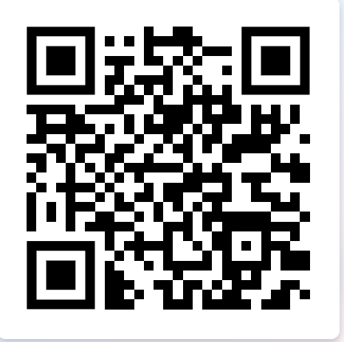
Prerequisites
• Python 3.11+
• AWS account with admin access and Bedrock model access enabled
• AWS CLI configured (aws configure)
• uv package manager

