Slide 1

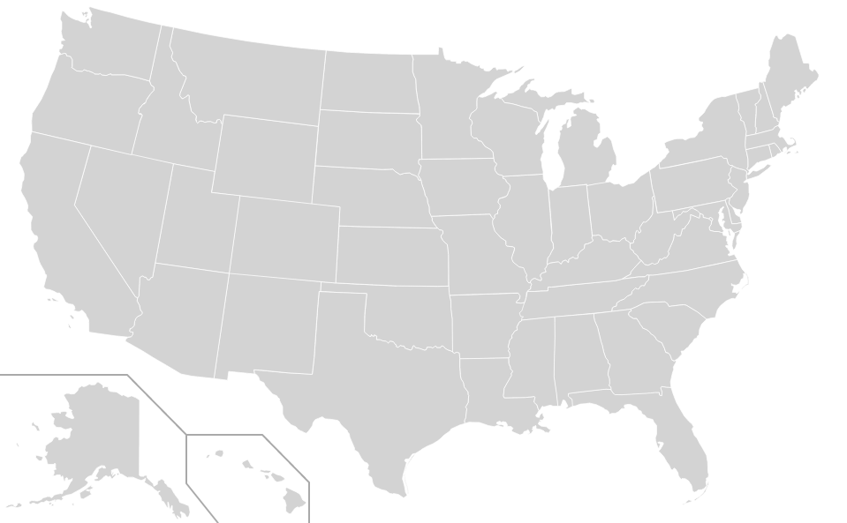


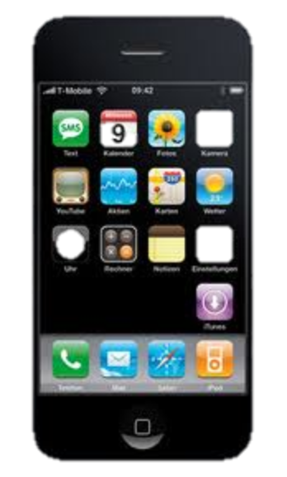
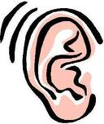
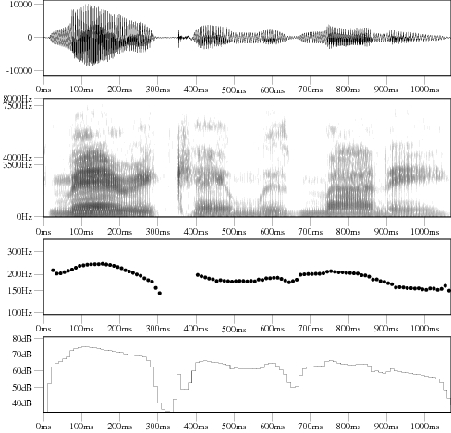
Sensing Stress Network for Social Coping
Mashfiqui Rabbi, Syed Ishtiaque Ahmed
1
Motivation and goals
75%
75% Americans have stress related
symptoms
Social relationships are both sources of stress and providers for coping
2
Stress network and social coping
Conversation network
Audio
Stress network
Emotion, power, stress from conversation
Coping suggestion from stress network

