Slide 1
IPV6

Slide 2
Overview
IPv4 address:
32 Bits (4 Bytes)
Presented as 4 decimal numbers separated by a dot
192.168.1.240
IPv6 address:
128 Bits (16 Bytes)
Presented as:
8 Groups separated by colons ( : )
Each group represent 4 Hexadecimal digits (i.e. 16 bits)
2001:0db8:85a3:0000:0000:8a2e:0370:7334
IPv6 = IPv4 × 4 ?!!!
IPv4 addresses = 2³² = 4.294967296 × 10⁹
IPv6 addresses = 2¹²⁸ = 3.40282367 × 10³⁸
6.65 x 10²³ addresses for every square meter of the Earth’s surface
2

Slide 3
Syntax
IPv6 address in binary form
0010000000000001000011011011100000000000000000000010111100111011 0000001010101010000000001111111111111110001010001001110001011010
Divided along 16-bit boundaries
0010000000000001 0000110110111000 0000000000000000 0010111100111011 0000001010101010 0000000011111111 1111111000101000 1001110001011010
Each 16-bit block is converted to hexadecimal and delimited with colons
2001:0DB8:0000:2F3B:02AA:00FF:FE28:9C5A
Suppress leading zeros within each block
2001:DB8:0:2F3B:2AA:FF:FE28:9C5A
2+ consecutive groups of 0 replaced with two consecutive colons (::)
2001:0db8:85a3:0000:0000:8a2e:0370:7334
2001:db8:85a3:0:0:8a2e:370:7334
2001:db8:85a3::8a2e:370:7334

Slide 4
Scope
Every IPv6 address has a scope
Link-Local
Used for directly attached network (link)
Not routable
Connect to IPs on same link (LAN)
e.g.
Loopback (::1)
Link-Local addresses (start with fe80)
Global
Global/Universal address
Routable
Connect to any global scope address anywhere (almost)
e.g.
ipv6tf.org: 2001:470:1f1d:275::7
4

Slide 5
Types of IPv6 Addresses
Unicast
Address of a single interface within a scope
Delivery to single interface
Multicast
Address of a set of interfaces
Delivery to all interfaces in the set
Anycast
Address of a set of interfaces
Delivery to a single interface in the set
No more broadcast addresses similar to IPv4

Slide 6
Special Addresses
Unspecified Address
0:0:0:0:0:0:0:0 or ::
Similar to 0.0.0.0 in IPv4
Loopback Address
0:0:0:0:0:0:0:1 or ::1
Similar to 127.0.0.1 in IPv4

Slide 7
Subnet and Gateway
Subnet Mask
IPV4
e.g.
255.255.255.0
IPV6
e.g.
IPV6ADDRESS/64
Gateway Address
The concept of the network gateway in IPv6 is the same as in IPv4, a gateway address will be designated noting how traffic can be routed out of the current subnet

Slide 8
IPv6 Address: ifconfig
$ ifconfig -a
lo Link encap:Local Loopback
inet addr:127.0.0.1 Mask:255.0.0.0
inet6 addr: ::1/128 Scope:Host
eth0 Link encap:Ethernet HWaddr 00:1e:0b:d6:7b:b8
inet addr:88.85.245.43 Bcast:88.85.245.47 Mask:255.255.255.248
inet6 addr: fe80::21e:bff:fed6:7bb8/64 Scope:Link
he-ipv6 Link encap:IPv6-in-IPv4
inet6 addr: 2001:470:1f08:1160::2/64 Scope:Global
inet6 addr: fe80::5855:f52b/64 Scope:Link
8

Slide 9
IPv6 Ping: Loopback Address
Loopback = localhost = same machine
Command:
ping6 ::1
Must enable IPv6, most OS enabled by default
IPv4 version:
ping 127.0.0.1
9

Slide 10
IPv6 Ping: Link Local Address
Link Local Address = Machine in the same “Link” = Same LAN
Each interface has an IPv6 Link Local address:
fe80:: + MAC address
Command:
ping6 fe80::216:cbff:fe8a:1bb (Will not work!)
ping6 fe80::216:cbff:fe8a:1bb%en0
ping6 -I en0 fe80::216:cbff:fe8a:1bb
IPv4:
Link Local is optional
Random address from the block: 169.254.0.0/16
10

Slide 11
IPv6 Ping: Global Address
Global Address = Routable
Unique Local Address (ULAs):
Private address space
fc00::/7
IPv4: 10.0.0.0/8 or 172.16.0.0/12 or 192.168.0.0/16
Not routed through public Internet
Global Unicast
Routed through the public Internet
Command:
ping6 2001:470:1f08:1160::2
11

Slide 12
IPv6 and DNS: Overview
DNS = Domain Name System
Map: hostname <=> IP
IPv4:
rayed.com => 88.85.245.43
IPv4 address stored in “A” record
IPv6:
rayed.com => 2001:470:1f08:1160::2
IPv6 stored in “AAAA” record (Quad-A)
12

Slide 13
IPv6 and DNS: Using “nslookup”
IPv4: $ nslookup google.com // OR $ nslookup -type=a google.com Name: google.com
Addresses: 173.194.32.131
173.194.32.134
173.194.32.129
173.194.32.130
IPv6: $ nslookup -type=aaaa ipv6.google.com Name: ipv6.l.google.com
Address: 2a00:1450:4010:c02::8b
13

Slide 14
IPv6 and the Web
Web Server Dual Stack (IPv4 + IPv6)
http://rayed.com/
A record (88.85.245.43)
AAAA record (2001:470:1f08:1160::2)
http://ipv6.rayed.com/
Only AAAA record (2001:470:1f08:1160::2)
http://test.rayed.com/
Only A record (88.85.245.43)
14

Slide 15
IPv6 and the Web
What about IP address in URL?
IPv4:
http://88.85.245.43/
IPv6:
http://2001:470:1f08:1160::2/ WRONG
http://2001:470:1f08:1160::2:88/ (88 port or part of the address)
http://[2001:470:1f08:1160::2]/ CORRECT
http://[2001:470:1f08:1160::2]:88/ CORRECT
15

Slide 16
Transition From IPv4 to IPv6
Complete transition from IPv4 to IPv6 might not be possible because IPv6 is not backward compatible
Technologies for Transition:
Dual Stack Routers
Tunneling
NAT Protocol Translation

Slide 17
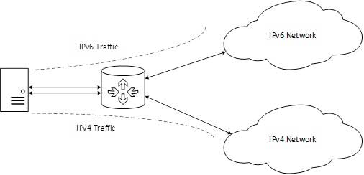
Dual Stack Routers
a router which can support both IPv4 and IPv6 addresses

Slide 18
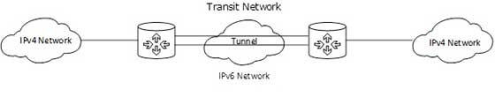
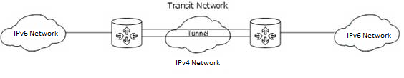
Tunneling
Different IP versions exist on intermediate path or transit networks

Slide 19
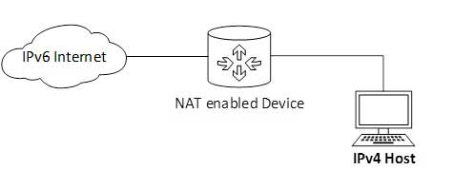
NAT Protocol Translation

Slide 20
Thank You

