Slide 1
AYUBO DRIVE
We drive when you need……

Slide 2
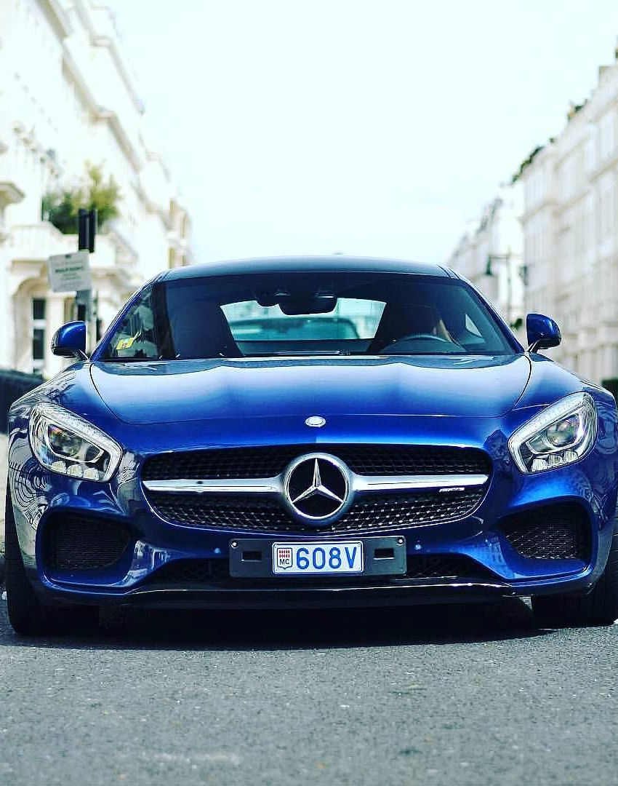
Ayubo Drive
Ayubo Drive is the transport arm of Ayubo Leisure (Pvt) Ltd, an emerging travel & tour company in Sri Lanka.
This is a complete system for the vehicle reservation and billing for Ayubo drive. It includes suitable interfaces for vehicle and package additions and reservation handling and customer billing.

Slide 3
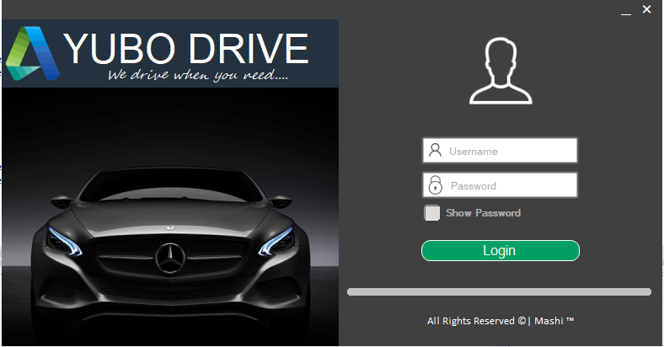
Login Window
Type the username – AyuboDrive and the password – Ayubo123 to log into the home page of Ayubo Drive. To check whether the password is correct “Show Password ” option can be used.

Slide 4
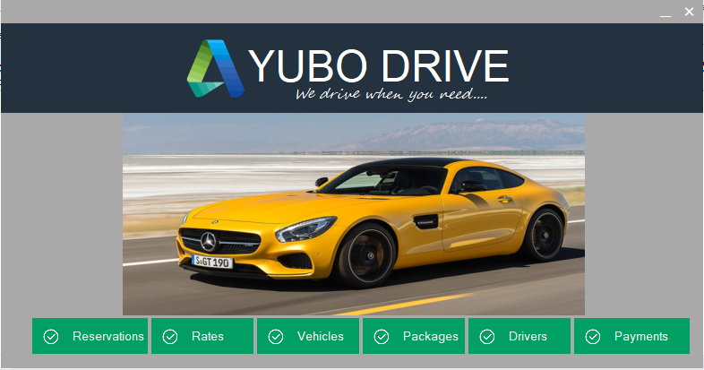
Homepage

Slide 5
Detail Adding Windows
This point onwards the windows have two main buttons “Add New” and “View”.
“Add New” button can be used to add new records and “View” is used to view already existing records.
Add New window has two main buttons,
Clear – Clear values in the textboxes
Save - Save new records
View window has four main buttons,
Select – Select specific records
Delete – delete records
Update – update records
Clear - clear the values in the textbox
Clicking the home shaped button on the top right corner will take you back to the home page.
By clicking the back arrow next to home button will take to you to the previous page.(Only in reservations, hire rates, rental rates and payments windows)

Slide 6
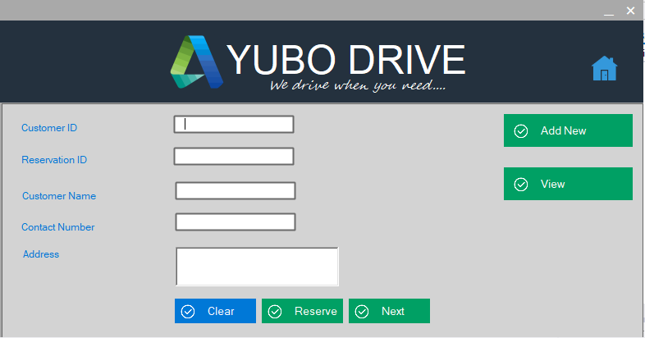
Reservations Window
In this window we can view the details of the customers and add new reservations. Click next to go to the next form and fill the next set of details.

Slide 7
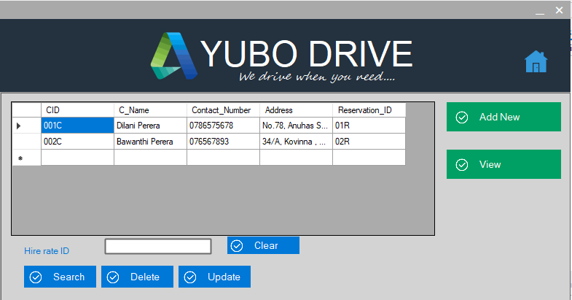
View details of the customers
In this view window there are update, delete select options to delete, update already existing records of the database.

Slide 8
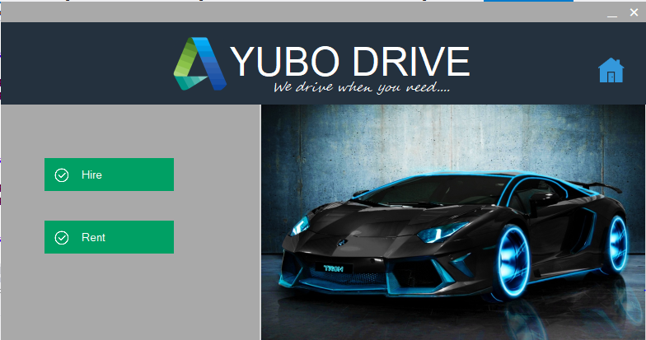
Select tour type to add new rates

Slide 9
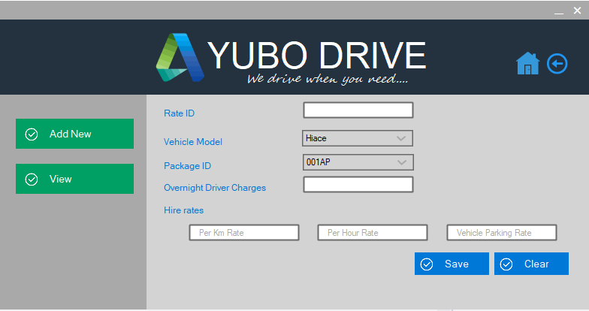
To add new hire rates

Slide 10
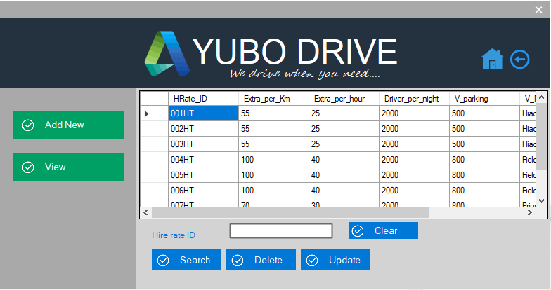
To view already present hire rates

Slide 11
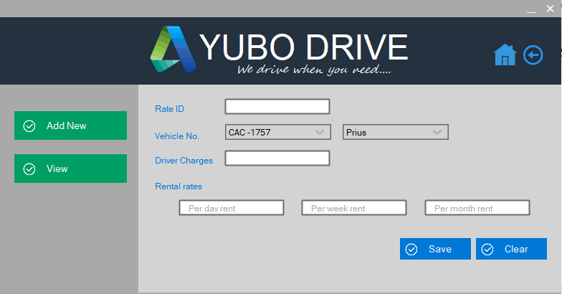
To add new rental rates

Slide 12
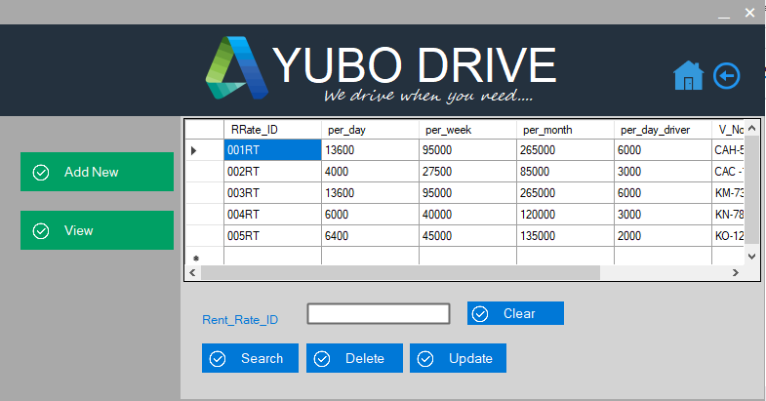
To view already present rental rates

Slide 13
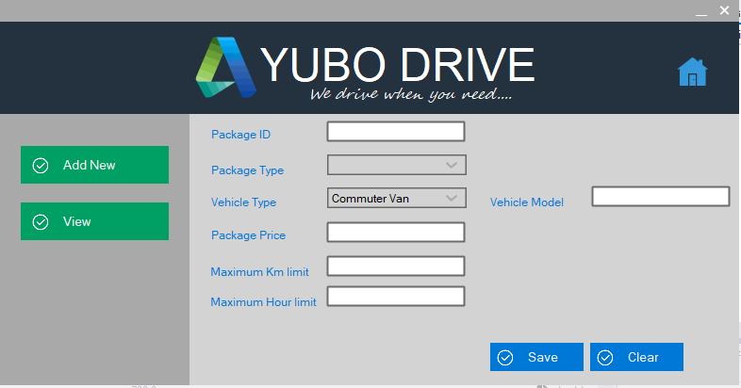
To add new hire packages

Slide 14
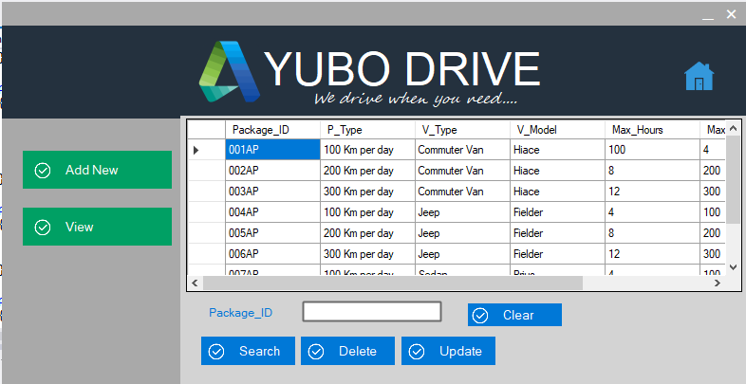
To view already present hire packages

Slide 15
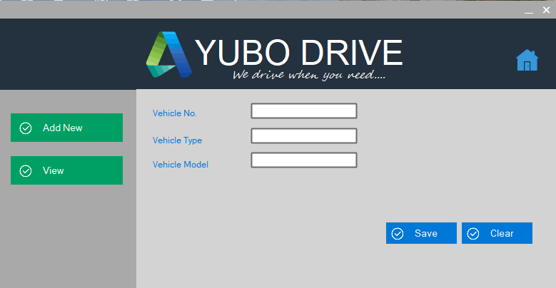
To add new Vehicle details

Slide 16
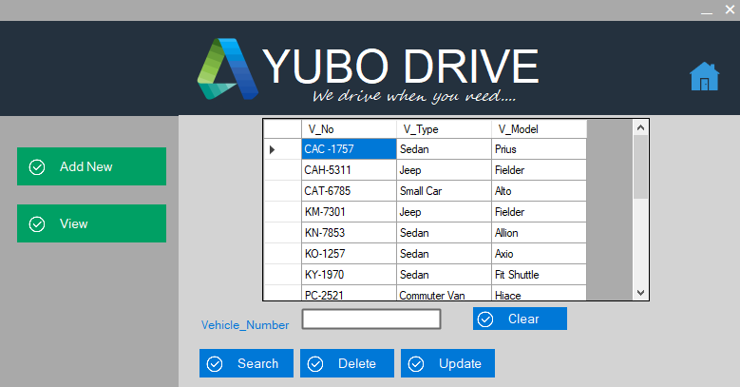
To view already present vehicle details

Slide 17
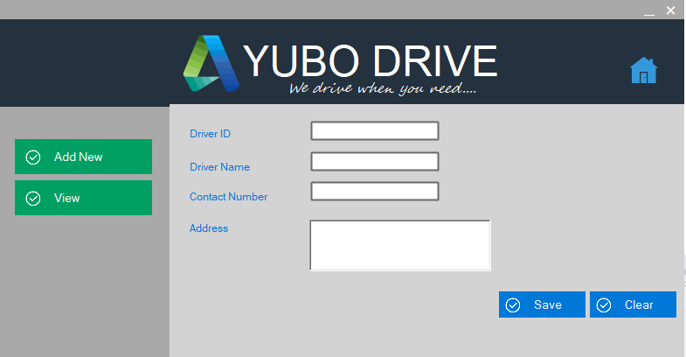
To add new driver details

Slide 18
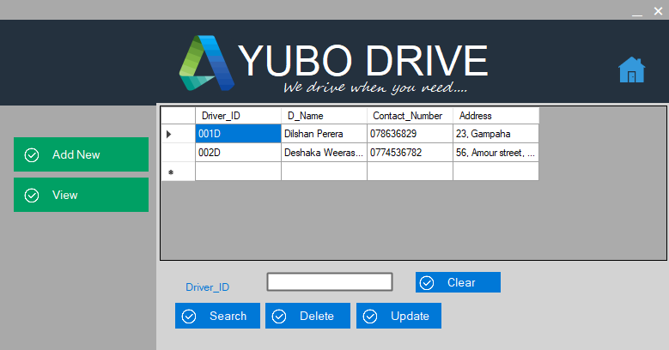
To view already present driver details

Slide 19
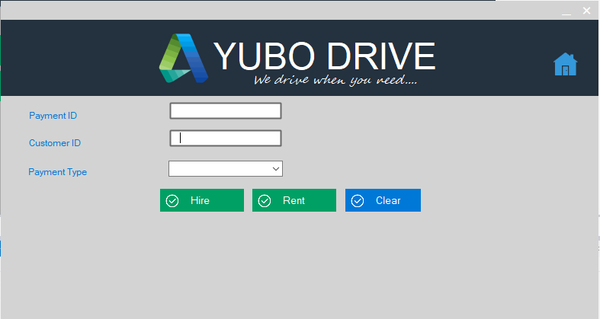
Payments Window
Fill the textboxes and choose the tour type to calculate the charges and to save them.

Slide 20
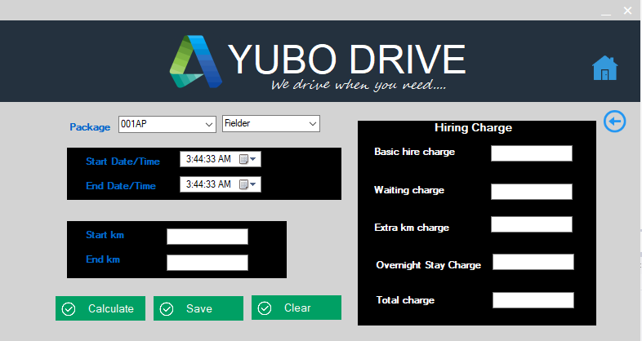
Hire Payments
Fill the details on the left hand side and click calculate to calculate the hire charges. The calculated hire charges will be displayed in the right hand side. Click save to save all the details abut the payments.

Slide 21
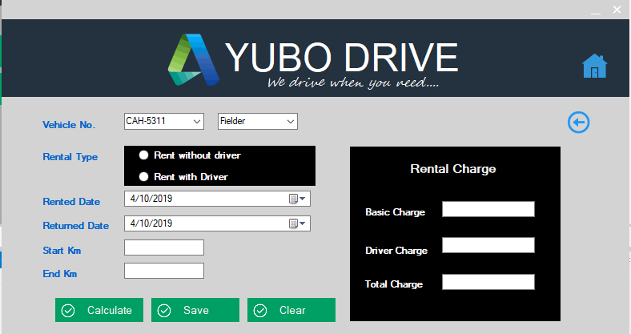
Rent Payments
Fill the details on the left hand side and click calculate to calculate the rental charges. The calculated rental charges will be displayed in the right hand side. Click save to save all the details abut the payments.

Slide 22
THE END
O. H. Minoli Fonseka
HND Batch 31

