Slide 1

ServiceFlow
A bounded, AI-assisted help-desk triage agent
The model suggests. Software decides. Humans approve.
Group F · BSE4104 AI-Native & Agentic Engineering Capstone · v1.0.0
Notes:
TIMING: 0:00 to 0:20.
Introduce the group and the project in one sentence: ServiceFlow is a help-desk triage agent for internet customers that is deliberately bounded. The tagline is the whole design philosophy: the model only suggests a category, deterministic software decides what happens, and a human approves anything with consequences. Say what the next 14 minutes contain: the problem, the design, a live demo, the evidence behind it, what still fails, and what we learned.

Slide 2



Is it my router, or is the network down?
Customers can't tell where the fault is
ServiceFlow must never
They guess, restart things and call support.
change network infrastructure
approve its own tickets
claim an outage without evidence
use a tool outside a fixed list
Staff repeat the same first-line triage
The same questions, every ticket, every day.
Wrong automation is costly
A false outage claim or an unapproved change is worse than no automation.
Notes:
TIMING: 0:20 to 1:30.
The problem is simple and familiar. Customers cannot tell whether the fault is in their own equipment or in the network, and support repeats the same first questions. The interesting engineering question is not 'can an AI answer this?' but 'how do we let an AI help without letting it do damage?'. The box on the right is our scope boundary from Week 1: no infrastructure changes, no self-approval, no outage claims without evidence, no tools outside a fixed list. Everything in the rest of the talk is about enforcing those four lines.

Slide 3
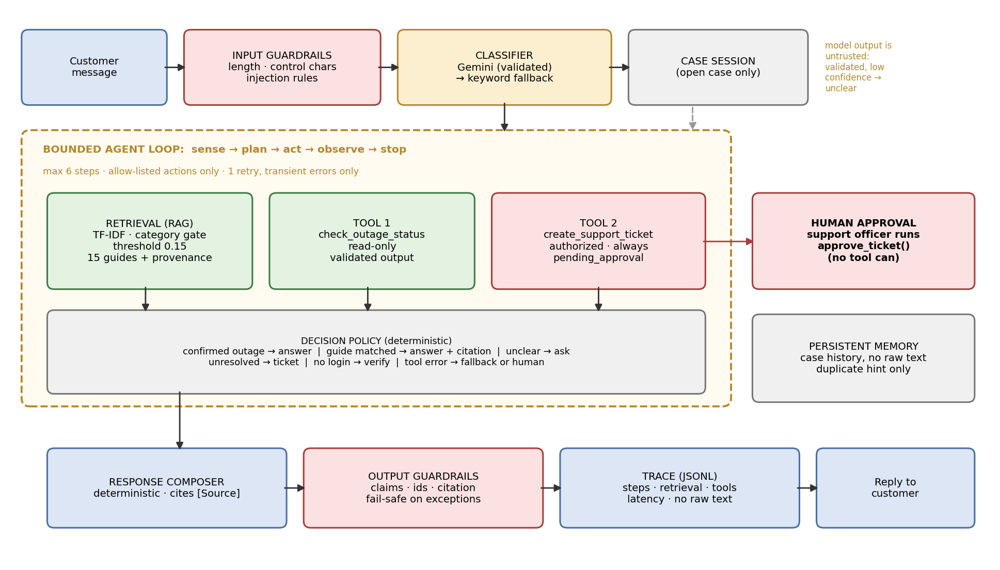



The model suggests. Software decides. Humans approve.
Model
Only classifies. Output is validated; any failure falls back to rules.
Software
Deterministic policy, 6-step cap, allow-listed actions, authorization.
Humans
Tickets are always pending. No tool can approve one.
Notes:
TIMING: 1:30 to 3:00.
Walk the diagram left to right, top to bottom. A message passes input guardrails, then the classifier, which is the only model call. The bounded agent loop then chooses among three capabilities: retrieval over fifteen cited guides, a read-only outage tool, and a ticket tool. Replies are composed deterministically, checked again by output guardrails and written to a trace. Three pillars: the model only classifies; software decides everything else; humans approve consequences. Point out the deliberate deviation from our Week 1 matrix: we planned for the model to choose actions and write text, and chose not to ship that because deterministic behaviour is testable. That is a trade-off we can defend and it is also a limitation.

Slide 4
Built layer by layer, each tested before the next
W2
W3
W4
W5
W6
W7
W8
Model & prompt
Retrieval
Tools
Bounded agent
Memory & state
Evaluate & guard
Harden & release
Versioned prompt, validated output
15 cited guides, TF-IDF
Outage lookup, ticket + approval gate
Loop, limits, stop conditions
Case session, duplicate hint
46 scenarios, guardrails, traces
Held-out set, 79 tests, v1.0.0
Honest note: Week 8 review found Week 2's chosen model had been shut down by Google, and some Week 2 text described tests that were never run. Both were corrected.
Notes:
TIMING: 3:00 to 3:40.
One sentence per layer, do not linger. The point is the method: every layer was tested before the next was added, which is why the failures we found later were findable. Then the honesty note, because it matters: during the final review we found that the model recommended in Week 2 had already been shut down on 1 June 2026, and that some Week 2 documents described testing that nobody had actually run. We corrected both and we list them in the report. Say this plainly; it is a strength of the process, not a confession.

Slide 5

Live demo
1
Grounded answer with a [Source]
RUN
2
Outage tool: confirmed outage + ETA
python src/run_demo.py
--scene 4 one scene
--interactive type your own
3
Vague message, then reply continues the case
4
No answer → ticket → human approves
WHAT TO WATCH
5
Tool down: one retry, then recovery
Every reply is followed by its trace. If anything breaks: evidence/demo/demo_transcript.txt
6
Prompt injection blocked before the agent
7
A real failure: “No wifi.”
Notes:
TIMING: 3:40 to 7:40 (4 minutes). Run SERVICEFLOW_CLASSIFIER=keyword python src/run_demo.py in a terminal that is already open and sized up. With a Gemini key set and no override it will use Gemini and the trace will say so.
SCENE 1: a grounded answer; point at [Source: doc07] and the retrieval score.
SCENE 2: the outage tool; the answer comes from the tool, not from the AI.
SCENE 3: 'my internet is bad' gets a clarifying question; the reply continues the same case.
SCENE 4: no guide matched, so a ticket is created as pending_approval; then the human step: approve_ticket is a separate function the agent cannot call.
SCENE 5: outage service down; two attempts, no third; it falls back and tells the customer the check failed.
SCENE 6: the injection is blocked before the agent runs.
SCENE 7: the real failure: 'No wifi.' returns a router factory-reset guide. Say: this is failure FC-10, we know about it, we did not hide it.
IF THE DEMO FAILS: open evidence/demo/demo_transcript.txt and read the same scenes from it. Do not debug live.

Slide 6
Engineering view: every decision leaves a trace
step | ms | what happened
classify | 0.003 | possible_outage
check_outage_status | 0.015 | error: unavailable
check_outage_status (retry) | 0.021 | unavailable → budget spent
retrieve_and_answer | 0.778 | doc13 (0.237) clears 0.15
stop_resolved | 0.784 | reply discloses the failed check
1 record per message
JSONL: components, guardrail events, steps, retrieval scores, tool errors, latency.
No raw text logged
Only a fingerprint and length, so traces are safe to keep and share.
Scenario T01: outage service down
Found real faults
Traces exposed a 4x retry loop, wrong-guide answers and needless retries.
Notes:
TIMING: 7:40 to 9:10 (about 1.5 minutes).
This is the engineering evidence view the brief asks for. Left: a real trace from scenario T01, where the outage service is down. Read it: classified as a possible outage, called the tool, it failed, retried once, failed again, stopped retrying as designed, fell back to retrieval, and the reply tells the customer the check could not be completed. Right: what a trace captures and what it does not (no raw customer text). Say that traces are how we found faults: the four-times retry loop in Week 7 was visible in a trace before it was visible anywhere else. Be candid about the gap: model token counts and model latency are not captured yet because the model is not called in offline runs.

Slide 7

Safety is structural, not a policy note
Allow-list and limits
Authorization first
Six steps maximum. One retry, transient errors only. Unapproved actions refused.
A verified session is checked before the ticket tool can run.
Approval gate
Untrusted model
Tickets are created pending. No tool exists that can approve one.
Output validated; low confidence, errors or timeouts fall back to rules.
0
safety violations in 66 scenarios
6 / 6
injected bugs caught by tests
79
automated tests, run offline
Notes:
TIMING: 9:10 to 10:10 (1 minute).
The key idea: the controls that matter do not depend on the model behaving. If the model is fooled, it still cannot call a tool outside the list, cannot create a ticket without a verified session, and cannot approve anything. We tested the guardrails by mutation: we deliberately broke the code six ways, for example removing the authorization check, auto-creating tickets and reverting to the shut-down model, and each one made a test fail. Zero safety violations across all 66 scenarios on the final code. Do not claim the system is secure; claim that the impact of a failure is contained.

Slide 8
Evaluation: the gap between two numbers is the finding
41 points
gap between dev and held-out: we tuned to our own test set.
0 violations
safety held in every scenario of both sets.
Keyword mode
Offline classifier. Gemini accuracy: not yet measured by us.
Notes:
TIMING: 10:10 to 11:20 (about 1 minute).
The chart makes one point. In Week 7 we reported 44 out of 46, which is 95.7 percent, up from 25 out of 46. That number is optimistic because we fixed things against the same scenarios. So in Week 8 we wrote twenty new scenarios in natural phrasing, fixed expectations first, and ran them once: 55 percent. After fixes it is 70 percent, but three of those scenarios drove fixes so that number is not clean. Say clearly that the honest generalisation estimate is the 55 percent, and that all six remaining held-out failures are the offline keyword classifier's vocabulary; they fail safely by asking a question. Gemini's accuracy is the next thing to measure and we have a script for it, but we have not run it with a key yet. If anyone asks: yes, we know that is a gap, and it is in the report.

Slide 9


What still fails, and why we left it
“No wifi.” gets a factory-reset guide
Natural phrasing the fallback can't read
A paraphrased injection slips through
Lexical retrieval matches words, not meaning. Cited, but wrong for the symptom. (FC-10)
6 of 9 held-out failures. They fail safe: it asks a question. The Gemini slot is meant for this.
No trigger words, so the rules miss it. Allow-list, authorization and approval contain it. (FC-11)
We did not tune the stand-in classifier or change any expectation to hide these. Each is recorded in the failure catalogue with a next step.
Notes:
TIMING: 11:20 to 12:50 (about 1.5 minutes).
This is the failure and limitation slide the brief requires. Three real, open problems. First, 'No wifi.' returns a cited but wrong guide because retrieval is lexical; we saw it live in scene 7. Second, the offline keyword classifier misses natural phrasing; that accounts for six of the nine held-out failures and it fails safely. Third, an injection phrased as a pure paraphrase is not caught by our rules; the damage is contained by the structural controls. The closing strip is the stance: we could have added keywords until the held-out set passed, but then it would no longer be held-out. Be ready for the question 'why not just fix it?': because tuning to the test set would have made the number look better and the system no better.

Slide 10


What we learned
Verify AI output
Hold data out
Real errors: a shut-down model, untested claims, a wrong detector, wrong-audience guides. Each was caught by running it.
95.7% became 55% on new scenarios. One number hid the truth.
Re-test after every fix
Make control structural
Our first round of fixes caused four regressions. Regression gates now fail the build.
Approval, authorization and limits live in code paths, not in prompts.
Notes:
TIMING: 12:50 to 14:00 (about 1 minute).
Four lessons, each tied to something that actually happened. Verify AI output: we used an AI assistant heavily, and reviewing its work found a recommended model that was already shut down, project text describing tests that had not been run, an evaluation check that mis-scored responses, knowledge-base guides written for staff but shown to customers, and fixes that caused regressions. Hold data out. Re-test after every fix. Make control structural. Be honest that AI assistance was used throughout and that the team's job is to be accountable for it: we can run, explain and defend every claim in the report.

Slide 11
Next steps
1
Measure the Gemini classifier
Run gemini_eval.py and the harness with a key; compare with the 74% keyword baseline.
2
Replace lexical retrieval
Embeddings plus a relevance check, aimed at FC-10.
3
Stronger injection defence
A model-based detector and a larger red-team set (FC-11).
4
Fresh held-out set each cycle
So the headline number stays honest; then a web interface and a real status service.
Notes:
TIMING: 14:00 to 14:30.
Keep it brief. The first step is the most important and the most honest: we have verified the model integration at contract level against the real SDK, but we have not measured Gemini's accuracy live. Then retrieval, injection defence, and the habit of a fresh held-out set each cycle.

Slide 12
Questions?
Reproduce everything:
pip install -r requirements-dev.txt
python -m pytest (79 tests)
python src/run_demo.py
github.com/mashimwe/GROUP-F-Capstone- · v1.0.0
Notes:
TIMING: 14:30 onward.
Stop talking and invite questions. Likely questions and where the answers are: Why not let the model choose actions? (Appendix B: testability and safety trade-off.) How do you know the guardrails work? (mutation checks, 79 tests.) Is the Gemini part working? (contract-tested against the real SDK; live accuracy not yet measured; the script is ready.) Why is the held-out score lower? (we tuned to the dev set; this is the honest number.) What would you do with real customer data? (not with the free tier; paid tier or local model, privacy review, retention policy.)

