Slide 1

Assignment: SQL Developer Installation
Name: Syed Mujtaba Ul Hassan
BS-IT Department

Slide 2
How to Install & Run
Oracle SQL Developer
Step 1:
Download Oracle SQL Developer from https://www.oracle.com/database/sqldeveloper/ official site.
Step 2:
Install Docker Desktop (macOS) from https://docs.docker.com/desktop/setup/install/mac-install/ official site.
Step 3:
Run Database Container (Docker).
Step 4:
Launch SQL Developer.
Step 5:
Connect to Database via Docker.
Follow each step carefully " screenshots are included"

Slide 3
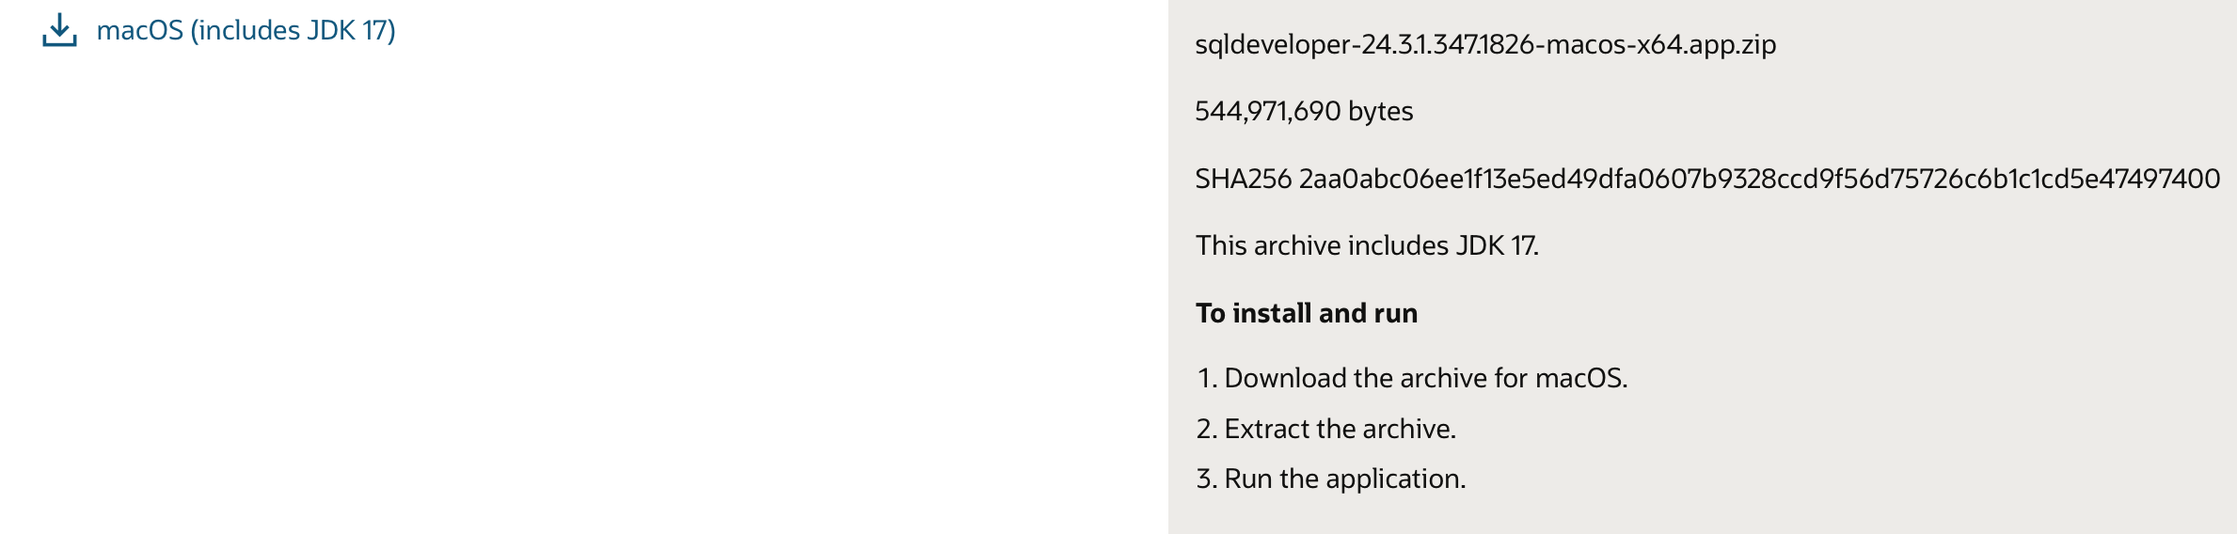
STEP 1
Download Oracle SQL Developer
How to download:
1
Go to oracle.com/database/sqldeveloper
Click HERE to download
2
Click 'Download SQL Developer'
3
Choose macOS (includes JDK 17)
4
Sign in with free Oracle account
5
Download the .zip file

Slide 4
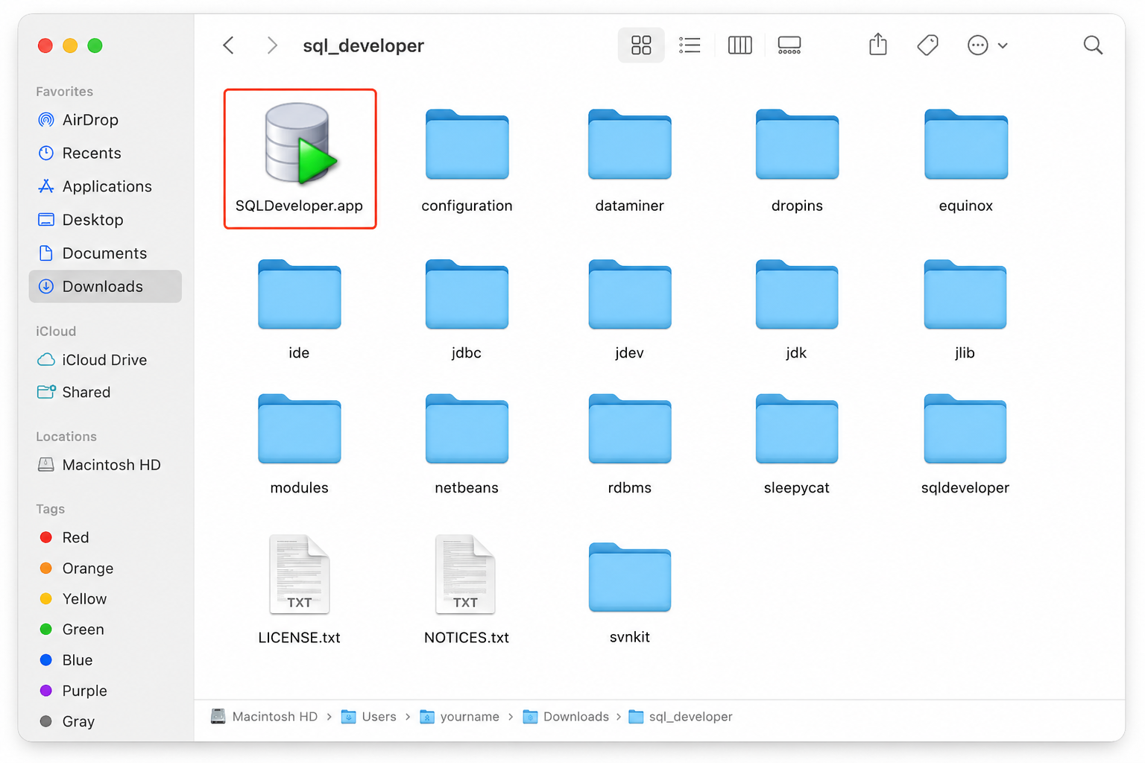
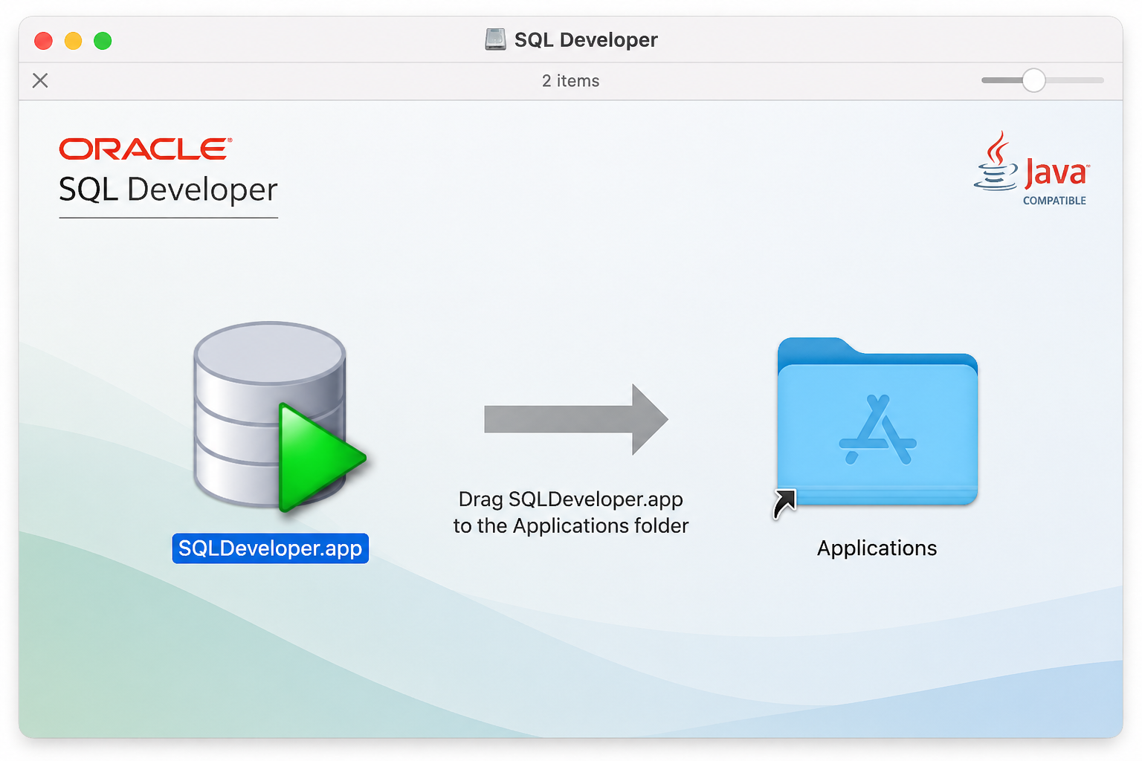
STEP 1
Install & Launch SQL Developer
After downloading:
1
Unzip the downloaded .zip file
2
Find 'SQL Developer.app' inside
3
Drag it to your Applications folder
Open — if blocked:
System Settings → Privacy & Security
→ click 'Open Anyway'
4
5
Click the green + button
to add a new connection
Click + to add connection
3

Slide 5
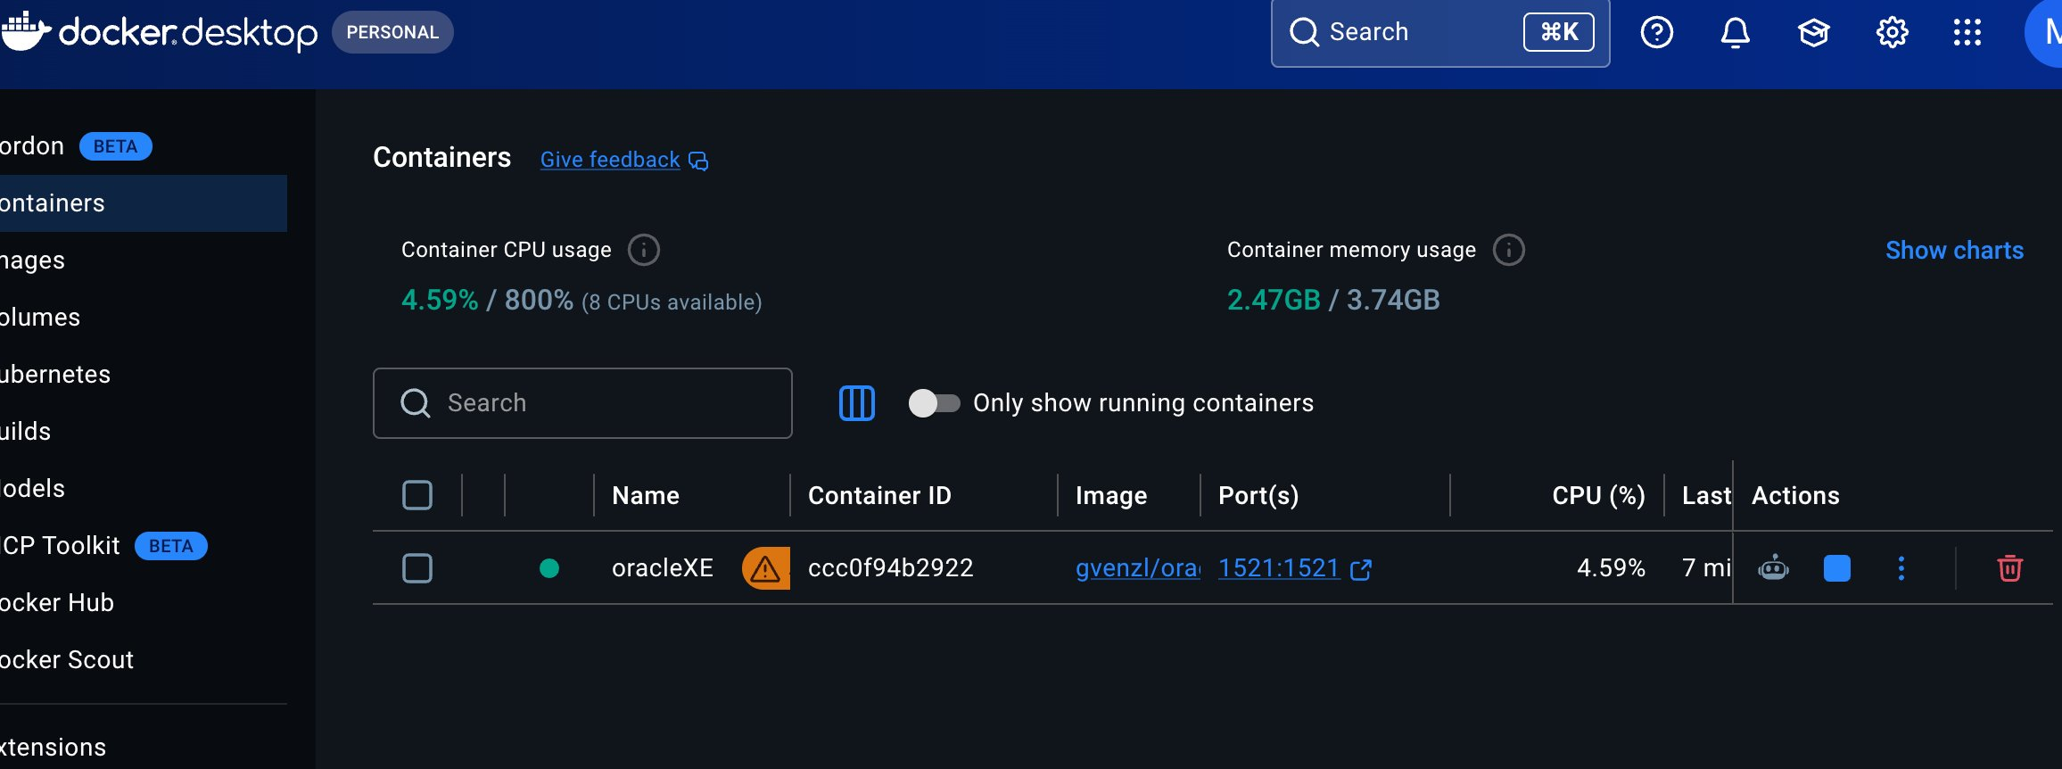
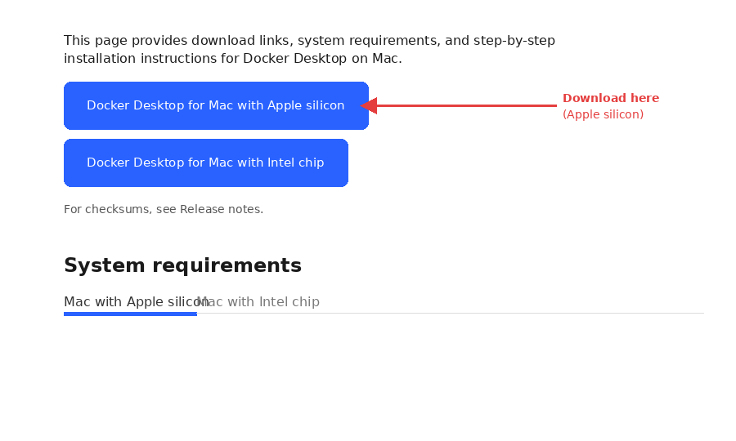
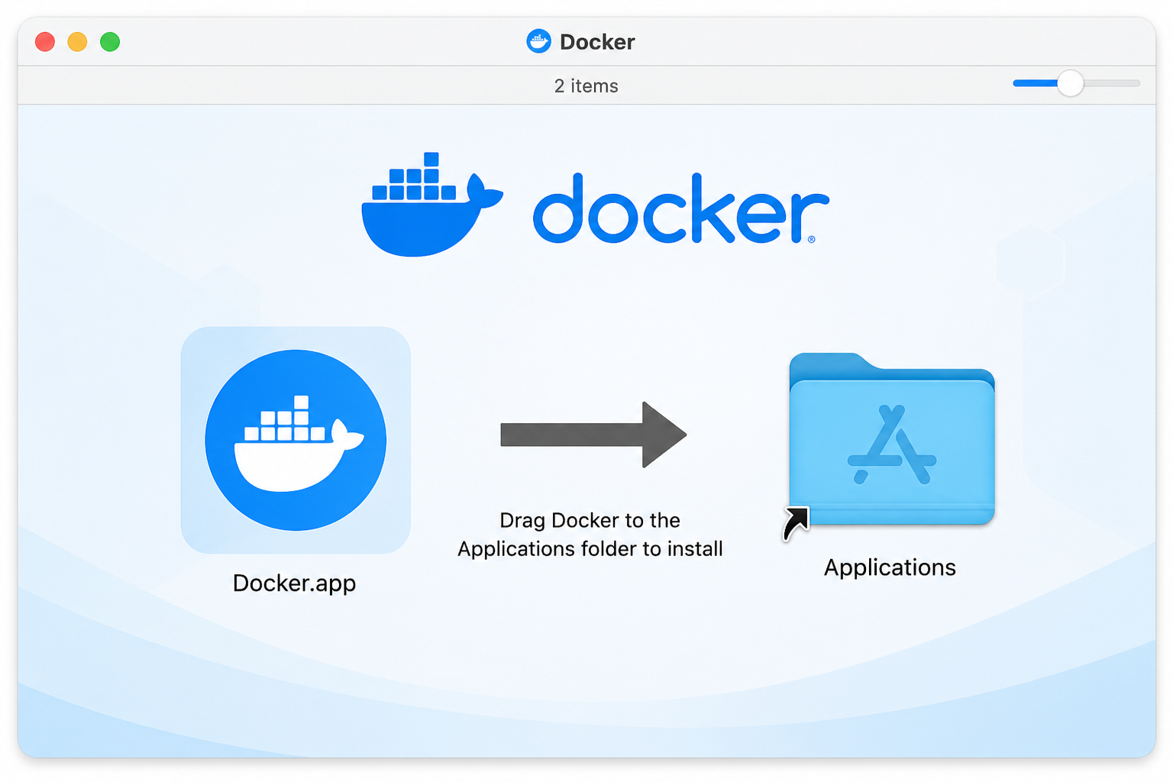
STEP 2
Install Docker Desktop (macOS M1 / M2 / M3 Setup)
Step 1 Download Docker
Step 2 Install & Open
Step 3 Enable Rosetta
Step 4 Apply & Restart
Go to docker.com/products/
docker-desktop , pick
Apple Silicon version
Install like a normal app.
Wait for the whale icon
to appear in menu bar
Settings → General → turn on
'Use Rosetta for x86/amd64
emulation on Apple Silicon'
Click Apply & Restart.
Docker is now ready
for Oracle XE on M1/M2/M3
docker.com download page
✅ Green dot = container is running

Slide 6
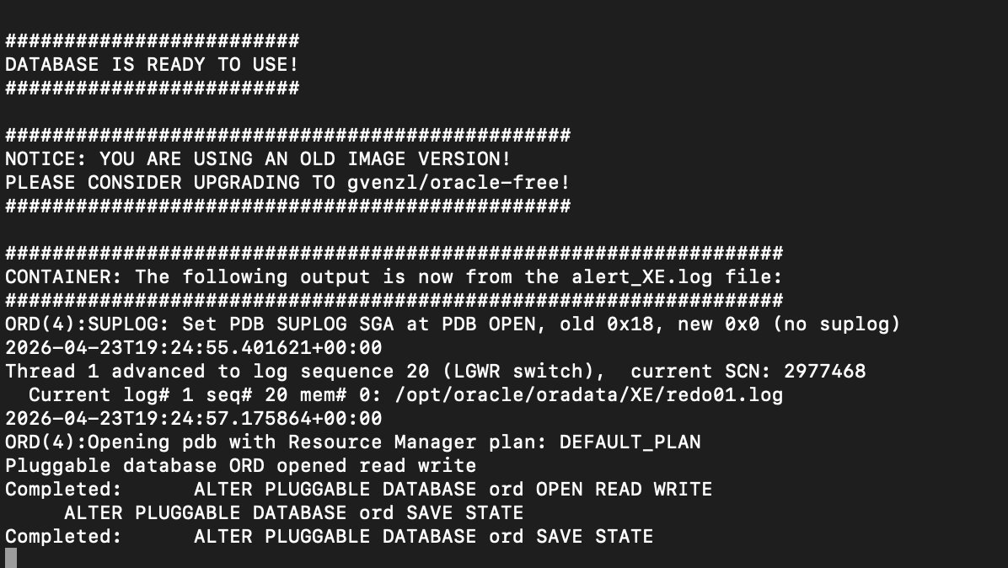
STEP 3
Run Oracle XE Database via Docker Terminal
● ● ● Terminal — killerzone@KillerZones-MacBook-Air
docker run -d
--platform linux/amd64 -p 1521:1521 \
-e ORACLE_PWD=Oracle123 -e ORACLE_SID=ord \
--name oracleXE gvenzl/oracle-xe:21-slim
Run this command in your Terminal to access the oracle database XE (Express Edition) locally.
Terminal Steps:
✅ DATABASE IS READY TO USE !
1
Open Terminal (Cmd + Space → type Terminal → Enter)
2
Copy & paste the full command above → press Enter
3
Run: docker logs -f oracleXE
4
Wait for "DATABASE IS READY TO USE" message
5
Press Ctrl+C to stop viewing logs
Your Pluggable database (ORD) has been opened in READ WRITE mode and is now operational

Slide 7
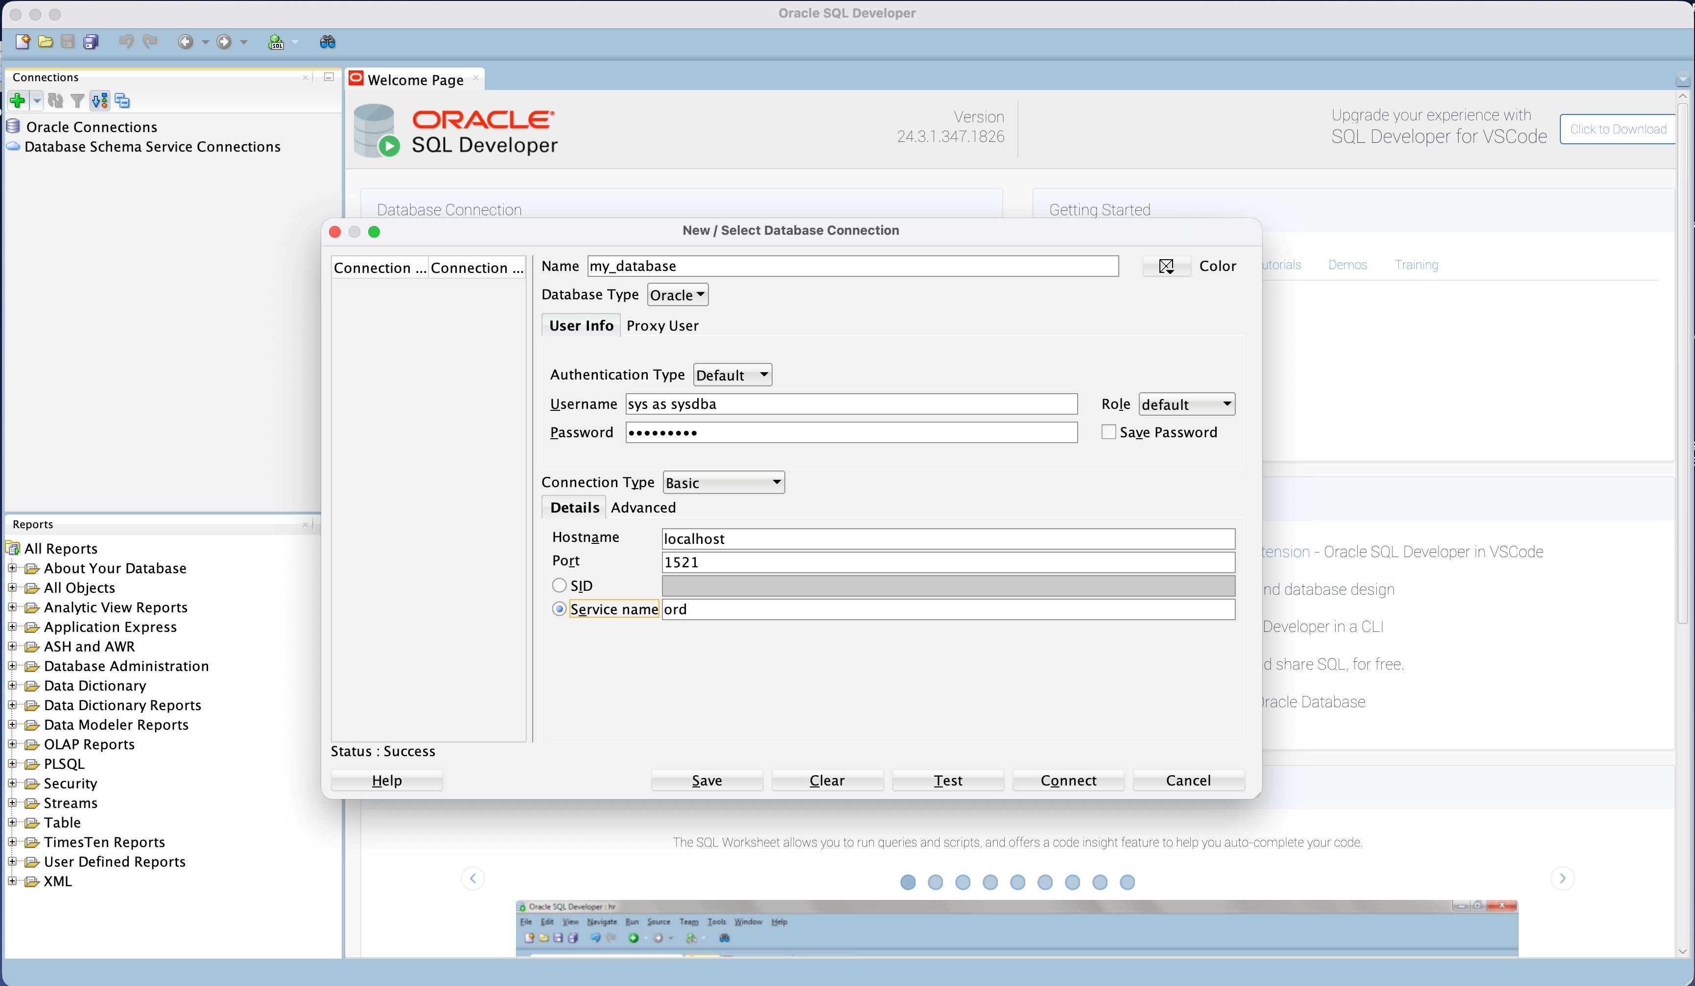
STEP 4
Connect SQL Developer to Oracle Database
Fill in exactly these settings:
Name
my_database
Username
sys as sysdba
Password
Oracle123
Hostname
localhost
Port
1521
Select 'Service name', type: ord
Service name
Ord < Important>
Status: Success → Test & Then Click Connect.

Slide 8
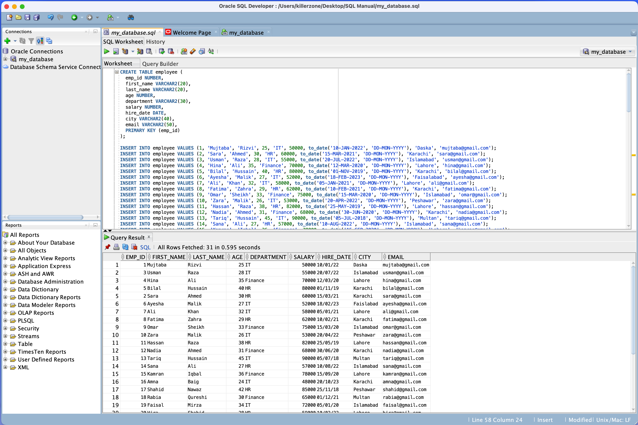
STEP 5
Run SQL Queries , Create Tables & Insert Data
Key SQL Commands:
CREATE TABLE
Define table structure
with columns & primary key
INSERT INTO
Add employee records
with values
COMMIT
Permanently save all
changes to database
SELECT *
Retrieve and display
all rows from table
DESC
Show column names
and data types
Press F5 to run the full script at once.

Slide 9
Part 2: Database Concepts & SQL*Plus Queries
Definitions (DBA, SysAdmin, Data Administrator) and instance queries,
run on the Oracle XE container (oracleXE) set up in Steps 1 to 5

Slide 10
CONCEPT
What is a Database?
A database is a structured collection of related data, stored electronically so it can be added to, searched, updated and managed easily.
Instead of scattering records across many separate files, everything lives in one organised place that many users and programs can share safely.
Example: a university STUDENTS table
Student ID | Name | Department | Marks
101 | Ali | CS | 85
102 | Sara | IT | 90
103 | John | SE | 78
In this assignment, the database is Oracle XE running inside Docker on macOS: container oracleXE, pluggable database ORD (Step 3).

Slide 11
CONCEPT
What is Oracle Database XE (21c)?
Oracle Database is a relational database management system (RDBMS) made by Oracle Corporation. It stores, secures and retrieves large amounts of data for organisations.
XE = Express Edition: the free edition of Oracle. 21c = release 21, c = cloud.
My setup (MacBook Air, Apple Silicon)
Oracle Database XE 21c in Docker
image: gvenzl/oracle-xe:21-slim
container: oracleXE · port 1521
pluggable database (PDB): ORD
client: Oracle SQL Developer
A bank, for example, would keep:
1
Customer & employee information
Same SQL & SQL*Plus commands as Oracle 19c Enterprise Edition
2
Account details & transactions
3
Loan records

Slide 12
CONCEPT
Database Administrator (DBA)
A DBA is the person responsible for running an organisation’s database system, keeping its data secure, available, correctly managed and fast.
Security
Backup & Recovery
Performance
Install & Configure
Controls who can access data and what they may do
Keeps copies of data and restores it after loss or failure
Watches speed and fixes slow queries or settings
Installs the DBMS and sets it up for the organisation
Troubleshooting
Storage Planning
High Availability
Finds and solves database problems
Makes sure there is room for future data
Keeps the database online with minimal downtime

Slide 13
CONCEPT
What is a System Administrator?
A System Administrator (SysAdmin) looks after an organisation’s computers, servers, operating systems and networks.
On my Mac setup, the SysAdmin side covers installing Docker Desktop and enabling Rosetta (Step 2).
1
Install operating systems & software
2
Manage servers & hardware
3
Create and manage system users
4
Configure networks
5
Monitor system performance
6
Manage system security
7
Troubleshoot system problems

Slide 14
CONCEPT
DBA vs System Administrator
Database Administrator (DBA) | System Administrator (SysAdmin)
Manages databases | Manages computer systems
Works with database software | Works with operating systems & servers
Protects data & DB security | Protects OS & system security
Database backup & recovery | System / server backup & recovery
Monitors database performance | Monitors system performance
Example: Oracle XE 21c, SQL Developer | Example: macOS, Docker Desktop, Linux

Slide 15
CONCEPT
Data Administrator vs Database Administrator
Data Administrator (DA): business side
Database Administrator (DBA): technical side
Decides how the organisation’s data is collected, organised, stored, protected and used.
Handles the technical management and maintenance of the database itself.
1
Decides what data is needed
1
Installs & configures Oracle XE
2
Sets data rules & standards
2
Creates and manages databases
3
Keeps data accurate & consistent
3
Creates users & grants permissions
4
Writes data policies & procedures
4
Performs backup & recovery
5
Decides who may access which data
5
Monitors performance & fixes problems
6
Works with departments on their data needs
6
Keeps the database available

Slide 16
QUERY 0
Connect to Oracle as SYSDBA (macOS Terminal)
Terminal — sqlplus (oracleXE)
Paste your own Terminal screenshot here
(Cmd + Shift + 4 → drag over the Terminal window)
$ docker start oracleXE
$ docker exec -it oracleXE sqlplus / as sysdba
SQL>
What it does:
1
Start the oracleXE container from Step 3 (if stopped)
2
Open SQL*Plus inside it as SYS (connects to the whole instance, CDB)
3
Why not SQL Developer? Its connection opens PDB ORD, where SHUTDOWN / ALTER SYSTEM for the instance aren’t allowed
4
Expect: “Oracle Database 21c Express Edition Release 21.0.0.0.0”

Slide 17
QUERY 1
Startup & Shutdown the Instance
Terminal — sqlplus (oracleXE)
Paste your own Terminal screenshot here
(Cmd + Shift + 4 → drag over the Terminal window)
SQL> startup
SQL> shutdown immediate;
SQL> startup
What it does:
1
STARTUP on a running DB gives ORA-01081 (already running)
2
SHUTDOWN IMMEDIATE closes, dismounts, stops the instance
3
STARTUP again: instance started → mounted → opened
4
Output also lists SGA sizes (your numbers will differ)

Slide 18
QUERY 2
Check Instance Name & Status
Terminal — sqlplus (oracleXE)
Paste your own Terminal screenshot here
(Cmd + Shift + 4 → drag over the Terminal window)
SQL> select instance_name, status
from v$instance;
What it does:
1
v$instance is a dynamic performance view
2
instance_name: XE (the Oracle XE instance in Docker)
3
status: OPEN means users can work in the database
4
Can also run in SQL Developer (my_database connection)

Slide 19
QUERY 3
View the db_writer_processes Parameter
Terminal — sqlplus (oracleXE)
Paste your own Terminal screenshot here
(Cmd + Shift + 4 → drag over the Terminal window)
SQL> select name, value
from v$parameter
where name='db_writer_processes';
What it does:
1
v$parameter lists initialization parameters
2
db_writer_processes = number of DBWn background processes
3
DBWn writes changed blocks from buffer cache to data files
4
Also works in SQL Developer worksheet (F5)

Slide 20
QUERY 4
Change a Static Parameter (SCOPE=SPFILE)
Terminal — sqlplus (oracleXE)
Paste your own Terminal screenshot here
(Cmd + Shift + 4 → drag over the Terminal window)
SQL> alter system set db_writer_processes=2;
→ ORA-02095: specified initialization
parameter cannot be modified
SQL> alter system set db_writer_processes=2
scope=spfile;
→ System altered.
What it does:
1
Static parameter: cannot change in the running instance
2
SCOPE=SPFILE saves it to the server parameter file
3
New value takes effect only after a restart
4
(If ORA-32001 appears, the DB was started without SPFILE)

Slide 21
QUERY 5
Restart & Verify the New Value
Terminal — sqlplus (oracleXE)
Paste your own Terminal screenshot here
(Cmd + Shift + 4 → drag over the Terminal window)
SQL> shutdown immediate;
SQL> startup
SQL> select name, value from v$parameter
where name='db_writer_processes';
What it does:
1
Restart so the instance re-reads the SPFILE
2
Run the same query from Query 3 again
3
VALUE should now show 2
4
Proves the change was applied

Slide 22
QUERY 6
Show the System Global Area (SGA)
Terminal — sqlplus (oracleXE)
Paste your own Terminal screenshot here
(Cmd + Shift + 4 → drag over the Terminal window)
SQL> show sga
What it does:
1
SGA = shared memory area of the Oracle instance
2
Fixed Size, Variable Size: internal structures & pools
3
Database Buffers: cache of data blocks
4
Redo Buffers: holds redo entries before writing to logs

