Slide 1

DATA ANALYSIS AND PROCESSING
Francesca Valeria Hansstein
Research Assistant Professor
School of Public Economics & Administration
f.v.hansstein@mail.shufe.edu.cn

Slide 2
Outline
Course information:
goals and expectations
content
resources
Final research projects
Datasets
Introduction to Stata
Descriptive statistics and association tests

Slide 3
Goals and expectations
Common applications in data analysis
Students are expected to:
Learn what statistical techniques are appropriate according to variable types and research questions
Become familiar with at least two techniques and reproduce them with Stata
Read and appropriately interpret statistical results
Write a brief research project (3 to 5 pages)

Slide 4
Course content (tentative)
C1: Introduction, descriptive statistics, confidence interval and association tests
C2: Hypothesis testing
C3: Analysis of Variance (ANOVA)
C4: Simple and multiple linear regression
C5: Logit and probit regression
C6: Multinomial regression and principal component analysis
C7: Factor and Structural Equation Modeling (Path analysis, introduction)
C8: Students’ presentations (on a voluntary basis)

Slide 5
Textbooks (optional)
An Introduction to Modern Econometrics using Stata, Christopher F. Baum (various editions)
Statistics with STATA, Lawrence C. Hamilton (various editions)
A gentle introduction to STATA, Acock (various editions)
Discovering Structural Equation Modeling Using Stata, by Acock (various editions) – recommended only for the last four classes

Slide 6
Getting help
Statalist: http://www.statalist.org/ (the Stata forum)
Institute for Digital Research and Education IDRE) of UCLA: http://www.ats.ucla.edu/stat/stata/
Stata Tutorial Content of LSE: http://www.lse.ac.uk/methodology/tutorials/Stata/home.aspx
Use the help command followed by what you’re looking for (e.g. help regression)
Type “help help” in the command window and click on anything shown in blue in the viewer window

Slide 7
Important Information
Class slides, datasets, and do file will be uploaded on the BB system one day before the class
Office hours: by appointment
Final project: to be delivered by the last day of class
My email: f.v.hansstein@mail.shufe.edu.cn

Slide 8
Info about the final project
Research project (3 to 5 pages)
Project’s sections:
Introduction and background
Research question(s) and research hypothesis
Variable description and methodology
Results
Discussion
Conclusions

Slide 9
What is a survey?
A survey is a sampling, or partial collection, of facts, figures, or opinions taken and used to approximate or indicate what a complete collection and analysis might reveal
Researchers usually use questionnaires to collect data
Type of questions:
Socio-demographic: gender, age, income, education level, etc.
Attitudinal: beliefs, opinions, attitudes, or expectations
Behavioral: health behaviors, reading, physical activity, food choices etc.
Environmental: neighborhood characteristics, (number of parks, shops, schools etc.)

Slide 10
Survey used in this course
Survey on perceptions towards food waste among a sample of Shanghai residents (teaching and exercises)
Survey on motivations towards buying organic fruits and vegetables (teaching and exercises)
Students can use for their final project one of these two, or other datasets upon teacher’s approval

Slide 11
Organic fruits and vegetables
Definition: organic produce and other ingredients are grown without the use of pesticides, synthetic fertilizers, sewage sludge, genetically modified organisms, or ionizing radiation.
Target: Chinese students living in Shanghai, 350 observations, face to face interview, 58 variables.
Goals: to understand beliefs, attitudes and barriers towards the intention of buying organic fruits and vegetables.
Source: data were collected by students from the survey research and design class.

Slide 12
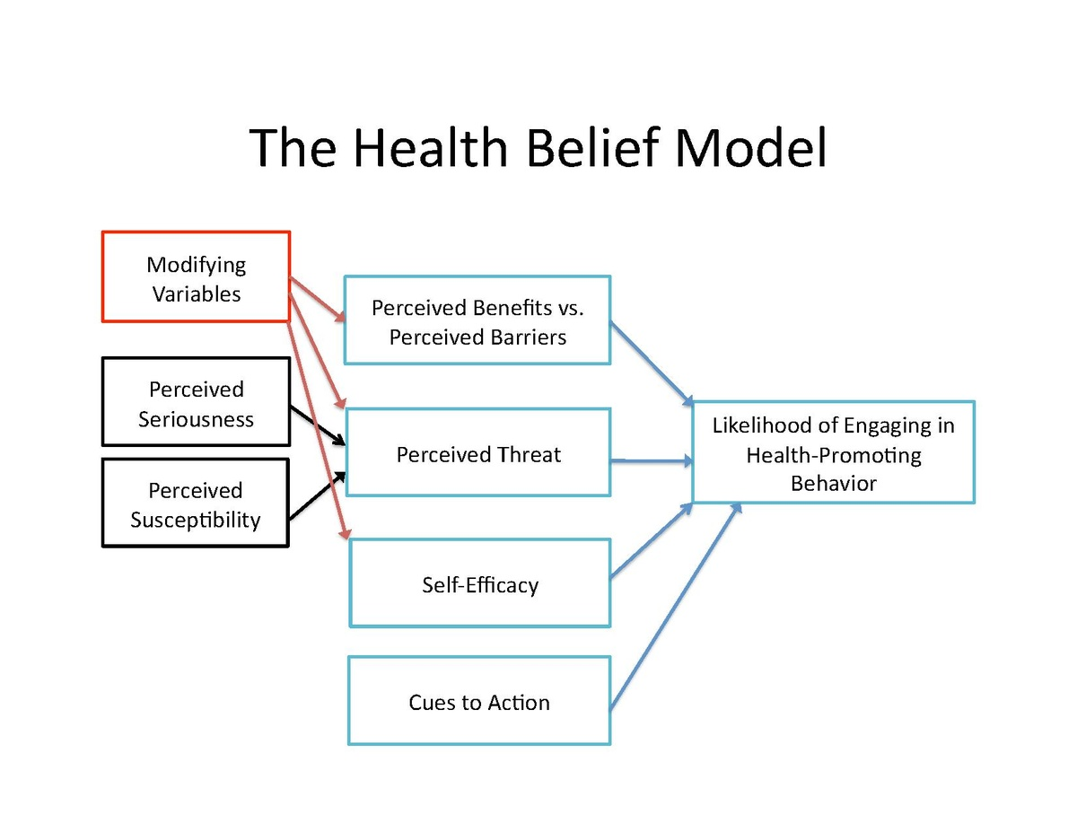
Organic fruits and vegetables
The questionnaire was built upon the Health Belief Model (Rosenstock et al., 1950)

Slide 13
Attitudes towards food recycling behaviors
Definition: the goal of the survey was to analyse food-waste and food-recycling attitudes and behaviors
Target: urban residence in Shanghai, 509 observations, face to face interview, 58 variables.
Source: joint research project, Professor Wang Keqiang (SUFE) and Francesca Hansstein (SUFE)

Slide 14
Attitudes towards food recycling behaviors
The questionnaire included the following sections:
Demographics
Food expenditure and food consumption habits
Behavioral questions on recycling practices
Attitudes and perceptions towards food waste management
Recycling behavior and compliance with law

Slide 15
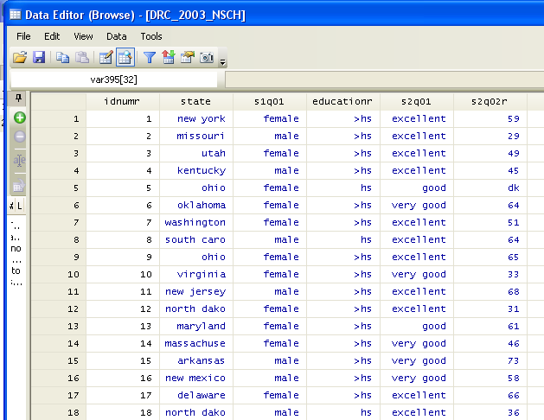
Introuction: The dataset
Statistical units are displayed in rows
Variables are displayed in columns

Slide 16
Types of variables
General classification:
Continuous variables
Ordered categorical variables (c > 2)
Unordered categorical variables (c >=2)
Stata codification:
Numerical (black)
Coded (blue)
String (red)

Slide 17
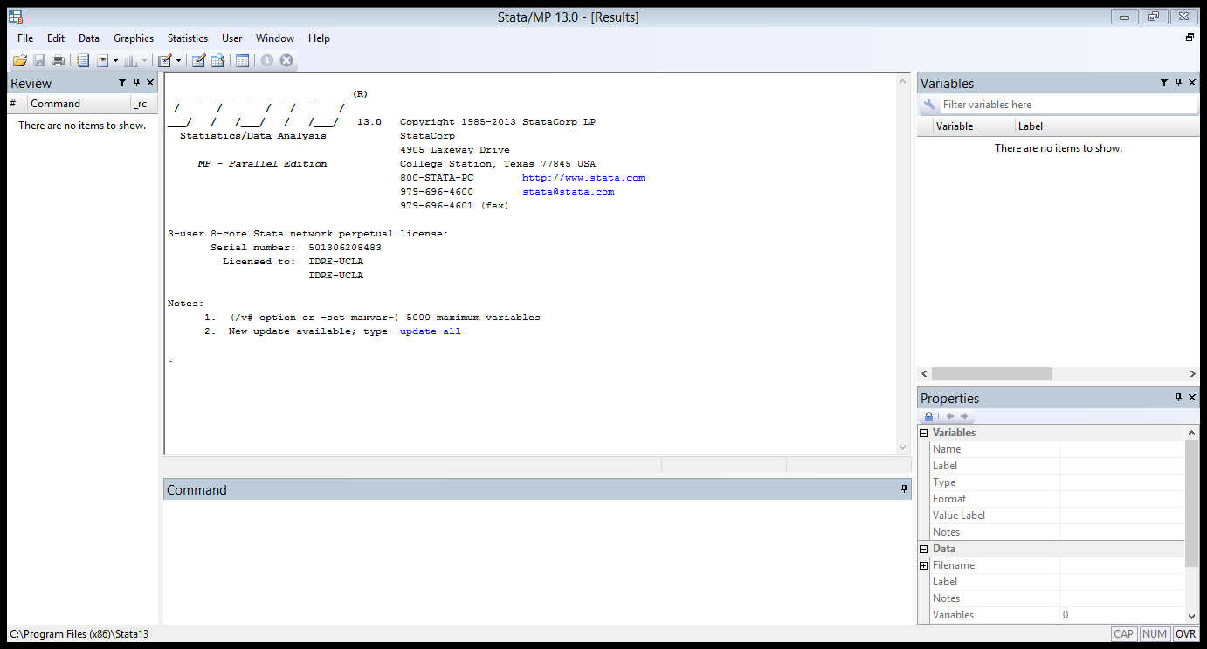
Stata main windows
RESULTS window
VARIABLE window
REVIEW window
COMMAND window

Slide 18
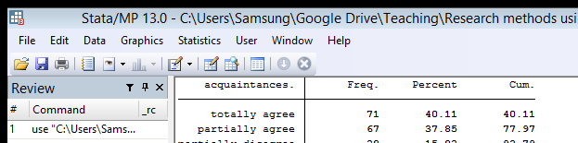
Data Editor and Data Browser
The data editor opens the original dataset, it looks like a spreadsheet. Be careful: data can be edited
The data browser displays the same, but data cannot be modified

Slide 19
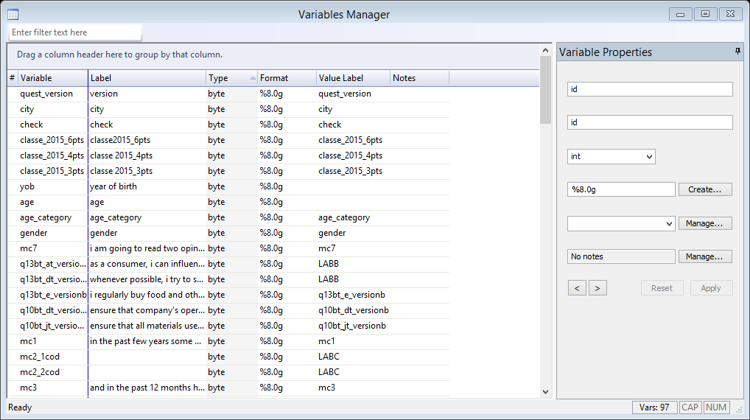
Variable manager
This is the variable manager with all the information on our variables

Slide 20
Examples of research questions
Do rural children play computer games more often than their urban peers?
How does income affect the likelihood of purchasing organic fruits and vegetables?
What are the determinants of the intention to participate in collaborative consumption?
How can we measure individual risk perception?

Slide 21
Variable, label and value label
Variable is a general abbreviation of the variable’s name (for example ID, q1, gender etc.)
The label indicates an in-depth description of the variable
Value label indicates how to codify and interpret variables categories
All these attributes are specified when a dataset is built

Slide 22
Exploring the data
describe varname
lookfor varname
list varname
rename varname
help command
To install a new command
ssc install command
findit command → a new window with a list of command will open up → select and install the command you are looking for

Slide 23
Qualifiers, Comparison operators, logical operators
Qualifiers:
The IF qualifier introduces a restriction on the variables value
The IN qualifiers introduces a restriction on the observations
Comparison operators (used together with IF or IN):
== equal to != not equal to ~= not equal to >, <, >=, <
Logical operators
I (or) & (and)

Slide 24
Commands for descriptive statistics
tabulate varname (used for categorical variables)
tabulate varlist
summarize varname (used for continuous variables)
summarize varlist
Note: sometimes summarize is also used for categorical variables

Slide 25
Contingency tables
Contingency tables: the category a person is in one of the variables is contingent on the category the person is in another variable
tabulate var1 var2
(row) (column)
If you have an hypothesis on variable dependency (x = independent) (y=dependent), remember that var1 goes first (row) and var2 goes after (column)

Slide 26
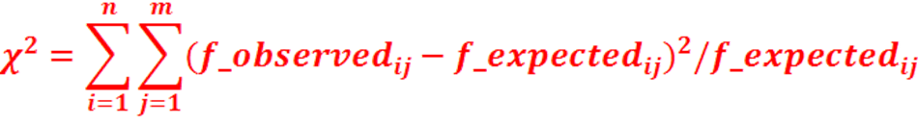
Chi-squared test
The Chi-squared test compares the observed frequency with the expected frequency we would have observed if the two variables were independent
Is this difference sufficiently different from zero?
if Yes the variables are dependent
if No the variables are independent
As a rule of thumb, a large value indicates that the two variables are not independent, but we always have to check for the statistical significance (p < 0.05)

Slide 27
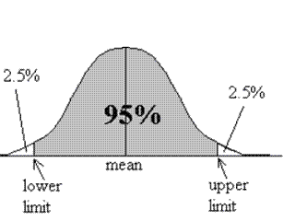

Confidence interval for the mean
1-α is the confidence level which is usually set by the researcher and can be 0.95, 0.99 and 0.90
The interval between brackets is the confidence interval
Z_{α/2} indicates the zeta statistics which is it the z-value associated to the probability of α/2

Slide 28
Confidence Level, Significance Level and Confidence interval
The confidence level 1 – α refers to the % of all possible samples that are expected to include the true population parameter. It indicates how sure we want to be that the population parameter falls within the interval (90% - 95% - 99%)
The confidence level depends on the significance level α which is the error we are willing to accept (0.1 - 0.05 - 0.01) and, as the CI, it is also set by the researcher
The confidence interval is a range of values towards the sample average that is expected to contain the real population value

Slide 29
Confidence interval for the mean in Stata
Calculating the confidence interval is very easy in Stata
mean var1, level ( )
ci vari1, level ( )
If you do not specify any level as option, Stata gives a 95% confidence level by default
What do you think happen to the confidence interval if you increase the confidence level (99)?
What if you decrease the confidence level (90)?

