Slide 1

DATA ANALYSIS AND PROCESSING
Francesca Valeria Hansstein
Research Assistant Professor
School of Public Economics & Administration
f.v.hansstein@mail.shufe.edu.cn

Slide 2
Outline
Descriptive statistics and association tests
Hypothesis testing

Slide 3
Commands for descriptive statistics
tabulate varname (used for categorical variables)
tabulate varlist
summarize varname (used for continuous variables)
summarize varlist
Note: sometimes summarize is also used for categorical variables

Slide 4
Contingency tables
Contingency tables: the category a person is in one of the variables is contingent on the category the person is in another variable
tabulate var1 var2
(row) (column)
If you have an hypothesis on variable dependency (x = independent) (y=dependent), remember that var1 goes first (row) and var2 goes after (column)

Slide 5
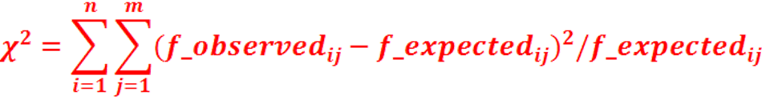
Chi-squared test (categorical variables)
The Chi-squared test compares the observed frequency with the expected frequency we would have observed if the two variables were independent
Is this difference sufficiently different from zero?
if Yes the variables are dependent
if No the variables are independent
As a rule of thumb, a large value indicates that the two variables are not independent, but we always have to check for the statistical significance (p < 0.05)

Slide 6
Chi-squared test (categorical variables)
Does the belief towards recycling affect the behavior? No, because the test is not statistically significant. The p-value > 0.05. If the p-value was < 0.05 the variables would have been said to be dependent.

Slide 7
Summary: summary stats and graphics in Stata

Slide 8


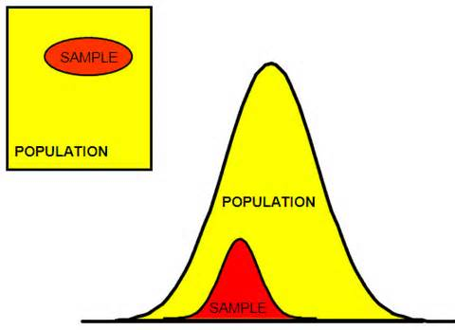
From sample to population
We need a sample to estimate the real value in the population
Randomness, selection rule, sample & population
Not all the surveys follow a random selection of the sample, but if we want to generalize the findings to a broader population, it is important to make sure that sample units are extracted randomly

Slide 9
Inferential Statistics
Sampling all the units in the population is often unfeasible due to time and money constraints
The goal of inferential statistics is to estimate parameters in the population by observing statistics in the sample
Inferential statistics is rooted in probability theory
We observe statistics in the sample (mean and standard deviation) to make inference on the population parameters (pop. mean and standard deviation)

Slide 10
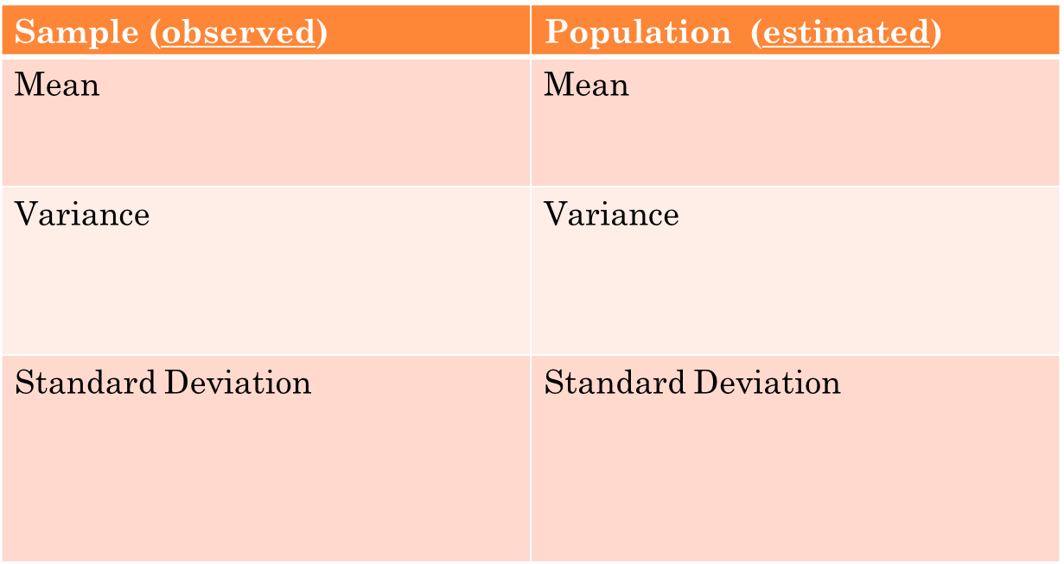




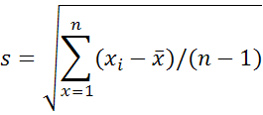
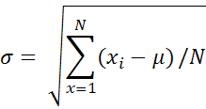
Statistics and parameters

Slide 11
The Gaussian (Normal) distribution
Many phenomena in nature have been shown to have a normal probability distribution, symmetric respect to the mean (central) value

Slide 12
Central Limit Theory
This is the fundamental theorem that allows us to use sample parameters to estimate population parameters
The central limit theorem states that the distribution of all the possible sample means of a random variable approaches to a Normal Distribution as the sample size increases
So if we have a large enough sample size, the distribution of the variables will follow a normal distribution, provided that the sample units have been extracted randomly from the population

Slide 13
The Standard Normal
The standard normal is a special normal distribution with zero mean an unit variance
The normal random variable of a standard normal distribution is called a standard score or a z-score.
Every normal random variable X can be transformed into a z score via the following equation: z = (X - μ) / σ
where X is a normal random variable, μ is the mean of X, and σ is the standard deviation of X.

Slide 14
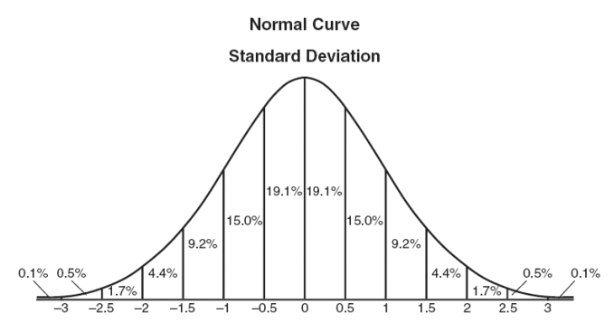
The Standard Normal
To each z-score value is associated to a p-value (probability) usually expresses in terms of cumulative probability or intervals
For large sample size, instead of the Standard Normal, the T-Student distribution is used instead
probability
z-scores

Slide 15
Confidence interval for the mean
For continuous variables, it is useful to calculate the confidence interval
If the sample units have been extracted randomly – so that they are representative of the population under study – it is possible to calculate the CI
CI a range of values so defined that there is a specified probability that the value of a parameter (of the unobserved and real population value) that lies within it.

Slide 16
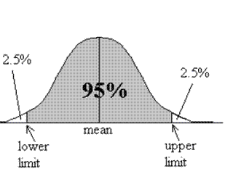

Confidence interval for the mean
1-α is the confidence level which is usually set by the researcher and can be 0.95, 0.99 and 0.90
The interval between brackets is the confidence interval
Z_{α/2} indicates the zeta statistics which is it the z-value associated to the probability of α/2

Slide 17
Confidence Level, Significance Level and Confidence interval
The confidence level 1 – α refers to the % of all possible samples that are expected to include the true population parameter. It indicates how sure we want to be that the population parameter falls within the interval (90% - 95% - 99%)
The confidence level depends on the significance level α which is the error we are willing to accept (0.1 - 0.05 - 0.01) and, as the CI, it is also set by the researcher
The confidence interval is a range of values towards the sample average that is expected to contain the real population value

Slide 18
Confidence interval for the mean in Stata
Calculating the confidence interval is very easy in Stata
mean var1, level ( )
ci vari1, level ( )
If you do not specify any level as option, Stata gives a 95% confidence level by default
What do you think happen to the confidence interval if you increase the confidence level (99)?
What if you decrease the confidence level (90)?

Slide 19
Hypothesis testing
Hypothesis testing is the method with which we select the samples to learn more about the population characteristics
This method can be summarized in four steps:
State the hypothesis
Set the criteria for a decision
Compute the test statistics
Make a decision

Slide 20
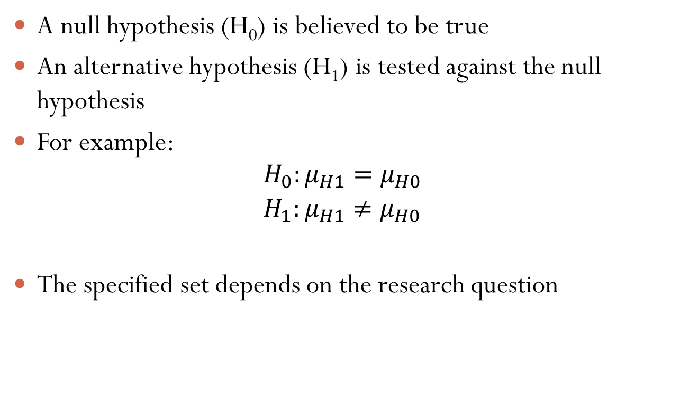
1. State the hypothesis
A null hypothesis (H₀) is believed to be true
An alternative hypothesis (H₁) is tested against the null hypothesis
For example:
$$H_{0}:μ_{H1}=μ_{H0}$$
$$H_{1}:μ_{H1}≠μ_{H0}$$
The specified set depends on the research question

Slide 21
2. Set the criteria for decision
We state the level of significance α for a test. In behavioural science is set at 5%
It means that we make a conclusion by accepting the possibility that the decision is correct 95% of times and wrong 5%

Slide 22
3. Compute the test statistics
Stata computes a test statistic (or z-statistic) that is compared with the test score associated to the significance level
The greater the value of the test statistic, the greater the probability that our alternative hypothesis is true

Slide 23
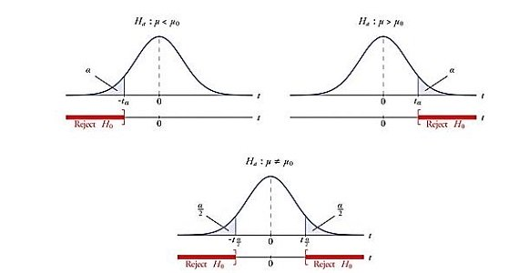
4. Make a decision
If your test statistic follows in the rejection region, the null hypothesis is rejected and the alternative is considered as the true one (the rejection region depends on the type of H1)

Slide 24
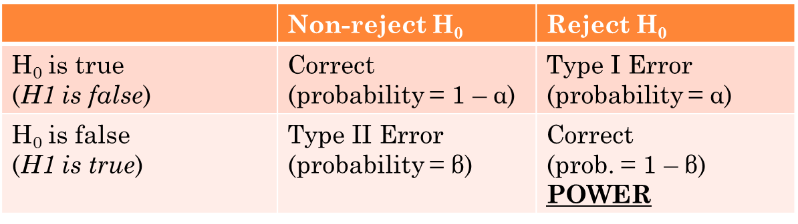
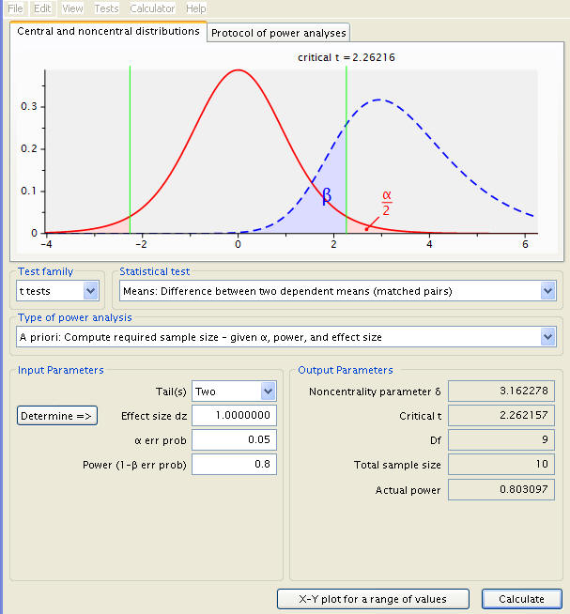
Power, Types of errors
Distribution of X under H0
Distribution of X under H1

Slide 25
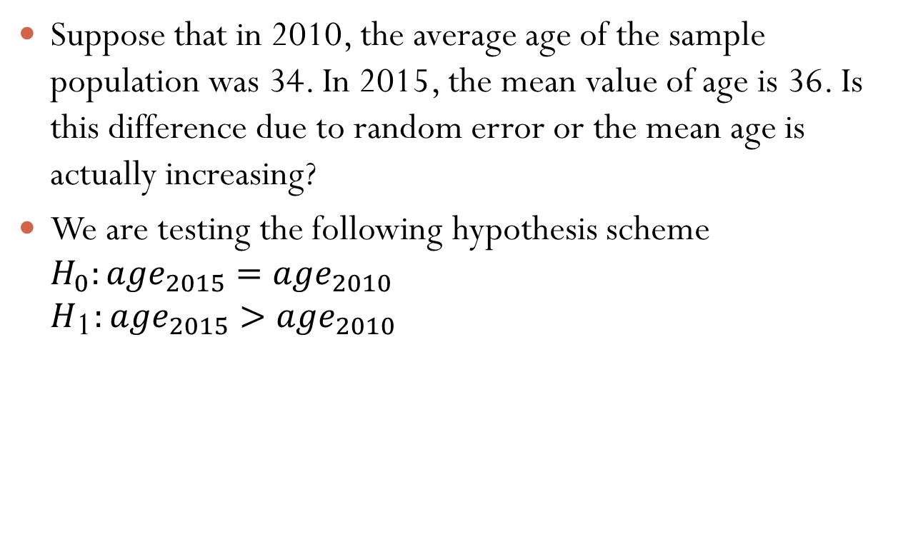
Example
Suppose that in 2010, the average age of the sample population was 34. In 2015, the mean value of age is 36. Is this difference due to random error or the mean age is actually increasing?
We are testing the following hypothesis scheme
$$H_{0}:{age}_{2015}={age}_{2010}$$
$$H_{\text{1}}:{age}_{2015}>{age}_{2010 }$$

Slide 26
Research Hypothesis on one mean
The Stata command is the following:
ttest age = 34
Stata by default always set the confidence interval at 95%. You can change it by using the option level (99)
1
2
3
Stata by default always tests three alternative hypotheses. However we are only interested in looking at the third one
If the p-value < 0.05, H₀ is rejected with a 95% confidence level

Slide 27

Research Hypothesis on two means
Sometimes we want to understand if two sub-groups (a, b) of our population are differ in some aspects
The two means research hypothesis scheme is the following:
For example, is the age different between individuals who are more likely to recycle?
$H_{0}:μ_{a}−μ_{b}=0$
$$H_{1}:μ_{a}−μ_{b}≠0$$
$$H_{1}:μ_{a}−μ_{b}>0$$
$$H_{1}:μ_{a}−μ_{b}<0$$

Slide 28

Research Hypothesis on two means
ttest age, by(s3_1dummy)
The p-value > 0.05, in all cases. Therefore we do not reject the null hypothesis.

Slide 29
Exercises (food waste)
Is the average age significantly different between men and women?
Is the average age significantly different between people who live nearby a recycling site than those who don’t? (variable s5_4). If so why?
Concerning the belief that recycling is fully a personal choice (variable s4_2), is this belief stronger in respondents below 30 years old compared to respondents above 30 years old?

