Slide 1

DATA ANALYSIS AND PROCESSING
Francesca Valeria Hansstein
Research Assistant Professor
School of Public Economics & Administration
f.v.hansstein@mail.shufe.edu.cn

Slide 2
Outline
Analysis of Variance (ANOVA)
One-way
Two-way
Examples

Slide 3
Analysis of Variance (ANOVA)
ANOVA is a statistical technique largely used in experimental settings where the researcher has control on the potential noise that could lead to biased results
Experimental design is the only research design that allows to claim causality because observations are randomly assignment to different treatments
For example: a researcher wants to compare three teaching methods and randomly assigns students to the three groups. Do the three different methods lead to a different student’s performance?

Slide 4
ANOVA with survey data
Nowadays, ANOVA is also largely used with survey data especially for measuring differences in attitudes, opinions and behaviors among groups
Some researchers use ANOVA as the main method of their analysis, while others use it together with other more sophisticated method
Opinions Toward Using Volunteers in Ecological Restoration: A Survey of Federal Land Manager (Bruce et al, 2014, Restoration Ecology)

Slide 5
Introduction to one-way ANOVA
The Analysis of Variance is a statistical technique that allows to test how an outcome varies among different groups or conditions (groups or conditions > 2)
With the test of hypothesis on two means we compared the average distribution of one variable among two groups (body mass index by gender)
The ANOVA allows us to test how a continuous variable varies among more than two groups (body mass index by education level)

Slide 6
ANOVA’s terminology
The main idea is that ANOVA tests whether the variance between groups is higher or lower than the variance within groups
The intuitive idea is that if the outcome varies between groups, then the variability between them will be larger than the variability within the groups.
ANOVA is based on variance decomposition:
total variance = variance between + variance within

Slide 7



Variance decomposition: an example
How does the expenditure for organic food (x) vary between working status?
Each observation is defined by its position in the sample (row) and the group (column)

Slide 8
ANOVA’s assumptions
The outcome variable is quantitative (or interval level)
The outcome variable is normally distributed (this is problematic if we have a small sample, while is not a problem for large samples)
The observations represent a random sample of the population
The variance of each group is equal (we can test this assumption)
The sample size of each group does not vary widely
Violating combinations of this assumptions is problematic. For example, unequal Ns combined with unequal variances is far worse than unequal variances when Ns are equal.

Slide 9
Testing hypotheses with one-way ANOVA
How can we present our research hypothesis in a formal way?
With hypothesis testing we still refer to differences in the MEAN of an outcome between different groups.
You can be more specific according to your research goals. I.e. you expect that health expenditure is higher among individuals between 40-50

Slide 10
Post-hoc comparison tests for One-way ANOVA
ANOVA analysis only tells us whether the means are different or not
To know what group is different from the other, we need to run post-hoc comparisons tests
Stata offers three options for post-hoc tests:
Bonferroni
Sheffe
Sidak

Slide 11
Example
For the example in Stata we will use the default dataset “systolic”
How does the systolic blood pressure of different patients change with the drug employed?
What is the goal? To individuate which drugs is more effective

Slide 12
ANOVA output in Stata
We expect MS of Between groups > MS of within groups
MS = SS/DF
The p-value of the F statistics is < 0.0000 so we reject the null hypothesis of equal means across groups.
By default, Stata also tests the assumption about the equality of variance. The test is non-significant which is good, because we do not reject H0 (equal variance among groups)

Slide 13
One-way ANOVA output in Stata
Which groups are different? Bonferroni test takes the difference between row mean and column mean of the respective groups and determine its significance. In our case, all groups are different but the highest difference in systolic blood pressure is observed between treatment 3 and treatment 1.

Slide 14
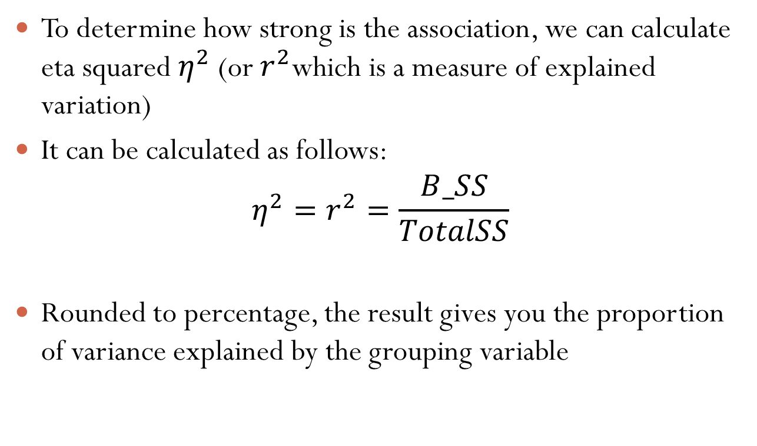
Effect size
To determine how strong is the association, we can calculate eta squared $η^{2}$ (or $r^{2}$which is a measure of explained variation)
It can be calculated as follows:
$$η^{2}=r^{2}=\frac{B_SS}{TotalSS}$$
Rounded to percentage, the result gives you the proportion of variance explained by the grouping variable

Slide 15
Effect size
Alternatively, you can also use omega2 or Cohen’s F
Omega2, compared to eta squared, is adjusted y degrees of freedom and error term
You can install the command effectsize for a display of all the size measures
Roughly, the interpretation of the coefficient’s values is the following:
Test | Small | Medium | Large
Omega2 / Eta2 | .01 | .06 | .14
F Cohen’s | .10 | .15 | .40

Slide 16
Two-way ANOVA
Two-way ANOVA has two predictors and one outcome
Considering our previous example, suppose that we want to see how systolic blood pressure changes with drug and type of disease
To fully evaluate the efficacy of a treatment we need to “control” for other external and potential confounding factors
It is also useful to observe the interaction effect

Slide 17
Two-way ANOVA
Steps for two-way ANOVA:
Descriptive statistics: report the mean of the outcome for each predictors
Run the ANOVA and discuss the results: are the variables both significant?
Determine the effect size

Slide 18
Two-way ANOVA

Slide 19
Two-way ANOVA

Slide 20
Two-way ANOVA

Slide 21
Two-way ANOVA: Stata Output
Overall the model is statistically significant, with a p-value < 0.001
In this example, the blood pressure does not vary with the type of diseases (p-value > 0.05), but only with the type of drug

Slide 22
Two-way ANOVA: Stata Output
The interaction term between disease and drug is also not significant

Slide 23
Two-way ANOVA
Sequential sums of squares depend on the order the factors are entered into the model. It is the unique portion of SS Regression explained by a factor, given any previously entered factors.
For example, if you have a model with three factors, X1, X2, and X3, the sequential sums of squares for X2 shows how much of the remaining variation X2 explains, given that X1 is already in the model. To obtain a different sequence of factors, repeat the regression procedure entering the factors in a different order.

Slide 24
Two-way ANOVA
As an extra check, we can run the ANOVA by specifying that the sum of squares is calculated with sequential sum of squares

