Slide 1

DATA ANALYSIS AND PROCESSING
Francesca Valeria Hansstein
Research Assistant Professor
School of Public Economics & Administration
f.v.hansstein@mail.shufe.edu.cn

Slide 2
Outline
Covariance and Correlation
Simple regression
Multiple regression

Slide 3
Final Research Project
Project structure
Formulate your research questions. Look for some other papers or studies related to your topic (1 or 2). Do you know anything about the theory behind? | Introduction
Describe the dataset you want to use and the variables involved in the analysis. Explain data transformation and management (if any) Discuss the method you chose and explain why it is appropriate for your analysis | Data & Methods
Report descriptive statistics of the variables and some graphs Report the regression results Carefully explain the interpretation of the results | Results
Comment your findings, and discuss possible explanations, discuss their significance. If the variance is low or some of the assumptions do not work, try to explain what may have gone wrong (I do not expect a perfect result!) | Discussion
Summarize your findings in one sentence | Conclusions

Slide 4
Covariance and Correlation
Covariance and correlation describe how two continuous or interval variables are related:
Variables are positively related if they move in the same direction
Variables are negatively related if they move in opposite direction
Both covariance and correlation indicate whether two variables are positively or inversely associated

Slide 5
From Covariance to Correlation
Covariance measures the association of two variables that have different units of measurement: we cannot compare the intensity of the association
Correlation standardizes the measure of interdependance so that it is not affected by the different units of measurement
Correlation tells not only whether two variables are related but also the degree to which they move together
It is measured by the Pearson Correlation Coefficient
We can also calculate the significance of this relation

Slide 6

How to calculate covariance
Sometimes it is also indicated as s_{xy ,} or 𝜎_{xy} for population parameter
x is the independent variable
y is the dependent variable
n = sample size
x-bar = mean of the independent variable
y-bar = mean of the dependent variable
If the Cov (x,y) is positive it means that the two variables are positively related, if Cov (x, y) is negative the two variables are inversely related.

Slide 7

How to calculate correlation
Also indicated as 𝜌_{xy} for population parameter
cov (x,y) indicates the covariance between variable x and variable y
s_{x} = sample standard deviation of the random variable x s_{y} = sample standard deviation of the random variable y
The correlation coefficient takes value between -1 and 1
If r ≈ 0 it means no correlation
If r ≈ 1 it means perfect positive correlation
If r ≈ -1 it means perfect negative correlation

Slide 8
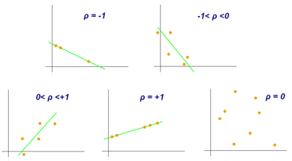
Graphical representation of Correlation
Notes:
Do not be confused with the regression: here we are still one step behind. We do not have any estimation of the beta coefficient yet, we are only observing if two variables are related and to what degree.

Slide 9
Correlation and Covariance in Stata
Correlation in Stata can be performed using the command correlate followed by the variables’ list
Covariance can be obtained using the command pairwise correlation (pwcorr followed by the variables’ list)
The advantage of using pwcorr is that you can also display the p-value for the correlation and you can chose how treating missing values among two types of deletion:
Casewise (default): the correlation is run on all the available pairs
Listwise (available as an option): if a respondent does not answer to one variable, he/she is dropped from the calculation

Slide 10
Correlation in Stata
a8, trust level towards food chain stakeholders
b8, trust level towards mass media
c8, trust level towards doctors
d8, trust level towards labels
e8, trust level towards supermarket

Slide 11
Covariance in Stata

Slide 12
Statistical Significance versus Substantive Significance
It is easy to confuse statistical and substantive significance.
With a large sample size, we can find statistical significance even when the Pearson’s coefficient is very small.
This does not mean that two variables are weakly correlated in the population, rather that their correlation in the population is not important.
Statistical significance is based on the probability that you can get the same results in the population
Substantive signficance is based on the size of the correlation

Slide 13
Scattergram
A scattegram is a graphical representation of two continuous or interval variables where each dot corresponds to a pair of values (x_{i}, y_{i})
For example, what is the relationship between the death rate (number of deaths per one thousand people per year) and the median age the US States?
The relationship is positive –> the intuituion is that the population of some States is older than others

Slide 14
Scattergram

Slide 15
Fitted scattergram

Slide 16
Introduction to Regression
If correlation describes variable comovement, regression analysis quantifies the relation between an independent and a depedent variable
Regression analysis estimates how the dependendent variable changes when the independent variable increases by one unit

Slide 17
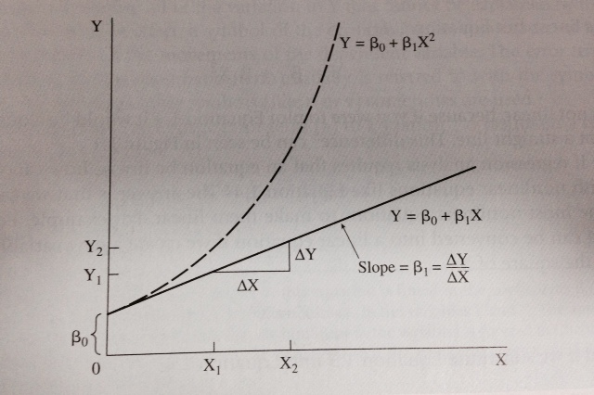

Single-Equation Linear Model
Non-linear with increasing slope
Linear with constant slope
Notes:
Let’s start with the basics.

Slide 18
Stochastic Error
The error term or disturbance term (indicated by 𝜀) includes all the sources of variation that are not explained by the regression. What are the sources of this variation?
Omission: lack of information about additional factors that affect the dependent variable
Errors of measurement of the dependent variable
The underlying theoretical equation has a different functional form (= non linear)
Pure randomness

Slide 19
Example on the Stochastic Error
Aggregate consumption may be also affected by uncertainty over future which is not easy to measure
The function may not necessarily be linear
Consumption may vary for random or unpredictable behavior (i.e. impulsive behaviros)
Sampling Error in measuring the consumption level (misreporting by respondents)

Slide 20
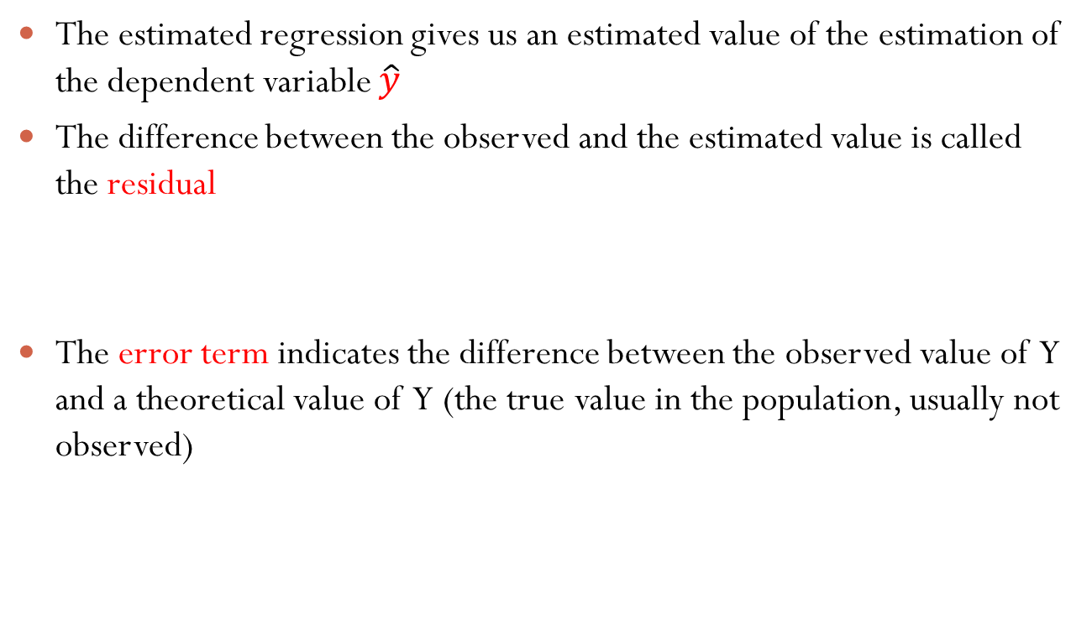
The estimated regression: residuals
The estimated regression gives us an estimated value of the estimation of the dependent variable $\hat{y}$
The difference between the observed and the estimated value is called the residual
The error term indicates the difference between the observed value of Y and a theoretical value of Y (the true value in the population, usually not observed)

Slide 21
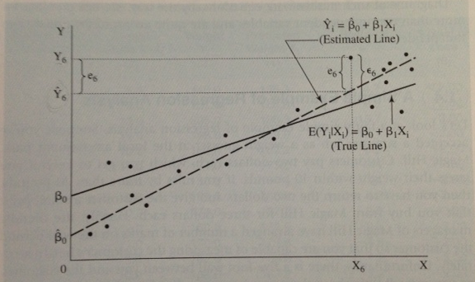
The estimated Regression: residuals
However, an important property of the residuals is that they are a good estimator of the error term and can be indicated as
e6 indicates the difference between the observed and the estimated value of the dependent variable
𝜀6 indicates the difference between the observed and the theoretical value
There are two regression lines we need to consider: the theoretical regression line (impossible to know) , and the estimated one (dashed)
Notes:
This is theory: we never observed the true line, but with proper methodology we can estimate one.

Slide 22


Estimating the Regression Line: Ordinary Least Squares (OLS)
The most widely used method is the Ordinary Least Squares (OLS). It calculates the 𝛽_{s} so that the sum of the squared residuals is minimal
That is equivalent to minimize the squared distances of the observed and estimated values of Y:

Slide 23
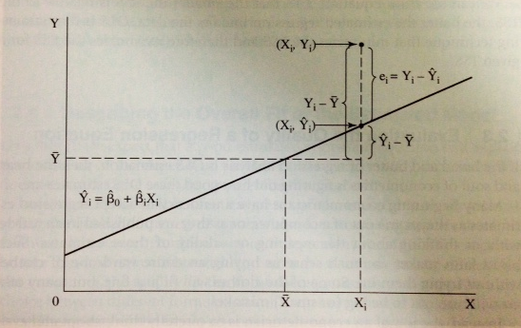
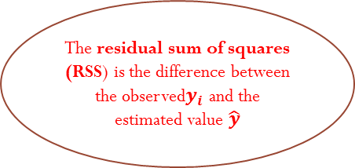
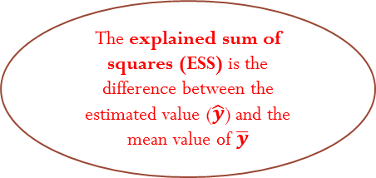
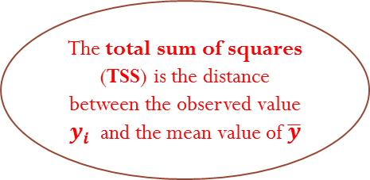
Total, Explained and Residual Sums of Squares
The total sum of squares (TSS) is the distance between the observed value $y_{i}$ and the mean value of $\overline{y}$
The residual sum of squares (RSS) is the difference between the observed$y_{i}$ and the estimated value $\hat{y}$
The explained sum of squares (ESS) is the difference between the estimated value ($\hat{y}$) and the mean value of $\overline{y}$
Notes:
Tip: think about the variance decomposition

Slide 24


Total, Explained and Residual Sums of Squares and R2
Note that this ratio is equal to 1 it means that our model does not explain anything and Y depend entirely by the errors, that is by variables that we did not included in the model.
This is how it is calculated. Since ESS, RSS and TSS sre all non-negative, the R-squared is included between 0 and 1. If closer to 0 it means that the estimated regression does not explain well the variability of the error. If it is close or equal to 1 it means that it is a very good model.
The R-squared is the ratio between the explained and the total sum of squares. The higher, the better. The R-squared measures the goodness of fit of the estimated regression. CORRECT THE DENOMINATOR IS Y-Ybar

Slide 25

The Adjusted R2
The problem of R2 is that whenever we add a new independent variable, the R2 never decreases and this can lead to misleading results. We thus need to calculate the adjusted R-squared (reported by Stata)
Where, N is the sample size and K is the number of coefficients

Slide 26
Simple linear regression in Stata
When AGE increases by 1, death rate increases by 5.6
p < 0.000

Slide 27
Multiple linear regression
Multiple regression is an extension of the simple linear regression
The model specifies more than one predictors
It opens the door to most publications in social sciences
Many phenomena are in fact explained at the light of many predictors, not just one

Slide 28
Simple linear regression in Stata
Another example with the dataset nlsw88
What is the relationship between wage and tenure?
Wage is the hourly wage in USD and tenure “how long a person has worked in the current job”
Scatter your graph
Run the regression
Postestimation (from the menu statistics)

Slide 29
Multiple linear regression
When running multiple regression in Stata, you can proceed as follows:
Specify the model
Produce tables with descriptive statistics
Produce correlation matrix
Run the regression and interpret the results
Test the validity of the OLS assumptions
Allow for other functional forms (optional)
Add dummy and/or categorical variables to regression (optional)
Add quadratic terms (optional)
Examine interactions (optional)

Slide 30
Model specification
Identify your dependent continuous variable Y and your independent variables X_{n}
Support your research hypotheses with appropriate arguments and theory
For example, using a default dataset, we can explore how wage varies with tenure, total years of experience, and working hours by week
Regression tests that the beta coefficients of each predictor is equal to zero and, based on the results of the p-value, we decide whether to reject the null hypothesis or not
After you run the regression, you can write now the fitted regression line

Slide 31
Multiple regression: Stata output
We can see that the overall model is highly significant F=MSm/MSr
How well does the model fit the data? R2
The column coef. report the values of the and regression coeffiecients (β), their significance (p-value) in explaining environmental concern
In the output we have three blocks.

Slide 32
R2 interpretation
If you are just exploring a relation, R2 of 0.3 is considered good
Usually, in social sciences research, when R2 is lower than 0.1, the relationship is weak, if it is between 0.1 and 0.2 is moderate, and above 0.3 is strong
This interpretation is especially correct when the objective is to explore human behaviors

Slide 33
The advantage of using the option beta
Do not confuse the option beta with the coefficients
The column reporting the betas calculates standardized coefficients that allow a fair comparison among variables
The problem of the coefficients is that they have a different unit of measurement (i.e. income is measured in dollars, education in year etc.) that makes difficult to compare the variables’ relative impact
Beta weights instead allow to compare coefficients more objectively

Slide 34
The Classical OLS Assumptions
The regression model is linear (in its coefficients), correctly specified (no omitted variable bias) and has an additive error term
The error term has constant variance (no heteroskedasticity)
The expected value of the error term is zero (always verified)
Errors are identically and independently distributed (iid)
No explanatory variable is a perfect linear function of any other explanatory variables (no perfect multicollinearity)
Exogeneity: all explanatory variables are uncorrelated with the error (otherwise you get a biased estimator)
If these assumptions hold, the OLS estimator of betas is said to be BLUE (Best Linear Unbiased Estimator). This is the Gauss- Markov Theorem.
Notes:
For the Four assumption: factors that affect my error are not related by factors that affect your error (if we are both part of a sample)

Slide 35
Testing for homoscedasticity
An important assumption of the OLS regression is that the residuals (obtained as the difference between the observed and the estimated value) are homoscedastic (same variance) and not heteroscedastic (different variance)
This means that the variance of the residuals, given the explanatory (independent) variables is constant across the observations

Slide 36
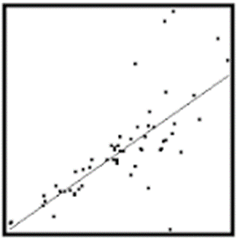
Testing for homoscedasticity
To test for homoscedasticity you can proceed as follow:
Scatter the predicted values and the residuals
Run the Breusch-Pagan test
Homoscedasticity. This assumption means that the variance around the regression line is the same for all values of the predictor variable (X). The plot shows a violation of this assumption. For the lower values on the X-axis, the points are all very near the regression line.

Slide 37
Testing for Homoscedasticity
If the assumption on Homoscedasticity holds, we should not expect any pattern. However, this does not seem to be the case in our example.
Differences between values observed and estimated – variance not explained by the regression
Estimated Y

Slide 38
Testing for Homoscedasticity
The Breusch-Pagan test is based on the following hypotheses:
H₀: errors have equal variance
H₁: errors are heteroskedastic
After the regression just hettest
We reject the null hypothesis and conclude that errors are heteroskedastic. To correct for not meeting this assumption, we will run the regression with robust standard errors

Slide 39
Testing for Homoscedasticity
We correct our regression by typing the following:
Note that not meeting this assumption is very common. The significance of our estimates does not change drastically (only the t values change a bit) but we are confident that they are now more precise.

Slide 40
Testing for multicollinearity
A fundamental assumption is that none of the explanatory variables is a perfect combination of other explanatory variables (otherwise standard errors would be inflated)
Some correlation among variable is unavoidable and it is not problem
To check for multicollinearity, the command VIF (Variance Inflation Factor) is used
After the regression, just type vif

Slide 41
Testing for multicollinearity
As a rule of thumb, if VIF > 10 there is a problem with that variable. In our case the assumption is met.
Note that if we use interactions, the VIF for the variable and its interaction can be higher than 10. This does not mean that we have a problem.

Slide 42
Testing for omitted variable bias
How do we know that we have included all the relevant explanatory variables?
Testing for omitted variable bias is important, especially when an omitted variable is linked to both explanatory and dependent variable
In Stata we can do this by using the omitted variable test (ovtest command)
In the command line, just right after the regression type ovtest

Slide 43
Testing for specification: omitted variable bias
The test is based on the following hypotheses:
Ho: the model has no omitted variable(s)
H1: the model has omitted variable(s) This model is used when you want to test whether to add or not an additional variable in the specificiation.

