Slide 1

DATA ANALYSIS AND PROCESSING
Francesca Valeria Hansstein
Research Assistant Professor
School of Public Economics & Administration
f.v.hansstein@mail.shufe.edu.cn

Slide 2
Final Research Project
Project structure
Formulate your research questions. Look for some other papers or studies related to your topic (1 or 2). Do you know anything about the theory behind? | Introduction
Describe the dataset you want to use and the variables involved in the analysis. Explain data transformation and management (if any) Discuss the method you chose and explain why it is appropriate for your analysis | Data & Methods
Report descriptive statistics of the variables and some graphs Report the regression results Carefully explain the interpretation of the results | Results
Comment your findings, and discuss possible explanations, discuss their significance. If the variance is low or some of the assumptions do not work, try to explain what may have gone wrong (I do not expect a perfect result!) | Discussion
Summarize your findings in one sentence | Conclusions

Slide 3
Outline
Testing regression assumptions
Building theoretical constructs:
The principal component factor analysis (PCFA)
Generating a construct: factor score and mean score

Slide 4
The Classical OLS Assumptions
The regression model is linear (in its coefficients), correctly specified (no omitted variable bias) and has an additive error term
The error term has constant variance (no heteroskedasticity)
The expected value of the error term is zero
No explanatory variable is a perfect linear function of any other explanatory variables (no perfect multicollinearity)
All explanatory variables are uncorrelated with the error (otherwise you get a biased estimator)
If these assumptions hold, the OLS estimator of betas is said to be BLUE (Best Linear Unbiased Estimator). This is the Gauss- Markov Theorem.
Notes:
For the Four assumption: factors that affect my error are not related by factors that affect your error (if we are both part of a sample)

Slide 5
Testing for homoscedasticity
An important assumption of the OLS regression is that the residuals (obtained as the difference between the observed and the estimated value) are homoscedastic (same variance) and not heteroscedastic (different variance)
This means that the variance of the residuals, given the explanatory (independent) variables is constant across the observations

Slide 6
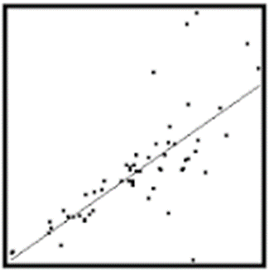
Testing for homoscedasticity
To test for homoscedasticity you can proceed as follow:
Scatter the predicted values and the residuals
Run the Breusch-Pagan test
Homoscedasticity. This assumption means that the variance around the regression line is the same for all values of the predictor variable (X). The plot shows a violation of this assumption. For the lower values on the X-axis, the points are all very near the regression line.

Slide 7
Testing for Homoscedasticity
If the assumption on Homoscedasticity holds, we should not expect any pattern. However, this does not seem to be the case in our example.

Slide 8
Testing for Homoscedasticity
The Breusch-Pagan test is based on the following hypotheses:
H₀: errors have equal variance
H₁: errors are heteroskedastic
After the regression just hettest
We reject the null hypothesis and conclude that errors are heteroskedastic. To correct for not meeting this assumption, we will run the regression with robust standard errors

Slide 9
Testing for Homoscedasticity
We correct our regression by typing the following:
Note that not meeting this assumption is very common. Our estimates do not change drastically (only the t values change a bit) but we are confident that they are now more precise.

Slide 10
Testing for multicollinearity
A fundamental assumption is that none of the explanatory variables is a perfect combination of other explanatory variables (otherwise standard errors would be inflated)
Some correlation among variable is unavoidable and it is not problem
To check for multicollinearity, the command VIF (Variance Inflation Factor) is used
After the regression, just type vif

Slide 11
Testing for multicollinearity
As a rule of thumb, if VIF > 10 there is a problem with that variable. In our case the assumption is met.
Note that if we use interactions, the VIF for the variable and its interaction can be higher than 10. This does not mean that we have a problem.

Slide 12
Testing for omitted variable bias
How do we know that we have included all the relevant explanatory variables?
Testing for omitted variable bias is important, especially when an omitted variable is linked to both explanatory and dependent variable
In Stata we can do this by using the omitted variable test (ovtest command)
In the command line, just right after the regression type ovtest

Slide 13
Testing for omitted variable bias
The test is based on the following hypotheses:
Ho: the model has no omitted variable(s)
H1: the model has omitted variable(s)
We reject the Null Hypothesis, so we need to add more variables. Many other factors that are not included in the analysis are in fact likely to explain environmental concerns.

Slide 14
From theory to constructs
Sometimes researchers are interested to measure “latent constructs” which are by nature theoretical
To measure a latent construct, researchers capture indicators (or variables) that represent the underlying construct
Latent variables are largely employed to understand specific behaviors, for example
TRUST
RISK PERCEPTION
SOCIAL NORM

Slide 15
The theoretical model: Health Belief Model
Consider the dataset Fruit and Vegetables Organic Consumption
The goal was to understand what factors affect the intention to consume organic fruits and vegetables among a sample of young individuals in Shanghai
The questionnaire was built upon the Health Belief Model (Godfrey Hochbaum, Irwin Rosenstock, and Stephen Kegels, 1950)

Slide 16
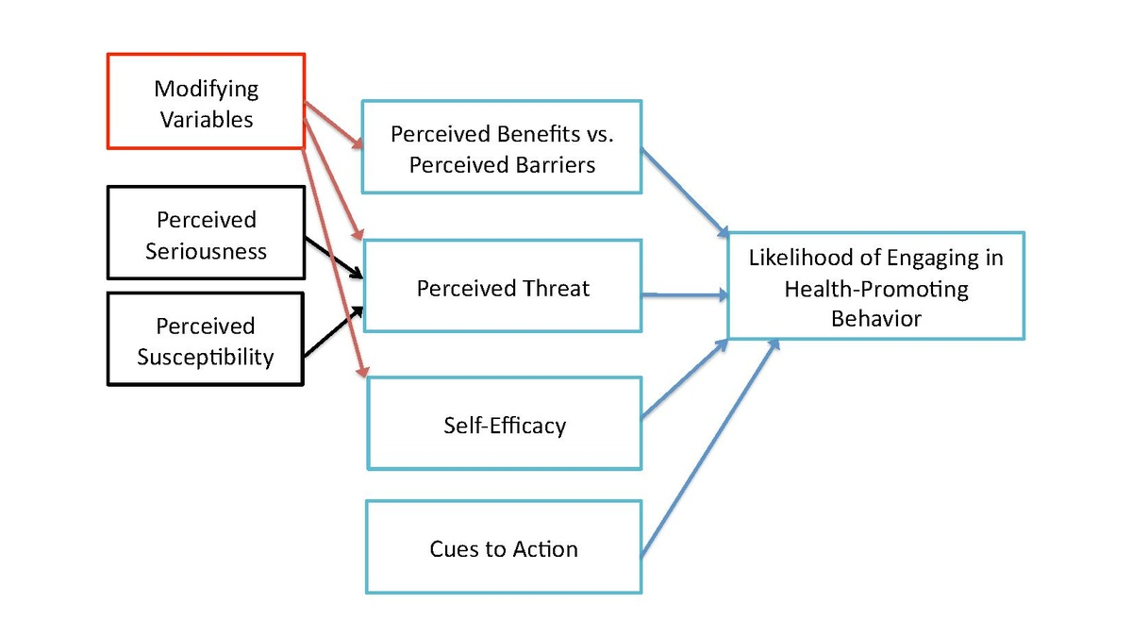
The theoretical model: Health Belief Model
trust

Slide 17
From constructs to items (or questions)
How was the construct TRUST measured?
Given that trust can be expressed in multiple ways, we split in the following questions:
Workers in the food chain can be trusted
When reporting news about organic fruits and vegetables media do a good job
When talking about organic fruits and vegetables, experts and doctors are reliable
Organic labels guarantee that the fruits and vegetables are organic
Supermarkets do not mislead their customers

Slide 18
Measuring trust
When we are measuring a concept it should be unidimensional
For example, if we were measuring health, it is likely that the general concept is bi-dimensional (mental and physical health)
Even if we plan the questionnaire in details, only an appropriate statistical technique test if a concept is unidimensional PRINCIPAL COMPONENT FACTOR ANALYSIS (PCFA)
If the concept is not unidimensional, we will drop some items (questions)

Slide 19
PCFA: how many factors?
F1 = TRUST
The factors indicate how much variance the items have in common (in our case, the intention is the factor we are interested in)
When the eigenvalue is > 1 the factor is very strong
We can say that our items are measuring only one factor (= unidimensional)

Slide 20
PCFA: analyse the loadings
When we run the analysis, we also have to evaluate the following table; it reports how each variable “loads” to the factor intention. The relationship of each variable to the underlying factor is expressed by the so-called factor loading. When the loading is above 0.30 is substantial. If one or more factors had a loading lower than 0.30, we should drop that item(s) from the calculation

Slide 21
Cronbach's Alpha: reliability
The next step is to assess the reliability of our items
Cronbach's alpha is a measure of internal consistency, that is, how closely related a set of items are as a group.
Be careful: a "high" value for alpha does not imply that the measure is unidimensional (for this we used the factor analysis!)
The Cronbach’s alpha must be above 0.70 for saying that the scale is reliable

Slide 22
Cronbach's Alpha: reliability
We also have asked Stata to report what the value of the Cronbach's alpha would be without each item. it never improves so we have again a confirmation that we do not need to drop any variable.
CRONBACH’S ALPHA

Slide 23
Generate the variable TRUST
The final step is to generate a new variable TRUST that varies among all the respondents
The variable is a combination of the items with his own variability: each observations has a value
The variable can be generated with two methods:
Factor score (items are weighted differently)
Mean score (items are weighted in the same way)

Slide 24
Factor score
The first method is using the FACTOR SCORE
This method weights each item based on its loading
The factor score allows for negative values
Scores generated by -predict- after -factor- or -pca- are standardized to a mean of zero

Slide 25
Mean method
The mean score method simply calculate the total score or the mean score for each respondents
The mean score weights each item in the same way
The advantage of using the mean score is that the final score has the same scale as the original items (1 to 4): it is easier to interpret

Slide 26
Choosing between factor and mean scores
If the loadings vary then the factor score is the appropriate choice
If the loadings do not vary significantly and the items are equally important (tau equivalent) then the mean score is more convenient
You can correlate the two factor scores: if the correlation is very high (0.90 or above) the two scores are very similar

Slide 27
Conclusions and summary
identify the key constructs based on theory
Develop the questionnaire and collect the data
Make sure that the questions you chose are measuring one concept (unidimensional) PCFA
If not, drop some items.
Check the internal consistency
CRONBACH’s ALPHA
Build your variable using either the factor score method or the mean score method
Go ahead and use this new variable to perform further statistical analysis

