Slide 1

DATA ANALYSIS AND PROCESSING
Francesca Valeria Hansstein
Research Assistant Professor
School of Public Economics & Administration
f.v.hansstein@mail.shufe.edu.cn

Slide 2
Outline
Logit regression
Ordered categorical regrssions
Building theoretical constructs:
The principal component factor analysis (PCFA)
Generating a construct: factor score and mean score

Slide 3
Dummy dependent Variable: Introduction
Simple and multiple regressions focus on a quantitative interpretation and the dependent variable is assumed to be continuous
However, the dependent variable can sometimes take the form of a dummy
Do you smoke?
Do you go to the doctor at least once per year?
In this case we have to use a binary regression model, that has a dummy variable as outcome

Slide 4
The linear probability model (LPM)
The LPM uses OLS method to estimate the model
The OLS places no restrictions on the values of the independent variables (continuous, ordered categorical or dummy)
The dependent variable, however, is assumed to be continuous, so it must be “free” to range in value from negative infinite to positive infinite
In practice, given that a dichotomous dependent variable only takes two values (0-1), only a small range of Y will be observed

Slide 5
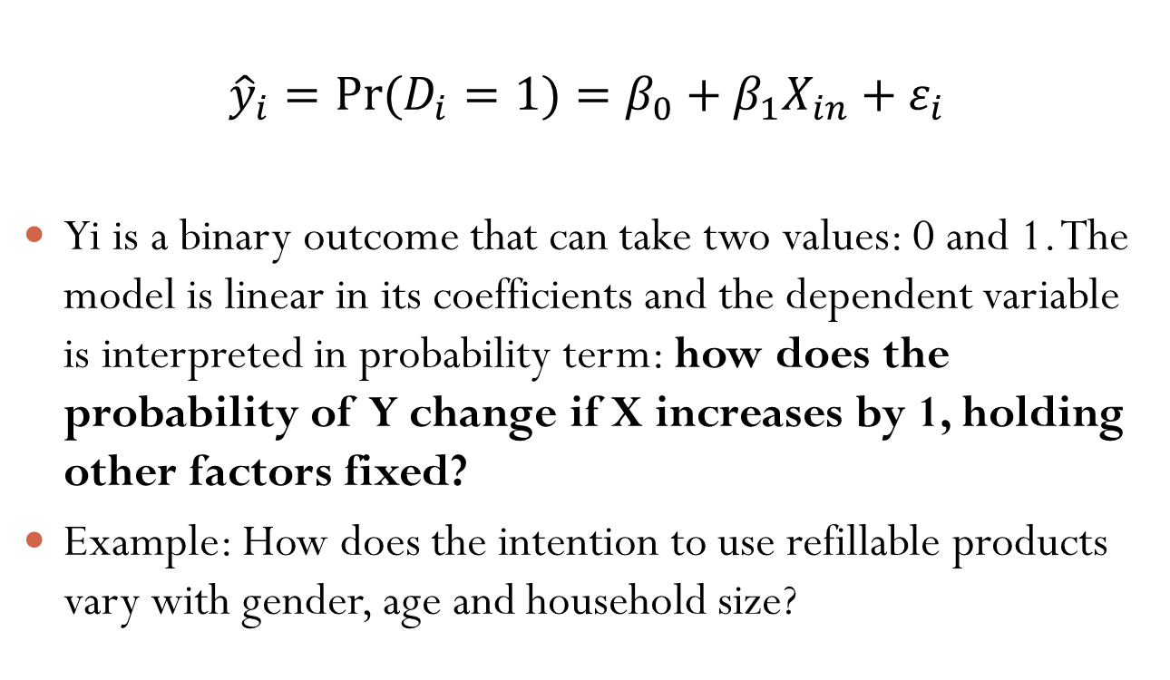
The linear probability model: an Example
$${\hat{y}}_{i}={Pr⁡(D}_{i}=1)=β_{0}+β_{1}X_{in}+ε_{i}$$
Yi is a binary outcome that can take two values: 0 and 1. The model is linear in its coefficients and the dependent variable is interpreted in probability term: how does the probability of Y change if X increases by 1, holding other factors fixed?
Example: How does the intention to use refillable products vary with gender, age and household size?
Notes:
The first possibility is to estimate a linear probability model

Slide 6
The LPM in Stata
When using the Linear Probability Model, the method for estimating the coefficients is always the OLS
How can we interpret the coefficients? For a unit increase of the variable d1_3 (older people), the probability of using refilled products decreases (however, p > 0.05)

Slide 7
Dummy dependent variable: Graphical Output
Yes
From the graphical representation we cannot see a clear pattern. If there were a strong relationship, we would expected a higher concentration of YES on the right side of the x axis and a higher concentration of NO on the left side.
No

Slide 8
Limitations of the LPM
There are two problems with the linear probability model:
R² is not an accurate measure of overall fit.
Y-hat is not bounded by 0 and 1 (this is the most serious)

Slide 9
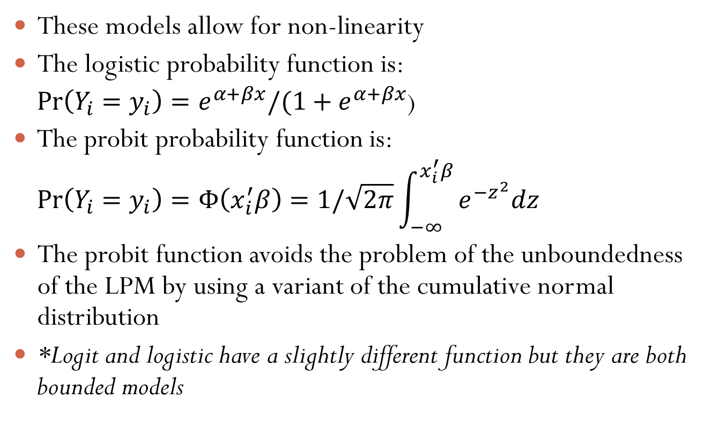
Probit and Logistic (or Logit)*
These models allow for non-linearity
The logistic probability function is:
$\operatorname{Pr}\left(Y_{i}=y_{i}\right)=e^{α+βx}/(1+e^{α+βx}$)
The probit probability function is:
$$\operatorname{Pr}\left(Y_{i}=y_{i}\right)=Φ\left(x_{i}^{′}β\right)=1/\sqrt{2π}\int_{−∞}^{x_{i}^{′}β}{e^{−z^{2}}dz}$$
The probit function avoids the problem of the unboundedness of the LPM by using a variant of the cumulative normal distribution
*Logit and logistic have a slightly different function but they are both bounded models

Slide 10
Logit, logistic and probit in Stata
These models have different functions, but in practical applications they are often used interchangeably
In fact, regression results will not substantially change
You can try all of them anyway and chose the one that best fits the data
While the probit and logit outputs report coefficients, logistic regression’s output reports the odds ratios (this is the most noticeable difference between the two models)

Slide 11
Stata Output: Logistic Regression
Logistic regression is based on the maximum likelihood estimation (rather than OLS). Several iterations are repeated until the best solution is found.
The values are followed by the likelihood ratio chi-squared test and by its significance.
The Logistic regression also reports the McFadden R2 (pseudo R2) which is usually small and rarely reported in papers. Do not confound it with the R2 of the OLS.
When age-category increases by one, the odds of using refillable products decreases by 5% (1-0.95) (howeer not significant)

Slide 12
Interpreting odds ratios
odds ratio (OR) = 1 → no association between X and Y
OR > 1 → positive association between X and Y
OR < 1 → negative association between X and Y
Odds ratio values can be expressed in terms of %:
if the OR > 1 we calculate (OR-1)*100
if the OR < 1 we calculate (1-OR)*100

Slide 13
Stata output: Logit & Probit
The only difference with the logistic regression is that the logit and probit give us the coefficient scores that are difficult to interpret (only look at their sign and significance)
LOGIT

Slide 14

Stata output: Logit & Probit

