Slide 1
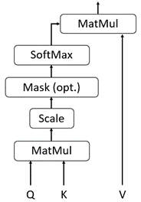
MatMul
SoftMax
MatMul
SoftMax
Mask (opt.)
Mask (opt.)
Scale
Scale
MatMul
MatMul
Q
K
V
Q
K
V

Slide 2
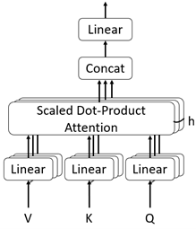
Linear
Concat
Scaled Dot-Product Attention
Linear
Linear
Linear
K
V
Q

