Slide 1
EDA Case Study
(Batch: DS C24)
By,
Sundara Rajan Jeyaraj : srajan87@gmail.com
Vyshnavi K: kvredu61@gmail.com

Slide 2
Problem Statement
The loan providing companies find it hard to give loans
  Due to their insufficient or non-existent credit history
Some consumers use it as their advantage
  by becoming a defaulter.
The company has to decide for loan approval based on the applicant’s profile.
Two types of risks are associated with the bank’s decision:
  Loss of business - Denying applicant who is likely to repay
  Financial Loss – Approving applicant who is not likely to repay

Slide 3
Exploratory Data Analysis
Data Sourcing
  application_data.csv
  previous_application.csv
Data Cleaning
  Numpy
  Pandas
Univariate, Bivariate & Multivariate
  Matplotlib
  Seaborn

Slide 4
Initial Steps
Read ‘application_data.csv’ file,
  Rows – 307511
  Columns - 122
Understand column descriptions using ‘columns_description’ file.
Data cleaning
  Check for NULL/Missing values
  Understand NULL/Missing values
  Handle NULL/Missing values
    Remove
    Impute
    Ignore

Slide 5
Checking & treating Null values
OCCUPATION_TYPE Column:
Total 96,391 NULLs of 3+ Lac records
  55,357 are pensioners in NAME_INCOME_TYPE column
  22 are unemployed,
55,379/ 96,391 are valid NULL values
Remaining 41,019 were imputed with MODE (Laborer)
ORGANIZATION_TYPE column:
55,374 “XNA”.
Corresponds to Pensioners and Unemployed
Valid NULLs
Hence replaced with NULL

Slide 6
Checking and treating Null values
OWN_CAR_AGE Column:
2+ Lac NULL values
These are valid ones, those customers don’t had a CAR
No data fix done
NAME_TYPE_SUITE Column:
1,292 NULL values
Replaced with MODE (Unaccompanied)
AMT_GOODS_PRICE Column:
278 NULL values
Corresponds to NAME_CONTRACT_TYPE “Revolving loans”
Almost all “Revolving loans” has AMT_CREDIT equal to AMT_GOODS_PRICE .
Replaced it with corresponding AMT_CREDIT

Slide 7
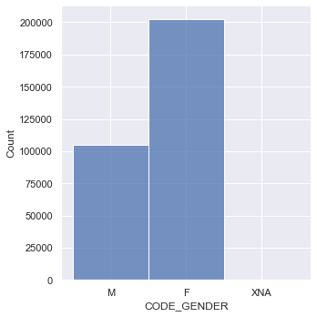
Univariate Analysis
Gender column:
When Univariate analysis was being conducted for Gender column
and it was found that there is a field named XNA which has 2 values in that.
We don't see any observations from these records, may be these are operator entry error, as they have missing values in OCCUPATION_TYPE column as well for 2 out of 4
So these can be either replaced with Mode (Female)
This is the displot drawn for the gender column
Where we can see that there are
100% more Females getting loan
when compared with Male.

Slide 8
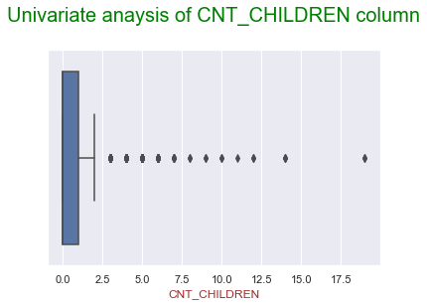
Univariate Analysis
CNT_CHILDREN : We drew a box plot to find the outliers in this column
And also used describe function to know the statistics of the data.
We found that the 75% value is 1 and max value is 19
I

Slide 9
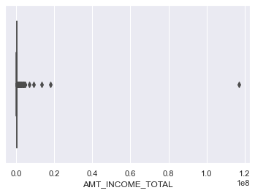
Univariate Analysis
AMT_INCOME_TOTAL: When we drew a boxplot for this column we found
that there is only one outlier as shown below:
When we checked that outlier we found an
Interesting fact that the occupation type of the person is Laborer and he has a salary of more than 9 digit.
A laborer having a 9 digit salary is not logically possible, so we can remove this row.
We don't have sufficient data to confirm these 4 customers as outliers, so leaving those as it is.

Slide 10
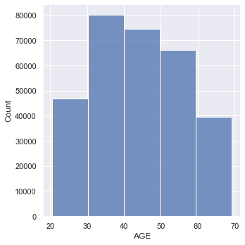
Univariate Analysis
To know the age of the people who are most likely to apply loan a distplot with
binning was created as shown below:
We can infer that more number of Applicant's are in age group of 30-60.
NAME_FAMILY_STATUS:
Most of the loan are taken by married people.
As married people have many responsibilities and need more financial aid to run the family, they are prone to take loans more.

Slide 11
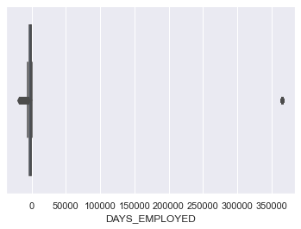
Univariate Analysis
DAYS_EMPLOYED:
When we checked DAYS_EMPLOYED column we found that there is an outlier which has an experience of 1000 yrs.
On further analysis found that these customers are either Pensioners or Unemployed
They have DAY_EMPLOYED as 36,5243 (1000 years)
Replaced 36,5243 with NULL.

Slide 12
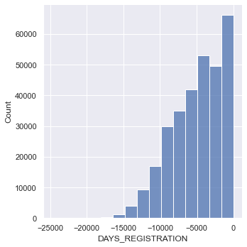
Univariate Analysis
DAYS_REGISTRATION: It is the number of days before which the
registration was changed.
We started our analysis by drawing the distplot
Many people have changed their registration very recently before application for a loan

Slide 13
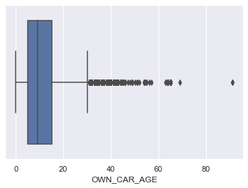
Univariate Analysis
OWN_CAR_AGE: This tells us the age of the car which is owned by person
who is taking loan. When drew a box plot to check the outliers.
Average life of cars in India is 15 years, which is
matching with 75% percentile for the given data
We could see some outliers having car age greater
than 60 years.
There are 3339 customers with cars of 60 years
or older, which is an outlier.
i.e. there 3.19 % outliers in OWN_CAR_AGE.

Slide 14
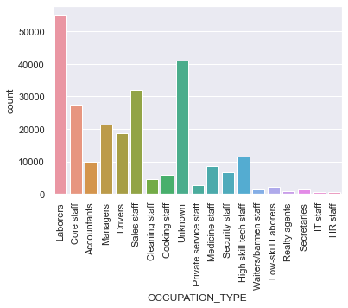
Univariate Analysis
OCCUPATION_TYPE : This is occupation of the applicants whoever are taking
loans.
Count-plot was drawn for the same to draw some insights from it.
We can see from the count plot that most of the people who take loans are
laborers as their salary would be very less and they have many financial
responsibilities to fulfill.

Slide 15
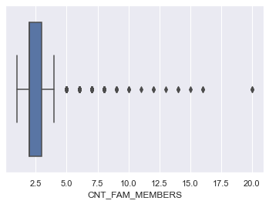
Univariate Analysis
CNT_FAM_MEMBERS: This is number of family members present of loan
holder.
We found outliers when we drew Box-plot. There were more than 10
people in a family.
These are valid data as they have many children that results in more number of family members.

Slide 16
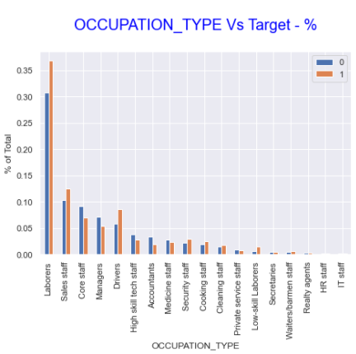
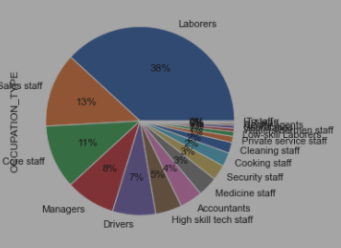
Bi-variate Analysis :
Occupation_Type Vs Target
Insights:
We can see from the pie chart that laborers are more likely to take loan because of their financial conditions.
Laborers, Sales staff, Drivers are among the top 5 borrowers and has more difficulties in repaying their loans.
Other lower wage people, like Security Staff, Cooking Staff, Cleaning Staff, Low-Skill Laborers too have difficulties in repaying their loans

Slide 17
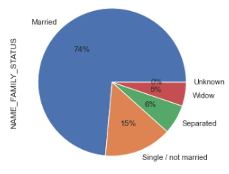
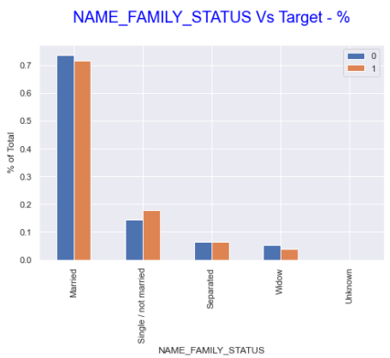
Family_Status Vs Target
Insights:
74% of the loan was applied by Married customers and they are very good in repaying them on time.
Single/Not Married people are having trouble in repaying their loans on time.

Slide 18
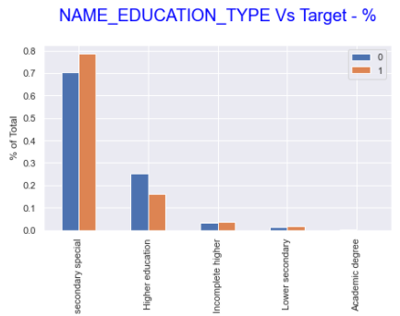
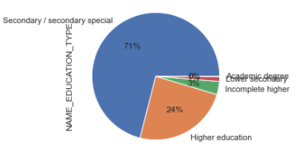
Education_Type Vs Target
Insights:
Most of the loans are applied by who have finished just Secondary / Secondary Special education as they do not have proper job for their education level.
As their salary is very less ,these are the people having more difficulties in paying back their loans on time

Slide 19
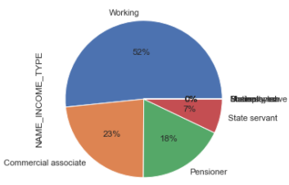
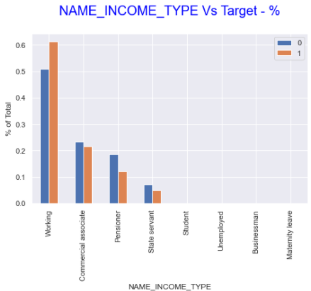
Income_Type Vs Target
Insights:
More than half of the loan i.e 52 % of the loans are applied by Working class people.
They are the ones having more difficulties in paying back their loans on time.
Pensioners and commercial associates are more likely to re-pay the loan

Slide 20
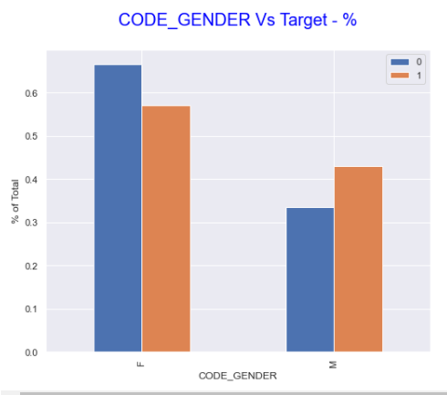
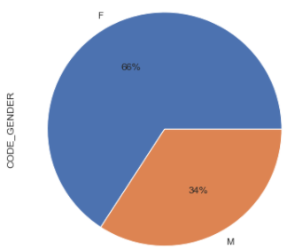
Gender Vs Target
Insights:
Most of the loans are taken by Female and very less men are likely to take loans
Even though Female borrows more loan, they are very reliable for repaying them on time

Slide 21
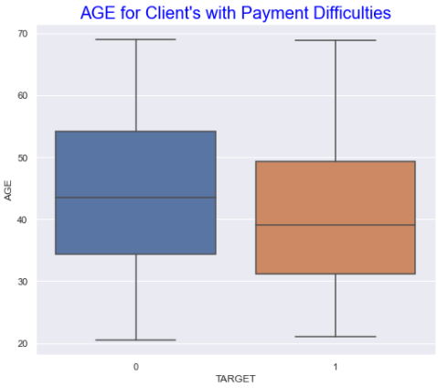
Bivariate analysis-(numeric columns)
Days_Birth Vs Target
Insights:
Older clients (ages between 35 and 55) tend to make payments promptly. So whenever an old person approaches bank for loans. It has to be approved otherwise it would be a business loss.
Majority of defaulters are younger (ages between 30 and 50) when compared with ones who makes on time payments. So more care should be taken before approving loan for young people.

Slide 22
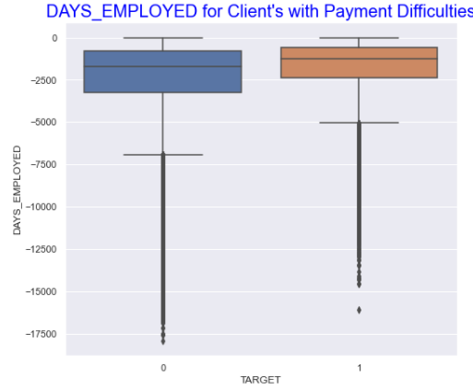
Days_Employed Vs Target
Insights:
Clients who have stayed longer in their current jobs are tend to repay their loans promptly
Even though the mean for both client's who have changed their jobs recently and for those one's who has not are close, there is significant difference is their interquartile range

Slide 23
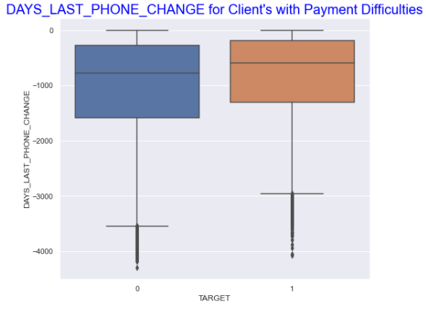
Days_Last_Phone_Changed Vs Target
Insights:
Client's who have recently changed their Phone number are more prone to be a defaulter. So this factor has to be taken into consideration before providing loan.
Even though interquartile range for customers without any payment difficulties is wider, they have almost same mean as defaulters

Slide 24
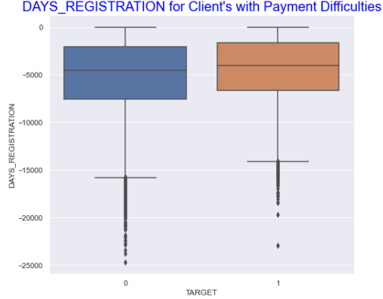
Days_Registration Vs Target
Insights:
Client's who have recently changed their Registration are more prone to be a defaulter and this is another factor which should be keenly observed
Even though interquartile range for customers without any payment difficulties is wider, they have almost same mean as defaulters

Slide 25
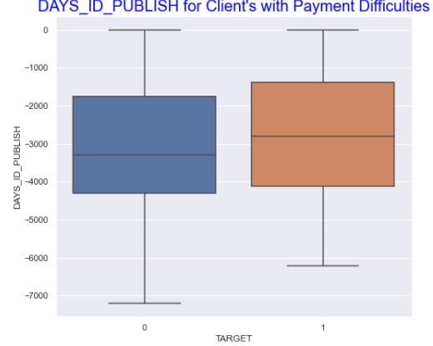
Days_ID_Publish Vs Target
Insights:
Client's who have recently changed their Identification document are more prone to be a defaulter
Even though interquartile range for customers without any payment difficulties is wider, they have almost same mean as defaulters

Slide 26
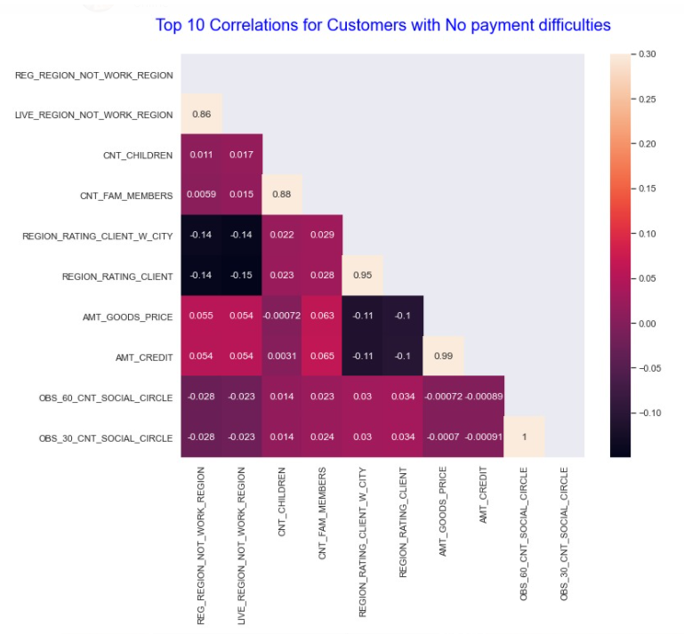
Correlation between Numerical Columns for Customers with NO payment difficulties

Slide 27
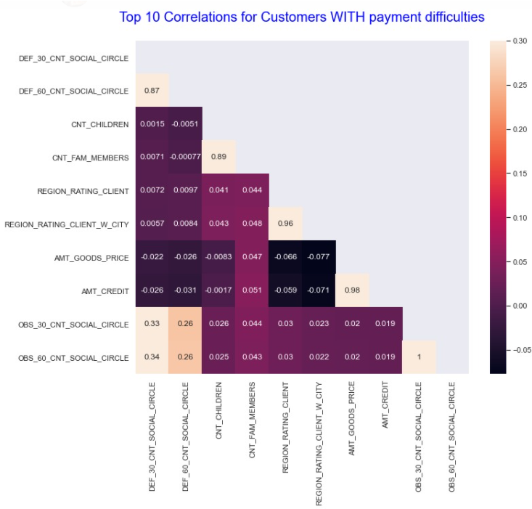
Correlation between Numerical Columns for Customers WITH payment difficulties

