Slide 1
Fast Incremental Discovery of Pointwise Order Dependencies
Zijing Tan^{1,2} , Ai Ran^{1,2} , Shuai Ma^{3,4} , Sheng Qin^{1,2}
School of Computer Science, Fudan University
Shanghai Key Laboratory of Data Science
SKLSDE Lab, Beihang University
Beijing Advanced Innovation Center for Big Data and Brain Computing

Slide 2
Organization
Motivation & related works
Problem Statement
Main Contributions:
A novel index
A set of algorithms for index:
Visit, Build, Select, Update
Algorithm for constraint set evolution
Experiments
Conclusion

Slide 3
Motivation
Dependency discoveries are usually costly, with a complexity concerning data (the number of tuples) and schema (the number of attributes)
Data in practice keep changing, and it is too expensive to perform dependency discovery from scratch every time. This motivates the quest for incremental dependency discovery
Notes:
Schema integration – queries are artifact of integrated view creation process
Schema mapping – schemas may be arbitrarily different

Slide 4
Pointwise Order Dependencies
Pointwise order dependencies (PODs) specify ordering (including equality) semantics on attributes of tuples, with both equality and inequality operators.
A person with a lower salary and a higher tax exemption amount has a lower tax rate.
Notes:
Schema integration – queries are artifact of integrated view creation process
Schema mapping – schemas may be arbitrarily different

Slide 5
Pointwise order dependencies (PODS) v.s. other constraints
PODs subsume functional dependencies (FDs), unique column combinations (UCCs)
PODs strictly generalize lexicographical order dependences (LODs): each LOD can be mapped into a set of PODs, and a relation satisfies the LOD iff it satisfies all PODs in the set.
PODs also strictly generalize set-based canonical order dependencies (SODs)
Notes:
Schema integration – queries are artifact of integrated view creation process
Schema mapping – schemas may be arbitrarily different

Slide 6
Pointwise order dependencies (PODS) v.s. other constraints
POD is a subclass of denial constraint (DC). The main difference is that DCs allow comparisons across attributes, e.g., t.A < s.B, while PODs don’t
There is a tradeoff between the expressiveness and complexity
There is a sound and complete set of inference rules for PODs, but not for DCs yet
Most running examples of DCs for data cleaning can be expressed in PODs
Notes:
Schema integration – queries are artifact of integrated view creation process
Schema mapping – schemas may be arbitrarily different

Slide 7
Related works
constraint | (batch) discovery | incremental discovery
UCCs | GORDIAN、DUCC | SWAN
FDs | TANE、FASTFD、HYFD、DHyFD | DynFD
LODs | ORDER、OCDDISCOVER、FINDOD | IncLOD
SODs | FASTOD
PODs | Hydra*、Finder* | this work
DCs | FASTDC、Hydra、DCFinder

Slide 8

Problem Statement
Incremental POD discovery is to find changes in the POD set in response to changes in the data set
Input: the complete set $Σ$ of minimal valid PODs on D, and a set $ΔD$ of tuple insertions to D
Output: changes $ΔΣ$ to$Σ$ such that$Σ ΔΣ$ is the complete set of minimal and valid PODs on D+$Δ$D
$ΔΣ=ΔΣ$⁺ $ΔΣ$⁻
$ΔΣ$⁺ contains new minimal valid PODs on D + $Δ$D that are to be added into $Σ$
$ΔΣ$⁻ contains PODs in $Σ$ that are invalid on D + $Δ$D and to be removed from $Σ$

Slide 9
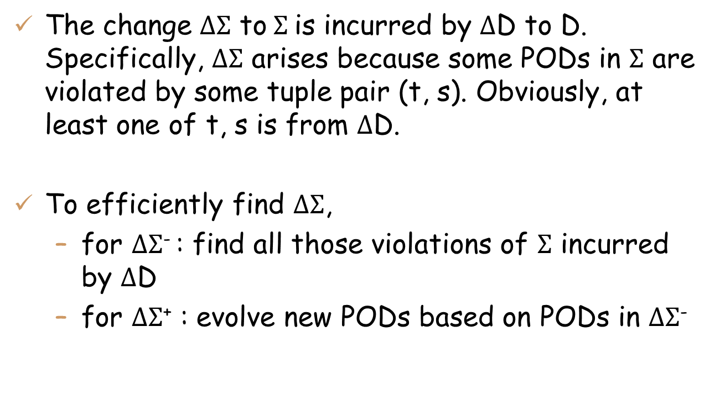
Roadmap
The change $ΔΣ$ to$Σ$is incurred by $Δ$D to D. Specifically, $ΔΣ$ arises because some PODs in $Σ$ are violated by some tuple pair (t, s). Obviously, at least one of t, s is from $Δ$D.
To efficiently find $ΔΣ$,
for $ΔΣ$⁻ : find all those violations of $Σ$ incurred by $Δ$D
for $ΔΣ$⁺ : evolve new PODs based on PODs in $ΔΣ$⁻

Slide 10
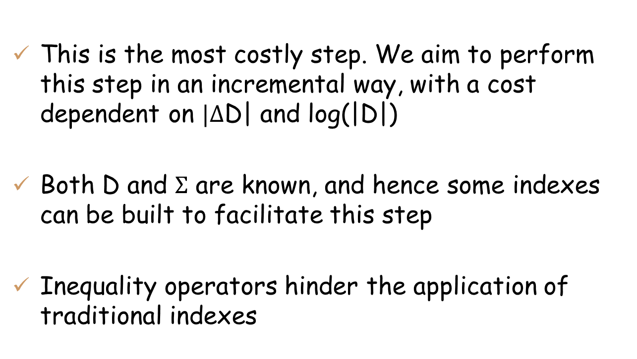

Find violations of $Σ$ incurred by $Δ$D to D
This is the most costly step. We aim to perform this step in an incremental way, with a cost dependent on $|Δ$D| and log(|D|)
Both D and $Σ$ are known, and hence some indexes can be built to facilitate this step
Inequality operators hinder the application of traditional indexes

Slide 11

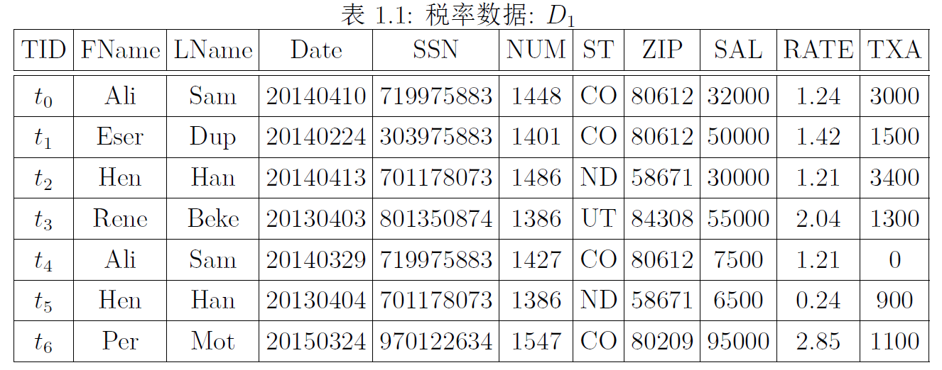
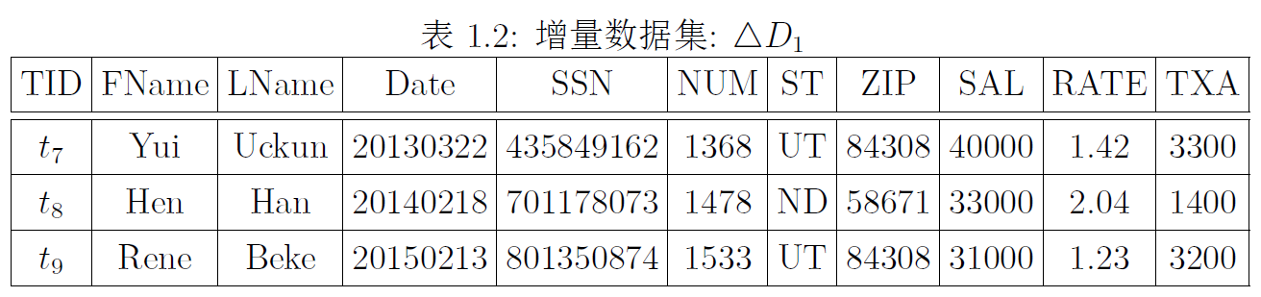

D
$Δ$D
Notes:
对于一个在原始数据集D1上成立的PODsigma3，当增加数据集delta D1后，可能会出现约束的矛盾。比如（点击）元组t3和t8。t8的免税额比t3的大，工资比t3的少，但是税率是相同的。这就和约束sigma3产生矛盾。

Slide 12
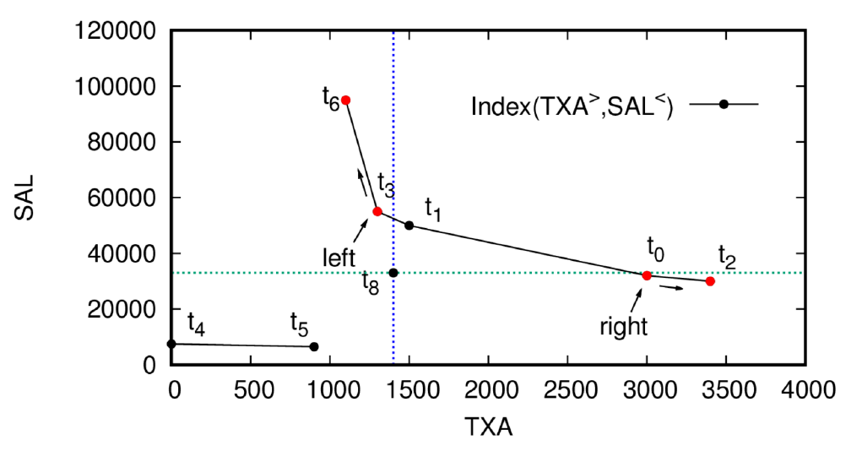
A new index structure
Combine two inequality operators on TXA and SAL together
Divide D into several sorted structure, and tuples in the same structure are sorted on both TXA and SAL
Two sorted structure here

Slide 13
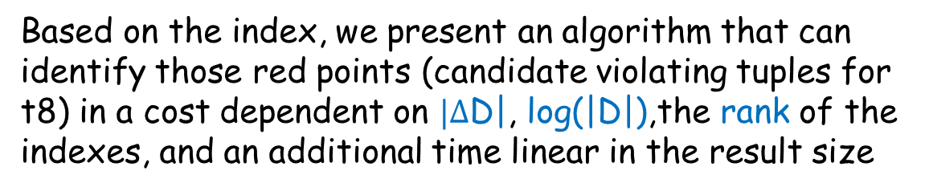
A new index
A rank of 2
Based on the index, we present an algorithm that can identify those red points (candidate violating tuples for t8) in a cost dependent on $|Δ$D|, log(|D|),the rank of the indexes, and an additional time linear in the result size

Slide 14
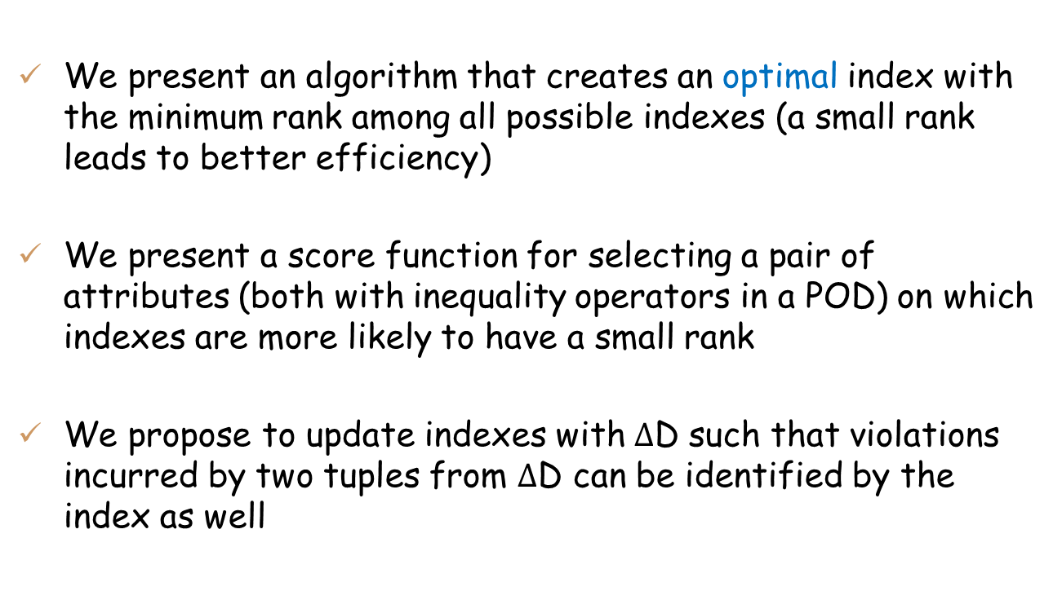
Algorithms for indexes
We present an algorithm that creates an optimal index with the minimum rank among all possible indexes (a small rank leads to better efficiency)
We present a score function for selecting a pair of attributes (both with inequality operators in a POD) on which indexes are more likely to have a small rank
We propose to update indexes with $Δ$D such that violations incurred by two tuples from $Δ$D can be identified by the index as well

Slide 15

Algorithms for indexes (cont.)
Given a set $Σ$of PODs, we present an algorithm that builds a set of indexes for $Σ$
One index may be shared by several PODs in $Σ$, to reduce index space and creation time
Combine index proposed in this paper with common equality indexes for “=” operator

Slide 16
Experimental findings
The number of indexes for $Σ ( )$, and the average ranks of all indexes, are insensitive to |D|.
When |D| increases from 100K to 300K on dataset FLI,
varies from 22 to 25, and AvgRank varies in the range of [13, 17]
Similar results are seen on other datasets

Slide 17


Compute $ΔΣ$
Violations of $Σ$directly lead to PODs in $ΔΣ$⁻
We present an algorithm to evolve PODs for $ΔΣ$⁺, based on the detected violations, $ΔΣ$⁻ and the schema R

Slide 18
Experimental findings
We conduct a set of experiments
To verify the effectiveness and efficiency of incremental POD discovery: the incremental approach performs far better on all datasets, up to two orders of magnitude
To verify the effectiveness and efficiency of the indexing technique: indexes help skip up to 80% of the tuples
To provide more details of the index updates, creation time and space cost

Slide 19
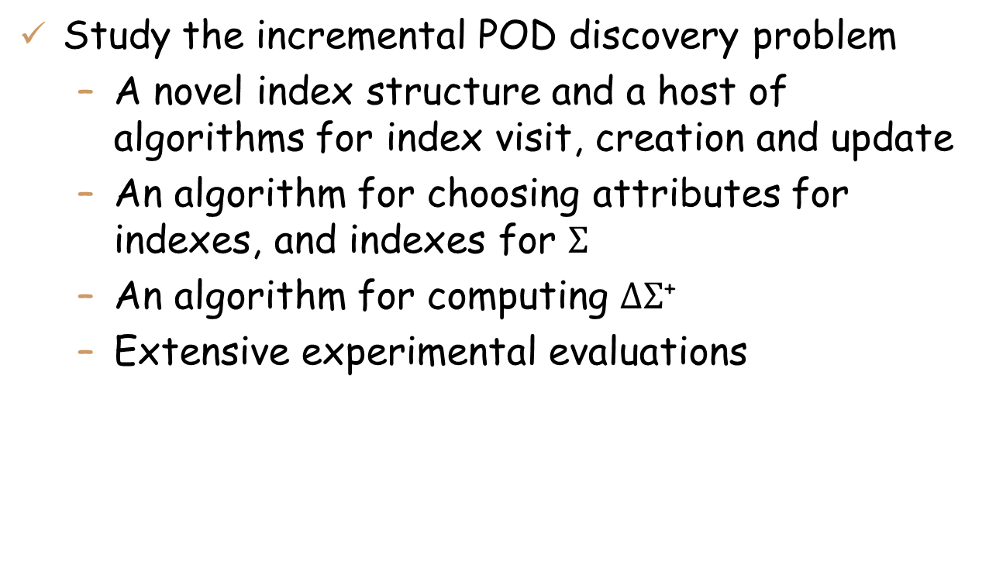
Conclusion
Study the incremental POD discovery problem
A novel index structure and a host of algorithms for index visit, creation and update
An algorithm for choosing attributes for indexes, and indexes for $Σ$
An algorithm for computing $ΔΣ$⁺
Extensive experimental evaluations

Slide 20
Thank you for your attention！
Questions?

