Slide 1
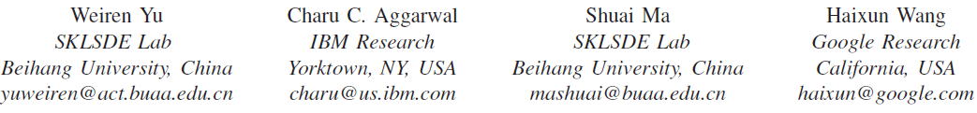



On Anomalous Hot Spot Discovery in Graph Streams
2013-12-08
@Dallas

Slide 2
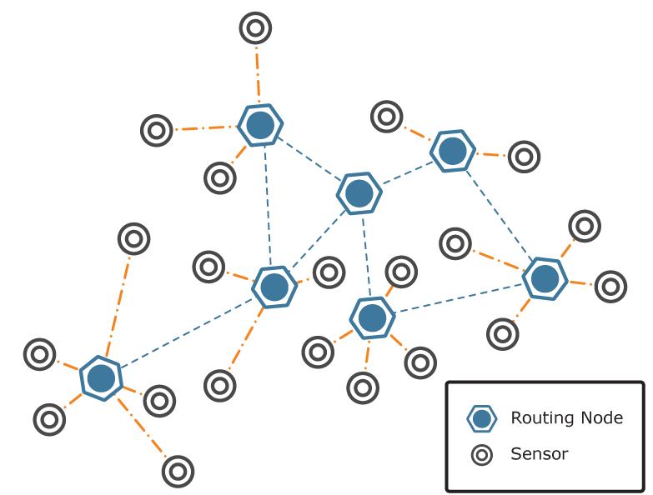
Introduction
Background
We care about data stream of interactions between network participants.
Social Network, Communication Network, etc.
Abrupt changes in level and patterns of interaction of participants may be associated with critical events.
A simple Illustration

Slide 3

Introduction
Graph Stream
Graph:
E.g., SNS, Communication Net: Node – User; Edge – User Interaction;
Stream:
edge sequence -> (Node A – Node B : timestamp),…
Hot spot: a node of such abrupt changes:
(a) high activity level
(b) patterns of activity
at specific time periods, associated with anomalous or critical events in the underlying network.
Application Scenarios
SN: A person got popular.
SN: Your follower could be a spammer
Notes:
Network data stream have become increasingly popular in recent years.
Tremendous number of dynamic applications generate continuous streams of data.
We focus on the data stream about interactions and data stream of interaction records between network participants.
In networks, take an interaction record as a graph object with timestamp and Imagine a DBLP record for something like a reference in your papers, we are interested in who the authors are, as the nodes, and the time of publication, as time stamps. Develop a complete graph over the nodes and assign each edge with the same timestamp. You get a set of edges which is a part of an edge sequence.
Because of the anomalous or critical events in the underlying network, Such streams may show unusual localized regions of High activity level change or Evolution in node correlations at specific time periods.
Specifically, nodes of such unusual changes are called hot spots.
It might be desirable to determine these hot spots because they can provide valuable insights about the underlying network.
In IP network, we might be interested in finding sudden increased magnitudes of interaction level, which might suggest a localized intrusion or attack.
In sensor network, interaction with many new nodes might be caused by large area nodes shutdown.
In social network, this might mean the person got popular or had made a new group of friends.
In scenarios such as Taobao.com, records of browsing might easily reveal one’s new point of interest or recent lust on a particular item， because if you are interested in something you might end up looking at it again and again.
…
And What we do in this work, is to find these hot spots

Slide 4

Introduction
Basic idea – Localized Principal Component Analysis(PCA)
Adjacency matrix should capture edge correlations between the target node and the node in its neighborhood/locality.
Analyze edge correlation structure of a node using PCA
Changes in absolute levels of activity – Dominant Eigenvalue
Local edge correlation patterns – Dominant Eigenvector
Challenging problems
Anomaly over different time granularity
Computing Pressure of PCA
Stream Update
High Dimension
Notes:
The basic idea is to use PCA.
PCA is usually used to reduce dimensions of a feature vector.
The procedure is that from the feature vector, generate its covariace Matrix. Calculate the eigenvectors and eigenvalues of the covariance matrix and extract the principal vector or vector space, or only eigenvalues.
We will see that a localized principal component analysis of the edge correlation structure can be very useful from an analytical perspective.
Using PCA, Changes in the dominant eigenvectors provide useful information about the local edge correlation patterns, whereas changes in the eigenvalues provide insights about changes in absolute levels of activity.
There are 2 major challenges about this approach:
Such analytics as PCA are traditionally considered too computationally intensive to apply in an online setting. In this paper, we will use an approach which performs the updates minimally as required and re-use results from previous time periods.
Another challenge is that changes could occur over different horizons in time. Say you ate 4 meals yesterday, and follow the routine the rest of the week. The 4 meal incident is considered abnormal in a days perspective but relatively normal when you look at it from the time span of a weak. In some cases, anomalies may be detected over a short period of time, whereas in other cases, significant anomalies can only be detected or understood over a longer period. There seems to be no optimal temporal granularity at which the analysis needs to be performed.
Therefore, we will design an approach which can analyze the stream automatically at multiple levels of temporal granularity in an efficient way.

Slide 5
Model Framework
Graph of Temporal Network: G(t) = (N(t), A(t))
Assumptions:
A sequence of edges is continuously received over time.
The set of nodes changes over time.
N(t) is the set of all distinct nodes in the stream at time t.
A(t) is a sequence of edges corresponding to all edges received so far.
A(t) may contain repetitions
Model Intuition
Quantify interaction level and pattern (measure edges).
LEVEL: Model decay of time
Provide greater importance/ weight to recent edges.
PATTERN: Measure temporal edge arrival correlation of target node
Use pairwise product.
Notes:
As introduced in the last slides, we first give the definition of a temporal network.
We assume that we have a network stream, which is defined by a continuously arriving sequence of edges.
Since some edges may contain new nodes, the set of nodes also changes over time.
Read the PPT of Graph Temporal Network
Observe that
In order to evaluate edge correlations and activity level, we need to quantify edge frequencies.
The relative edge frequencies, meaning assigning the weight of each edge to 1, aggregate all the weights and divide with total time, will stabilize over a long period of time (and will not show much relative change in the presence of unusual events),
Think about it when you are using a soap, assume that you use 1 soap per month. This is usually very stable. Even you used 10 soaps a month, the average of your soap using speed in your life so far might still be 1 per month.
unless the frequencies of the recent edges are counted by providing greater importance and the effects of history fades gradually.
Based on this observation, we give the definition of the weight of edge and edge frequency.

Slide 6
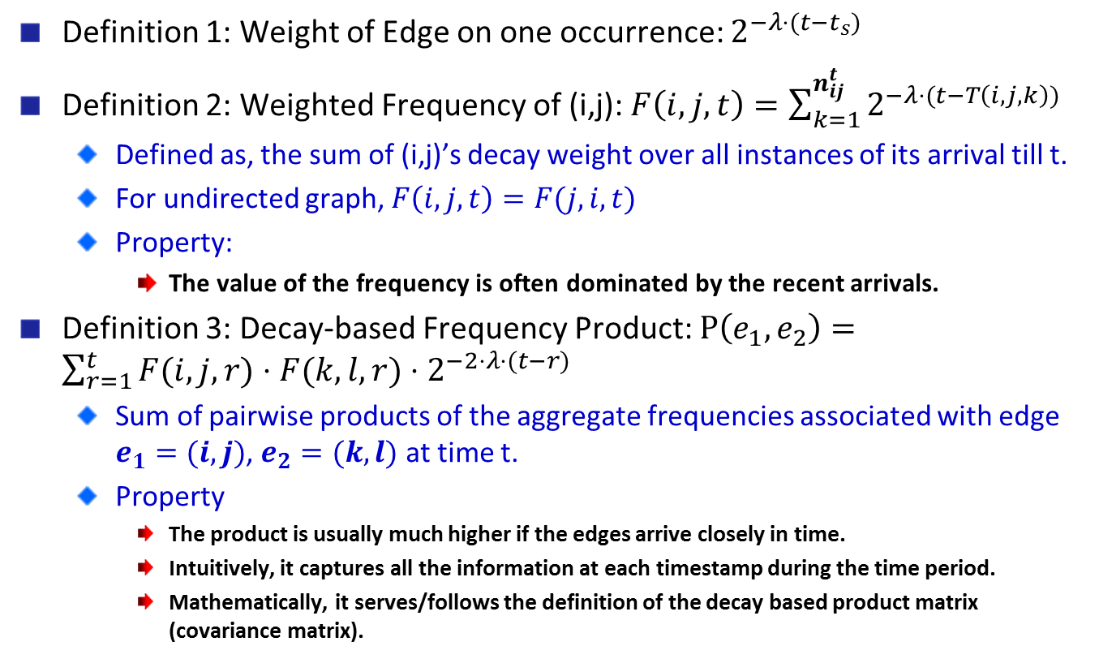
Model Framework
Definition 1: Weight of Edge on one occurrence: $2^{−λ⋅(t−t_{s})}$
Definition 2: Weighted Frequency of (i,j): $F\left(i,j,t\right)=\sum_{k=1}^{n_{ij}^{t}}{2^{−λ⋅(t−T\left(i,j,k\right))}}$
Defined as, the sum of (i,j)’s decay weight over all instances of its arrival till t.
For undirected graph, $F\left(i,j,t\right)=F(j,i,t)$
Property:
The value of the frequency is often dominated by the recent arrivals.
Definition 3: Decay-based Frequency Product: $P\left(e_{1},e_{2}\right)=\sum_{r=1}^{t}{F(i,j,r)⋅F(k,l,r)⋅2^{−2⋅λ⋅(t−r)}}$
Sum of pairwise products of the aggregate frequencies associated with edge $e_{1}=(i,j)$, $e_{2}=(k,l)$ at time t.
Property
The product is usually much higher if the edges arrive closely in time.
Intuitively, it captures all the information at each timestamp during the time period.
Mathematically, it serves/follows the definition of the decay based product matrix (covariance matrix).
Notes:
Read the PPT.
After Definition.
Definition 2: this is the weight of the Kth arrival of edge (I,j). And we have total of nijt times of edge (I,j), we sum it together and get the weighted frequency.
We can see that the history records count, but their effect fades.
Properties:
We note that the value of the frequency is often dominated by the relative recency of arrivals. Therefore, in hot spots of suddenly increasing activity, the corresponding edges may show high frequency. On the other hand, a sudden
unexpected decrease in the activity will also show up as a reduction in the underlying frequencies.

Slide 7
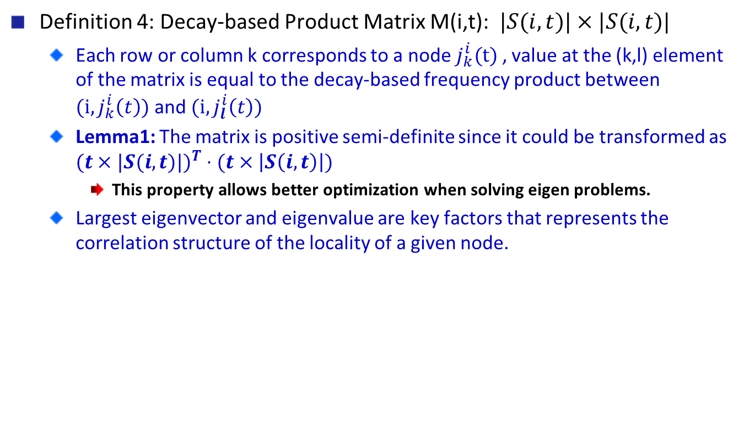
Model Framework
Definition 4: Decay-based Product Matrix M(i,t): $|S(i,t)|×|S(i,t)|$
Each row or column k corresponds to a node $j_{k}^{i}(t)$ , value at the (k,l) element of the matrix is equal to the decay-based frequency product between $(i,j_{k}^{i}\left(t\right))$ and $(i,j_{l}^{i}\left(t\right))$
Lemma1: The matrix is positive semi-definite since it could be transformed as $(t×|S(i,t)|)^{T}⋅(t×\left|S\left(i,t\right)\right|)$
This property allows better optimization when solving eigen problems.
Largest eigenvector and eigenvalue are key factors that represents the correlation structure of the locality of a given node.
Notes:
Significance:
Since the matrix M(i,t) represents the correlation struc-
ture of the locality of a given node, its largest eigenvector
and eigenvalue provide key insights about the underlying
edge-correlation dynamics.

Slide 8
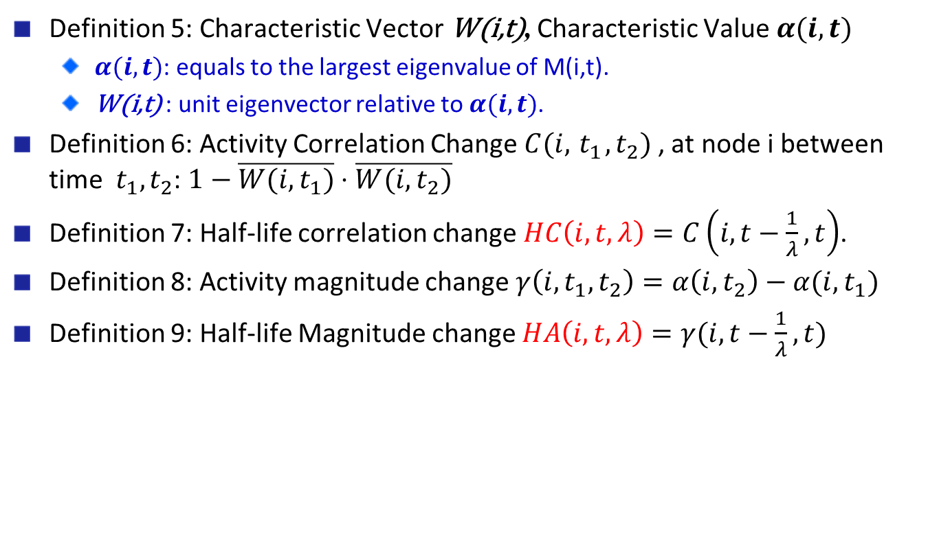
Model Framework
Definition 5: Characteristic Vector W(i,t), Characteristic Value$α(i,t)$
$α(i,t)$: equals to the largest eigenvalue of M(i,t).
W(i,t) : unit eigenvector relative to$α(i,t)$.
Definition 6: Activity Correlation Change $C(i,{ t}_{1},t_{2})$ , at node i between time ${ t}_{1},t_{2}$: $1−\overline{W(i,t_{1})}⋅\overline{W(i,t_{2})}$
Definition 7: Half-life correlation change $HC\left(i,t,λ\right)=C\left(i, t−\frac{1}{λ},t\right)$.
Definition 8: Activity magnitude change $γ\left(i, t_{1},t_{2}\right)=α\left(i,t_{2}\right)−α(i,t_{1})$
Definition 9: Half-life Magnitude change $HA\left(i,t,λ\right)=γ(i,t−\frac{1}{λ},t)$
Notes:
Explain the half-life thing here.

Slide 9
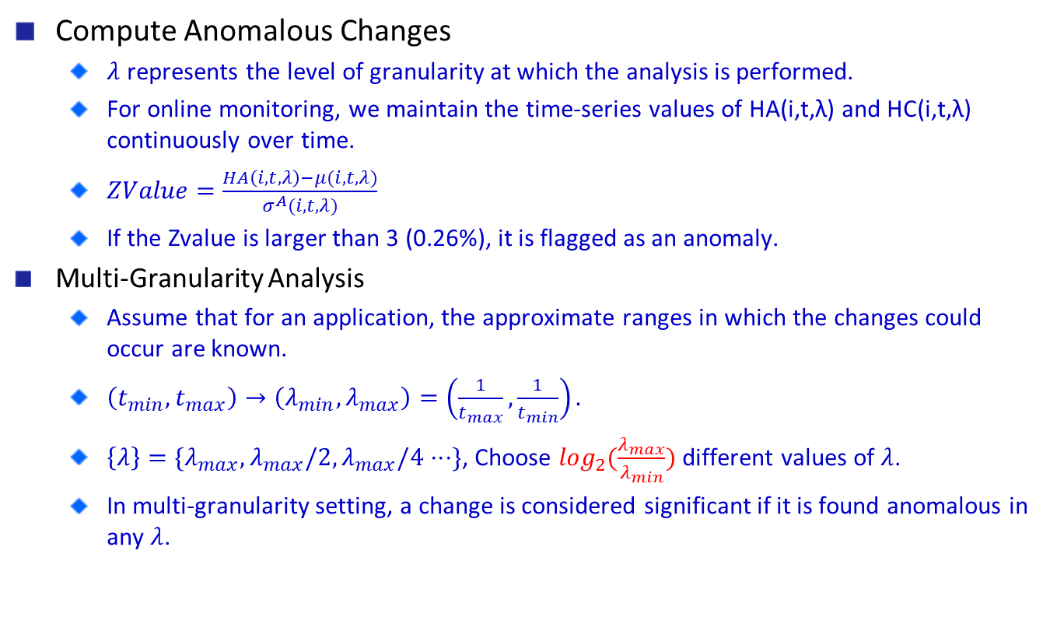
HotSpot Algorithm
Compute Anomalous Changes
$λ$ represents the level of granularity at which the analysis is performed.
For online monitoring, we maintain the time-series values of HA(i,t,λ) and HC(i,t,λ) continuously over time.
$ZValue=\frac{HA\left(i,t,λ\right)−μ(i,t,λ)}{σ^{A}(i,t,λ)}$
If the Zvalue is larger than 3 (0.26%), it is flagged as an anomaly.
Multi-Granularity Analysis
Assume that for an application, the approximate ranges in which the changes could occur are known.
$\left(t_{min},t_{max}\right)→\left(λ_{min},λ_{max}\right)=\left(\frac{1}{t_{max}},\frac{1}{t_{min}}\right).$
$\left\{λ\right\}=\{λ_{max},λ_{max}/2,λ_{max}/4⋅⋅⋅\}$, Choose $\log_{2}(\frac{λ_{max}}{λ_{min}})$ different values of $λ$.
In multi-granularity setting, a change is considered significant if it is found anomalous in any $λ$.
Notes:
For online monitoring, we maintain the time-series values of HA(i,t,λ) and HC(i,t,λ) continuously over time. A variety of auto-regressive models may be maintained in order to compute the unusual deviations among these values. However, in the streaming scenario, we choose a much simpler solution in which the mean value and standard deviations of these values are maintained continuously over time. Specifically, the square sum of these values, sum of these values and the number of values are continuously maintained.
The anomalous changes could be detected by different methods.

Slide 10

HotSpot Algorithm
Computational Challenges
Principal components analysis
Power Iteration for Eigen-problem
Decay-based approach
All matrices, eigenvalues, eigenvectors need to be updated.
Lazy update technique
Absent new arrivals, updates to the quantities aforementioned can be expressed purely as a function of the quantities at t’(<t) and the value of (t-t’)
No need to explicitly update matrix value because of time decay.
We don’t monitor unusual inactivity.
When edge (i,j) arrives, the statistics of only nodes i and j need to be updated.
Scales well.
Could be distributed if data segmented properly.
Notes:
In this part we introduce how we would use the model to find hot spots.
Computational Challenges
Principal components analysis
Determination of matrix, eigen solver complexity quadratic to node degree.
Decay-based approach
All matrices, eigenvalues, eigenvectors need to be updated.
The anomalous trends may show up over different time-horizons.
it would seem, at least at first sight, that even the update process in a fast network stream is likely to be intractable from a computational perspective.
However, it turns out that many of the temporal updates at nodes can be performed in lazy fashion, and maintained implicitly, as long as there are no changes in the locality of the node because of arrivals of edges.

Slide 11
Experimental Results
Experimental Setting
Data sets:
DBLP Data Set:
1942 – 2012, author pair as edges, nodes of an author pair being different.
1,141,301 authors, 1,690,933 papers and 7,778,687 author pairs in total.
Internet Movie Database (IMDB) Data Set:
1892 – 2012, director – actor pair, director node would have larger S(i,t) set.
1,008,978 records, 2,214,210 nodes and 13,529,524 edges in total.
Half-life being 1,2,4,8 years and all of them for multi-granularity analysis.
Algorithms and Implementation:
HotSpot algorithm implementation: C++.
Eigen-solver:
Intel Math Kernel Library(MKL) 11.0 update 1 : optimized LAPACK.
Nvidia CUDA 5.0 SDK: parallelized linear algebra function(CUBLAS).
Computing unit: Core i5-2400 @ 3.10GHz, 16GB of RAM.

Slide 12
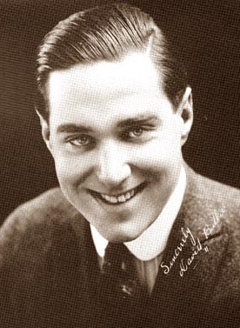


Experimental Results
Case study
David Butler, Director
Half-life being 1 year, identified as hot spots in 1929, 1934, 1943,
1949, 1956 and 1962, temporary bursts of production.
Half-life being 2 years, 1956-1957 and 1962-1963, active period.
Half-life being 4 years, 1956-1963, peak period in career.
Half-life being 8 years, not detected.
Al Pacino, Actor
Detected 2 out of 3 times when he directed films in 1996, 2011.
Thomas S. Huang, Computer Scientist
Half-life being 1 year, 1997, 1998, 2001, 2006, 2007, 2008
Half-life being 2 years, 1998-1999, 2006-2009
Over 2 years, undetected.
In total, we found 5589 hot spots in DBLP and 17393 hot
spots in IMDB for all half-life values.
Notes:
We introduce case study instead of comparing with baseline because there is no baseline to beat.
The cases here are interesting discoveries made by HotSpot algorithm.

Slide 13
Experimental Results
Performance Evaluation – Efficiency Tests
DBLP
IMDB

Slide 14
Experimental Results
Performance Evaluation – Space Overhead Tests
DBLP
IMDB

Slide 15
Thanks!
Q&A?

