Slide 1


In Search of Influential Event Organizers in Online Social Networks
Kaiyu Feng¹, Gao Cong¹, Sourav S. Bhowmick¹, and Shuai Ma²
¹Nanyang Technological University
²Beihang University

Slide 2
Outline
Motivation & Problem Definition
Greedy solutions
Approximation solutions
Experiments

Slide 3


Motivation
A data-driven approach to selecting influential event organizers in online social networks
Increasing popularity and growth of online social networks (e.g., event based social networks)
To organize an event (picnic), we need to find some organizers who together have relevant expertise (driving, cooking) and can influence as many people as possible to attend and contribute

Slide 4




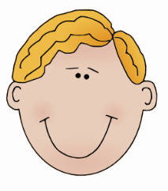
Motivating example
Tom,
“Machine Learning”, “Data Mining”
Bob
“Psychology”, “Sociology”
……
……
Bill,
“NLP”, “Machine Learning”
Sam,
“Database”, “Data Mining”
……
Query:
Search for 2 chairs
(1) who together have knowledge in “Psychology”, “Sociology” and “Data Mining”;
(2) influence as many people as possible to contribute and attend
Notes:
加粗箭头
goal

Slide 5
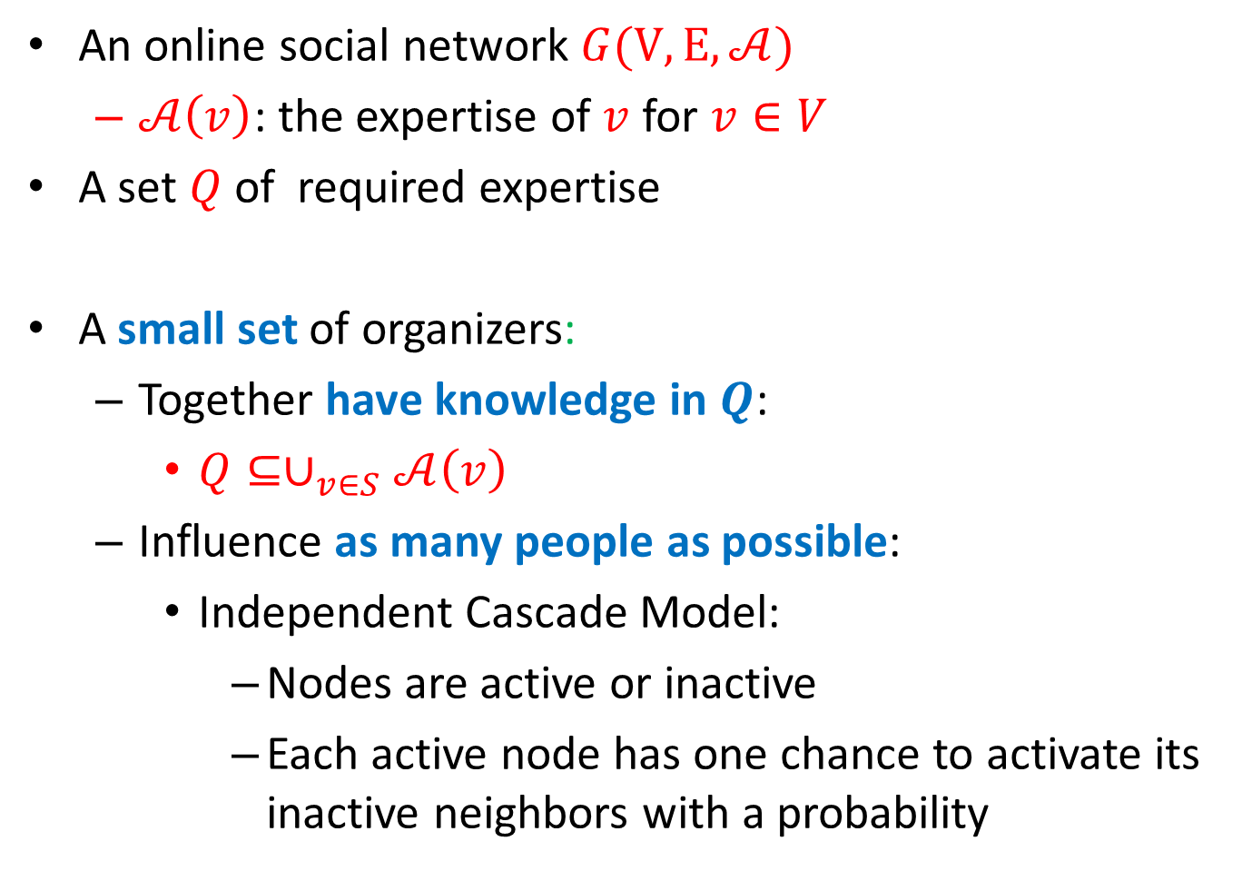
An inside look at the example
An online social network $G(V, E, 𝒜)$
$𝒜\left(v\right)$: the expertise of $v$ for $v∈V$
A set $Q$ of required expertise
A small set of organizers:
Together have knowledge in $Q$:
${Q⊆∪}_{v∈S}𝒜\left(v\right)$
Influence as many people as possible:
Independent Cascade Model:
Nodes are active or inactive
Each active node has one chance to activate its inactive neighbors with a probability
Notes:
Influence model
Reference
Color keyword

Slide 6
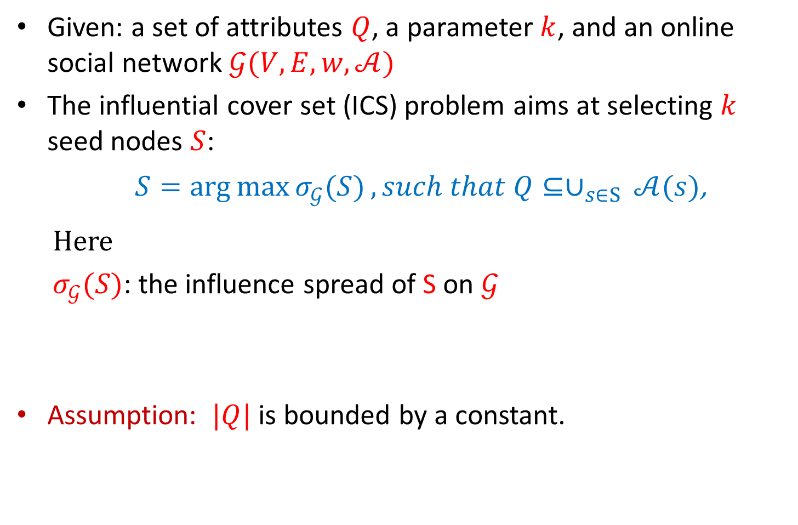
Problem definition
Given: a set of attributes $Q$, a parameter $k$, and an online social network $𝒢(V, E, w, 𝒜)$
The influential cover set (ICS) problem aims at selecting $k$ seed nodes $S$:
$S=\arg{\max_{}{σ_{𝒢}(S)}}, such that Q⊆∪_{s∈S }𝒜(s)$,
Here
$σ_{𝒢}(S)$: the influence spread of S on $𝒢$
Assumption: $|Q|$ is bounded by a constant.

Slide 7
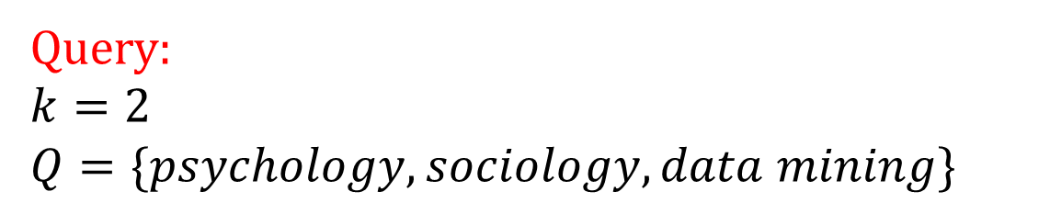
Example
Tom,
“Machine Learning”, “Data Mining”
Bob
“Psychology”, “Sociology”
……
……
Bill,
“NLP”, “Machine Learning”
Sam,
“Database”, “Data Mining”
……
Query:
$$k=2$$
$$Q=\{psychology, sociology, data mining\}$$

Slide 8
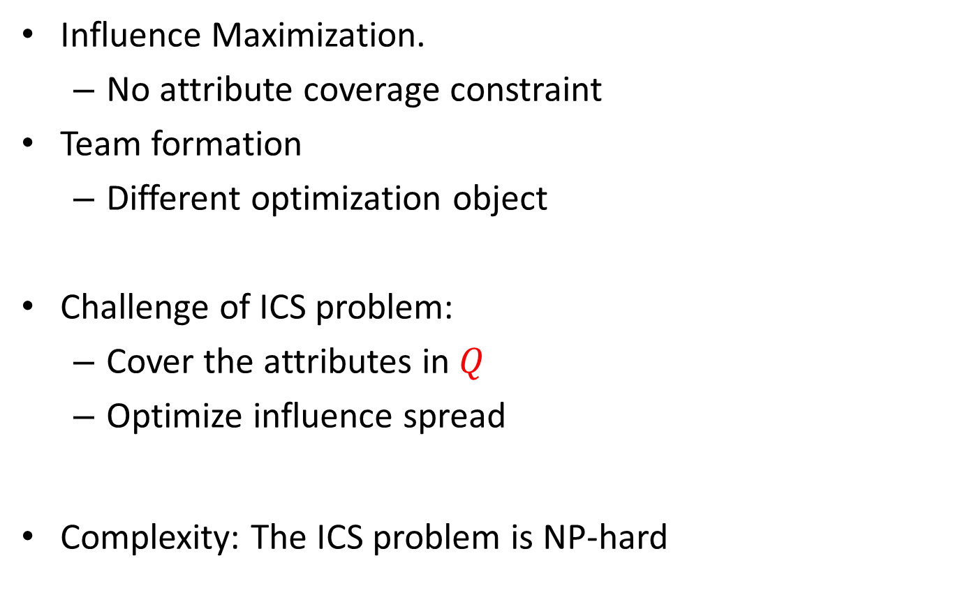
Novelty and challenge
Influence Maximization.
No attribute coverage constraint
Team formation
Different optimization object
Challenge of ICS problem:
Cover the attributes in $Q$
Optimize influence spread
Complexity: The ICS problem is NP-hard
Notes:
Challenge and nolvety

Slide 9
Outline
Motivation & Problem Definition
Greedy solutions
Approximate solutions
Experiments

Slide 10
Greedy solutions
ScoreGreedy
Based on a score function
PigeonGreedy
Based on the pigeonhole principle

Slide 11
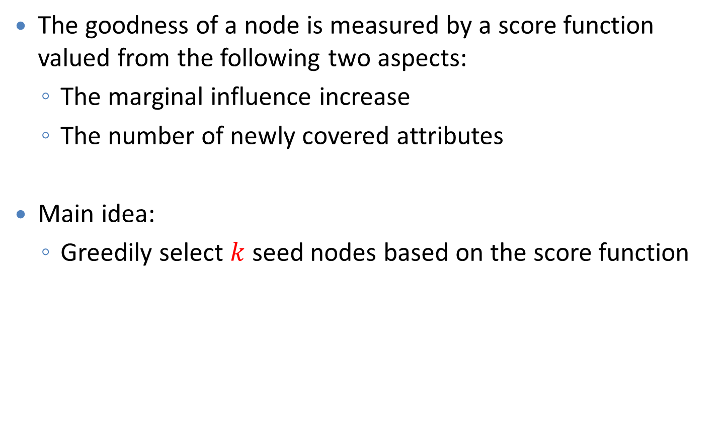
ScoreGreedy
The goodness of a node is measured by a score function valued from the following two aspects:
The marginal influence increase
The number of newly covered attributes
Main idea:
Greedily select $k$ seed nodes based on the score function

Slide 12
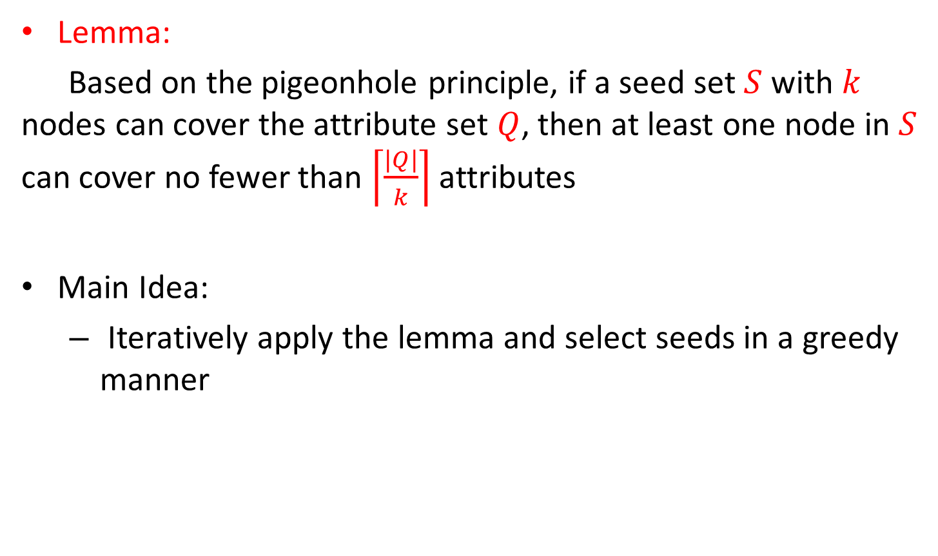
PigeonGreedy
Lemma:
Based on the pigeonhole principle, if a seed set $S$ with $k$ nodes can cover the attribute set $Q$, then at least one node in $S$ can cover no fewer than $\left\lceil \frac{|Q|}{k}\right\rceil$ attributes
Main Idea:
Iteratively apply the lemma and select seeds in a greedy manner

Slide 13
Outline
Motivation & Problem Definition
Greedy solutions
Approximation solutions
Experiments

Slide 14
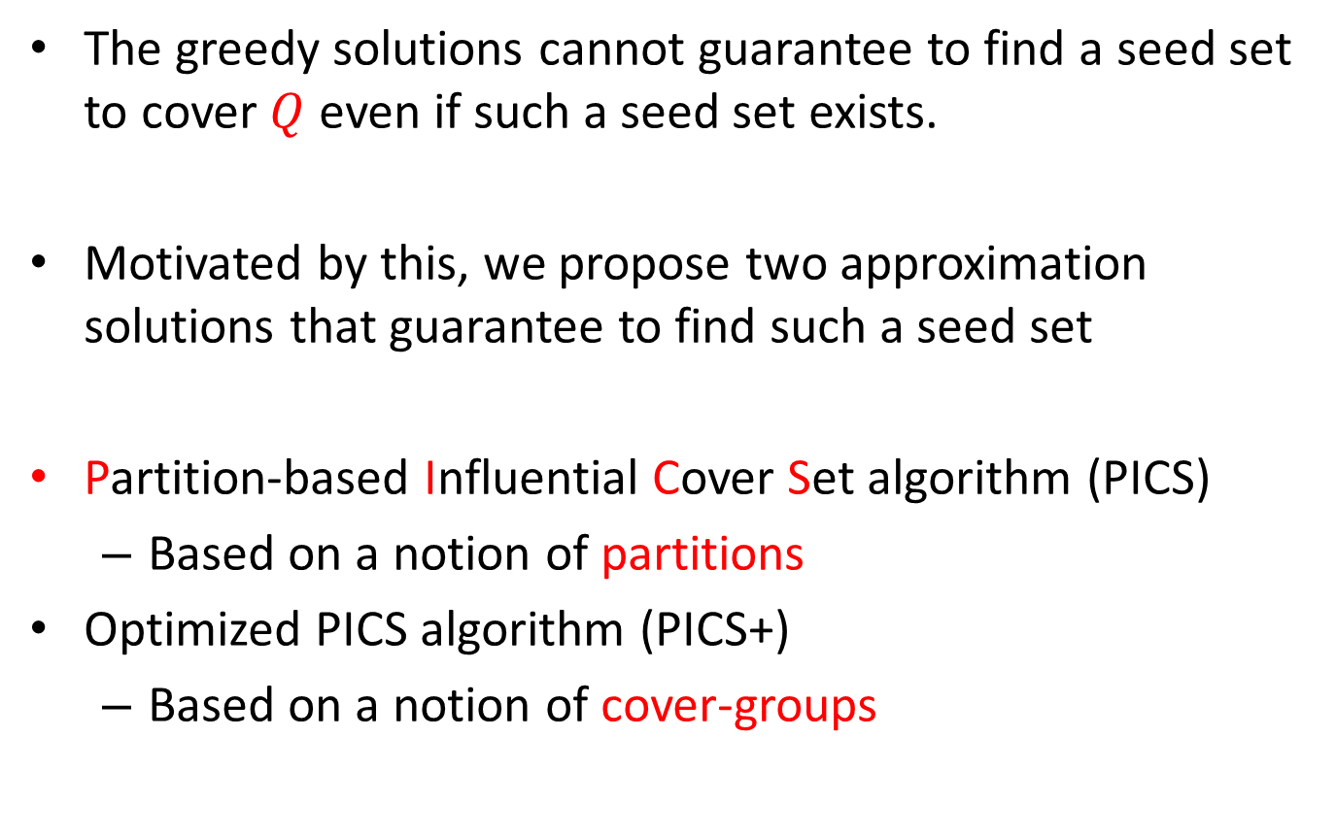
Approximation solutions
The greedy solutions cannot guarantee to find a seed set to cover $Q$ even if such a seed set exists.
Motivated by this, we propose two approximation solutions that guarantee to find such a seed set
Partition-based Influential Cover Set algorithm (PICS)
Based on a notion of partitions
Optimized PICS algorithm (PICS+)
Based on a notion of cover-groups

Slide 15
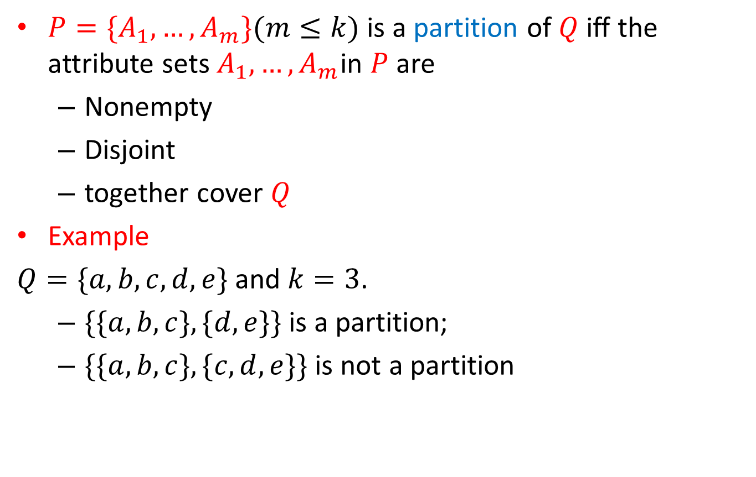
PICS: partition
$P=\{A_{1}, …, A_{m}\}(m≤k)$ is a partition of $Q$ iff the attribute sets $A_{1}, …, A_{m}$in $P$ are
Nonempty
Disjoint
together cover $Q$
Example
$Q=\{a,b,c,d,e\}$and $k=3$.
$\{\{a,b,c\},\{d,e\}\}$is a partition;
$\{\{a,b,c\},\{c,d,e\}\}$ is not a partition

Slide 16

PICS algorithm
For each partition
Compute a seed set
Return the seed set with maximum influence spread
Theorem. Approximation Ratio: $½−φ$

Slide 17





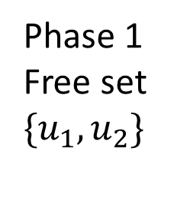




PICS: compute seed set for a partition
$Q=\{a,b,c,d,e\}, k = 3$
$$P=\{\{a,b,c\},\{d,e\}\}$$
$$S=\{\}$$
Select from $V_{Q}$
$u_{1}$ covers $\{c,d,e\}$
Phase 1
Free set
$$\{u_{1}, u_{2}\}$$
$$P=\{\{a,b\}\}$$
$$S=\{u_{1}\}$$
Select from $V_{Q}$
$u_{2}$ covers $\{c,e\}$
$$P=\{\{a,b\}\}$$
$$S=\{u_{1}, u_{2}\}$$
Partial partition
Select from $V(\left\{a,b\right\})$
Phase 2
Constraint set
$$\{u_{3}\}$$
$$P=\{\{a,b\}\}$$
$$S=\{u_{1}, u_{2}, u_{3}\}$$

Slide 18
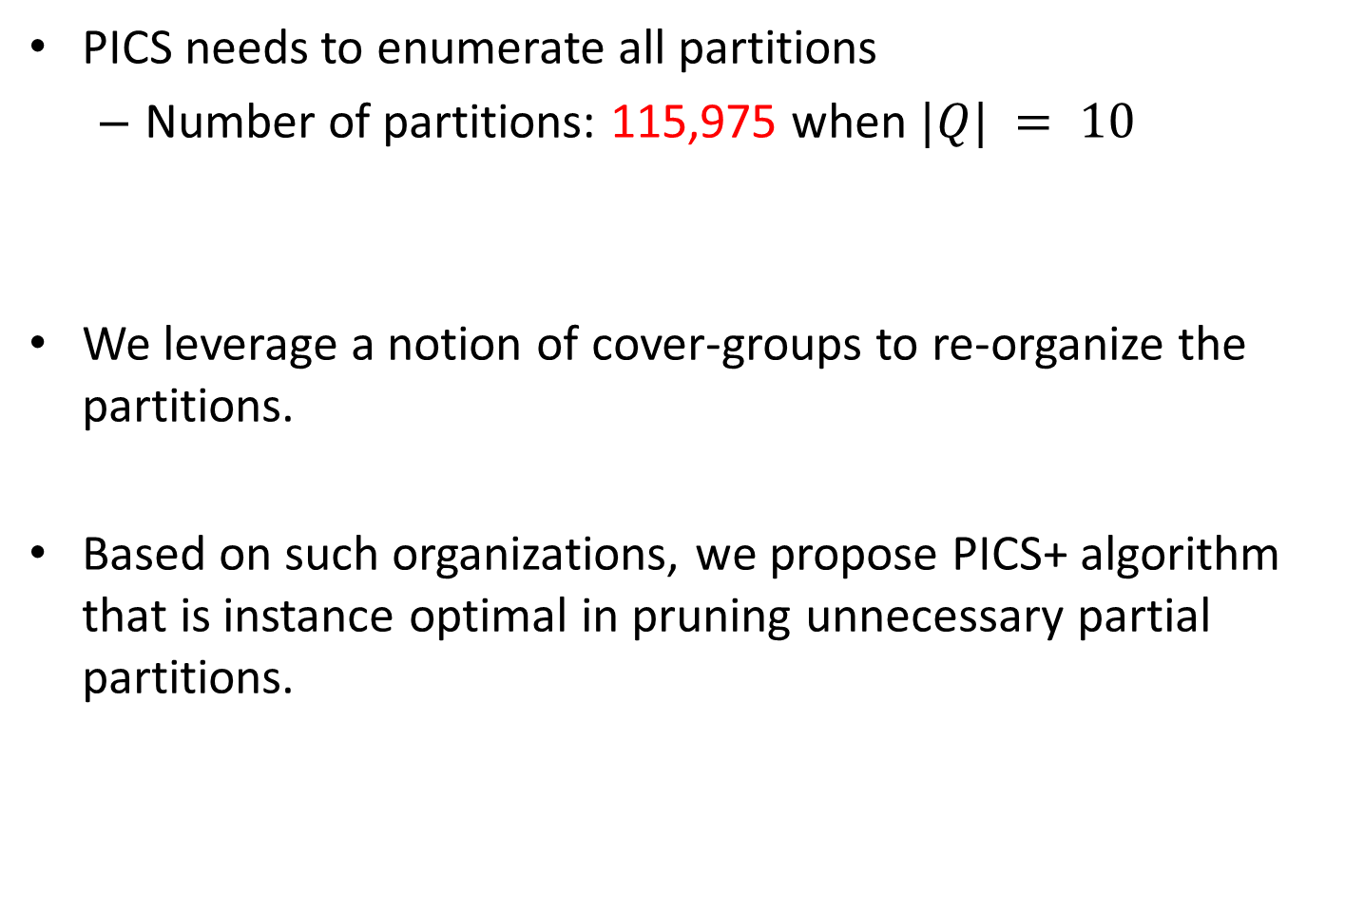
PICS+ algorithm
PICS needs to enumerate all partitions
Number of partitions: 115,975 when $|Q| = 10$
We leverage a notion of cover-groups to re-organize the partitions.
Based on such organizations, we propose PICS+ algorithm that is instance optimal in pruning unnecessary partial partitions.

Slide 19

PICS+: cover-group
A cover-group of a partial partition is a multiset of integers $\{r_{1}, …, r_{m}\}$, each of which is the size of an attribute set in the partition.
Partial partition $\{\{a,b,c\},\{d,e\}\}$‘s cover-group is $\{3,2\}$.

Slide 20
PICS+: organize partitions
Reorganization
Partitions are first organized according to their free set.
For the partial partitions generated in the fist step, we further group them based on their cover-groups

Slide 21

PICS+ algorithm
Select free set with size $i∈[0,k]$
For each cover-group
Compute a constraint set
Get the seed set
Return the seed set with best influence spread
Theorem.
Approximation ratio: $½−φ$
Instance optimal in pruning unnecessary partial partitions

Slide 22
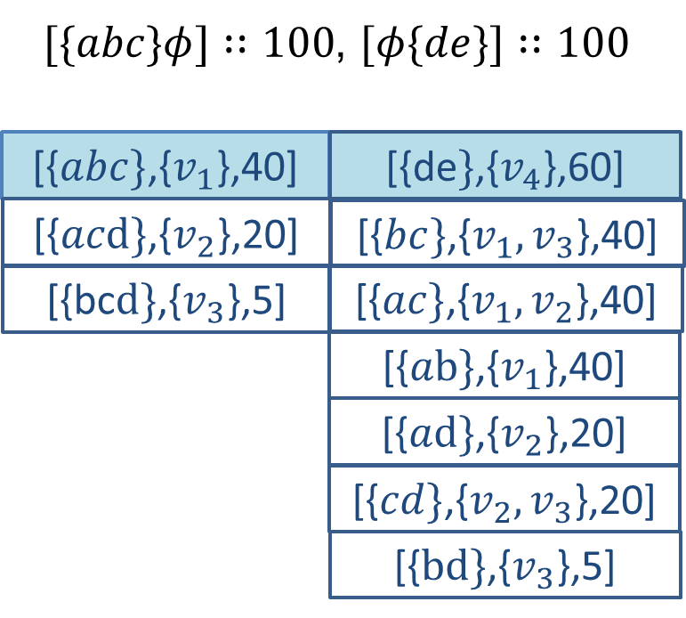


PICS+: compute constraint set for a cover-group
Construct lists for each cover-group. Each list corresponds an integer in the cover-group
Cover-group $\{3,2\}$
$$[\{abc\}\{de\}]:\left\{v_{1},v_{4}\right\}:95$$

Slide 23


PICS+: compute constraint set for a cover-group
Cover-group $\{3,2\}$
$$[\{abc\}\{de\}]:\left\{v_{1},v_{4}\right\}:95$$

Slide 24
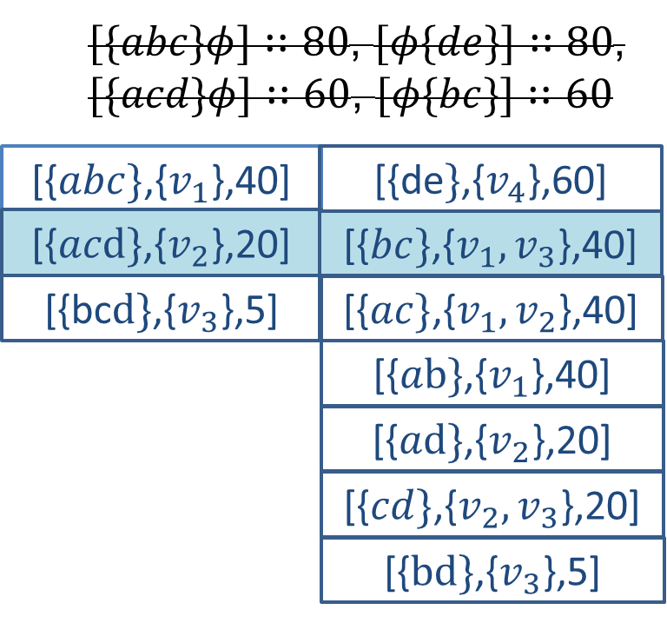


PICS+: compute constraint set for a cover-group
Cover-group $\{3,2\}$
Instance optimal
$$[\{abc\}\{de\}]:\left\{v_{1},v_{4}\right\}:95$$

Slide 25
Experimental results
Datasets
Evaluated algorithms
ScoreGreedy, denoted as SG
PigeonGreedy, denoted as PG
PICS
PICS+
We adopt IRIE (K. Jung et al., ICDM 2012) to compute the influence spread.
Property | Flixster (FX) | PlanCast (PC) | DBLP | MeetUp
# of nodes | 38,834 | 76,665 | 874,305 | 1,013,453
# of edges | 164,093 | 1,702,058 | 9,415,206 | 34,410,754
# of distinct attr. | 37,036 | 103,289 | 89,975 | 64,721
Avg. # of attr. per node | 47 | 9 | 27 | 11

Slide 26
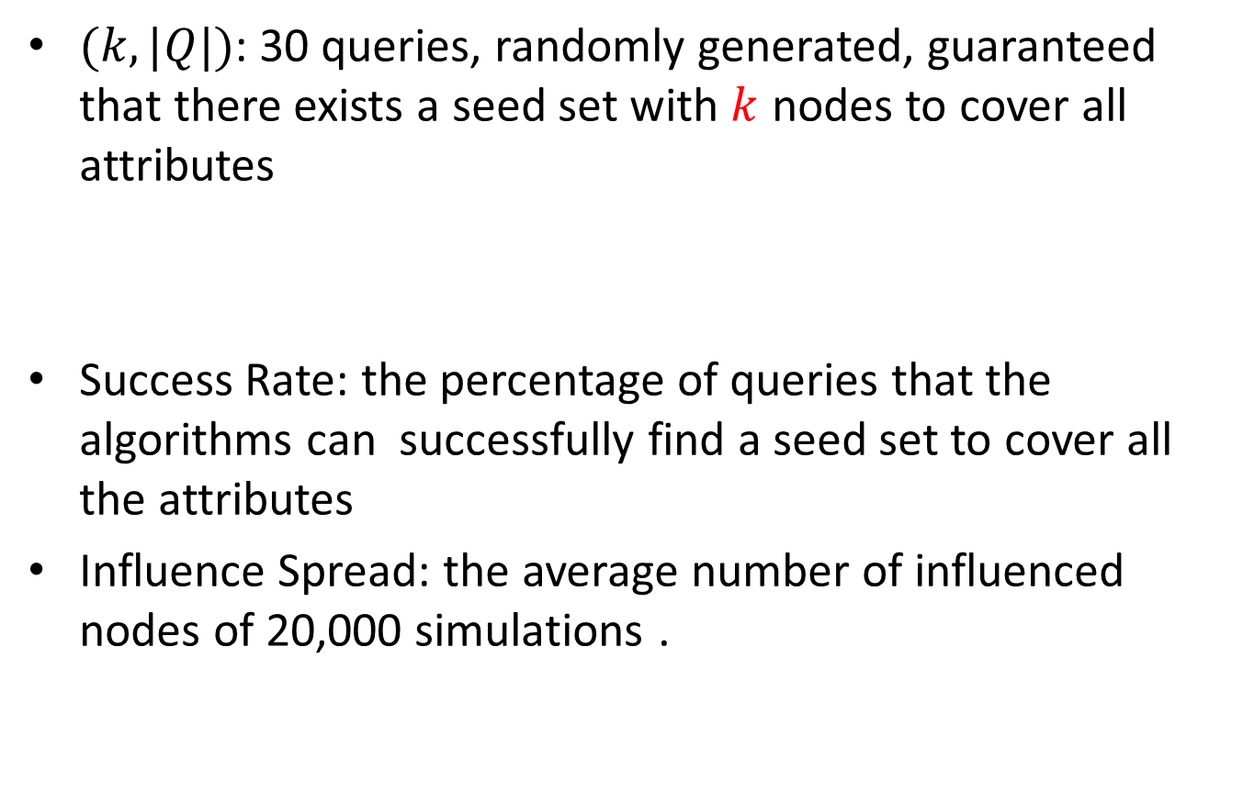
Query and measures
$(k, |Q|)$: 30 queries, randomly generated, guaranteed that there exists a seed set with $k$ nodes to cover all attributes
Success Rate: the percentage of queries that the algorithms can successfully find a seed set to cover all the attributes
Influence Spread: the average number of influenced nodes of 20,000 simulations .

Slide 27
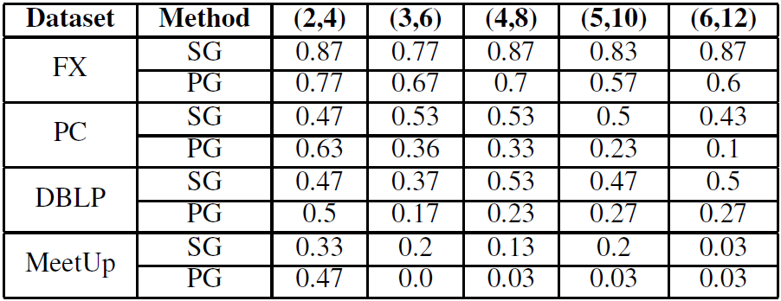
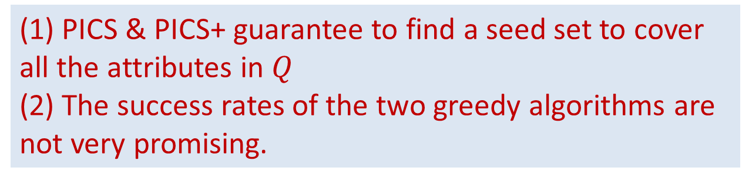
Success Rate
(1) PICS & PICS+ guarantee to find a seed set to cover all the attributes in $Q$
(2) The success rates of the two greedy algorithms are not very promising.

Slide 28
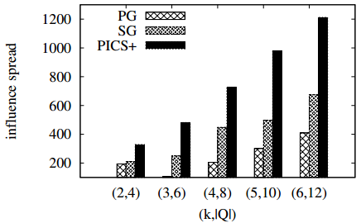
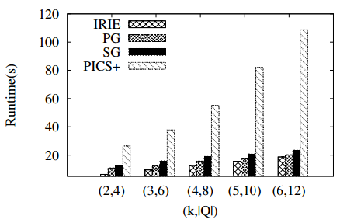
Comparison of greedy solutions and Approximation solutions
Influence spread
Runtime
(1) Greedy algorithms are efficient, PICS+ is also acceptable.
(2) The PICS+ outperforms the two greedy algorithms in terms of influence spread.

Slide 29
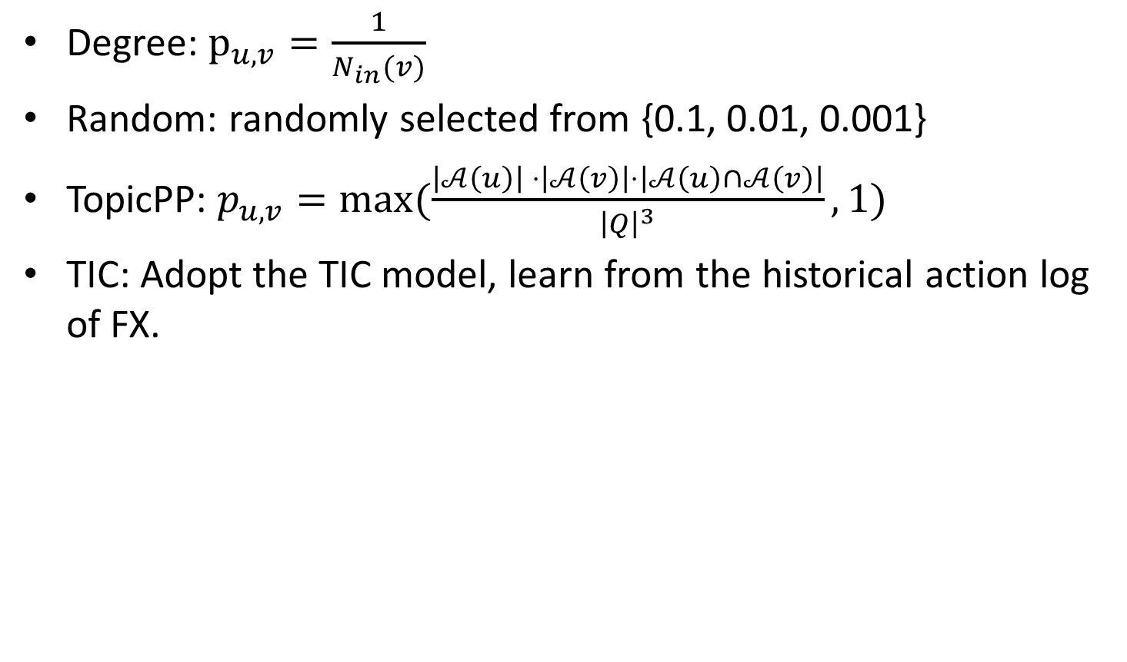
Effects of propagation probability
Degree: $p_{u,v}=\frac{1}{N_{in}(v)}$
Random: randomly selected from {0.1, 0.01, 0.001}
TopicPP: $p_{u,v}=max⁡(\frac{\left|𝒜\left(u\right)\right| ⋅\left|𝒜\left(v\right)\right|⋅\left|𝒜\left(u\right)∩𝒜\left(v\right)\right|}{{\left|Q\right|}^{3}}, 1)$
TIC: Adopt the TIC model, learn from the historical action log of FX.

Slide 30
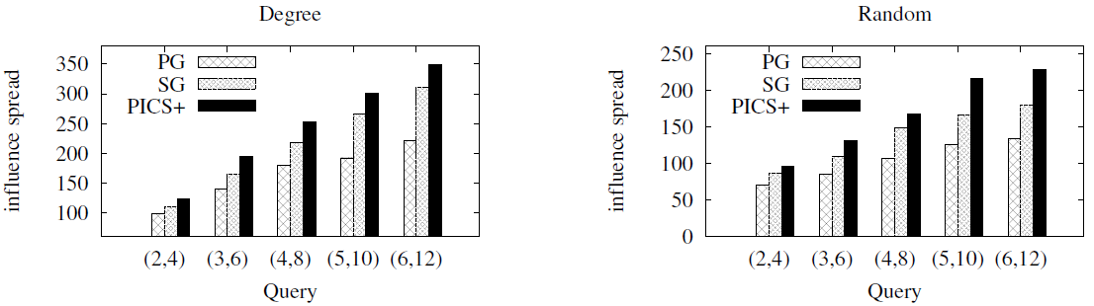
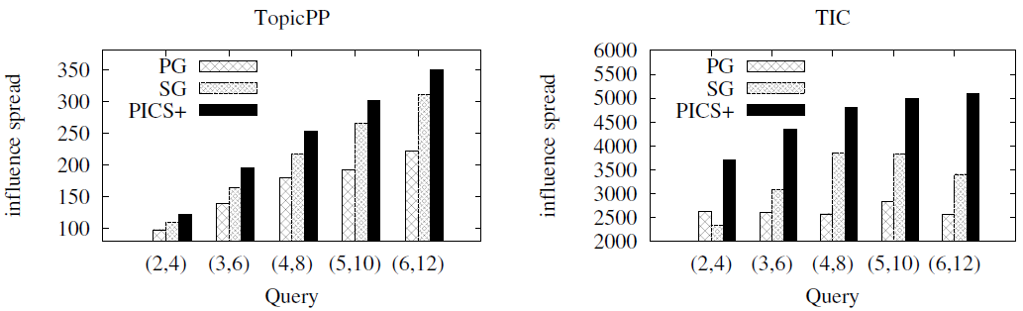
Effect of propagation probability
Our solutions to the ICS problem are insensitive to the influence probability of each edge in the graph.

Slide 31
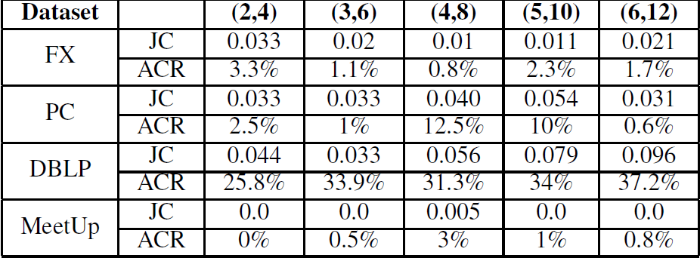

Comparison of IM and ICS
Jaccard Similarity(JC): $\frac{|S_{ICS}∩S_{IM}|}{|S_{ICS}∪S_{IM}|}$
Attribute Coverage Ratio(ACR): $\frac{|∪_{s∈S}A\left(s\right)∩Q|}{|Q|}$
Traditional IM techniques can not be directly used to solve the ICS problem

Slide 32
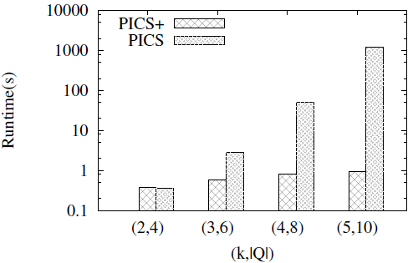
Comparison of PICS and PICS+
PICS+ is much more efficient than PICS for larger $|Q|$

Slide 33
Conclusion
We formulate ICS problem to select influential event organizers from online social networks
NP-hard
Greedy solutions
Based on score function
Based on the pigeonhole principle
Approximation Solutions
PICS – based on a notion of partitions
PICS+ – based on a notion of cover-groups
Experiments show our solutions are effective and efficient

Slide 34
Thanks
Q&A

