Slide 1
Multi-faceted Classification of Big Data Uses and Proposed Architecture Integrating High Performance Computing and the Apache Stack
Sixth International Workshop on Cloud Data Management
CloudDB 2014
Chicago March 31 2014
Geoffrey Fox
gcf@indiana.edu
http://www.infomall.org
School of Informatics and Computing
Digital Science Center
Indiana University Bloomington

Slide 2
Abstract
We introduce the NIST collection of 51 use cases and describe their scope over industry, government and research areas. We look at their structure from several points of view or facets covering problem architecture, analytics kernels, micro-system usage such as flops/bytes, application class (GIS, expectation maximization) and very importantly data source.
We then propose that in many cases it is wise to combine the well known commodity best practice (often Apache) Big Data Stack (with ~120 software subsystems) with high performance computing technologies.
We describe this and give early results based on clustering running with different paradigms.
We identify key layers where HPC Apache integration is particularly important: File systems, Cluster resource management, File and object data management, Inter process and thread communication, Analytics libraries, Workflow and Monitoring.

Slide 3
NIST Big Data Use Cases

Slide 4
NIST Requirements and Use Case Subgroup
Part of NIST Big Data Public Working Group (NBD-PWG) June-September 2013 http://bigdatawg.nist.gov/
Leaders of activity
Wo Chang, NIST
Robert Marcus, ET-Strategies
Chaitanya Baru, UC San Diego
The focus is to form a community of interest from industry, academia, and government, with the goal of developing a consensus list of Big Data requirements across all stakeholders. This includes gathering and understanding various use cases from diversified application domains.
Tasks
Gather use case input from all stakeholders
Derive Big Data requirements from each use case.
Analyze/prioritize a list of challenging general requirements that may delay or prevent adoption of Big Data deployment
Develop a set of general patterns capturing the “essence” of use cases (to do)
Work with Reference Architecture to validate requirements and reference architecture by explicitly implementing some patterns based on use cases

Slide 5
Big Data Definition
More consensus on Data Science definition than that of Big Data
Big Data refers to digital data volume, velocity and/or variety that:
Enable novel approaches to frontier questions previously inaccessible or impractical using current or conventional methods; and/or
Exceed the storage capacity or analysis capability of current or conventional methods and systems; and
Differentiates by storing and analyzing population data and not sample sizes.
Needs management requiring scalability across coupled horizontal resources
Everybody says their data is big (!) Perhaps how it is used is most important

Slide 6
What is Data Science?
I was impressed by number of NIST working group members who were self declared data scientists
I was also impressed by universal adoption by participants of Apache technologies – see later
McKinsey says there are lots of jobs (1.65M by 2018 in USA) but that’s not enough! Is this a field – what is it and what is its core?
The emergence of the 4th or data driven paradigm of science illustrates significance - http://research.microsoft.com/en-us/collaboration/fourthparadigm/
Discovery is guided by data rather than by a model
The End of (traditional) science http://www.wired.com/wired/issue/16-07 is famous here
Another example is recommender systems in Netflix, e-commerce etc. where pure data (user ratings of movies or products) allows an empirical prediction of what users like

Slide 7
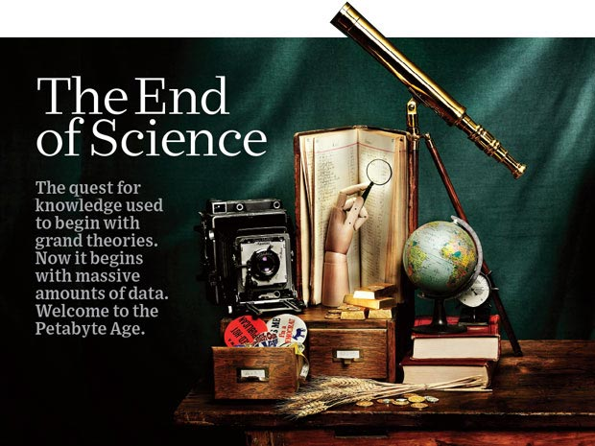
http://www.wired.com/wired/issue/16-07 September 2008

Slide 8
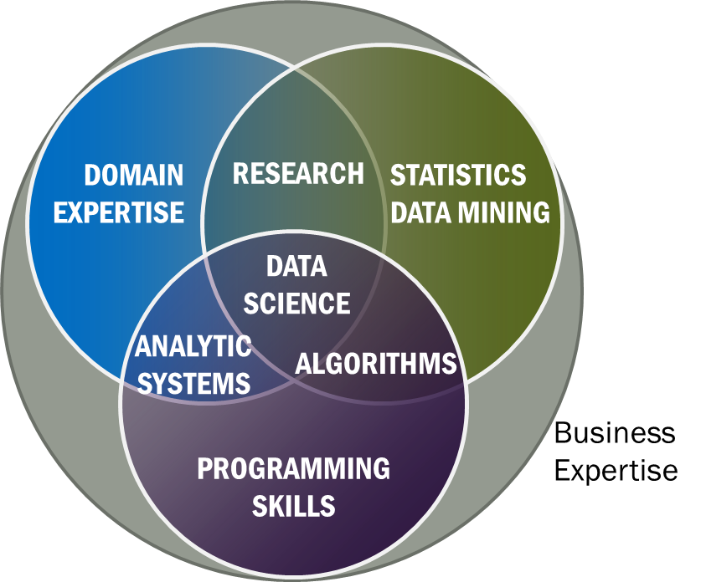
Data Science Definition
Data Science is the extraction of actionable knowledge directly from data through a process of discovery, hypothesis, and analytical hypothesis analysis.
A Data Scientist is a practitioner who has sufficient knowledge of the overlapping regimes of expertise in business needs, domain knowledge, analytical skills and programming expertise to manage the end-to-end scientific method process through each stage in the big data lifecycle.
Notes:
Big Data refers to digital data volume, velocity and/or variety whose management requires scalability across coupled horizontal resources
Data Science is the extraction of actionable knowledge directly from data through a process of discovery, hypothesis, and analytical hypothesis analysis.
A Data Scientist is a practitioner who has sufficient knowledge of the overlapping regimes of expertise in business needs, domain knowledge, analytical skills and programming expertise to manage the end-to-end scientific method process through each stage in the big data lifecycle.

Slide 9
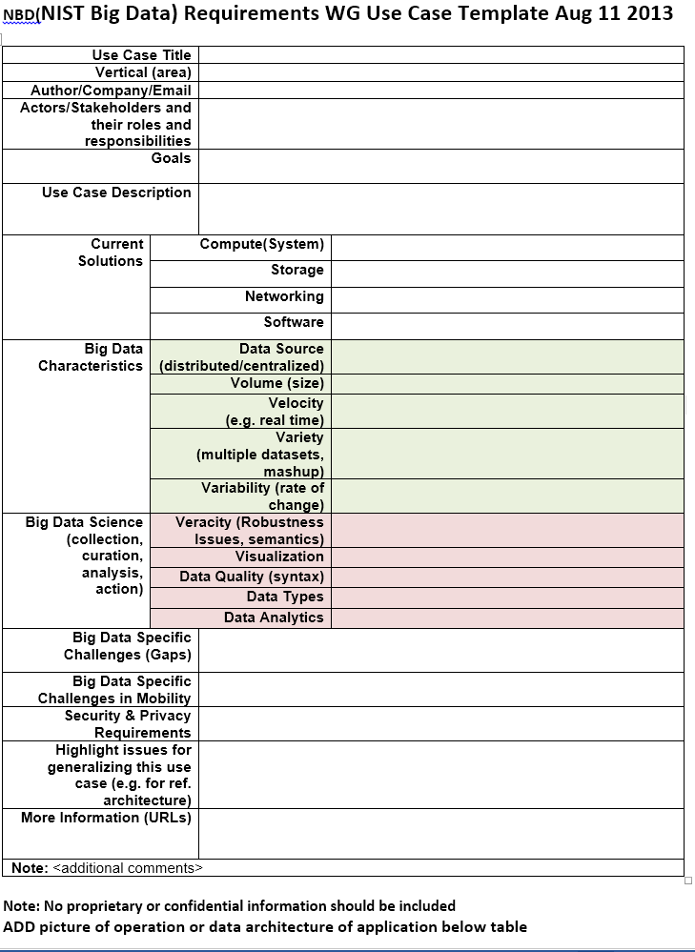
Use Case Template
26 fields completed for 51 areas
Government Operation: 4
Commercial: 8
Defense: 3
Healthcare and Life Sciences: 10
Deep Learning and Social Media: 6
The Ecosystem for Research: 4
Astronomy and Physics: 5
Earth, Environmental and Polar Science: 10
Energy: 1

Slide 10
51 Detailed Use Cases: Contributed July-September 2013 Covers goals, data features such as 3 V’s, software, hardware
26 Features for each use case
Biased to science
http://bigdatawg.nist.gov/usecases.php
https://bigdatacoursespring2014.appspot.com/course (Section 5)
Government Operation(4): National Archives and Records Administration, Census Bureau
Commercial(8): Finance in Cloud, Cloud Backup, Mendeley (Citations), Netflix, Web Search, Digital Materials, Cargo shipping (as in UPS)
Defense(3): Sensors, Image surveillance, Situation Assessment
Healthcare and Life Sciences(10): Medical records, Graph and Probabilistic analysis, Pathology, Bioimaging, Genomics, Epidemiology, People Activity models, Biodiversity
Deep Learning and Social Media(6): Driving Car, Geolocate images/cameras, Twitter, Crowd Sourcing, Network Science, NIST benchmark datasets
The Ecosystem for Research(4): Metadata, Collaboration, Language Translation, Light source experiments
Astronomy and Physics(5): Sky Surveys including comparison to simulation, Large Hadron Collider at CERN, Belle Accelerator II in Japan
Earth, Environmental and Polar Science(10): Radar Scattering in Atmosphere, Earthquake, Ocean, Earth Observation, Ice sheet Radar scattering, Earth radar mapping, Climate simulation datasets, Atmospheric turbulence identification, Subsurface Biogeochemistry (microbes to watersheds), AmeriFlux and FLUXNET gas sensors
Energy(1): Smart grid

Slide 11
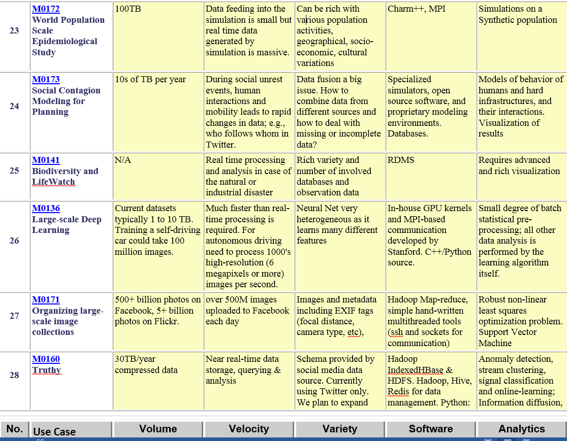
Part of Property Summary Table

Slide 12
3: Census Bureau Statistical Survey Response Improvement (Adaptive Design)
Government
Application: Survey costs are increasing as survey response declines. The goal of this work is to use advanced “recommendation system techniques” that are open and scientifically objective, using data mashed up from several sources and historical survey para-data (administrative data about the survey) to drive operational processes in an effort to increase quality and reduce the cost of field surveys.
Current Approach: About a petabyte of data coming from surveys and other government administrative sources. Data can be streamed with approximately 150 million records transmitted as field data streamed continuously, during the decennial census. All data must be both confidential and secure. All processes must be auditable for security and confidentiality as required by various legal statutes. Data quality should be high and statistically checked for accuracy and reliability throughout the collection process. Use Hadoop, Spark, Hive, R, SAS, Mahout, Allegrograph, MySQL, Oracle, Storm, BigMemory, Cassandra, Pig software.
Futures: Analytics needs to be developed which give statistical estimations that provide more detail, on a more near real time basis for less cost. The reliability of estimated statistics from such “mashed up” sources still must be evaluated.

Slide 13
7: Netflix Movie Service
Commercial
Application: Allow streaming of user selected movies to satisfy multiple objectives (for different stakeholders) -- especially retaining subscribers. Find best possible ordering of a set of videos for a user (household) within a given context in real-time; maximize movie consumption. Digital movies stored in cloud with metadata; user profiles and rankings for small fraction of movies for each user. Use multiple criteria – content based recommender system; user-based recommender system; diversity. Refine algorithms continuously with A/B testing.
Current Approach: Recommender systems and streaming video delivery are core Netflix technologies. Recommender systems are always personalized and use logistic/linear regression, elastic nets, matrix factorization, clustering, latent Dirichlet allocation, association rules, gradient boosted decision trees etc. Winner of Netflix competition (to improve ratings by 10%) combined over 100 different algorithms. Uses SQL, NoSQL, MapReduce on Amazon Web Services. Netflix recommender systems have features in common to e-commerce like Amazon. Streaming video has features in common with other content providing services like iTunes, Google Play, Pandora and Last.fm.
Futures: Very competitive business. Need to be aware of other companies and trends in both content (which Movies are hot) and technology. Need to investigate new business initiatives such as Netflix sponsored content

Slide 14
15: Intelligence Data Processing and Analysis
Defense
Application: Allow Intelligence Analysts to a) Identify relationships between entities (people, organizations, places, equipment) b) Spot trends in sentiment or intent for either general population or leadership group (state, non-state actors) c) Find location of and possibly timing of hostile actions (including implantation of IEDs) d) Track the location and actions of (potentially) hostile actors e) Ability to reason against and derive knowledge from diverse, disconnected, and frequently unstructured (e.g. text) data sources f) Ability to process data close to the point of collection and allow data to be shared easily to/from individual soldiers, forward deployed units, and senior leadership in garrison.
Current Approach: Software includes Hadoop, Accumulo (Big Table), Solr, Natural Language Processing, Puppet (for deployment and security) and Storm running on medium size clusters. Data size in 10s of Terabytes to 100s of Petabytes with Imagery intelligence device gathering petabyte in a few hours. Dismounted warfighters would have at most 1-100s of Gigabytes (typically handheld data storage).
Futures: Data currently exists in disparate silos which must be accessible through a semantically integrated data space. Wide variety of data types, sources, structures, and quality which will span domains and requires integrated search and reasoning. Most critical data is either unstructured or imagery/video which requires significant processing to extract entities and information. Network quality, Provenance and security essential.

Slide 15
26: Large-scale Deep Learning
Deep Learning
Social Networking
Application: Large models (e.g., neural networks with more neurons and connections) combined with large datasets are increasingly the top performers in benchmark tasks for vision, speech, and Natural Language Processing. One needs to train a deep neural network from a large (>>1TB) corpus of data (typically imagery, video, audio, or text). Such training procedures often require customization of the neural network architecture, learning criteria, and dataset pre-processing. In addition to the computational expense demanded by the learning algorithms, the need for rapid prototyping and ease of development is extremely high.
Current Approach: The largest applications so far are to image recognition and scientific studies of unsupervised learning with 10 million images and up to 11 billion parameters on a 64 GPU HPC Infiniband cluster. Both supervised (using existing classified images) and unsupervised applications
Futures: Large datasets of 100TB or more may be necessary in order to exploit the representational power of the larger models. Training a self-driving car could take 100 million images at megapixel resolution. Deep Learning shares many characteristics with the broader field of machine learning. The paramount requirements are high computational throughput for mostly dense linear algebra operations, and extremely high productivity for researcher exploration. One needs integration of high performance libraries with high level (python) prototyping environments
Classified OUT
IN

Slide 16
35: Light source beamlines
Research Ecosystem
Application: Samples are exposed to X-rays from light sources in a variety of configurations depending on the experiment. Detectors (essentially high-speed digital cameras) collect the data. The data are then analyzed to reconstruct a view of the sample or process being studied.
Current Approach: A variety of commercial and open source software is used for data analysis – examples including Octopus for Tomographic Reconstruction, Avizo (http://vsg3d.com) and FIJI (a distribution of ImageJ) for Visualization and Analysis. Data transfer is accomplished using physical transport of portable media (severely limits performance) or using high-performance GridFTP, managed by Globus Online or workflow systems such as SPADE.
Futures: Camera resolution is continually increasing. Data transfer to large-scale computing facilities is becoming necessary because of the computational power required to conduct the analysis on time scales useful to the experiment. Large number of beamlines (e.g. 39 at LBNL ALS) means that total data load is likely to increase significantly and require a generalized infrastructure for analyzing gigabytes per second of data from many beamline detectors at multiple facilities.

Slide 17
36: Catalina Real-Time Transient Survey (CRTS): a digital, panoramic, synoptic sky survey I
Astronomy & Physics
Application: The survey explores the variable universe in the visible light regime, on time scales ranging from minutes to years, by searching for variable and transient sources. It discovers a broad variety of astrophysical objects and phenomena, including various types of cosmic explosions (e.g., Supernovae), variable stars, phenomena associated with accretion to massive black holes (active galactic nuclei) and their relativistic jets, high proper motion stars, etc. The data are collected from 3 telescopes (2 in Arizona and 1 in Australia), with additional ones expected in the near future (in Chile).
Current Approach: The survey generates up to ~ 0.1 TB on a clear night with a total of ~100 TB in current data holdings. The data are preprocessed at the telescope, and transferred to Univ. of Arizona and Caltech, for further analysis, distribution, and archiving. The data are processed in real time, and detected transient events are published electronically through a variety of dissemination mechanisms, with no proprietary withholding period (CRTS has a completely open data policy). Further data analysis includes classification of the detected transient events, additional observations using other telescopes, scientific interpretation, and publishing. In this process, it makes a heavy use of the archival data (several PB’s) from a wide variety of geographically distributed resources connected through the Virtual Observatory (VO) framework.

Slide 18
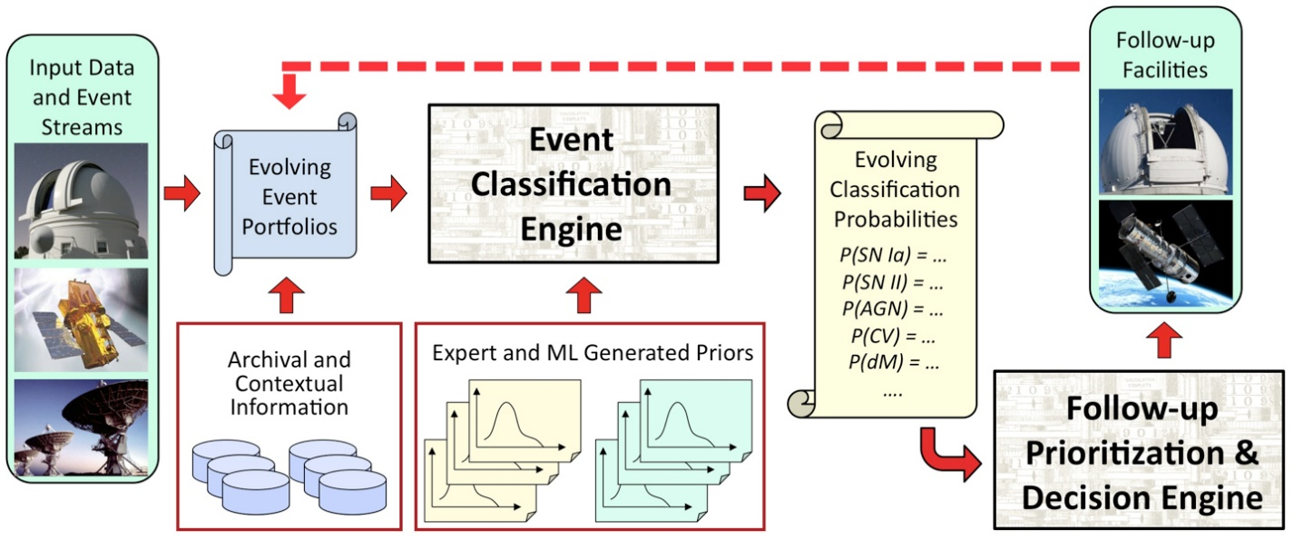
36: Catalina Real-Time Transient Survey (CRTS): a digital, panoramic, synoptic sky survey II
Astronomy & Physics
Futures: CRTS is a scientific and methodological testbed and precursor of larger surveys to come, notably the Large Synoptic Survey Telescope (LSST), expected to operate in 2020’s and selected as the highest-priority ground-based instrument in the 2010 Astronomy and Astrophysics Decadal Survey. LSST will gather about 30 TB per night.

Slide 19
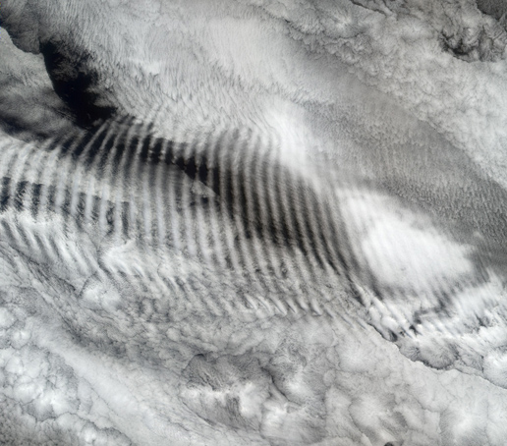
47: Atmospheric Turbulence - Event Discovery and Predictive Analytics
Earth, Environmental and Polar Science
Application: This builds datamining on top of reanalysis products including the North American Regional Reanalysis (NARR) and the Modern-Era Retrospective-Analysis for Research (MERRA) from NASA where latter described earlier. The analytics correlate aircraft reports of turbulence (either from pilot reports or from automated aircraft measurements of eddy dissipation rates) with recently completed atmospheric re-analyses. This is of value to aviation industry and to weather forecasters. There are no standards for re-analysis products complicating system where MapReduce is being investigated. The reanalysis data is hundreds of terabytes and slowly updated whereas turbulence is smaller in size and implemented as a streaming service.
Current Approach: Current 200TB dataset can be analyzed with MapReduce or the like using SciDB or other scientific database.
Futures: The dataset will reach 500TB in 5 years. The initial turbulence case can be extended to other ocean/atmosphere phenomena but the analytics would be different in each case.
Typical NASA image of turbulent waves

Slide 20
51: Consumption forecasting in Smart Grids
Energy
Application: Predict energy consumption for customers, transformers, sub-stations and the electrical grid service area using smart meters providing measurements every 15-mins at the granularity of individual consumers within the service area of smart power utilities. Combine Head-end of smart meters (distributed), Utility databases (Customer Information, Network topology; centralized), US Census data (distributed), NOAA weather data (distributed), Micro-grid building information system (centralized), Micro-grid sensor network (distributed). This generalizes to real-time data-driven analytics for time series from cyber physical systems
Current Approach: GIS based visualization. Data is around 4 TB a year for a city with 1.4M sensors in Los Angeles. Uses R/Matlab, Weka, Hadoop software. Significant privacy issues requiring anonymization by aggregation. Combine real time and historic data with machine learning for predicting consumption.
Futures: Wide spread deployment of Smart Grids with new analytics integrating diverse data and supporting curtailment requests. Mobile applications for client interactions.

Slide 21
10 Suggested Generic Use Cases
Multiple users performing interactive queries and updates on a database with basic availability and eventual consistency (BASE)
Perform real time analytics on data source streams and notify users when specified events occur
Move data from external data sources into a highly horizontally scalable data store, transform it using highly horizontally scalable processing (e.g. Map-Reduce), and return it to the horizontally scalable data store (ELT)
Perform batch analytics on the data in a highly horizontally scalable data store using highly horizontally scalable processing (e.g MapReduce) with a user-friendly interface (e.g. SQL like)
Perform interactive analytics on data in analytics-optimized database
Visualize data extracted from horizontally scalable Big Data score
Move data from a highly horizontally scalable data store into a traditional Enterprise Data Warehouse
Extract, process, and move data from data stores to archives
Combine data from Cloud databases and on premise data stores for analytics, data mining, and/or machine learning
Orchestrate multiple sequential and parallel data transformations and/or analytic processing using a workflow manager

Slide 22
10 Security & Privacy Use Cases
Consumer Digital Media Usage
Nielsen Homescan
Web Traffic Analytics
Health Information Exchange
Personal Genetic Privacy
Pharma Clinic Trial Data Sharing
Cyber-security
Aviation Industry
Military - Unmanned Vehicle sensor data
Education - “Common Core” Student Performance Reporting
Need to integrate 10 “generic” and 10 “security & privacy” with 51 “full use cases”

Slide 23
NIST Big Data Reference Architecture
INFORMATION VALUE CHAIN
System Orchestrator
Big Data Application Provider
Analytics
Data Provider
Curation
Visualization
Data Consumer
DATA
DATA
SW
Collection
Access
SW
DATA
SW
K E Y :
Big Data Framework Provider
Processing Frameworks (analytic tools, etc.)
IT VALUE CHAIN
Horizontally Scalable
Service Use
Vertically Scalable
Security & Privacy
DATA
Platforms (databases, etc.)
Management
Horizontally Scalable
Data Flow
Vertically Scalable
Infrastructures
SW
Horizontally Scalable (VM clusters)
Vertically Scalable
Analytics Tools Transfer
Physical and Virtual Resources (networking, computing, etc.)

Slide 24
Requirements Extraction Process
Two-step process is used for requirement extraction:
Extract specific requirements and map to reference architecture based on each application’s characteristics such as:
data sources (data size, file formats, rate of grow, at rest or in motion, etc.)
data lifecycle management (curation, conversion, quality check, pre-analytic processing, etc.)
data transformation (data fusion/mashup, analytics),
capability infrastructure (software tools, platform tools, hardware resources such as storage and networking), and
data usage (processed results in text, table, visual, and other formats).
all architecture components informed by Goals and use case description
Security & Privacy has direct map
Aggregate all specific requirements into high-level generalized requirements which are vendor-neutral and technology agnostic.

Slide 25
Size of Process
The draft use case and requirements report is 264 pages
How much web and how much publication?
35 General Requirements
437 Specific Requirements
8.6 per use case, 12.5 per general requirement
Data Sources: 3 General 78 Specific
Transformation: 4 General 60 Specific
Capability (Infrastructure): 6 General 133 Specific
Data Consumer: 6 General 55 Specific
Security & Privacy: 2 General 45 Specific
Lifecycle: 9 General 43 Specific
Other: 5 General 23 Specific
Not clearly useful – prefer to identify common “structure/kernels”

Slide 26
Significant Web Resources
Index to all use cases http://bigdatawg.nist.gov/usecases.php
This links to individual submissions and other processed/collected information
List of specific requirements versus use case http://bigdatawg.nist.gov/uc_reqs_summary.php
List of general requirements versus architecture component http://bigdatawg.nist.gov/uc_reqs_gen.php
List of general requirements versus architecture component with record of use cases giving requirement http://bigdatawg.nist.gov/uc_reqs_gen_ref.php
List of architecture component and specific requirements plus use case constraining this component http://bigdatawg.nist.gov/uc_reqs_gen_detail.php

Slide 27
Would like to capture “essence of these use cases”
“small” kernels, mini-apps
Or Classify applications into patterns
Do it from HPC background not database view point
e.g. focus on cases with detailed analytics
Section 5 of my class https://bigdatacoursespring2014.appspot.com/preview classifies 51 use cases with ogre facets

Slide 28
What are “mini-Applications”
Use for benchmarks of computers and software (is my parallel compiler any good?)
In parallel computing, this is well established
Linpack for measuring performance to rank machines in Top500 (changing?)
NAS Parallel Benchmarks (originally a pencil and paper specification to allow optimal implementations; then MPI library)
Other specialized Benchmark sets keep changing and used to guide procurements
Last 2 NSF hardware solicitations had NO preset benchmarks – perhaps as no agreement on key applications for clouds and data intensive applications
Berkeley dwarfs capture different structures that any approach to parallel computing must address
Templates used to capture parallel computing patterns
I’ll let experts comment on database benchmarks like TPC

Slide 29
HPC Benchmark Classics
Linpack or HPL: Parallel LU factorization for solution of linear equations
NPB version 1: Mainly classic HPC solver kernels
MG: Multigrid
CG: Conjugate Gradient
FT: Fast Fourier Transform
IS: Integer sort
EP: Embarrassingly Parallel
BT: Block Tridiagonal
SP: Scalar Pentadiagonal
LU: Lower-Upper symmetric Gauss Seidel

Slide 30
7 Original Berkeley Dwarfs (Colella)
Structured Grids (including locally structured grids, e.g. Adaptive Mesh Refinement)
Unstructured Grids
Fast Fourier Transform
Dense Linear Algebra
Sparse Linear Algebra
Particles
Monte Carlo
Note “vaguer” than NPB

Slide 31
13 Berkeley Dwarfs
Dense Linear Algebra
Sparse Linear Algebra
Spectral Methods
N-Body Methods
Structured Grids
Unstructured Grids
MapReduce
Combinational Logic
Graph Traversal
Dynamic Programming
Backtrack and Branch-and-Bound
Graphical Models
Finite State Machines
First 6 of these correspond to Colella’s original.
Monte Carlo dropped
N-body methods are a subset of Particle
Note a little inconsistent in that MapReduce is a programming model and spectral method is a numerical method
Need multiple facets!

Slide 32
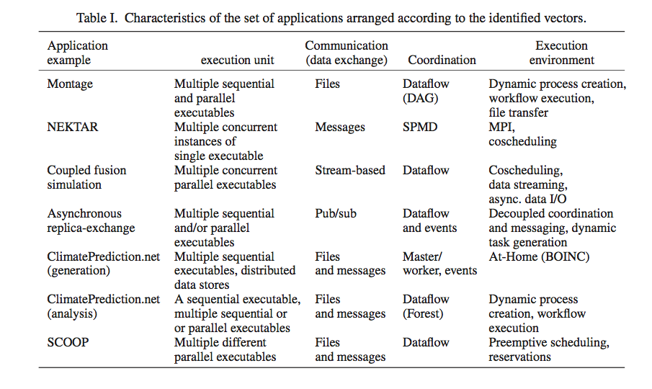
Distributed Computing MetaPatterns I Jha, Cole, Katz, Parashar, Rana, Weissman

Slide 33
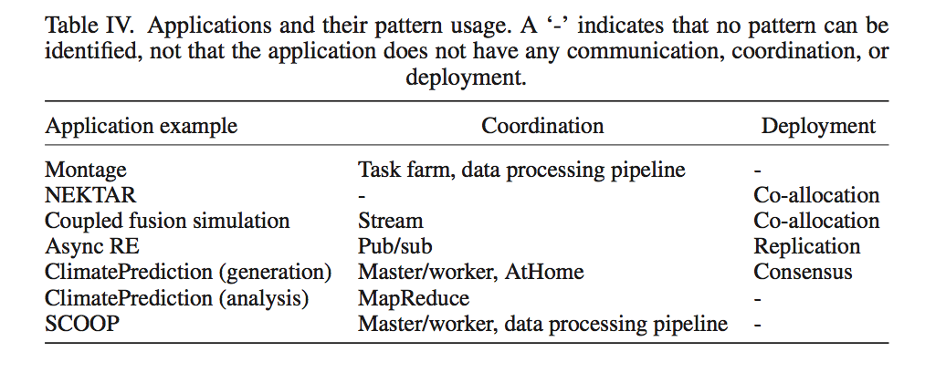
Distributed Computing MetaPatterns II Jha, Cole, Katz, Parashar, Rana, Weissman

Slide 34
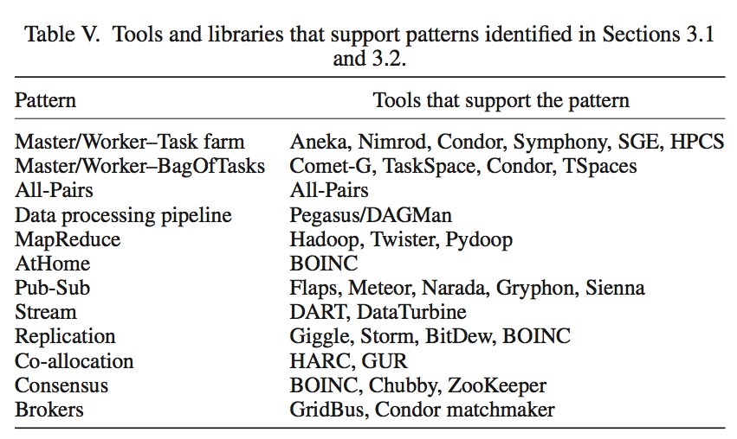
Distributed Computing MetaPatterns III Jha, Cole, Katz, Parashar, Rana, Weissman

Slide 35
Core Analytics Facet of Ogres (microPattern)
Search/Query
Local Machine Learning – pleasingly parallel
Summarizing statistics
Recommender Systems (Collaborative Filtering)
Outlier Detection (iORCA)
Clustering (many methods),
LDA (Latent Dirichlet Allocation) or variants like PLSI (Probabilistic Latent Semantic Indexing),
SVM and Linear Classifiers (Bayes, Random Forests),
PageRank, (Find leading eigenvector of sparse matrix)
SVD (Singular Value Decomposition),
Learning Neural Networks (Deep Learning),
MDS (Multidimensional Scaling),
Graph Structure Algorithms (seen in search of RDF Triple stores),
Network Dynamics - Graph simulation Algorithms (epidemiology)
Global
Optimization
Matrix Algebra

Slide 36
Problem Architecture Facet of Ogres (Meta or MacroPattern)
Pleasingly Parallel – as in Blast, Protein docking, some (bio-)imagery
Local Analytics or Machine Learning – ML or filtering pleasingly parallel as in bio-imagery, radar images (really just pleasingly parallel but sophisticated local analytics)
Global Analytics or Machine Learning seen in LDA, Clustering etc. with parallel ML over nodes of system
SPMD (Single Program Multiple Data)
Bulk Synchronous Processing: well defined compute-communication phases
Fusion: Knowledge discovery often involves fusion of multiple methods.
Workflow (often used in fusion)
Notes:
Big dwarfs are Ogres
Implement Ogres in ABDS+

Slide 37
18: Computational Bioimaging
Healthcare
Life Sciences
Application: Data delivered from bioimaging is increasingly automated, higher resolution, and multi-modal. This has created a data analysis bottleneck that, if resolved, can advance the biosciences discovery through Big Data techniques.
Current Approach: The current piecemeal analysis approach does not scale to situation where a single scan on emerging machines is 32TB and medical diagnostic imaging is annually around 70 PB even excluding cardiology. One needs a web-based one-stop-shop for high performance, high throughput image processing for producers and consumers of models built on bio-imaging data.
Futures: Goal is to solve that bottleneck with extreme scale computing with community-focused science gateways to support the application of massive data analysis toward massive imaging data sets. Workflow components include data acquisition, storage, enhancement, minimizing noise, segmentation of regions of interest, crowd-based selection and extraction of features, and object classification, and organization, and search. Use ImageJ, OMERO, VolRover, advanced segmentation and feature detection software.
Largely Local Machine Learning

Slide 38
27: Organizing large-scale, unstructured collections of consumer photos I
Deep Learning
Social Networking
Application: Produce 3D reconstructions of scenes using collections of millions to billions of consumer images, where neither the scene structure nor the camera positions are known a priori. Use resulting 3d models to allow efficient browsing of large-scale photo collections by geographic position. Geolocate new images by matching to 3d models. Perform object recognition on each image. 3d reconstruction posed as a robust non-linear least squares optimization problem where observed relations between images are constraints and unknowns are 6-d camera pose of each image and 3-d position of each point in the scene.
Current Approach: Hadoop cluster with 480 cores processing data of initial applications. Note over 500 billion images on Facebook and over 5 billion on Flickr with over 500 million images added to social media sites each day.
Global Machine Learning after Initial Local steps

Slide 39
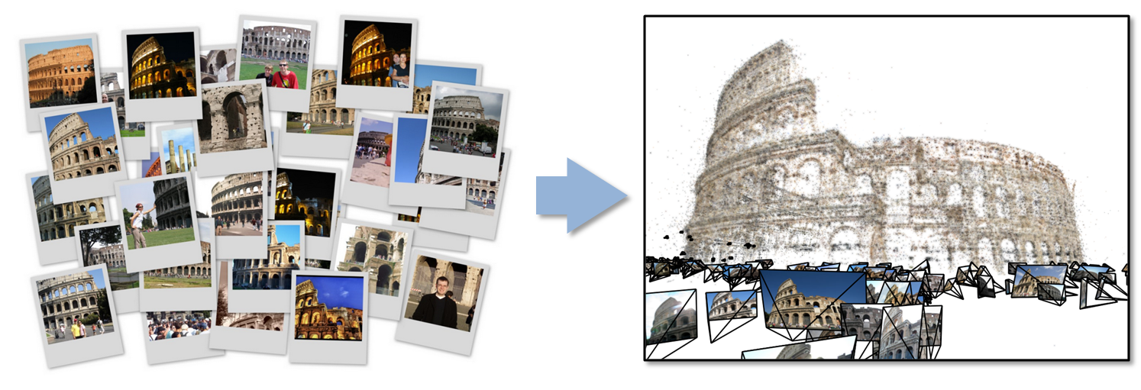
27: Organizing large-scale, unstructured collections of consumer photos II
Deep Learning
Social Networking
Futures: Need many analytics including feature extraction, feature matching, and large-scale probabilistic inference, which appear in many or most computer vision and image processing problems, including recognition, stereo resolution, and image denoising. Need to visualize large-scale 3-d reconstructions, and navigate large-scale collections of images that have been aligned to maps.
Global Machine Learning after Initial Local steps

Slide 40
This Facet of Ogres has Features
These core analytics/kernels can be classified by features like
(a) Flops per byte;
(b) Communication Interconnect requirements;
(c) Is application (graph) constant or dynamic
(d) Most applications consist of a set of interconnected entities; is this regular as a set of pixels or is it a complicated irregular graph
(d) Is communication BSP or Asynchronous; in latter case shared memory may be attractive
(e) Are algorithms Iterative or not?
(f) Are data points in metric or non-metric spaces

Slide 41
Application Class Facet of Ogres
(a) Search and query
(b) Maximum Likelihood,
(c) χ² minimizations,
(d) Expectation Maximization (often Steepest descent)
(e) Global Optimization (Variational Bayes)
(f) Agents, as in epidemiology (swarm approaches)
(g) GIS (Geographical Information Systems).
Not as essential

Slide 42
Data Source Facet of Ogres
(i) SQL,
(ii) NOSQL based,
(iii) Other Enterprise data systems (10 examples from Bob Marcus)
(iv) Set of Files (as managed in iRODS),
(v) Internet of Things,
(vi) Streaming and
(vii) HPC simulations.
Before data gets to compute system, there is often an initial data gathering phase which is characterized by a block size and timing. Block size varies from month (Remote Sensing, Seismic) to day (genomic) to seconds or lower (Real time control, streaming)
There are storage/compute system styles: Shared, Dedicated, Permanent, Transient
Other characteristics are need for permanent auxiliary/comparison datasets and these could be interdisciplinary implying nontrivial data movement/replication
Notes:
Big dwarfs are Ogres
Implement Ogres in ABDS+

Slide 43
Lessons / Insights
Ogres classify Big Data applications by multiple facets – each with several exemplars and features
Guide to breadth and depth of Big Data
Does your architecture/software support all the ogres?
Add database exemplars
In parallel computing, the simple analytic kernels dominate mindshare even though agreed limited

Slide 44
HPC-ABDS
Integrating High Performance Computing with Apache Big Data Stack

Slide 45
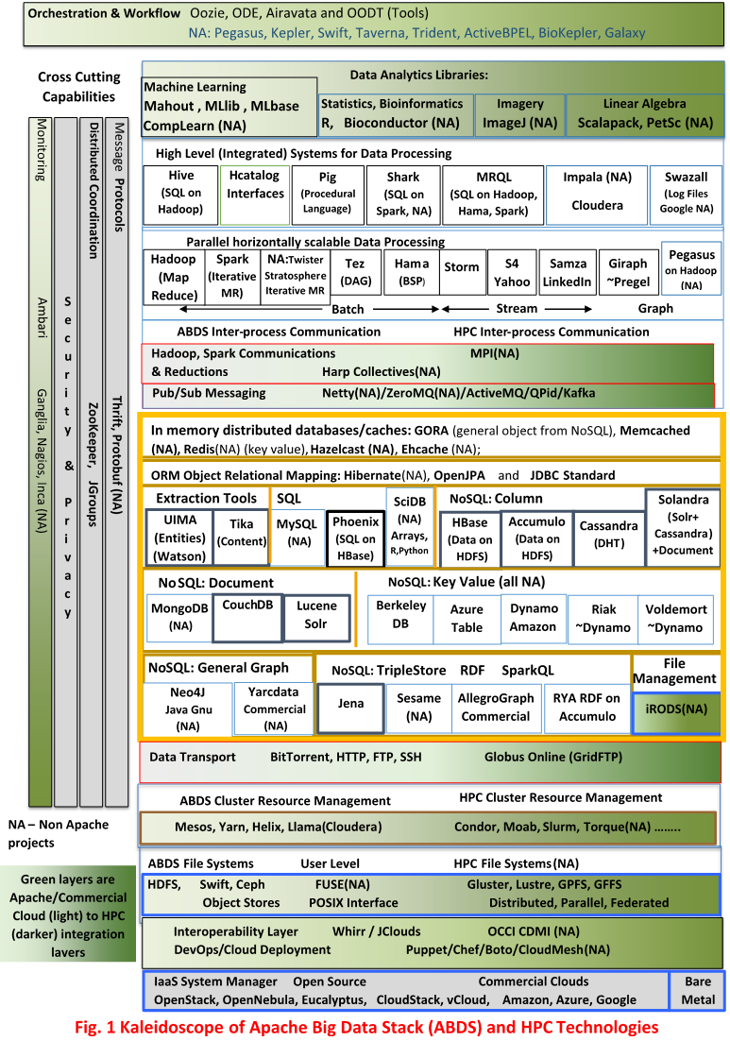
Enhanced Apache Big Data Stack ABDS
~120 Capabilities
>40 Apache
Green layers have strong HPC Integration opportunities
Goal
Functionality of ABDS
Performance of HPC

Slide 46
Broad Layers in HPC-ABDS
Workflow-Orchestration
Application and Analytics
High level Programming
Basic Programming model and runtime
SPMD, Streaming, MapReduce, MPI
Inter process communication
Collectives, point to point, publish-subscribe
In memory databases/caches
Object-relational mapping
SQL and NoSQL, File management
Data Transport
Cluster Resource Management (Yarn, Slurm, SGE)
File systems(HDFS, Lustre …)
DevOps (Puppet, Chef …)
IaaS Management from HPC to hypervisors (OpenStack)
Cross Cutting
Message Protocols
Distributed Coordination
Security & Privacy
Monitoring

Slide 49
Getting High Performance on Data Analytics (e.g. Mahout, R …)
On the systems side, we have two principles
The Apache Big Data Stack with ~120 projects has important broad functionality with a vital large support organization
HPC including MPI has striking success in delivering high performance with however a fragile sustainability model
There are key systems abstractions which are levels in HPC-ABDS software stack where Apache approach needs careful integration with HPC
Resource management
Storage
Programming model -- horizontal scaling parallelism
Collective and Point to Point communication
Support of iteration
Data interface (not just key-value)
In application areas, we define application abstractions to support
Graphs/network
Geospatial
Images etc.

Slide 50
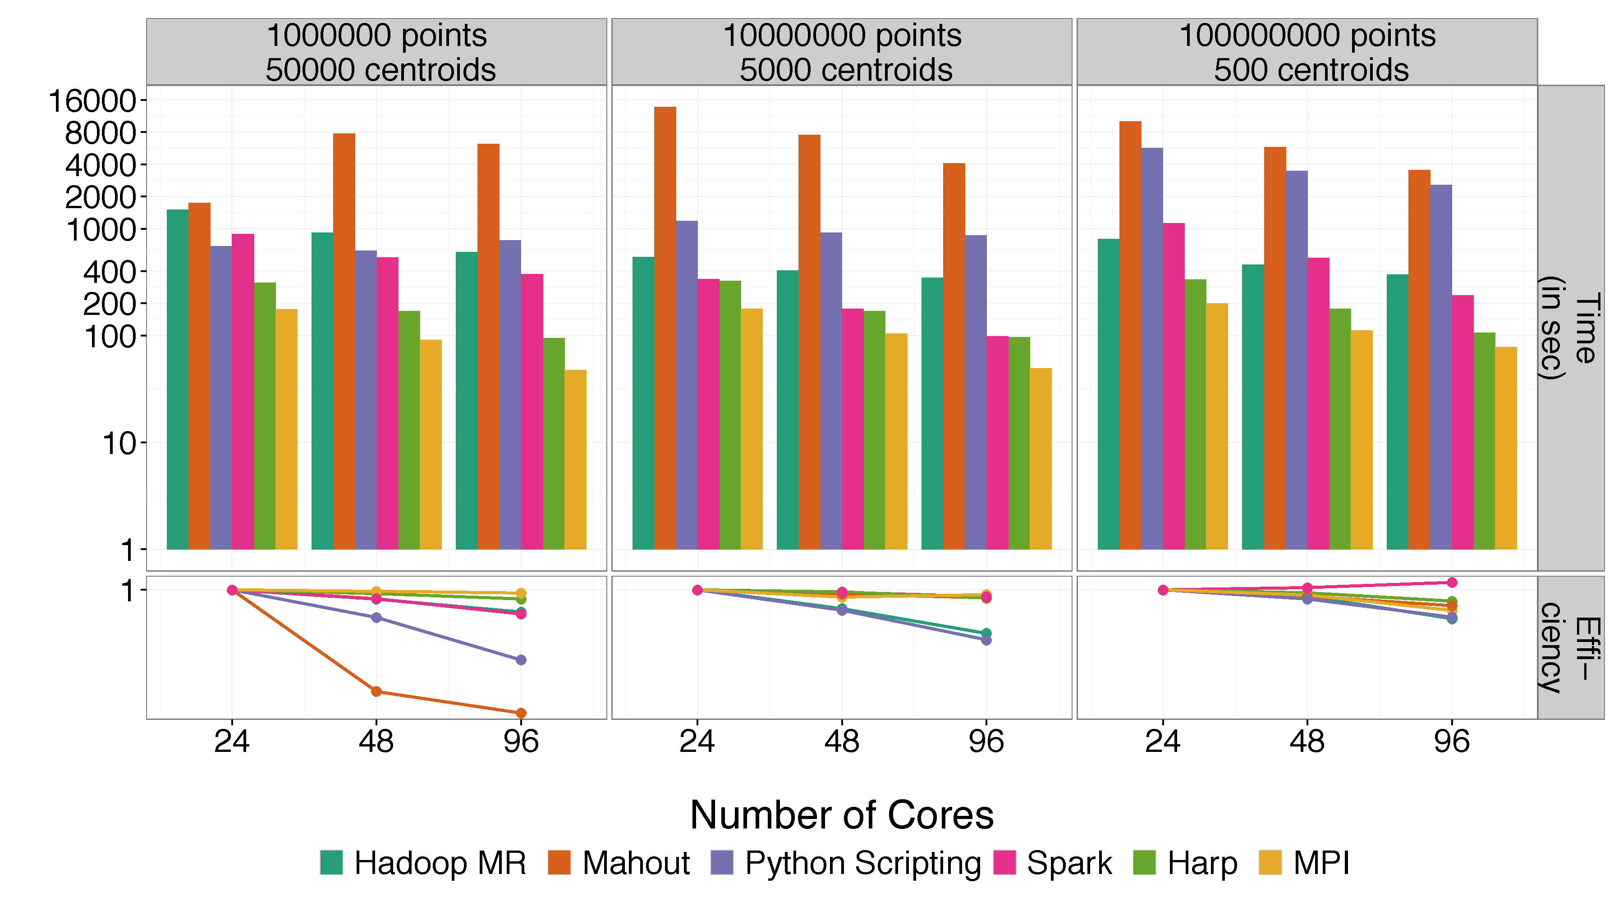
Mahout and Hadoop MR – Slow due to MapReduce Python slow as Scripting Spark Iterative MapReduce, non optimal communication Harp Hadoop plug in with ~MPI collectives MPI fastest as C not Java
Increasing Communication
Identical Computation

Slide 51
4 Forms of MapReduce
(a) Map Only
(b) Classic MapReduce
(c) Iterative MapReduce
(d) Loosely Synchronous
Input
Input
Iterations
Input
map
map
map
P_{ij}
reduce
reduce
Output
BLAST Analysis
Parametric sweep
Pleasingly Parallel
High Energy Physics (HEP) Histograms
Distributed search
Expectation maximization Clustering e.g. Kmeans
Linear Algebra, Page Rank
Classic MPI
PDE Solvers and particle dynamics
Domain of MapReduce and Iterative Extensions
Science Clouds
MPI
Giraph
MPI is Map followed by Point to Point or Collective Communication
– as in style c) plus d)

Slide 52
Map Collective Model (Judy Qiu)
Generalizes Iterative MapReduce
Combine MPI and MapReduce ideas
Implement collectives optimally on Infiniband, Azure, Amazon ……
Iterate
Input
map
Initial Collective Step
Generalized Reduce
Final Collective Step

Slide 53
Major Analytics Architectures in Use Cases
Pleasingly Parallel including local machine learning as in parallel over images and apply image processing to each image -- Hadoop
Search including collaborative filtering and motif finding implemented using classic MapReduce (Hadoop) or non iterative Giraph
Iterative MapReduce using Collective Communication (clustering) – Hadoop with Harp, Spark …..
Iterative Giraph (MapReduce) with point to point communication (most graph algorithms such as maximum clique, connected component, finding diameter, community detection)
Vary in difficulty of finding partitioning (classic parallel load balancing)
Shared memory thread based (event driven) graph algorithms (shortest path, Betweenness centrality)

Slide 54

HPC-ABDS Hourglass
HPC ABDS
System (Middleware)
120 Software Projects
System Abstractions/standards
Data format
Storage
HPC Yarn for Resource management
Horizontally scalable parallel programming model
Collective and Point to Point communication
Support of iteration
Application Abstractions/standards
Graphs, Networks, Images, Geospatial ….
High performance
Applications
SPIDAL (Scalable Parallel Interoperable Data Analytics Library) or High performance Mahout, R, Matlab …..

Slide 55
Integrating Yarn with HPC

Slide 56
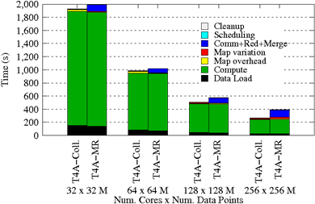
Using Optimal “Collective” Operations
Twister4Azure Iterative MapReduce with enhanced collectives
Map-AllReduce primitive and MapReduce-MergeBroadcast.
Strong Scaling on Kmeans for up to 256 cores on Azure

Slide 57
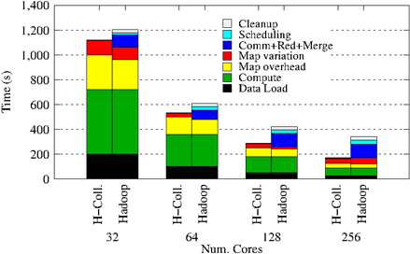
Collectives improve traditional MapReduce
This is Kmeans running within basic Hadoop but with optimal AllReduce collective operations
Running on Infiniband Linux Cluster

Slide 58
Kmeans and (Iterative) MapReduce
Shaded areas are computing only where Hadoop on HPC cluster fastest
Areas above shading are overheads where T4A smallest and T4A with AllReduce collective has lowest overhead
Note even on Azure Java (Orange) faster than T4A C# for compute

Slide 59
Harp Architecture
MapReduce Applications
Map-Collective Applications
Application
MapReduce V2
Harp
Framework
YARN
Resource Manager

Slide 60
Features of Harp Hadoop Plug in
Hadoop Plugin (on Hadoop 1.2.1 and Hadoop 2.2.0)
Hierarchical data abstraction on arrays, key-values and graphs for easy programming expressiveness.
Collective communication model to support various communication operations on the data abstractions.
Caching with buffer management for memory allocation required from computation and communication
BSP style parallelism
Fault tolerance with check-pointing

Slide 61
Performance on Madrid Cluster (8 nodes)
Increasing Communication
Identical Computation
Note compute same in each case as product of centers times points identical

Slide 62
Mahout and Hadoop MR – Slow due to MapReduce Python slow as Scripting Spark Iterative MapReduce, non optimal communication Harp Hadoop plug in with ~MPI collectives MPI fastest as C not Java
Increasing Communication
Identical Computation

Slide 63
Performance of MPI Kernel Operations
Pure Java as in FastMPJ slower than Java interfacing to C version of MPI

Slide 64
Lessons / Insights
Integrate (don’t compete) HPC with “Commodity Big data” (Google to Amazon to Enterprise data Analytics)
i.e. improve Mahout; don’t compete with it
Use Hadoop plug-ins rather than replacing Hadoop
Enhanced Apache Big Data Stack HPC-ABDS has 120 members – please improve list!
HPC-ABDS+ Integration areas include
file systems,
cluster resource management,
file and object data management,
inter process and thread communication,
analytics libraries,
Workflow
monitoring

