Slide 1
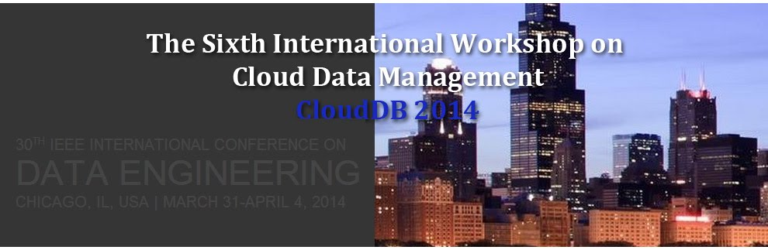



Introduction to CloudDB 2014
Shuai Ma, Xiaofeng Meng & Fusheng Wang

Slide 2
History
Previously co-held with CIKM
CloudDB’ 2009 (Hong Kong, China)
CloudDB’ 2010 (Toronto, Canada)
CloudDB’ 2011 (Glasgow, UK)
CloudDB’ 2012 (Maui, USA)
CloudDB’ 2013 (San Francisco, USA)
From now on co-held with ICDE
CloudDB’ 2014 (Chicago, USA)

Slide 3
Scope
To address the challenges of large data management in a cloud computing environment.
fundamental research issues, with an emphasis on personal and social applications of cloud-based data management.
system level research related to cloud computing and data-intensive computing.

Slide 4
Some # from CloudB2014
21 abstract submissions
19 full paper submissions
10 papers got accepted.
From 7 countries.
Australia, Japan, USA, Switzerland, Brazil, Germany, China

Slide 5
Program
08:45AM-08:50AM : Opening session
08:50AM-10:00AM: Keynote 1
10:00AM-10:30AM: Coffee Break
10:30AM-12:10AM: Session 1 & Session 2
12:00PM-01:30PM: Lunch
01:50PM-03:00PM: Keynote 2
03:00PM-03:30PM: Coffee Break
03:30PM-05:10PM: Session 3 & Session 4

Slide 6
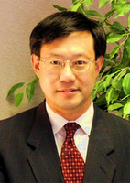
Keynote 1
Title
Building Big Data Processing Systems under New Computing Model
Invited speaker: Xiaodong Zhang
The Robert M. Critchfield Professor in Engineering and chair of the Computer Science and Engineering Department at the Ohio State University
Distinguished Engineering Alumni Award
University of Colorado at Boulder
ACM Fellow, IEEE Fellow

Slide 7
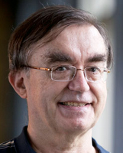
Keynote 2
Title
Multi-faceted Classification of Big Data Uses and Proposed Architecture Integrating High Performance Computing and the Apache Stack
Invited speaker: Geoffrey Charles Fox,
Distinguished Professor of Computer Science and Informatics and Physics at Indiana University,
ACM Fellow, APS Fellow

Slide 8
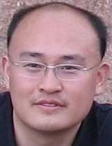
Homepage: http://mashuai.buaa.edu.cn
Email: mashuai@buaa.edu.cn
Address: Room G1122,
New Main Building,
Beihang University
Thanks!

