Slide 1
Some Tips for Paper Writing
NDBC 2014 Phd Workshop
Jian Li
Institute for Interdisiplinary Information Sciences (IIIS), Tsinghua University

Slide 2
There is no substitute of good research
Do good research first (develop good theory, build good systems, create good applications…)
Paper writing is also extremely important:
The most important way to tell others your contribution
Degree, jobs, etc.
What is written without effort is in general read without pleasure - Samuel Johnson

Slide 3
Be Honest. Never Plagiarize
Do not copy-paste from other papers!
Very bad concequences
Do not modify experiment results.
….

Slide 4
The Review Process
Conferences
A deadline
One shot (some confs have more than one round, e.g., vldb)
rebuttal
Journals
No deadline
Multiple rounds
Cover letter, response, ….

Slide 5
The Review Process
The review process is a random process
Mobicom 2004
The review can be very frustrating
ALL authors get rejections
Do not take it personal and blame the reviewer (especially in rebuttal or response, ALWAYS respond with politeness and professionalism)
Use feedbacks to improve your paper

Slide 6
The Review Process
Despite the randomness in the review process, do not submit half-baked papers
Papers are often rejected due to their weakest part, not accepted due to their strongest.

Slide 7
The Review Process
Despite the randomness in the review process, do not submit half-baked papers
Papers are often rejected due to their weakest part, not accepted due to their strongest.

Slide 8
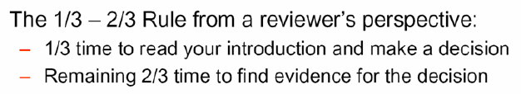
Think like a reviewer

Slide 9
A Principle
Do not make the reviewer think….
The reviewer is usually heavily loaded, or maybe on a deadline, or just had some beer….
They may think wrong!
If 10 hours' work can save the reviewer 10 mins, do it!

Slide 10
Introduction
Motivate your problem
(background, why your problem is important or/and interesting, use motivating examples)
State the problem and existing solutions (if any)
State why it is nontrivial
State your contribution clearly
Compare with previous work
Use a subsection, or bullets

Slide 11
State your contribution
In most cases, do not assume the problem is solved, or that algorithm X is the best, just because someone claims this.
When your result contradicts other’s (who may review your paper), try to spend more effort to explain.
Do not oversell!

Slide 12
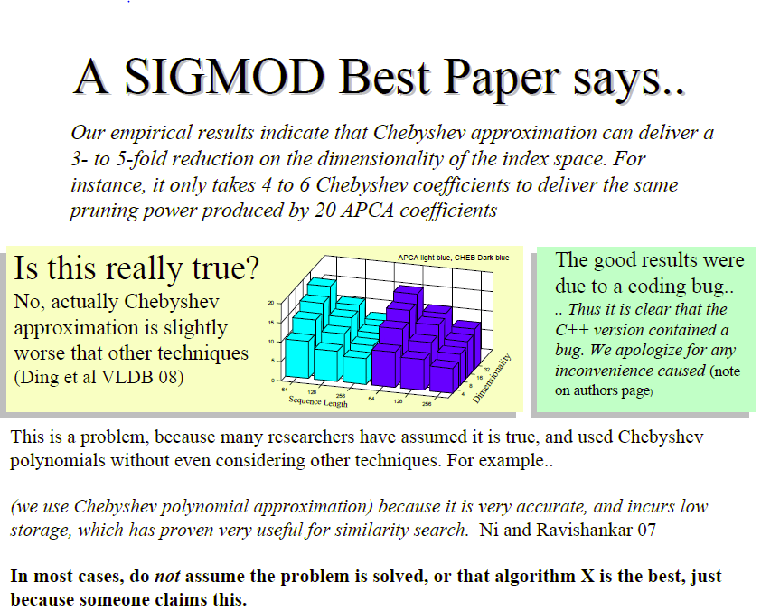

Slide 13
State your algorithm
Some tricks:
First state a naïve algorithm (like greedy). Provide an example to show it does not work well. Then propose a remedy to the naïve approach
First state a simplified version of your solution (but more elegant and easier to state), then extend it step by step
Make your algorithm as simple as possible (but not simpler). Do not make your algorithm unnecessarily complicate.

Slide 14
Experiment
Report experimental results with appropriate statistical info like error bars, confidence intervals, size.
When selecting data to exclude, describe what you did and why. Otherwise it's not clear what the bias in dataset will be.
Try be precise how you choose parameters in your exp – especially you have many parameters

Slide 15
Conclusion
Restating the paper's contributions does not make a conclusion
A good place to state the limitation of your method and to propose future work
Any open questions.

Slide 16
Tips
Acknowledge your weakness
Proper citation
Acknowledge other’s help
Use good picture
Use spacing
Use Good notations

Slide 17
Acknowledge your weakness
Do not pretend it does not exist or attempt to hide it (as the reviewer can find it out and reject your paper)
Explicitly acknowledge the weaknesses, and explain why the work is still useful (and, if possible, how it might be fixed)
E.g., Our algorithm only works for continuous functions. For discontinuous functions, blabla may happen. We are planning to try blabla methods to handle such functions….

Slide 18
Tips
Acknowledge your weakness
Proper citation
Acknowledge other’s help
Use good picture
Use spacing
Use Good notations

Slide 19
Properly Cite Other’s Work
Do not misspell other’s name! They may review your paper.
Do not:
[17] gives an algorithm which …….
Do:
Wang et al. [17] proposed ……
Sometimes, you may want to list all authors

Slide 20
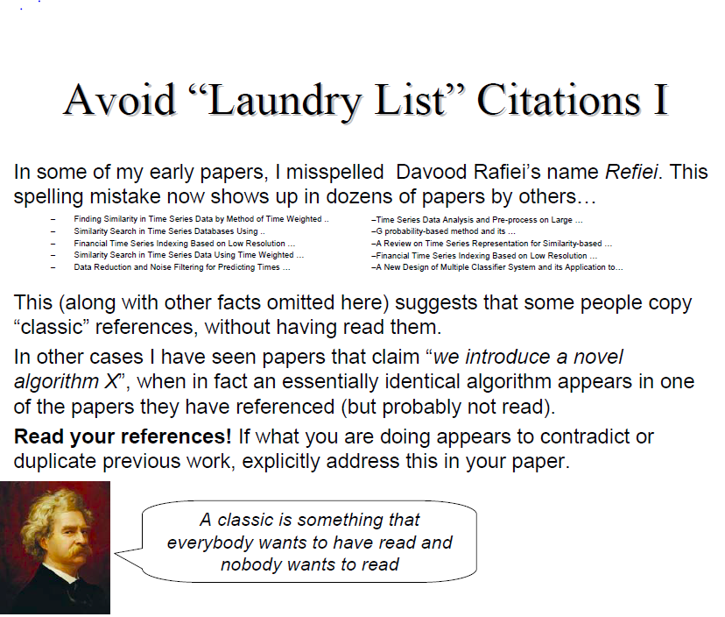
Properly Cite Other’s Work

Slide 21
Tips
Acknowledge your weakness
Proper citation
Acknowledge other’s help
Use good picture
Use spacing
Use Good notations

Slide 22
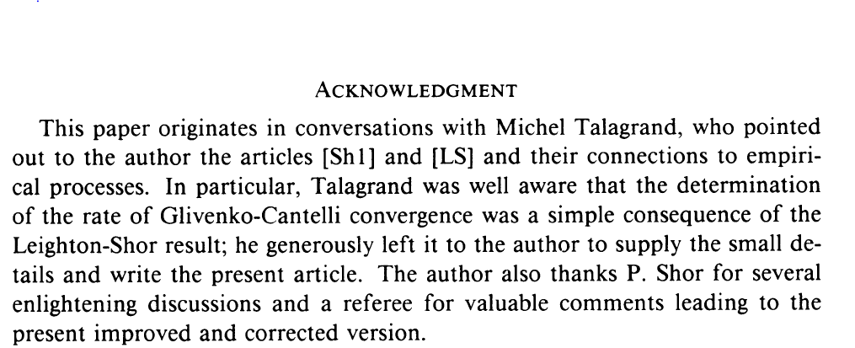
Acknowledgement
At the end of the paper, acknowledge those who helped you
In double-blind submission (like sigmod), omit this part in the submission. But you can include it in the camera-ready version
Example:

Slide 23
Tips
Acknowledge your weakness
Proper citation
Acknowledge other’s help
Use good picture
Use spacing
Use Good notations

Slide 24
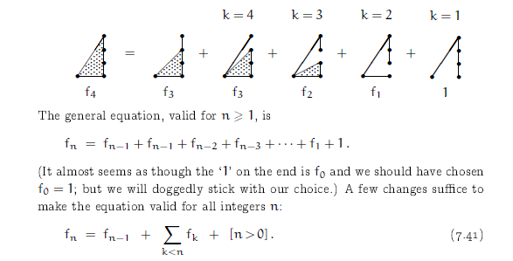
A Picture is Worth One Thousand Words
Concrete Math. Graham, Knuth, Patashnik

Slide 25
Tips
Acknowledge your weakness
Proper citation
Acknowledge other’s help
Use good picture
Use spacing
Use Good notations

Slide 26
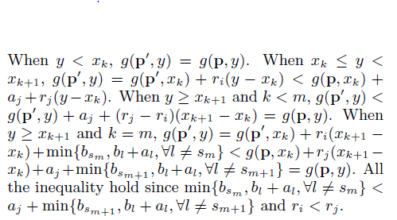
Good Spacing
An example:
Properly use \forall, \exist
Do not use them for saving space

Slide 27
Tips
Acknowledge your weakness
Proper citation
Acknowledge other’s help
Use good picture
Use spacing
Use Good notations

Slide 28
Choosing Good Notations
Just like choosing variable names in a programming language.
E.g.,
Family of sets: \mathcal{A}, \mathcal{F}, …
set: A, B, S, T, …..
elements: a, b, e, ….
special constant: \pi, \phi, \epsilon, ….
Reals: \mathbb{R}, Integers: mathbb{Z} …
Concrete Math. Graham, Knuth, Patashnik

Slide 29
Choosing Good Notations
Use \mathsf
E.g., \mathsf{OPT} for optimal solution
\mathsf{Cost}, \mathsf{Val} ….
Do not use variable name like: st (which may be confused with s times t), k5 (you can use subscript) in math formulas

Slide 30
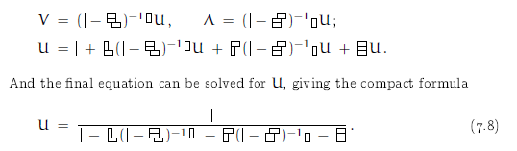
Choosing Good Notations
Concrete Math. Graham, Knuth, Patashnik

Slide 31
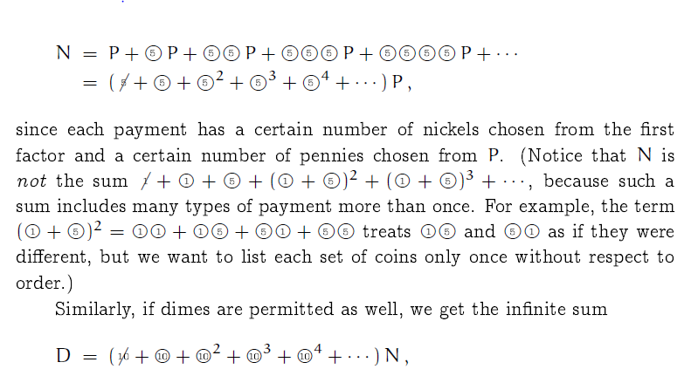
Choosing Good Notations

Slide 32
Use proper phrases
We picked the optimal value for X... No! (unless you can prove it)
We picked a value for X that produced the best
Our idea is significantly better than Smiths
Our idea is statistically significantly better than Smiths, at a confidence level of…
Our algorithm is much simpler than ….
Our algorithm is arguably simpler than ….

Slide 33
Use Proper Phrases
Some words in CS have special meanings!
Complexity:
The complexity of the algorithm makes it very hard to analysis
Hardness:
The hardness of the algorithm
Correlated:
When you say some words, make sure you know what it means:
It is an NP problem.

Slide 34
Do not use too many “in this paper”
From a single SIGMOD paper
In this paper, we attempt to approximate..
Thus, in this paper, we explore how to use..
In this paper, our focus is on indexing large collections..
In this paper, we seek to approximate and index..
Thus, in this paper, we explore how to use the..
The indexing proposed in this paper belongs to the class of..
Figure 1 summarizes all the symbols used in this paper…
In this paper, we use Euclidean distance..
The results to be presented in this paper do not..
A key result to be proven later in this paper is that the..
In this paper, we adopt the Euclidean

Slide 35
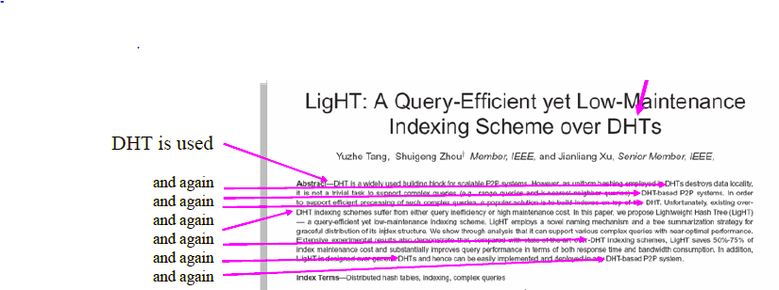
Define a term before you use it
But DHT is not defined….

Slide 36
Sources
Many material of this slides are from the following sources:
How to do good research, get it published in SIGKDD and get it cited! - Eamonn Keogh
Tips for Writing Technical Papers - Jennifer Widom
SIGIR Paper Writing Tips -http://research.microsoft.com/en-us/people/pbailey/sigir-paper-writing-tips.aspx
Craft Your Research Future – Charles Ling, Qiang Yang

