Slide 1
Theoretical Elements in Computer Science Research and Paper Writing: Why, What, and How
Ke Yi
Dept CSE, HKUST

Slide 2


WHY
Why do we do research?
Practical impact and better life
Human knowledge and intellectual satisfaction

Slide 3
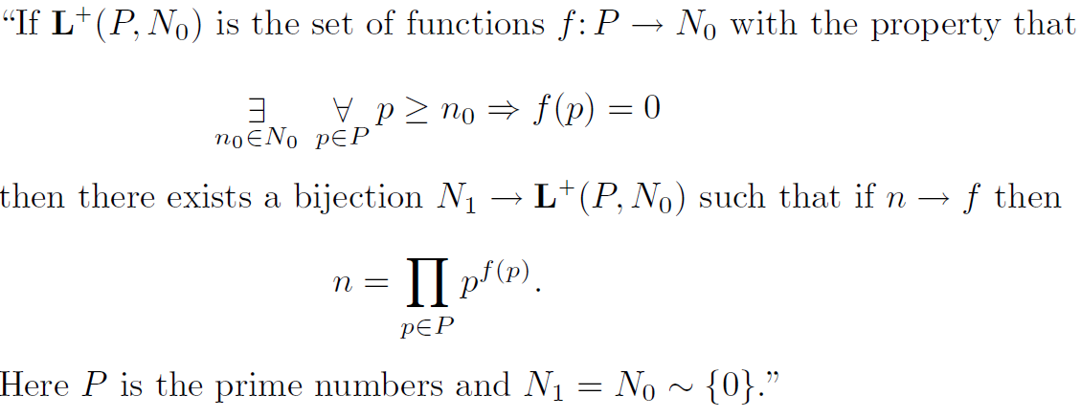
WHY
Why do papers have theoretical components?
Makes the paper look deep

Slide 4
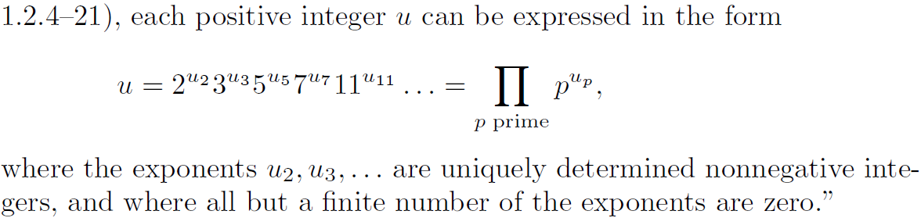
Fundamental Law of Arithmetic

Slide 5
WHY
Why do papers have theoretical components?
Makes the paper look deep
Performance evaluation & comparison
Empirical
Analytical
Practice is where everything works, but no one knows why; theory is where we know everything, but nothing works

Slide 6
Disclaimer: This workshop is about how to theoretically analyze your algorithms/solutions of your problem, NOT how to solve your problem.

Slide 7
WHAT
What to analyze
Time
Space
I/O cost
Communication
Work (for parallel / distributed algorithms)
…

Slide 8
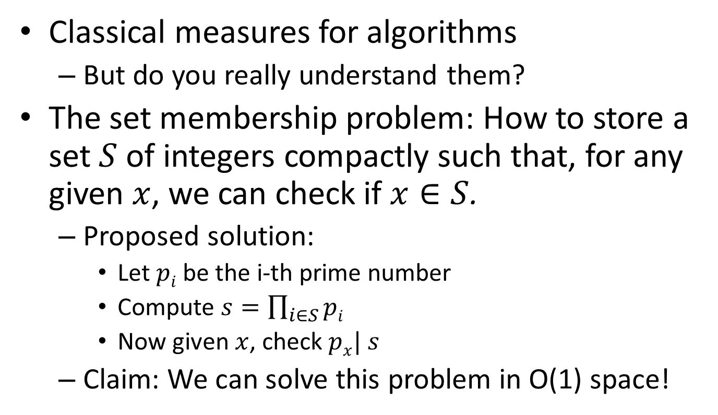
Time and Space
Classical measures for algorithms
But do you really understand them?
The set membership problem: How to store a set $S$ of integers compactly such that, for any given $x$, we can check if $x∈S$.
Proposed solution:
Let $pi$ be the i-th prime number
Compute $s=\prod_{i∈S}{pi}$
Now given $x$, check $px| s$
Claim: We can solve this problem in O(1) space!

Slide 9
Time and Space
Cannot have unbounded integers!
Can also screw up time complexity
Can solve NP-complete problems in polynomial time if allow unbounded integers
Consider bit-level complexity?
Then multiplication/division more costly than addition/subtraction
Common assumption
Each integer has O(log n) bits, any arithmetic operation (+, - , *, /, mod) on O(log n)-bit integers takes one unit of time
How about real numbers?
Real RAM

Slide 10
Time: Variants
Bit-level vs word-level
# of comparisons
User-defined types, real numbers, crowdsourcing?
Time vs work
Parallel algorithms
# of rounds
MapReduce/Pregel

Slide 11
Space: Variants
Algorithm reads in input in one pass with small working memory
Streaming algorithms
Multiple passes
Input on read-only memory, want small working memory
Input on read/write memory, want small extra space
In-place algorithms
Input must be restored when algorithm finishes
Internal memory vs external memory

Slide 12
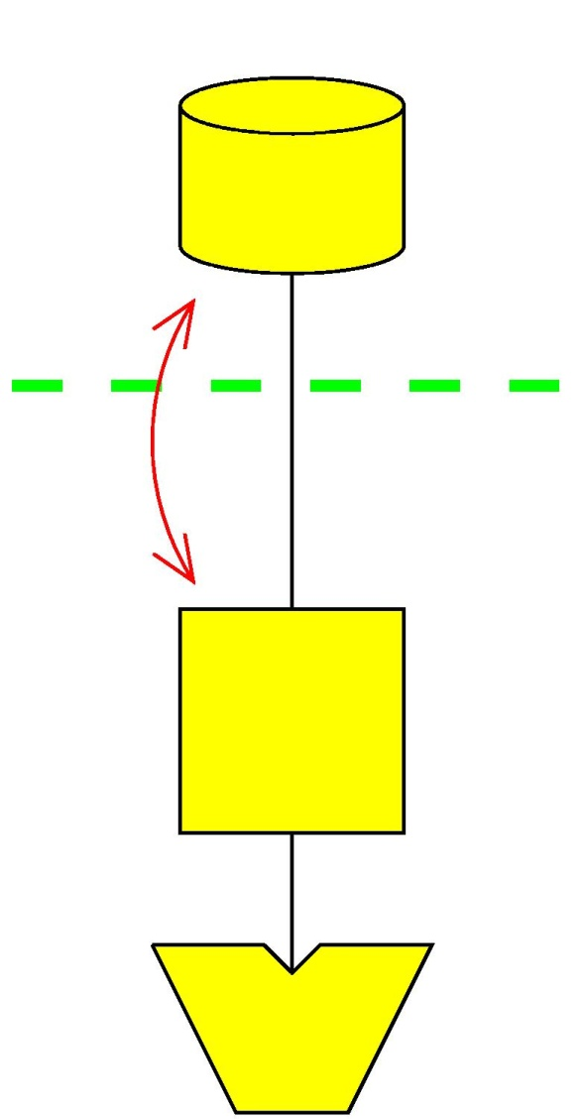
I/O Cost
I/O: # blocks moved between memory and disk
CPU time is ignored
Successful model used extensively in massive data algorithms and database communities
D
Block I/O
M
P

Slide 13
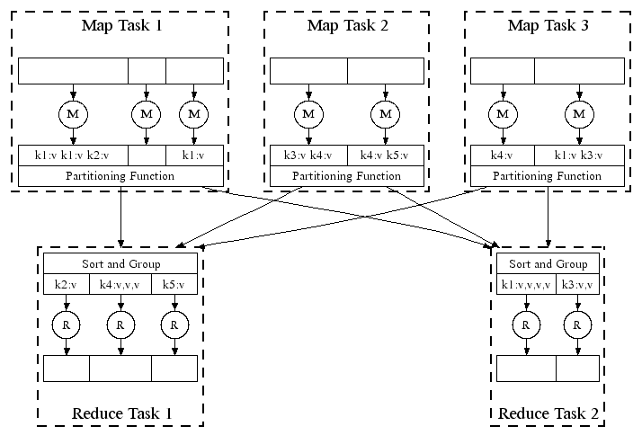
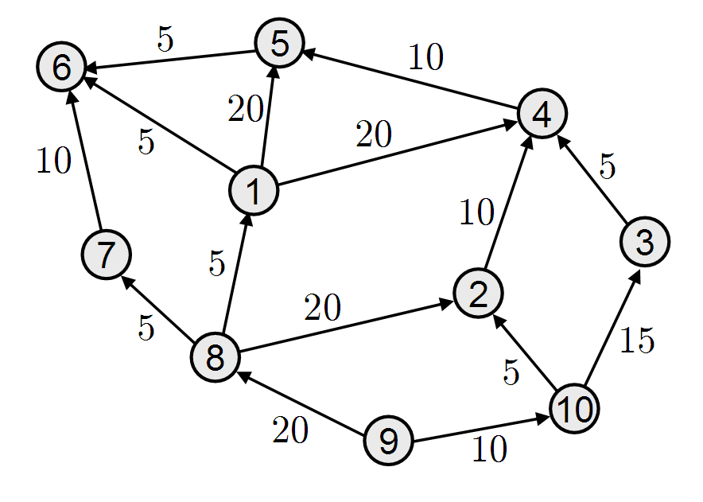
Communication
Distributed systems
MapReduce
Pregal

Slide 14
Big Data: What’s the Bottleneck?
CPU speed approaching limit
Does it matter?
From CPU-intensive computing to data-intensive computing
Algorithm has to be near-linear, linear, or even sub-linear!
Data movement, i.e., communication is the bottleneck!

Slide 15
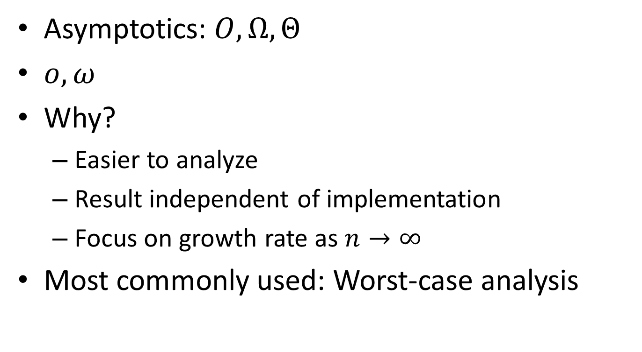
HOW
Asymptotics: $O, Ω, Θ$
$o, ω$
Why?
Easier to analyze
Result independent of implementation
Focus on growth rate as $n→∞$
Most commonly used: Worst-case analysis

Slide 16
Upper and Lower Bounds
Can you tell the differences of these statements:
The complexity of algorithm A is O(n log n)
The complexity of algorithm A is Ω(n log n)
The complexity of algorithm A is Θ(n log n)
The complexity of problem P is O(n log n)
The complexity of problem P is Ω(n log n)
The complexity of problem P is Θ(n log n)

Slide 17
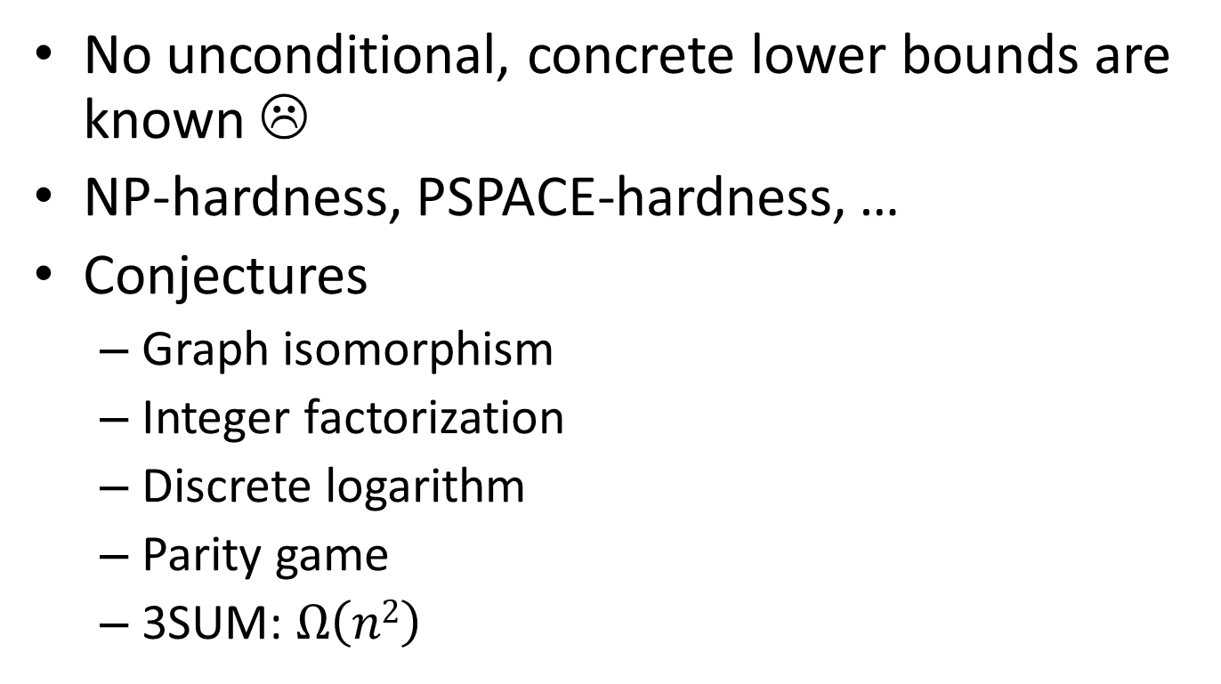
Lower Bounds
No unconditional, concrete lower bounds are known ☹
NP-hardness, PSPACE-hardness, …
Conjectures
Graph isomorphism
Integer factorization
Discrete logarithm
Parity game
3SUM: $Ω\left(n2\right)$

Slide 18
Lower Bounds
Non-time lower bounds
Communication lower bounds
Space lower bounds
I/O lower bounds
Restricted computational models
Comparison model
Decision tree
Circuit complexity

Slide 19
Beyond Worst-Case Analysis
Expected case (for randomized algorithms)
High-probability bound
Instance-optimality
Average-case analysis
Parameterized analysis
Smoothed Analysis

Slide 20
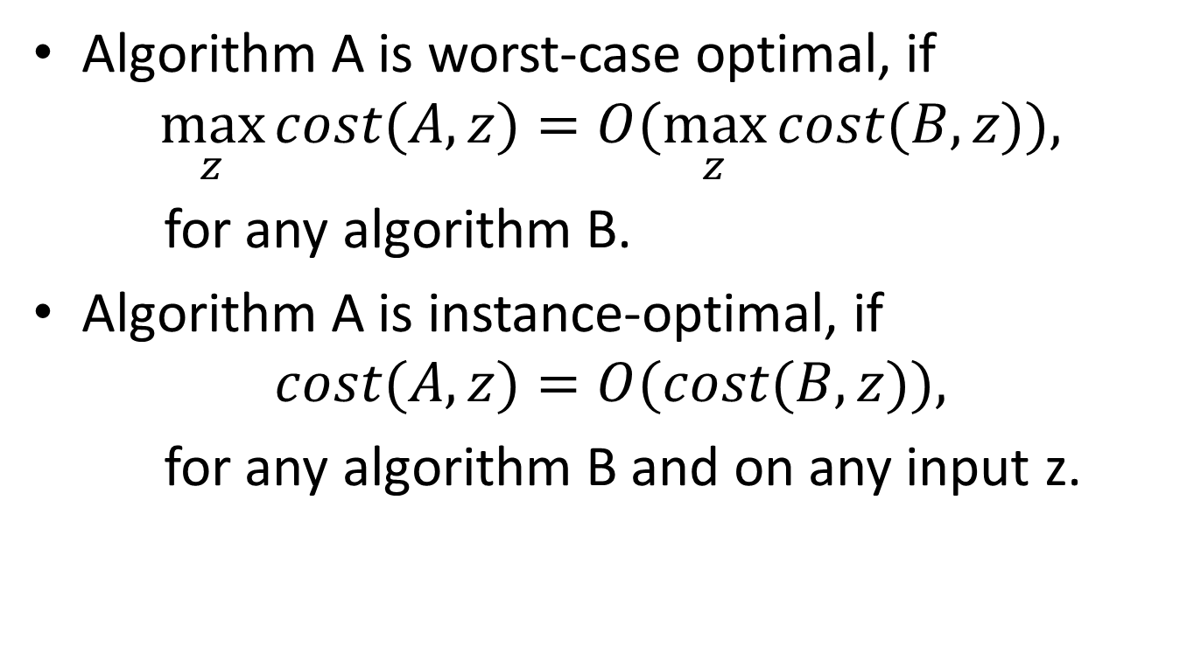
Instance Optimality
Algorithm A is worst-case optimal, if
$$\max_{z}{cost(A,z)}=O(\max_{z}{cost(B,z)}),$$
for any algorithm B.
Algorithm A is instance-optimal, if
$$cost(A,z)=O(cost(B,z)),$$
for any algorithm B and on any input z.

Slide 21
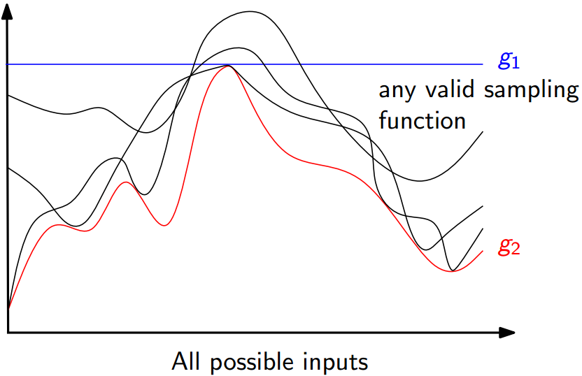
Instance Optimality
Algorithm

Slide 22
Example: Top-k Aggregation
Sorted L₁
Sorted L₂
Goal: find the top-k objects with largest
combined score
Operations allowed:
Sorted access
For a given object, look up its attributes
(a, 0.9)
(d, 0.9)
(b, 0.8)
(a, 0.85)
(c, 0.72)
(b, 0.75)
.
.
.
.
.
.
.
.
(d, 0.6)
(c, 0.2)

Slide 23
Example – Threshold Algorithm
Step 1: - parallel sorted access to each list
For each object seen: - look up all attributes - compute A1+A2 - amongst k=2 highest seen ? keep in buffer
L₁
L₂
(a, 0.9)
(d, 0.9)
ID
A₁
A₂
A₁+ A₂
(b, 0.8)
(a, 0.85)
(c, 0.72)
(b, 0.75)
a
0.9
0.85
1.75
.
.
.
.
.
.
.
.
d
0.6
0.9
1.5
(d, 0.6)
(c, 0.2)

Slide 24
Example – Threshold Algorithm
Step 2: - Determine threshold value based on objects currently seen under sorted access.
- 2 objects with overall grade ≥ threshold value ? stop
else go to next entry position in sorted list and repeat step 1
L₁
L₂
a: 0.9
d: 0.9
ID
A₁
A₂
Min(A₁,A₂)
b: 0.8
a: 0.85
c: 0.72
b: 0.75
a
0.9
0.85
1.75
d
0.6
0.9
1.5
.
.
.
.
.
.
.
.
d: 0.6
c: 0.2
T = 0.9 + 0.9 = 1.8

Slide 25
Example – Threshold Algorithm
Step 1 (Again): - parallel sorted access to each list
For each object seen: - look up all attributes - compute A1 + A2 - amongst 2 highest seen ? keep in buffer
L₁
L₂
(a, 0.9)
(d, 0.9)
ID
A₁
A₂
Min(A₁,A₂)
(b, 0.8)
(a, 0.85)
(c, 0.72)
(b, 0.75)
a
0.9
0.85
1.75
.
.
.
.
.
.
.
.
d
0.6
0.9
1.5
b
0.8
0.75
1.55
(d, 0.6)
(c, 0.2)

Slide 26
Example – Threshold Algorithm
Step 2 (Again): - Determine threshold value based on objects currently seen.
- 2 objects with overall grade ≥ threshold value ? stop
else go to next entry position in sorted list and repeat step 1
L₁
L₂
a: 0.9
d: 0.9
ID
A₁
A₂
Min(A₁,A₂)
b: 0.8
a: 0.85
c: 0.72
b: 0.75
a
0.9
0.85
1.75
b
0.8
0.75
1.55
.
.
.
.
.
.
.
.
d: 0.6
c: 0.2
T = 0.8 + 0.85 = 1.65

Slide 27
Example – Threshold Algorithm
Situation at stopping condition
L₁
L₂
a: 0.9
d: 0.9
ID
A₁
A₂
Min(A₁,A₂)
b: 0.8
a: 0.85
c: 0.72
b: 0.75
a
0.9
0.85
1.75
b
0.8
0.75
1.55
.
.
.
.
.
.
.
.
d: 0.6
c: 0.2
T = 0.72 + 0.75 = 1.47

Slide 28
Instance Optimal
Is this algorithm instance-optimal?
No
No “wild guesses”
Why is this algorithm instance optimal among all algorithms that don’t make wild guesses?
Up to a factor of 2.

Slide 29
Average-Case Analysis
Assume that the input is drawn from some distribution (e.g., uniform)
Analyze the expected cost of the algorithm
Compare with randomized algorithms
Use with caution
Example: The Erdos-Renyi random graph model and Minimum Bisection

Slide 30
Parameterized Analysis
Relate the algorithm’s cost to another parameter describing the difficulty of the input
This parameter is believed to be small for real-world inputs
Examples:
Highway dimension
Doubling dimension
Entropy
Aspect ratio
Spread

Slide 31
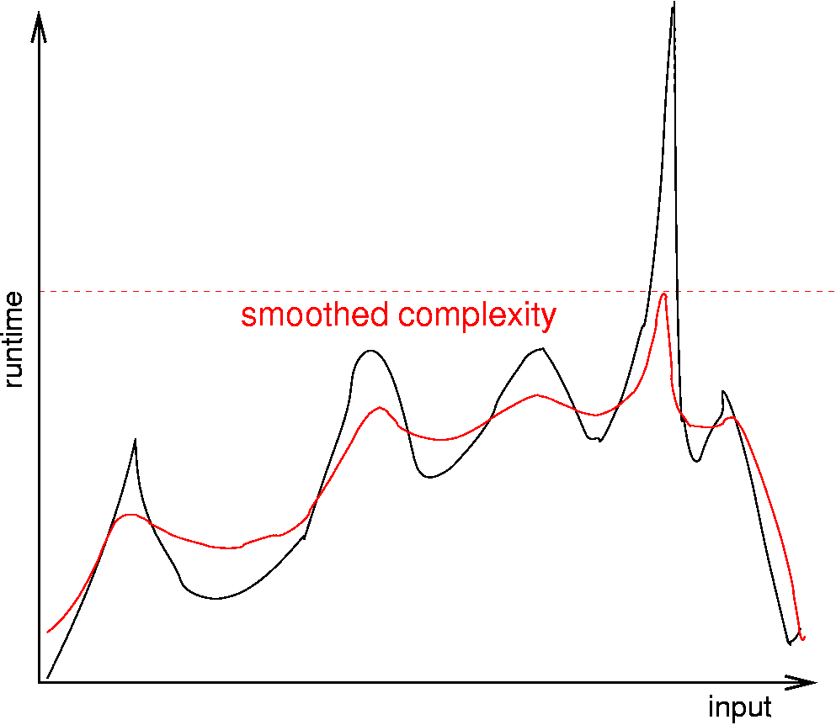
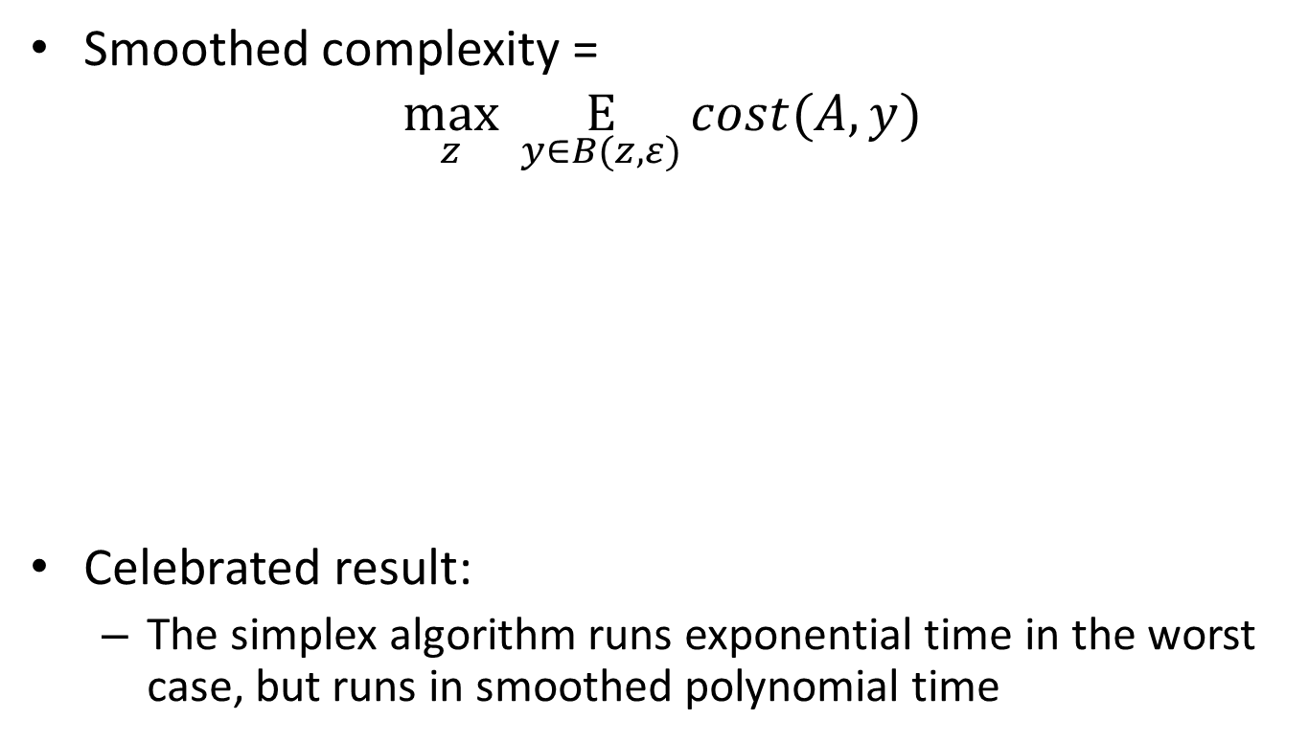
Smoothed Analysis
Smoothed complexity =
$$\max_{z} \underset{y∈B(z,ε)}{E}{cost(A, y)}$$
Celebrated result:
The simplex algorithm runs exponential time in the worst case, but runs in smoothed polynomial time

Slide 32
How to Improve Your Paper
Have me as a co-author ☺
Take some theory courses
COMP5711, 5712, 5713
Books:
The Art of Computer Programming?
CLRS, Kleinberg and Tardos
Randomized algorithms and probability
Motwani and Raghaven
Mitzenmacher and Upfal
Computational geometry, “mark book”
Approximation algorithms, VVV

Slide 33
Thank you!

