Slide 1
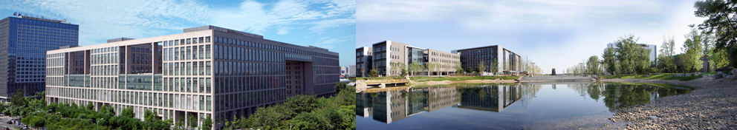

FCS青年AE研讨会-高校行系列
Towards Big Graph Search:
Challenges & Techniques
Shuai Ma
Beijing Advanced Innovation Center for Big Data and Brain Computing

Slide 2
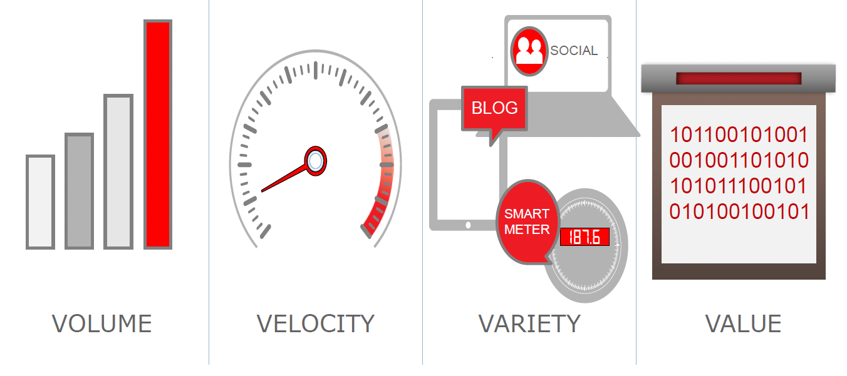

Big Graph, e.g., Social Networks
Big volume: a balance between search efficiency and accuracy
Frequent changes: incorporate dynamic and temporal features
Noise & uncertainty: improve data quality, alleviate side effects
Notes:
《福布斯》日前评选出十位最年轻的亿万富翁，26岁的马克-扎克伯格以69亿美元的身价排在首位，他也因此成为世界上最年轻的亿万富翁。

Slide 3

The FAE Challenge
Big dynamic and uncertain graphs:
F: how to provide a Friendly search interface?
A: how to search “information” more Accurately?
E: how to search “information” more Efficiently?
Shuai Ma, Jia Li, Chunming Hu, Xuelian Lin, and Jinpeng Huai. Big Graph Search: Challenges and Techniques. Frontiers of Computer Science, 2016. (invited)

Slide 4
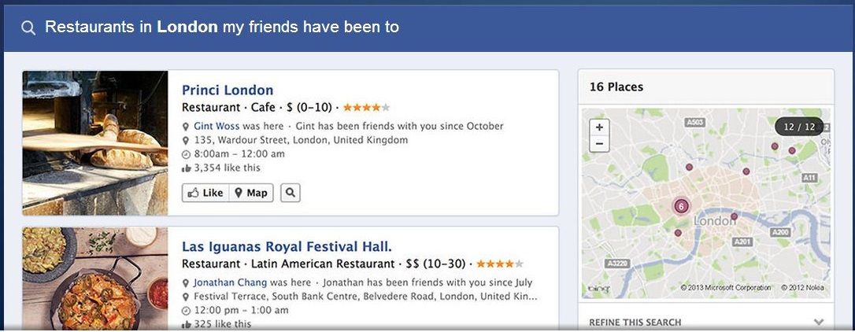
Friendliness
How to provide a friendly interface for graph search?
key words based searches are friendly
directly input query graphs by users are very unfriendly
implicitly express query graphs in a convenient way
e.g., Facebook uses a simplified NLP interface
Facebook Graph Search

Slide 5





E.g., Search Influential Event Organizers
Keywords based search of K influential event organizers from online social networks
Incorporate keywords based search
Incorporate event influence propagation
Provide an approximation algorithm - (1/2 – ξ)
Tom,
“Machine Learning”, “Data Mining”
Bob
“Psychology”, “Sociology”
Facebook Graph Search
Example Query Q:
K = 2
Q = {Psychology,
Sociology,
Data mining }
……
……
Bill,
“NLP”, “Machine Learning”
Sam,
“Database”, “Data Mining”
……
[11] Kaiyu Feng, Gao Cong, Sourav S. Bhowmick, Shuai Ma: In search of influential event organizers in online social networks. SIGMOD 2014.

Slide 6

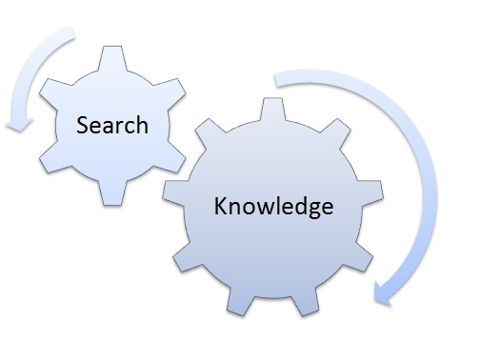
Accuracy
How to search “information” more accurately?
User intension understanding (combine user behavior features)
Incorporate Knowledge Graph
Query transformation based on knowledge graph and user intension
Mobile Networks
Search super markets/ restaurants near Hotel Arthur
at Beijing vs. at Helsinki
at Helsinki: on Sunday vs. NOT
LUMI Supermarket - Flagship Boutique (close on Sunday)
at Helsinki: at noon vs at midnight
K-supermarket Kaisaniemi (7am~9pm)
Knowledge Graph
Notes:
移动互联网的发展：
在Android2.3 gingerbread系统中，google提供了11种传感器: 加速度、磁力、方向、陀螺仪、光线感应、压力、温度、接近、重力、线性加速度、旋转矢量

Slide 7
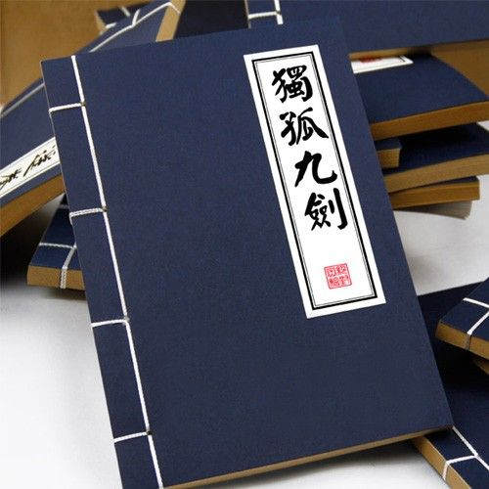
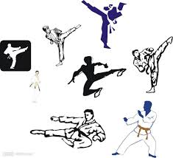
Efficiency
How to search “information” more efficiently?
Query approximation techniques
Data approximation techniques
Inexact
近似性
Incremental
增量性
Inductive
归纳性
Big Data Computation (3I)
R = Q(D)
天下武功 唯快不破

Slide 8
Query Techniques for Big Graph Search
R = Q(D)

Slide 9

Query Approximation Techniques
Main idea: For a class Q of queries with a high computational complexity, find another class Q’ of queries that has a lower computational complexity without loss of quality or with a bounded loss of quality.
approximation
Q(D)
Q’(D)
Challenge: balancing accuracy and computational complexity!

Slide 10
(1) E.g., Strong Simulation
approximation
Subgraph Isomorphism
(NP-Complete)
Strong Simulation
(O(n³))
Subgraph Isomorphism: Pattern graph Q, subgraph G_{s} of data graph G
Q matches G_{s} if there exists a bijective function f: V_{Q}→ V_{Gs} such that
for each node u in Q, u and f(u) have the same label
An edge (u, u‘) in Q if and only if (f(u), f(u')) is an edge in G_{s}
Q matches G, via subgraph isomorphsim, if there is such a subraph Gs
Goodness：Keep exact structure topology between Q and G_{s}
Badness：NP-complete; may return exponential many matched subgraphs; In certain scenarios, too restrictive to find matches
Shuai Ma, Yang Cao, Wenfei Fan, Jinpeng Huai, and Tianyu Wo. Strong Simulation: Capturing Topology in Graph Pattern Matching. TODS 2014.
Shuai Ma, Yang Cao, Wenfei Fan, Jinpeng Huai, and Tianyu Wo, Capturing Topology in Graph Pattern Matching. VLDB 2012.

Slide 11
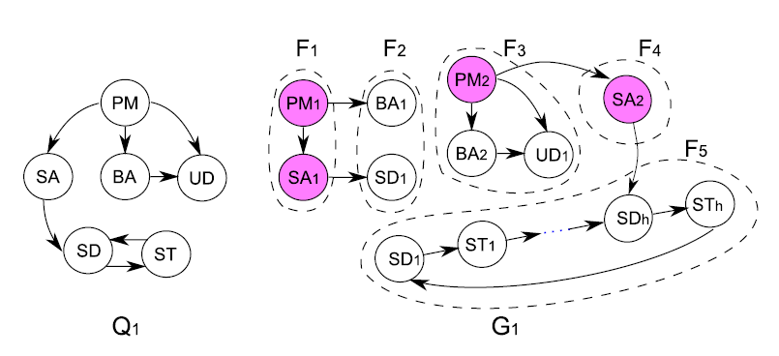

(1) E.g., Strong Simulation
Set up a team to develop a new software product
Strong simulation returns F3, F4 and F5;
Subgraph isomorphism returns empty!
Subgraph isomorphism is too strict for emerging applications!

Slide 12
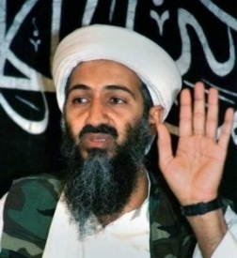
(1) E.g., Strong Simulation
Terrorist Collaboration Network
“Those who were trained to fly didn’t know the others. One group of people did not know the other group.” (Osama Bin Laden, 2001)

Slide 13
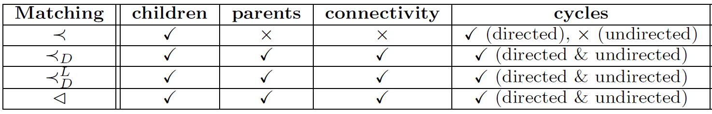
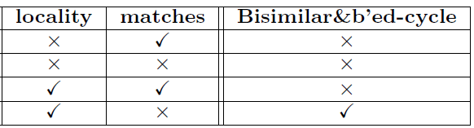
(1) E.g., Strong Simulation
Subgraph
Isomorphism
(NP-Complete)
Strong
Simulation
Dual
Simulation
Graph
Simulation
(O(n³))
Preserve 70-80% subgraph isomorphism & 100 times faster!

Slide 14
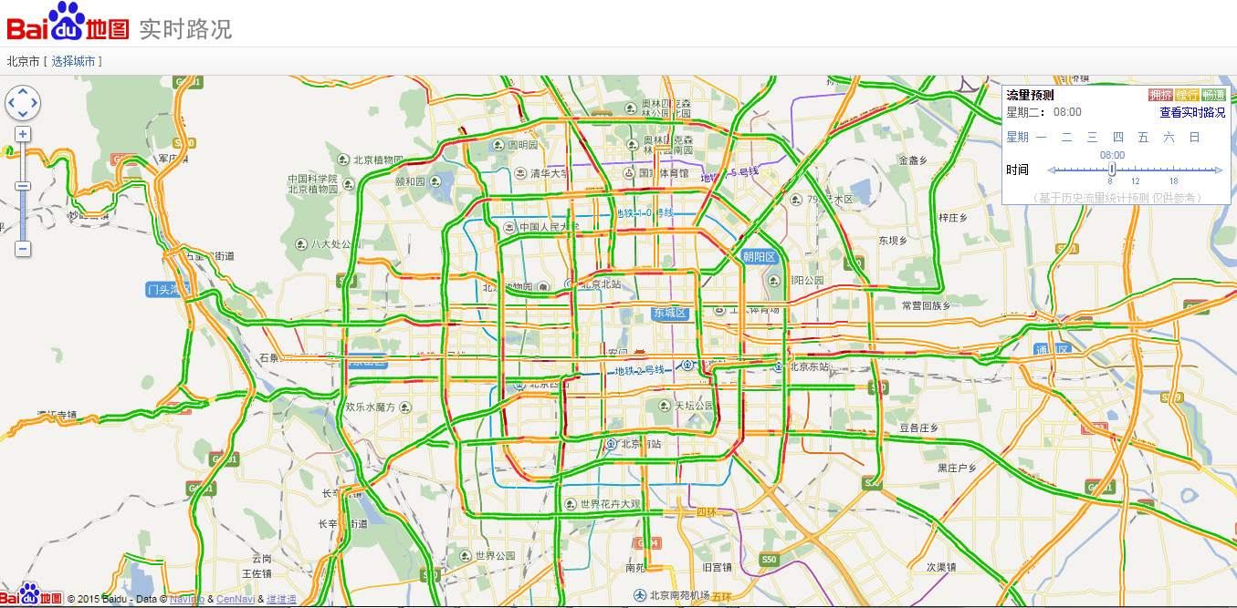
(2) E.g., Temporal Dense Subgraphs

Slide 15
(2) E.g., Temporal Dense Subgraphs
Filter-and-Verification methods:
Data Driven Query Approximation methods:
Choose k (a small constant, e.g., 10 or 15)
Experimental results (with the state of the art solution ^{[Bogdanov et al. 2011]})
10⁴ | 10⁵ | 10⁶ | ··· | 10⁸
5×10² | 5×10³ | 5×10⁴ |  | 5×10⁶
95% are filtered
10⁴ | 10⁵ | 10⁶ | ··· | 10⁸
k | k | k |  | k
 | Accuracy | Efficiency
BEIJING DATA | 100.25% | 4,870 times faster
SYNTHETIC DATA | 99.69% | 1,468 times faster
P. Bogdanov, M. Mongiov, and A. K. Singh. Mining heavy subgraphs in time-evolving networks. In ICDM, 2011.
Haixing Huang, Jinghe Song, Xuelian Lin, Shuai Ma, Jinpeng Huai, TGraph: A Temporal Graph Data Management System (demo), CIKM 2016.
Shuai Ma, Renjun Hu, Luoshu Wang, Xuelian Lin, Jinpeng Huai, Fast Computation of Temporal Dense Subgraphs, draft

Slide 16

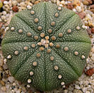
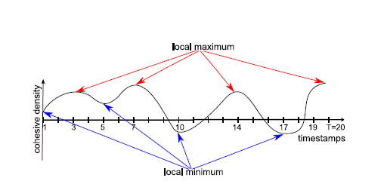
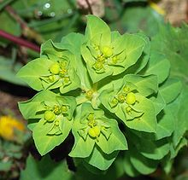

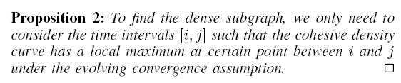

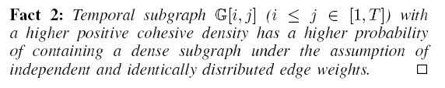
(2) E.g., Temporal Dense Subgraphs
In evolutionary biology, convergent evolution is the process whereby organisms not closely related (not monophyletic), independently evolve similar traits as a result of having to adapt to similar environments or ecological niches.
Evolving convergence assumption
Shuai Ma, Renjun Hu, Luoshu Wang, Xuelian Lin, Jinpeng Huai, Fast Computation of Temporal Dense Subgraphs, draft
Notes:
Example: Two succulent plant genera, Euphorbiaand Astrophytum, are only distantly related, but the species within each have independently converged on a similar body form
大戟属，又称翡翠塔属，是大戟科植物的一个属，包括了2160多种不同种类的植物，当中有些比较常见的，例如：一品红、灯台草等。大戟属植物是现时地球上其中一种生长范围极广的植物种属，主要在非洲及美洲的热带及亚热带地区生长，但在温带亦有发现。生长年期有一年生或多年生，有草本、木本灌木及乔木，而且都有树液。
仙人掌

Slide 17
Data Techniques for Big Graph Search
R = Q(D)

Slide 18
Data Approximation Techniques
Main idea: For a class Q of queries on data D, transform D to smaller data D’ that can be processed efficiently without loss of quality or with a bounded loss of quality.
approximation
Q(D)
Q (D’)
Pareto principle: for many events, roughly 80% of the effects come from 20% of the causes
D = HARD(D) + SOFT(D)
×
Challenge: balancing accuracy and computational complexity!

Slide 19
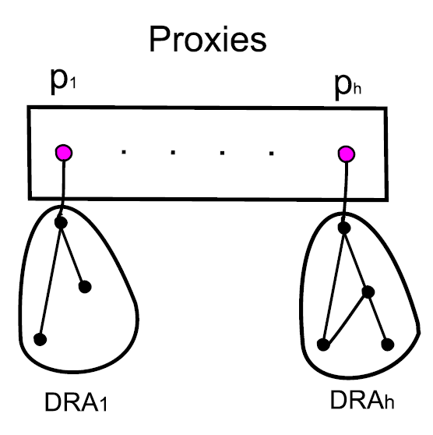
(1) E.g., Shortest Paths/Distances
For weighted undirected graphs, we propose a notion of “proxies”
Each proxy represents the nodes in its DRA (non-overlapping for all proxies)
Proxies can be computed in O(n) time
Key property: Given nodes u,v in G, proxies u_{p},v_{p}, then:
(1) path(u, v) = path(u, u_{p}) + path(u_{p}, v_{p}) + path(v_{p}, v)
(2) dist(u, v) = dist(u, u_{p}) + dist(u_{p}, v_{p}) + dist(v_{p}, v)
On Real-life road and social networks, graphs are reduced by 1/3!
A light-weight general data reduction technique for shortest paths/distances!
Shuai Ma, Kaiyu Feng, Jianxin Li, Haixun Wang, Gao Cong, and Jinpeng Huai, Proxies for Shortest Path and Distance Queries. TKDE, to appear, 2016.

Slide 20
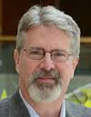
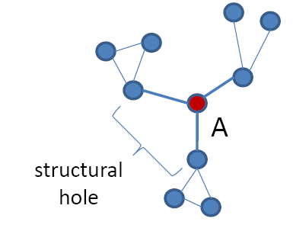
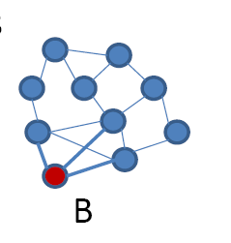
(2) E.g., Network Anomaly
Structural hole theory ^{[Burt 1992,2004]}
Theory of social capital
Lack of connection between two nodes that is bridged by a broker
Prof. Ronald S. Burt
University of Chicago
Fellow, American Academy of Arts and Sciences (1993)
Fellow, Center for Advanced Study in the Behavioral Sciences(1984)
Bridge counts: a simple and intuitive measure of structural holes in a network.
Node A (brokers) is more likely to get novel information than node B, even though they have the same number of links.
Burt, Ronald S. (1992). Structural holes: the social structure of competition. Harvard University Press.
Burt, Ronald S. (2004). Structural Holes and Good Ideas. American Journal of Sociology 110 (2): 349–399.

Slide 21

(2) E.g., Network Anomaly
Structural hole theory (1992)
Theory of social capital
Lack of connection between two nodes that is bridged by a broker
Prof. Ronald S. Burt
University of Chicago
Fellow, American Academy of Arts and Sciences (1993)
Fellow, Center for Advanced Study in the Behavioral Sciences(1984)
How to detect social brokers?
A formal quantitative definition is needed in the first place!
定义: Those nodes that connect to a number of diverse influential communities.
Renjun Hu, Charu C. Aggarwal, Shuai Ma, Jinpeng Huai: An Embedding Approach to Anomaly Detection. ICDE 2016.
Notes:
With a fixed number of training samples, the predictive power reduces as the dimensionality increases, and this is known as the Hughes effect^{[3]} or Hughes phenomenon(named after Gordon F. Hughes)

Slide 22
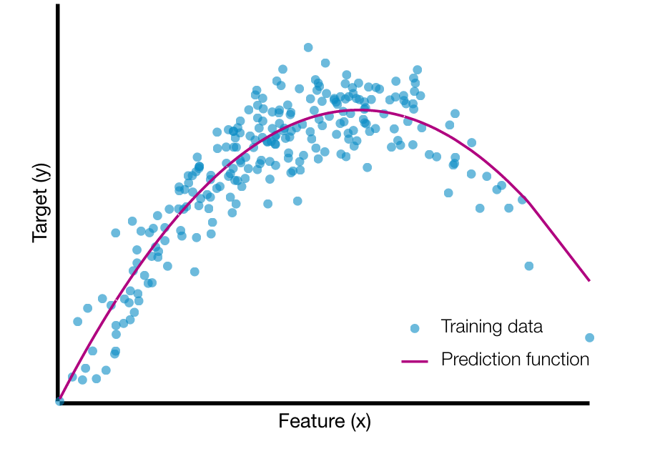
(2) E.g., Network Anomaly
A graph embedding approach
Two-in-One
Graphs are represented as matries
Data Approximation (k + α reduction)
High storage cost of matrix
Transform a n*d matrix to a n*k one,
n: # of nodes, d: # of communities
k: average node degree, k<<d
The ith entry (feature ) in a d-dimension vector is the weight that the node belongs to community i
(Gordon) Hughes Effect
Our data approximation technique (k + α reduction) improves (1%, F1) on accuracy and 25% on efficiency!
Renjun Hu, Charu C. Aggarwal, Shuai Ma, Jinpeng Huai: An Embedding Approach to Anomaly Detection. ICDE 2016.
Notes:
With a fixed number of training samples, the predictive power reduces as the dimensionality increases, and this is known as the Hughes effect^{[3]} or Hughes phenomenon(named after Gordon F. Hughes)
Gordon Hughes earned his PhD degree at Cal Tech, and began his technology career at Xerox Research, later serving as the Senior Director of Recording Technology at Seagate, in its early years. He is now a research scientist at the Center for Memory and Recording Research at the University of California San Diego.
In 2001, he was named Fellow of the IEEE for "contributions to magnetic recording physics and for pioneering work in thin film disk media".
“Comments on the mean accuracy of statistical pattern recognizers'ce”, K. Abend, T.J. Harley Jr., B. Chandrasekaran, T.J. Harley, and G.F. Hughes, IEEE Transactions on Information Theory, Vol.IT-15, No. 3, (May 1969), pp. 420-423

Slide 23
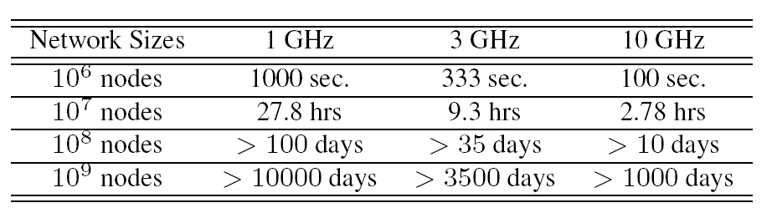
(3) E.g., Network Link Prediction
Link Prediction
A network with n nodes，O(n²) possible links
CPU speeds: xGHz/s, and assume that a single machine cycle could deal with a node pair.
Most link prediction algorithms only predict a subset of the possible links, not all possible links, such as [Dashun et al. 2011, Chungmok et al. 2014].
Dashun Wang, Dino Pedreschi, Chaoming Song, Fosca Giannotti, Albert-László Barabási: Human mobility, social ties, and link prediction. KDD 2011.
Chungmok Lee, Minh Pham, Norman Kim, Myong K. Jeong, Dennis K. J. Lin, Wanpracha Art Chaovalitwongse. A novel link prediction approach for scale-free networks. WWW 2014.

Slide 24
(3) E.g., Network Link Prediction
sample₁
Ensemble
Direct Non-negative Matrix Factorization
Low efficiency
The sparser the data, the worse the prediction
Data approximation technique (Ensemble Enabled Sampling)
Sampling must assure a coverage on O(n²) possible links
Link prediction characteristics (triangles)
Ensemble: the predicted value of a link is the maximum among all ensembles
Data
．．．
max
sample_{n}
Ensemble
Small data | Accuracy | Big data | Efficiency
YouTube | +18% | Friendster | 31 times faster
Wikipedia | +16% | Twitter | 21 times faster
Improves both accuracy and efficiency!
Liang Duan, Charu Aggarwal, Shuai Ma, Renjun Hu, and Jinpeng Huai, Scaling up Link Prediction with Ensembles, WSDM 2016 - Big Data Algorithms Session.

Slide 25
Other Query and Data Techniques
Q(D₁)
Distributed algorithms:
Q(D)
Q(D_{i})
Q(D_{n})
Incremental Computation:
Incremental computation
Q(D + Δ)
Q(D) + Q(Δ)
Known results
compression
Data Compression:
Q(D)
Q(D’)
partitioning
Data Partition:
Q(D)
Q(D₁) + … + Q(D_{n})

Slide 26
Summary
Graph Search: a new search paradigm for social networks
Big Graph Search Challenges (FAE)
Big Graph Search Techniques (Query and Data Techniques)
Just a start,
there is a long way to go for Big Graph Search!

Slide 27







Acknowledgements
Collaborators:
Charu Aggarwal, Sourav S Bhowmick, Yang Cao, Gao Cong, Liang Duan, Wenfei Fan, Kaiyu Feng, Haixing Huang, Renjun Hu, Jinpeng Huai, Jia Li, Jianxin Li, Xuelian Lin, Xudong Liu, Jinghe Song, Haixun Wang, Luoshu Wang, Tianyu Wo…
They are from:

Slide 28
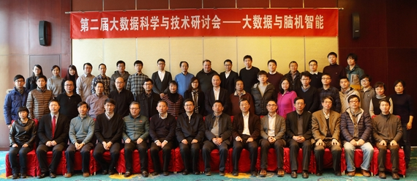
Beijing Advanced Innovation Center for Big Data & Brain Computing, Beihang University
Faculty and postdoc positions (computational theory, artificial intelligence, machine learning, database management, novel computing architecture …)
Part time/ full time/ visiting
Principle Investigator (USD 154,000 -- 231,000)
Senior Research Scientist (USD 77,000 -- 123,000)
Research Scientist (USD 47,000 -- 69,000)
Postdoctoral Research Fellow (USD 39,000 -- 62,000)
Contact: dongxh@buaa.edu.cn; lixf@act.buaa.edu.cn.

Slide 29
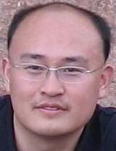
Homepage: http://mashuai.buaa.edu.cn
Email: mashuai@buaa.edu.cn
Address:
Room G1122,
New Main Building,
Beihang University
Beijing, China
Thanks!

