Slide 1



2016双清论坛社会科学与自然科学交叉系列—服务科学：跨学科研讨
服务科学：大数据视角
Service Science: A Big Data Point of View
马 帅

Slide 2
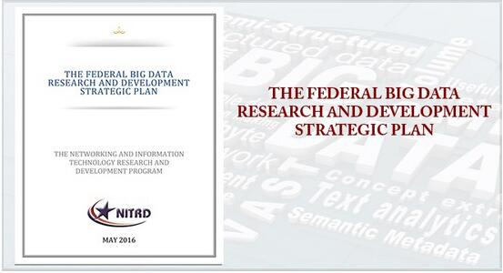
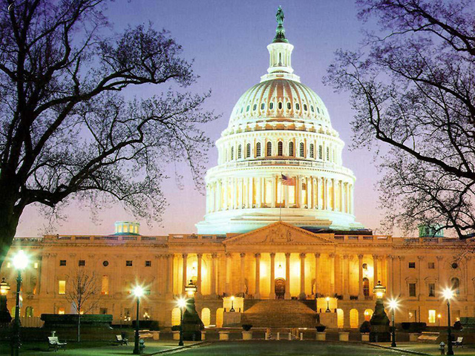
大数据的政策与引导：国家大力支持
2012年3月29日，美国总统科技政策办公室OSTP（Office of Science and Technology Policy）宣布了每年投资两亿美元的“大数据研究计划”（Big Data R&D Initiative）
同天，我国科技部发布的“‘十二五’国家科技计划信息技术领域2013年度备选项目征集指南”把“大数据研究”列在首位
美国2016年5月发布《联邦大数据研究与开发战略计划》
其目标是对联邦机构的大数据相关项目和投资进行指导,主要围绕代表大数据研发关键领域的七个战略进行，包括促进人类对科学、医学和安全所有分支的认识；确保美国在研发领域继续发挥领导作用；通过研发来提高美国和世界解决紧迫社会和环境问题的能力。
“数据是一项有价值的国家资本，应对公众开放，而不是把其禁锢在政府体制。”
——美国联邦政府
2
http://www.thebigdata.cn/YeJieDongTai/30500.html

Slide 3
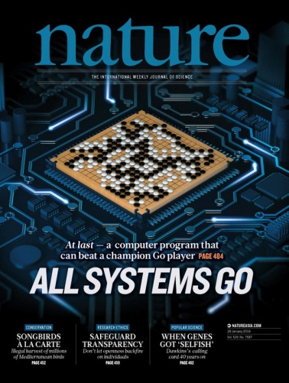

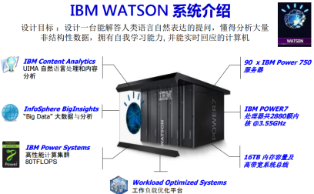
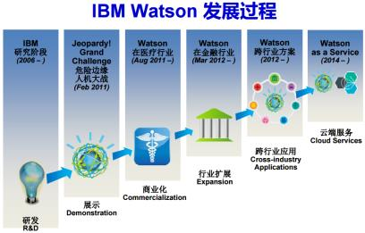

大数据的研究与应用：取得重大突破
过去5年大数据的研究，已经产生了重大突破，并在部分领域取得良好的应用
计算基础：大规模云计算、大规模深度学习
感知处理的角度：大规模深度学习，imageNet
知识组织与管理角度：大规模知识图谱
基于数据产生知识的问答系统与个人辅助系统
Watson DeepQA：智能搜索→知识引擎
Apple Siri & Wolfram Alpha
Watson和Wolfram|Alpha的成功说明：AI可以用一个纯粹的计算系统(交互+计算)实现

Slide 4

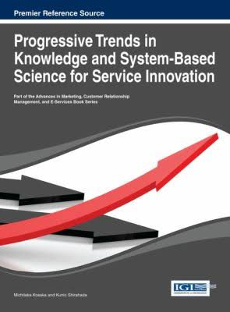


大数据与服务科学
服务的核心价值共创、服务系统是基本的抽象、服务科学最终目标是提出方法和理论来解释和提高服务系统价值共创的能力
客户
协作
服务提供商
人、信息系统、社会基础设施
客户分析
共同创造
服务价值
服务优化
大数据
[1] Online Materials from Jordi Busquets, Paul P. Maglio, and Wendy Murphy
[2] Tu-Bao Ho, Siriwon Taewijit, Quang-Bach Ho, Hieu-Chi Dam. Big Data and Service Science, in Progressive Trends in Knowledge and System-Based Science for Service Innovation,IGI Global, 2013
Notes:
Service is value-cocreation, that is, useful changes that result from communication, planning, or other purposeful interactions between distinct entities.
A service system is a collection of entities and interactions that cocreate value, that is, a set of distinct configurations of resources (including people, organizations, shared information, and technology) that are better off working together than working alone.
Service Science aims to create a body of knowledge that describes, explains, predicts, and improves value-cocreation between entities as they interact, that is, relying on methods and standards used by a community to account for observable phenomenon with conceptual frameworks, theories, models, and laws that can be empirically tested.
So the object of study value-cocreation, the basic abstraction is the service system, and the ultimate goal is develop methods and theories that can be used to explain and improve value-cocreation in service systems.
客户分析,行为分析，满意度分析-ERM
信息获取的透明、方便性；对话和风险分析
服务集成、特征优化、服务评估

Slide 5
大数据案例：精准医疗服务
据统计，目前我国重大病患者有近2.6亿人，同时老龄化严重：60岁以上的老年人已经达2.02亿，此外，全国还有大概8千万的残疾人，这都是我国目前面临的一个严重的健康事业难题 - 医疗器械创新网www.innomd.org
现在人类已知的疾病，大概有1万种，各国批准的临床诊断标准，有标准的诊断方法，全球批准了大概3000种。美国人批准的药物是4600种，粗粗的算了一下中国是3000种，中国有3万-4万家医院，近1千万的医务人员，这几个数字列在一起，3000种，3-4万，1千万，最后的结论就是三个字，就是不靠谱，到医院去不靠谱。-华大基因董事长汪建
Big data redefines the traditional scientific methods used in medicine(www.techrepublic.com)
斯坦福大学将于2015年5月20到22日举办一个生物医学领域的大数据会议，该会议针对各大高校、医院、政府部门和机构的医学研究人员，旨在鼓励合作、应对挑战以及建立在医疗保健领域使用大数据的可行步骤。
会议通告中写到：“在从大数据的大规模整合及分析中攫取价值这方面，其它行业已经取得了极大成功，而医疗健康行业才刚起步（沾湿了脚 丫，getting its feetwet）。是的，医疗健康的提供者（如医疗机构等）和付费者（如病人等）正日益增加在分析能力上的投入，以更好地理解不断变化的健康医疗环境，但 这还只是处于初级阶段。”
5

Slide 6
大数据案例：精准医疗服务
医生们需要数据
2011年的斯坦福Lucile Packard儿童医院，一位来自内华达州里诺的女孩被用直升机送到该医院的加护病房（ICU）。她患有狼疮，一种攻击人体健康组织并能导致永久性肾损伤的疾病。一个多学科医生团队不得不在使用凝结剂和复合手术的风险间权衡，凝结剂能够稀释血液以防止血液结块，复合手术会导致中风或者器官内出血。
基于数据的医疗手段
一位叫Jennifer Frankovich的年青医师诉诸于使用狼疮患儿数据库，她曾参与建立该数据库。作为数据库工作的一部分，需要将图表数字化并使数据可通过关键字来检 索。通过搜索数据库，Frankovich医生能够查阅每位来院的狼疮患儿，从而了解他们中出现血凝现象的人数，以及导致危险的因素。据此，她可以计算出 使用抗凝血剂的风险能否佐证小女孩出现血液凝块的风险。计算结果表明，值得冒这个险：使用了抗凝血剂后，小女孩的病情出现了好转迹象。
需要解析数据的系统
医院的管理层仍然认为，对于紧急病例，相比于查找过往成功案例的医疗数据，相信医师团队的集体智慧更加安全稳妥。在今年一月份接受NPR采访 时，Frankovich医生坦言， “分析数据是一个复杂的工作，需要特定的专业知识和技能。试想，假若搜索引擎有程序错误，亦或档案被错误的转录，后果将会如何？真的有太多地方会出现错误… …。这将需要一个系统来解析数据，而这样的系统是我们还尚未拥有。”
观点：确实如此，但是在诸如克利夫兰临床中心（ClevelandClinic）这样的医疗健康机构中，医生和医学实践者们已经在利用大数据和分析 法来诊断病情和实施治疗。当跨学科医生团队评估病人时，数据分析结果已然进入了他们的讨论之中。并且，尽管医疗健康数据的质量和整合问题将持续存在，无容 置疑的是，重新定义传统科学方法已初现端倪。
6

Slide 7


大数据案例：共享经济服务
共享经济
通过整合线下的闲散物品或服务资源，使得需求方以较低价格通过租借等共享方式使用物品，而不直接拥有物品的所有权。（百度百科）

Slide 8
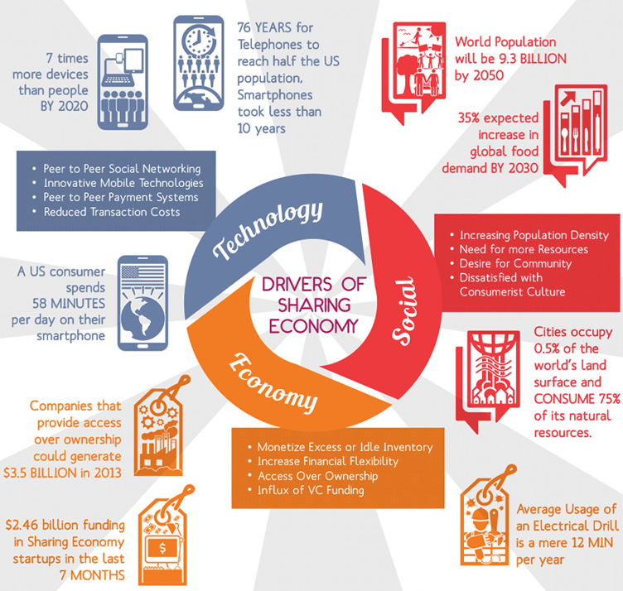
大数据服务案例：共享经济
美国《时代周刊》统计，在美国提供共享经济类服务公司在2013年产生350亿美元的红利
在美国仅2014年上半年，新注入到共享经济类创业公司的风险投资额为25亿美元

Slide 9





大数据的科学价值：发现计算的规律
互联网改变
、 交流方式
大数据处理改变
经济和社会方式
大数据处理
影响计算理论
转变1:抽样与全样
量大、快变，数据统计特征分布不均匀，传统方法不适用－ “尝菜”
从无序数据到信息关联
转变2:精确与非精确
精确性不再是绝对追求目标，需对宏观趋势给出快速预测－买鞋
从信息关联到知识图谱
转变3:因果与关联
仅需知其然，有时无需知其所有然，用于发现事实、预测未来－医学
形成关联网谱
？？
如何理解数据是科学或工程技术？
是否本质上产生新的现象，或只是一种适应过程？
只有掌握规律才能更好理解BD，才能发挥更好价值

Slide 10
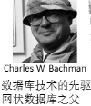



问题：是否有坚实的理论基础
（大）数据科学是否能真的成为一种“科学”？
回顾数据库领域的发展历程
1960s前后，外部存储设备问世，催生数据管理需求，将数据库从文件系统中分离出来
1969年，具有完备理论的“关系数据模型”
1981年，事务处理
2000年以来，数据量持续增大带来的挑战
现代数据库概念和实践
-Ingres(查询改写)
-Postgres(对象关系模型)
-列存储、流处理
Michael Stonebraker
（2014年图灵奖）
具有完备理论的
关系数据模型
Edgar Frank Codd
（1981年图灵奖）
第三代RDBMS
大规模普及
IBM DB2
MS SQL Server
Oracle DB
（80年代后期）
1963
1969
1981
2014
第二代RDBMS:
IBM R系统
Ingres
（70年代）
Oracle DB
（1976）
海量数据存储与处理
GFS, MR, Bigdata
Spark, Impala, …
KV，列存储…
（2008--）
早期：网状数据库
集成数据存储（IDS）
Charles W.Bachman
（1973年图灵奖）
事务处理：解决一 致性与数据恢复问题
James Gray
（1998年图灵奖）

Slide 11













问题：是否有坚实的理论基础
（大）数据科学是否能真的成为一种“科学”？
其中一个可能性：计算问题、复杂性与算法
计算问题是计算机科学的本质问题，而算法是一切计算问题的核心
算法
G=F(x)
数据
John E Hopcroft
Robert Tarjan
(1986）
Stephen Cook
（1982）
Donald Knuth
（1974）
70年代前 | 算法研究
70年代 | 确定性多项式时间算法 发现NP困难性
80年代 | 随机化算法 随机性能加速算法
90年代 | 近似算法 后期发现近似困难性
Leslie Valiant
（2010）
Manuel Blum
（1995）
Juris Hartmanis ,
Richard Edwin Stearns
（1993）
21世纪－大数据时代：计算复杂度与算法理论是否有新的理论问题和新方法？
Shafi Goldwasser
Silvio Micali
（2012）

Slide 12
回答“可计算”问题(1)
G=F(x)
任务1：易解类复杂性理论
如何定义大数据易解类？
计算问题
如何判断给定查询是否为易解？
不可判定问题
可判定问题
NP and beyond
多项式易解类
多项式易解类
难解问题
易解问题
(多项式易解类)
非大数据
易解类
大数据易解类
不可近
似问题
可近似
问题
非大数据 易解类
大数据 易解类
若硬盘读取速度6Gbps,log(|D|)时间扫描
1PB数据，只需15秒(v.s.1.99天）
1EB数据，只需18秒(v.s.5.28年)
大数据下，考虑 x 与F 的耦合
传统认为易解问题 可能成为“难解”问题！
近似算法
（多项式算法）
易解类查询:在大数据上是可行的！
针对传统易解成为实际难解问题，提出大数据易解类复杂性理论；发表在数据库领域顶级会议VLDB ,审稿专家认为:“The paper is going to start a new line of research and products ”

Slide 13
回答“可计算”问题(2)
G=F(x)
任务2：数据驱动的近似算法理论
什么是大数据计算中可近似问题？
计算问题
如何衡量数据量与近似效果的关系?
不可判定问题
可判定问题
NP and beyond
多项式易解类
多项式易解类
难解问题
易解问题
(多项式易解类)
非大数据
易解类
大数据易解类
不可近
似问题
可近似
问题
非大数据 易解类
大数据 易解类
大数据下，传统近似方法局限性
近似算法
（多项式算法）
大数据可近似问题
⊕
大数据不可近似问题
近似的新挑战：
F →F’
X →X’

Slide 14
回答“可计算”问题(3)
G=F(x)
任务3：大数据高效算法理论
如何设计更有效的算法？
计算问题
如何以“以局部观全局”？
不可判定问题
可判定问题
NP and beyond
多项式易解类
多项式易解类
难解问题
易解问题
(多项式易解类)
非大数据
易解类
大数据易解类
不可近
似问题
可近似
问题
非大数据 易解类
大数据 易解类
针对大数据非易解类问题，提出高效算法理论与算法！
近似算法
（多项式算法）

Slide 15
Challenge 1:
Learning from Limited Data

Slide 16
Challenging Aspect1
Ernő Téglás*, Edward Vul, Vittorio Girotto, Michel Gonzalez, Joshua B. Tenenbaum, Luca L. Bonatti, Pure Reasoning in 12-Month-Old Infants as Probabilistic Inference. Science, Vol.332, Issue 6033, pp. 1054-1059, 2011 (research article).
Joshua B. Tenenbaum, Charles Kemp, Thomas L. Griffiths, Noah D. Goodman, How to Grow a Mind: Statistics, Structure, and Abstraction, Science, Vol. 331, Issue 6022, pp. 1279-1285, 2011 (review).
Brenden M. Lake, Ruslan Salakhutdinov, Joshua B. Tenenbaum, Human-level concept learning through probabilistic program induction, Science, Vol. 350, Issue 6266, pp. 1332-1338, 2015 (research article).

Slide 17
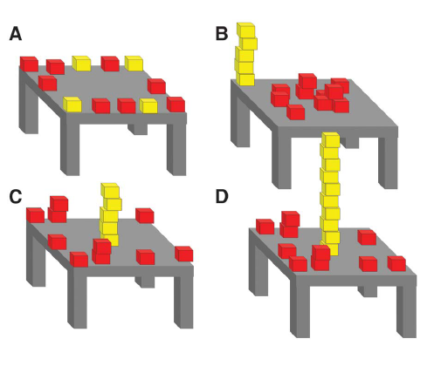
Challenging Aspect1-例1
A Bayesian model of infants’ pure reasoning.
Probe infants’ expectations about unknown future events when they witness dynamic scenes that contain multiple potentially relevant–but also potentially conflicting–sources of information
Infants’ looking times are consistent with a Bayesian ideal observer embodying abstract principles of object motion.
Infants possess surprisingly sophisticated abilities to integrate multiple information sources and abstract knowledge in reasoning about future outcomes.
Ernő Téglás*, Edward Vul, Vittorio Girotto, Michel Gonzalez, Joshua B. Tenenbaum, Luca L. Bonatti, Pure Reasoning in 12-Month-Old Infants as Probabilistic Inference. Science, Vol.332, Issue 6033, pp. 1054-1059, 2011 (research article).

Slide 18
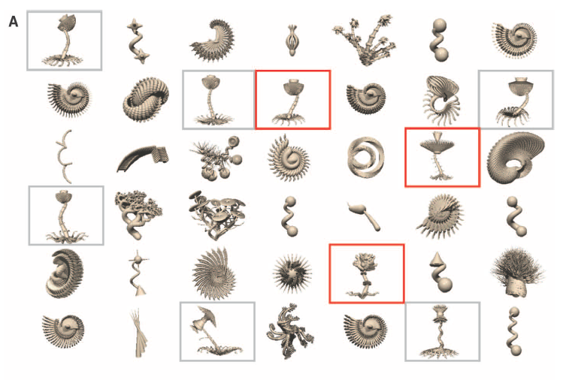
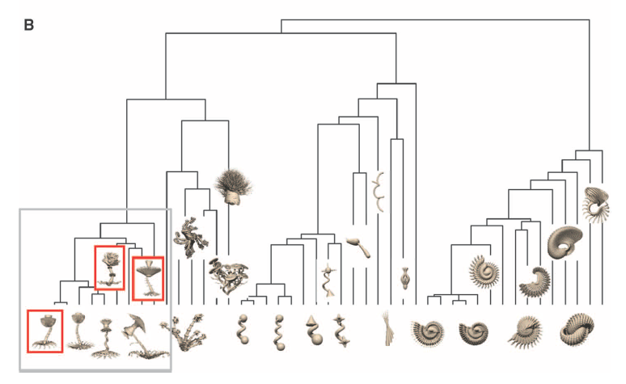
Challenging Aspect1-例2
Learning names for categories can be modeled as Bayesian inference over a tree-structured domain representation
The Form of Abstract Knowledge: a directed graphical model, where nodes represent variables and directed edges between nodes represent probabilistic causal links.
Understanding cognition and its origins in terms of Bayesian inference over richly structured, hierarchical generative models.
Joshua B. Tenenbaum, Charles Kemp, Thomas L. Griffiths, Noah D. Goodman, How to Grow a Mind: Statistics, Structure, and Abstraction, Science, Vol. 331, Issue 6022, pp. 1279-1285, 2011 (review).

Slide 19
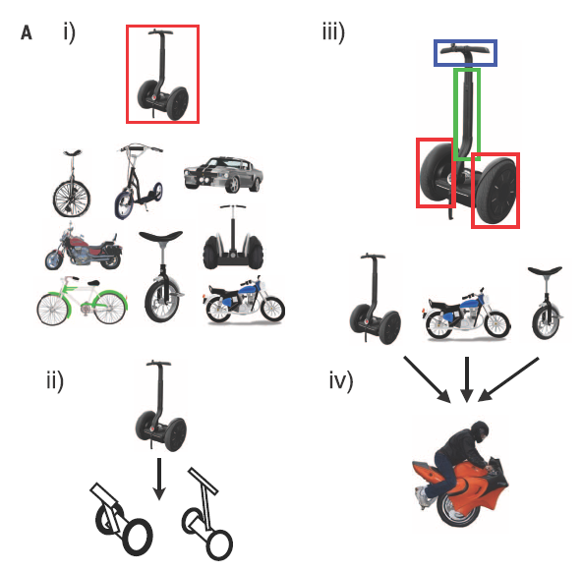
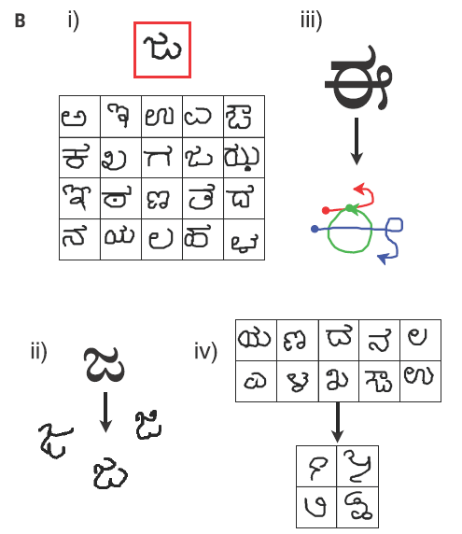
Challenging Aspect1-例3
http://omniglot.com/
People can learn rich concepts from limited data.
A single example of a new concept (red boxes) can be enough information to support
the (i) classification of new examples, (ii) generation of new examples, (iii) parsing an object into parts and relations (parts segmented by color), and (iv) generation of new concepts from related concepts.
Brenden M. Lake, Ruslan Salakhutdinov, Joshua B. Tenenbaum, Human-level concept learning through probabilistic program induction, Science, Vol. 350, Issue 6266, pp. 1332-1338, 2015 (research article).

Slide 20
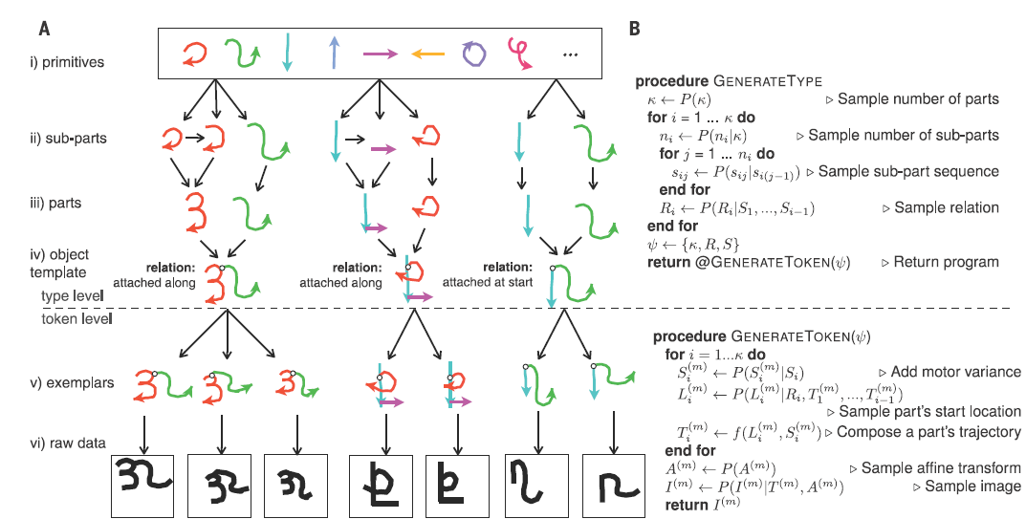
Challenging Aspect1-例3
Propose a computational model (Bayesian Program Learning) that captures these human learning abilities for a large class of simple visual concepts: handwritten characters from the world’s alphabets.
BPL learns simple stochastic programs to represent concepts, building them compositionally from parts, subparts, and spatial relations.
BPL defines a generative model that can sample new types of concepts (an “A,” “B,” etc.) by combining parts and subparts in new ways.

Slide 21
Challenge 2:
Learning from Rich Data

Slide 22
Challenging Aspect2-例4
Michael L. Littman, Reinforcement learning improves behaviour from evaluative feedback, Nature 521, 445–451, 2015 (review).
Google DeepMind, Human-level control through deep reinforcement learning, Nature 518, 529–533, 2015 (letter).
Google DeepMind, Mastering the game of Go with deep neural networks and tree search, Nature 529, pp. 484–489, 2016 (article).
Deep Reinforcement Learning (DRL)
Deep Learning (DL)
Reinforcement Learning (RL)
DRL = DL +RL
Reinforcement learning is the problem of getting an agent to act in the world so as to maximize its rewards. It has to figure out what it did that made it get the reward/punishment, which is known as the credit assignment problem.
Consider teaching a dog a new trick: you cannot tell it what to do, but you can reward/punish it if it does the right/wrong thing.

Slide 23
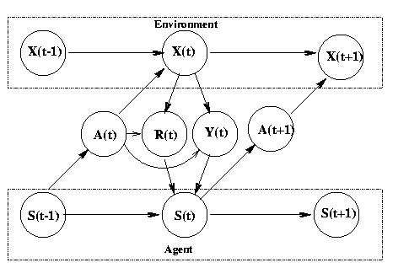
Challenging Aspect2-例4
The environment is a modeled as a stochastic finite state machine with inputs (actions sent from the agent) and outputs (observations and rewards sent to the agent)
The agent is also modelled as stochastic FSM with inputs (observations/rewards sent from the environment) and outputs (actions sent to the environment)
The agent's goal is to find a policy and state-update function so as to maximize the expected sum of discounted rewards
State transition function P(X(t)|X(t-1),A(t))
Observation (output) function P(Y(t) | X(t), A(t))
Reward function E(R(t) | X(t), A(t))
In the special case Y(t)=X(t), we say the world is fully observable, and the model becomes a Markov Decision Process (MDP)
Approximately solve an MDP by replacing the sum over all states with a Monte Carlo approximation
State transition function: S(t) = f (S(t-1), Y(t), R(t), A(t))
Policy/output function: A(t) = pi(S(t)))
Current research topics include: adaptive methods which work with fewer (or no) parameters under a large number of conditions, addressing the exploration problem in large MDPs,
learning and acting under partial information (e.g., using Predictive State Representation),
modular and hierarchical reinforcement learning,
improving existing value-function and policy search methods,
algorithms that work well with large (or continuous) action spaces,
transfer learning, lifelong learning, efficient sample-based planning (e.g., based on Monte-Carlo tree search), and multi-agent or distributed reinforcement Learning
Notes:
If we know the model (i.e., the transition and reward functions), we can solve for the optimal policy in about n^2 time using policy iteration. Unfortunately, if the state is composed of k binary state variables, then n = 2^k, so this is way too slow. In addition, what do we do if we don't know the model?
Reinforcement Learning (RL) solves both problems: we can approximately solve an MDP by replacing the sum over all states with a Monte Carlo approximation. In other words, we only update the V/Q functions (using temporal difference (TD) methods) for states that are actually visited while acting in the world. If we keep track of the transitions made and the rewards received, we can also estimate the model as we go, and then "simulate" the effects of actions without having to actually perform them.
There are three fundamental problems that RL must tackle: the exploration-exploitation tradeoff, the problem of delayed reward (credit assignment), and the need to generalize. We will discuss each in turn.
We mentioned that in RL, the agent must make trajectories through the state space to gather statistics. The exploration-exploitation tradeoff is the following: should we explore new (and potentially more rewarding) states, or stick with what we know to be good (exploit existing knowledge)? This problem has been extensively studied in the case of k-armed bandits, which are MDPs with a single state and k actions. The goal is to choose the optimal action to perform in that state, which is analogous to deciding which of the k levers to pull in a k-armed bandit (slot machine). There are some theoretical results (e.g., Gittins' indices), but they do not generalise to the multi-state case.

Slide 24
Challenge 3:
Dealing with Noisy and Uncertain Data

Slide 25
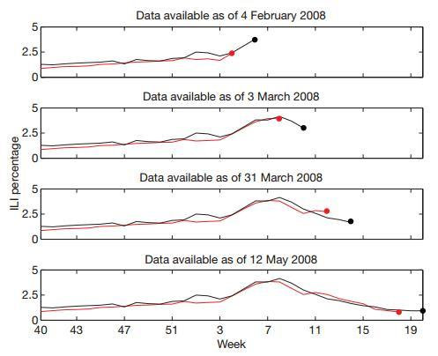
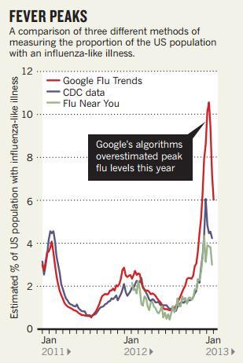
Challenging Aspect3-例5
Ginsberg J, Mohebbi M H, Patel R S, et al. Detecting influenza epidemics using search engine query data. Nature, 2009, 457(7232): 1012-1014 (letter).
Lazer D, Kennedy R, King G, et al. The Parable of Google Flu: Traps in Big Data Analysis. Science, 2014, 343(6176): 1203-1205 (policy forum).

Slide 26
Challenging Aspect3-例5
Ginsberg J, Mohebbi M H, Patel R S, et al. Detecting influenza epidemics using search engine query data. Nature, 2009, 457(7232): 1012-1014 (letter).
Lazer D, Kennedy R, King G, et al. The Parable of Google Flu: Traps in Big Data Analysis. Science, 2014, 343(6176): 1203-1205 (policy forum).
教训：
Big Data Hubris
Algorithm Dynamics
建议：
Transparency and Replicability
Use Big Data to Understand the Unknown
Study the Algorithms
It’s Not Just About Size of the Data.
Notes:
1. 傲娇的大数据（Big Data Hubris ）
意思是说，大家都把大数据作为传统数据收集和分析的“终结者”，而非锦上添花的角色。（原文：Big data are a substitute for, rather than a supplement to, traditional data collection and analysis.）
2. “唯一不变的就是不停在变的”算法（Algorithm Dynamics ）
这种变化包括两个方面：Google工程师的优化，用户使用习惯的进化。（原文：Algorithm dynamics are the changes make by engineers to improve the commercial service and by consumers in using that service.）
1. 【特别地献给Google 】关于数据公开的事儿事儿（Transparency and Replicability ）
经过（靠谱）科研训练（实在是不敢恭维一些科研单位的教学质量）的同学都应该有印象，科学研究的特点之一是可复制，也就是原文的Replicability。
首先，作者们知道Google不可能完全将数据攻来，伦理上也不能被接受（隐私问题）。这件事的亮点在于，即便是有人能够接触到Google的数据，想要重复做一遍Google原来那篇论文的研究也不可能。（原文：Even if one had access to all of Google’s data, it would be impossible to replicate the analyses of the original paper from the information provided regarding the analysis.）
有个东西叫Google Correlate，表面上看（原文：ostensibly，请体会作者们写作时的心情）能够模拟GFT，而实际上是不能的[捂嘴笑]。作者们悻悻地猜测，Google的人大概没觉得有必要遮掩。原文：Clicking the link titled “match the pattern of actual flu activity (this is how we built Google Flu Trends!)” will not, ironically, produce a replication of the GFT search terms. Oddly, the few search terms offered in the papers do not seem to be strongly related with either GFT or the CDC data – we surmise that the authors felt an unarticulated need to cloak the actual search terms identified.
（涉及到另一篇文章： Cook S, Conrad C, Fowlkes A L, et al. Assessing Google flu trends performance in the United States during the 2009 influenza virus A (H1N1) pandemic[J]. PloS one, 2011, 6(8): e23610. ）
2. 大数据有继续揭露未知的潜力（Use Big Data to Understand the Unknown ）
3. 科研人员要关注生产大数据的算法（及变化）（Study the Algorithms ）
4. 不全是“大小” 的事儿（It’s Not Just About Size … of the Data. ）

Slide 27
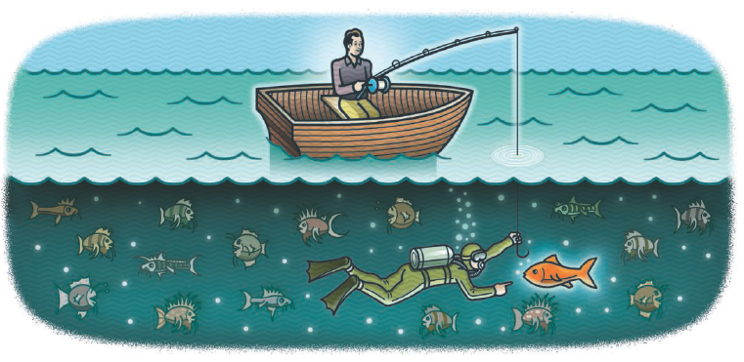
Challenging Aspect3-例6
D. J. Spiegelhalter, The future lies in uncertainty, Science, Vol. 345, Issue 6194, pp. 264-265, 2014 (Perspective).
2013年
The 300th anniversary of Jacob Bernoulli’s Ars Conjectandi, which uses probability theory to explore the properties of statistics as more observations were taken.
The 250th anniversary of Thomas Bayes’ essay on how humans can sequentially learn from experience, steadily updating their beliefs as more data become available.
Notes:
1. 傲娇的大数据（Big Data Hubris ）
意思是说，大家都把大数据作为传统数据收集和分析的“终结者”，而非锦上添花的角色。（原文：Big data are a substitute for, rather than a supplement to, traditional data collection and analysis.）
2. “唯一不变的就是不停在变的”算法（Algorithm Dynamics ）
这种变化包括两个方面：Google工程师的优化，用户使用习惯的进化。（原文：Algorithm dynamics are the changes make by engineers to improve the commercial service and by consumers in using that service.）
1. 【特别地献给Google 】关于数据公开的事儿事儿（Transparency and Replicability ）
经过（靠谱）科研训练（实在是不敢恭维一些科研单位的教学质量）的同学都应该有印象，科学研究的特点之一是可复制，也就是原文的Replicability。
首先，作者们知道Google不可能完全将数据攻来，伦理上也不能被接受（隐私问题）。这件事的亮点在于，即便是有人能够接触到Google的数据，想要重复做一遍Google原来那篇论文的研究也不可能。（原文：Even if one had access to all of Google’s data, it would be impossible to replicate the analyses of the original paper from the information provided regarding the analysis.）
有个东西叫Google Correlate，表面上看（原文：ostensibly，请体会作者们写作时的心情）能够模拟GFT，而实际上是不能的[捂嘴笑]。作者们悻悻地猜测，Google的人大概没觉得有必要遮掩。原文：Clicking the link titled “match the pattern of actual flu activity (this is how we built Google Flu Trends!)” will not, ironically, produce a replication of the GFT search terms. Oddly, the few search terms offered in the papers do not seem to be strongly related with either GFT or the CDC data – we surmise that the authors felt an unarticulated need to cloak the actual search terms identified.
（涉及到另一篇文章： Cook S, Conrad C, Fowlkes A L, et al. Assessing Google flu trends performance in the United States during the 2009 influenza virus A (H1N1) pandemic[J]. PloS one, 2011, 6(8): e23610. ）
2. 大数据有继续揭露未知的潜力（Use Big Data to Understand the Unknown ）
3. 科研人员要关注生产大数据的算法（及变化）（Study the Algorithms ）
4. 不全是“大小” 的事儿（It’s Not Just About Size … of the Data. ）

Slide 28
Negative Aspect3-例6
Traditional Statistical Problems ：large n, small p
many observations (n), such as participants in a clinical trial,
but few parameters were measured (p), and just a handful of hypotheses tested.
Current statistical problems ：small n, large p
The expression of tens of thousands of genes in a limited number of tissue samples.
Future statistical problems ：large n, large p
Images, genomes, and electronic health records become linked together.
Big Data means that we can get more precise answers;
Bernoulli proved when he showed how the variability in an estimate goes down as the sample size increases.
This apparent precision will delude us
if issues such as selection bias, regression to the mean, multiple testing, and over interpretation of associations as causation are not properly taken into account.
As data sets get larger, these problems get worse, because the complexity and number of potential false findings grow exponentially.
Serious statistical skill is required to avoid being misled.
Notes:
Traditional statistical problems could be
termed “large n, small p”: There were many
observations (n), such as participants in a
clinical trial, but few parameters were measured
(p), and just a handful of hypotheses
tested.

Slide 29
Challenging Aspect3-例7
Derek Ruths, Jürgen Pfeffer, Social media for large studies of behavior, Science, Vol. 346, Issue 6213, pp. 1063-1064, 2014 (POLICY FORUM).
Large-scale studies of human behavior in social media need to be held to higher methodological standards
On 3 November 1948, the day after Harry Truman won the United States presidential elections, the Chicago Tribune published one of the most famous erroneous headlines in newspaper history: “Dewey Defeats Truman”
REPRESENTATION OF HUMAN POPULATIONS.
Population bias, Proprietary algorithms for public data.
REPRESENTATION OF HUMAN BEHAVIOR.
Human behavior and online platform design
Distortion of human behavior, Nonhumans in large-scale studies.
ISSUES WITH METHODS.
Proxy population mismatch, Incomparability of methods and data.
Multiple comparison problems, Multiple hypothesis testing.
Notes:
For example, the highest-volume source of public
Twitter data, which are used by thousands
of researchers worldwide, is not an
accurate representation of the overall platform’s
data ( 11).
Multiple comparison problems. The body
of social media analysis that concerns the development
of user/content classification and
prediction has unaddressed issues with overfitting.

Slide 30
Challenge 4:
Dealing with Networked System Risks

Slide 31
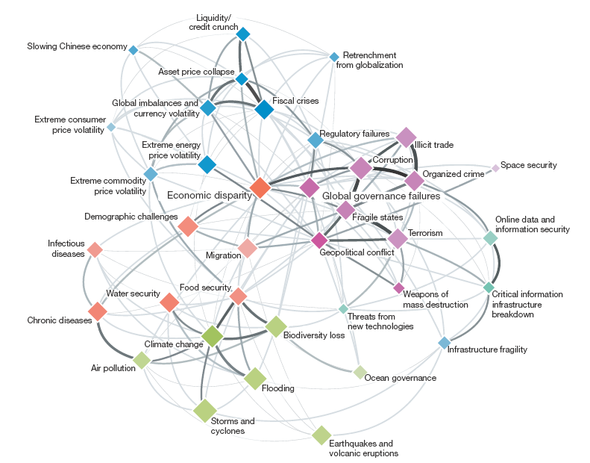
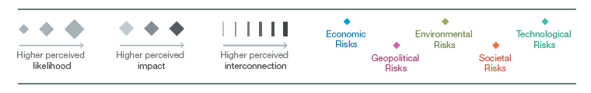
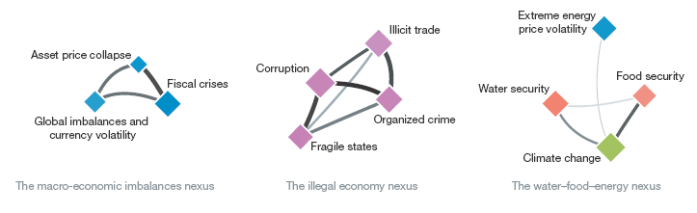
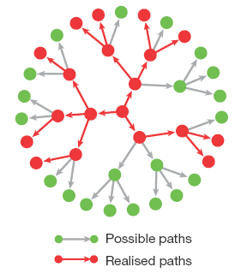
Challenging Aspect4-例8
Dirk Helbing, Globally networked risks and how to respond, Nature , vol. 497, pp.51–59 , 2013 (Perspective).
Time Bomb?.
According to the standard ISO 31000, risk is defined as ‘‘effect of uncertainty on objectives’’.
Often quantified as the probability of occurrence of an (adverse) event, times its (negative) impact (damage), but may also create positive impacts, such as opportunities for stakeholders.
The author argues that systemic failures and extreme events are consequences of the highly interconnected systems and networked risks humans have created.
Notes:
Traditional statistical problems could be
termed “large n, small p”: There were many
observations (n), such as participants in a
clinical trial, but few parameters were measured
(p), and just a handful of hypotheses
tested.

Slide 32
Challenge 5: 如何隐私保护？

Slide 33
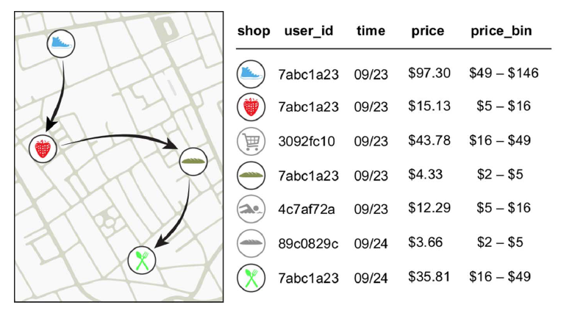
Challenging Aspect5-例9
Yves-Alexandre de Montjoye, Laura Radaelli, Vivek Kumar Singh, Alex Pentland, Unique in the shopping mall: On the reidentifiability of credit card metadata,Science, Vol. 347, Issue 6221, pp. 536-539, 2015 (report).
Financial traces in a simply anonymized data set such as the one we use for this work.
Arrows represent the temporal sequence of transactions for user 7abc1a23..
Notes:
Traditional statistical problems could be
termed “large n, small p”: There were many
observations (n), such as participants in a
clinical trial, but few parameters were measured
(p), and just a handful of hypotheses
tested.

Slide 34
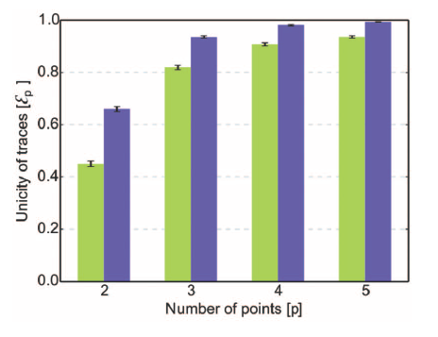
Challenging Aspect5-例9
Yves-Alexandre de Montjoye, Laura Radaelli Vivek Kumar Singh, Alex Pentland, Unique in the shopping mall: On the reidentifiability of credit card metadata, Science, Vol. 347, Issue 6221, pp. 536-539, 2015 (report).
The unicity of the credit card data set given p points.
The green bars represent unicity when spatio-temporal tuples are known.
The blue bars represent unicity when using spatial-temporal-price triples
Large-scale data sets of human behavior have the potential to fundamentally transform the way we fight diseases, design cities, or perform research. Metadata, however, contain sensitive information.
We study 3 months of credit card records for 1.1 million people and show that four spatiotemporal points are enough to uniquely reidentify 90% of individuals.
Notes:
Traditional statistical problems could be
termed “large n, small p”: There were many
observations (n), such as participants in a
clinical trial, but few parameters were measured
(p), and just a handful of hypotheses
tested.

Slide 35

北京市大数据科学与脑机智能创新中心
2015年，北京市首批北京高校高精尖创新中心
引领未来数据科学与计算智能的研究与应用方向
加速计算科学、数据科学与脑科学的交叉研究
促进高效智能的下一代计算与数据分析技术创新
通过以数据为中心的智能机器、系统及应用改变未来
Notes:
认定了13个

Slide 36

研究方向与机构设置
瓶颈1：计算的有效性遇到障碍
计算的有效性：
认识数据的内在特征，复杂网络、数学（统计）方法
瓶颈2：能耗成为突出问题
随着规模增大，调度复杂，计算系统功耗问题日益突出
传统存算分离的结构，产生大量的数据搬移开销
传统的计算和存储器件“功耗”不友好
瓶颈3：学习效率和灵活性
学习效率：需要大量的输入数据及标定数据，学习效率低
灵活性：普遍缺乏“类比、联想”等学习功能
数据科学与计算智能
数据工程与
脑机系统
新型计算技术与系统
认知机理与仿真
http://www.bdbc.org.cn/

