Slide 1


工作进展
马 帅

Slide 2
轨迹交通数据
管理/分析
学术论文数据
管理/分析
TGraph：
时态图数据库

Slide 3
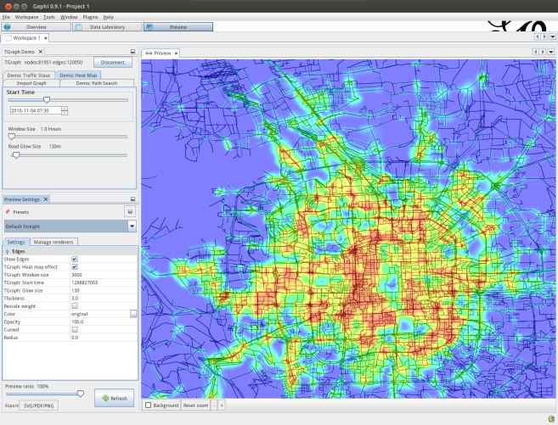
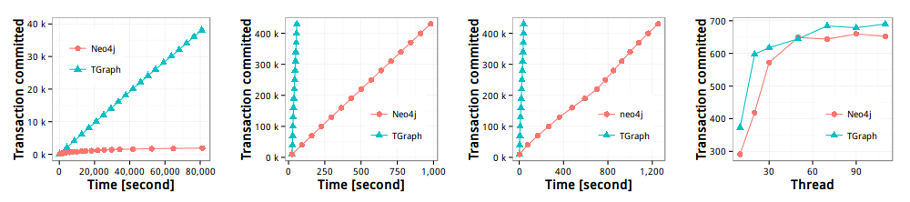
TGraph：时态图数据库
Operation | TGraph (operations/s) | Neo4j (operations/s)
Write | 52,551 ( 20x faster ) | 2,621
time point read | 12,500 ( 28.5x faster ) | 439
time range read | 10,858 ( 27x faster ) | 403
Haixing Huang, Jinghe Song, Xuelian Lin, Shuai Ma, and Jinpeng Huai. TGraph: A Temporal Graph Data Management System, CIKM demo paper, 2016.
Notes:
马帅

Slide 4

TGraph：时态图数据库
LevelDB is an open source on-disk key-value store written by Google fellows Jeffrey Dean and Sanjay Ghemawat. Inspired by Bigtable
功能：增加了对属性值随时间变化管理
正在进行的系统工作
索引
时态查询语言: TCypher
对分布式功能的支持
LevelDB

Slide 5
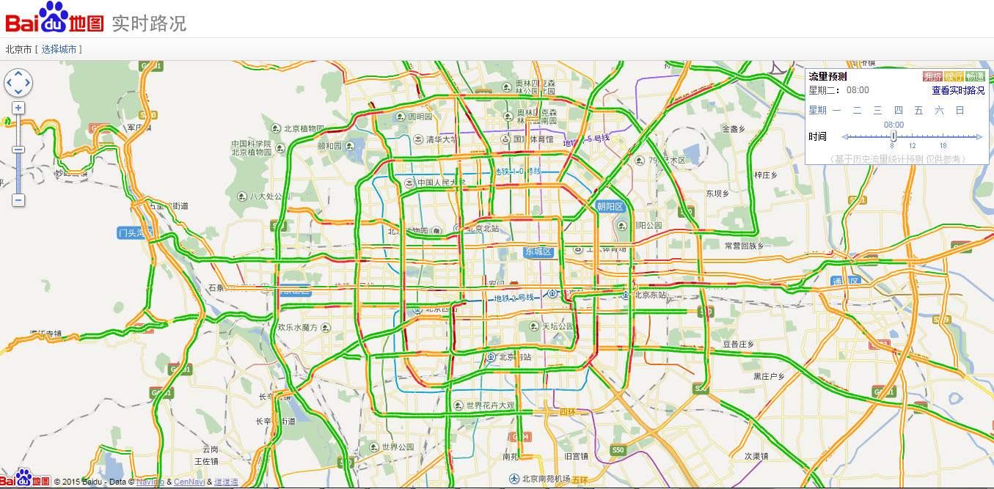
轨迹交通数据管理/分析-时态子图

Slide 6
轨迹交通数据管理/分析-时态子图
Filter-and-Verification methods:
Data Driven Query Approximation methods:
Choose k (a small constant, e.g., 10 or 15)
Experimental results (with the state of the art solution ^{[Bogdanov et al. 2011]})
10⁴ | 10⁵ | 10⁶ | ··· | 10⁸
5×10² | 5×10³ | 5×10⁴ |  | 5×10⁶
95% are filtered
10⁴ | 10⁵ | 10⁶ | ··· | 10⁸
k | k | k |  | k
 | Accuracy | Efficiency
BEIJING DATA | 100.25% | 4,870 times faster
SYNTHETIC DATA | 99.69% | 1,468 times faster
P. Bogdanov, M. Mongiov, and A. K. Singh. Mining heavy subgraphs in time-evolving networks. In ICDM, 2011.
Haixing Huang, Jinghe Song, Xuelian Lin, Shuai Ma, Jinpeng Huai, TGraph: A Temporal Graph Data Management System (demo), CIKM 2016.
Shuai Ma, Renjun Hu, Luoshu Wang, Xuelian Lin, Jinpeng Huai, Fast Computation of Temporal Dense Subgraphs, draft

Slide 7
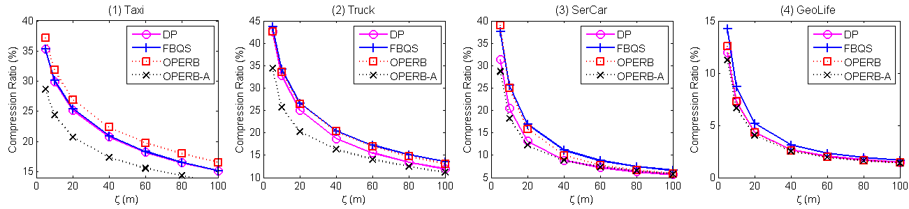
轨迹交通数据管理/分析
轨迹压缩
提出了One-Pass Error Bounded Trajectory Simplification
4个真实数据集(Taxi, Truck,SerCar, GeoLife)
OPERB and OPERB-A are on average (4.1, 4.1, 5.4, 5.2) times faster than FBQS on (Taxi, Truck, SerCar, GeoLife), respectively
For compression, tios, OPERB is comparable with DP, and OPERB-A is better than DP, on average (84.2%, 86.4%, 97.1%, 94.7%) of DP on (Taxi, Truck, SerCar, GeoLife), respectively

Slide 8
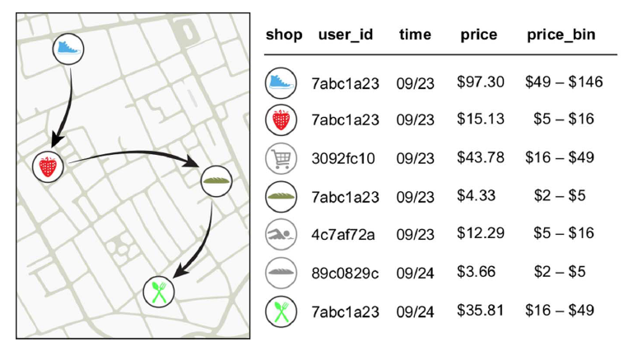
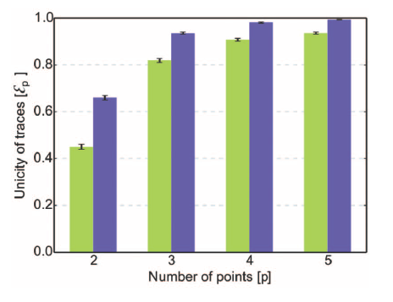
轨迹交通数据管理/分析
轨迹数据的隐私与保护
Financial traces in a simply anonymized data set such as the one we use for this work.
Arrows represent the temporal sequence of transactions for user 7abc1a23..
用户行为大数据很可能包含敏感数据.
对信用卡数据（1.1百万人，3个月）分析表明：
4个时空的采样点足够识别出90%的个体
Yves-Alexandre de Montjoye, Laura Radaelli, Vivek Kumar Singh, Alex Pentland, Unique in the shopping mall: On the reidentifiability of credit card metadata, Science, Vol. 347, Issue 6221, pp. 536-539, 2015 (report).

Slide 9
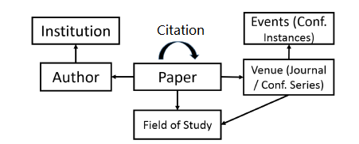
学术论文数据管理/分析
Dongsheng Luo, Chen Gong, Renjun Hu, Liang Duan, and Shuai Ma. Ensemble Enabled Weighted PageRank. The WSDM Cup - Entity Ranking Challenge, 2016. (The 2nd place in the final ranking)
The Heterogeneous Microsoft Academic Graph

Slide 10
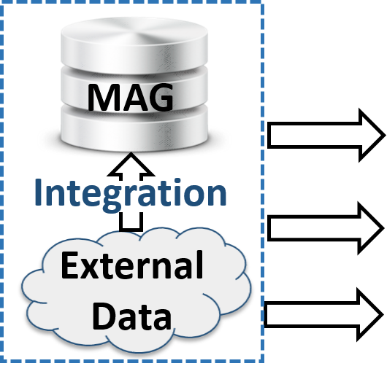

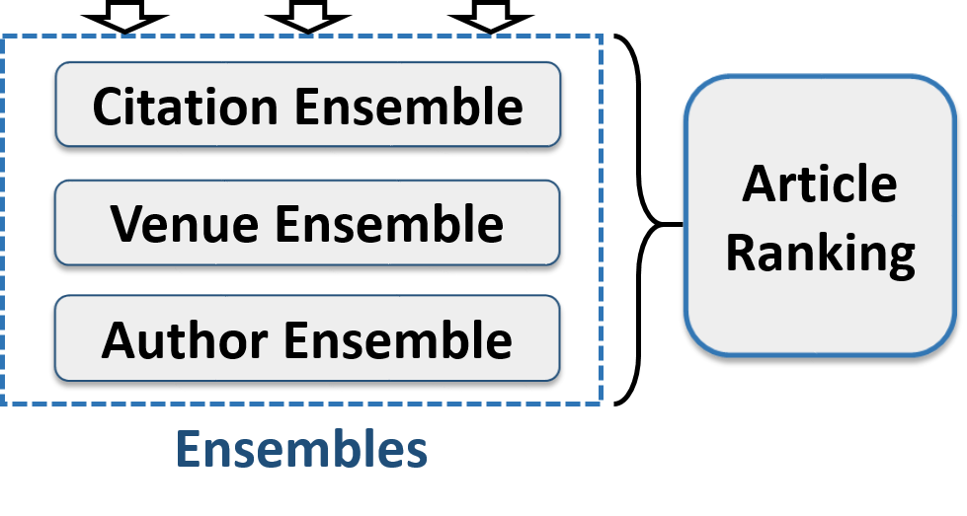
学术论文数据管理/分析
Ensemble Enabled Scholarly Article Ranking
效果： : 比FutureRank 和 HHGBiRank (AAAI‘16) 高3%
效率
1) ensemble-power : FutureRank : HHGBiRank (AAAI'16) = 331 : 443 : 40669，ensemble-power / FutureRank = 0.8；
2) ensemble-batch 在 ensemble-power上继续提升，平均 batch/power = 0.45;
3) 当delta_G/G >=1.0时，increm / batch=0.9；delta_G/G 在我们数据中最小是0.05 （只增加1年的数据），increm / batch在0.3左右；
4) 所有算法的效率一起比，只考虑1年的更新量的话，increm / batch / power / FutureRank / HHGBiRank = 1 : 3 : 6.7 : 8 : 700;

Slide 11
学术论文数据管理/分析
下一步工作：
数据质量问题，提高排名的质量
数据缺失/错误
同名不同人
同人不同名
原型系统
作者、单位、会议/期刊的学术影响力排名
构建在Tgraph图数据库之上

Slide 12
Q&A? Thanks!
Homepage: http://mashuai.buaa.edu.cn
Email: mashuai@buaa.edu.cn
Address: Room G1122,
New Main Building,
Beihang University
Beijing, China

