Slide 1


大数据之自然&科学文选
马 帅

Slide 2
Science和Nature杂志论文
(1)学术论文：
《Nature》：Article；
《Science》：Research article；
(2)研究报道：
《Nature》：Letter;
《Science》：Report;
(3)通讯：
《Nature》:Correspondence；
《Science》：Letter。
研究文章较长，一般可在5—7页左右。研究报道一般为2—4页，通讯一般不超过1页。

Slide 3
Science的内容：
1） Science报道科学新闻：其新闻栏目的作者遍布全球，包括Science的记录、特约通讯员和自由撰稿人。来自中国新华社特稿社（features@public.bat.net.cn）的熊雷等人常给Science提供有关中国的新闻稿件。Science的科学新闻报道公正、客观，可使读者了解到中国及世界各地的科学实况。新闻栏目包括：本周新闻（科学政策和科研新闻）和新闻聚焦（深入报道和专题）。Science也报道一些与科学政策和基金管理决策者的访谈。
2）科学罗盘栏目包括：社论、读者来信、政策论坛、科学与社会、书评、研究评述、综述、技术特写等。该栏目主要是向科学家约稿。中国科学家也曾在Science上发表过社论和政策论坛文章。
3）研究成果栏目包括：研究文章（特别重要的研究进展）和报告（重要研究进展的短篇论文）。Science编委会和16位编辑每周选择大约1篇研究文章和15篇报告发表。

Slide 4
Nature的特点：
《Nature》杂志反映原始研究工作的主要论文格式是“来信”（Letters to Nature）和“文章”（Articles）。
1）“来信”（Letters to Nature）：是较短的原始研究工作报告，集中反映某一重要发现，它的重要性意味着其他领域的科学家也会对其感兴趣。这种论文的长度一般不应超过《Nature》杂志的2.5个页面，参考文献不应超过30条。论文以一个不超过180个单词的自然段开头，标明所有必要的参考文献，其读者对象是其他领域的科学家。这段文字概述研究工作的背景和原理，接下来介绍论文的主要结论，用“Here we show”或类似的短语来引导。允许再有一小段引言内容，但其后的正文部分则应仅限于对发现做简短描述，并且只能有一小段的讨论部分。
2）“文章”（Articles）： 是反映原始研究工作的报告，其结论代表着人们在理解某一重要问题上所取得的一个实质性进展，许多不同领域的读者都会对其感兴趣。这类论文的长度一般不超过《Nature》杂志5个页面参考文献不超过50条。（一整页文字大约为1300个单词）。这类论文有一个不标参考文献的摘要部分，与正文分开，长度最多150个单词，其中不含数字、缩写或计量单位，除非确有必要。同“来信”类论文的开头一段一样，“文章”类论文的这一摘要部分也是对研究工作的背景和原理的简短介绍，随后为用“Here we show”或类似短语引导的论文的主要结论。文章本身以长达500字、标注参考文献的文字开始，对研究工作的背景做进一步介绍（与摘要部分有一些重复是允许的），接下来对研究工作的发现做精练的、集中的分析，最后为一到两段较短的讨论部分。这类论文应有几个小标题，每个小标题的长度不应超过40个字符。
1. 如何在《Nature》杂志上发表文章，http://lib.ncut.edu.cn/tgzn/new/ziranzazhi.htm
2. GETTING PUBLISHED IN NATURE: THE EDITORIAL PROCESS， http://www.nature.com/nature/authors/get_published/
3. Science和Nature杂志论文异同简述，http://blog.sciencenet.cn/blog-470246-600221.html

Slide 5
Artificial Intelligence

Slide 6
Social Networks

Slide 7
Big Data

Slide 8
AI + SN + BD

Slide 9
Challenge 1:
Learning from Limited Data

Slide 10
Challenging Aspect1
Ernő Téglás*, Edward Vul, Vittorio Girotto, Michel Gonzalez, Joshua B. Tenenbaum, Luca L. Bonatti, Pure Reasoning in 12-Month-Old Infants as Probabilistic Inference. Science, Vol.332, Issue 6033, pp. 1054-1059, 2011 (research article).
Joshua B. Tenenbaum, Charles Kemp, Thomas L. Griffiths, Noah D. Goodman, How to Grow a Mind: Statistics, Structure, and Abstraction, Science, Vol. 331, Issue 6022, pp. 1279-1285, 2011 (review).
Brenden M. Lake, Ruslan Salakhutdinov, Joshua B. Tenenbaum, Human-level concept learning through probabilistic program induction, Science, Vol. 350, Issue 6266, pp. 1332-1338, 2015 (research article).

Slide 11
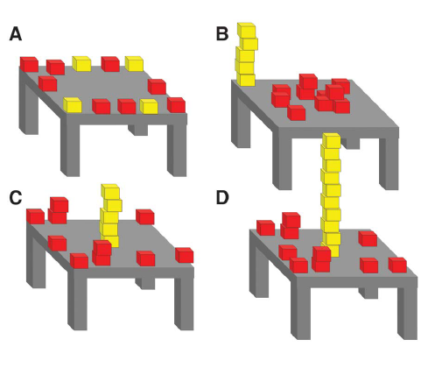
Challenging Aspect1-例1
A Bayesian model of infants’ pure reasoning.
Probe infants’ expectations about unknown future events when they witness dynamic scenes that contain multiple potentially relevant–but also potentially conflicting–sources of information
Infants’ looking times are consistent with a Bayesian ideal observer embodying abstract principles of object motion.
Infants possess surprisingly sophisticated abilities to integrate multiple information sources and abstract knowledge in reasoning about future outcomes.
Ernő Téglás*, Edward Vul, Vittorio Girotto, Michel Gonzalez, Joshua B. Tenenbaum, Luca L. Bonatti, Pure Reasoning in 12-Month-Old Infants as Probabilistic Inference. Science, Vol.332, Issue 6033, pp. 1054-1059, 2011 (research article).

Slide 12
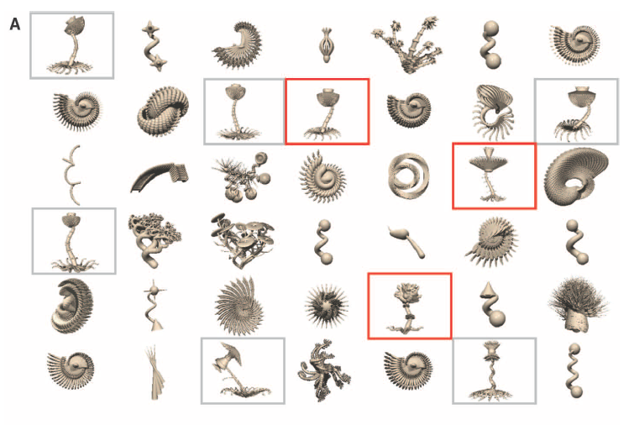
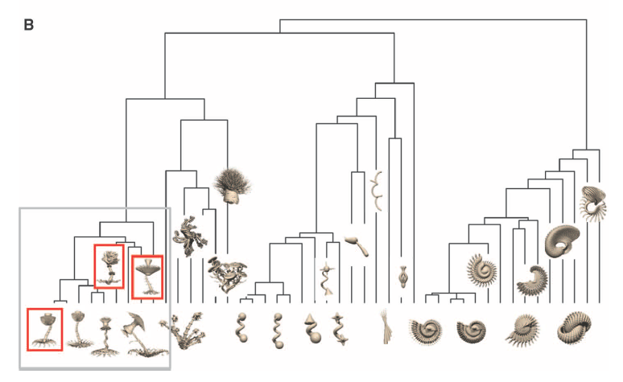
Challenging Aspect1-例2
Learning names for categories can be modeled as Bayesian inference over a tree-structured domain representation
The Form of Abstract Knowledge: a directed graphical model, where nodes represent variables and directed edges between nodes represent probabilistic causal links.
Understanding cognition and its origins in terms of Bayesian inference over richly structured, hierarchical generative models.
Joshua B. Tenenbaum, Charles Kemp, Thomas L. Griffiths, Noah D. Goodman, How to Grow a Mind: Statistics, Structure, and Abstraction, Science, Vol. 331, Issue 6022, pp. 1279-1285, 2011 (review).

Slide 13
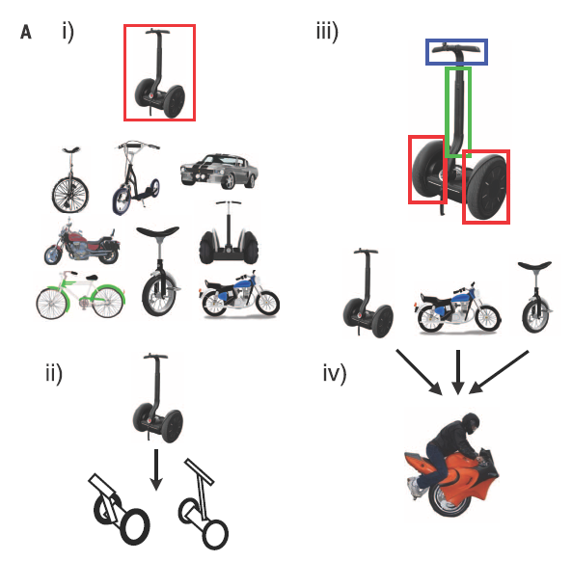
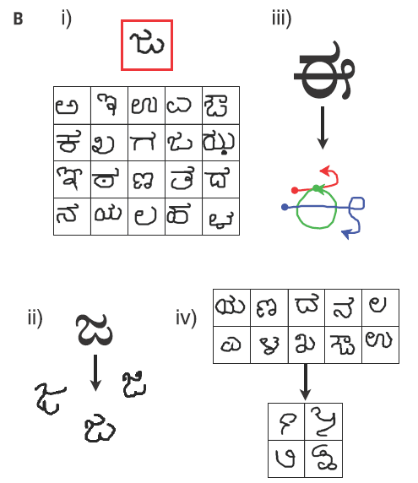
Challenging Aspect1-例3
http://omniglot.com/
People can learn rich concepts from limited data.
A single example of a new concept (red boxes) can be enough information to support
the (i) classification of new examples, (ii) generation of new examples, (iii) parsing an object into parts and relations (parts segmented by color), and (iv) generation of new concepts from related concepts.
Brenden M. Lake, Ruslan Salakhutdinov, Joshua B. Tenenbaum, Human-level concept learning through probabilistic program induction, Science, Vol. 350, Issue 6266, pp. 1332-1338, 2015 (research article).

Slide 14
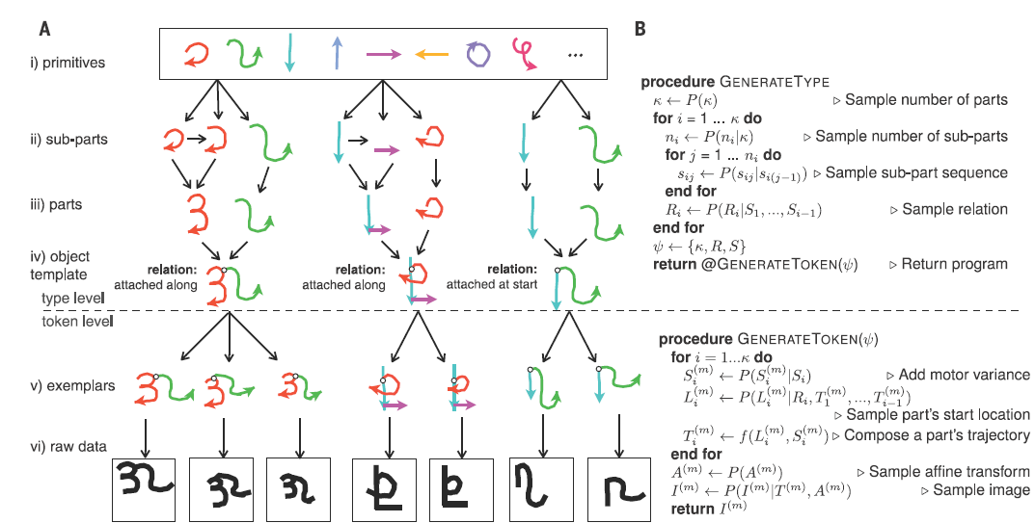
Challenging Aspect1-例3
Propose a computational model (Bayesian Program Learning) that captures these human learning abilities for a large class of simple visual concepts: handwritten characters from the world’s alphabets.
BPL learns simple stochastic programs to represent concepts, building them compositionally from parts, subparts, and spatial relations.
BPL defines a generative model that can sample new types of concepts (an “A,” “B,” etc.) by combining parts and subparts in new ways.

Slide 15
Challenge 2:
Learning from Rich Data

Slide 16
Challenging Aspect2-例4
Michael L. Littman, Reinforcement learning improves behaviour from evaluative feedback, Nature 521, 445–451, 2015 (review).
Google DeepMind, Human-level control through deep reinforcement learning, Nature 518, 529–533, 2015 (letter).
Google DeepMind, Mastering the game of Go with deep neural networks and tree search, Nature 529, pp. 484–489, 2016 (article).
Deep Reinforcement Learning (DRL)
Deep Learning (DL)
Reinforcement Learning (RL)
DRL = DL +RL
Reinforcement learning is the problem of getting an agent to act in the world so as to maximize its rewards. It has to figure out what it did that made it get the reward/punishment, which is known as the credit assignment problem.
Consider teaching a dog a new trick: you cannot tell it what to do, but you can reward/punish it if it does the right/wrong thing.

Slide 17
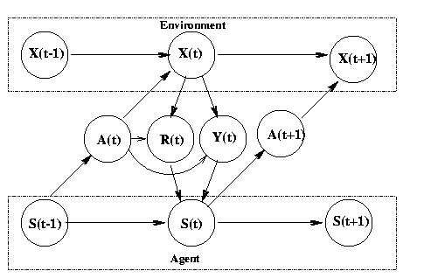
Challenging Aspect2-例4
The environment is a modeled as a stochastic finite state machine with inputs (actions sent from the agent) and outputs (observations and rewards sent to the agent)
The agent is also modelled as stochastic FSM with inputs (observations/rewards sent from the environment) and outputs (actions sent to the environment)
The agent's goal is to find a policy and state-update function so as to maximize the expected sum of discounted rewards
State transition function P(X(t)|X(t-1),A(t))
Observation (output) function P(Y(t) | X(t), A(t))
Reward function E(R(t) | X(t), A(t))
In the special case Y(t)=X(t), we say the world is fully observable, and the model becomes a Markov Decision Process (MDP)
Approximately solve an MDP by replacing the sum over all states with a Monte Carlo approximation
State transition function: S(t) = f (S(t-1), Y(t), R(t), A(t))
Policy/output function: A(t) = pi(S(t)))
Current research topics include: adaptive methods which work with fewer (or no) parameters under a large number of conditions, addressing the exploration problem in large MDPs,
learning and acting under partial information (e.g., using Predictive State Representation),
modular and hierarchical reinforcement learning,
improving existing value-function and policy search methods,
algorithms that work well with large (or continuous) action spaces,
transfer learning, lifelong learning, efficient sample-based planning (e.g., based on Monte-Carlo tree search), and multi-agent or distributed reinforcement Learning
Notes:
If we know the model (i.e., the transition and reward functions), we can solve for the optimal policy in about n^2 time using policy iteration. Unfortunately, if the state is composed of k binary state variables, then n = 2^k, so this is way too slow. In addition, what do we do if we don't know the model?
Reinforcement Learning (RL) solves both problems: we can approximately solve an MDP by replacing the sum over all states with a Monte Carlo approximation. In other words, we only update the V/Q functions (using temporal difference (TD) methods) for states that are actually visited while acting in the world. If we keep track of the transitions made and the rewards received, we can also estimate the model as we go, and then "simulate" the effects of actions without having to actually perform them.
There are three fundamental problems that RL must tackle: the exploration-exploitation tradeoff, the problem of delayed reward (credit assignment), and the need to generalize. We will discuss each in turn.
We mentioned that in RL, the agent must make trajectories through the state space to gather statistics. The exploration-exploitation tradeoff is the following: should we explore new (and potentially more rewarding) states, or stick with what we know to be good (exploit existing knowledge)? This problem has been extensively studied in the case of k-armed bandits, which are MDPs with a single state and k actions. The goal is to choose the optimal action to perform in that state, which is analogous to deciding which of the k levers to pull in a k-armed bandit (slot machine). There are some theoretical results (e.g., Gittins' indices), but they do not generalise to the multi-state case.

Slide 18
Challenge 3:
Dealing with Noisy and Uncertain Data

Slide 19
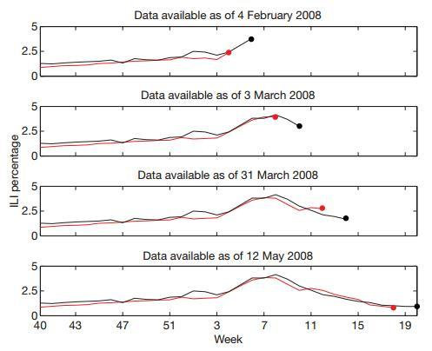
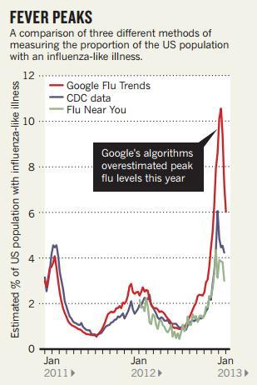
Challenging Aspect3-例5
Ginsberg J, Mohebbi M H, Patel R S, et al. Detecting influenza epidemics using search engine query data. Nature, 2009, 457(7232): 1012-1014.
Lazer D, Kennedy R, King G, et al. The Parable of Google Flu: Traps in Big Data Analysis. Science, 2014, 343(6176): 1203-1205.

Slide 20
Challenging Aspect3-例5
Ginsberg J, Mohebbi M H, Patel R S, et al. Detecting influenza epidemics using search engine query data. Nature, 2009, 457(7232): 1012-1014.
Lazer D, Kennedy R, King G, et al. The Parable of Google Flu: Traps in Big Data Analysis. Science, 2014, 343(6176): 1203-1205.
教训：
Big Data Hubris
Algorithm Dynamics
建议：
Transparency and Replicability
Use Big Data to Understand the Unknown
Study the Algorithms
It’s Not Just About Size of the Data.
Notes:
1. 傲娇的大数据（Big Data Hubris ）
意思是说，大家都把大数据作为传统数据收集和分析的“终结者”，而非锦上添花的角色。（原文：Big data are a substitute for, rather than a supplement to, traditional data collection and analysis.）
2. “唯一不变的就是不停在变的”算法（Algorithm Dynamics ）
这种变化包括两个方面：Google工程师的优化，用户使用习惯的进化。（原文：Algorithm dynamics are the changes make by engineers to improve the commercial service and by consumers in using that service.）
1. 【特别地献给Google 】关于数据公开的事儿事儿（Transparency and Replicability ）
经过（靠谱）科研训练（实在是不敢恭维一些科研单位的教学质量）的同学都应该有印象，科学研究的特点之一是可复制，也就是原文的Replicability。
首先，作者们知道Google不可能完全将数据攻来，伦理上也不能被接受（隐私问题）。这件事的亮点在于，即便是有人能够接触到Google的数据，想要重复做一遍Google原来那篇论文的研究也不可能。（原文：Even if one had access to all of Google’s data, it would be impossible to replicate the analyses of the original paper from the information provided regarding the analysis.）
有个东西叫Google Correlate，表面上看（原文：ostensibly，请体会作者们写作时的心情）能够模拟GFT，而实际上是不能的[捂嘴笑]。作者们悻悻地猜测，Google的人大概没觉得有必要遮掩。原文：Clicking the link titled “match the pattern of actual flu activity (this is how we built Google Flu Trends!)” will not, ironically, produce a replication of the GFT search terms. Oddly, the few search terms offered in the papers do not seem to be strongly related with either GFT or the CDC data – we surmise that the authors felt an unarticulated need to cloak the actual search terms identified.
（涉及到另一篇文章： Cook S, Conrad C, Fowlkes A L, et al. Assessing Google flu trends performance in the United States during the 2009 influenza virus A (H1N1) pandemic[J]. PloS one, 2011, 6(8): e23610. ）
2. 大数据有继续揭露未知的潜力（Use Big Data to Understand the Unknown ）
3. 科研人员要关注生产大数据的算法（及变化）（Study the Algorithms ）
4. 不全是“大小” 的事儿（It’s Not Just About Size … of the Data. ）

Slide 21
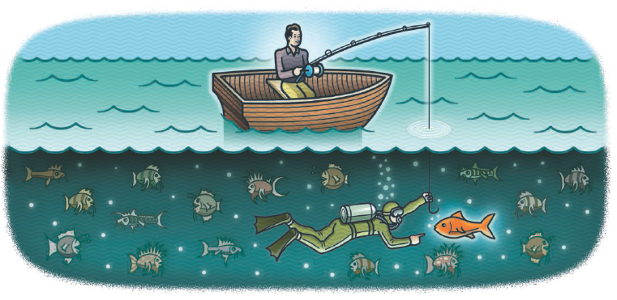
Challenging Aspect3-例6
D. J. Spiegelhalter, The future lies in uncertainty, Science, Vol. 345, Issue 6194, pp. 264-265, 2014 (Perspective).
2013年
The 300th anniversary of Jacob Bernoulli’s Ars Conjectandi, which uses probability theory to explore the properties of statistics as more observations were taken.
The 250th anniversary of Thomas Bayes’ essay on how humans can sequentially learn from experience, steadily updating their beliefs as more data become available.
Notes:
1. 傲娇的大数据（Big Data Hubris ）
意思是说，大家都把大数据作为传统数据收集和分析的“终结者”，而非锦上添花的角色。（原文：Big data are a substitute for, rather than a supplement to, traditional data collection and analysis.）
2. “唯一不变的就是不停在变的”算法（Algorithm Dynamics ）
这种变化包括两个方面：Google工程师的优化，用户使用习惯的进化。（原文：Algorithm dynamics are the changes make by engineers to improve the commercial service and by consumers in using that service.）
1. 【特别地献给Google 】关于数据公开的事儿事儿（Transparency and Replicability ）
经过（靠谱）科研训练（实在是不敢恭维一些科研单位的教学质量）的同学都应该有印象，科学研究的特点之一是可复制，也就是原文的Replicability。
首先，作者们知道Google不可能完全将数据攻来，伦理上也不能被接受（隐私问题）。这件事的亮点在于，即便是有人能够接触到Google的数据，想要重复做一遍Google原来那篇论文的研究也不可能。（原文：Even if one had access to all of Google’s data, it would be impossible to replicate the analyses of the original paper from the information provided regarding the analysis.）
有个东西叫Google Correlate，表面上看（原文：ostensibly，请体会作者们写作时的心情）能够模拟GFT，而实际上是不能的[捂嘴笑]。作者们悻悻地猜测，Google的人大概没觉得有必要遮掩。原文：Clicking the link titled “match the pattern of actual flu activity (this is how we built Google Flu Trends!)” will not, ironically, produce a replication of the GFT search terms. Oddly, the few search terms offered in the papers do not seem to be strongly related with either GFT or the CDC data – we surmise that the authors felt an unarticulated need to cloak the actual search terms identified.
（涉及到另一篇文章： Cook S, Conrad C, Fowlkes A L, et al. Assessing Google flu trends performance in the United States during the 2009 influenza virus A (H1N1) pandemic[J]. PloS one, 2011, 6(8): e23610. ）
2. 大数据有继续揭露未知的潜力（Use Big Data to Understand the Unknown ）
3. 科研人员要关注生产大数据的算法（及变化）（Study the Algorithms ）
4. 不全是“大小” 的事儿（It’s Not Just About Size … of the Data. ）

Slide 22
Negative Aspect3-例6
Traditional Statistical Problems ：large n, small p
many observations (n), such as participants in a clinical trial,
but few parameters were measured (p), and just a handful of hypotheses tested.
Current statistical problems ：small n, large p
The expression of tens of thousands of genes in a limited number of tissue samples.
Future statistical problems ：large n, large p
Images, genomes, and electronic health records become linked together.
Big Data means that we can get more precise answers;
Bernoulli proved when he showed how the variability in an estimate goes down as the sample size increases.
This apparent precision will delude us
if issues such as selection bias, regression to the mean, multiple testing, and over interpretation of associations as causation are not properly taken into account.
As data sets get larger, these problems get worse, because the complexity and number of potential false findings grow exponentially.
Serious statistical skill is required to avoid being misled.
Notes:
Traditional statistical problems could be
termed “large n, small p”: There were many
observations (n), such as participants in a
clinical trial, but few parameters were measured
(p), and just a handful of hypotheses
tested.

Slide 23
Challenging Aspect3-例7
Derek Ruths, Jürgen Pfeffer, Social media for large studies of behavior, Science, Vol. 346, Issue 6213, pp. 1063-1064, 2014 (POLICY FORUM).
Large-scale studies of human behavior in social media need to be held to higher methodological standards
On 3 November 1948, the day after Harry Truman won the United States presidential elections, the Chicago Tribune published one of the most famous erroneous headlines in newspaper history: “Dewey Defeats Truman”
REPRESENTATION OF HUMAN POPULATIONS.
Population bias, Proprietary algorithms for public data.
REPRESENTATION OF HUMAN BEHAVIOR.
Human behavior and online platform design
Distortion of human behavior, Nonhumans in large-scale studies.
ISSUES WITH METHODS.
Proxy population mismatch, Incomparability of methods and data.
Multiple comparison problems, Multiple hypothesis testing.
Notes:
For example, the highest-volume source of public
Twitter data, which are used by thousands
of researchers worldwide, is not an
accurate representation of the overall platform’s
data ( 11).
Multiple comparison problems. The body
of social media analysis that concerns the development
of user/content classification and
prediction has unaddressed issues with overfitting.

Slide 24
Challenge 4:
Dealing with Networked System Risks

Slide 25
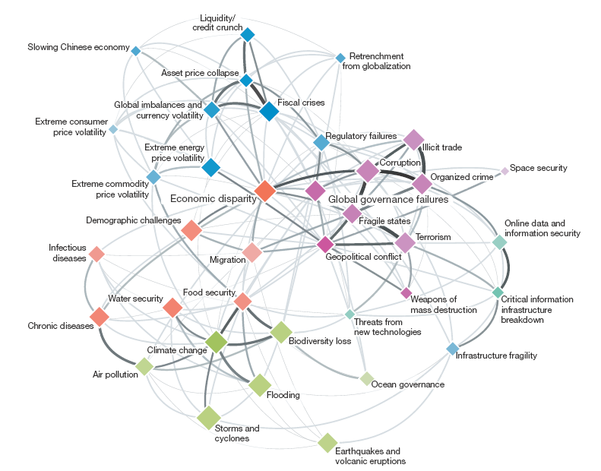
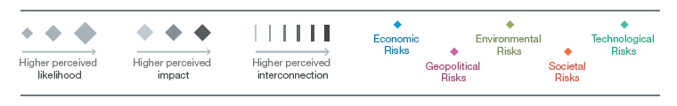
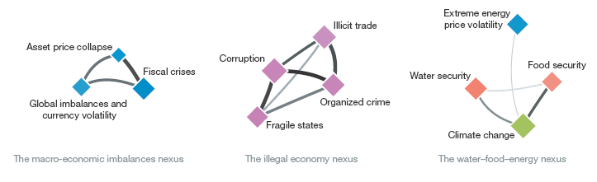
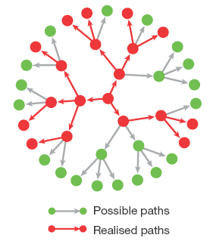
Challenging Aspect4-例8
Dirk Helbing, Globally networked risks and how to respond, Nature , vol. 497, pp.51–59 , 2013 (Perspective).
Time Bomb?.
According to the standard ISO 31000, risk is defined as ‘‘effect of uncertainty on objectives’’.
Often quantified as the probability of occurrence of an (adverse) event, times its (negative) impact (damage), but may also create positive impacts, such as opportunities for stakeholders.
The author argues that systemic failures and extreme events are consequences of the highly interconnected systems and networked risks humans have created.
Notes:
Traditional statistical problems could be
termed “large n, small p”: There were many
observations (n), such as participants in a
clinical trial, but few parameters were measured
(p), and just a handful of hypotheses
tested.

Slide 26
Challenge 5:
Deal with Privacy

Slide 27
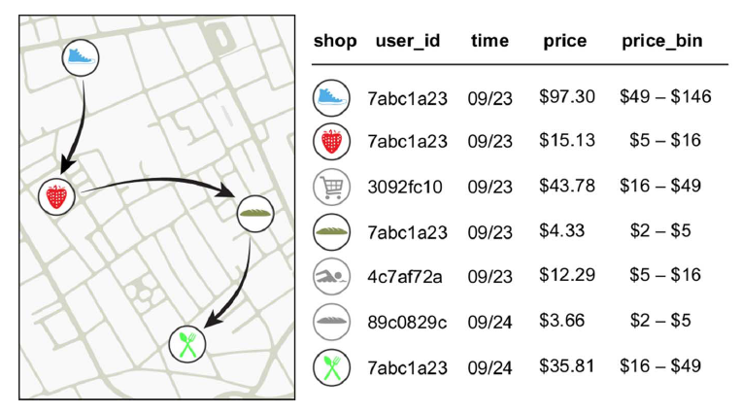
Challenging Aspect5-例9
Yves-Alexandre de Montjoye, Laura Radaelli, Vivek Kumar Singh, Alex Pentland, Unique in the shopping mall: On the reidentifiability of credit card metadata,Science, Vol. 347, Issue 6221, pp. 536-539, 2015 (report).
Financial traces in a simply anonymized data set such as the one we use for this work.
Arrows represent the temporal sequence of transactions for user 7abc1a23..
Notes:
Traditional statistical problems could be
termed “large n, small p”: There were many
observations (n), such as participants in a
clinical trial, but few parameters were measured
(p), and just a handful of hypotheses
tested.

Slide 28
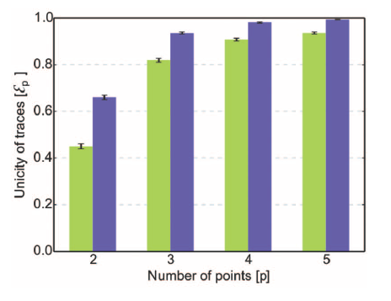
Challenging Aspect5-例9
Yves-Alexandre de Montjoye, Laura Radaelli Vivek Kumar Singh, Alex Pentland, Unique in the shopping mall: On the reidentifiability of credit card metadata, Science, Vol. 347, Issue 6221, pp. 536-539, 2015 (report).
The unicity of the credit card data set given p points.
The green bars represent unicity when spatio-temporal tuples are known.
The blue bars represent unicity when using spatial-temporal-price triples
Large-scale data sets of human behavior have the potential to fundamentally transform the way we fight diseases, design cities, or perform research. Metadata, however, contain sensitive information.
We study 3 months of credit card records for 1.1 million people and show that four spatiotemporal points are enough to uniquely reidentify 90% of individuals.
Notes:
Traditional statistical problems could be
termed “large n, small p”: There were many
observations (n), such as participants in a
clinical trial, but few parameters were measured
(p), and just a handful of hypotheses
tested.

Slide 29

The Fourth Age of Research
Jonathan Adams analyses papers from the past three decades and finds that the best science comes from international collaboration.– Nature vol 497, pp 560, 2013 (comment).

Slide 30
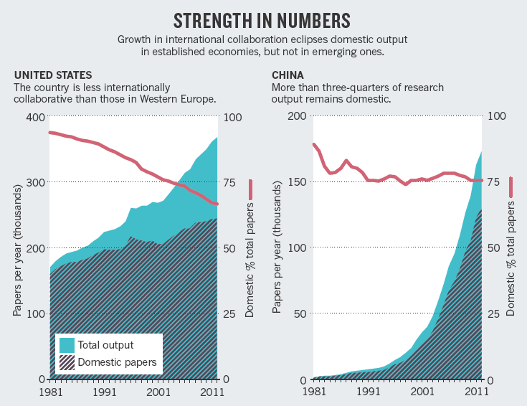
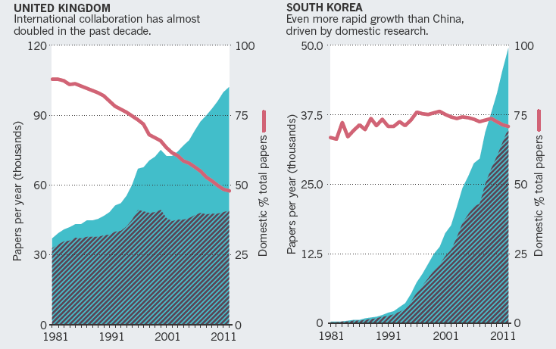
The Fourth Age of Research
Notes:
Jonathan Adams was formerly director of research evaluation at Thomson Reuters and is now a research-management consultant in Leeds, UK.
e-mail: jonathanzadams@gmail.com

Slide 31

Homepage: http://mashuai.buaa.edu.cn
Email: mashuai@buaa.edu.cn
Address: Room G1122,
New Main Building,
Beihang University
VBeijing, China

