Slide 1


大图搜索：进展报告
(Big Graph Search: Progress Report)
马 帅

Slide 2
大图搜索
R = Q(D)
大图搜索的数据技术
(Data Techniques for Big Graph Search)
R = Q(D)

Slide 3

数据近似技术
主要思想：对一类查询复杂性高的查询语言Q ，将查询数据D变换机器能够高效处理的较小量D’ ，并且尽量不影响查询结果的准确性。
approximation
Q(D)
Q (D’)
二八定律：在众多现象中，80%的结果取决于20%的原因
D = HARD(D) + SOFT(D)
×
挑战: 平衡查询的效率和查询的准确性!

Slide 4

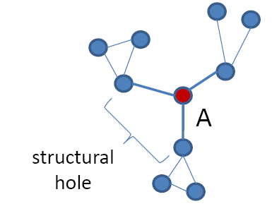
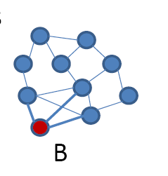
如一，网络异常检测
Structural hole theory ^{[Burt 1992,2004]}
Theory of social capital
Lack of connection between two nodes that is bridged by a broker
Prof. Ronald S. Burt
University of Chicago
Fellow, American Academy of Arts and Sciences (1993)
Fellow, Center for Advanced Study in the Behavioral Sciences(1984)
Bridge counts: a simple and intuitive measure of structural holes in a network.
Node A (brokers) is more likely to get novel information than node B, even though they have the same number of links.
Burt, Ronald S. (1992). Structural holes: the social structure of competition. Harvard University Press.
Burt, Ronald S. (2004). Structural Holes and Good Ideas. American Journal of Sociology 110 (2): 349–399.

Slide 5

如一，网络异常检测
Structural hole theory (1992)
Theory of social capital
Lack of connection between two nodes that is bridged by a broker
Prof. Ronald S. Burt
University of Chicago
Fellow, American Academy of Arts and Sciences (1993)
Fellow, Center for Advanced Study in the Behavioral Sciences(1984)
How to detect social brokers?
A formal quantitative definition is needed in the first place!
定义: Those nodes that connect to a number of diverse influential communities.
Renjun Hu, Charu C. Aggarwal, Shuai Ma, Jinpeng Huai: An Embedding Approach to Anomaly Detection. ICDE 2016.
Notes:
With a fixed number of training samples, the predictive power reduces as the dimensionality increases, and this is known as the Hughes effect^{[3]} or Hughes phenomenon(named after Gordon F. Hughes)

Slide 6
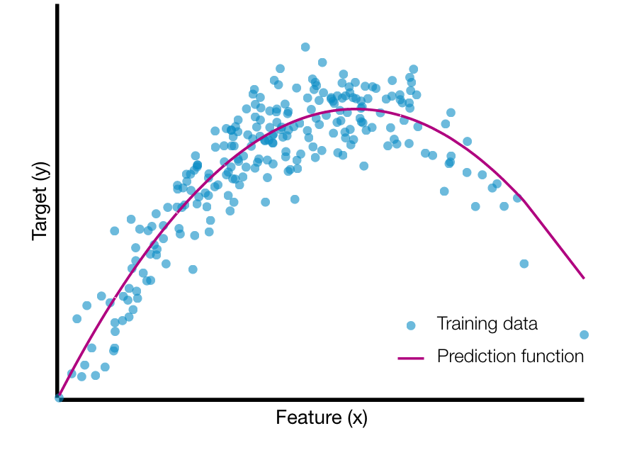
如一，网络异常检测
A graph embedding approach
Two-in-One
图采用矩阵表示
数据近似技术(k+a reduction)：
矩阵表示存储代价较高
将n*d 维矩阵转换,为n*k维矩阵,
n为图顶点的数量，d为社群的数量
k取顶点的平均度数， k<<d
一个d维向量的第i维的值(feature)实际上表示顶点属于该社群的权重
(Gordon) Hughes Effect
实验分析：数据近似技术提高了(1%, F1)准确性和(25%)效率!
Renjun Hu, Charu C. Aggarwal, Shuai Ma, Jinpeng Huai: An Embedding Approach to Anomaly Detection. ICDE 2016.
Notes:
With a fixed number of training samples, the predictive power reduces as the dimensionality increases, and this is known as the Hughes effect^{[3]} or Hughes phenomenon(named after Gordon F. Hughes)
Gordon Hughes earned his PhD degree at Cal Tech, and began his technology career at Xerox Research, later serving as the Senior Director of Recording Technology at Seagate, in its early years. He is now a research scientist at the Center for Memory and Recording Research at the University of California San Diego.
In 2001, he was named Fellow of the IEEE for "contributions to magnetic recording physics and for pioneering work in thin film disk media".
“Comments on the mean accuracy of statistical pattern recognizers'ce”, K. Abend, T.J. Harley Jr., B. Chandrasekaran, T.J. Harley, and G.F. Hughes, IEEE Transactions on Information Theory, Vol.IT-15, No. 3, (May 1969), pp. 420-423

