Slide 1


YOCSEF知识图谱与图数据库新进展学术报告会，天津（2017年）
Towards Big Graph Search:
Challenges & Techniques
马 帅
北京大数据与脑机智能高精尖中心 软件开发环境国家重点实验室

Slide 2




国家重点基础研究发展计划
网络信息空间大数据计算的基础研究(2014-2018)
Chief Scientist: Prof. Jinpeng Huai.
8 institutes involved
Focus on “computing theory and practice on Big Data”
http://cnbigdata.org/

Slide 3


北京市大数据科学与脑机智能创新中心
2015年，北京市首批北京高校高精尖创新中心
引领未来数据科学与计算智能的研究与应用方向
加速计算科学、数据科学与脑科学的交叉研究
促进高效智能的下一代计算与数据分析技术创新
通过以数据为中心的智能机器、系统及应用改变未来
Notes:
认定了13个

Slide 4


研究方向与机构设置
瓶颈1：计算的有效性遇到障碍
计算的有效性：
认识数据的内在特征，复杂网络、数学（统计）方法
瓶颈2：能耗成为突出问题
随着规模增大，调度复杂，计算系统功耗问题日益突出
传统存算分离的结构，产生大量的数据搬移开销
传统的计算和存储器件“功耗”不友好
瓶颈3：学习效率和灵活性
学习效率：需要大量的输入数据及标定数据，学习效率低
灵活性：普遍缺乏“类比、联想”等学习功能
数据科学与计算智能
数据工程与
脑机系统
新型计算技术与系统
认知机理与仿真
http://www.bdbc.org.cn/

Slide 5



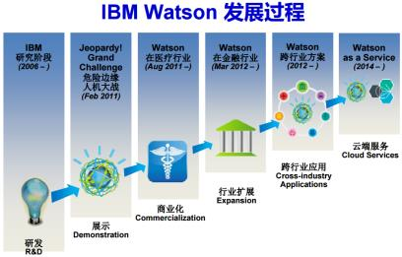
大数据的研究与应用：取得重大突破
过去5年大数据的研究，已经产生了重大突破，并在部分领域取得良好的应用
计算基础：大规模云计算、大规模深度学习
感知处理的角度：大规模深度学习，imageNet
知识组织与管理角度：大规模知识图谱
基于数据产生知识的问答系统与个人辅助系统
Watson DeepQA：智能搜索→知识引擎
Apple Siri & Wolfram Alpha
Watson和Wolfram|Alpha的成功说明：AI可以用一个纯粹的计算系统(交互+计算)实现

Slide 6










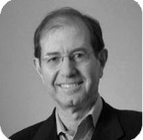



问题：是否有坚实的理论基础
（大）数据科学是否能真的成为一种“科学”？
其中一个可能性：计算问题、复杂性与算法
计算问题是计算机科学的本质问题，而算法是一切计算问题的核心
算法
G=F(x)
数据
John E Hopcroft
Robert Tarjan
(1986）
Stephen Cook
（1982）
Donald Knuth
（1974）
70年代前 | 算法研究
70年代 | 确定性多项式时间算法 发现NP困难性
80年代 | 随机化算法 随机性能加速算法
90年代 | 近似算法 后期发现近似困难性
Leslie Valiant
（2010）
Manuel Blum
（1995）
Juris Hartmanis ,
Richard Edwin Stearns
（1993）
21世纪－大数据时代：计算复杂度与算法理论是否有新的理论问题和新方法？
Shafi Goldwasser
Silvio Micali
（2012）

Slide 7
回答“可计算”问题
G=F(x)
任务：大数据高效算法理论
如何设计更有效的算法？
计算问题
如何以“以局部观全局”？
不可判定问题
可判定问题
NP and beyond
多项式易解类
多项式易解类
难解问题
易解问题
(多项式易解类)
非大数据
易解类
大数据易解类
不可近
似问题
可近似
问题
非大数据 易解类
大数据 易解类
针对大数据非易解类问题，提出高效算法理论与算法！
近似算法
（多项式算法）

Slide 8
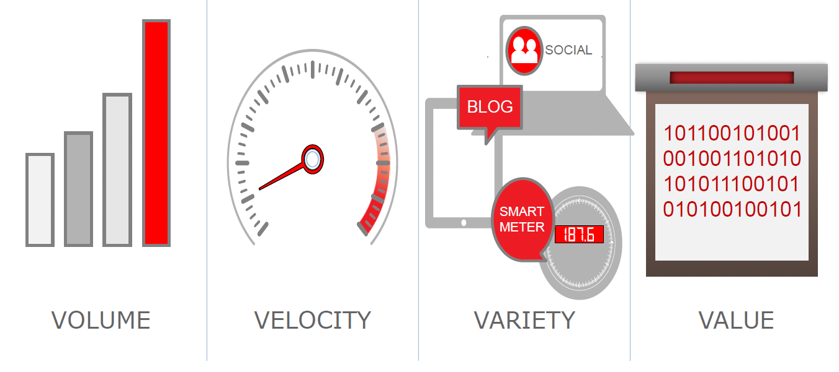

Big Graph, e.g., Social Networks
Big volume: a balance between search efficiency and accuracy
Frequent changes: incorporate dynamic and temporal features
Noise & uncertainty: improve data quality, alleviate side effects
Notes:
《福布斯》日前评选出十位最年轻的亿万富翁，26岁的马克-扎克伯格以69亿美元的身价排在首位，他也因此成为世界上最年轻的亿万富翁。

Slide 9
Query Techniques for Big Graph Search
R = Q(D)

Slide 10
Query Approximation Techniques
Main idea: For a class Q of queries with a high computational complexity, find another class Q’ of queries that has a lower computational complexity without loss of quality or with a bounded loss of quality.
approximation
Q(D)
Q’(D)
Challenge: balancing accuracy and computational complexity!

Slide 11
(1) E.g., Strong Simulation
approximation
Subgraph Isomorphism
(NP-Complete)
Strong Simulation
(O(n³))
Subgraph Isomorphism: Pattern graph Q, subgraph G_{s} of data graph G
Q matches G_{s} if there exists a bijective function f: V_{Q}→ V_{Gs} such that
for each node u in Q, u and f(u) have the same label
An edge (u, u‘) in Q if and only if (f(u), f(u')) is an edge in G_{s}
Q matches G, via subgraph isomorphsim, if there is such a subraph Gs
Goodness：Keep exact structure topology between Q and G_{s}
Badness：NP-complete; may return exponential many matched subgraphs; In certain scenarios, too restrictive to find matches
Shuai Ma, Yang Cao, Wenfei Fan, Jinpeng Huai, and Tianyu Wo. Strong Simulation: Capturing Topology in Graph Pattern Matching. TODS 2014.
Shuai Ma, Yang Cao, Wenfei Fan, Jinpeng Huai, and Tianyu Wo, Capturing Topology in Graph Pattern Matching. VLDB 2012.

Slide 12
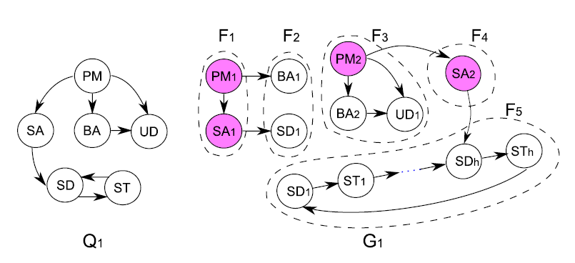

(1) E.g., Strong Simulation
Set up a team to develop a new software product
Strong simulation returns F3, F4 and F5;
Subgraph isomorphism returns empty!
Subgraph isomorphism is too strict for emerging applications!

Slide 13

(1) E.g., Strong Simulation
Terrorist Collaboration Network
“Those who were trained to fly didn’t know the others. One group of people did not know the other group.” (Osama Bin Laden, 2001)
Build upon (revised) strong simulation to aid the detection of homegrown violent extremists (HVEs) who seek to commit acts of terrorism in the United States and abroad, Colorado State University, Benjamin W. K. Hung, Anura P. Jayasumana: Investigative simulation: Towards utilizing graph pattern matching for investigative search. ASONAM 2016.

Slide 14
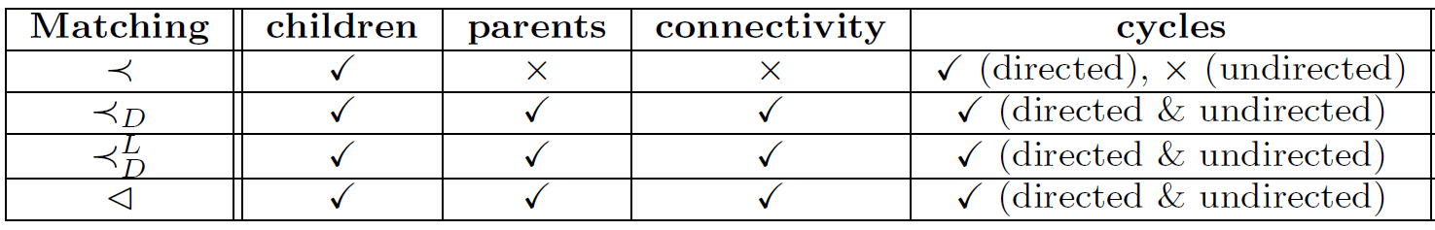
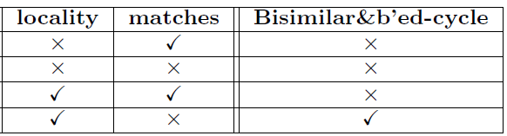
(1) E.g., Strong Simulation
Subgraph
Isomorphism
(NP-Complete)
Strong
Simulation
Dual
Simulation
Graph
Simulation
(O(n³))
Preserve 70-80% subgraph isomorphism & 100 times faster!

Slide 15
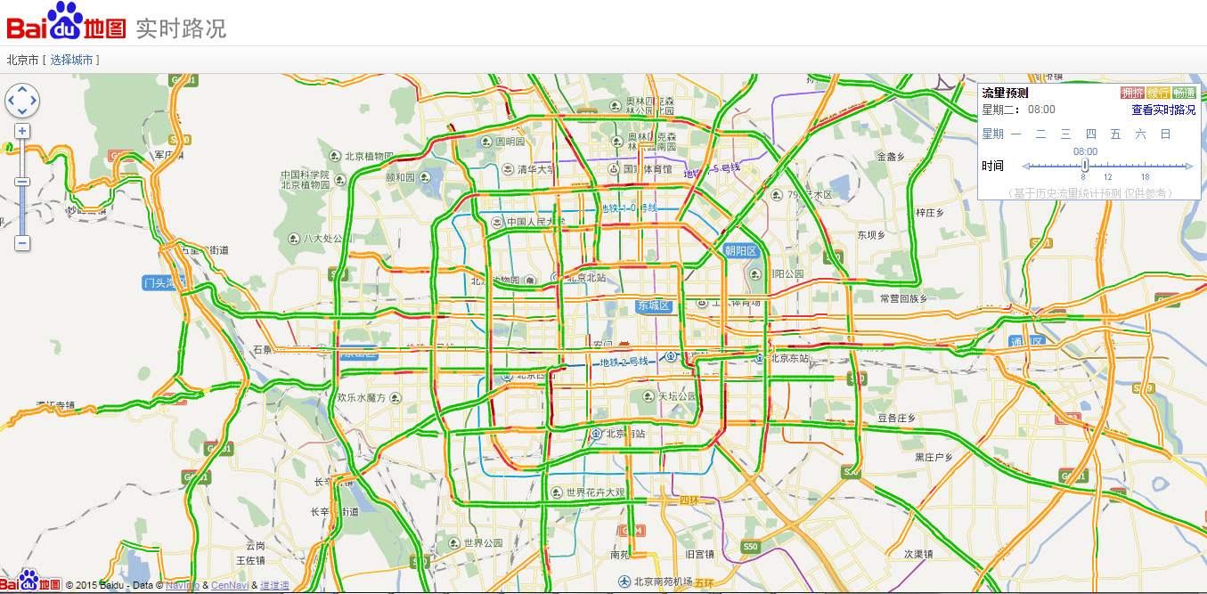
(2) E.g., Temporal Dense Subgraphs

Slide 16
(2) E.g., Temporal Dense Subgraphs
Filter-and-Verification methods:
Data Driven Query Approximation methods:
Choose k (a small constant, e.g., 10 or 15)
Experimental results (with the state of the art solution ^{[Bogdanov et al. 2011]})
10⁴ | 10⁵ | 10⁶ | ··· | 10⁸
5×10² | 5×10³ | 5×10⁴ |  | 5×10⁶
95% are filtered
10⁴ | 10⁵ | 10⁶ | ··· | 10⁸
k | k | k |  | k
 | Accuracy | Efficiency
BEIJING DATA | 100.28% | 2980 times faster
SYNTHETIC DATA | 99.84% | 1,079 times faster
P. Bogdanov, M. Mongiov, and A. K. Singh. Mining heavy subgraphs in time-evolving networks. In ICDM, 2011.
Haixing Huang, Jinghe Song, Xuelian Lin, Shuai Ma, Jinpeng Huai, TGraph: A Temporal Graph Data Management System (demo), CIKM 2016.
Shuai Ma, Renjun Hu, Luoshu Wang, Xuelian Lin, Jinpeng Huai, Fast Computation of Temporal Dense Subgraphs, ICDE 2017

Slide 17


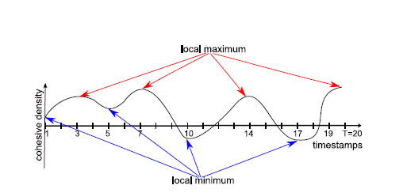
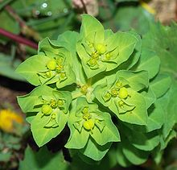

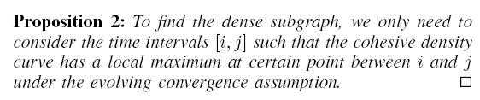

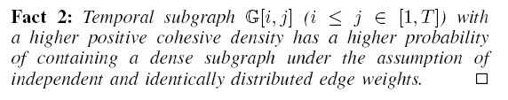
(2) E.g., Temporal Dense Subgraphs
In evolutionary biology, convergent evolution is the process whereby organisms not closely related (not monophyletic), independently evolve similar traits as a result of having to adapt to similar environments or ecological niches.
Evolving convergence assumption
Shuai Ma, Renjun Hu, Luoshu Wang, Xuelian Lin, Jinpeng Huai, Fast Computation of Temporal Dense Subgraphs, ICDE 2017
Notes:
Example: Two succulent plant genera, Euphorbiaand Astrophytum, are only distantly related, but the species within each have independently converged on a similar body form
大戟属，又称翡翠塔属，是大戟科植物的一个属，包括了2160多种不同种类的植物，当中有些比较常见的，例如：一品红、灯台草等。大戟属植物是现时地球上其中一种生长范围极广的植物种属，主要在非洲及美洲的热带及亚热带地区生长，但在温带亦有发现。生长年期有一年生或多年生，有草本、木本灌木及乔木，而且都有树液。
仙人掌

Slide 18
Data Techniques for Big Graph Search
R = Q(D)

Slide 19
Data Approximation Techniques
Main idea: For a class Q of queries on data D, transform D to smaller data D’ that can be processed efficiently without loss of quality or with a bounded loss of quality.
approximation
Q(D)
Q (D’)
Pareto principle: for many events, roughly 80% of the effects come from 20% of the causes
D = HARD(D) + SOFT(D)
×
Challenge: balancing accuracy and computational complexity!

Slide 20
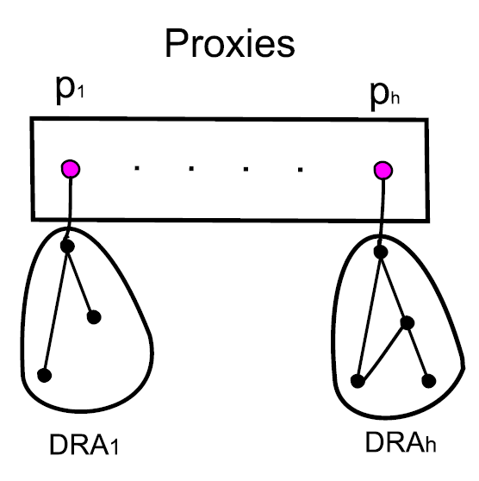
(1) E.g., Shortest Paths/Distances
For weighted undirected graphs, we propose a notion of “proxies”
Each proxy represents the nodes in its DRA (non-overlapping for all proxies)
Proxies can be computed in O(n) time
Key property: Given nodes u,v in G, proxies u_{p},v_{p}, then:
(1) path(u, v) = path(u, u_{p}) + path(u_{p}, v_{p}) + path(v_{p}, v)
(2) dist(u, v) = dist(u, u_{p}) + dist(u_{p}, v_{p}) + dist(v_{p}, v)
On Real-life road and social networks, graphs are reduced by 1/3!
A light-weight general data reduction technique for shortest paths/distances!
Shuai Ma, Kaiyu Feng, Jianxin Li, Haixun Wang, Gao Cong, and Jinpeng Huai, Proxies for Shortest Path and Distance Queries. TKDE 2016.
Shuai Ma, Kaiyu Feng, Jianxin Li, Haixun Wang, Gao Cong, and Jinpeng Huai, Proxies for Shortest Path and Distance Queries. ICDE 2017 (TKDE Extended Abstract).

Slide 21
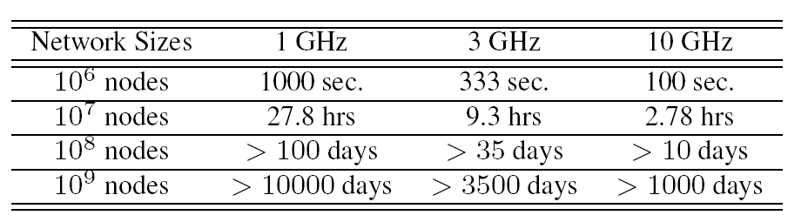
(2) E.g., Network Link Prediction
Link Prediction
A network with n nodes，O(n²) possible links
CPU speeds: xGHz/s, and assume that a single machine cycle could deal with a node pair.
Most link prediction algorithms only predict a subset of the possible links, not all possible links, such as [Dashun et al. 2011, Chungmok et al. 2014].
Dashun Wang, Dino Pedreschi, Chaoming Song, Fosca Giannotti, Albert-László Barabási: Human mobility, social ties, and link prediction. KDD 2011.
Chungmok Lee, Minh Pham, Norman Kim, Myong K. Jeong, Dennis K. J. Lin, Wanpracha Art Chaovalitwongse. A novel link prediction approach for scale-free networks. WWW 2014.

Slide 22
(2) E.g., Network Link Prediction
sample₁
Ensemble
Direct Non-negative Matrix Factorization
Low efficiency
The sparser the data, the worse the prediction
Data approximation technique (Ensemble Enabled Sampling)
Sampling must assure a coverage on O(n²) possible links
Link prediction characteristics (triangles)
Ensemble: the predicted value of a link is the maximum among all ensembles
Data
．．．
max
sample_{n}
Ensemble
Framework
Small data | Accuracy | Big data | Efficiency
YouTube | +18% | Friendster | 31 times faster
Wikipedia | +16% | Twitter | 21 times faster
Improves both accuracy and efficiency!
Liang Duan, Charu Aggarwal, Shuai Ma, Renjun Hu, and Jinpeng Huai, Scaling up Link Prediction with Ensembles, WSDM 2016 - Big Data Algorithms Session.
Liang Duan, Shuai Ma, Charu Aggarwal, Tiejun Ma, and Jinpeng Huai. An Ensemble Approach to Link Prediction. TKDE, 2017, to appear.

Slide 23
Other Query and Data Techniques
Q(D₁)
Distributed algorithms:
Q(D)
Q(D_{i})
Q(D_{n})
Incremental Computation:
Incremental computation
Q(D + Δ)
Q(D) + Q(Δ)
Known results
compression
Data Compression:
Q(D)
Q(D’)
partitioning
Data Partition:
Q(D)
Q(D₁) + … + Q(D_{n})

Slide 24






Acknowledgements
Collaborators:
Charu Aggarwal, Sourav S Bhowmick, Yang Cao, Gao Cong, Liang Duan, Wenfei Fan, Kaiyu Feng, Haixing Huang, Renjun Hu, Jinpeng Huai, Jia Li, Jianxin Li, Xuelian Lin, Xudong Liu, Jinghe Song, Haixun Wang, Luoshu Wang, Tianyu Wo…
They are from:

Slide 25
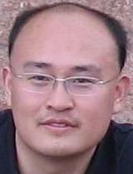
Homepage: http://mashuai.buaa.edu.cn
Email: mashuai@buaa.edu.cn
Address:
Room G1122,
New Main Building,
Beihang University
Beijing, China
Thanks!

