Slide 1
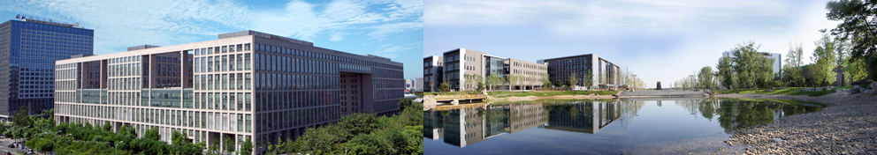

Towards Big Graph Search
马 帅
北京大数据与脑机智能高精尖中心 软件开发环境国家重点实验室

Slide 2




国家重点基础研究发展计划
网络信息空间大数据计算的基础研究(2014-2018)
Chief Scientist: Prof. Jinpeng Huai.
8 institutes involved
Focus on “computing theory and practice on Big Data”
http://cnbigdata.org/

Slide 3


北京市大数据科学与脑机智能创新中心
2015年，北京市首批北京高校高精尖创新中心
引领未来数据科学与计算智能的研究与应用方向
加速计算科学、数据科学与脑科学的交叉研究
促进高效智能的下一代计算与数据分析技术创新
通过以数据为中心的智能机器、系统及应用改变未来
Notes:
认定了13个

Slide 4


研究方向与机构设置
瓶颈1：计算的有效性遇到障碍
计算的有效性：
认识数据的内在特征，复杂网络、数学（统计）方法
瓶颈2：能耗成为突出问题
随着规模增大，调度复杂，计算系统功耗问题日益突出
传统存算分离的结构，产生大量的数据搬移开销
传统的计算和存储器件“功耗”不友好
瓶颈3：学习效率和灵活性
学习效率：需要大量的输入数据及标定数据，学习效率低
灵活性：普遍缺乏“类比、联想”等学习功能
数据科学与计算智能
数据工程与
脑机系统
新型计算技术与系统
认知机理与仿真
http://www.bdbc.org.cn/

Slide 5
大图的查询近似技术
R = Q(D)

Slide 6

查询近似技术
主要思想：对一类查询复杂性高的查询语言Q ，变换为一类查询复杂性低的查询语言Q’ ，并且尽量不影响查询结果的准确性。
approximation
Q(D)
Q’(D)
挑战: 平衡查询的复杂性和查询的准确性!

Slide 7
如一，强模拟图查询
approximation
子图同构
(NP-Complete)
强模拟
(O(n³))
子图同构^{[11]}:
给定模式图Q, 数据图G的子图G_{s：}
Q 图同构 G_{s} 如果存在一一映射函数f: V_{Q}→ V_{Gs} 满足：
对Q中的任何顶点u，u 和f(u) 有相同的标签
边(u, u‘)在Q当且仅当 (f(u), f(u’)) 在G_{s}
Q 子图同构G，如果G中存在如上子图Gs
优点：Q 和 G_{s}一模一样
缺点：NP完全问题；最坏情况下指数个匹配子图；约束过于严格
Shuai Ma, Yang Cao, Wenfei Fan, Jinpeng Huai, and Tianyu Wo. Strong Simulation: Capturing Topology in Graph Pattern Matching. TODS 2014.
Shuai Ma, Yang Cao, Wenfei Fan, Jinpeng Huai, and Tianyu Wo, Capturing Topology in Graph Pattern Matching. VLDB 2012.

Slide 8
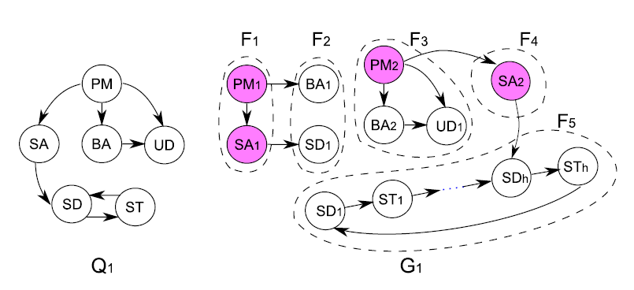

子图同构图查询
组成一个软件开发团队
强模拟：返回F3 + F4 + F5;
子图同构：返回空集！
子图同构约束过于严格，并不适合一些新型应用！

Slide 9
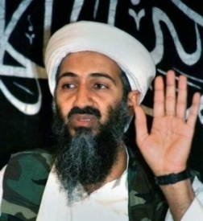
Terrorist Collaboration Network
“Those who were trained to fly didn’t know the others. One group of people did not know the other group.” (Osama Bin Laden, 2001)
Build upon (revised) strong simulation to aid the detection of homegrown violent extremists (HVEs) who seek to commit acts of terrorism in the United States and abroad, Colorado State University, Benjamin W. K. Hung, Anura P. Jayasumana: Investigative simulation: Towards utilizing graph pattern matching for investigative search. ASONAM 2016.

Slide 10
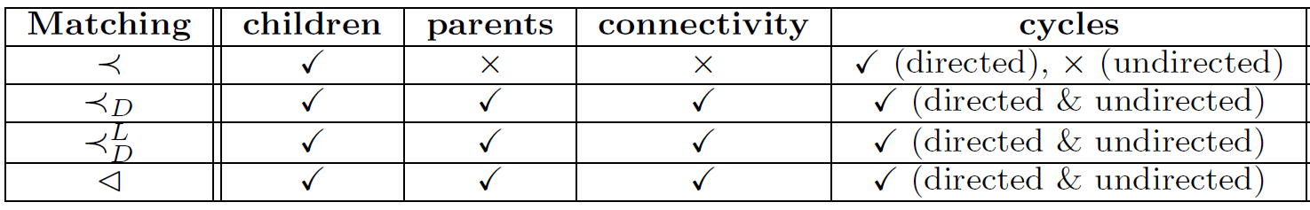
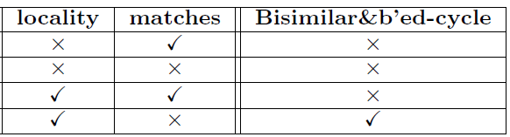
强模拟图查询
子图同构
(NP-Complete)
强模拟
(O(n³))
双模拟
(O(n²))
图模拟
(O(n²))
查询结果保持70-80%子图同构结构，效率提高100倍！

Slide 11
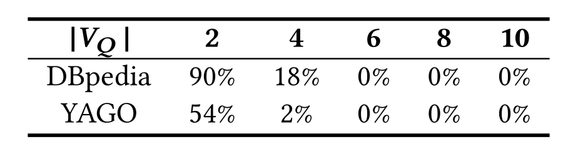
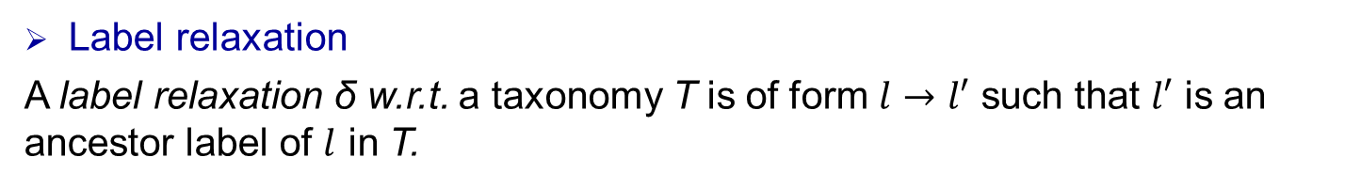
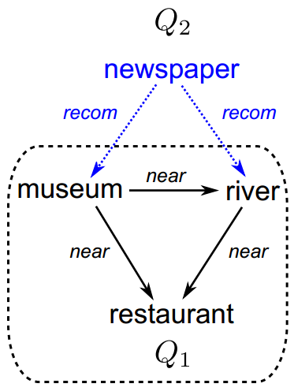
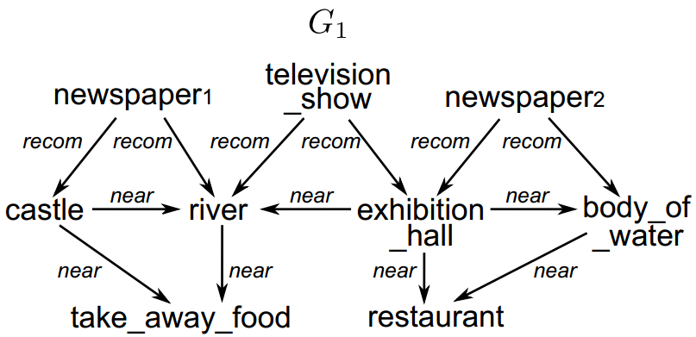
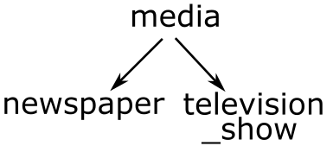
Taxonomy图模拟
标签松弛
模式松弛
A pattern relaxation ∆ for Q w.r.t. T is a set of label relaxations for Q.
Q ⊕ ∆ is the relaxed pattern derived from Q by applying ∆.
Media
Taxonomy T
(Partial)
Relaxation
Jia Li, Yang Cao, and Shuai Ma. Relaxing Graph Pattern Matching With Explanations. CIKM 2017.

Slide 12
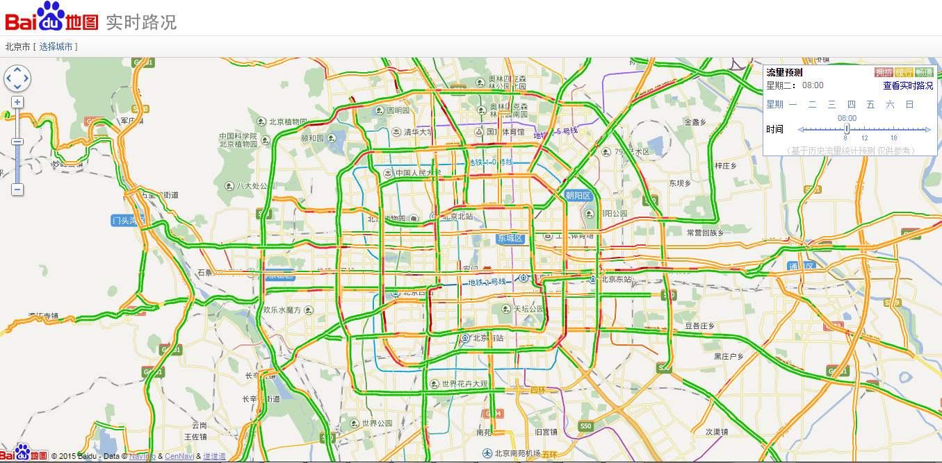
如二，时态稠密图查询

Slide 13
如二，时态稠密图查询
筛选与验证的方法 (Filter-and-Verification)
数据驱动的查询近似方法(Data Driven Query Approximation)
根据数据的特点选取k个(k是个小的常数，比如10或15)
实验结果 (With the state of the art solution^{[Bogdanov et al. 2011]})
10⁴ | 10⁵ | 10⁶ | ··· | 10⁸
5×10² | 5×10³ | 5×10⁴ |  | 5×10⁶
过滤掉95%
10⁴ | 10⁵ | 10⁶ | ··· | 10⁸
k | k | k |  | k
 | 准确性 | 效率
BEIJING DATA | 100.25% | 快4,870倍
SYNTHETIC DATA | 99.69% | 快1,468倍
P. Bogdanov, M. Mongiov, and A. K. Singh. Mining heavy subgraphs in time-evolving networks. In ICDM, 2011.
Haixing Huang, Jinghe Song, Xuelian Lin, Shuai Ma, Jinpeng Huai, TGraph: A Temporal Graph Data Management System (demo), CIKM 2016.
Shuai Ma, Renjun Hu, Luoshu Wang, Xuelian Lin, Jinpeng Huai, Fast Computation of Temporal Dense Subgraphs, ICDE 2017

Slide 14
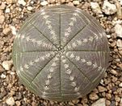
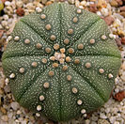
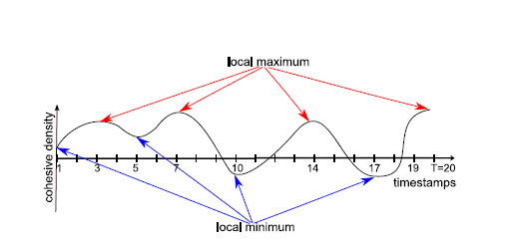
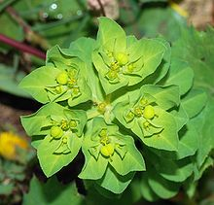

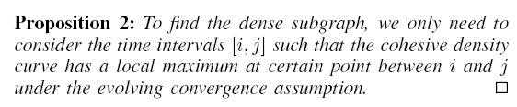

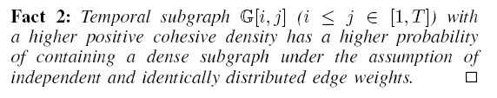
如二，时态稠密图查询
在演化生物学中，趋同演化（Convergent evolution）指的是两种不具亲缘关系的动物/植物长期生活在相同或相似的环境，或曰生态系统，它们因应需要而发展出相同功能的器官的现象，即同功器官
Evolving convergence assumption
Shuai Ma, Renjun Hu, Luoshu Wang, Xuelian Lin, Jinpeng Huai, Finding Dense Subgraphs in Temporal Networks, ICDE 2017
Notes:
大戟属，又称翡翠塔属，是大戟科植物的一个属，包括了2160多种不同种类的植物，当中有些比较常见的，例如：一品红、灯台草等。大戟属植物是现时地球上其中一种生长范围极广的植物种属，主要在非洲及美洲的热带及亚热带地区生长，但在温带亦有发现。生长年期有一年生或多年生，有草本、木本灌木及乔木，而且都有树液。
仙人掌

Slide 15
大图的数据近似技术
R = Q(D)

Slide 16
数据近似技术
主要思想：对一类查询复杂性高的查询语言Q ，将查询数据D变换机器能够高效处理的较小量D’ ，并且尽量不影响查询结果的准确性。
approximation
Q(D)
Q (D’)
二八定律：在众多现象中，80%的结果取决于20%的原因
D = HARD(D) + SOFT(D)
×
挑战: 平衡查询的效率和查询的准确性!

Slide 17
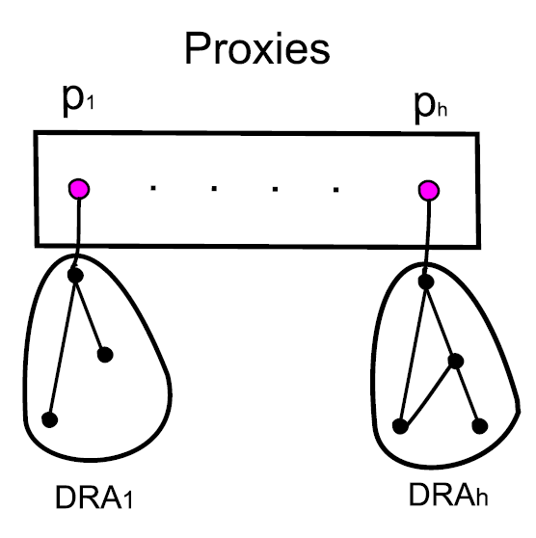
如一、最短路径/距离
针对有权无向图，提出 “proxies”概念
每个proxy代表了一个子图DRA中的顶点(互补重叠)
Proxies 能够在O(n)时间内算出
关键性质: 给定图G、顶点u和v及其代理u_{p}和v_{p}，则：
(1) path(u, v) = path(u, u_{p}) + path(u_{p}, v_{p}) + path(v_{p}, v)
(2) dist(u, v) = dist(u, u_{p}) + dist(u_{p}, v_{p}) + dist(v_{p}, v)
在真实的公路网络和社会网络中，数据减少了1/3!
是一种针对最短路径/距离的轻量级的通用的数据缩减技术!
Shuai Ma, Kaiyu Feng, Jianxin Li, Haixun Wang, Gao Cong, and Jinpeng Huai, Proxies for Shortest Path and Distance Queries. TKDE 2016.
Shuai Ma, Kaiyu Feng, Jianxin Li, Haixun Wang, Gao Cong, and Jinpeng Huai, Proxies for Shortest Path and Distance Queries. ICDE 2017 (TKDE Extended Abstract).

Slide 18
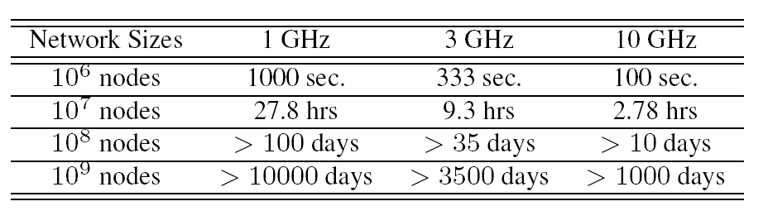
如二，网络链接预测
链接预测：
n个顶点网络，O(n²)个可能链接
CPU速度XGHz/s，假定1个机器时钟处理1个顶点对。
多数链接预测算法仅仅预测一个可能链接子集，而不是整个网络所有可能的链接，如[Dashun et al. 2011,Chungmok et al. 2014].
Dashun Wang, Dino Pedreschi, Chaoming Song, Fosca Giannotti, Albert-László Barabási: Human mobility, social ties, and link prediction. KDD 2011.
Chungmok Lee, Minh Pham, Norman Kim, Myong K. Jeong, Dennis K. J. Lin, Wanpracha Art Chaovalitwongse. A novel link prediction approach for scale-free networks. WWW 2014.

Slide 19
如二，网络链接预测
sample₁
Ensemble
直接采用非负矩阵分解的代价高
效率低
数据越稀疏，效果越差
数据近似技术(Ensemble Enabled Sampling)
采样要保证一定的覆盖率
基于链接预测特征的抽样 - Triangles
结合Ensemble的思想：链接e的预测分值是所有Ensemble中的最大值
Data
．．．
max
sample_{n}
Ensemble
小数据 | 准确性 | 大数据 | 效率
YouTube | 高18% | Friendster | 快31倍
Wikipedia | 高16% | Twitter | 快21倍
同时提高了准确性和检测效率!
Liang Duan, Charu Aggarwal, Shuai Ma, Renjun Hu, and Jinpeng Huai, Scaling up Link Prediction with Ensembles, WSDM 2016 - Big Data Algorithms Session.
Liang Duan, Shuai Ma*, Charu Aggarwal, Tiejun Ma, and Jinpeng Huai, An Ensemble Approach to Link Prediction. TKDE, 29(11): 2402-2416, 2017.

Slide 20
Approximation
Approximation Algorithms
Approximate
Query Processing
Approximation Computing

Slide 21
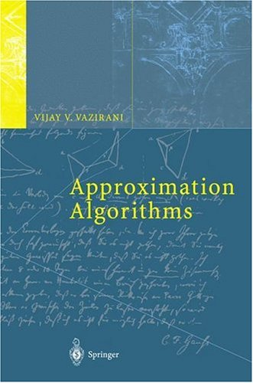
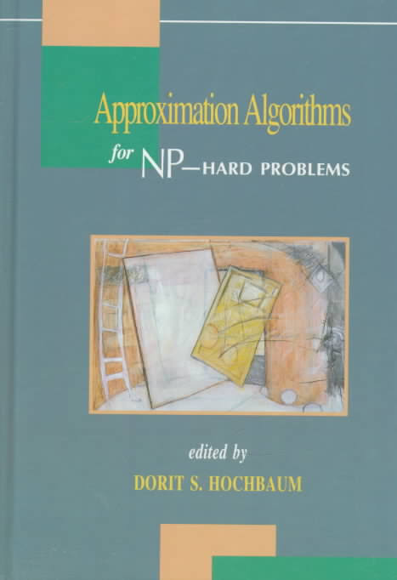
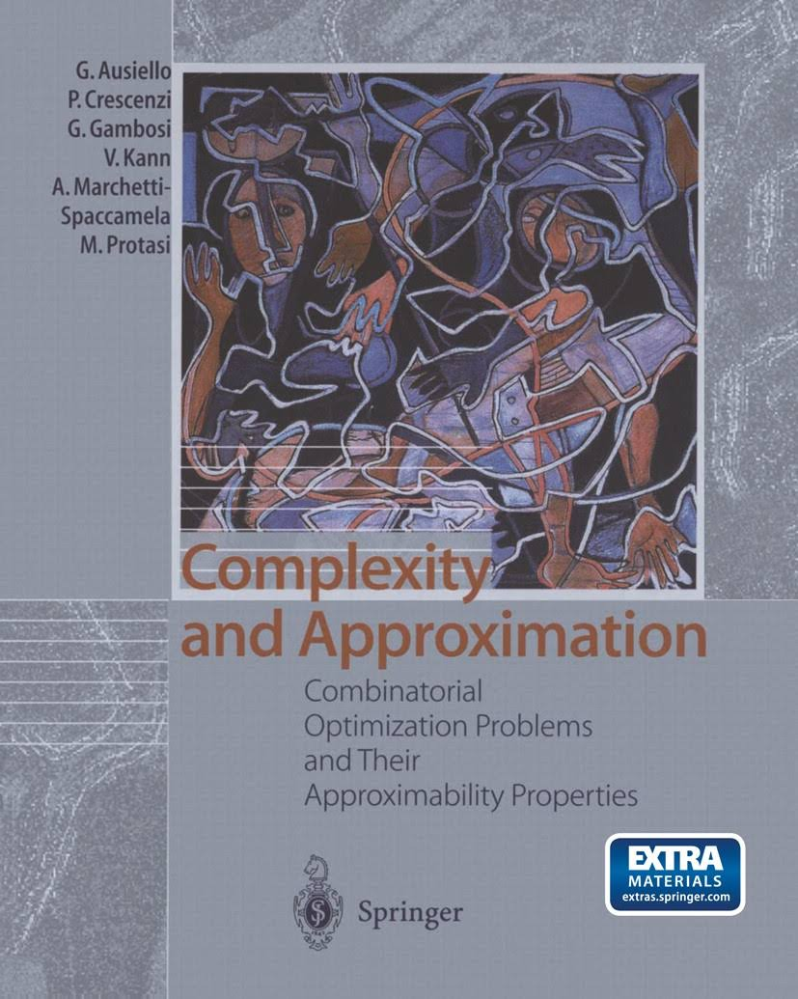
Approximation Algorithms

Slide 22
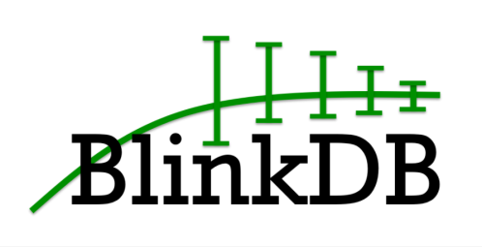



Approximate Query Processing
AQP supports a slightly constrained set of SQL-style declarative queries
Specifically provides approximate results for standard SQL aggregate queries, e.g., queries involving COUNT, AVG, SUM and PERCENTILE.
Sampling is a key technique

Slide 23
Approximate Computing
Approximate computing is a computation technique which returns a possibly inaccurate result rather than a guaranteed accurate result, and can be used for applications where an approximate result is sufficient for its purpose.
Approximate circuits
Approximate storage
Software-level approximation
Approximate computer system
In an approximate system, different subsystems of the system such as the processor, memory, sensor, and communication modules are synergistically approximated to obtain a much better system-level Q-E trade-off curve compared to individual approximations to each of the subsystems.

Slide 24
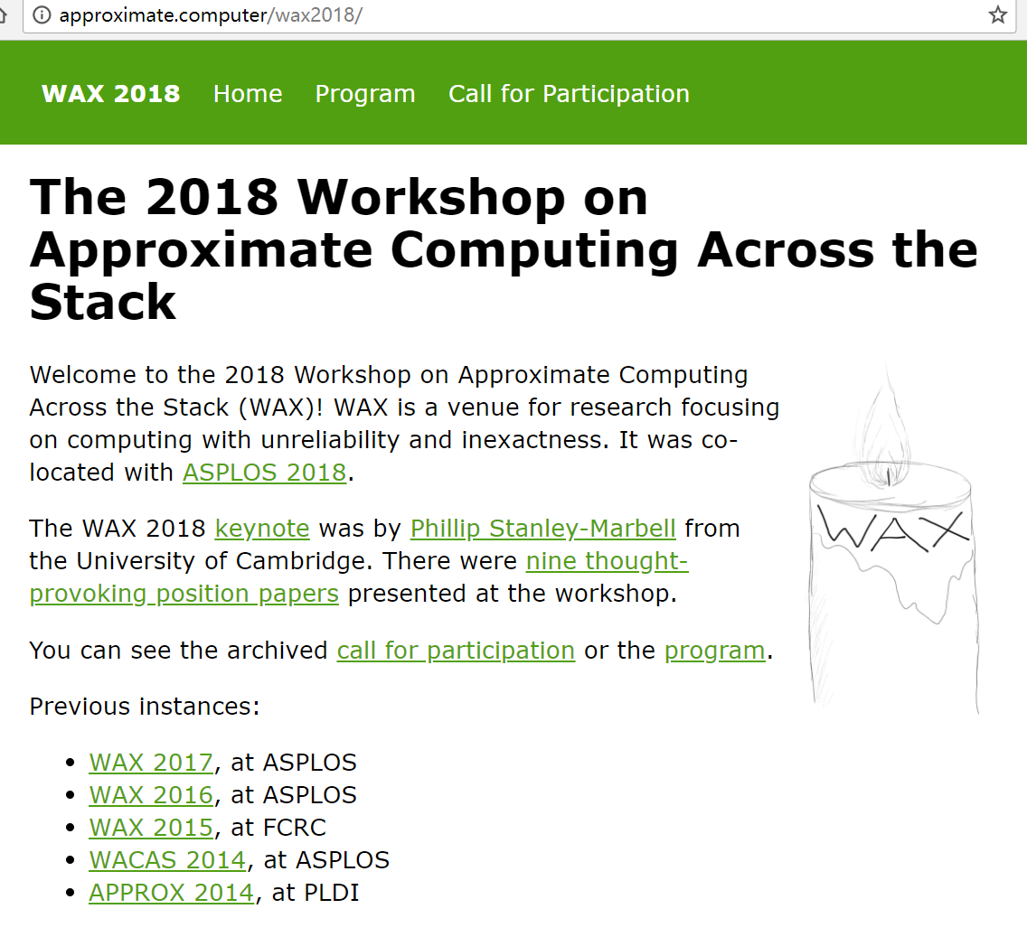
Hardware support for approximate computing
Programming languages and compiler support for approximate computing
Tools for writing, debugging, and testing approximate programs
Modeling and understanding approximate computing opportunities and systems
Applications amenable to approximation and domain-specific strategies
Formal reasoning about programs with approximations
Retrospectives on past approximate-computing work, including both reflections on your own past projects and reproduction of others’ results
Position papers on approximate computing, potential, how it could fail, what we need to succeed, etc.

Slide 25







Acknowledgements
Collaborators:
Charu Aggarwal, Sourav S Bhowmick, Yang Cao, Gao Cong, Liang Duan, Wenfei Fan, Kaiyu Feng, Haixing Huang, Renjun Hu, Jinpeng Huai, Jia Li, Jianxin Li, Xuelian Lin, Xudong Liu, Jinghe Song, Haixun Wang, Luoshu Wang, Tianyu Wo…
They are from:

Slide 26
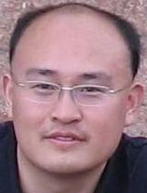
Homepage: http://mashuai.buaa.edu.cn
Email: mashuai@buaa.edu.cn
Address:
Room G1122,
New Main Building,
Beihang University
Beijing, China
Thanks!

