Slide 1



Collaborative Research Alliance on Big Data 2018
Approximate Computation for
Big Data Analytics
Shuai Ma

Slide 2

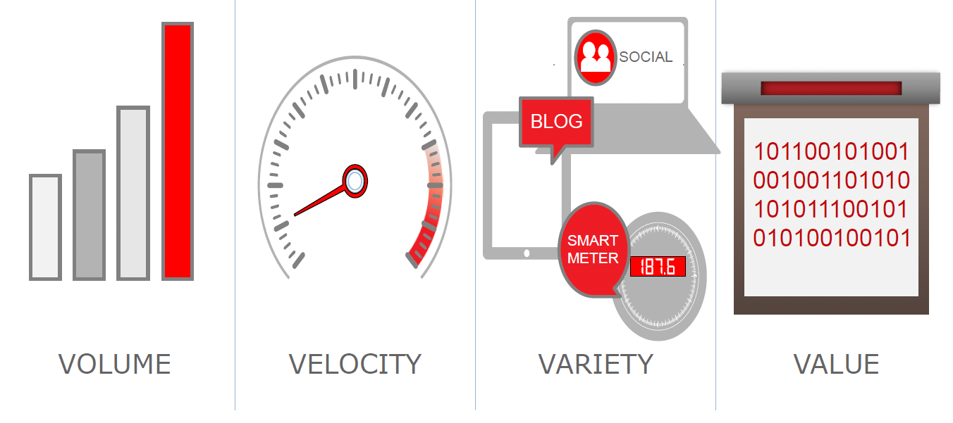
Big Data Analytics is Challenging

Slide 3
Approximation
Approximation Algorithms
Approximate
Query Processing
Approximation Computing

Slide 4
(1) Approximation Algorithms
Approximation Algorithms are efficient (polynomial time) algorithms that find approximate solutions to NP-hard optimization problems with provable guarantees on the distance of the solution returned to the optimal one.
Naturally arise in the field of theoretical computer science as a consequence of the widely believed P ≠ NP conjecture.

Slide 5
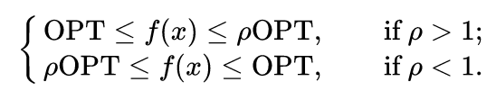

(1) Approximation Algorithms
Relative performance guarantee
Absolute performance guarantee

Slide 6
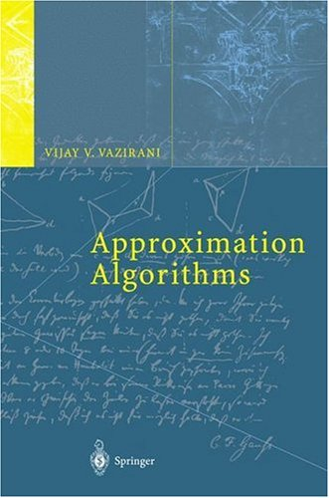


(1) Approximation Algorithms

Slide 7




(2) Approximate Query Processing
AQP supports a slightly constrained set of SQL-style declarative queries
Specifically provides approximate results for standard SQL aggregate queries, e.g., queries involving COUNT, AVG, SUM and PERCENTILE.
Sampling is a key technique

Slide 8
(2) Approximate Query Processing
Approximate Functions in Oracle Database 12c Release 2 that provide approximate results.
APPROX_COUNT_DISTINCT
APPROX_COUNT_DISTINCT_AGG
APPROX_COUNT_DISTINCT_DETAIL
APPROX_MEDIAN
APPROX_PERCENTILE
APPROX_PERCENTILE_AGG
APPROX_PERCENTILE_DETAIL
TO_APPROX_COUNT_DISTINCT
TO_APPROX_PERCENTILE
https://oracle-base.com/articles/12c/approximate-query-processing-12cr2
Notes:
APPROX_COUNT_DISTINCT_AGG takes as its input a column of details containing information about approximate distinct value counts, and enables you to perform aggregations of those counts.
APPROX_COUNT_DISTINCT_DETAIL calculates information about the approximate number of rows that contain a distinct value for expr and returns a BLOB value, called a detail, which contains that information in a special format.

Slide 9
(2) Approximate Query Processing
The following statement returns the approximate number of distinct customers for each product.
SELECT prod_id, APPROX_COUNT_DISTINCT(cust_id) AS "Number of Customers"
FROM sales
GROUP BY prod_id
ORDER BY prod_id;
PROD_ID Number of Customers
---------- -------------------
13 2516
14 2030
15 2105
16 2367
… …
https://oracle-base.com/articles/12c/approximate-query-processing-12cr2

Slide 10
(3) Approximate Computing
Approximate computing is a computation technique which returns a possibly inaccurate result rather than a guaranteed accurate result, and can be used for applications where an approximate result is sufficient for its purpose.
Approximate circuits
Approximate storage
Software-level approximation
Approximate computer system
In an approximate system, different subsystems of the system such as the processor, memory, sensor, and communication modules are synergistically approximated to obtain a much better system-level Q-E trade-off curve compared to individual approximations to each of the subsystems.

Slide 11
(3) Approximate Computing
Approximate computing is based on the observation that in many scenarios, although performing exact computation requires large amount of resources, allowing approximation can provide disproportionate gains in performance and energy, while still achieving acceptable result accuracy.
for a search engine where no exact answer may exist for a certain search query and hence, many answers may be acceptable.
occasional dropping of some frames in a video application can go undetected due to perceptual limitations of humans.

Slide 12
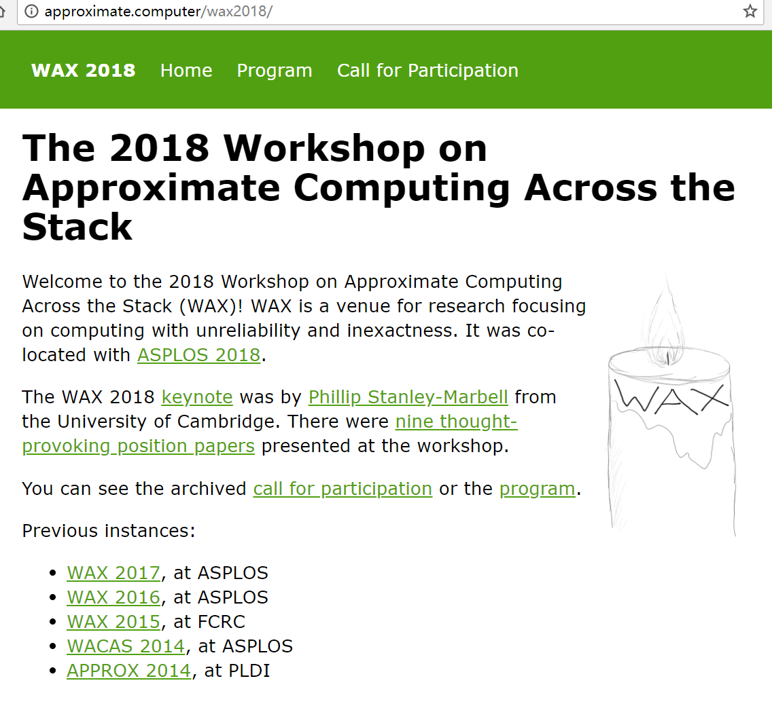
(3) Approximate Computing
Hardware support for approximate computing
Programming languages and compiler support for approximate computing
Tools for writing, debugging, and testing approximate programs
Modeling and understanding approximate computing opportunities and systems
Applications amenable to approximation and domain-specific strategies
Formal reasoning about programs with approximations
Retrospectives on past approximate-computing work, including both reflections on your own past projects and reproduction of others’ results
Position papers on approximate computing, potential, how it could fail, what we need to succeed, etc.

Slide 13
Approximation
Approximation Algorithms
Approximate
Query Processing
Approximation Computing
Bounded Errors
SQL-Style Queries
Sampling
System Design Oriented

Slide 14
Query Techniques for Big Data Analytics
R = Q(D)

Slide 15


Query Approximation Techniques
Main idea: For a class Q of queries with a high computational complexity, find another class Q’ of queries that has a lower computational complexity without loss of quality or with a bounded loss of quality.
Q → Q’
D
D
Q
Approximation
Q’
Q(D)
Q’(D)
Challenge: balancing accuracy and computational complexity!

Slide 16
(1) E.g., Strong Simulation
approximation
Subgraph Isomorphism
(NP-Complete)
Strong Simulation
(O(n³))
Subgraph Isomorphism: Pattern graph Q, subgraph G_{s} of data graph G
Q matches G_{s} if there exists a bijective function f: V_{Q}→ V_{Gs} such that
for each node u in Q, u and f(u) have the same label
An edge (u, u‘) in Q if and only if (f(u), f(u')) is an edge in G_{s}
Q matches G, via subgraph isomorphsim, if there is such a subraph Gs
Goodness：Keep exact structure topology between Q and G_{s}
Badness：NP-complete; may return exponential many matched subgraphs; In certain scenarios, too restrictive to find matches
Shuai Ma, Yang Cao, Wenfei Fan, Jinpeng Huai, and Tianyu Wo. Strong Simulation: Capturing Topology in Graph Pattern Matching. TODS 2014.
Shuai Ma, Yang Cao, Wenfei Fan, Jinpeng Huai, and Tianyu Wo, Capturing Topology in Graph Pattern Matching. VLDB 2012.

Slide 17
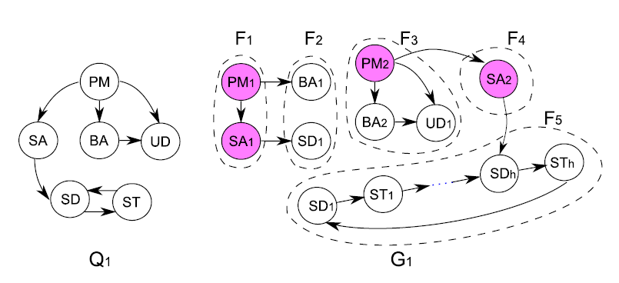

(1) E.g., Strong Simulation
Set up a team to develop a new software product
Strong simulation returns F3, F4 and F5;
Subgraph isomorphism returns empty!
Subgraph isomorphism is too strict for emerging applications!

Slide 18

(1) E.g., Strong Simulation
Terrorist Collaboration Network
“Those who were trained to fly didn’t know the others. One group of people did not know the other group.” (Osama Bin Laden, 2001)
Build upon (revised) strong simulation to aid the detection of homegrown violent extremists (HVEs) who seek to commit acts of terrorism in the United States and abroad, Colorado State University, Benjamin W. K. Hung, Anura P. Jayasumana: Investigative simulation: Towards utilizing graph pattern matching for investigative search. ASONAM 2016.

Slide 19
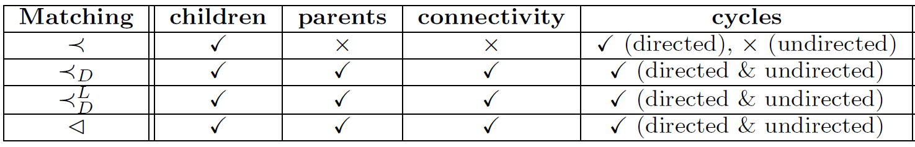
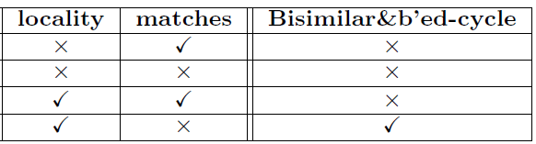
(1) E.g., Strong Simulation
Subgraph
Isomorphism
(NP-Complete)
Strong
Simulation
Dual
Simulation
Graph
Simulation
(O(n³))
Preserve 70-80% subgraph isomorphism & 100 times faster!

Slide 20
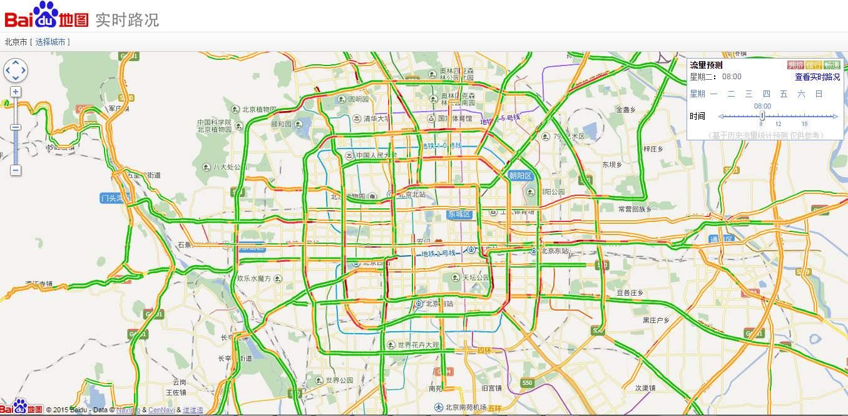
(2) E.g., Temporal Dense Subgraphs

Slide 21
(2) E.g., Temporal Dense Subgraphs
Filter-and-Verification methods:
Data Driven Query Approximation methods:
Choose k (a small constant, e.g., 10 or 15)
Experimental results (with the state of the art solution ^{[Bogdanov et al. 2011]})
10⁴ | 10⁵ | 10⁶ | ··· | 10⁸
5×10² | 5×10³ | 5×10⁴ |  | 5×10⁶
95% are filtered
10⁴ | 10⁵ | 10⁶ | ··· | 10⁸
k | k | k |  | k
 | Accuracy | Efficiency
BEIJING DATA | 100.28% | 2980 times faster
SYNTHETIC DATA | 99.84% | 1,079 times faster
P. Bogdanov, M. Mongiov, and A. K. Singh. Mining heavy subgraphs in time-evolving networks. In ICDM, 2011.
Haixing Huang, Jinghe Song, Xuelian Lin, Shuai Ma, Jinpeng Huai, TGraph: A Temporal Graph Data Management System (demo), CIKM 2016.
Shuai Ma, Renjun Hu, Luoshu Wang, Xuelian Lin, Jinpeng Huai, Fast Computation of Temporal Dense Subgraphs, ICDE 2017

Slide 22


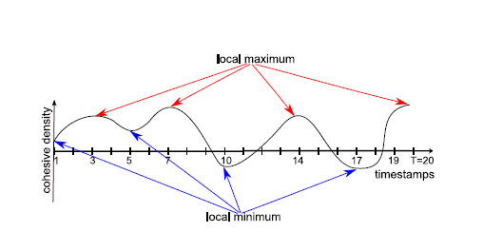


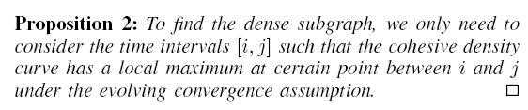

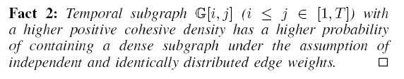
(2) E.g., Temporal Dense Subgraphs
In evolutionary biology, convergent evolution is the process whereby organisms not closely related (not monophyletic), independently evolve similar traits as a result of having to adapt to similar environments or ecological niches.
Evolving convergence assumption
Shuai Ma, Renjun Hu, Luoshu Wang, Xuelian Lin, Jinpeng Huai, Fast Computation of Temporal Dense Subgraphs, ICDE 2017
Notes:
Example: Two succulent plant genera, Euphorbiaand Astrophytum, are only distantly related, but the species within each have independently converged on a similar body form
大戟属，又称翡翠塔属，是大戟科植物的一个属，包括了2160多种不同种类的植物，当中有些比较常见的，例如：一品红、灯台草等。大戟属植物是现时地球上其中一种生长范围极广的植物种属，主要在非洲及美洲的热带及亚热带地区生长，但在温带亦有发现。生长年期有一年生或多年生，有草本、木本灌木及乔木，而且都有树液。
仙人掌

Slide 23

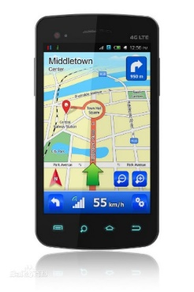

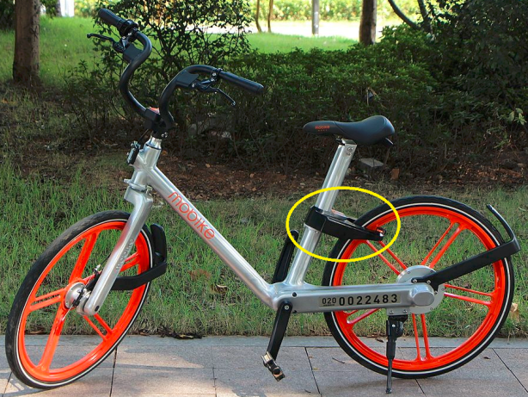
(3) E.g., Trajectory Compression
Vehicles
Sharing bikes
Smartphones
GPS data points：P(x, y, t),
where x is latitude, y is longitude, and t is time.
e.g. (34.6259, 111.4085, 1499644819000)

Slide 24
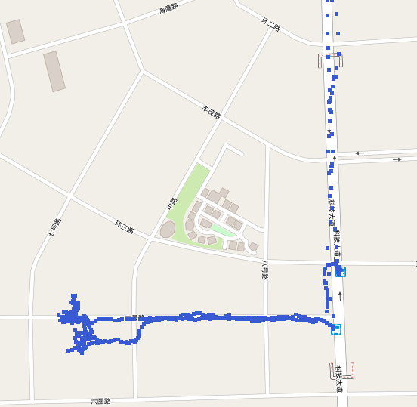
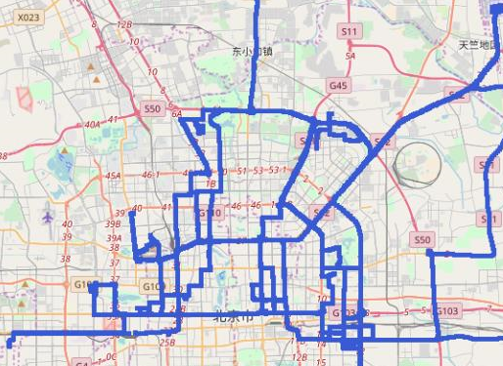
(3) E.g., Trajectory Compression
A Trajectory T[P0,…, Pn] is a sequence of data points in a monotonically increasing order of their associated time values (i.e., Pi.t < Pj .t for any 0≤ i < j ≤ n)
Sensors | Time (s) per point | Points per day | # of Sensors | total points per day
Truck | 1-30 | 2.88K - 86.4K | 20K | 57.6M - 1.728G
Service Car | 1-5 | 17.28k- 86.4K | 100K | 1.728G - 8.64G
Sharing bikes | 1-10 | 8.64K - 86.4K | 1M | 9.6G - 96G
Smartphones | 1-60 | 1.44K - 86.4K | 10M | 14.4G - 864G

Slide 25
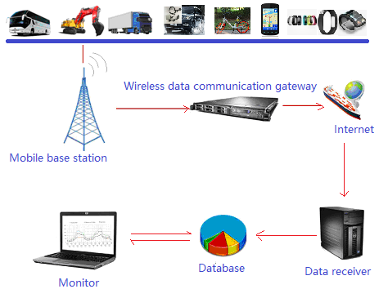
(3) E.g., Trajectory Compression
The uploading and saving of the raw GPS data is
wasting of network bandwidth and Storage space
slowing the performance of queries
Line-based trajectory simplification (trajectory simplification for convenience) algorithms alleviate this issue, and are commonly used in practice.

Slide 26
(3) E.g., Trajectory Compression
The “Min-#” problem of trajectory simplification
Compression ratio: to get the minimal number of line segments to represent the original trajectory
Error-bounded: to ensure that the distance of any original point to its corresponding line segment is less than a pre-defined threshold ζ
ζ

Slide 27
(3) E.g., Trajectory Compression
The optimal algorithm has a time complexity of O(n²)
Sub-optimal algorithms
Good (near optimal) compression ratios
Error-bounded
Type | Time complexity | Space complexity
Batch | O(n²) | O(n)
Online | O(n logW) | O(W)
ζ
Global distance checking: a point is checked multiple times.
They are not efficient enough for compressing big trajectory data, especially with limited computing resources, e.g., mobile devices.

Slide 28
(3) E.g., Trajectory Compression
Error bound ζ
> ζ/2
Directed line segment
Start Point
Learning from dead reckoning (in position tracking)
and Reumann’s method (in computer graphics)
Features of the naïve approach
One-pass
O(1) time and O(1) space for each point
Error bounded by ζ
Poor compression ratios

Slide 29
(3) E.g., Trajectory Compression
Key Idea: dynamically adjust the directed line segment L and make L more close to the new data point, then it is potential to represent more data points.
(1) P_{s+2} to L₁
(2) P_{s+3} to L₂
(3) P_{s+4} to L₃
a dynamic L may represent more data point than a static L

Slide 30
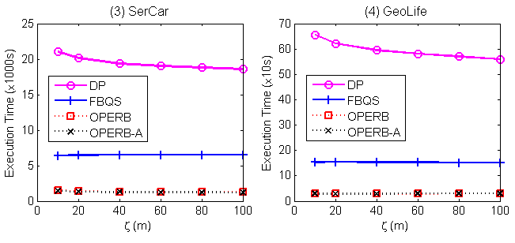
(3) E.g., Trajectory Compression
One-pass error-bounded approach applying a local distance checking method
One-pass: each point is checked only once
O(n) time and O(1) space complexities
Error bounded
Good compression ratio
Xuelian Lin, Shuai Ma, Han Zhang, Tianyu Wo, Jinpeng Huai: One-Pass Error Bounded Trajectory Simplification. VLDB, 2017

Slide 31
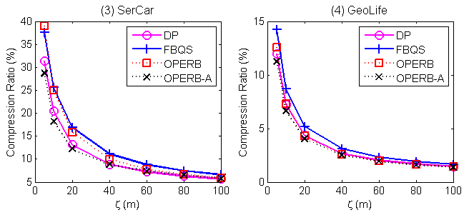
(3) E.g., Trajectory Compression
One-pass error-bounded approach applying a local distance checking method
One-pass: each point is checked only once
O(n) time and O(1) space complexities
Error bounded
Good compression ratio
Xuelian Lin, Shuai Ma, Han Zhang, Tianyu Wo, Jinpeng Huai: One-Pass Error Bounded Trajectory Simplification. VLDB, 2017

Slide 32
Data Techniques for Big Data Analytics
R = Q(D)

Slide 33
Data Approximation Techniques
Main idea: For a class Q of queries on data D, transform D to smaller data D’ that can be processed efficiently without loss of quality or with a bounded loss of quality.
D → D’
D
D’
Q
Q’
Approximation
Q(D)
Q’(D’)
Challenge: balancing accuracy and computational complexity!

Slide 34


Data Approximation Techniques
Main idea: For a class Q of queries on data D, transform D to smaller data D’ that can be processed efficiently without loss of quality or with a bounded loss of quality.
Pareto principle: for many events, roughly 80% of the effects come from 20% of the causes
D = HARD(D) + SOFT(D)
×
Challenge: balancing accuracy and computational complexity!

Slide 35
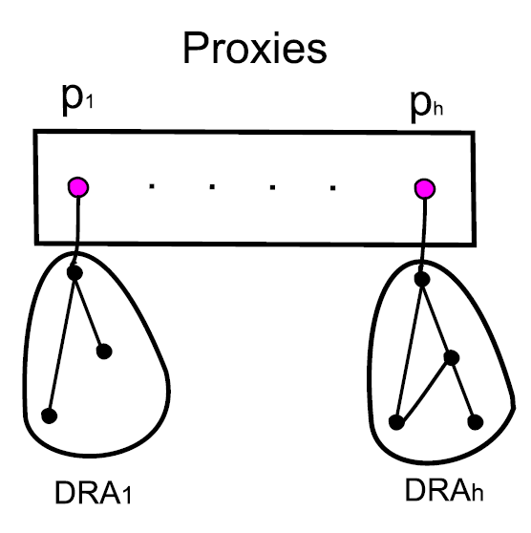
(1) E.g., Shortest Paths/Distances
For weighted undirected graphs, we propose a notion of “proxies”
Each proxy represents the nodes in its DRA (non-overlapping for all proxies)
Proxies can be computed in O(n) time
Key property: Given nodes u,v in G, proxies u_{p},v_{p}, then:
(1) path(u, v) = path(u, u_{p}) + path(u_{p}, v_{p}) + path(v_{p}, v)
(2) dist(u, v) = dist(u, u_{p}) + dist(u_{p}, v_{p}) + dist(v_{p}, v)
On Real-life road and social networks, graphs are reduced by 1/3!
A light-weight general data reduction technique for shortest paths/distances!
Shuai Ma, Kaiyu Feng, Jianxin Li, Haixun Wang, Gao Cong, and Jinpeng Huai, Proxies for Shortest Path and Distance Queries. TKDE 2016.
Shuai Ma, Kaiyu Feng, Jianxin Li, Haixun Wang, Gao Cong, and Jinpeng Huai, Proxies for Shortest Path and Distance Queries. ICDE 2017 (TKDE Extended Abstract).

Slide 36

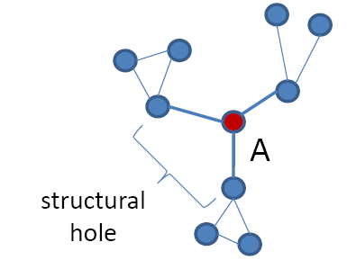
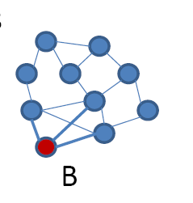
(2) E.g., Network Anomaly
Structural hole theory ^{[Burt 1992,2004]}
Theory of social capital
Lack of connection between two nodes that is bridged by a broker
Prof. Ronald S. Burt
University of Chicago
Fellow, American Academy of Arts and Sciences (1993)
Fellow, Center for Advanced Study in the Behavioral Sciences(1984)
Bridge counts: a simple and intuitive measure of structural holes in a network.
Node A (brokers) is more likely to get novel information than node B, even though they have the same number of links.
Burt, Ronald S. (1992). Structural holes: the social structure of competition. Harvard University Press.
Burt, Ronald S. (2004). Structural Holes and Good Ideas. American Journal of Sociology 110 (2): 349–399.

Slide 37

(2) E.g., Network Anomaly
Structural hole theory (1992)
Theory of social capital
Lack of connection between two nodes that is bridged by a broker
Prof. Ronald S. Burt
University of Chicago
Fellow, American Academy of Arts and Sciences (1993)
Fellow, Center for Advanced Study in the Behavioral Sciences(1984)
How to detect social brokers?
A formal quantitative definition is needed in the first place!
定义: Those nodes that connect to a number of diverse influential communities.
Renjun Hu, Charu C. Aggarwal, Shuai Ma, Jinpeng Huai: An Embedding Approach to Anomaly Detection. ICDE 2016.
Notes:
With a fixed number of training samples, the predictive power reduces as the dimensionality increases, and this is known as the Hughes effect^{[3]} or Hughes phenomenon(named after Gordon F. Hughes)

Slide 38
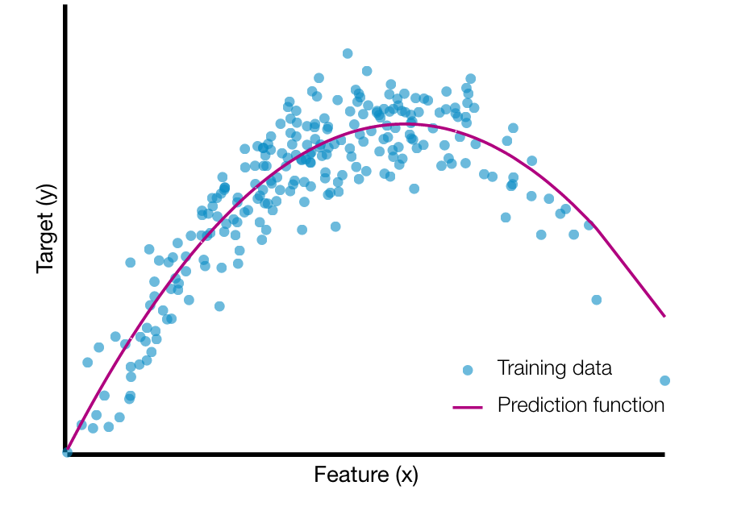
(2) E.g., Network Anomaly
A graph embedding approach
Two-in-One
Graphs are represented as matries
Data Approximation (k + α reduction)
High storage cost of matrix
Transform a n*d matrix to a n*k one,
n: # of nodes, d: # of communities
k: average node degree, k<<d
The ith entry (feature ) in a d-dimension vector is the weight that the node belongs to community i
(Gordon) Hughes Effect
Our data approximation technique (k + α reduction) improves (1%, F1) on accuracy and 25% on efficiency!
Renjun Hu, Charu C. Aggarwal, Shuai Ma, Jinpeng Huai: An Embedding Approach to Anomaly Detection. ICDE 2016.
Notes:
With a fixed number of training samples, the predictive power reduces as the dimensionality increases, and this is known as the Hughes effect^{[3]} or Hughes phenomenon(named after Gordon F. Hughes)
Gordon Hughes earned his PhD degree at Cal Tech, and began his technology career at Xerox Research, later serving as the Senior Director of Recording Technology at Seagate, in its early years. He is now a research scientist at the Center for Memory and Recording Research at the University of California San Diego.
In 2001, he was named Fellow of the IEEE for "contributions to magnetic recording physics and for pioneering work in thin film disk media".
“Comments on the mean accuracy of statistical pattern recognizers'ce”, K. Abend, T.J. Harley Jr., B. Chandrasekaran, T.J. Harley, and G.F. Hughes, IEEE Transactions on Information Theory, Vol.IT-15, No. 3, (May 1969), pp. 420-423

Slide 39
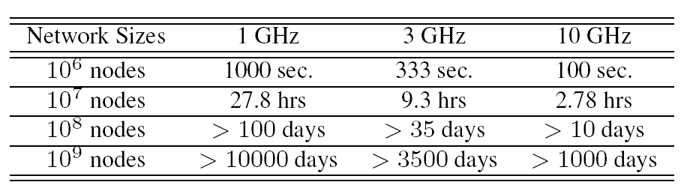
(3) E.g., Network Link Prediction
Link Prediction
A network with n nodes，O(n²) possible links
CPU speeds: xGHz/s, and assume that a single machine cycle could deal with a node pair.
Most link prediction algorithms only predict a subset of the possible links, not all possible links, such as [Dashun et al. 2011, Chungmok et al. 2014].
Dashun Wang, Dino Pedreschi, Chaoming Song, Fosca Giannotti, Albert-László Barabási: Human mobility, social ties, and link prediction. KDD 2011.
Chungmok Lee, Minh Pham, Norman Kim, Myong K. Jeong, Dennis K. J. Lin, Wanpracha Art Chaovalitwongse. A novel link prediction approach for scale-free networks. WWW 2014.

Slide 40
(3) E.g., Network Link Prediction
sample₁
Ensemble
Direct Non-negative Matrix Factorization
Low efficiency
The sparser the data, the worse the prediction
Data approximation technique (Ensemble Enabled Sampling)
Sampling must assure a coverage on O(n²) possible links
Link prediction characteristics (triangles)
Ensemble: the predicted value of a link is the maximum among all ensembles
Data
．．．
max
sample_{n}
Ensemble
Framework
Small data | Accuracy | Big data | Efficiency
YouTube | +18% | Friendster | 31 times faster
Wikipedia | +16% | Twitter | 21 times faster
Improves both accuracy and efficiency!
Liang Duan, Charu Aggarwal, Shuai Ma, Renjun Hu, and Jinpeng Huai, Scaling up Link Prediction with Ensembles, WSDM 2016 - Big Data Algorithms Session.
Liang Duan, Shuai Ma*, Charu Aggarwal, Tiejun Ma, and Jinpeng Huai, An Ensemble Approach to Link Prediction. TKDE, 29(11): 2402-2416, 2017.

Slide 41
Summary
Approximation
Approximation Algorithms
Approximate
Query Processing
Approximation Computing
Bounded Errors
SQL-Style Queries
Samping
System Design Oriented

Slide 42
Summary
Approximation
Query
Approximation
Data
Approximation
Big Data Analytics

Slide 43
Reference
Approximate Query Processing
SIGMOD 2017 Keynote
Surajit Chaudhuri, Bolin Ding, Srikanth Kandula, Approximate Query Processing: No Silver Bullet
Barzan Mozafari, Approximate Query Engines: Commercial Challenges and Research Opportunities
Tim Kraska, Approximate Query Processing for Interactive Data Science
VLDB 2014 Tutorial
Minos N. Garofalakis and Phillip B. Gibbon Approximate Query Processing: Taming the Terabytes
Approximate Query Processing in Oracle Database 12c Release 2,
https://oracle-base.com/articles/12c/approximate-query-processing-12cr2
Approximate Computing
Ankur Agrawal, Jungwook Choi, Kailash Gopalakrishnan, Suyog Gupta, Ravi Nair, Jinwook Oh, Daniel A. Prener, Sunil Shukla, Vijayalakshmi Srinivasan, Zehra Sura: Approximate computing: Challenges and opportunities. ICRC 2016: 1-8

Slide 44
Reference
Query Approximation Techniques
Shuai Ma, Yang Cao, Wenfei Fan, Jinpeng Huai, and Tianyu Wo. Strong Simulation: Capturing Topology in Graph Pattern Matching. TODS 2014.
Shuai Ma, Yang Cao, Wenfei Fan, Jinpeng Huai, and Tianyu Wo, Capturing Topology in Graph Pattern Matching. VLDB 2012.
Haixing Huang, Jinghe Song, Xuelian Lin, Shuai Ma, Jinpeng Huai, TGraph: A Temporal Graph Data Management System (demo), CIKM 2016.
Shuai Ma, Renjun Hu, Luoshu Wang, Xuelian Lin, Jinpeng Huai, Fast Computation of Temporal Dense Subgraphs, ICDE 2017
Xuelian Lin, Shuai Ma, Han Zhang, Tianyu Wo, Jinpeng Huai: One-Pass Error Bounded Trajectory Simplification. VLDB, 2017.
Data Approximation Techniques
Shuai Ma, Kaiyu Feng, Jianxin Li, Haixun Wang, Gao Cong, and Jinpeng Huai, Proxies for Shortest Path and Distance Queries. TKDE 2016.
Shuai Ma, Kaiyu Feng, Jianxin Li, Haixun Wang, Gao Cong, and Jinpeng Huai, Proxies for Shortest Path and Distance Queries. ICDE 2017 (TKDE Extended Abstract).
Renjun Hu, Charu C. Aggarwal, Shuai Ma, Jinpeng Huai: An Embedding Approach to Anomaly Detection. ICDE 2016.

Slide 45
Reference
Liang Duan, Charu Aggarwal, Shuai Ma, Renjun Hu, and Jinpeng Huai, Scaling up Link Prediction with Ensembles, WSDM 2016 - Big Data Algorithms Session.
Liang Duan, Shuai Ma*, Charu Aggarwal, Tiejun Ma, and Jinpeng Huai, An Ensemble Approach to Link Prediction. TKDE, 29(11): 2402-2416, 2017.

Slide 46






Acknowledgements
Collaborators:
Charu Aggarwal, Sourav S Bhowmick, Yang Cao, Gao Cong, Liang Duan, Wenfei Fan, Kaiyu Feng, Haixing Huang, Renjun Hu, Jinpeng Huai, Jia Li, Jianxin Li, Xuelian Lin, Xudong Liu, Jinghe Song, Haixun Wang, Luoshu Wang, Tianyu Wo…
They are from:

Slide 47



Acknowledgements
Research supported in part by:

Slide 48

Homepage: http://mashuai.buaa.edu.cn
Email: mashuai@buaa.edu.cn
Address:
Room G1122,
New Main Building,
Beihang University
Beijing, China
Thanks!

Slide 49
Other Query and Data Techniques
Q(D₁)
Distributed algorithms:
Q(D)
Q(D_{i})
Q(D_{n})
Incremental Computation:
Incremental computation
Q(D + Δ)
Q(D) + Q(Δ)
Known results
compression
Data Compression:
Q(D)
Q(D’)
partitioning
Data Partition:
Q(D)
Q(D₁) + … + Q(D_{n})

