Slide 1


Easy First Relation Extraction with Information Redundancy
Shuai Ma^{1,2}, Gang Wang^{1,2}, Yansong Feng³, and Jinpeng Huai^{1,2}
¹SKLSDE Lab, Beihang University, China
²Beijing Advanced Innovation Center for Big Data and Brain Computing, Beijing, China
³Peking University, China
Notes:
My name is . Today I will be presenting our recent work on outlier detection in sparse data with factorization machines, joint with my supervisor , and other colleges from Beihang Univ.

Slide 2



Motivation
Relation Extraction (RE)
Crucial role for many knowledge based applications
Two types of relation extractors:
local (based on sentences) and global (based on corpora)
Global RE as a constrained optimization
Resolve conflict decisions
Utilize the dependencies among extracted facts
Be solved by mature optimization models
e.g. integer linear programming (ILP)
Notes:
As we know, Relation extraction (RE) has been extensively studied due to its crucial role for many knowledge based applications, such as question answering, knowledge graph, and recommender system.
There are two types of relation extractors: local and global. The former identify relationships between entity pairs individually according to the local features of sentences; The latter make decisions by further considering joint features of the entire corpus
Global relation extractors are able to resolve conflict decisions, and to utilize the dependencies among extracted facts to improve the performance, commonly by formalizing RE as a constrained optimization problem and solving RE with integer linear programming

Slide 3
Motivation
Challenges of Integer Linear Programming for RE
too much computing time and memory of ILP with voluminous variables and constraints
Redundant information needs to be encoded cautiously
Entity Pair | Top-3 Candidate Relations
Australia, Sydney | capital : 0.6 | birthPlace : 0.35 | nationality : 0.05
Australia, Sydney | capital : 0.7 | country : 0.23 | deathPlace : 0.07
… | … | … | …
Australia, Canberra | capital : 0.96 | country : 0.03 | birthPlace : 0.01
Simple statistical methods fail:
Confidence summation:
<Australia, capital : 1.3, Sydney>, <Australia, capital : 0.96, Canberra>
A efficient and effective relation extractor is needed
Notes:
Using integer linear programming for RE as a blackbox solver is a challenging task.
First, with the increase of entity pairs and candidate relations, the variables and constraints encoded for ILP increase dramatically, which in return may consume too much computing time and memory.
Second, redundant information needs to be encoded cautiously.
For example, when we choose which city is the capital of Australia based on input data, the simple statistical methods, such as confidence summation, may easily lead to a wrong decision in this case.
So, A efficient and effective global relation extractor is neede.

Slide 4
Outline
Related Concepts
Easy First Strategy
Constraints
Information Redundancies
Easy First Relation Extraction Framework
Experimental Study
Summary
Notes:
First, we introduce some necessary concepts for our framework.

Slide 5
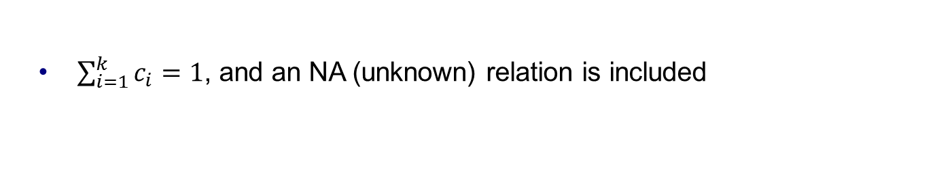
Easy First Strategy for Relation Extraction
What is the Easy First Strategy
Easy (most confident) decisions should be made early, and eliminating conflicts with constraints aids hard decisions
Two keys
Constraints ---- eliminate conflicts
Redundancies ---- increase information
Mention Format produced by Local Extractors
Entity pair. K candidate relations and their confidence scores
s, o | r₁: c₁ | r₂: c₂ | … | r_{k}: c_{k}
m = (s; o; r₁ : c₁; …; r_{k} : c_{k})
$\sum_{i=1}^{k}{c_{i}=1}$, and an NA (unknown) relation is included
Notes:
Easy First Strategy is that [Easy…]
How to incorporate easy first strategy into relation extraction? There are two key points: first, we need increase information from input to help us distinguish which decisions is easy and which decisions is hard; second, we need eliminate the conflict candidates to decrease interference for the later decisions.
Before we introduce the details of redundancies and constraints, we show the format of input, that is, the mentions produced by local extractors. Each mention corresponds to a sentence. In a mention, there is an entity pair and k candidate relations and their confidence scores. The sum of those scores is one. Also an unknown relation is included in the candidate relation set.

Slide 6
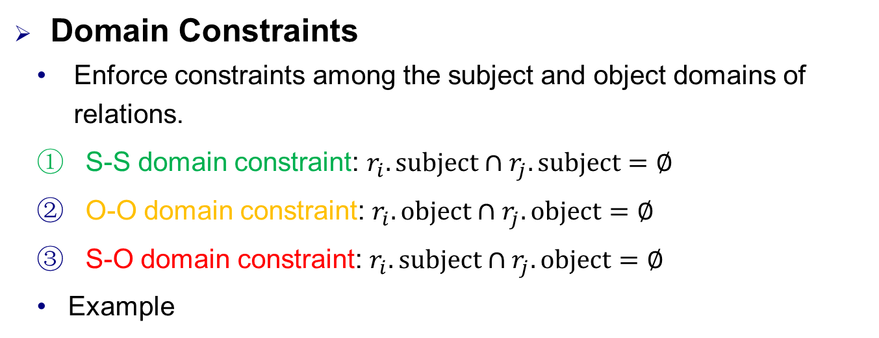
Constraints
Domain Constraints
Enforce constraints among the subject and object domains of relations.
S-S domain constraint: $r_{i}.subject∩r_{j}.subject=∅$
O-O domain constraint: $r_{i}.object∩r_{j}.object=∅$
S-O domain constraint: $r_{i}.subject∩r_{j}.object=∅$
Example
Subject Domain | Relation | Object Domain
Countries | largestCity | Cities
Organizations | locationCity | Cities
Persons | nationality | Countries
… | … | …
Notes:
We enforce three constraints [among …]
S-S domain constraint ensures that ri and rj share no common entities between their subjects
O-O domain constraint ensures that ri and rj share no common entities between their objects
S-O domain constraint ensures that ri and rj share no common entities between the subject of ri and the object of rj
Let’s see three example, (1) relations largestCity and locationCity have their subjects as countries and organizations respectively. They hold an S-S domain constraint; (2) relations locationCity and Nationality have their objects as cities and countries, respectively. They hold an O-O domain constraint; (3) nationality has its subjects as persons and largestCity has its objects as cities. It holds an S-O domain constraint.

Slide 7
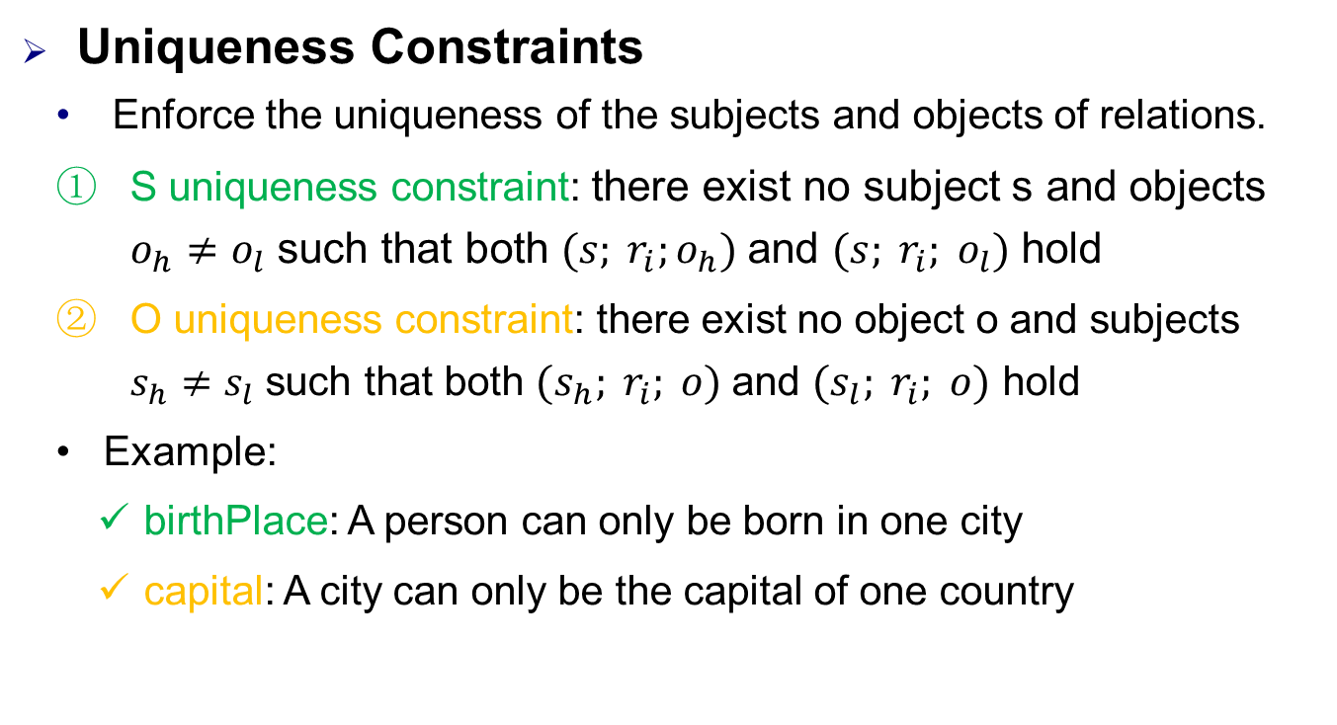
Constraints
Uniqueness Constraints
Enforce the uniqueness of the subjects and objects of relations.
S uniqueness constraint: there exist no subject s and objects $o_{h}≠o_{l}$ such that both $(s; r_{i};o_{h})$and $(s; r_{i}; o_{l})$ hold
O uniqueness constraint: there exist no object o and subjects $s_{h}≠s_{l}$ such that both $(s_{h}; r_{i}; o)$and $(s_{l}; r_{i}; o)$ hold
Example:
birthPlace: A person can only be born in one city
capital: A city can only be the capital of one country
Subject Domain | Relation | Object Domain
Persons | birthPlace | Cities
Countries | capital | Cities
Notes:
We use two other constraints to [Enforce …]
Given a relation ri, S uniqueness constraint ensures that [there …]
O uniqueness constraint ensures that [there …]
Let’s see two example, relation birthplace has S uniqueness constraint, because [A person …]; relation capital has O uniqueness constraint, because [A city …].

Slide 8
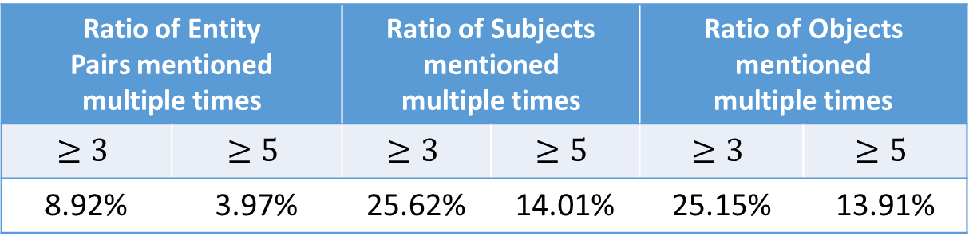
Information Redundancies
Redundancies are Common
#Mentions | #Entity Pairs | #Subjects | #Objects
53162 | 30864 | 11360 | 9709
Ratio of Entity Pairs mentioned multiple times |  | Ratio of Subjects mentioned multiple times |  | Ratio of Objects mentioned multiple times
$$≥3$$ | $$≥5$$ | $$≥3$$ | $$≥5$$ | $$≥3$$ | $$≥5$$
8.92% | 3.97% | 25.62% | 14.01% | 25.15% | 13.91%
Redundancies Types
S-O redundancies
S-R redundancies
O-R redundancies
R redundancies
Notes:
Redundancies are used to pick up hidden information, and are very common in the corpus, as revealed by the statistics in the table. Specifically, subjects, objects and entity pairs repeat multiple times.
We will introduce four redundancies to mine information from input.

Slide 9
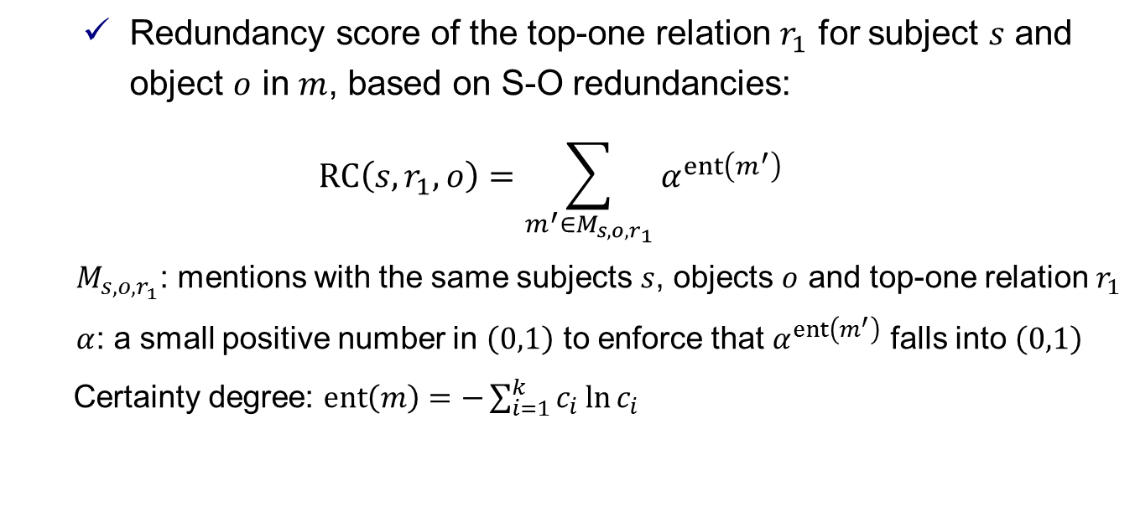
Information Redundancies
(1) S-O redundancies
Aid the decision making of the top-one relations of mentions with the same subjects and objects
Top-one relation has the highest score in a mention
Redundancy score of the top-one relation $r_{1}$ for subject $s$ and object $o$ in $m$, based on S-O redundancies:
$$RC\left(s, r_{1}, o\right)=\sum_{m^{′}∈M_{s, o, r_{1}}}{α^{ent\left(m^{′}\right)}}$$
$M_{s, o, r_{1}}$: mentions with the same subjects $s$, objects $o$ and top-one relation $r_{1}$
$α$: a small positive number in $\left(0,1\right)$ to enforce that $α^{ent\left(m^{′}\right)}$ falls into $\left(0,1\right)$
Certainty degree: $ent\left(m\right)=−\sum_{i=1}^{k}{c_{i}\ln{c_{i}}}$
Notes:
S-O redundancies are introduced to [aid …]
[Top-one …]
[Redundancy score …]

Slide 10
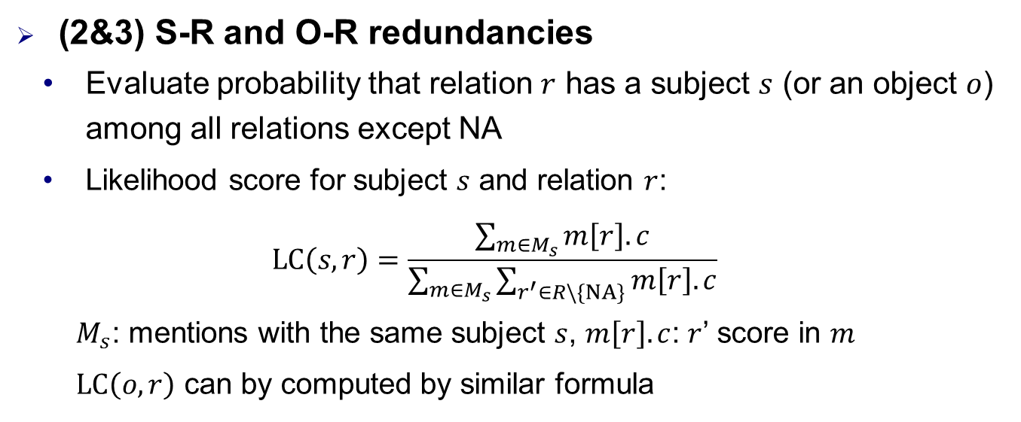
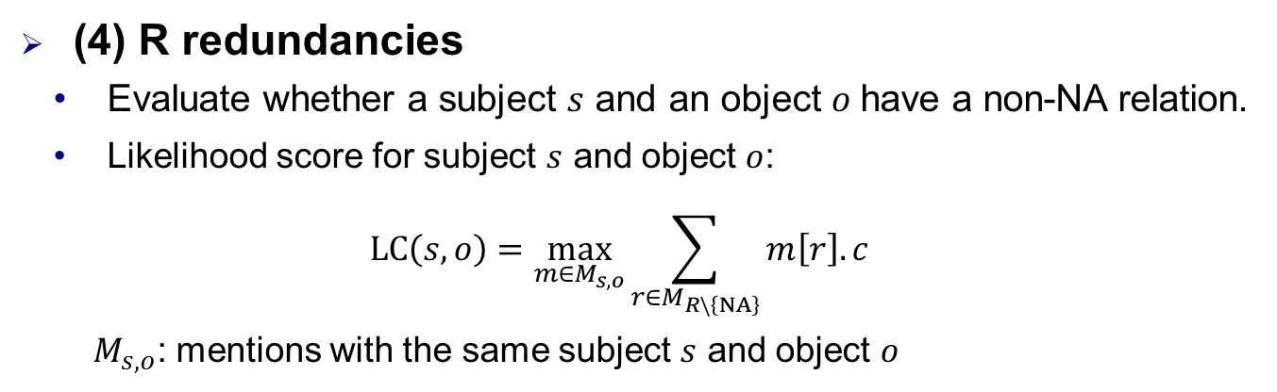
Information Redundancies
(2&3) S-R and O-R redundancies
Evaluate probability that relation $r$ has a subject $s$ (or an object $o$) among all relations except NA
Likelihood score for subject $s$ and relation $r$:
$$LC\left(s,r\right)=\frac{\sum_{m∈M_{s}}{m\left[r\right].c}}{\sum_{m∈M_{s}}{\sum_{r^{′}∈R\backslash \left\{NA\right\}}{m\left[r\right].c}}}$$
$M_{s}$: mentions with the same subject $s$, $m\left[r\right].c$: $r$’ score in $m$
$LC\left(o,r\right)$ can by computed by similar formula
(4) R redundancies
Evaluate whether a subject $s$ and an object $o$have a non-NA relation.
Likelihood score for subject $s$ and object $o$:
$$LC\left(s, o\right)=\max_{m∈M_{s, o}}{\sum_{r∈M_{R\backslash \left\{NA\right\}}}{m\left[r\right].c}}$$
$M_{s, o}$: mentions with the same subject $s$ and object $o$
Notes:
S-R and O-R redundancies are introduced to aid the decision making whether a subject (or an object) meets the domain requirement of a relation. When computing the likelihood score, we make use of the confidence scores of the same subjects and relations
Finally, R redundancies are introduced to aid the decision making whether a subject and an object have a non-NA relation. The Likelihood score selects prominent information from local decisions to measure the probability of having at least one non-NA relation between subject and object

Slide 11
Outline
Related Concepts
Easy First Relation Extraction Framework
Easy Decisions Making
Hard Decisions Making
Experimental Study
Summary
Notes:
How to make use of the above constraints and redundancies?
We propose an Easy First Relation Extraction Framework

Slide 12
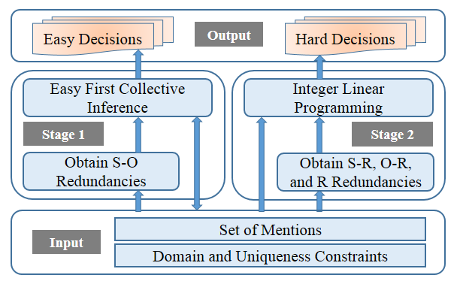
Easy First Relation Extraction Framework
Stage 1: Easy First Collective Inference
Make easy (most confident) decisions
Utilize S-O redundancies
Stage 2: Integer Linear Programming
Make hard decisions with ILP
Utilize S-R, O-R, and R redundancies
Notes:
Our approach obtains S-O redundancies, and makes easy decisions with easy first collective inference in the first stage.
Then it derives S-R, O-R and R redundancies, and makes hard decisions with ILP in the second stage.
We next introduce our approach in detail.

Slide 13
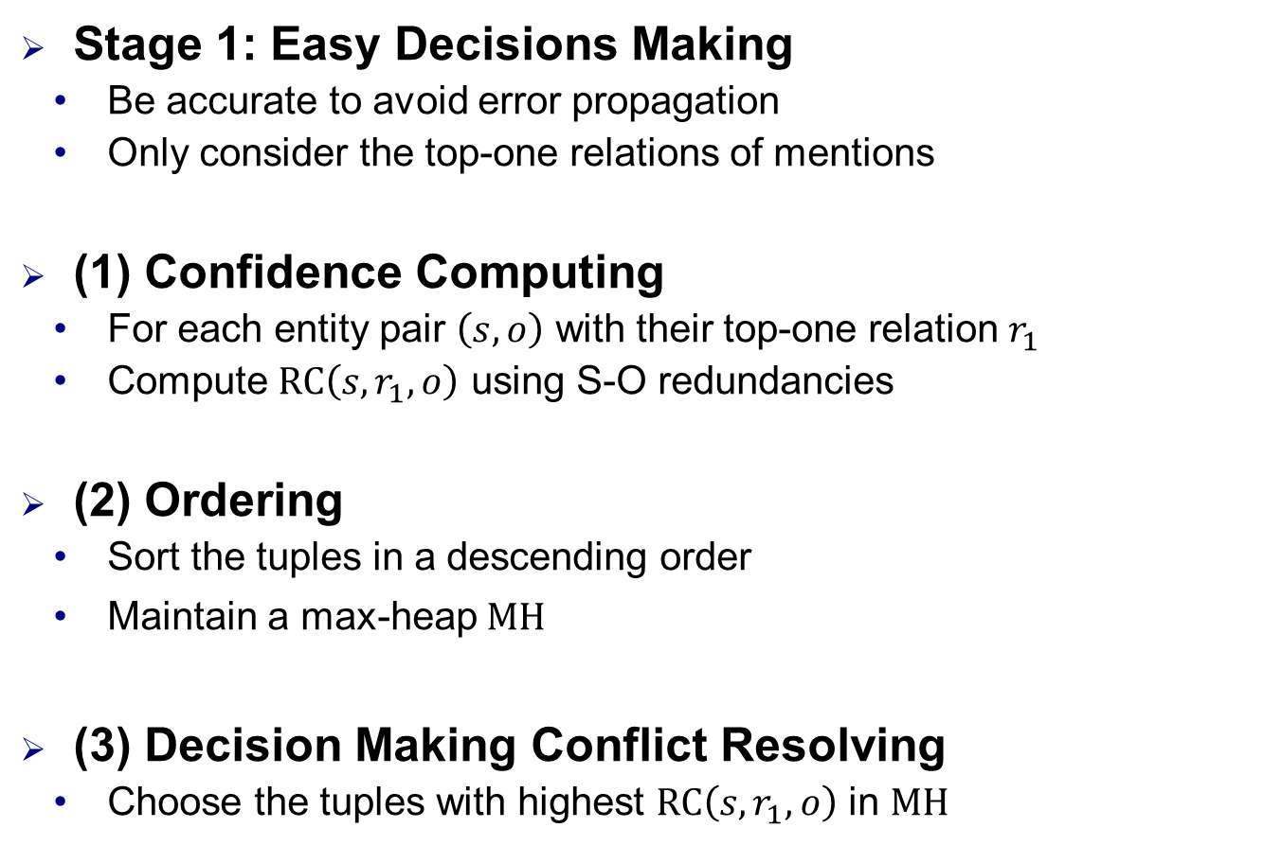
Easy First Collective Inference
Stage 1: Easy Decisions Making
Be accurate to avoid error propagation
Only consider the top-one relations of mentions
(1) Confidence Computing
For each entity pair $\left(s, o\right)$ with their top-one relation $r_{1}$
Compute $RC\left(s, r_{1}, o\right)$ using S-O redundancies
(2) Ordering
Sort the tuples in a descending order
Maintain a max-heap $MH$
(3) Decision Making Conflict Resolving
Choose the tuples with highest $RC\left(s, r_{1}, o\right)$ in $MH$
Notes:
In the first stage, easy decisions must be highly accurate to avoid error propagation. So we first makes decisions for entity pairs using their top-one relations only.
In first step, It computes the redundancy scores RC of all the entity pairs (s; o) with their top-one relations r1 in mentions M, using S-O redundancies. The higher redundancy scores are, the more confident subject s and object o have a relation r1.
In second step, entity pairs with their top-one relations are sorted in a descending order of their redundancy scores. As updating operations happen very often during the process of decision making, we introduce a max-heap MH to maintain all the entity pairs with their top-one relations and redundancy scores for the sake of efficiency.
In third step, makes a decision for the entity pair by choosing its top-one relation r1 such that the redundancy score RC is the highest in max-heap

Slide 14
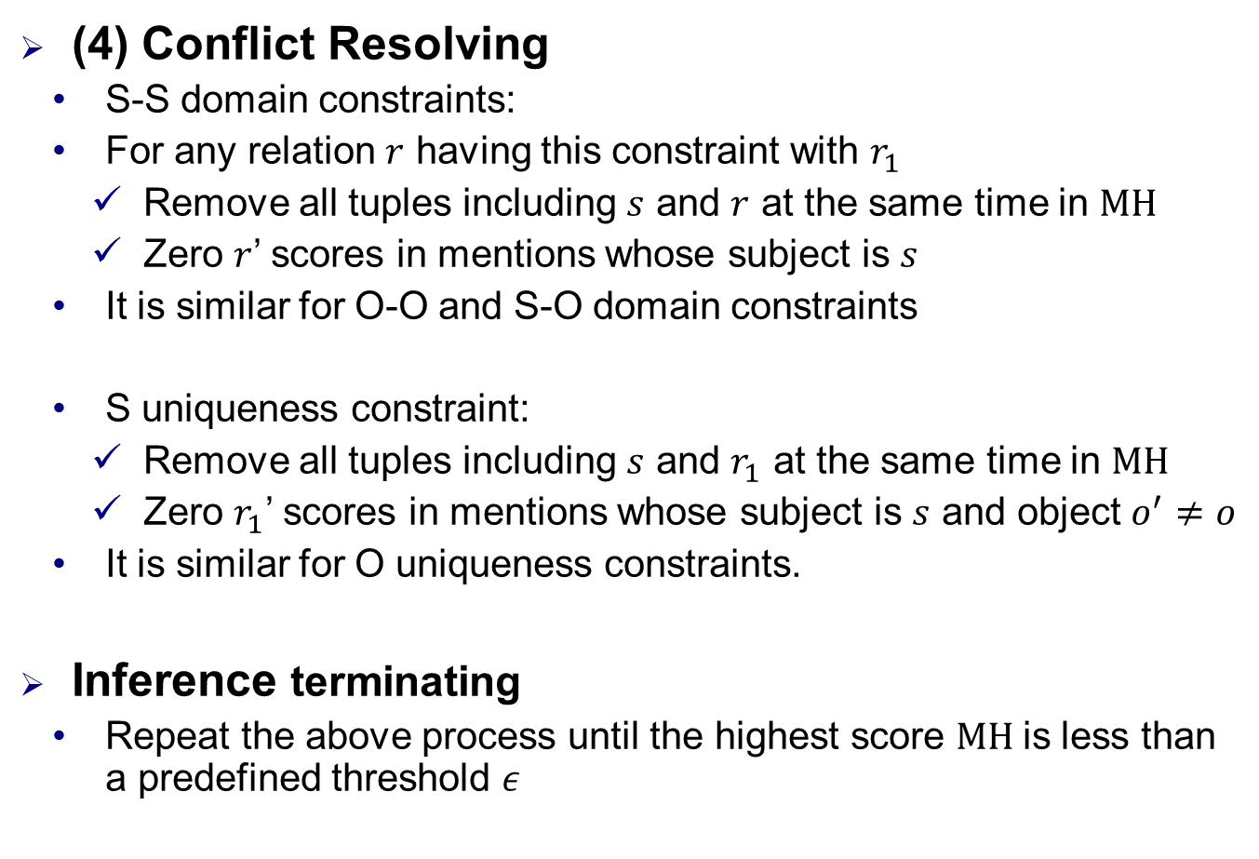
Easy First Collective Inference
(4) Conflict Resolving
S-S domain constraints:
For any relation $r$ having this constraint with $r_{1}$
Remove all tuples including $s$ and $r$ at the same time in $MH$
Zero $r$’ scores in mentions whose subject is $s$
It is similar for O-O and S-O domain constraints
S uniqueness constraint:
Remove all tuples including $s$ and $r_{1}$ at the same time in $MH$
Zero $r_{1}$’ scores in mentions whose subject is $s$ and object $o^{′}≠o$
It is similar for O uniqueness constraints.
Inference terminating
Repeat the above process until the highest score $MH$is less than a predefined threshold $ε$
Notes:
Once a decision is made, disagreements are resolved immediately with domain and uniqueness constraints directly
For any relation r having an S-S domain constraint with r1, all entity pairs with subject s and top-one relation r are deleted from Max-heap, and for entity pairs with subject s in mentions M, their scores of relation r are set to zeroes. It is similar for O-O and S-O domain constraints.
If relation r1 has an S uniqueness constraint, all entity pairs with subject s and top-one relation r1 are deleted from Max-heap, and for entity pairs with subject s and object o’ not equal to o in mentions M, their scores of relation r1 are set to zeroes. It is similar for O uniqueness constraints.
The above process is repeated until the highest redundancy score in the max-heap MH is less than a predefined threshold (/'epsɪlɒn/), which is to ensure the correctness of decisions.

Slide 15
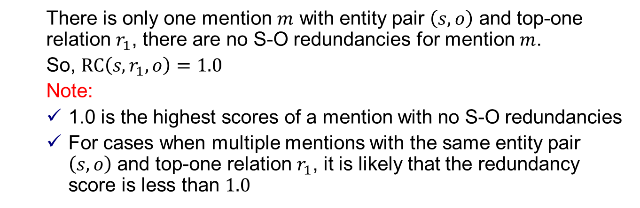
Easy First Collective Inference
Intention of Threshold 𝜖
Distinguish easy decisions from hard ones
Setting of Threshold 𝜖
A letter less than 1.0
Extreme case:
Entity Pair | Top-3 Candidate Relations
Australia, Canberra | capital : 1.0 | country : 0.0 | birthPlace : 0.0
There is only one mention $m$ with entity pair $\left(s, o\right)$ and top-one relation $r_{1}$, there are no S-O redundancies for mention $m$.
So, $RC\left(s, r_{1}, o\right)=1.0$
Note:
1.0 is the highest scores of a mention with no S-O redundancies
For cases when multiple mentions with the same entity pair $\left(s, o\right)$ and top-one relation $r_{1}$, it is likely that the redundancy score is less than $1.0$
Notes:
The intention of threshold is to distinguish easy decisions from hard ones based on S-O redundancies.
The threshold is typically set to a value a little less than 1. Why? Considersee an extreme case.
There is only one mention m in M with subject s, object o and top-one relation r1 whose score is 1, i.e., there are no S-O redundancies for mention m. In this case, we have RC(s; r1; o) = 1.
1.0 is the highest scores of mention 𝑚 with no S-O redundancies can obtain
However, for cases when multiple mentions with the same entity pair (𝑠, 𝑜) and top-one relation 𝑟1, it is likely that the redundancy score is less than 1.0

Slide 16
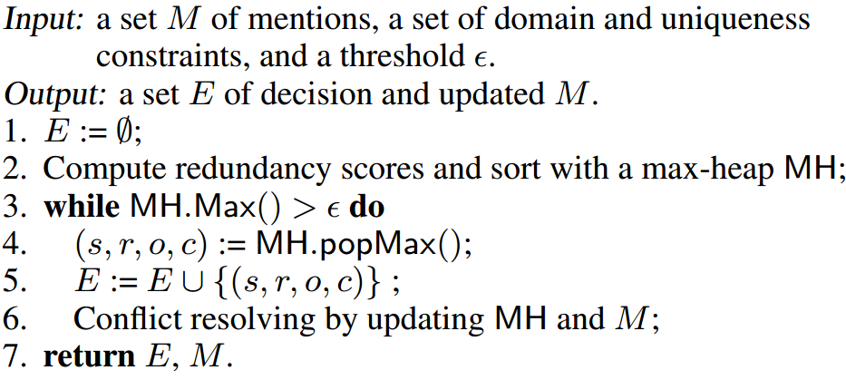
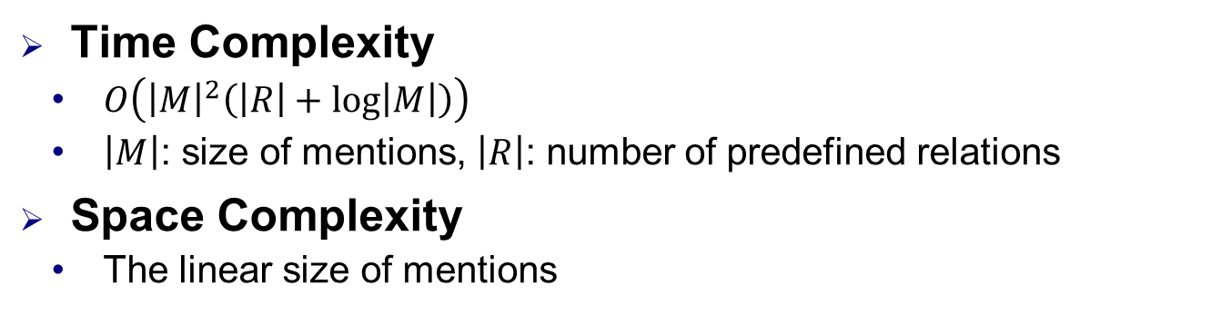
Easy First Collective Inference
Algorithm for Making Easy Decisions
Time Complexity
$O\left({\left|M\right|}^{2}\left(\left|R\right|+\log\left|M\right|\right)\right)$
$\left|M\right|$: size of mentions, $\left|R\right|$: number of predefined relations
Space Complexity
The linear size of mentions
Stage 1 greatly reduces the number of variables and constraints to be considered in Stage 2.
Notes:
The Algorithm for Making Easy Decisions is a summary of the above process.
In the whole process, we only need to modify the conflict relations’ scores and maintain the max-heap. So our approach is very efficient and save space

Slide 17
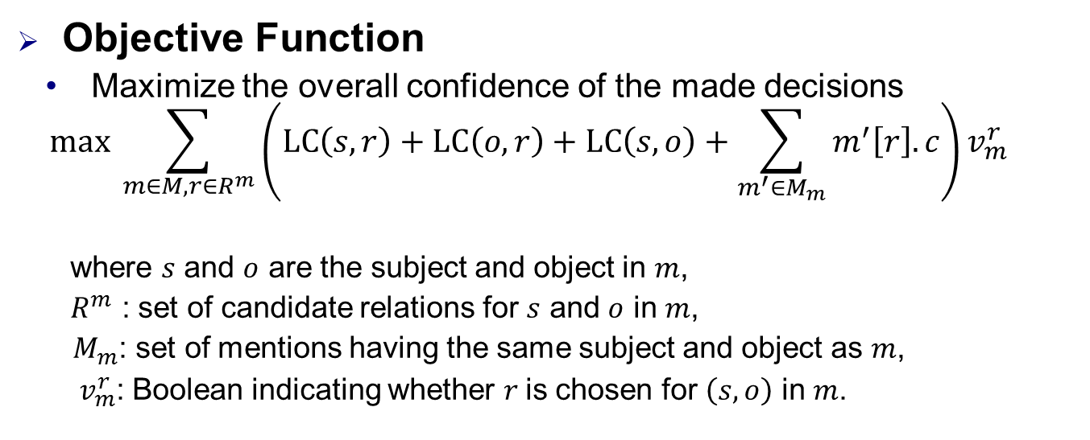
Integer Linear Programming
Stage 2: Hard Decisions Making
Find an optimal configuration for the remaining mentions
Solve the disagreements by domain and uniqueness constraints
Adopt the ILP tool “IBM ILOG CPLEX”
Objective Function
Maximize the overall confidence of the made decisions
$$max \sum_{m∈M, r∈R^{m}}{\left(LC\left(s, r\right)+LC\left(o, r\right)+LC\left(s, o\right)+\sum_{m^{′}∈M_{m}}{m^{′}\left[r\right].c}\right)v_{m}^{r}}$$
where $s$ and $o$ are the subject and object in $m$,
$R^{m}$ : set of candidate relations for $s$ and $o$ in $m$,
$M_{m}$: set of mentions having the same subject and object as $m$,
$v_{m}^{r}$: Boolean indicating whether $r$is chosen for $\left(s, o\right)$ in $m$.
①
②
① Encourage to select candidates meeting the domain requirements of relations
② Consider decisions produced by sentence level extractors.
Notes:
In the second stage, our goal is to find an optimal configuration for the remaining mentions, making use of S-R, O-R and R redundancies, solving the disagreements by domain and uniqueness constraints, and maximizing the overall confidence of the made decisions.
This is an NP-hard optimization problem, and many optimization models can be used to obtain approximate solutions. Here, we adopt the ILP tool “IBM ILOG CPLEX”
Our objective is to maximize the total confidence of all the selected candidates based on the S-R, O-R and R redundancies
The objective function consists of two parts: The former is designed to encourage the model to select candidates meeting the domain requirements of relations, and the latter is designed to give consideration to decisions produced by sentence level extractors.

Slide 18
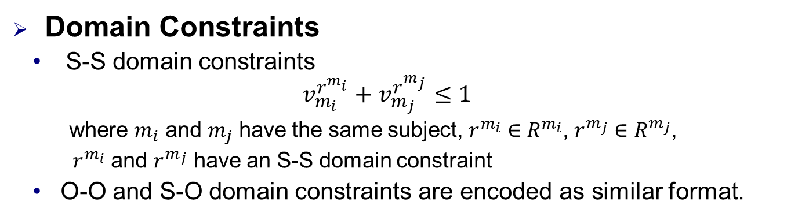
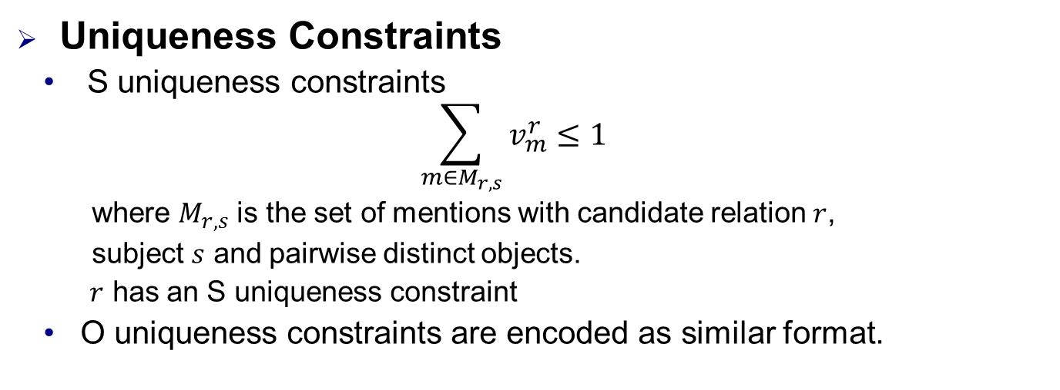
Constraints Encoded in ILP
Domain Constraints
S-S domain constraints
$$v_{m_{i}}^{r^{m_{i}}}+v_{m_{j}}^{r^{m_{j}}}≤1$$
where $m_{i}$ and $m_{j}$ have the same subject, $r^{m_{i}}∈R^{m_{i}}$, $r^{m_{j}}∈R^{m_{j}}$,
$r^{m_{i}}$ and $r^{m_{j}}$ have an S-S domain constraint
O-O and S-O domain constraints are encoded as similar format.
Uniqueness Constraints
S uniqueness constraints
$$\sum_{m∈M_{r, s}}{v_{m}^{r}}≤1$$
where $M_{r, s}$ is the set of mentions with candidate relation $r$,
subject $s$ and pairwise distinct objects.
$r$ has an S uniqueness constraint
O uniqueness constraints are encoded as similar format.
Notes:
The domain and uniqueness constraints are encoded to avoid conflict decisions
For S-S domain constraints, the framework ensure that ri and rj share no common entities between their subjects
For S uniqueness constraints, the framework ensure that there is only one object for a subject and a relation

Slide 19
Outline
Related Concepts
Easy First Relation Extraction Framework
Experimental Study
Summary
Notes:
Next, we show the experimental study

Slide 20
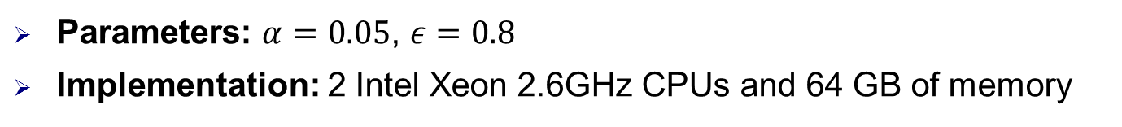
Experimental Setups
Datasets
Corpora | Datasets | Sentence level extractors | Relations | Mentions | Mentions with NA
DBpedia | DB_me | MaxEnt [ACL’ 14] | 51 | 53162 | 38654
 | DB_nn | NN [ACL’ 16]
Algorithms
baseline | ILP based global method for RE [ACL’ 14]
CNN+ATT | Neural network-based methods with attention mechanism to use all informative sentences [ACL’ 16]
PCNN+ATT
eFIRE | The easy FIrst approach for Relation Extraction with information redundancies
eFIRE-1S | A variant of eFIRE that makes easy decisions with the easy first collective inference, and adopts the same ILP method in baseline for making the rest decisions.
eFIRE-2S | A variant of eFIRE that makes all decisions with the second stage of eFIRE, i.e., the ILP solver
Parameters: $α=0.05$, $ε=0.8$
Implementation: 2 Intel Xeon 2.6GHz CPUs and 64 GB of memory
Notes:
1. All experiments are conducted on two datasets.
They stem from a same corpus, and use different sentence level local extractor to output the conference scores.
One is a traditional maximum entropy model, the other is a neural network model.
2. We compare our approach with the popular and the state-of-the art solutions.
And, we implement two variants of our approaches to evaluate the impacts of two stages.
A variant of our approach

Slide 21
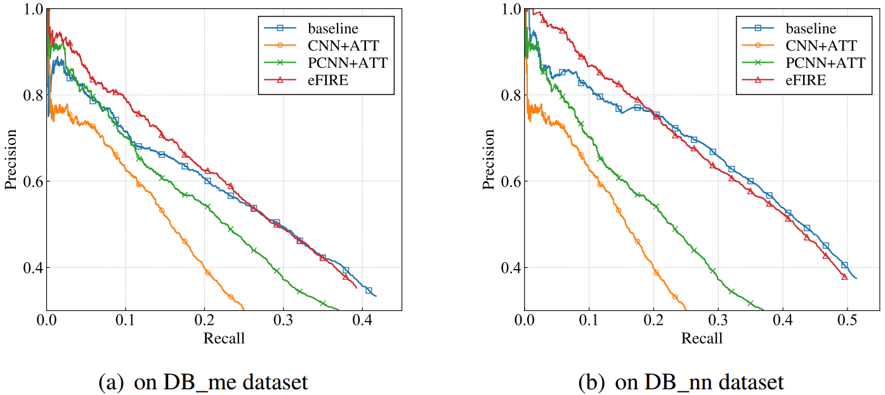
Overall performance: Effectiveness
Improve over the comparison methods in the low recall portion $\left[0, 0.25\right]$
Datasets | baseline | CNN+ATT | PCNN+ATT
DB_me | 4.80%↑ | 17.99%↑ | 7.69%↑
DB_nn | 4.36%↑ | 28.10%↑ | 17.82%↑
Notes:
For effectiveness, we use Precision-Recall Curve to measure.
On two datasets, our approach performs best, and improves over them by 4%-28% in the low recall portion.

Slide 22
Overall performance: Efficiency
Datasets | Methods | Running Time (s) | # of ILP Variables | # of ILP Constraints
DB_me | baseline | 52.70 | 12353 | 293361
 | eFIRE | 1.88 | 8185 | 34931
 | CNN+ATT | 69.49 | - | -
 | PCNN+ATT | 34.55 | - | -
DB_nn | baseline | 15.82 | 11770 | 94498
 | eFIRE | 1.11 | 9678 | 24314
 | CNN+ATT | 69.49 | - | -
 | PCNN+ATT | 34.55 | - | -
eFIRE is on average (28, 14), (37, 63) and (18, 31) times faster than baseline, CNN+ATT and PCNN+ATT on (DB_me, DB_nn), respectively
Notes:
For efficiency, we use the running time to measure.
Our approach is 14-63 times faster than them on two datasets.

Slide 23
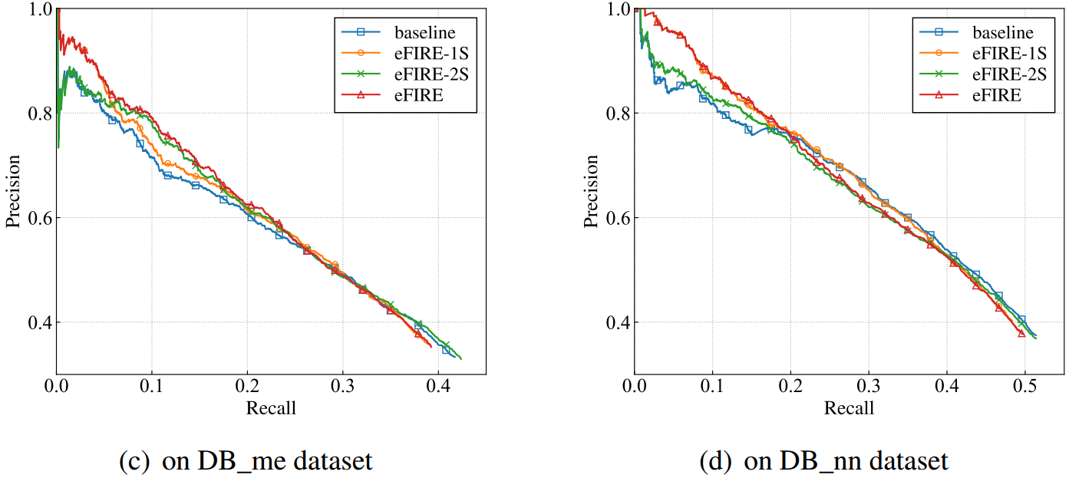
Improvement By Each Stage: Effectiveness
eFIRE-1S and eFIRE-2S outperform baseline in the low-recall portions of the P-R curves on all two datasets.
Those demonstrate the benefit of S-O, S-R, O-R, and R redundancies.
Notes:
Then, evaluate the impacts of two stages.
eFIRE-1S and eFIRE-2S outperform baseline on two datasets.
Those demonstrate the benefit of the redundancies.

Slide 24
Improvement By Each Stage: Efficiency
Datasets | Methods | Running Time (s) | # of ILP Variables | # of ILP Constraints
DB_me | baseline | 52.70 | 12353 | 293361
 | eFIRE | 1.88 | 8185 | 34931
 | eFIRE-1S | 1.90 | 8185 | 34931
 | eFIRE-2S | 52.35 | 12353 | 293361
DB_nn | baseline | 15.82 | 11770 | 94498
 | eFIRE | 1.11 | 9678 | 24314
 | eFIRE-1S | 1.20 | 9678 | 24314
 | eFIRE-2S | 15.81 | 11770 | 94498
Easy first collective inference using S-O redundancies can not only improve the effectiveness of decision making for RE, but also improve the efficiency
Notes:
The running time of eFIRE-1S is much less than that of baseline. This demonstrates that [Easy … efficiency]

Slide 25
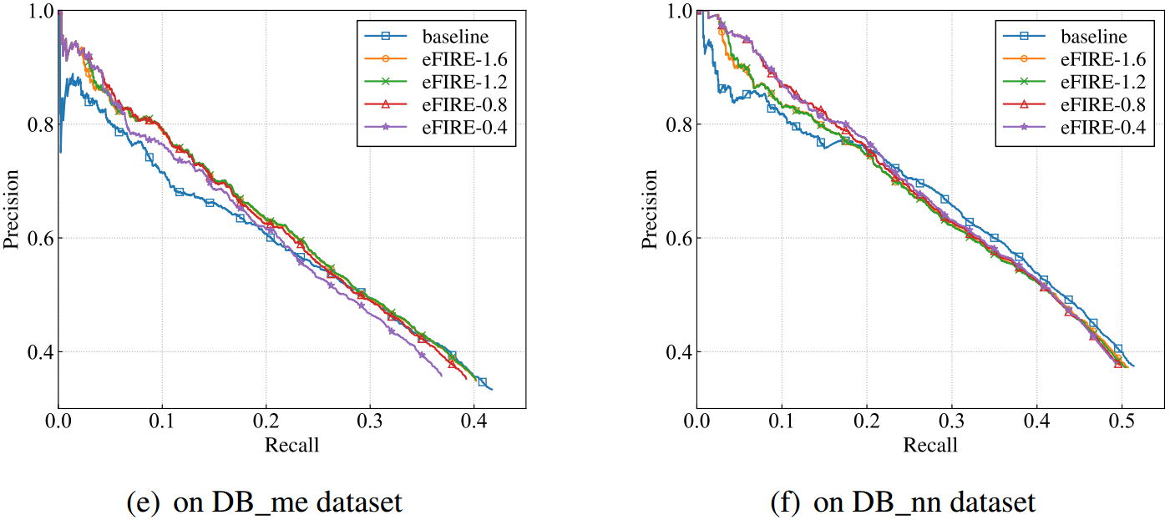

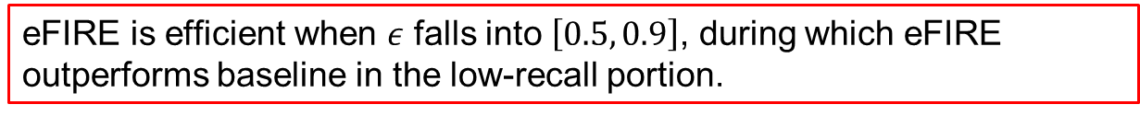
Setting verification of threshold$ε$: Effectiveness
eFIRE is efficient when $ε$ falls into $\left[0.5, 0.9\right]$, during which eFIRE outperforms baseline in the low-recall portion.
Notes:
Finally, we evaluate the impacts of different thresholds setting.
When threshold falls into a wide range, our approach outperforms baseline in the low-recall portion.

Slide 26
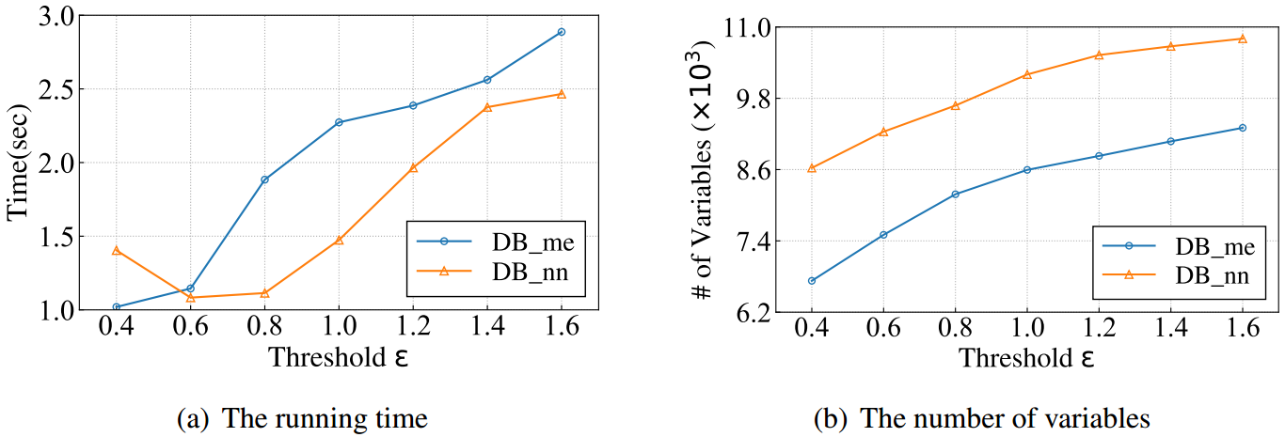
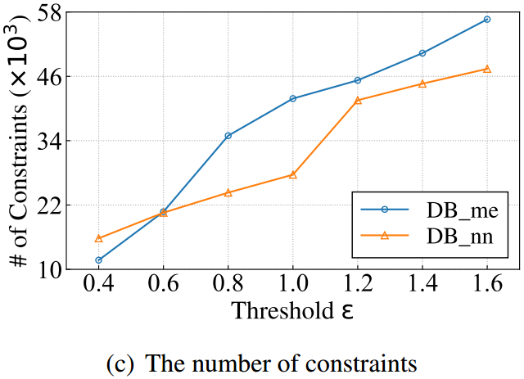

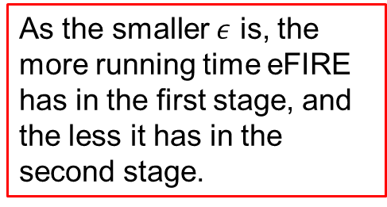
Setting verification of threshold$ε$: Efficiency
As the smaller $ε$ is, the more running time eFIRE has in the first stage, and the less it has in the second stage.
Notes:
Threshold obviously has an impact on the running time, As the smaller threshold is, the more running time the framework has in the first stage, and the less it has in the second stage.

Slide 27
Outline
Related Concepts
Easy First Relation Extraction Framework
Experimental Study
Summary
Notes:
Now, we briefly summarize

Slide 28
Summary
An fast easy first approach for relation extraction by making use of information redundancies
Relation extraction with two stages:
Easy decisions making by easy first collective inference
Hard decisions making by integer linear programming
Dual advantages of effectiveness and efficiency
Notes:
In this work, we introduce an [fast … redundancies];
The framework consists of two stages: First, make easy decisions by easy first collective inference; then make hard decisions by ILP
The experimental study shows that our approach has the dual advantages of effectiveness and efficiency.

Slide 29
Thanks! Q & A

