Slide 1



Easy-First关系抽取
Relation Extraction (RE)
Crucial role for many knowledge based applications
Two types of relation extractors:
local (based on sentences) and global (based on corpora)
Global RE as a constrained optimization
Resolve conflict decisions
Utilize the dependencies among extracted facts
Be solved by mature optimization models
e.g. integer linear programming (ILP)
Notes:
As we know, Relation extraction (RE) has been extensively studied due to its crucial role for many knowledge based applications, such as question answering, knowledge graph, and recommender system.
There are two types of relation extractors: local and global. The former identify relationships between entity pairs individually according to the local features of sentences; The latter make decisions by further considering joint features of the entire corpus
Global relation extractors are able to resolve conflict decisions, and to utilize the dependencies among extracted facts to improve the performance, commonly by formalizing RE as a constrained optimization problem and solving RE with integer linear programming

Slide 2
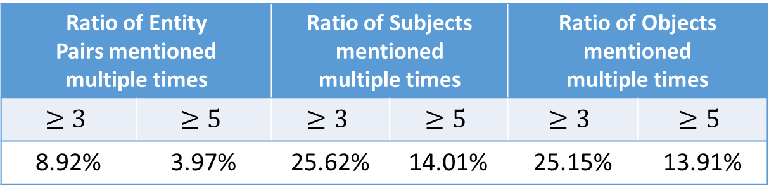
Easy-First关系抽取
Challenges of Integer Linear Programming for RE
too much computing time and memory of ILP with voluminous variables and constraints
Redundant information are common, but needs to be encoded cautiously
#Mentions | #Entity Pairs | #Subjects | #Objects
53162 | 30864 | 11360 | 9709
Ratio of Entity Pairs mentioned multiple times |  | Ratio of Subjects mentioned multiple times |  | Ratio of Objects mentioned multiple times
8.92% | 3.97% | 25.62% | 14.01% | 25.15% | 13.91%
Redundancies Types
S-O redundancies; S-R redundancies;
O-R redundancies; R redundancies
Shuai Ma, Gang Wang, Yansong Feng, and Jinpeng Huai, Easy First Relation Extraction with Information Redundancy, EMNLP 2019.
, Wanpracha Art Chaovalitwongse. A novel link prediction approach for scale-free networks. WWW 2014.
Notes:
Using integer linear programming for RE as a blackbox solver is a challenging task.
First, with the increase of entity pairs and candidate relations, the variables and constraints encoded for ILP increase dramatically, which in return may consume too much computing time and memory.
Second, redundant information needs to be encoded cautiously.
For example, when we choose which city is the capital of Australia based on input data, the simple statistical methods, such as confidence summation, may easily lead to a wrong decision in this case.
So, A efficient and effective global relation extractor is neede.

Slide 3
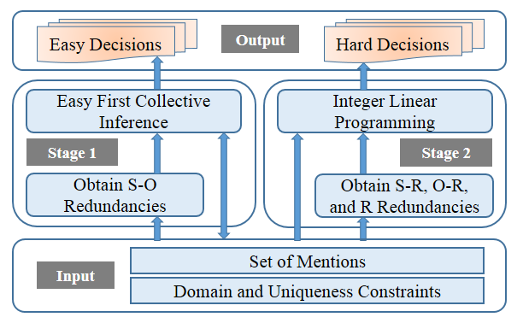
Easy-First关系抽取
Domain constraints
Uniqueness constraints
Subject Domain | Relation | Object Domain
Countries | largestCity | Cities
Organizations | locationCity | Cities
Persons | nationality | Countries
Subject Domain | Relation | Object Domain
Persons | birthPlace | Cities
Countries | capital | Cities
Shuai Ma, Gang Wang, Yansong Feng, and Jinpeng Huai, Easy First Relation Extraction with Information Redundancy, EMNLP 2019.
Notes:
Using integer linear programming for RE as a blackbox solver is a challenging task.
First, with the increase of entity pairs and candidate relations, the variables and constraints encoded for ILP increase dramatically, which in return may consume too much computing time and memory.
Second, redundant information needs to be encoded cautiously.
For example, when we choose which city is the capital of Australia based on input data, the simple statistical methods, such as confidence summation, may easily lead to a wrong decision in this case.
So, A efficient and effective global relation extractor is neede.

Slide 4
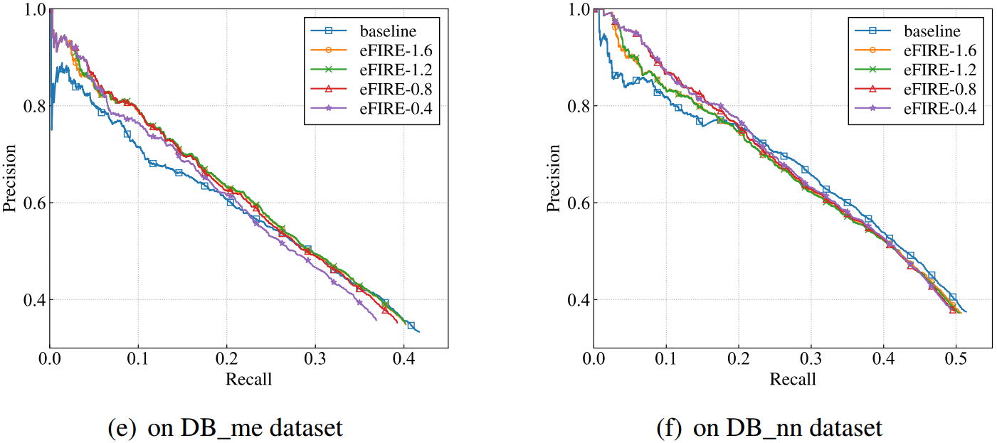
Easy-First关系抽取
Datasets | Methods | Running Time (s) | # of ILP Variables | # of ILP Constraints
DB_me | baseline | 52.70 | 12353 | 293361
 | eFIRE | 1.88 | 8185 | 34931
DB_nn | baseline | 15.82 | 11770 | 94498
 | eFIRE | 1.11 | 9678 | 24314
Shuai Ma, Gang Wang, Yansong Feng, and Jinpeng Huai, Easy First Relation Extraction with Information Redundancy, EMNLP 2019.

