Slide 1
A Collective Approach to Scholar Name Disambiguation
Dongsheng Luo
Dec 2018

Slide 2
Outline
Introduction
Problem Formulation
Proposed Method
Experimental Results
Conclusion with future work

Slide 3
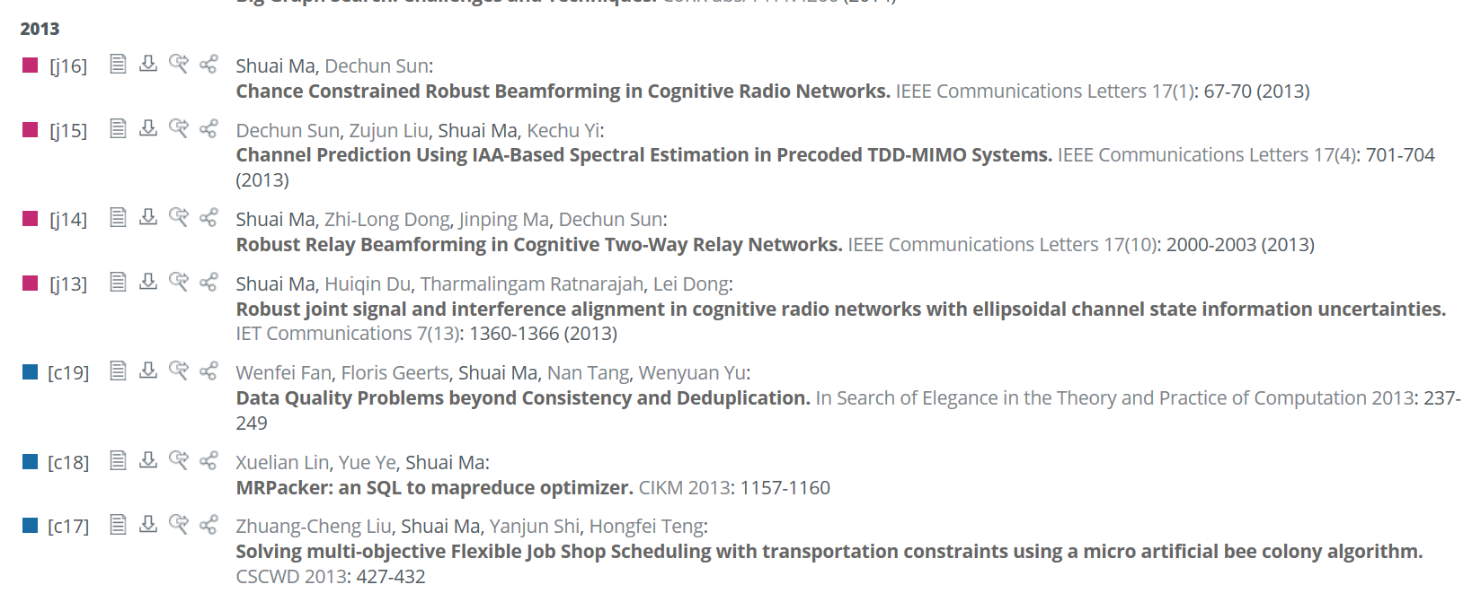
Introduction
Scholar name ambiguity is a common data quality problem for digital libraries such as DBLP and Microsoft Academic Search.
The searching results of DBLP with query “Shuai Ma” .
Xidian University
Beihang University

Slide 4
Introduction
Name Disambiguation is a hard and unsolved problem which causes troubles in many applications.
Scholar search
Document retrieval
Researcher interest analytics.
…

Slide 5
Challenges
Limited Information is available.
DBLP only provides basic paper and citation information, e.g., author names, publication title, venue and publication year.
Name disambiguation of each name affects others.
Instead of disambiguate each name separately, we treat all author names collectively.

Slide 6
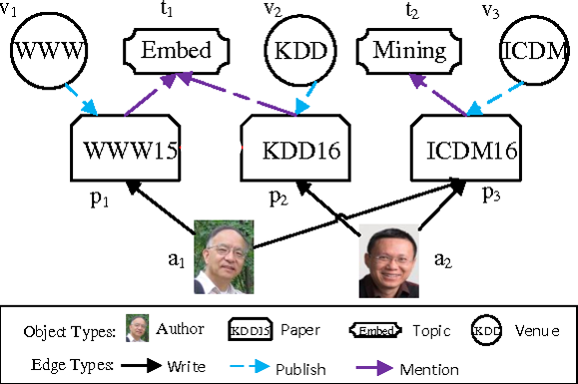
Problem Formulation
Use the heterogeneous information network to represent the data.
There are three types of nodes: Author, Paper, and Venue.
Three types of edges: write, publish and mention

Slide 7
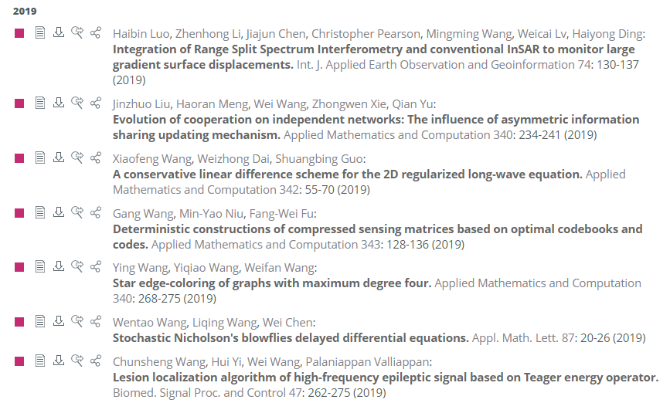
Problem Formulation
Input: a set of citation records.
A typical citation record is
Yizhou Sun, Jiawei Han, Xifeng Yan, Philip S. Yu, and Tianyi Wu, "PathSim: Meta Path-Based Top-K Similarity Search in Heterogeneous Information Networks", PVLDB4(11): 992-1003, 2011. (Also, Proc. of 2011 Int. Conf. on Very Large Data Bases (VLDB'11/PVLDB), Seattle, WA, Aug. 2011.
A record contains author names, publication title, venue (conference/journal name), publication year.
Output: A clean heterogeneous multipartite network, where each author connects to all and ideally only all papers written by him/her.
Name
disambiguation

Slide 8
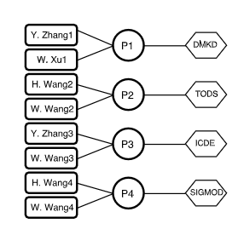
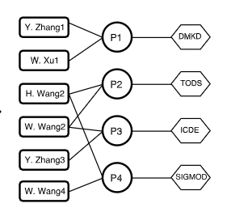
Proposed Framework
Records
Name Disambiguation via Collective Clustering
Data representation
heterogeneous multipartite network
Similarity measurement
Assembling Coauthor, Coauthor name, venue, and title similarity.
Collective Clustering
Initially, each author reference is considered as an author entity.
Merge the author pairs with high similarity scores and update the network.
Repeat until all names are fully disambiguated.
Initial network
…
Collective
Clustering
Final network
Notes:
This process need to be done many times, because merging authors will change the similarity scores of others

Slide 9

Similarity Measurement
Measure the similarity between two authors from 4 different perspectives.
Coauthors: $sim_{a}$
Title word: $sim_{t}$
Venue: $sim_v$
Coauthors Name$sim_{n}$
Wei Wang
P1
Phillips Yu
P2
Wei Wang
Wei Wang
P1
Learning
P2
Wei Wang
Wei Wang
P1
KDD
P2
Wei Wang
Wei Wang
P1
Phillips Yu
Phillips Yu
P2
Wei Wang
Notes:
This is an example to show the similarity between two Wei Wang from 4 persectives.
Coauthors: whether these two authors have the same coauthors.
Title word: whether these two authors use the same words in their paper titles.
Venue: whether these two authors
Coauthor names: whether these two authors have two coauthors with the same name

Slide 10
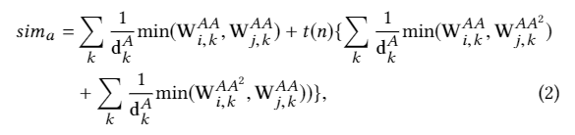
Similarity Measurement
For each perspective, normalized Histogram Intersection Kernel is used to calculate the similarity scores.
For example,
The first item measures how many coauthors they shared. The second item takes multi-hop coauthors into consideration.

Slide 11
Dealing with Sparsity
Some authors only publish a small number of papers, especially in the initial network.
To make a good judgment, we expand the limited information for authors by considering word-word similarity and venue-venue similarity.
Word-word Similarity
Use Word2vec* to learn word representations from normalized titles.
Use cosine similarity of representations to measure the similarity between words.
*Tomas Mikolov, Kai Chen, Greg Corrado, and Jeffrey Dean. Efficient estimation of word representations in vector space. arXiv:1301.3781 , 2013

Slide 12

Dealing with Sparsity
Venue-Venue Similarity
Two venues are similarity if many authors published papers in both.
Use Jaccard index of their author name sets as the similarity of two venues.
Notes:
The left part is the similarity between venue I and venue j.
N_i is the set of names of authors, who published at least one paper in venue i.

Slide 13

Author Similarity Assembling
Combine these four perspectives, we got the final similarity scores of two authors.
$sim=\sqrt{sim_{i}∗sim_{j}}$ where $i,j∈\{a,n,t,v\}$

Slide 14
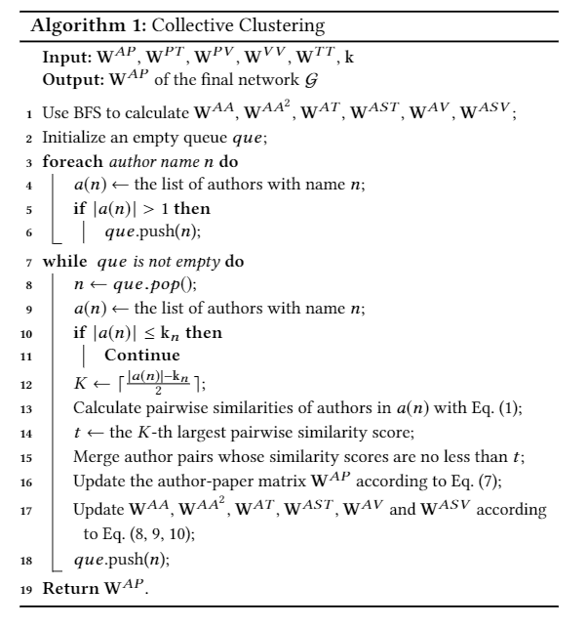
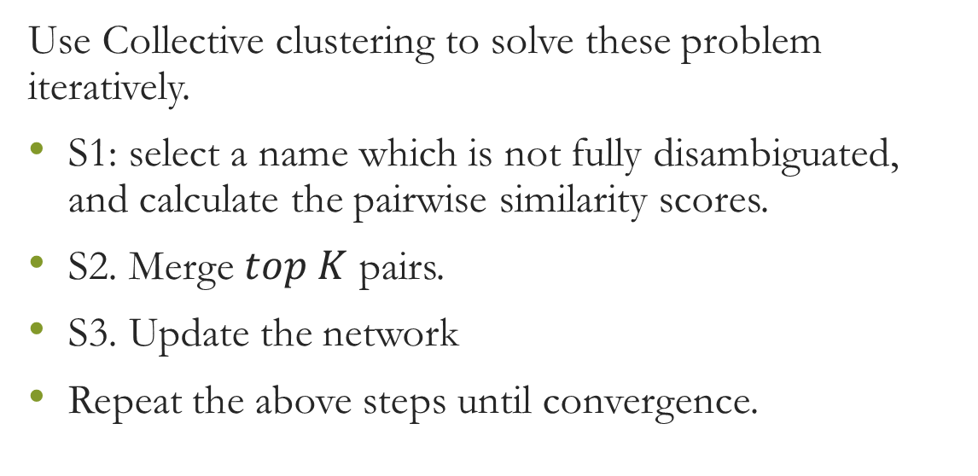
Collective Clustering
Use Collective clustering to solve these problem iteratively.
S1: select a name which is not fully disambiguated, and calculate the pairwise similarity scores.
S2. Merge $top K$ pairs.
S3. Update the network
Repeat the above steps until convergence.

Slide 15
Stop Condition
We estimate the number of authors for each name with a statistical method*, which is used as the stop condition.
A name is fully disambiguated is the number of authors reaches the estimated one.
*Shaohua Li, Gao Cong, and Chunyan Miao. Author name disambiguation using a new categorical distribution similarity. Machine learning and knowledge discovery in databases, pages 569–584, 2012.

Slide 16
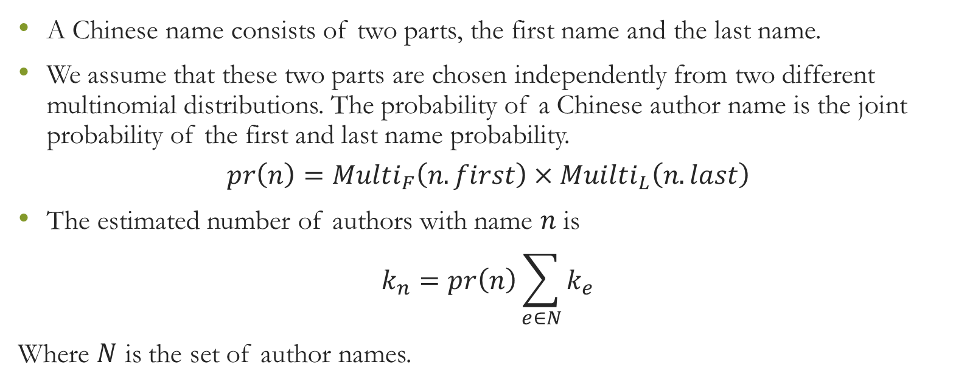
Stop Condition
A Chinese name consists of two parts, the first name and the last name.
We assume that these two parts are chosen independently from two different multinomial distributions. The probability of a Chinese author name is the joint probability of the first and last name probability.
$$pr\left(n\right)=Multi_{F}\left(n.first\right)×Muilti_{L}\left(n.last\right)$$
The estimated number of authors with name $n$ is
$$k_{n}=pr\left(n\right)\sum_{e∈N}{k_{e}}$$
Where $N$ is the set of author names.
Notes:
N(small case) is a (Chinese) name.
Pr(n) is the probability of an author’s name is n
n.First is the first name of n
n.Last is the last name of n
Multi_F is the multinomial distribution of the first name.
Multi_L is the multinomial distribution of the last name

Slide 17
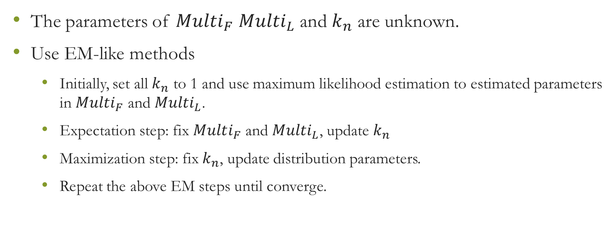
Stop Condition
The parameters of $Multi_{F}$ $Multi_{L}$ and $k_{n}$ are unknown.
Use EM-like methods
Initially, set all $k_{n}$ to 1 and use maximum likelihood estimation to estimated parameters in $Multi_{F}$ and $Multi_{L}$.
Expectation step: fix $Multi_{F}$ and $Multi_{L}$, update $k_{n}$
Maximization step: fix $k_{n}$, update distribution parameters.
Repeat the above EM steps until converge.

Slide 18
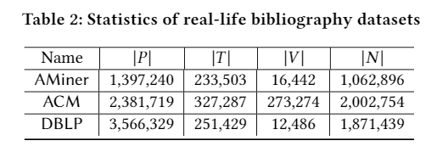

Experimental Results
Datasets
Test set
The test set comes from https://aminer.org/disambiguation. It contains 6,730 labeled papers of 110 author names.
Evaluation
F1-scores
Notes:
We compare the labelled papers with each dataset, and use their overlapped ones as the corresponding testing dataset. We use the Macro-F1 score to evaluate the effectiveness.

Slide 19
Experimental Results
Baselines
CE[1]: unsupervised, another collective method
Ghost[2]: unsupervised, based on coauthor networks
CSLR[3]: unsupervised
MIX[4]: supervised
[1] Indrajit Bhattacharya and Lise Getoor. Collective entity resolution in relational data.TKDD,1(1):5, 2007
[2] Xiaoming Fan, Jianyong Wang, Xu Pu, Lizhu Zhou, and Bing Lv. On graph-based name disambiguation. JDIQ, 2(2):10, 2011
[3] Shaohua Li, Gao Cong, and Chunyan Miao. Author name disambiguation using a new categorical distribution similarity. Machine learning and knowledge discovery in databases , pages 569–584, 2012.
[4] Madian Khabsa, Pucktada Treeratpituk, and C Lee Giles. Online person name disambiguation with constraints. In JCDL, 2015

Slide 20
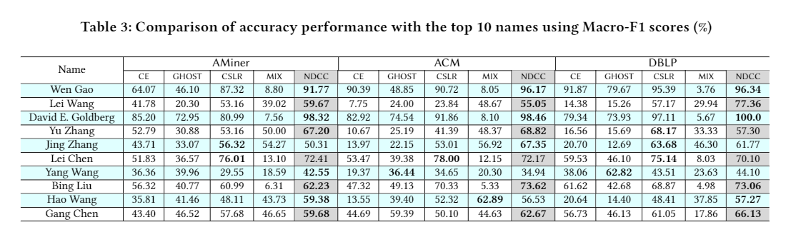
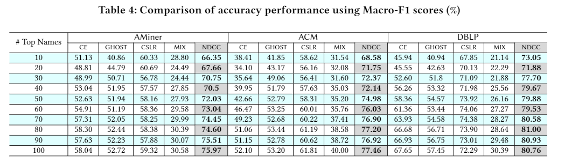
Accuracy performance comparison with baselines
Notes:
Setting: The accuracy results for all methods in three datasets are shown in Table3 and Table4 We rank the author names in the test set based on paper numbers . We list the Macro-F1 scores of the top 10 names with largest number of papers in Table3. We also calculate the Macro-F1 scores of top M names listed in Table4 where M \in [10,20,30,40,50,60,70,80,90,100]$. For each row, the top performer is highlighted in the bold font.
We observe that \ndcc consistently performs better than the other methods. \ndcc achieves the best performances on 8, 7 and 6 out of 10 names listed in~\aminer,~\acm and \dblp respectively.
With the top 100 names as the testing dataset, \ndcc improves the Macro-F1 over (\ce, \ghost, \cslr, \mix) by (17.87\%, 23.25\%,16.65\%, 45.39\%) on \aminer, (25.36\%, 24.26\%, 14.16\%, 37.46\%) on \acm, and (13.11\%, 23.31\%, 8.47\%, 50.37\%) on \dblp, on average, respectively.
The training data generated by \mix is quite biased, which leads to its low F1 scores.\ghost only uses coauthorships, which explains its unsatisfactory accuracy performance.Besides, 3 and 4-hop coauthorships used in \ghost are weak evidences. The ambiguity of (multi-hop) coauthors further harms the accuracy results.\ce neglects the venue-venue and word-word similarities, which leads to its low F1 scores.\cslr is a single name disambiguation method that also considers the similarity between venues and words to alleviate the problem caused by limited information. \ndcc outperforms it by (28.07\%, 25.32\% and 11.71\%) on (\aminer, \acm, \dblp), which justifies the advantage of collective clustering.

Slide 21
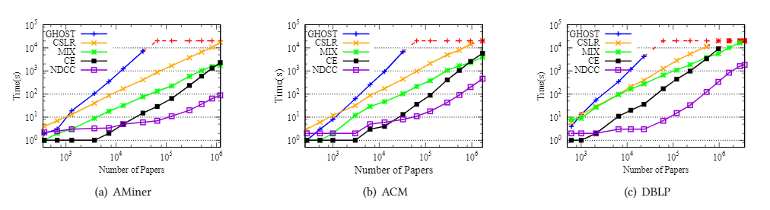
Efficiency evaluation.
For each datasets, we generate several subsets with different sizes.
Notes:
The results tell us that \ndcc is more efficient than the other four methods.
(a) \ndcc is (18, 195, 19) times faster than (\ce, \cslr and \mix) on \aminer, (15, 8) times faster than (\ce, \mix) on \acm, 10 times faster than \mix on \dblp, on average, respectively.
(b) While \ghost on (\aminer, \acm, \dblp), \cslr on (\acm, \dblp) and \ce on \dblp could not finish in 6 hours, \ndcc could finish on (\aminer, \acm, \dblp) in (98, 543, 2106) seconds, respectively.

Slide 22
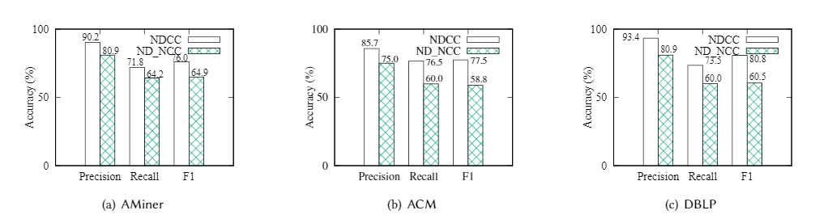
Compare with None Collective clustering
We compare NDCC with its non-collective version (NDNCC), which disambiguated authors names independently.
Notes:
The figures show that disambiguation of author names affects each other. By treating these names separately and independently, the disambiguation results of \ndncc are not satisfactory. On the other hand, by considering their relations and disambiguate all names collectively, \ndcc improves accuracy dramatically. Specifically, \ndcc improves the Macro-F1 over \ndcc by (11.1\%, 18.7\% and 20.3\%) on (\aminer, \acm, and \dblp), respectively.

Slide 23
Effectiveness of estimating author numbers
Since the only part of authors are labelled and the real author numbers are unknown.
Given an author name, we compare the number of clusters of the labelled papers with the number of labelled authors to verify the effectiveness of the proposed estimating method.

Slide 24
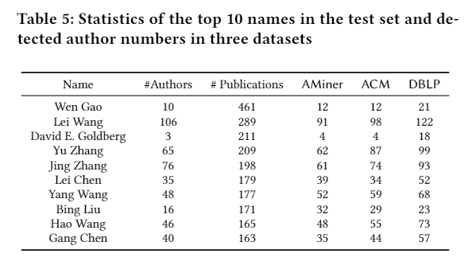
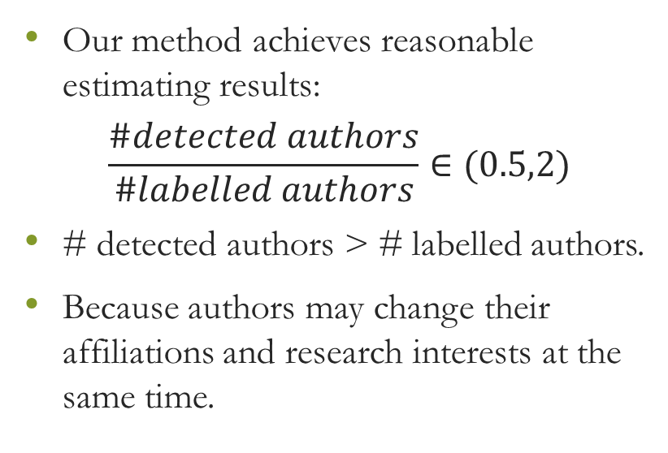
Effectiveness of estimating author numbers
Our method achieves reasonable estimating results:
$$\frac{\#detected authors}{\#labelled authors}∈(0.5,2)$$
# detected authors > # labelled authors.
Because authors may change their affiliations and research interests at the same time.
Notes:
In this case, it is hard for name disambiguation methods to tell whether papers published in two periods are written by the same person with limited information.

Slide 25
Conclusion

Slide 26
Future work
Use supervised learning methods to further improve the accuracy.
Develop algorithm for online setting.

Slide 27
Thanks!

Slide 28
Related Work
Supervised Learning methods. For each name to be disambiguated, supervised learning methods train a classifier, such as SVM, decision tree, to classify the related papers into different classes, with one class representing a author entity.
Unable to treat unseen authors.
One classifier for one name. It’s unpractical when we need to disambiguate all names.
Labelling data is time-consuming.

Slide 29
Related Work
Unsupervised learning methods. Given an author name, group the related papers into different clusters. Each cluster represents an author entity.
Agglomerative clustering
Affinity propagation
Markov clustering
…

Slide 30
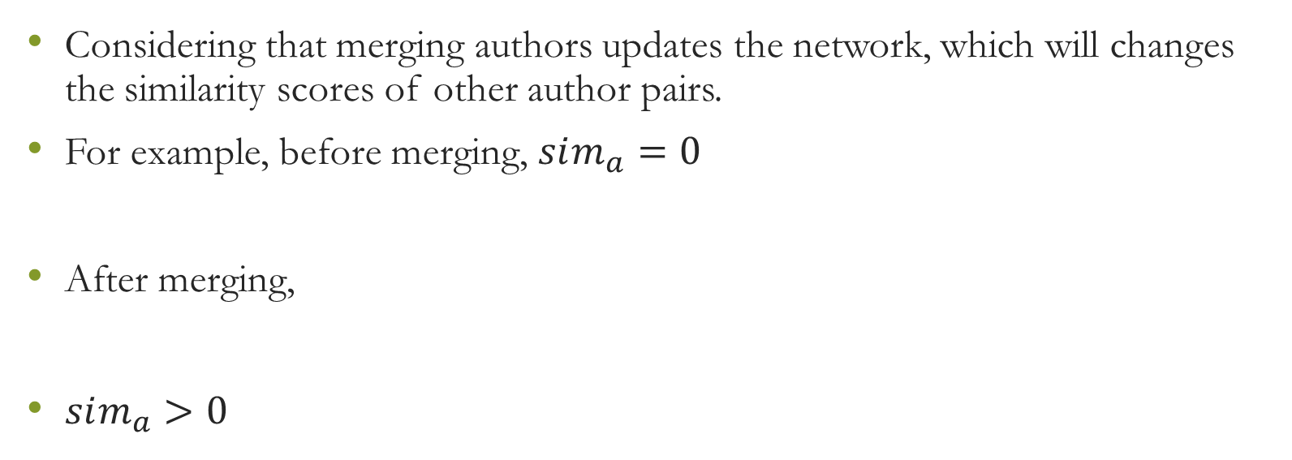
Collective Clustering
Considering that merging authors updates the network, which will changes the similarity scores of other author pairs.
For example, before merging, $sim_{a}=0$
After merging,
$sim_{a}>0$
Wei Wang
P1
Phillips Yu
Phillips Yu
P2
Wei Wang
Wei Wang
P1
Phillips Yu
P2
Wei Wang

Slide 31
Proposed Framework
Merge authors with high similarity scores
…
records
Initial network
Final Network
Notes:
This process need to be done many times, because merging authors will change the similarity scores of others

