Slide 1



Easy First Relation Extraction with Information Redundancy
马 帅

Slide 2




国家重点基础研究发展计划
网络信息空间大数据计算的基础研究(2014-2018)
Chief Scientist: Prof. Jinpeng Huai.
8 institutes involved
Focus on “computing theory and practice on Big Data”
http://cnbigdata.org/

Slide 3


北京市大数据科学与脑机智能创新中心
2015年，北京市首批北京高校高精尖创新中心
引领未来数据科学与计算智能的研究与应用方向
加速计算科学、数据科学与脑科学的交叉研究
促进高效智能的下一代计算与数据分析技术创新
通过以数据为中心的智能机器、系统及应用改变未来
Notes:
认定了13个

Slide 4

研究方向与机构设置
瓶颈1：计算的有效性遇到障碍
计算的有效性：
认识数据的内在特征，复杂网络、数学（统计）方法
瓶颈2：能耗成为突出问题
随着规模增大，调度复杂，计算系统功耗问题日益突出
传统存算分离的结构，产生大量的数据搬移开销
传统的计算和存储器件“功耗”不友好
瓶颈3：学习效率和灵活性
学习效率：需要大量的输入数据及标定数据，学习效率低
灵活性：普遍缺乏“类比、联想”等学习功能
数据科学与计算智能
数据工程与
脑机系统
新型计算技术与系统
认知机理与仿真
http://www.bdbc.org.cn/

Slide 5



研究方向面临的机遇与挑战
5
互联网改变
、 交流方式
大数据处理改变
经济和社会方式
计算数据量大
计算复杂度高
数据价值密度低
政治选举预测需要同时处理各种社交网络大数据(Facebook每天新增数据10TB )
发现危及国家安全的特定群体(若1个机器时钟处理1个顶点对，链接预测10⁸顶点网络需100天)
数据质量低严重制约许多企业的健康发展(全球1000强企业约25%的关键数据存在错误)
转变1:抽样与全样
量大、快变，数据统计特征分布不均匀，传统方法不适用－ “尝菜”
从无序数据到信息关联
转变2:精确与非精确
精确性不再是绝对追求目标，需对宏观趋势给出快速预测－买鞋
从信息关联到知识图谱
转变3:因果与关联
仅需知其然，有时无需知其所有然，用于发现事实、预测未来－医学
形成关联网谱
大数据：找不到最优解、最优解成本高
大数据近似计算：高效处理大数据问题

Slide 6
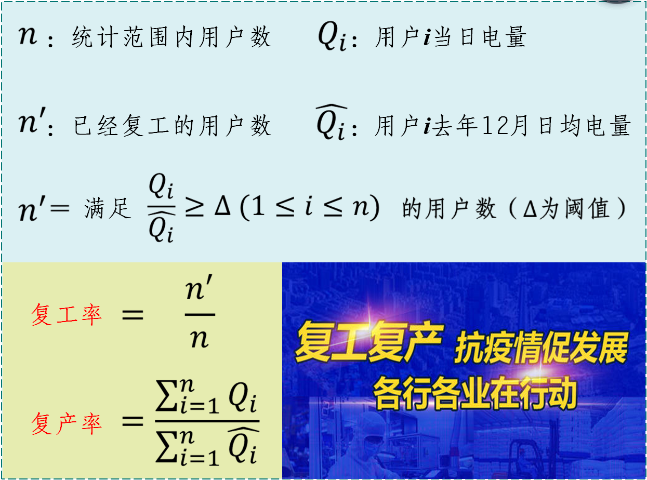

研究方向面临的机遇与挑战
6
分析背景
分析逻辑
2020年新冠肺炎疫情期间，受国家发改委委托，国家电网公司利用用电信息采集数据开展企业复工复产分析，按日提交分析报告，服务政府治理体系和治理能力现代化
基于大数据的复工复产分析：找不到最优解
一种企业复工复产情况智能分析方法, 国网大数据中心内部资料, 2020年7月
Notes:
人力-》直升机-》无人机

Slide 7



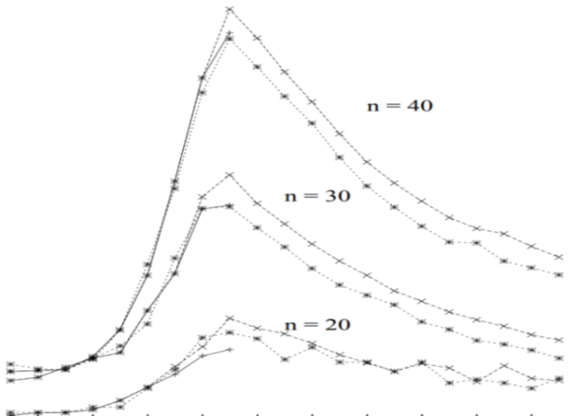
研究方向面临的机遇与挑战
7
国家大数据战略
与网络强国建设
联邦大数据战略
与美国情报战略
大数据产业推动
全球经济发展
普遍存在以难解易？难易实例的分离线？近似计算难解实例？
难解实例
任务感知
查询近似
大数据
近似
计算
数据感知
数据近似
新型存储
数据质量
易解
实例
易解
实例
Notes:
在已有研究基础上，我们针对普便存在的以难解易现象，深入分析了难解实例和易解实例的特性，猜想：在难易之间可能存在分离线，并思考了近似计算难解实例的可能性。
例如：结合任务感知、数据感知、新型存储，开展大数据近似计算研究。

Slide 8



Easy First Relation Extraction
Relation Extraction (RE)
Crucial role for many knowledge based applications
Two types of relation extractors:
local (based on sentences) and global (based on corpora)
Global RE as a constrained optimization
Resolve conflict decisions
Utilize the dependencies among extracted facts
Be solved by mature optimization models
e.g. integer linear programming (ILP)
Notes:
As we know, Relation extraction (RE) has been extensively studied due to its crucial role for many knowledge based applications, such as question answering, knowledge graph, and recommender system.
There are two types of relation extractors: local and global. The former identify relationships between entity pairs individually according to the local features of sentences; The latter make decisions by further considering joint features of the entire corpus
Global relation extractors are able to resolve conflict decisions, and to utilize the dependencies among extracted facts to improve the performance, commonly by formalizing RE as a constrained optimization problem and solving RE with integer linear programming

Slide 9
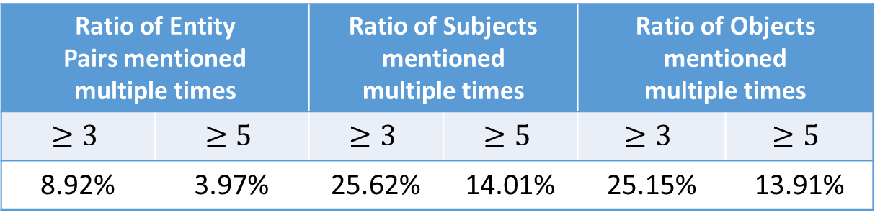
Easy First Relation Extraction
Challenges of Integer Linear Programming for RE
too much computing time and memory of ILP with voluminous variables and constraints
Redundant information are common, but needs to be encoded cautiously
#Mentions | #Entity Pairs | #Subjects | #Objects
53162 | 30864 | 11360 | 9709
Ratio of Entity Pairs mentioned multiple times |  | Ratio of Subjects mentioned multiple times |  | Ratio of Objects mentioned multiple times
8.92% | 3.97% | 25.62% | 14.01% | 25.15% | 13.91%
Redundancies Types
S-O redundancies; S-R redundancies;
O-R redundancies; R redundancies
Shuai Ma, Gang Wang, Yansong Feng, and Jinpeng Huai, Easy First Relation Extraction with Information Redundancy, EMNLP 2019.
Notes:
Using integer linear programming for RE as a blackbox solver is a challenging task.
First, with the increase of entity pairs and candidate relations, the variables and constraints encoded for ILP increase dramatically, which in return may consume too much computing time and memory.
Second, redundant information needs to be encoded cautiously.
For example, when we choose which city is the capital of Australia based on input data, the simple statistical methods, such as confidence summation, may easily lead to a wrong decision in this case.
So, A efficient and effective global relation extractor is neede.

Slide 10
Easy First Relation Extraction
Why Easy First Strategy?
Easy (most confident) decisions are accurate
Eliminate conflict candidates with constraints
Reduce the number of remaining variables to consider
Achieve precision and efficiency improvement
Relation Extraction Process
Traditional Methods
Easy First Method
All Candidates
Remaining Candidates
Constraints
Collective Inference
Constraints
Refined ILP
Integer Linear Programming
Redundancies
Easy Decisions
Hard Decisions
Decisions
Shuai Ma, Gang Wang, Yansong Feng, and Jinpeng Huai, Easy First Relation Extraction with Information Redundancy, EMNLP 2019.
Notes:
We propose an easy first approach for RE by making use of information redundancies
Why do we use easy first?
There are a lot of most confident decisions in the local results, and they are accurate
We make the easy decisions first and eliminate conflict candidates by constraints
It will exclude a lot of wrong candidates and the number of remaining candidates decrease greatly
The approach achieve precision and efficiency improvement
The process of the traditional approaches is that consider all candidates to make decisions by using ILP .
The easy first approach use redundancy to distinguish the easy decisions from all candidates. To remaining candidates, it use the ILP to find an optimal configuration

Slide 11
Outline
Redundancies and Constraints
Easy First Relation Extraction
Experimental Study
Notes:
Now, we show our work in details

Slide 12
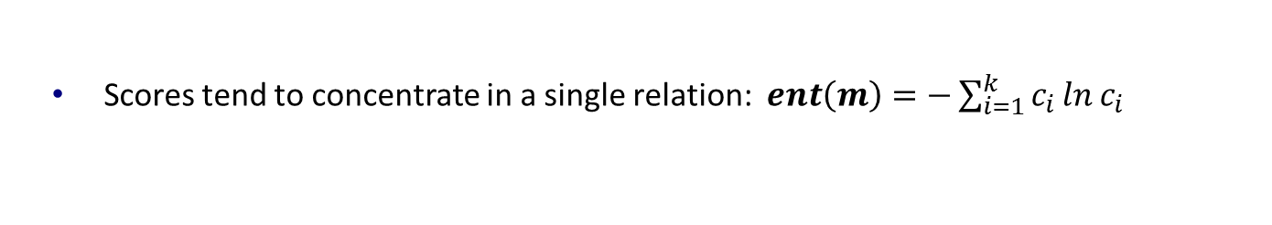


Redundancies for Easy Decisions
Characteristics of Easy Decisions
High certainty degree
Many repeated times
Most confident
Example of Local Results
 | Entity Pair (S, O) | Top-3 Candidate Relations (relation R: score C)
m₁ | Australia, Sydney | capital : 0.6 | birthPlace : 0.35 | nationality : 0.05
m₂ | Australia, Sydney | capital : 0.7 | country : 0.23 | birthPlace : 0.07
m₃ | Australia, Canberra | capital : 0.96 | birthPlace : 0.03 | unknown : 0.01
RC
0.18
0.57
Certainty Degree
(1) S-O Redundancy for Distinguishing Easy Decisions
Consider certainty degree and repeated times of mentions with
enforce that the more certain, the greater sum
same<subject, object, top-one relation>: $RC\left(s, r_{1}, o\right)=\sum_{m^{′}∈M_{s, o, r_{1}}}{α^{ent\left(m^{′}\right)}}$
Notes:
Easy Decisions have two characteristics: high certainty degree and many repeated times.
Let’s see a example
Each row is a mention, it corresponds a sentence in the corpus. It has subject, object and some candidate relations with scores
We define certainty degree to evaluate whether scores tend to concentrate in a single relation
To distinguish easy decisions, we consider both certainty degree and repeated times of mentions with same tuple
Alpha is a small positive number to enforce that the more certain, the greater redundancy score we can obtain
From the example, Canberra as the capital of Australia is more confident

Slide 13

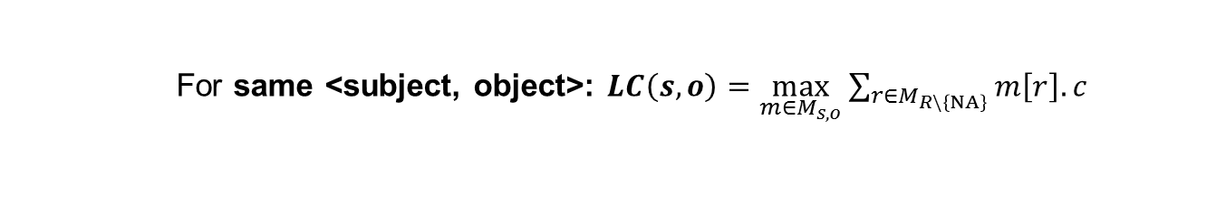
Redundancies for Easy Decisions
 | Entity Pair (S, O) | Top-3 Candidate Relations (relation R: score C)
m₁ | Australia, Sydney | capital : 0.6 | birthPlace : 0.35 | nationality : 0.05
m₂ | Australia, Sydney | capital : 0.7 | country : 0.23 | birthPlace : 0.07
m₃ | Australia, Canberra | capital : 0.96 | birthPlace : 0.03 | unknown : 0.01
(2&3) S-R and O-R redundancies
Whether a subject (or an object) meets the domain requirement of a relation
E.g. 𝑳𝑪(Australia, capital) > 𝑳𝑪(Australia, birthPlace) means
“Australia” tend to be the subject of capital rather than birthPlace
For same <subject, relation>: $LC\left(s,r\right)=\frac{\sum_{m∈M_{s}}{m\left[r\right].c}}{\sum_{m∈M_{s}}{\sum_{r^{′}∈R\backslash \left\{NA\right\}}{m\left[r\right].c}}}$
(4) R redundancies
Whether a subject and an object have a non-unknown relation
For same <subject, object>: $LC\left(s, o\right)=\max_{m∈M_{s, o}}{\sum_{r∈M_{R\backslash \left\{NA\right\}}}{m\left[r\right].c}}$
Notes:
We also find other redundancies
S-R and O-R redundancies evaluate whether a subject (or an object) meets the domain requirement of a relation. When computing the likelihood score, we use the scores of the same subjects and relations
For example, “Australia” tend to be the subject of capital rather than birthplace, the subject domain of capital and birthplace are country and person respectively
Finally, R redundancies evaluate whether a subject and an object have a relation. The Likelihood score selects prominent information to measure the probability
For example, there is a high probability of a relation between Australia and Canberra

Slide 14
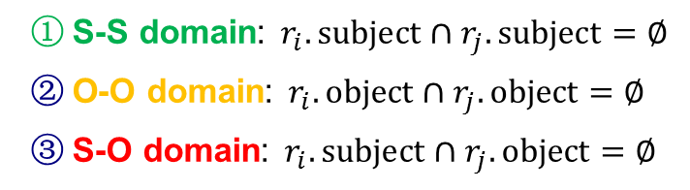
Redundancies for Easy Decisions
Domain Constraints
Enforce constraints among the subject and object domains of relations.
Subject Domain | Relation | Object Domain
Countries | largestCity | Cities
Organizations | locationCity | Cities
Persons | nationality | Countries
S-S domain: $r_{i}.subject∩r_{j}.subject=∅$
O-O domain: $r_{i}.object∩r_{j}.object=∅$
S-O domain: $r_{i}.subject∩r_{j}.object=∅$
Uniqueness Constraints
Enforce the uniqueness of the subjects and objects of relations.
O (S) uniqueness: Given a object (or an object), the relation should have unique subjects (or objects)
Subject Domain | Relation | Object Domain
Persons | birthPlace | Cities
Countries | capital | Cities
Notes:
Now, we introduce the constraints
S-S domain constraint ensures the subjects of two relations with this constraints belong to different domain, that is, the subjects of two relations are disjoint
For example, it ensure relations largestCity and locationCity share no common entities between their subjects
O-O and S-O domain constraints have similar definition
For Uniqueness constraints, if a relation has O uniqueness constraints, given a object, it should have unique subjects
For example, relation capital has O uniqueness, because a city can be capital of only one country.

Slide 15
Outline
Redundancies and Constraints
Easy First Relation Extraction Framework
Experimental Study
Notes:
Next, we show the experimental study

Slide 16
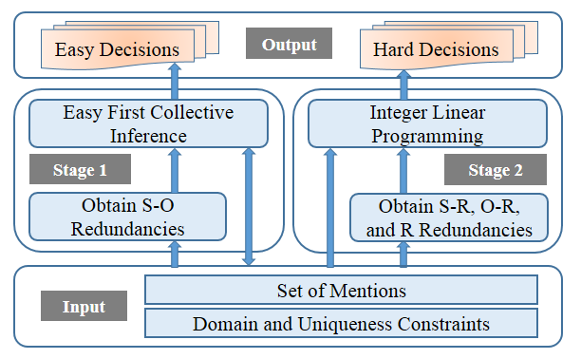
Easy First RE Framework
Stage 1: Easy First Collective Inference
Utilize S-O redundancies
Make easy (most confident) decisions
Stage 2: Integer Linear Programming
Utilize S-R, O-R, and R redundancies
Make hard decisions with ILP
Notes:
First, our approach obtains S-O redundancies, and makes easy decisions with collective inference in the first stage.
Then it obtains other three redundancies, and makes hard decisions with ILP in the second stage.

Slide 17
Stage 1: Easy First Collective Inference
A set M of mentions produced by local extractor
1. Compute S-O redundancy scores for each <subject, object, top-one relation>
2. Sort tuples in descending order of the scores, and store them in a max-heap
To avoid error propagation, using the top-one relations of mentions only
The highest redundancy score is greater than 𝜖
1. Put the candidate with the highest redundancy score into the decisions set
Threshold 𝜖 distinguish easy decisions from hard ones based on S-O redundancies
2. Remove the conflict candidates directly based
on domain and uniqueness constraints
Stage 1 greatly reduces the variables and constraints encoded in the ILP
Easy Decisions E
Notes:
First, It computes the S-O redundancy scores for all tuples.
In the first stage, easy decisions must be highly accurate to avoid error propagation. So we consider the top-one relations only.
In the loop, we first put the candidate with the highest score into the decisions set
Once a decision is made, disagreements are resolved immediately with domain and uniqueness constraints directly
The above process is repeated until the highest score in the max-heap is less than a threshold (/'epsɪlɒn/), which is to ensure the correctness of decisions.
Stage 1 greatly reduces the variables and constraints encoded in the ILP

Slide 18
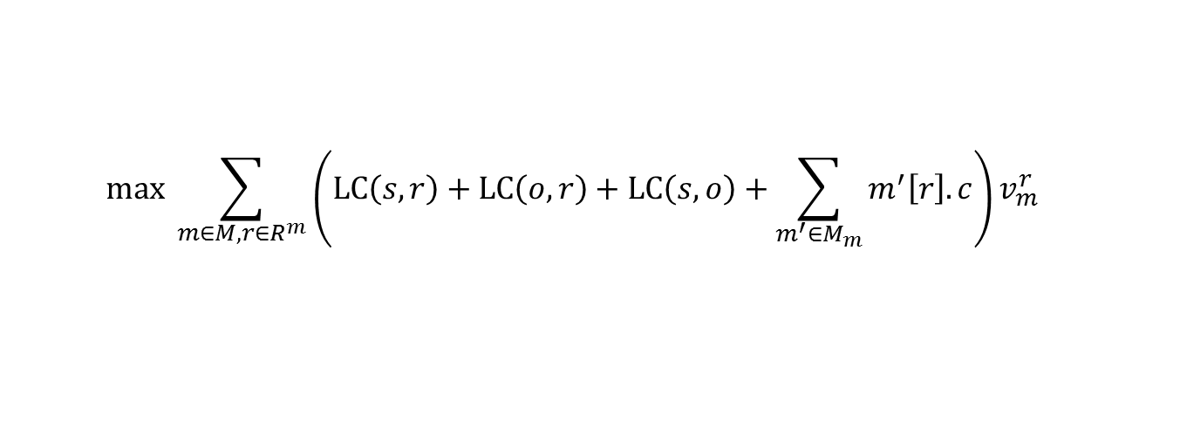
Stage 2: Integer Linear Programming
Hard Decisions Making
Find an optimal configuration for the remaining candidates
Utilize S-R, O-R, and R redundancies
Solve the disagreements by domain and uniqueness constraints
Adopt the ILP tool “IBM ILOG CPLEX”
Objective Function
Maximize the overall confidence of the made decisions
$$max \sum_{m∈M, r∈R^{m}}{\left(LC\left(s, r\right)+LC\left(o, r\right)+LC\left(s, o\right)+\sum_{m^{′}∈M_{m}}{m^{′}\left[r\right].c}\right)v_{m}^{r}}$$
①
②
① Encourage to select candidates meeting the domain requirements of relations
② Consider decisions produced by local extractors.
Notes:
In the second stage, our goal is to find an optimal configuration for the remaining candidates, making use of other three redundancies, solving the disagreements by domain and uniqueness constraints encoded in ILP, we use CPLEX to solve it
For each candidate, the objective function consists of two parts: The former is designed to encourage the model to select candidates meeting the domain requirements of relations, and the latter is designed to give consideration to decisions produced by local extractors.

Slide 19
Outline
Redundancies and Constraints
Easy First Relation Extraction Framework
Experimental Study
Notes:
Next, we show the experimental study

Slide 20
Experimental Setups
Datasets
Corpora | Datasets | Sentence level local extractors | Relations | Mentions | Mentions with unknown
DBpedia | DB_me | MaxEnt [ACL’ 14] | 51 | 53162 | 38654
 | DB_nn | NN [ACL’ 16]
Algorithms
eFIRE (Ours) | The easy FIrst approach for Relation Extraction with information redundancies
baseline | ILP based global method for RE [ACL’ 14]
CNN+ATT | Neural network-based methods with attention mechanism to use all informative sentences [ACL’ 16]
PCNN+ATT
Parameters: $α=0.05$,$ε=0.8$
Implementation: 2 Intel Xeon 2.6GHz CPUs and 64 GB of memory
Notes:
1. All experiments are conducted on two datasets.
2. We compare our approach with the popular and the state-of-the-art solutions.

Slide 21
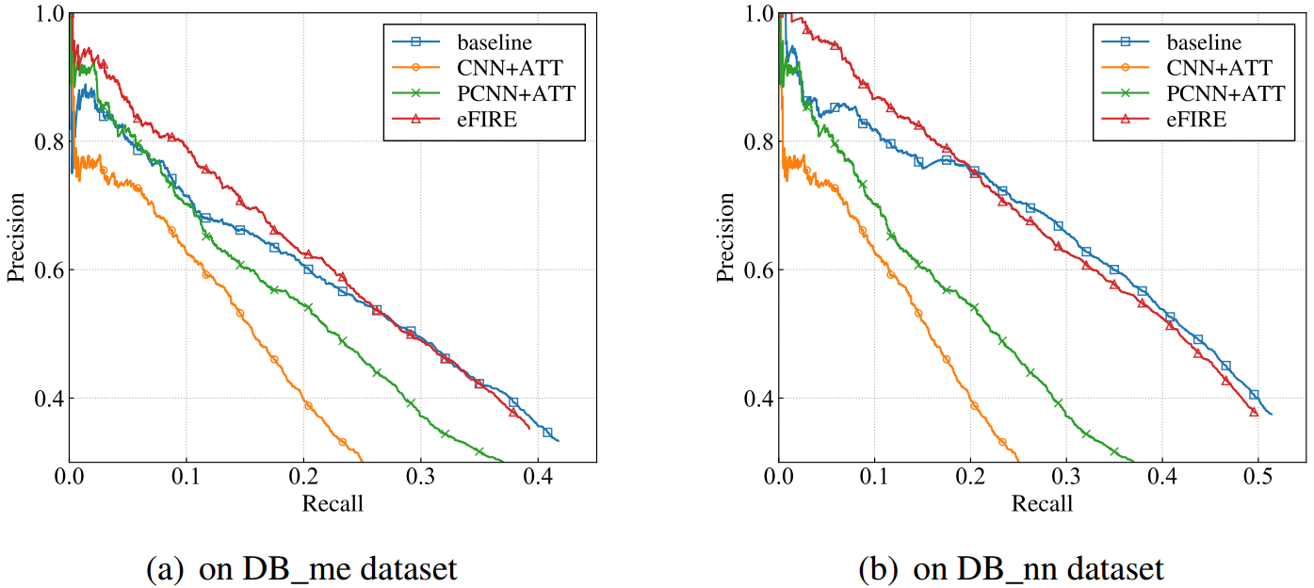
Overall performance: Effectiveness
Improve over the comparison methods in the low recall portion [0, 0.25]
Datasets | baseline | CNN+ATT | PCNN+ATT
DB_me | 4.80%↑ | 17.99%↑ | 7.69%↑
DB_nn | 4.36%↑ | 28.10%↑ | 17.82%↑
Notes:
For effectiveness, we use Precision-Recall Curve to measure.
Our approach performs best, and improves over them by 4%-28% in the low recall portion.

Slide 22
Overall performance: Efficiency
Datasets | Methods | Running Time (s) | # of ILP Variables | # of ILP Constraints
DB_me | baseline | 52.70 | 12353 | 293361
 | eFIRE | 1.88 | 8185 | 34931
 | CNN+ATT | 69.49 | - | -
 | PCNN+ATT | 34.55 | - | -
DB_nn | baseline | 15.82 | 11770 | 94498
 | eFIRE | 1.11 | 9678 | 24314
 | CNN+ATT | 69.49 | - | -
 | PCNN+ATT | 34.55 | - | -
Faster than all comparison methods on all datasets
Datasets | baseline | CNN+ATT | PCNN+ATT
DB_me | 28x↑ | 37x↑ | 18x↑
DB_nn | 14x↑ | 63x↑ | 31x↑
Notes:
For efficiency, our approach is 14-63 times faster than them

Slide 23
Summary
23
An easy first approach for relation extraction by making use of information redundancies
Relation extraction with two stages:
Easy decisions making by easy first collective inference
Hard decisions making by integer linear programming
Dual advantages of effectiveness and efficiency
难解实例
任务感知
大数据
近似
计算
数据感知
新型存储
易解
实例
易解
实例
Notes:
In this work, we introduce an [fast … redundancies];
The framework first make easy decisions by collective inference; then make hard decisions by ILP
The experimental study shows that our approach has the dual advantages of effectiveness and efficiency.

Slide 24

主页: http://mashuai.buaa.edu.cn
邮件: mashuai@buaa.edu.cn
地址:
新主楼G1122,
北京航空航天大学
Thanks!

