Slide 1
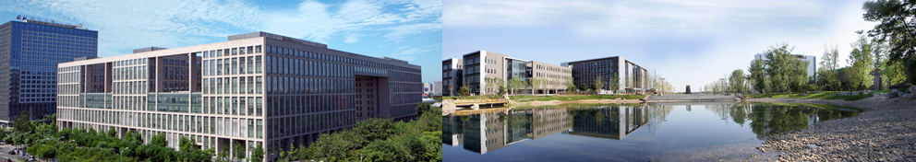

Big Graph Search for Social Networks
Shuai Ma

Slide 2
Big Data is a Big Deal

Slide 3
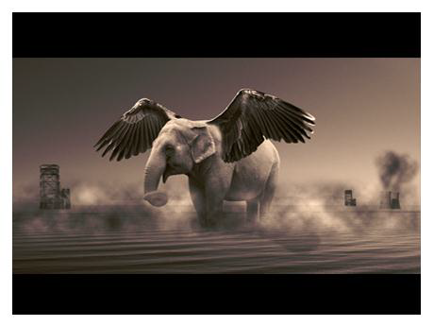

What is Big Data?
Big Data refers to datasets that grow so large that it is difficult to capture, store, manage, share, analyze and visualize with those traditional (database) software tools
Wikipedia
“Big data” becomes a buzz word, and the focus of both industrial and academic communities!

Slide 4
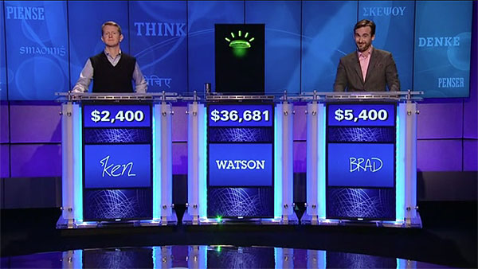
Human vs. Computer + Big Data
IBM “Watson” system challenges humans at Jeopardy!
In 2011, Watson beat former winners Brad Rutter and Ken Jennings. Watson received the first prize of $1 million.
Compared with “Deep Blue”, ““Watson” is equipped with Big Data!

Slide 5
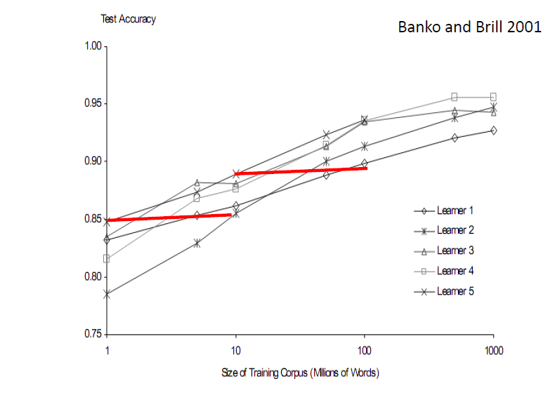
More Data Beats Better Algorithms

Slide 6
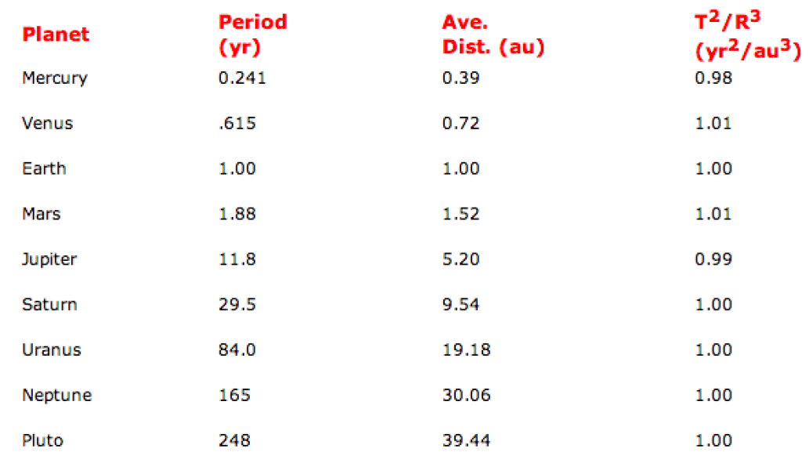
Kepler's Third Law of Planetary Motion
The square of the orbital period of a planet is directly proportional to the cube of the semi-major axis of its orbit

Slide 7
Challenges and Opportunities with Big Data
- A community white paper developed by leading researchers across US
Divyakant Agrawal, UC Santa Barbara
Philip Bernstein, Microsoft
Elisa Bertino, Purdue Univ.
Susan Davidson, Univ. of Pennsylvania
Umeshwar Dayal, HP
Michael Franklin, UC Berkeley
Johannes Gehrke, Cornell Univ.
Laura Haas, IBM
Alon Halevy, Google
Jiawei Han, UIUC
Alexandros Labrinidis, Univ. of Pittsburgh
Sam Madden, MIT
Yannis Papakonstantinou, UC San Diego
Jignesh M. Patel, Univ. of Wisconsin
Raghu Ramakrishnan, Yahoo!
Kenneth Ross, Columbia Univ.
Cyrus Shahabi, Univ. of Southern California
Dan Suciu, Univ. of Washington
Shiv Vaithyanathan, IBM
Jennifer Widom, Stanford Univ
A result of conversation lasted about 3 months (Nov. 2011 ~ Feb. 2012)

Slide 8
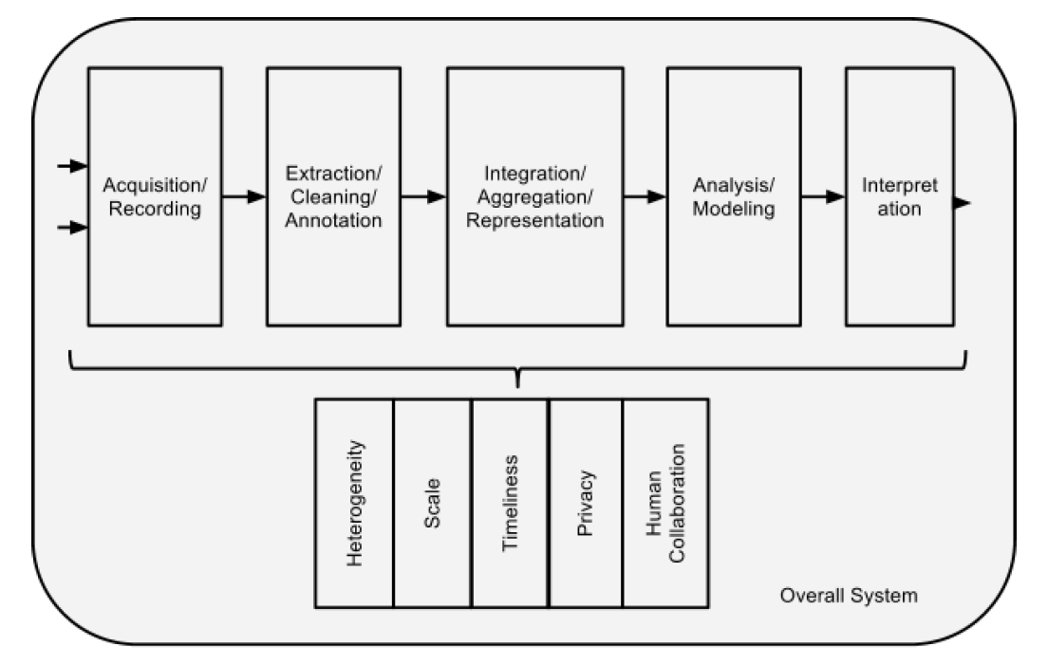
Challenges

Slide 9
Social Networks are Big Graphs

Slide 10
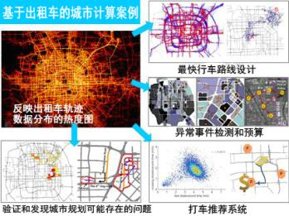
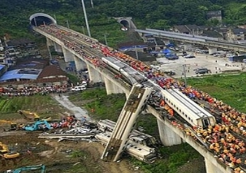

Social Networks are the New Media
金庸“被逝世”
Social networks are becoming an important way to get information in everyday life！

Slide 11
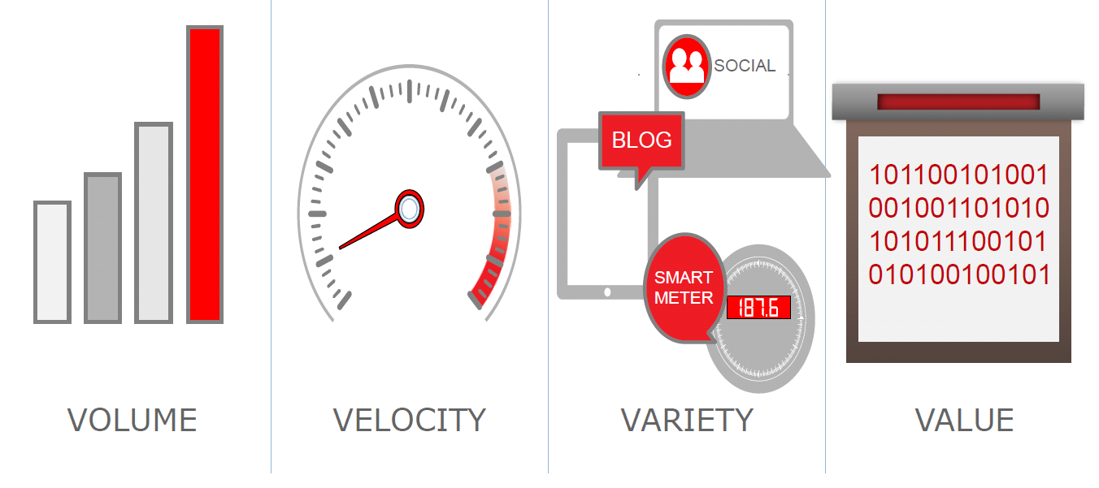
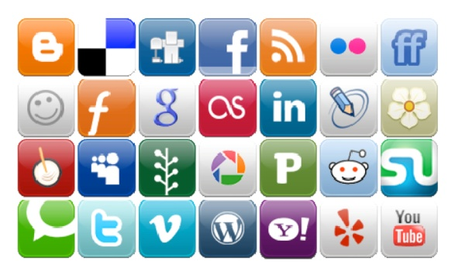
Social Networks are “Big Data”
Facebook:
Volume： 10 x 10⁸ users, 2400 x 10⁸ photos, 10⁴ x 10⁸ page visits
Velocity： 7.9 new users per second, over 60 thousands per day
Variety： text (weibo, blogs) , figures, videos, relationships (topology)
Value：1.5 x 10⁸ dollars in 2007, 3 x 10⁸ dollars in 2008, 6 ~ 7 x 10⁸ dollars in 2009, 10 x 10⁸ dollars in 2010.
Further, data are often dirty due to data missing and data uncertainty ^{[1, 2]}
Notes:
《福布斯》日前评选出十位最年轻的亿万富翁，26岁的马克-扎克伯格以69亿美元的身价排在首位，他也因此成为世界上最年轻的亿万富翁。

Slide 12


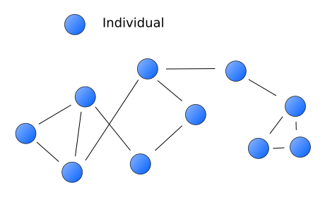
Social Networks are Big Graphs
Social networks are graphs
The nodes are the people and groups
The links/edges show relationships or flows between the nodes.

Slide 13
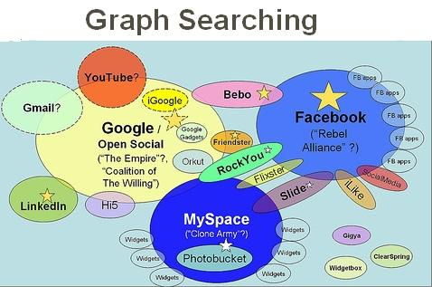


The Need for a Social Search Engine
File systems
Databases
World Wide Web
Social Networks
File systems - 1960’s： very simple search functionalities
Databases - mid 1960’s：SQL language
World Wide Web - 1990’s：keyword search engines
Social networks - late 1990’s:
Facebook launched “graph search” on 16th January, 2013
Assault on Google, Yelp, and LinkedIn with new graph search;
Yelp was down more than 7%
Graph search is a new paradigm for social computing!
Notes:
Yelp躺着中枪，股价大跌7%；

Slide 14
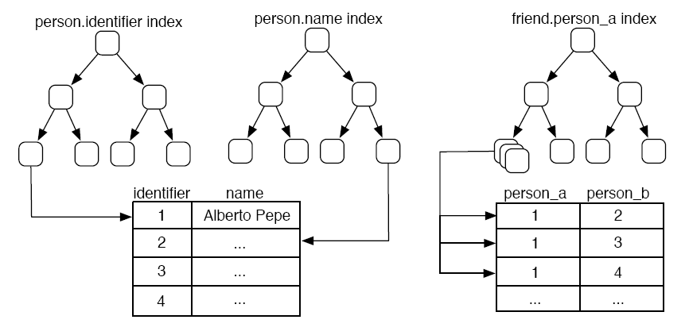
Graph Search vs. RDBMS^{[3]}
Query：
Find the name of all of
Alberto Pepe's friends.
Step 1: The person.name index -> the identifier of Alberto Pepe. [O(log₂n)]
Step 2: The friend.person index -> k friend identifiers. [O(log₂x) : x<<m]
Step 3: The k friend identifiers -> k friend names. [O(k log2n)]
Notes:
1. Query the person.name index to find the row in person table with the name Alberto Pepe." [O(log2n)]
2. Given the person row returned by the index, get the identifier for that row.[O(1)]
3. Query the friend.person a index to find all the rows in friend with the identier from previous. [O(log2x) : x<<m]
4. Given each of the k rows returned, get the person b identier for those
rows. [O(k)]
5. For each k friend identiers, query the person.identifier index for the row with friend identier. [O(k log2n)]
6. Given the k person rows, get the name value for those rows. [O(k)]

Slide 15
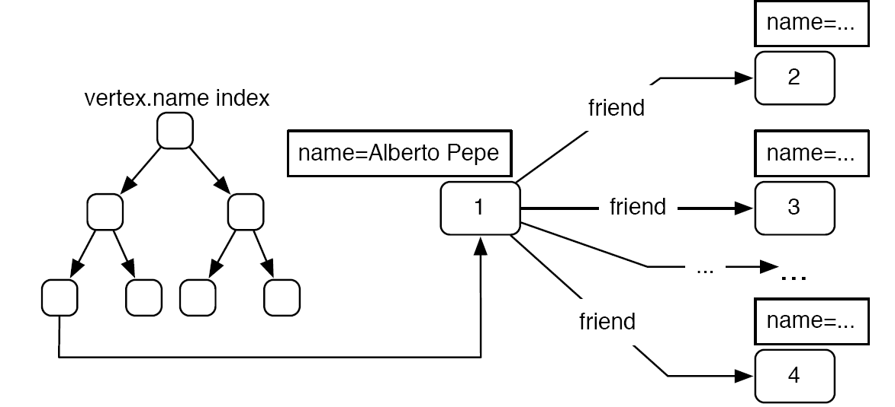
Graph Search vs. RDBMS^{[3]}
Query：
Find the name of all of
Alberto Pepe's friends.
Step 1: The vertex.name index -> the vertex with the name Alberto Pepe. [O(log2n)]
Step 2: The vertex returned -> the k friend names. [O(k + x)]
Notes:
1. Query the vertex.name index to find all the vertices in G with the name Alberto Pepe. [O(log2n)]
2. Given the vertex returned, get the k friend edges emanating from this vertex. [O(k + x)]
3. Given the k friend edges retrieved, get the k vertices on the heads of those edges. [O(k)]
4. Given these k vertices, get the k name properties of these vertices. [O(ky)]

Slide 16
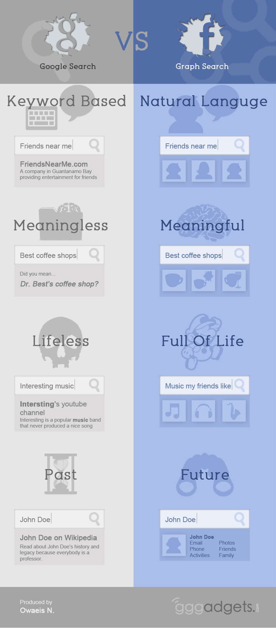
Social Search vs. Web Search
Phrases、short sentences vs. key words only
(Simple Web) pages vs. Entities
Lifeless vs. Full of life
History vs. Future
it’s interesting, and over the last 10 years, people have been trained on how to use search engines more effectively.
Keywords & Search In 2013: Interview With A. Goodman & M. Wagner
International Conference on Application of Natural Language to Information Systems (NLDB) started from 1995

Slide 17
Interesting Coincidence!
Social computing
&
Web 2.0
DB people started working on graphs at around the same time！

Slide 18
Applications of Graph Search

Slide 19
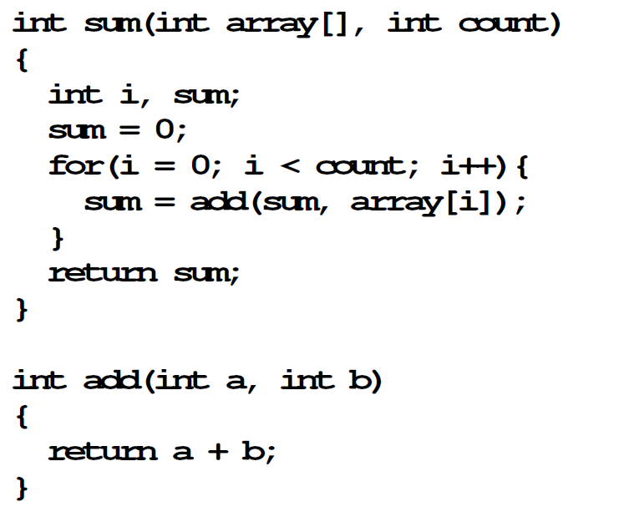
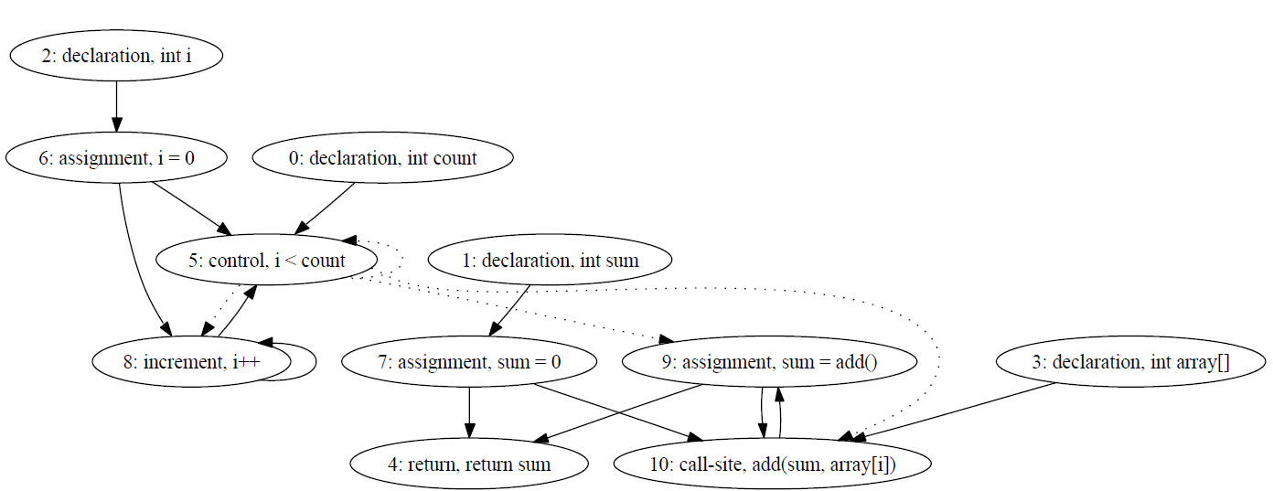
Application Scenarios
Software plagiarism detection ^{[4]}
Traditional plagiarism detection tools may not be applicable for serious software plagiarism problems.
A new tool based on graph pattern matching
Represent the source codes as program dependence graphs ^{[5]}.
Use graph pattern matching to detect plagiarism.

Slide 20
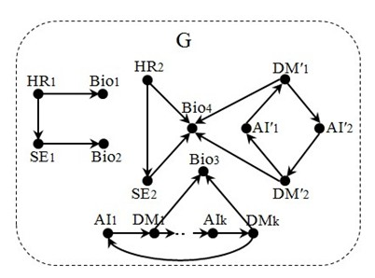
Application Scenarios
Recommender systems ^{[6]}
Recommendations have found its usage in many emerging specific applications, such as social matching systems.
Graph search is a useful tool for recommendations.
A headhunter wants to find a biologist (Bio) to help a group of software engineers (SEs) analyze genetic data.
To do this, (s)he uses an expertise recommendation network G, as depicted in G, where
a node denotes a person labeled with expertise, and
an edge indicates recommendation, e.g., HR₁ recommends Bio₁, and AI₁ recommends DM₁

Slide 21
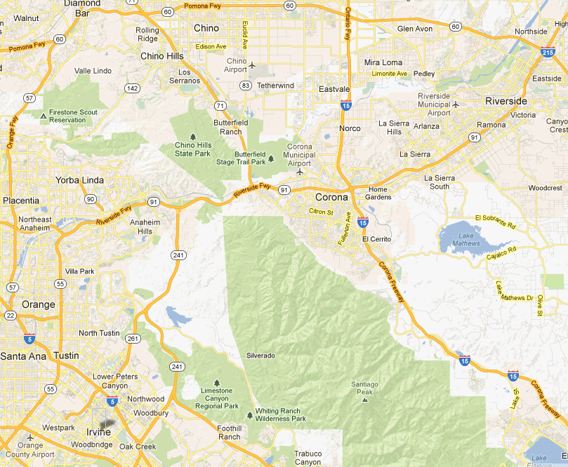
Application Scenarios
Transport routing ^{[7,10]}
Graph search is a common practice in transportation networks, due to the wide application of Location-Based Services.
Example: Mark, a driver in the U.S. who wants to go from Irvine to Riverside in California.
If Mark wants to reach Riverside by his car in the shortest time, the problem can be expressed as the shortest path problem. Then by using existing methods, we can get the shortest path from Irvine, CA to Riverside, CA traveling along State Route 261.
If Mark drives a truck delivering hazardous materials may not be allowed to cross over some bridges or railroad crossings. This time we can use a pattern graph containing specific route constraints (such as regular expressions) to find the optimal transport routes.
Notes:
Mark, a driver in the U.S. who wants to go from Irvine to Riverside in California .
Then the task is to choose the correct route, and whether the route is convenient depends on the requirements and constraints of Mark.

Slide 22
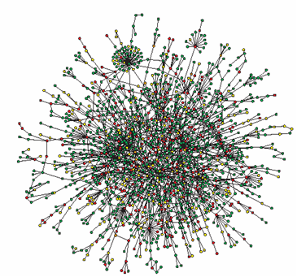
Application Scenarios
Biological data analysis ^{[8]}
A large amount of biological data can be represented by graphs, and it is significant to analyze biological data with graph search techniques.
“Protein-interaction network (PIN) analysis provides valuable insight into an organism’s functional organization and evolutionary behavior.”
For example, one can get the topological properties of a PIN formed by high-confidence human protein interactions obtained from various public interaction databases by PIN analysis.

Slide 23
Challenges & Related techniques

Slide 24
Challenges
The amount of data has reached hundred millions orders of magnitude.
The data are updated all the time, and the updated amount of data daily reaches hundred thousands orders of magnitude.
Same with traditional relational data, there exists data quality problems such as data uncertainty and data missing in the new applications.
Graph search with high efficiency, striking a balance between its performance and accuracy.
Consider the dynamic changes and timing characteristics of data.
Solve the data quality problems.

Slide 25
Distributed Processing
Real-life graphs are typically way too large:
Yahoo! web graph: 14 billion nodes
Facebook: over 0.8 billion users
Real-life graphs are naturally distributed:
Google, Yahoo! and Facebook have large-scale data centers
It is NOT practical to handle large graphs on single machines
Distributed graph processing is inevitable
It is nature to study “distributed graph search”!

Slide 26
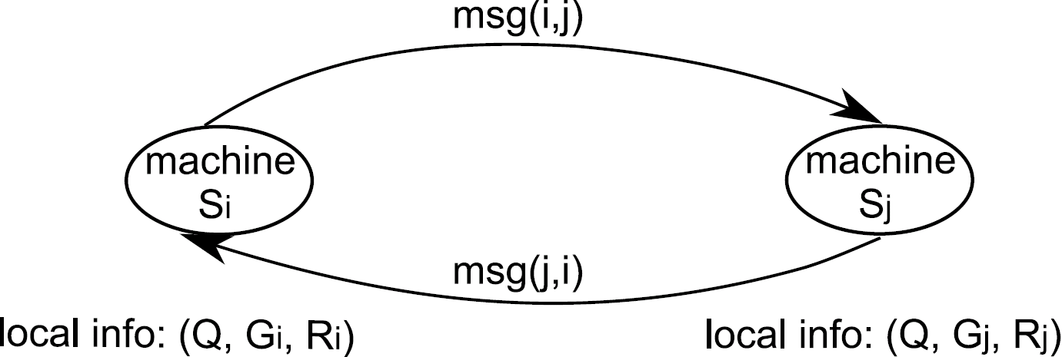
Distributed Processing
Model of Computation ^{[3]}:
A cluster of identical machines (with one acted as coordinator);
Each machine can directly send arbitrary number of messages to another one;
All machines co-work with each other by local computations and message-passing.
Complexity measures:
1. Visit times: the maximum visiting times of a machine (interactions)
2. Makespan: the evaluation completion time (efficiency)
3. Data shipment: the size of the total messages shipped among distinct
machines (network band consumption)
26

Slide 27
Incremental Techniques
Google Percolator ^{[9]}:
Converting the indexing system to an incremental system,
Reduce the average document processing latency by a factor of 100
Process the same number of documents per day, while reducing the average age of documents in Google search results by 50%.
It is a great waste to compute everything from scratch!

Slide 28
Data Preprocessing
Data Sampling
Instead of dealing with the entire data graphs, it reduces the size of data graphs by sampling and allows a certain loss of precision.
In the sampling process, ensure that the sampling data obtained can reflect the characteristics and information of the original data graphs as much as possible.
Data Compression
It generates small graphs from original data graphs that preserve the information only relevant to queries.
A specific compression method is applied to a specific query application, such that data graph compression is not universal for all query applications.
Reachability query, Neighbor query

Slide 29
Data Preprocessing
Indexing
There are mainly three standards for measuring the goodness of an indexing method.
The space of a graph index
Establishing time for a graph index
Query time with a graph index
Data Partitioning
Partition a data graph to relatively “small” graphs
Hash function is a simple approach for random partitioning.
There are well established tools, e.g. Metis [11].

Slide 30
References
[1] Eytan Adar and Christopher Re, Managing Uncertainty in Social Networks, IEEE Data Eng. Bull., pp.15-22, 30(2), 2007.
[2] Gueorgi Kossinets, Effects of missing data in social networks. Social Networks 28:247-268, 2006.
[3] Marko A. Rodriguez, Peter Neubauer: The Graph Traversal Pattern. Graph Data Management 2011: 29-46.
[4] Chao Liu, Chen Chen, Jiawei Han and Philip S. Yu, GPLAG: detection of software plagiarism by program dependence graph analysis. KDD 2006.
[5] J. Ferrante, K. J. Ottenstein, and J. D. Warren. The program dependence graph and its use in optimization. ACM Trans. Program. Lang. Syst., 9(3):319–349, 1987.
[6] Shuai Ma, Yang Cao, Jinpeng Huai, and Tianyu Wo, Distributed Graph Pattern Matching, WWW 2012.
[7] Rice, M. and Tsotras, V.J., Graph indexing of road networks for shortest path queries with label restrictions,VLDB 2010.
[8] David A. Bader and Kamesh Madduri, A graph-theoretic analysis of the human protein-interaction network using multicore parallel algorithms. Parallel Computing 2008.
[9] Daniel Peng, Frank Dabek: Large-scale Incremental Processing Using Distributed Transactions and Notifications. OSDI 2010.
[10] C. C. Aggarwal and H. Wang. Managing and Mining Graph Data. Springer, 2010.
[11] Metis. http://glaros.dtc.umn.edu/gkhome/views/metis.

Slide 31

Homepage: http://mashuai.buaa.edu.cn
Email: mashuai@buaa.edu.cn
Address: Room G1122,
New Main Building,
Beihang University
Thanks!

