Slide 1
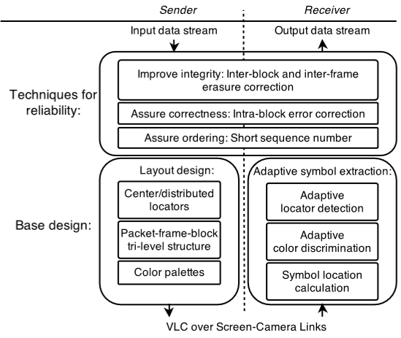
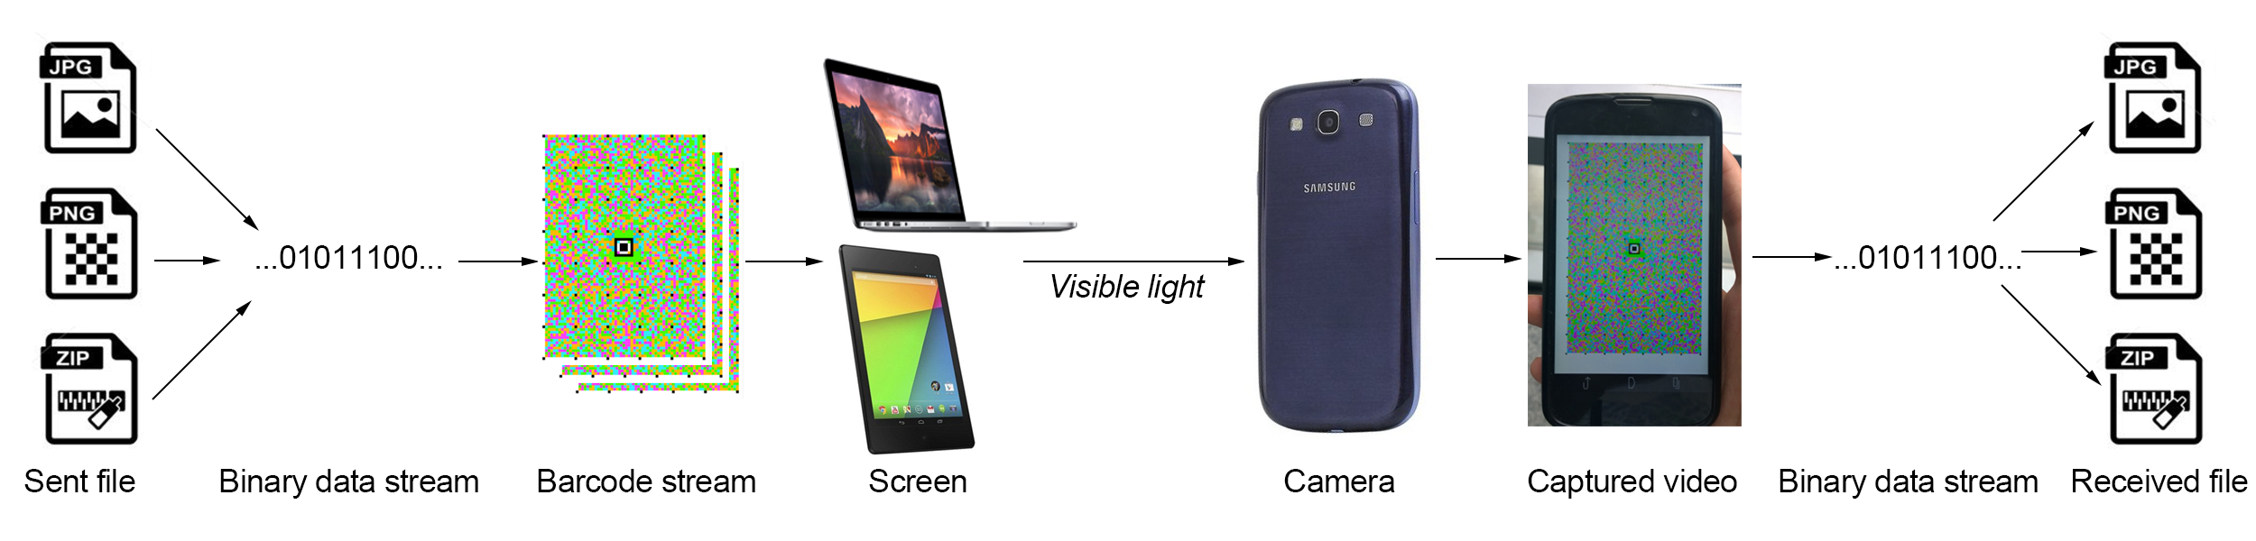
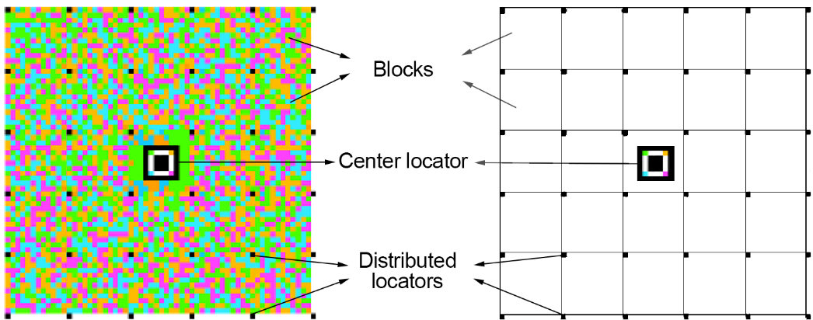
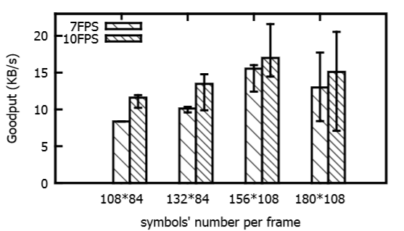
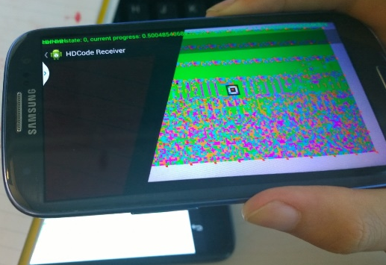
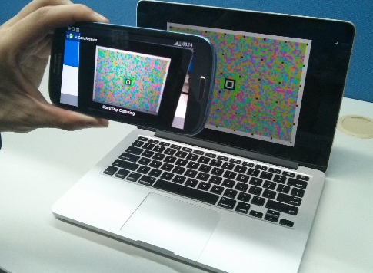
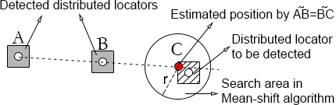
Demo: A Robust Barcode System for Data Transmissions over Screen-Camera Links
Anran Wang¹, Shuai Ma¹, Chunming Hu¹, Jinpeng Huai¹, Chunyi Peng², Guobin Shen³
¹Beihang University, ²The Ohio State University, ³Microsoft Research
{wangar@act., mashuai@, hucm@, huaijp@}buaa.edu.cn chunyi@cse.ohio-state.edu jackysh@microsoft.com
Abstract:
With the rapid proliferation of camera-equipped smart devices, visible light communication (VLC) over screen-camera links emerges as a novel form of near-field communication, and it offers a user-friendly, infrastructure-less and secure communication. However, the limitations of smart devices and the uncertainty of user behaviors seriously hinder its applicability. Hence, we designed RDCode, a novel barcode system proposed to boost the throughput over screen-camera links, by making use of a novel layered barcode design and several effective coding techniques to enhance the transmission reliability. We implemented a file transmission app on Android platform based on our work. The transmission rate can be up to 20KB/s.
RDCode architecture
Data transmission over screen-camera links ↓
RDCode barcode layout
RDCode design not only enhances the transmission reliability by addressing the smartphone limitations and user behavior uncertainty, but also improves the transmission rate.
←
Transmission rate could reach up to 20KB/s
A layered barcode layout
We designed a novel packet-frame-block barcode layout, such that a packet comprises a sequence of frames, each of which further consists of a set of independent blocks.
Adaptive symbol extraction
Our adaptive symbol extraction methods can locate available distributed locators even if a portion of the barcode is unavailable. Moreover, many practical problems in screen-camera links such as distortions and color inaccuracies can be alleviated.
Data protection techniques
Based on the observation of the error distribution, we apply three different error correction codes on blocks, frames and packets respectively. We also add a short sequence number in each block to guarantee the data ordering.
← Adaptive locating algorithm
↑Receiver can decode the barcode even if a portion of the barcode is unavailable
↑Screen (laptop) to camera scenario
References
[1] T. Hao, R. Zhou, and G. Xing. Cobra: color barcode streaming for smartphone systems. In MobiSys, 2012.
[2] T. Hao, R. Zhou, and G. Xing. Demo: a barcode streaming system for smartphones. In MobiSys, 2012.
[3] A. Wang, S. Ma, C. Hu, J. Huai, C. Peng, and G. Shen. Enhancing reliability to boost the throughput over screen-camera links. In MobiCom, 2014.
[4] Q. P. Wenjun Hu, Hao Gu. Lightsync: Unsynchronized visual communication over screen-camera links. In MobiCom, 2013.

